Slide 1
CADENCE LIVE · COMMERCIAL STRATEGY
Where to expand, defend, and hold back
A market segmentation & price-positioning analysis of 16,016 live events
$38 vs $19
Median Jazz ticket: New York vs Los Angeles — same product, double the price
Two live APIs (Ticketmaster + Deezer) · PostgreSQL · window-function analysis

Slide 2
THE SITUATION
A promoter is planning next quarter's booking calendar — on gut feel
1
2
3
The business
The stakeholder
The decision
Cadence Live books & sells tickets for concerts and comedy across 20 US metros. Margin depends on pricing right and allocating event volume right.
The VP of Commercial owns pricing and inventory. Recurring question: where are we underpriced, and which markets are over- or under-served?
Next quarter's booking calendar. Where to add events, where to pull back, and where pricing has room to move — a real allocation call worth money.

Slide 3
THE QUESTION
Which city-genre segments should we expand, defend, or avoid?
Two levers, one calendar: how much to book in each market (supply), and how to price it (position). The project answers both from live data — and fuses them into one prioritization map.
Supply: which markets are over- vs under-served per capita?
Price: where are we priced above or below comparable markets?

Slide 4
DATA & APPROACH
Live API in, cleaned and enriched, analyzed in SQL
1
2
3
4
→
→
→
Extract
Clean
Enrich
Analyze
16,016 events pulled live from the Ticketmaster Discovery API across 20 metros
Parsed messy dates & prices; excluded 398 zero-price & junk-genre records
Joined metro population to compute per-capita intensity
Window functions & percentiles for saturation and price position
Nobody hires on your cleaning pipeline — but the data-quality catches (missing prices, junk dates) shaped every finding.

Slide 5
FINDING 1
Normalizing by population flips the naive read
Share analysis called Las Vegas under-served in Rock. Per-capita shows it's #1 — the share signal was a mix artifact.
Why it matters
Vegas Comedy is so dominant it compressed every other genre's share — making Rock look thin when it's actually the most intense Rock market in the data.
Decisions use per-capita intensity, not share.

Slide 6
FINDING 2
I tested the obvious explanation — and the data refuted it
Hypothesis: Vegas & Nashville dominate per-capita because of a few tourist mega-venues. Test: how concentrated is each market's top 3 venues?
Refuted
Las Vegas has 63 venues and only 29.5% in its top 3 — one of the LEAST concentrated markets. Its dominance is genuine breadth, not tourist traps.
Conclusion changed by evidence.

Slide 7
FINDING 3 · THE HEADLINE
The same genre sells for double across markets
The signal
NYC Jazz commands $38 on 251 priced events (reliable). LA Jazz sits at $19 — $14 below peers on 85 events. LA applies the same low floor to R&B.
Action: test price increases on LA Jazz & R&B, or confirm LA is structurally price-sensitive.

Slide 8
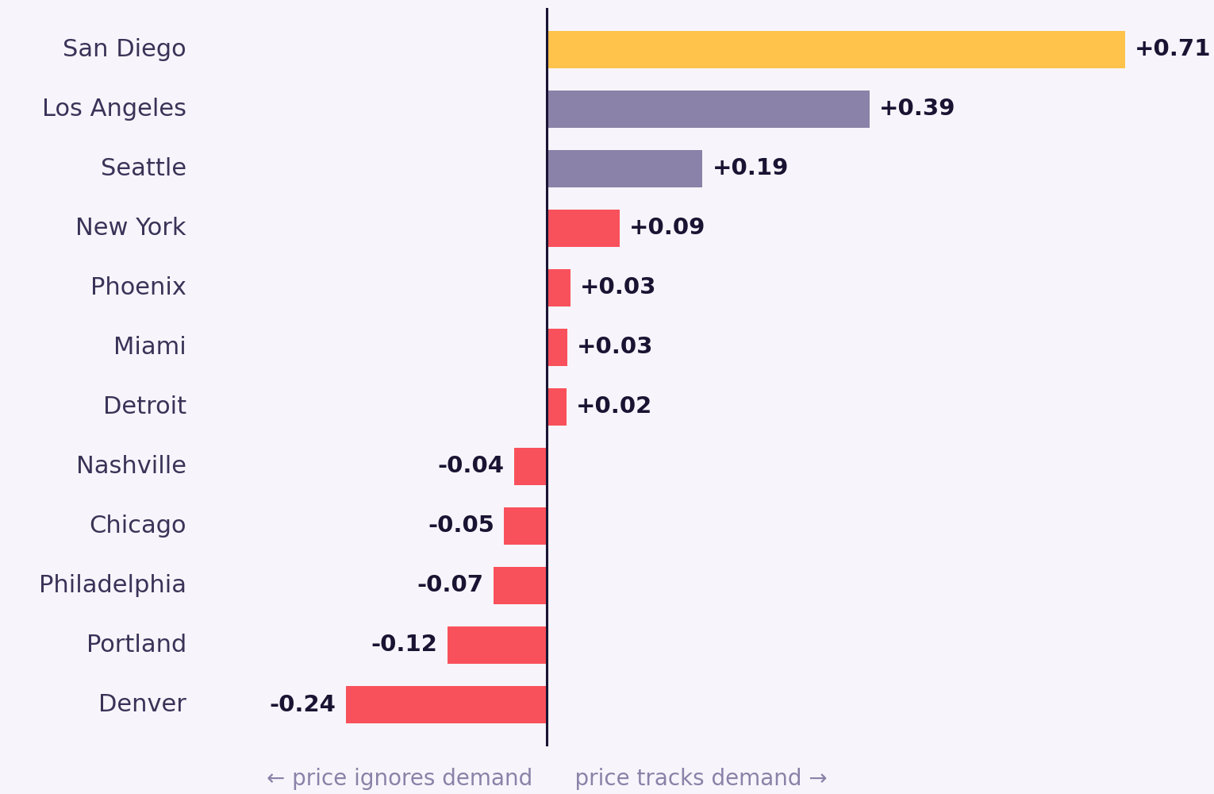
FINDING 4 · DEMAND
Most markets don't price to demand
The signal
Correlating artist fan-count against ticket price within each market: in 10 of 12 markets, price barely tracks demand. Denver (-0.25) and Portland (-0.12) run slightly inverse, pricing bigger-draw acts the same or lower.
So popular acts are the likeliest underpriced. Action: test demand-based price lifts on top-draw acts in Denver, Portland, and Chicago.

Slide 9
THE DIAGNOSIS
Two axes, one map: where to expand, defend, and avoid
TEST
EXPAND
The deliverable: every city-genre gets an action label — a ranked, defensible calendar, not gut feel.
under-served · soft price
under-served · premium
Chicago Blues · Detroit Metal
NYC R&B · NYC Jazz · Boston Jazz
SUPPLY per capita →
AVOID
DEFEND
saturated · soft price
saturated · premium
Nashville Rock · Denver Comedy
Nashville Country · Chicago Rock
PRICE vs peers →

Slide 10
RECOMMENDATION
Four moves for next quarter's calendar
1
Expand
Add inventory in NYC Jazz (+$5, 256 events) and NYC R&B — premium price, thin supply.
2
Reprice
Test price lifts on LA Jazz & R&B, ~$10–14 below comparable markets on solid samples.
3
Defend
Hold, don't flood, Nashville Country & Chicago Rock — lucrative but already saturated.
4
Time it
Book comedy & jazz for September, mainstream music for October, matching supply peaks.

Slide 11
WITH MORE DATA OR TIME
What I'd add next — and what the data can't yet say
Deeper demand signals
The fan-count demand layer is now built (Finding 4). Next: blend several demand sources (streaming, social, search) into a sturdier signal than any single proxy can give.
Real sales data
Listed prices ≠ realized demand. Sell-through would separate 'pricing power' from 'weak local demand' in the below-peer markets.
Multi-year history
Current findings are a single booking-calendar snapshot; true seasonality needs historical events, not one pull.
Naming the limits is the point — it's what separates a defensible read from an oversold one.

Slide 12
APPENDIX · TECHNICAL DEPTH
Under the hood — held in reserve
Pipeline
Key techniques
Python (requests) hits the Ticketmaster Discovery API, paginates 20 metros × 2 segments, dedupes on event id, flattens nested JSON → CSV → PostgreSQL.
percentile_cont WITHIN GROUP for medians & p25/p75 spread · SUM()/AVG() OVER (PARTITION BY …) for in-place benchmarks · RANK() for per-genre leaders · FILTER for conditional aggregation.
Cleaning layer
Opportunity score
A SQL view casts text→numeric/date, regex-guards malformed dates, strips '%' fields, flags priced vs free, and derives vintage/month buckets.
Saturation (events/100k) and price-vs-peers computed independently, then joined and cross-classified into EXPAND/DEFEND/TEST/AVOID via a CASE on each axis' mean.
Gating discipline
Data-quality catches
Every comparison is gated on min event count (10–30) so thin samples never surface as findings — the same rigor applied to the 15% price subset.
398 zero-price records, ~116 junk-genre rows, and far-future junk dates (2038–39) identified and excluded — each documented as a limitation.

