Slide 1
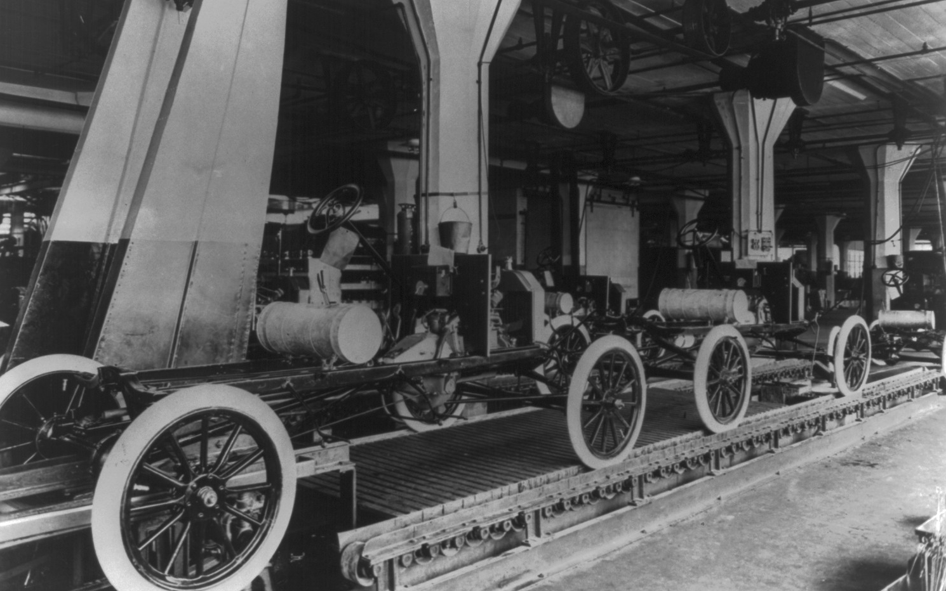


Evolution of the Software
Development Lifecycle (SDLC)
Into the Agentic Era
Jacques de Vos
Ford Highland Park assembly line, c. 1913 · Library of Congress

Slide 2
SDLC in the Agentic Era
In 2026, software engineering is undergoing its most dramatic change yet.
So how does this change the disciplined software engineering process?
Let’s look at how the lifecycle evolved to understand it.

Slide 3
SDLC v1 (pre-2000)
Waterfall with handovers
Design
Manual manufacturing
Plan
Spec
Dev
Test
Deploy
Req
This was seen as engineering design. It was done up front and handed over.
This was (incorrectly) seen as Mass Manufacturing
Notes:
http://www.developerdotstar.com/mag/articles/reeves_design.html

Slide 4
SDLC v2 (2002–2025)
Iterative development with CI/CD
Design
Automation
Plan
Spec
Dev
Test
Deploy
Req
All these steps are part of iterative engineering design
This is like repeatable Manufacturing
↶ Use what you learn to revise the design
Notes:
http://www.developerdotstar.com/mag/articles/reeves_design.html

Slide 5
SDLC v3 (2026+)
Plan
Spec
Dev
Test
Deploy
Req
AI-assisted iterative development
Automation: Repeatable Pipeline
AI automates repeatable engineering work as part of Continuous Engineering (CE).
Plan
Spec
Dev
Test
Deploy
Req
More creative
More deterministic
Design: Iterative Process
Non-repeatable learning and design in collaboration with AI
↶ Use what you learn to revise the design

Slide 6
What can we learn from this for 2027?
1. Automation: Move from CI/CD to CE
CE is Continuous Engineering.
Use AI to automate repeatable work throughout the lifecycle that CI/CD alone could not automate before.
2. Design: Use the extra room to iterate
AI makes it easier to try, test and revise a design. As in earlier versions of the SDLC, a focus on automation and handovers can obscure the design loop.
3. Tooling: Build end-to-end pipelines
Today’s tooling is split between agentic development environments (ADEs) and traditional CI/CD tools. I’d like to see them joined in one pipeline that carries a change from specification through delivery in a disciplined way.

