Slide 1
Influence and learn by ^joining a meetup
running
Cut the fluff and talk shop with other developers.
Jace Benson
Developer
@jacebenson
Notes:
Make title more precise
Attendees will be learn about supporting/running their own chapter
Essentially becoming an influencer on the group and also community building
Fix logo
Add talking points on notes at bottom of ppt
SN does 2 things;
SN will help sponsor it at a $/per head
Marketing
1

Slide 2


Speaker introduction
Name: Jace Benson
Title: ServiceNow Developer
Function: IT
Company: FICO
Experience: 12 years as a ServiceNow Developer
Expertise: Web APIs, Catalog Development, and Sharing my stuff!
Current Projects: IPAM IP range integration for Discovery.
Notes:
Note: Speaker Introduction slide – option 1. Please use one slide per presenter.
2

Slide 3
Why should you care?
If you remember nothing else in this presentation, remember this:
Developer meetups focus on the Developer not much else
Chances are if you’re not the host, the host would love your help
This is a great way to expand your network and build and influence the local community
Notes:
Benefit
Relationship w servicenow (marketing, product)
Expanding your network to other places
3

Slide 4
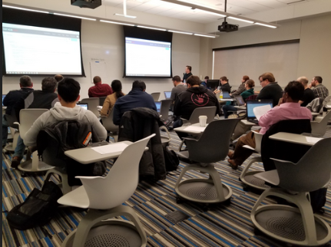

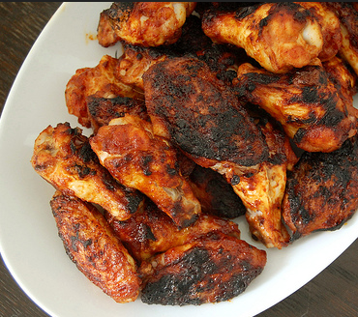
3 things I will be talking about
Space
Content
Food
Offer to host your meetup
Create / Prepare some content for a lab or discussion
Happy hours after a lab is a great way to end one.
Notes:
SN does 2 things;
Sponsors it
Marketing
Nixd
Finding consistent places to host is the biggest problem with meetups.
Since they are not organized by Servicenow, getting low-cost, free hosting locations is key.
Depending on what content you are going over you may need to think about power, wifi, and a projector.
Nixd
Finding content and adapting it your group can be time consuming
This is a great place to contribute to your meetup. Think about what you’d want to go over.
Lots of places to draw inspiration from.
Nixd
Updating the post
Reminding the rsvp’ers
Making yourself available
Finding appropriate food and drinks
Staying within your budget
Photo by rawpixel on Unsplash
4

Slide 5
My Story of how this started… and how it you can too
Source: Information goes here
Notes:
Two years ago Josh Nerius asked if anyone wanted to volunteer to get
5

Slide 6
Top takeaways
1 You don’t have to host
2 Attend and volunteer
3 Give feedback
You don’t have to host or run the event to help. There are lot’s of opportunity to help out.
This gives you an opportunity to reiterate your most important points
Provide feedback, it’s always useful.
Notes:
6

Slide 7
Questions?
jace.benson@protonmail.com
@jacebenson
Notes:
7

