Slide 1
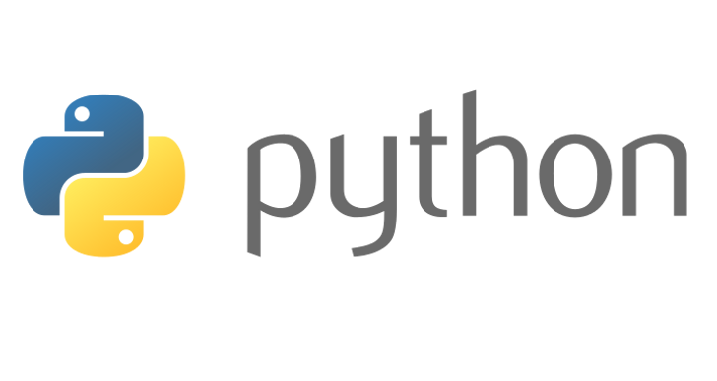
MIS 5400
Python Object Types
(Core Types)

Slide 2
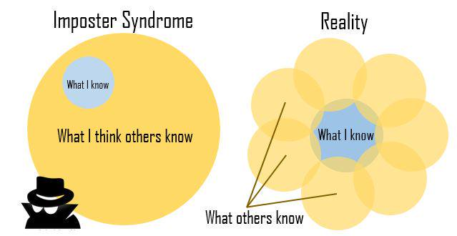
Impostor!!!
Impostor or not? That is the question.
https://en.wikipedia.org/wiki/Impostor_syndrome
The world is full of this. Knowledge is Power.

Slide 3
Module 1 Review
Basic programming concepts:
Values
Types
Variables
Expressions
Statements
Programming is a means to and end. This can be hard to remember sometimes when knee deep in code.
Python is a great language for quick development because it is dynamic and interpreted.

Slide 4
Module 1 Review (Continued)
How to use Python
Interactive Mode
Anywhere you see 3 angle brackets >>>
IDLE Shell
Command Line Interface (CLI)
Python Console in IDE
Script Mode
Create .py file or project, execute with:
IDE (PyCharm, Visual Studio, Other…)
CLI w / Text Editor (VS Code, Sublime)
IDLE (“Run Module”)

Slide 5
Module 2 Objectives
Getting Input / Printing
Importing Modules
Built-in Python object types
Bools
Numbers
Strings
Lists
Dictionaries
Tuples
Sets
Collections
Sequences
Mappings
Mutable vs. Immutable

Slide 6
Getting User Input
We use input() to get input from the user.
The value passed to input() is provided as a prompt to the user.
The value the user types (after hitting enter) is returned from input() and can be referenced by a variable
Example:
>>>name = input(‘Hello, what is your name?\n’)
>>>print(‘Hello {name}’.format(name=name))

Slide 7
Printing / REPL
print() –
Multiple parameters, concatenates with a space.
Interactive will cause to go to screen, script mode will cause to write to console.
REPL –
Interactive mode ONLY
A read–eval–print loop (REPL) takes single user inputs (i.e., single expressions), evaluates them, and returns the result to the user.

Slide 8
Importing Modules
A Module is some useful code that someone else has written… We don’t want to recreate the wheel!
Python provides many modules as part of their standard library.
Modules can be used after they are imported.
Example:
>>>import math
>>>square = math.sqrt(9)
>>>print(square)

Slide 9
Importing Modules (Cont)
Another Example
>>> from datetime import datetime
>>> now= datetime.now()
>>> print now.year
2014
>>> print now.month
7
>>> print now.day
1

Slide 10
Some Built-In (Core) Object Types
Object Type | Example
Bool | True, False
Numbers | 123, 3.1415,3+4j, Decimal(), Fraction()
Strings | ‘spam’, “Bob’s Shop”
Lists | [1, [2, ‘three’],4.5], list(range(10))
Dictionaries | {‘food’: ‘spam’, ‘taste’: ‘yum’}, dict(hours=10)
Tuples | (1,’spam’,4,’U’), tuple(‘spam’)
Sets | Set(‘abc’), {‘a’,’b’,’c’}
User-Defined | Class Car

Slide 11
Bool
bool
Bool will return either True or False.
Typically only used in conditional tests. (e.g. if)
E.g.
>>>some_test = bool(“”)
>>>some_test
False
>>>some_test = bool(“Hello”)
>>>some_test
True
Helpful to think “Is there something or nothing?”)

Slide 12
Numbers
Expression Operators: + , - , *, / , **, &, %
Built-In mathematical functions pow, abs, round, int, hex, bin
Floating point vs. Decimal Operations
Utility Modules random, math, decimal
Mixed expressions will follow the operator precedence.
When in doubt, use parentheses for clarity (remember explicit is better than implicit)
Python Operator Precedence

Slide 13
Numbers (Continued)
num_one = 5.1
num_two = 3.3
result = num_one + num_two
8.399999999999999 ?????
If you need precision, use decimal (import decimal)
import decimal
num_one = decimal.Decimal(‘5.1’)
num_two = decimal.Decimal(‘3.3’)
result = num_one + num_two

Slide 14
Strings
Technically a collection of characters in a sequence. This means we can use:
Access by Index (zero-based) (e.g. name[0])
Slicing – Get only part of the string (e.g. name[0:2])
Concatenation (e.g. f_name + ' ' + l_name)
Strings are Immutable, meaning they cannot be changed in-place, a new “instance” will be created.
Python includes many ways to format strings and use variable replacement. (more later)
Strings can be wrapped in either double of single quotes (or triple quotes).

Slide 15
String Formatting
>>> ‘First is %s, Last is %s’ % (‘Ken’, ‘Shabby’)
>>> ‘First is {0}, Last is {1}’.format(‘The’, ‘Knight’)
>>>’First is {}, Last is {}’.format(‘Spiny’, ‘Norman’)
>>>’First is {first}, Last is {last}’.format(first=‘Spiny’, last=‘Norman’)
>>>’The U.S. Debt is {:,}’.format(17701622650999)
https://docs.python.org/3.7/library/string.html

Slide 16
String Formatting (For 2019)
>>> ‘First is %s, Last is %s’ % (‘Ken’, ‘Shabby’)
>>> ‘First is {0}, Last is {1}’.format(‘The’, ‘Knight’)
>>>’First is {}, Last is {}’.format(‘Spiny’, ‘Norman’)
>>>’First is {first}, Last is {last}’.format(first=‘Spiny’, last=‘Norman’)
>>>’The U.S. Debt is {:,}’.format(17701622650999)
>>>f’Hello {first} {last}’ # f-strings ftw

Slide 17
String Methods
https://docs.python.org/3.7/library/stdtypes.html#string-methods
.find – Returns left most index of the search string, or -1 if not found.
>>>some_string = ‘A long string to search’
>>>some_string.find(‘long’)
.join – Joins each item in the sequence together
>>> ‘.’.join(‘Knights’)#K.n.i.g.h.t.s
.lower / .upper
.replace… e.g.
>>>'Hello my naem is, hello my naem is, hello my naem is'.replace('naem','name')
'Hello my name is, hello my name is, hello my name is'

Slide 18
String Methods continued…
.split – Splits a string into a list of strings on a specified character sequence. Returns a list of strings.
.strip – Removes Whitespace

Slide 19
Casting Values to Specific Types
We can use int() and str() to cast a value to a specific type.
This is useful for avoid errors in implicit conversions.
Example:
>>> someNum = 4
>>>print(‘My website is www.code’ + str(someNum) + ‘u.com’)

Slide 20
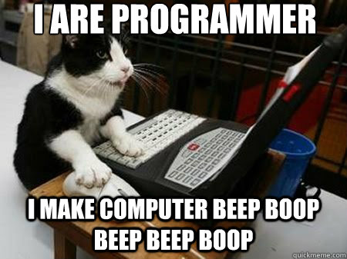
Bool, Number, and String Lab

Slide 21
Mutable vs. Immutable
Immutable – Unchanging over time or unable to be changed once created.
Numbers
Strings,
Tuples
Mutable – Liable to change after creation.
Lists,
Dictionaries

Slide 22
Collections
There are two types of collections in Python.
Sequences (Lists, Tuples, Strings) – Accessed by index, sequential
Mappings (Dictionaries) –Accessed by key, order CANNOT be assumed (different between Python versions, etc…)

Slide 23
Lists
Lists are the “workhorse” of Python.
They are mutable, meaning you can access and change values directly in the data structure.
You can nest lists, that is, you can have a list of a list of lists. (and so forth).
Bounds checking included (thanks Python!)
It is useful to be conscious of methods that actually modify the list (most of them do), as opposed to methods that create a new list.
Create by using
>>> L = []
Or
>>> L = list()

Slide 24
Lists continued…
Methods
Append – Adds object to the end of the list
Count – Counts number of occurrences of a value.
Extend Similar to using +, but actually modifies the list
e.g. [‘red’,’black’].extend([‘yellow’]) vs. [‘red’,’black’] + [‘yellow’]
Index – Finding location
Insert – Add to a specified index
Pop – Removes last element from the list
Remove – Delete the first occurrence in the list.
Sort – Sort the list in place****. Illustrate.

Slide 25
Lists - Multiple Object Types
Lists can hold many different object types
>>> some_stuff = [‘a string’, 440, [‘a’,’b’,’c’]]
>>> new_list = list(some_stuff)# Creates a new list
>>> l = [5,3,4,2,1]
>>> nl = l.sort() # acts on current list

Slide 26
Matrices (Lists of Lists)
Lists allow nesting, which means we can create matrices.
M = [[1, 2, 3],
[4, 5, 6],
[7, 8, 9]]
M[1], M[1][2]

Slide 27
Dictionaries
Where lists are an ordered list of objects, Dictionaries are an unordered list of objects.
This means that instead of accessing them by index we access them by a unique key, similar to an associative array or hash.
They are a “mapping” type, because they map keys to values.
Dictionaries are mutable, meaning they can be changed in place.

Slide 28
Dictionaries continued…
Create a dictionary:
>>> D = {‘name’:’Bob’, ‘age’:30}
>>> http_status_codes = {404:’Not Found’}
>>> http_status_codes[404]
‘Not Found’
>>> D = {}
>>> D = dict(name = ‘knight of ni’)

Slide 29
Sets
Sets are like lists but they are required to have only unique items. This makes them useful for storing things like colors, or number lookup tables.
They are created as follows:
>>>colors = {‘red’,’blue’,’green’}

Slide 30
Tuples
Just like lists, but they are immutable, meaning they can’t be changed.
Created using comma separated values or empty parentheses.
tuple() will convert a value to a tuple.
>>> T = (‘Hello’,’World’)

