Slide 1
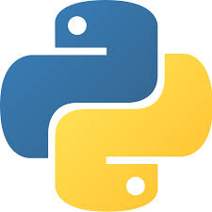
MIS 5400
Systems & Analytics Programming
McKelly Peart
mckelly@thepearts.com

Slide 2
Today’s Objectives
Introductions
Syllabus
Course Overview
What is Programming?
Variables, Expressions, Statements, Operators, Types
In-Class Lab
Python Introduction
Running Python (Getting Started)

Slide 3
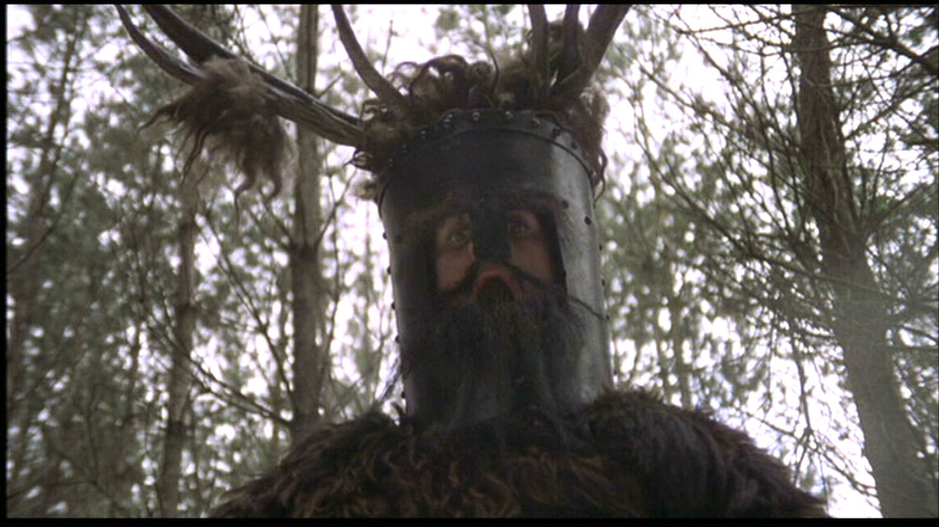
Welcome
Let’s all get to know each other just a little bit….

Slide 4
About Me
USU – Jon M. Huntsman College of Business MIS degree in 2008.
Continuing Education (seeking MS in GIS @ Penn St.)
SQL Developer and Reference Data Engineer for 4 years in Colorado at Markit. Worked with huge amounts of data, creating white-label technology for financial websites.
Currently Senior .NET Software Developer at CSC in Logan. Focus on “backend” technologies, SQL Server, Web API, Solr, Microservices.
Brief role at startup (Degreed). SQL Azure, .NET, ElasticSearch.
Married with 4 kids. Cache Valley Native.
I love extreme weather, and love hanging out with my family.

Slide 5
Syllabus Information
Syllabus
Instructor & Course Information
Introduction
Required Materials
Course Approach
Grading
Canvas
Email
Announcements
Assignments / Exams / Project
Discussions

Slide 6

What You Should Learn From This Class
What Python is, Where Python is used, How to use Python.
Fundamentals of programming with Python.
Applied use of Python to
Acquire data via other API’s
Acquire data through web scraping
Expose Data via an API

Slide 7
What You Should Expect From This Class
~ 4.5 hours of studying / homework per week outside of class.
The course is intentionally fast paced. We will not go into every detail of either Python or API design, and as such, you will not be expected to know every detail.
This course does expect that you have at least some familiarity with programming and some technological ability. You will be expected to install software, run commands from a command line, and other general technological tasks.
Collaboration. As an IT professional you are never alone, so I will not expect you to work alone. However, that does not mean you can just copy from someone else and get a grade for it.

Slide 8
Questions?
?

Slide 9
Welcome Quiz!
Please take the MIS 5400 Welcome Quiz. (Canvas)

Slide 10

Why Do We Program?

Slide 11
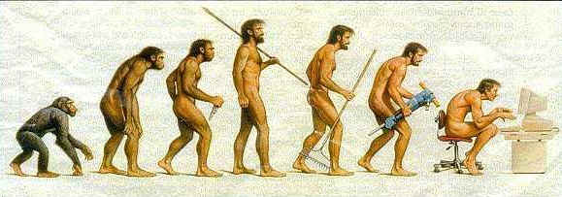
Programming is a Means to an End
“The single most important skill for a computer scientist is problem solving”.
“On one level, you will be learning to program, a useful skill by itself. On another level you will use programming as a means to an end”

Slide 12
Solving Problems with Programs
What is a program?
Sequence of instructions that specifies how to perform a computation.
Instructions include:
Input – Get the Data.
Math – Perform mathematical operators.
Conditional Execution – Evaluate conditional expressions and act accordingly.
Repetition – Do this multiple times, quickly.
Output – Display Data to the screen, or send the data somewhere else.

Slide 13

High-Level vs. Low-Level Languages
High-Level Language – A programming language that is designed to be easy for humans to read and write. Typically runs on multiple platforms without alteration. Python is a high-level language.
Low-Level Language – A programming language that is designed to be easy for a computer to execute, AKA “machine language” or “assembly language”.

Slide 14
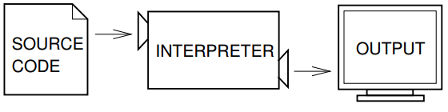
Interpreted vs Compiled
Interpreted languages rely upon an interpreter to convert source code into code that the host computer can understand (known as object code or executable) at runtime.

Slide 15
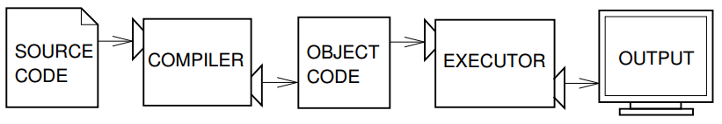
Interpreted vs Compiled
Compiled languages are first converted into object code (executable) and then executed by the host computer.

Slide 16
Interpreted vs. Compiled Languages
Interpreted
Compiled

Slide 17
Values and Types
A value is an actual number, character (string) or other object used in a program.
13 (int)
‘Fat Cats’ (string)
5.0 (float)
Mustang (Car)
All values have a type. >>> type(‘Hello MIS 5400’)

Slide 18
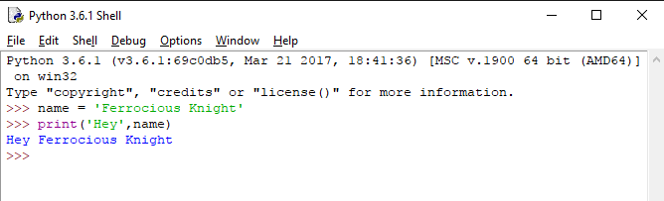
Variables
A Variable is a name or label that refers to a value.
For example, in the Python example below name is a variable that points to a string value of (“Ferrocious Knight”)

Slide 19
Operators & Operands
+ (Add)
- (Subtract)
* (Multiply)
/ (Divide)
% (Modulus)
** (Power)
Operators are special symbols that represent computations like addition and multiplication.
Operand is the value being operated on.

Slide 20
Expressions & Statements
An expression is a combination of values, variables, and operators that computes to return another value. Expressions are evaluated in a program.
A statement is a unit of code that causes a specific action by a program.
An expression has a value, where as a statement does not. (For example… What would the value of the following assignment statement be?)
>>> dude = ‘Knight’ # statement
(Nothing, since it just assigning a variable to a value)
But the below expression “evaluates to something”
>>> 3 + 7 # expression (evaluates to 10)
So even a single value (e.g. ‘hello’) is an expression, because it has a value.

Slide 21
In Summary
Programs are a means to an end. The career of a programmer is to use the available tools to write programs that provide solutions that help people.
The programs we write are made up of:
Values, each with a specific type.
Variables, which are names or labels for the values.
Expressions, which is a combination of one or more values or variables that point to values.
Statements, which tell the computer to do a specific action, usually contain an expression.
Operators, which are used in expressions and statements.

Slide 22
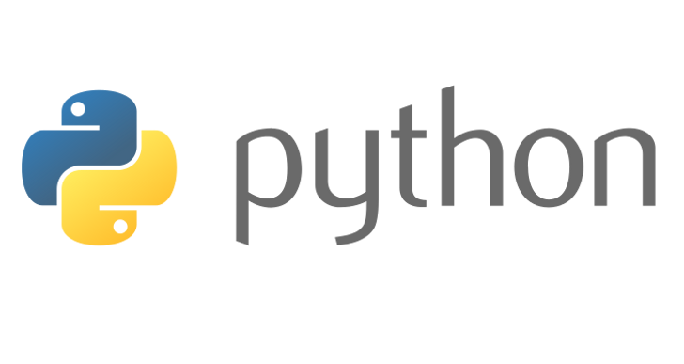
Welcoming Python
Python is powerful… and fast;
Plays well with others;
Runs everywhere;
Is friendly & easy to learn;
Is Open;
Has a huge community;
https://www.python.org/about/

Slide 23
Let’s Get To It!
Go to http://www.python.org/downloads
Download Python 3.7.0
(Mac / Linux users?) You probably already have it.
If prompted choose to “add python.exe to the PATH” variable.
Open up Idle (Interactive Shell)
print(‘Hello World’)
Viola.

Slide 24
Python 2.7 vs. 3.x
Python 2.7 -> Last version (most likely) in the 2.X branch. Many systems are currently running 2.X code.
Advantages of using 2.7 is that it is already in use (no need to update existing code)
No active development (will remain stable)
Python 3.7 -> Most recent version of the language. Many new features and fixes to issues.
Actively being developed.
NOT backwards compatible with 2.X

Slide 25
Python – A Glue Language
Question? Is Python a scripting language or a programming language?
Answer: It is really both, something many people refer to as a glue language.
Used to connect other software components.
Cross platform, which increases it’s flexibility.

Slide 26
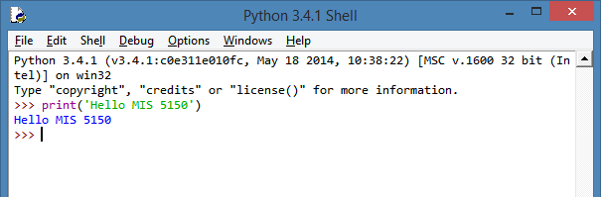
Python Is Interpreted
Python can run interactively. This means that when developing software we don’t have to wait for code to be compiled and then executed. It can be executed immediately in interactive mode.

Slide 27
2 ways to execute Python
Interactive Mode – Python code is typed into a shell, which is then executed. >>> 1 + 1 2
Stored in a file called a script(usually ending in .py) that can later be executed.
These two execution methods are known as interactive mode and script mode.

Slide 28
Running Python
There are many ways to run a python script or program. Because running Python is the most important thing we’ll do in this class let’s review these various ways now:

Slide 29
CLI with Files and a Text Editor / Windows
To run a python script in Windows from the command line with files we use the py command (a new feature introduced in Python 3.3 installer) and edit the .py files in a text editor.
Setup PATH variables to Sublime Text
Example:
Command Prompt
d:\code\usu> code pyexample.py
# Edit code in VS Code(or whichever text editor you are using)…
d:\code\usu> py -3.7 pyexample.py

Slide 30
CLI Interactive
If you want to run a quick expression without using a file to store the code then Windows, Linux, Unix, Mac, etc… all support interactive python coding.
Remember that the code is not saved anywhere when running in interactive mode!
Example
Windows
Linux (Ubuntu)

Slide 31
IDLE
IDLE is build right into Python distribution. There is a separate GUI for each version.
This is how I will do most of my quick samples because it has built in syntax highlighting and I know everyone (should) have it.
IDLE with files is more difficult (aka modules)
File->New File
F5 or “Run-> Run Module” (Must Save)
IDLE interactively
Fastest way to try new things, but will not work if you want to save code.

Slide 32

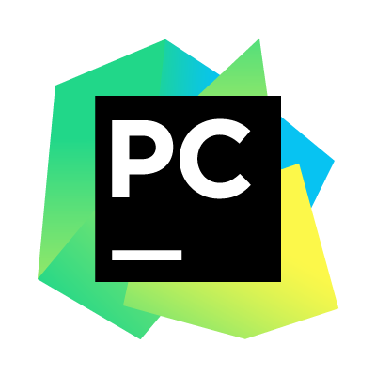


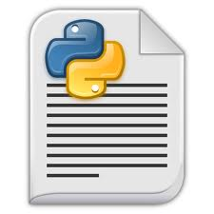


IDE’s
We will use PyCharm in the course this semester…
Professional Edition Free to Students!
Cross-Platform
Jet Brains makes good IDEs.
If you want to use another IDE or development method, that is fine with me.

Slide 33
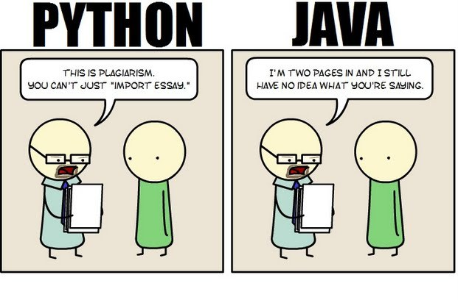
Awe…. Python

Slide 34

The Zen of Python
>>>import this
The Zen of Python, by Tim Peters
Beautiful is better than ugly.
Explicit is better than implicit.
Simple is better than complex.
Complex is better than complicated.
Flat is better than nested.
Sparse is better than dense.
Readability counts.
Special cases aren't special enough to break the rules.
Although practicality beats purity.
Errors should never pass silently.
Unless explicitly silenced.
In the face of ambiguity, refuse the temptation to guess.
There should be one-- and preferably only one --obvious way to do it.
Although that way may not be obvious at first unless you're Dutch.
Now is better than never.
Although never is often better than *right* now.
If the implementation is hard to explain, it's a bad idea.
If the implementation is easy to explain, it may be a good idea.
Namespaces are one honking great idea -- let's do more of those!

