Slide 1
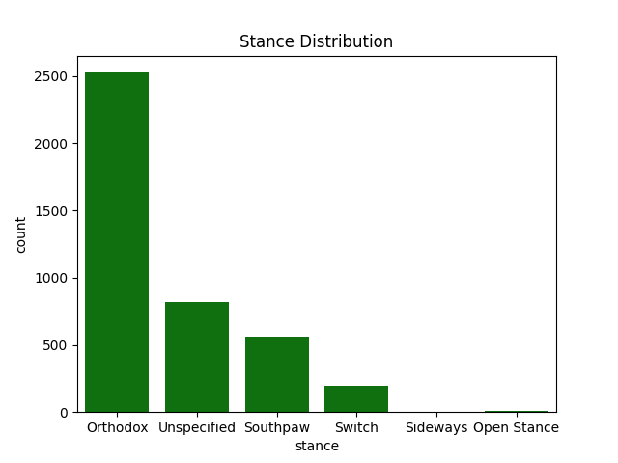
Stance Distribution

Slide 2
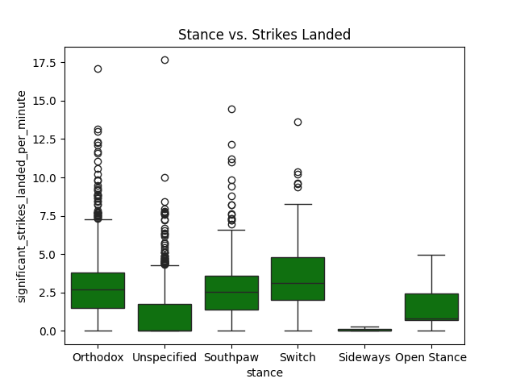
Stance vs. Strikes Landed

Slide 3
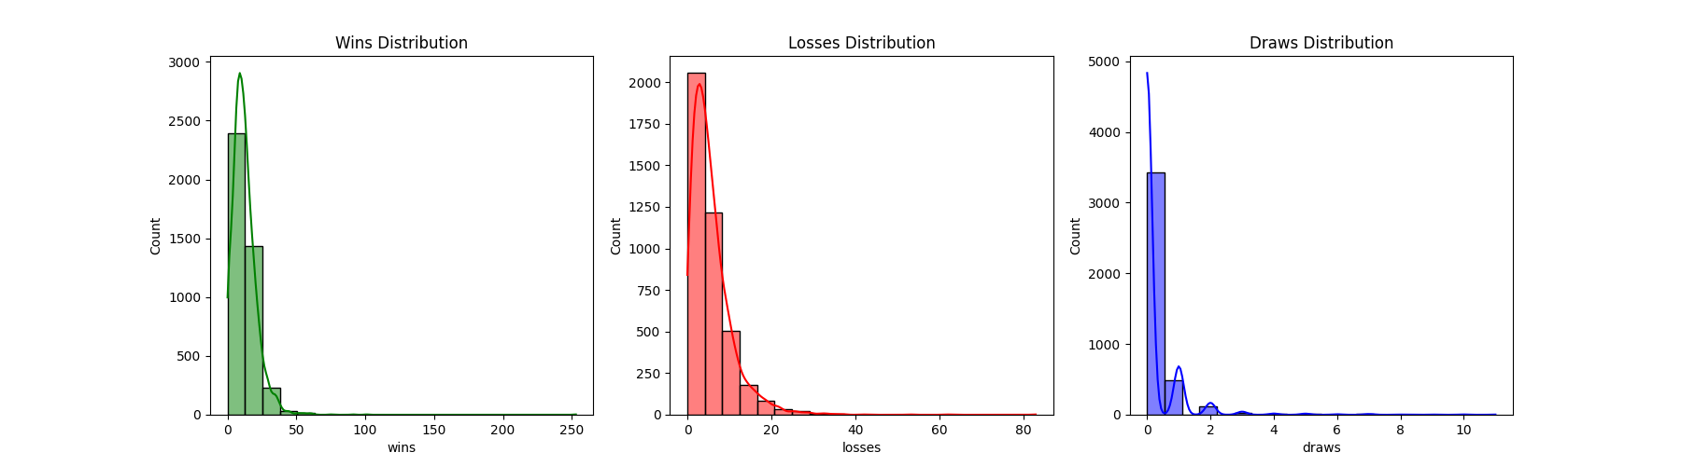
Wins, Losses, and Draws Distribution

Slide 4
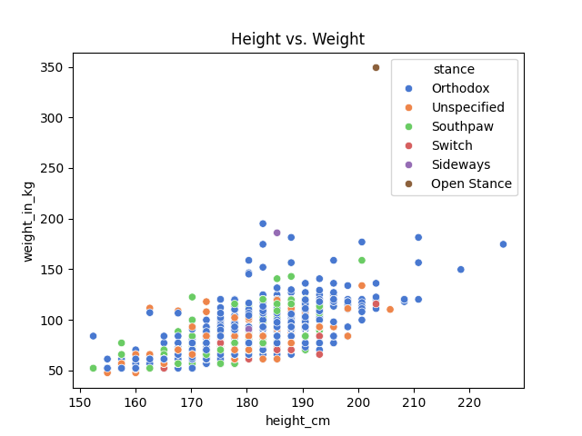
Height vs. Weight

Slide 5
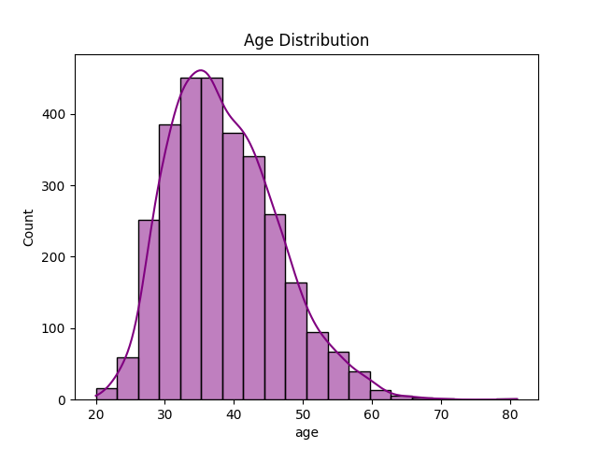
Age Distribution

Slide 6
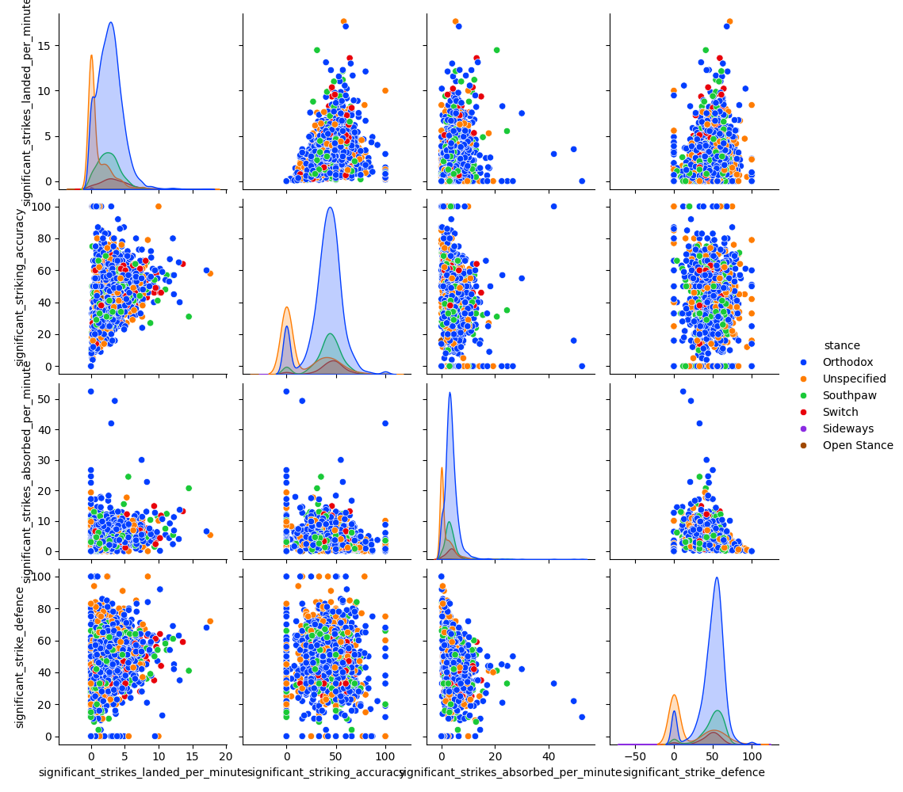
Striking Metrics Pairplot

Slide 7
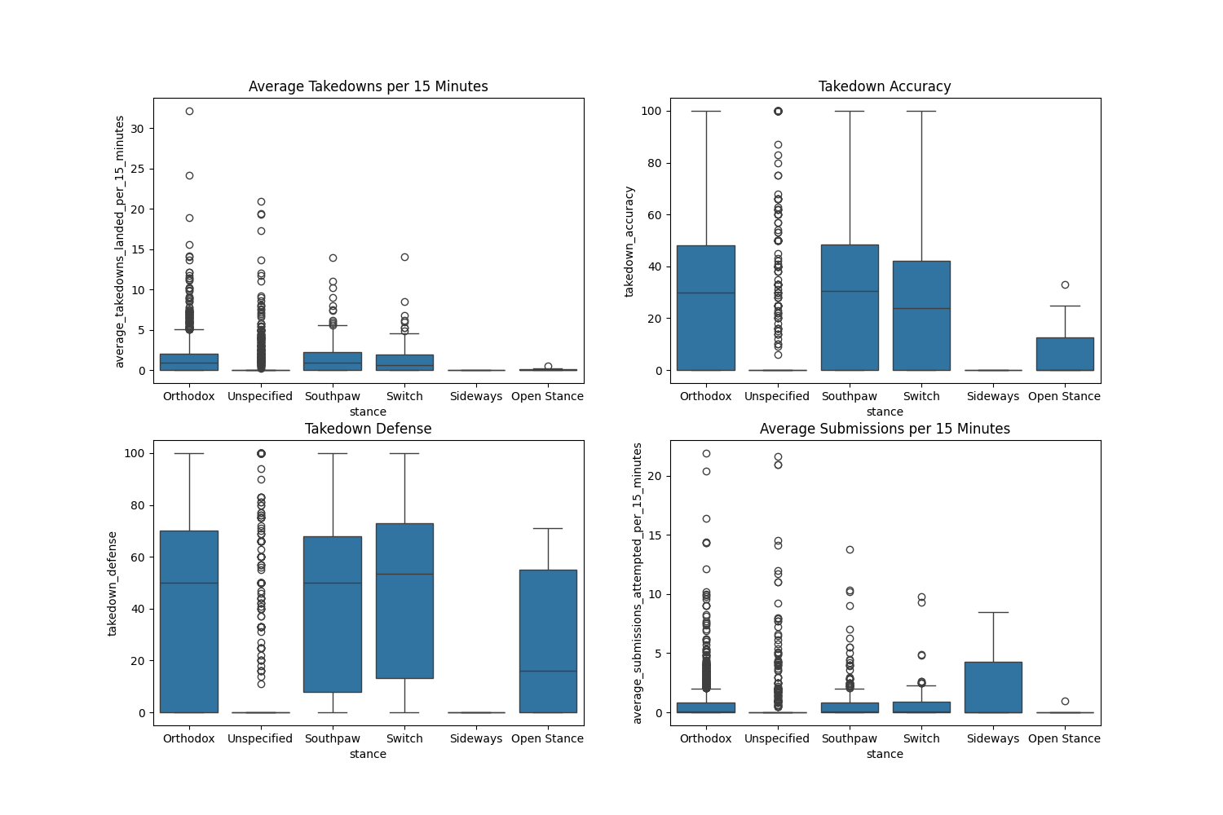
Takedown Metrics

Slide 8
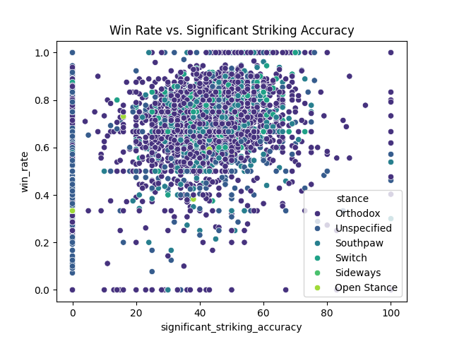
Win Rate vs. Significant Striking Accuracy

Slide 9
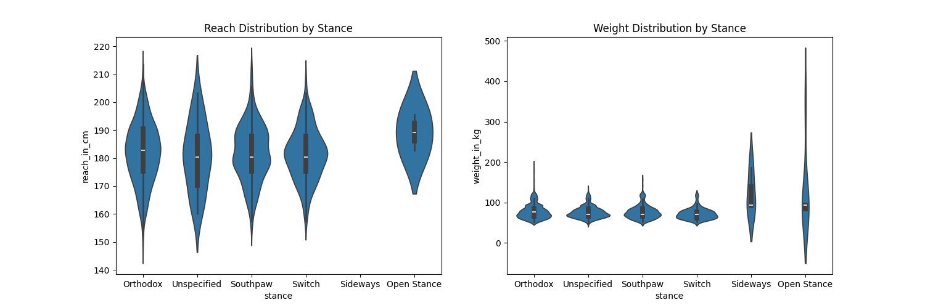
Reach and Weight Distribution by Stance

