Slide 1
DEMO PPTX presentation from JSON
Jacek Kowalczyk 2024-05-09

Slide 2
Setup ubuntu dev env
curl -s "https://get.sdkman.io" | bash
source "/home/ubuntu/.sdkman/bin/sdkman-init.sh"
sdk install gradle
sdk install java 11.0.22-tem
gradle init

Slide 3
knowledge and links
https://www.baeldung.com/apache-poi-slideshow
shttps://poi.apache.org/components/slideshow/xslf-cookbook.html
https://github.com/eugenp/tutorials/blob/master/apache-poi-2/src/main/java/com/baeldung/poi/powerpoint/PowerPointHelper.java

Slide 4
Building and running
./gradlew build # generate scripts and install package ./gradlew installDist # Running the default DummyPresentation code2present/build/install/code2present/bin/code2present

Slide 6
Slide with CODE
// Your First Program class HelloWorld { public static void main(String[] args) { System.out.println("Hello, World!"); } }

Slide 7
Slide with Text
this is a paragraph text on the slide 2

Slide 8
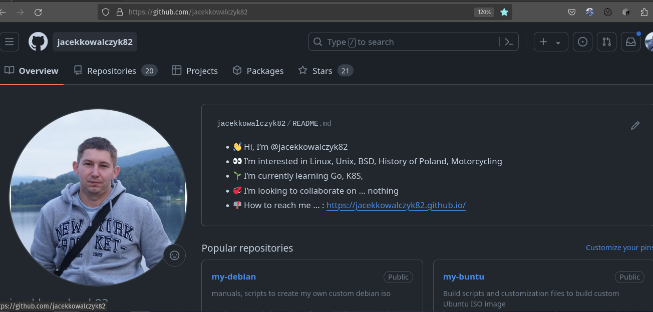
Slide with IMAGE

Slide 9
Slide with Bullet List
Element 1
Element 2
Element 3

Slide 10
Slide with Numbered List
Element 1
Element 2
Element 3

Slide 11
You can have empty slides
The next slide will be empty

