Slide 1


Web application Performance Testing From User Perspective
www.testarmy.com

Slide 2

About me
My foundation of technical expertise stems from hands on developing, testing along with team leading.
As consultant I was a part of various test teams and was involved in testing on all software life cycle stages. I build extensive experience while testing critical functions of real time system which is GSM, financial platforms and also web and desktop applications.
Currently I supervise performance and automation testing at TestArmy Group.
www.testarmy.com

Slide 3
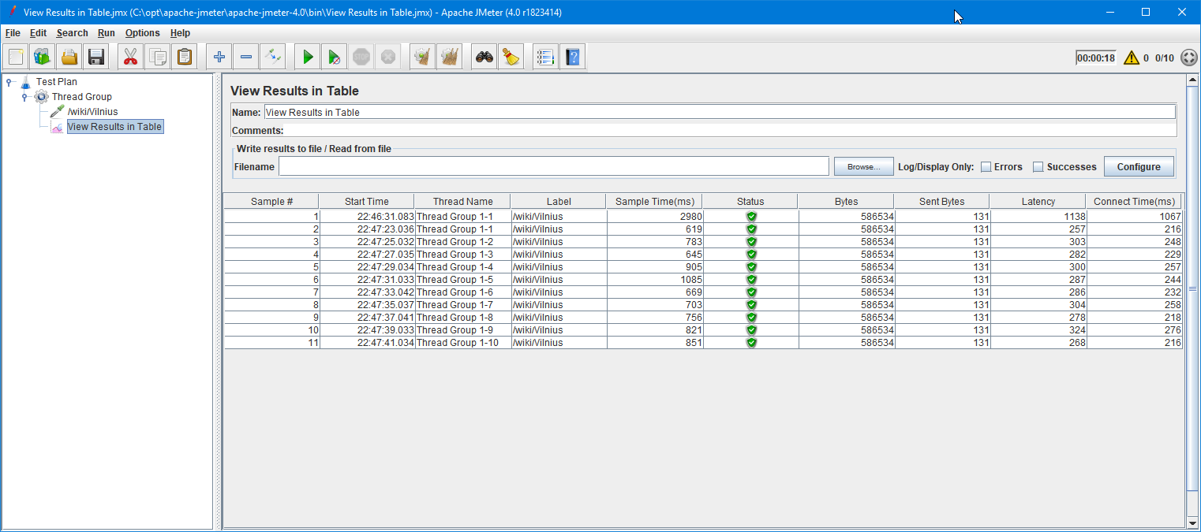
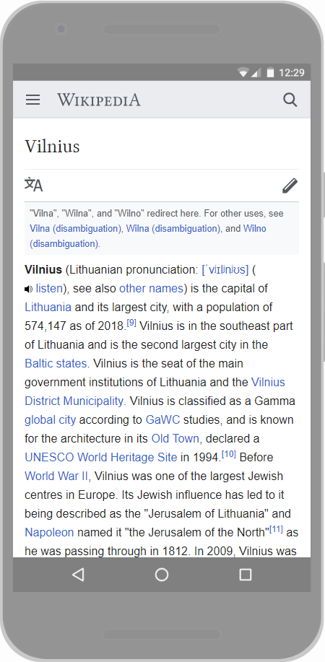
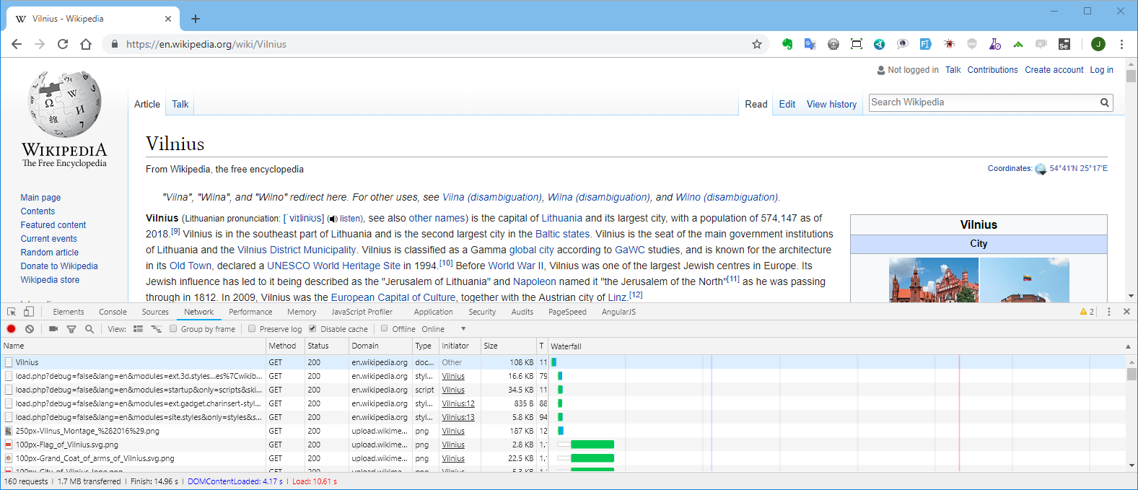
www.testarmy.com

Slide 4
What is important for user? Visibility of the requested content Ability to interact with the content
www.testarmy.com

Slide 5
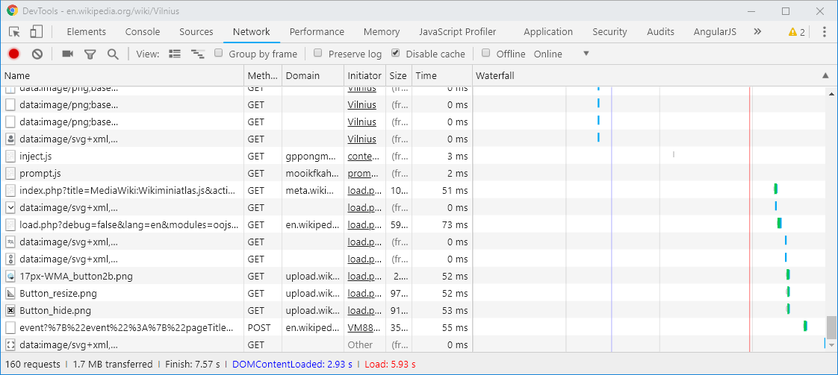
www.testarmy.com

Slide 6
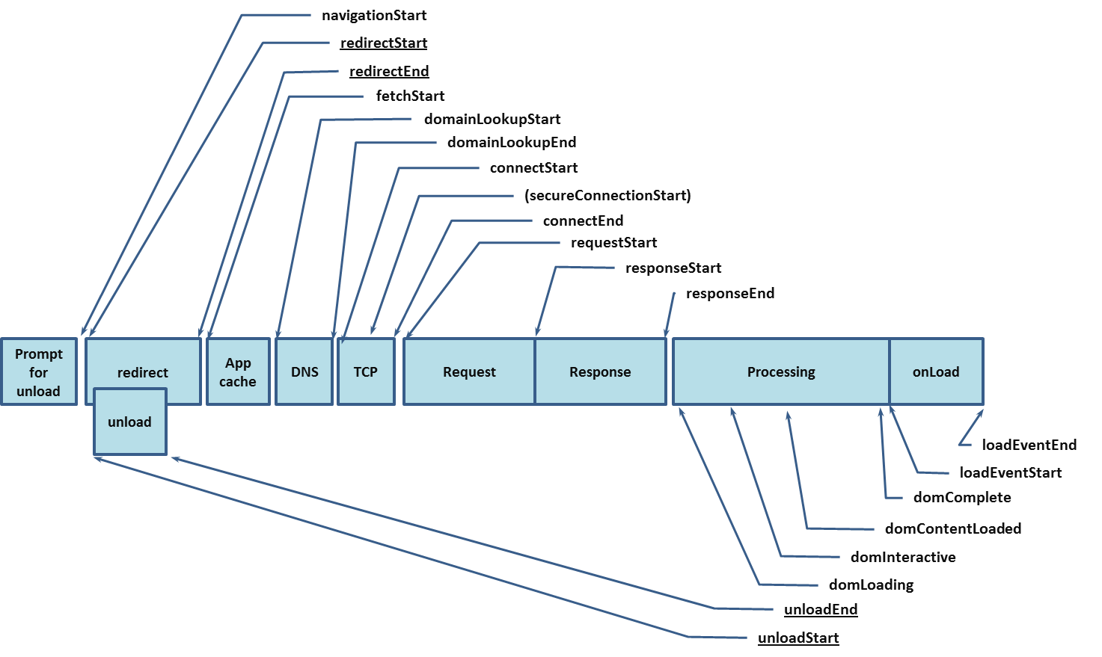
www.testarmy.com

Slide 7
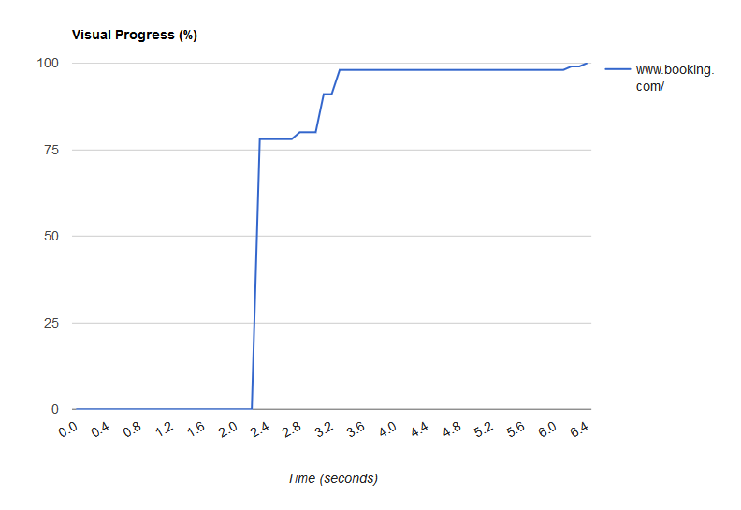
www.testarmy.com

Slide 8
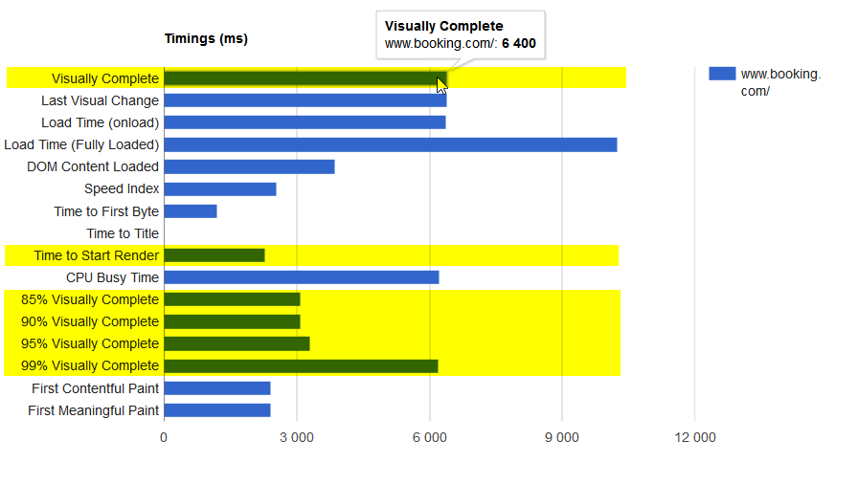
www.testarmy.com

Slide 9
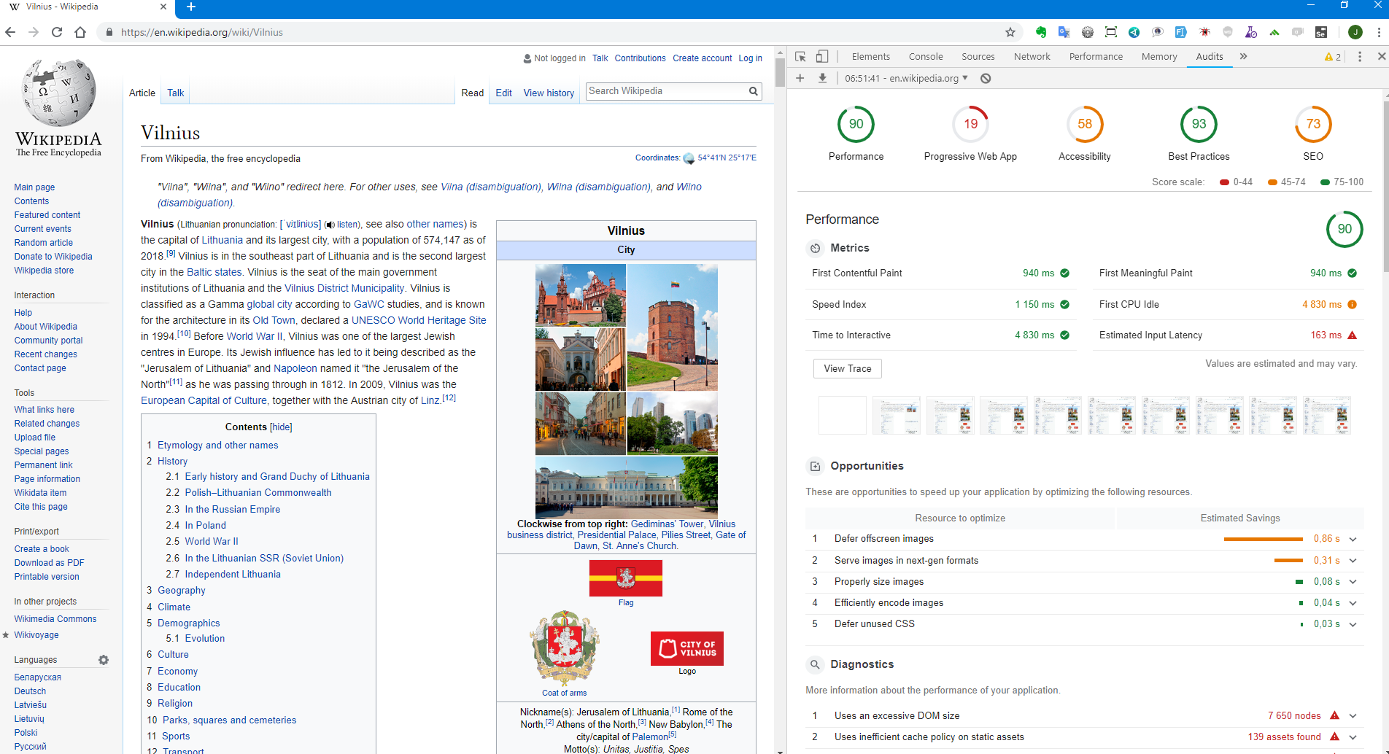
www.testarmy.com

Slide 10
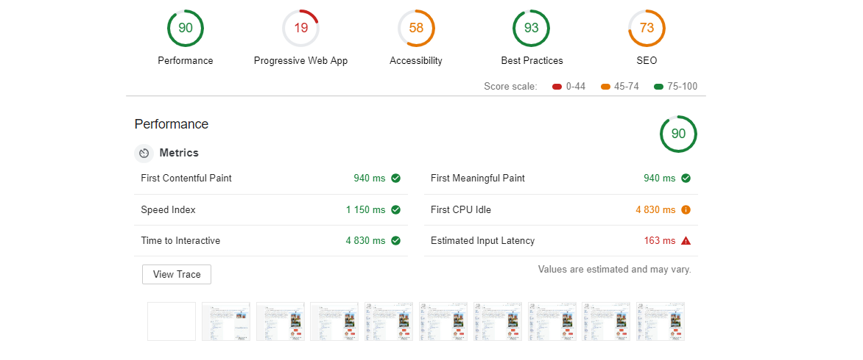
www.testarmy.com

Slide 11
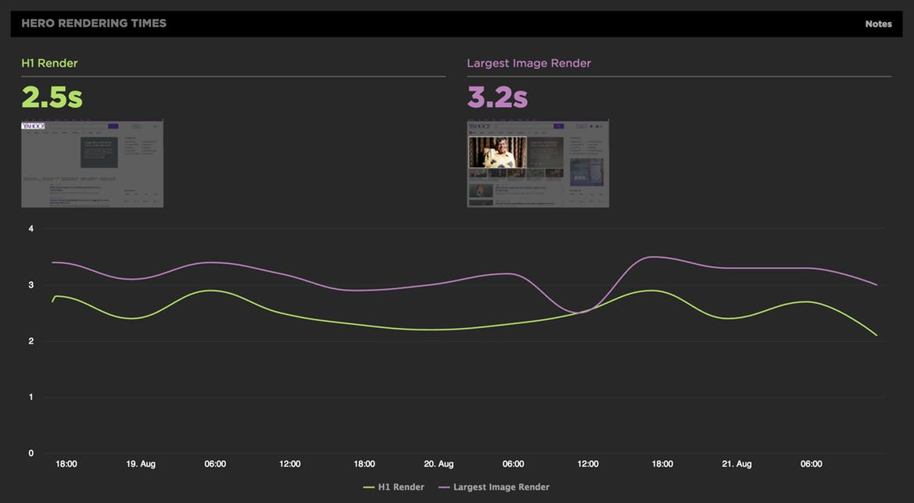
source: https://speedcurve.com/blog/web-performance-monitoring-hero-times/

Slide 12
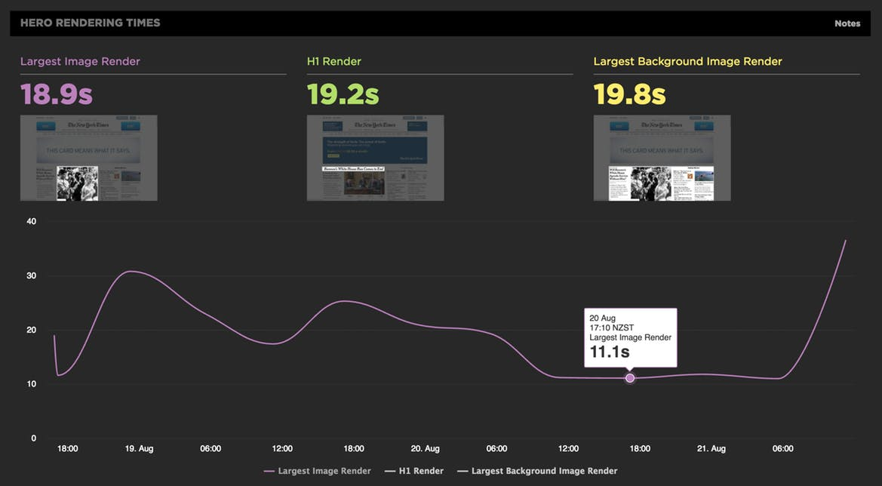
source: https://speedcurve.com/blog/last-painted-hero/

Slide 13
source: https://speedcurve.com/blog/last-painted-hero/

Slide 14
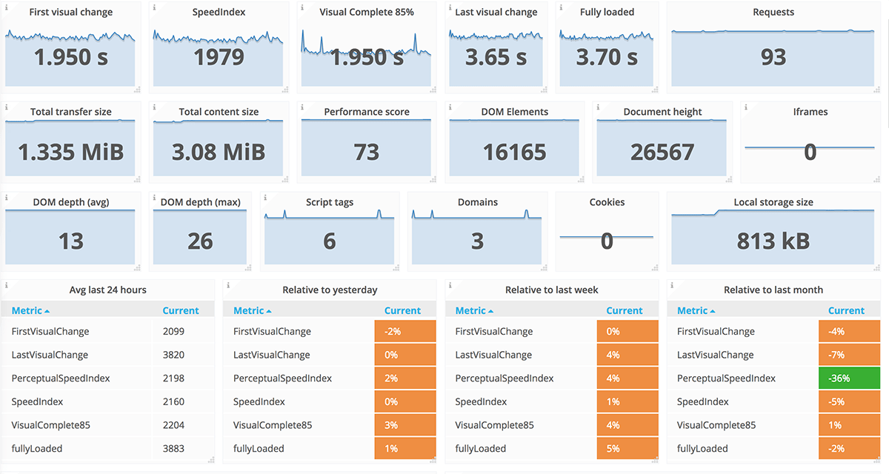
source: https://www.sitespeed.io/examples/

Slide 15
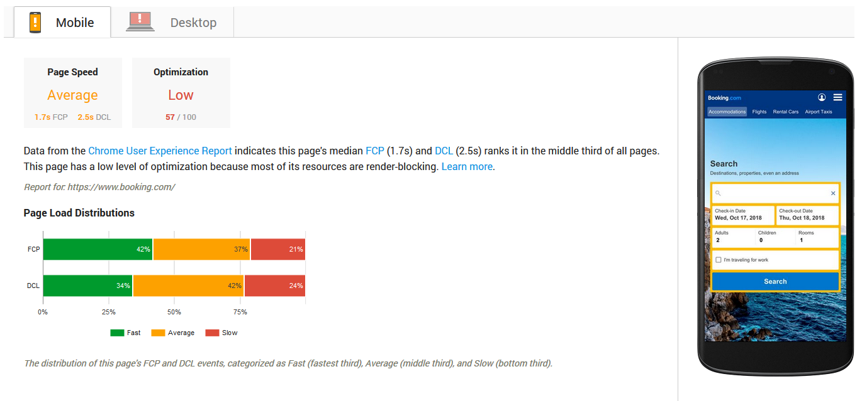
www.testarmy.com

Slide 16
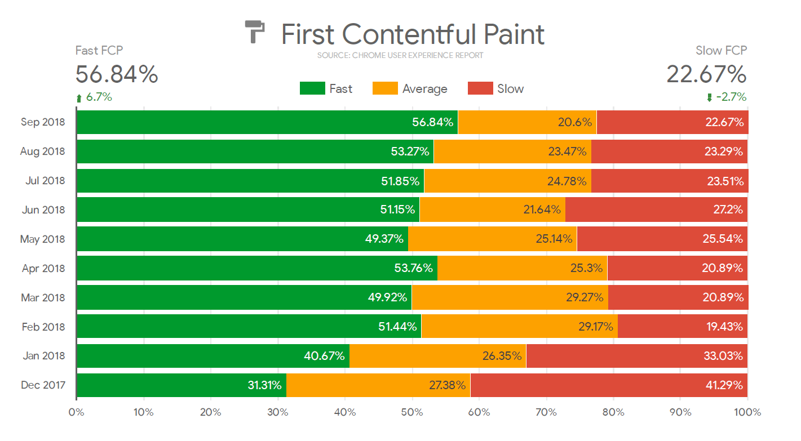
www.testarmy.com

Slide 17
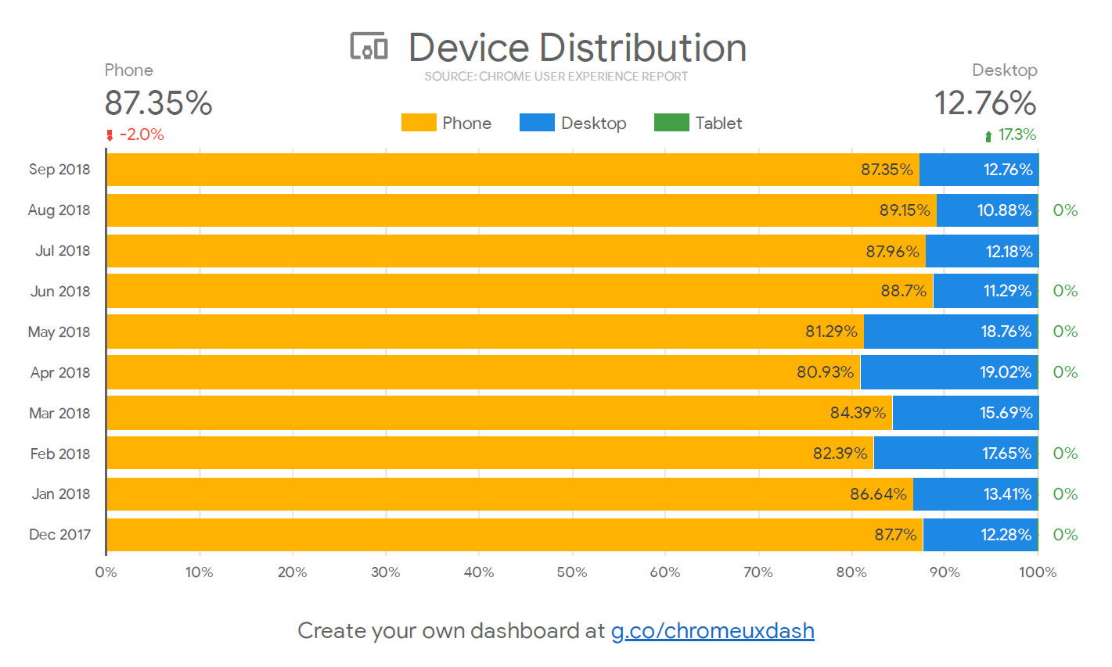
www.testarmy.com

Slide 18
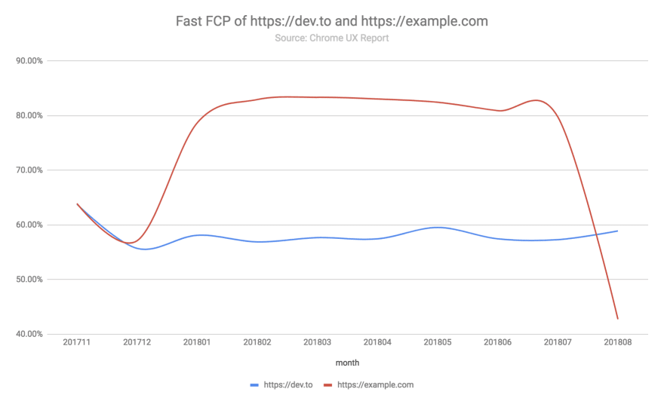
SELECT _TABLE_SUFFIX AS month, origin, SUM(fcp.density) AS fast_fcp
FROM `chrome-ux-report.all.*`, UNNEST(first_contentful_paint.histogram.bin) AS fcp
WHERE fcp.start < 1000 AND origin IN ('https://dev.to', 'https://example.com')
GROUP BY month, origin
ORDER BY month, origin
source: https://dev.to/rick_viscomi/a-step-by-step-guide-to-monitoring-the-competition-with-the-chrome-ux-report-4k1o

Slide 19
References
https://www.soasta.com/blog/measuring-web-performance-video/
http://www.softwareishard.com/blog/har-viewer/
https://www.soasta.com/blog/ebook-usertiming-performance-monitoring/
https://codeascraft.com/
https://www.soasta.com/blog/ebook-usertiming-performance-monitoring/
https://code.facebook.com/posts/991252547593574/the-technology-behind-preview-photos/
https://blog.twitter.com/2012/improving-performance-on-twittercom
http://www.stevesouders.com/blog/2015/05/12/hero-image-custom-metrics
www.testarmy.com

Slide 20
Time for questions
www.testarmy.com

