Slide 1
Prac9: Background
Abf1 is general regulatory factor (RFs) that contribute to transcriptional activation of a large number of genes, as well as to replication, silencing and telomere structure in yeast
In spite of their widespread roles in transcription, the scope of their functional targets genome-wide has not been previously determined
Yarragudi et al use microarrays to examine the contribution of these essential RFs to transcription genome-wide, by using mutants that dissociate from their binding sites at 37C
Yarragudi et al. Genome-wide analysis of transcriptional dependence and probable target sites for Abf1 and Rap1 in Saccharomyces cerevisiae. Nucleic Acids Res. 35(1) 2007.

Slide 2
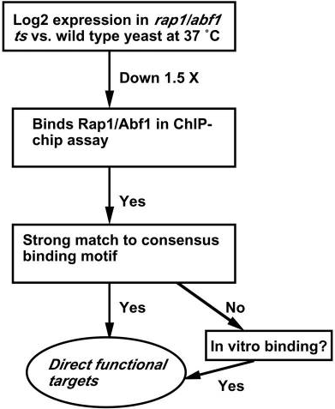
Bioinformatics: Identify targets
From: Yarragudi et al. Genome-wide analysis of transcriptional dependence and probable target sites for Abf1 in Saccharomyces cerevisiae. Nucleic Acids Res. 35(1) 2007.

Slide 3
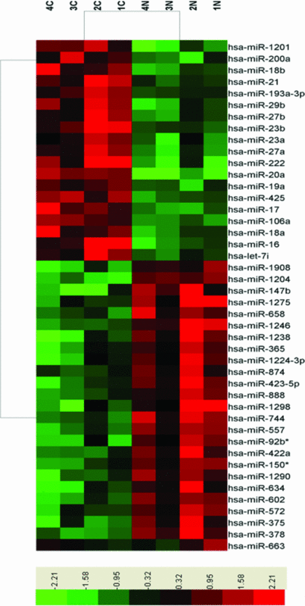
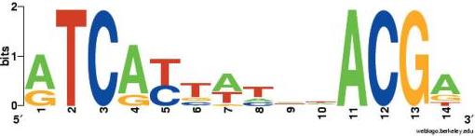
Differential expression: Identify targets
?
>YAL067W
AGAGTACTGTTTTATGGCGCTTATGTGTATTCGTATGCGCAGAATGTGGG
>YPL242C
AAAACTTATTGCACCAGTTCAATTATATGTAACAAGGTGGTGCAAAAACA
>YPR018W
TATGTTTTAGTGAACCTCAAGACAGAAGAGAATCGAAAGGAAAAGGGAAA
>YAL065C
ATCCAACATGGAGGCCACAGACTACGAATGAAGAGTCTGTCAGCTCTAAA
>YAL064W-B
TTGGATAGACCGTAACAACATCATTCACAGTAGCCGTGGCCGTCGAAACA

Slide 4
DNA binding: Identify targets
?
>YAL067W
AGAGTACTGTTTTATGGCGCTTATGTGTATTCGTATGCGCAGAATGTGGG
>YPL242C
AAAACTTATTGCACCAGTTCAATTATATGTAACAAGGTGGTGCAAAAACA
>YPR018W
TATGTTTTAGTGAACCTCAAGACAGAAGAGAATCGAAAGGAAAAGGGAAA
>YAL065C
ATCCAACATGGAGGCCACAGACTACGAATGAAGAGTCTGTCAGCTCTAAA
>YAL064W-B
TTGGATAGACCGTAACAACATCATTCACAGTAGCCGTGGCCGTCGAAACA

Slide 5
Fishers Exact Test
Quantify statistical significance of an association between two properties
Used gene set enrichment
 | Has Property | Does not have property | Row total
In gene set of interest | a | b | a+b
Not in gene set | c | d | c+d
Column total | a+c | b+d | a+b+c+d

Slide 6
Exercise 1
α or significance level – a probability which is fixed in advance of making the hypothesis test.
If the observed p-value is smaller than the significance level then the null hypothesis is rejected.
Null hypothesis
"Drug x is not indicative of chaperone regulator activity”

Slide 7
Exercise 1 Code
import stats
# 2 genes are annotated as negatives
c=2
#14 genes in our negative set
d= 14 -2
# Positive set of genes
Positives = set({"YPL106C", "YOL081W", "YOR027W", "YOR299W", "YNL006W", "YNL007C", "YLL039C", "YLR216C"})
# Genes annotated with GO Term
has_property=set({"YER048C", "YIL016W", "YLR090W", "YOR027W", "YMR161W", "YNL064C", "YNL281W", "YDR214W", "YPL106C", "YNL007C", "YNL227C"})
# We need to overlap Positives and has_property
a= # Fill me in here
#number of positives-a
b= Fill me in here
Print b
pval = stats.getFETpval(a, b, c, d, left=False)
print pval

Slide 8
Exercise 1
Provide the p-value and the significance level you are using.
And a statement (reject or not reject null hypothesis)

Slide 9
Exercise 2
seqs=readFastaFile("yeast_promoters.fa”)
print len(seqs)
Hint: look at SCPD as a source
1-2 lines (How they are biologically sensible)

Slide 10
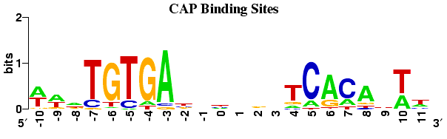
Exercise 3
Visualizing motifs using “logo”
Shows sequence conservation
Frequency of residue
Example

Slide 11
Exercise 3
Column 10
Why do you only see G and A (few lines)
Think about how PWMs are constructed
Why total height is around 1bit (1bit is half of 2 bits)
Think about what the height indicates.

Slide 12
Exercise 5 code
>>> bind_map = {}
>>> for s in yeast_prom: # yeast_prom is an array of sequences
#Insert condition here !!!
bind_map[s.name] = abf1_pwm.maxscore(s)[0] # save score

Slide 13
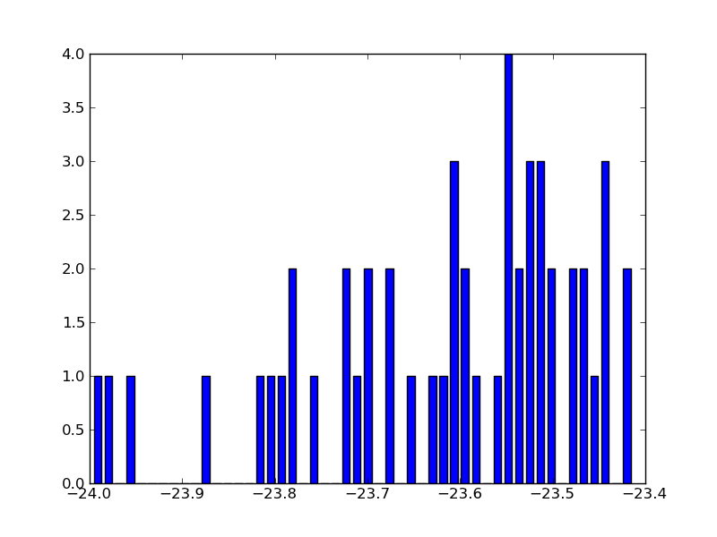
Exercise 5
Try to aim for this graph

Slide 14
Exercise 5
histogram
Provide the list of 50 target genes
Few lines (explaining your reason for the threshold)

Slide 15
Abf1 SOFT file

Slide 16
Exercise 6
Provide probe and gene numbers...
g1 = ge.readGEOFile('GDS3198.soft', id_column = 0)
g2 = ge.readGEOFile('GDS3198.soft', id_column = 1)
Hint: getGenes() and len() may be useful.

Slide 17
Exercise 7
Code
Pairing (WT/mutants)
Mention the transformations (ie. Log)
How you filtered the top 100 and lowest 100
Hint: indexing was useful.

Slide 18
Exercise 8
Code
result = sorted(meanfold.items(), key=lambda v: v[1])
print '========== Wildtype may down-regulate =========='
for r in result[0:100]:
#Fill me in I am only one condition:
print r[0]
print '========== Wildtype may up-regulate =========='
for r in result[-1:-100:-1]:
# fill me in I am only 1 condition
print r[0]

Slide 19
Exercise 8 cont’d
Provide the gene list of 50 genes like so.
========== Wildtype may down-regulate ==========
ATG29
YCLWOMEGA2
YLL067C
CDA1
YAL064W-B
YHR145C
YPR078C
RTG1
YOLCDELTA2
SPR3
YLR279W
...

Slide 20
Exercise 9
Submit: A simple explanation (1-2 lines) why it is useful
Hint: Consider multiple hypothesis testing
(i.e. testing n terms)

Slide 21
Exercise 10 +11
For Q10 Bind_map may be useful.
For Q11 Store the gene symbols
Provide
Significant GO Terms

Slide 22
Exercise 12
Helpful link:
http://www.yeastgenome.org/cgi-bin/locus.fpl?locus=abf1
Use get_GO_description

