Slide 1
Product
BSIDESDFW 2026 · WORKSHOP
Under the Hood of AI
Harness
Runtime
Model
Run, measure, secure, and break them
Jacen Kohler · TALON Cyber League · Saturday, November 7, 2026 · Arlington, TX
Notes:
Welcome everyone. Three hours, five labs, three breaks. The colored stack on the right is the one picture to remember: product, harness, runtime, model. We will keep coming back to it.

Slide 2
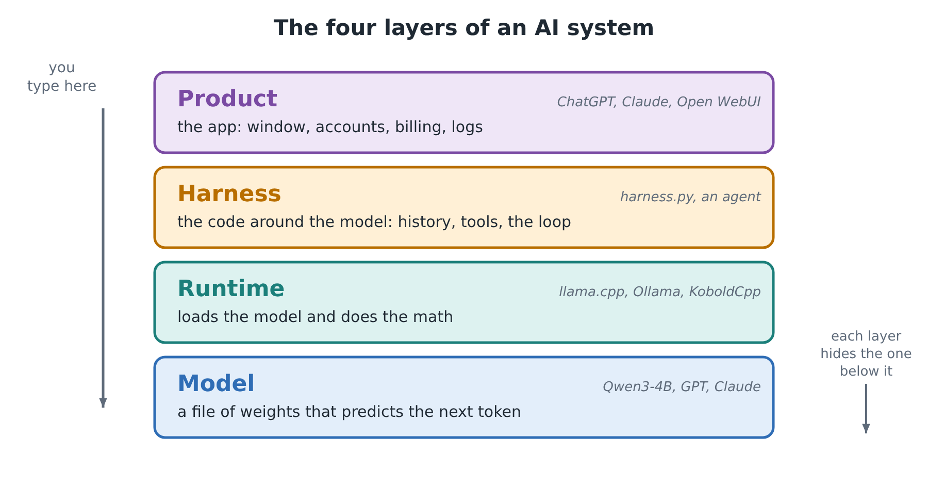
WELCOME
Run, measure, secure, break
Run real models on your own laptop.
Look inside a model file.
Measure speed, cost and quality.
Attack an agent, then defend it.
Under the Hood of AI · BSidesDFW 2026
Notes:
1:30 to 1:34. Most of today is hands-on: five labs. The talks are short on purpose; the handout has the detail. The four-layer picture is the map for the whole afternoon.

Slide 3
TODAY
The plan: 1:30 to 4:30 PM
Time | Block
1:30 | Welcome
1:34 | Who built it?
1:42 | What is it?
1:52 | Lab 1: Run a model
2:17 | Break
2:27 | How does it work? (1)
2:37 | Lab 2: Benchmark
2:52 | How does it work? (2)
Time | Block
3:00 | Break
3:10 | Lab 3: Integrations
3:30 | Securing AI (1)
3:38 | Lab 4: Logging
3:53 | Break
4:03 | Securing and breaking AI (2)
4:17 | Lab 5: Surprise Bonus Lab
4:25 | Wrap-up and homework
Blue rows are labs, amber rows are breaks. Five labs: 83 minutes. Three breaks: 30 minutes. Six talks with a discussion question each.
Notes:
Walk through the shape of the afternoon, not every row. Breaks sit next to labs on purpose: people can keep working or step away. Discussion questions land at about 1:40, 1:50, 2:35, 2:58, 3:36 and 4:14.

Slide 4






GROUND RULES
How we work today
Ask early
Optional can wait
Pair up
Stuck for a few minutes? Ask someone.
Finish the main steps first.
Share a laptop if you have 8 GB of RAM.
Guard your keys
Attack only your own
Be kind
Never paste an API key anywhere shared.
No written permission, no testing.
Everyone started somewhere.
Under the Hood of AI · BSidesDFW 2026
Notes:
Read the card titles only. Stress the attack-only-what-you-own rule: the security labs use models and agents running on your own machine. Help is in the BSidesDFW Discord, workshop channel.

Slide 5
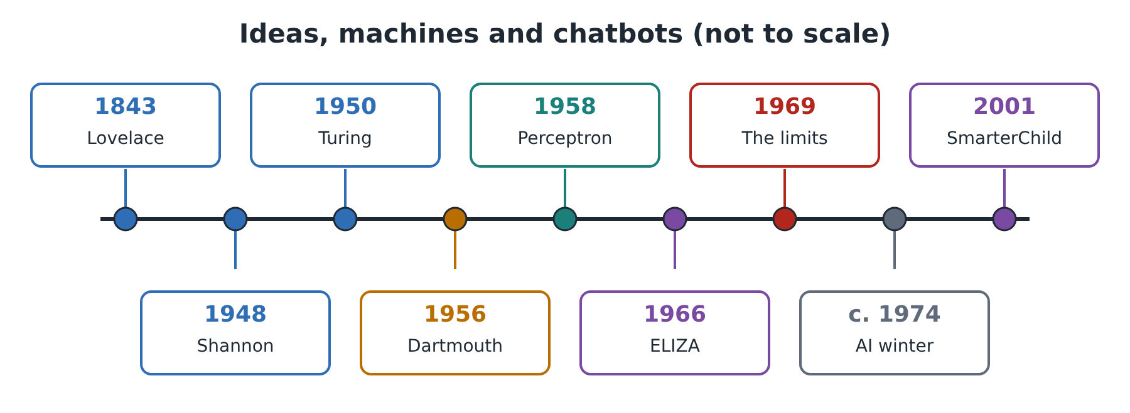
WHO BUILT IT?
Ideas, machines and chatbots
Lovelace imagined machines that work on more than numbers.
Turing asked in 1950: can machines think?
The perceptron learned from examples, then the first AI winter hit.
Under the Hood of AI · BSidesDFW 2026
Notes:
1:34 to 1:42, with the first discussion question at the end. Keep it moving: one beat per milestone. The point is that the ideas are old and the progress came in waves, with winters in between.

Slide 6
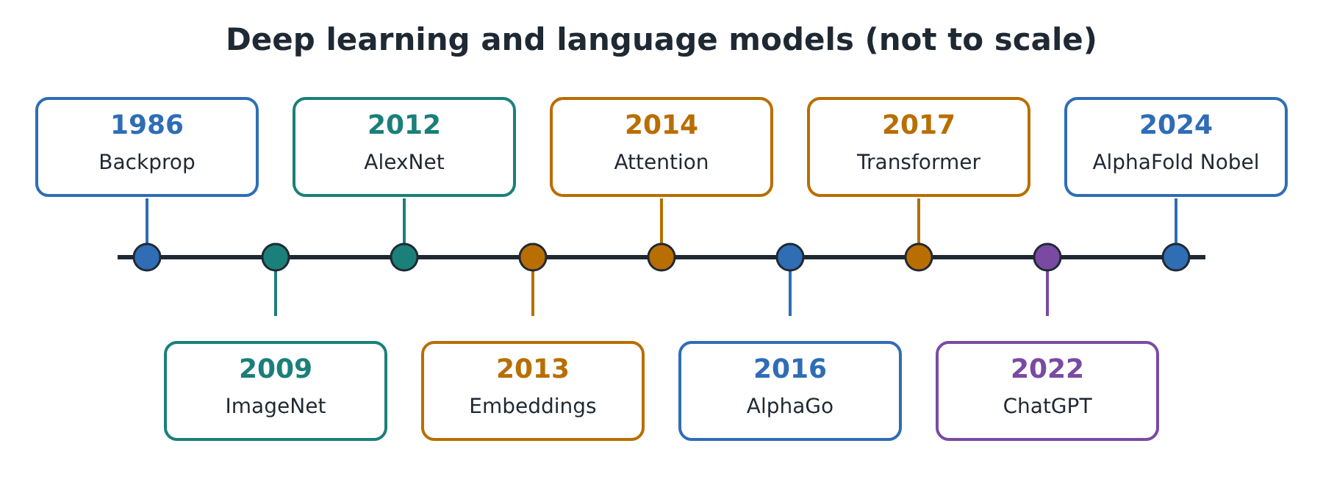
WHO BUILT IT?
Deep learning to language models
Backpropagation let deep networks learn from data.
ImageNet and GPUs set up AlexNet’s win in 2012.
Attention led to the transformer in 2017, then to chat.
Under the Hood of AI · BSidesDFW 2026
Notes:
Mention that behind every labeled data set are people who did the labeling. The recipe is the same each time: more data, more compute, a better architecture. Transformers are the architecture behind every model we run today.

Slide 7

TURN TO YOUR NEIGHBOR · 2 MINUTES
ELIZA fooled people in 1966 with simple rules. What makes us believe a machine understands us?
Notes:
About 1:40. Let people talk for two minutes, then take one or two answers. Good threads: fluent language, a friendly tone, and our habit of seeing a mind behind words. Do not resolve it. We come back to fluent-versus-true later.

Slide 8
WHAT IS IT?
Four layers
Model: a file of numbers.
Runtime: loads the model and does the math.
Harness: the code around the model.
Product: the app people use.
Under the Hood of AI · BSidesDFW 2026
Notes:
1:42 to 1:52. When something goes wrong, ask which layer. We go up from the bottom: model, runtime, harness, then product. Each layer is something you touch in Lab 1.

Slide 9
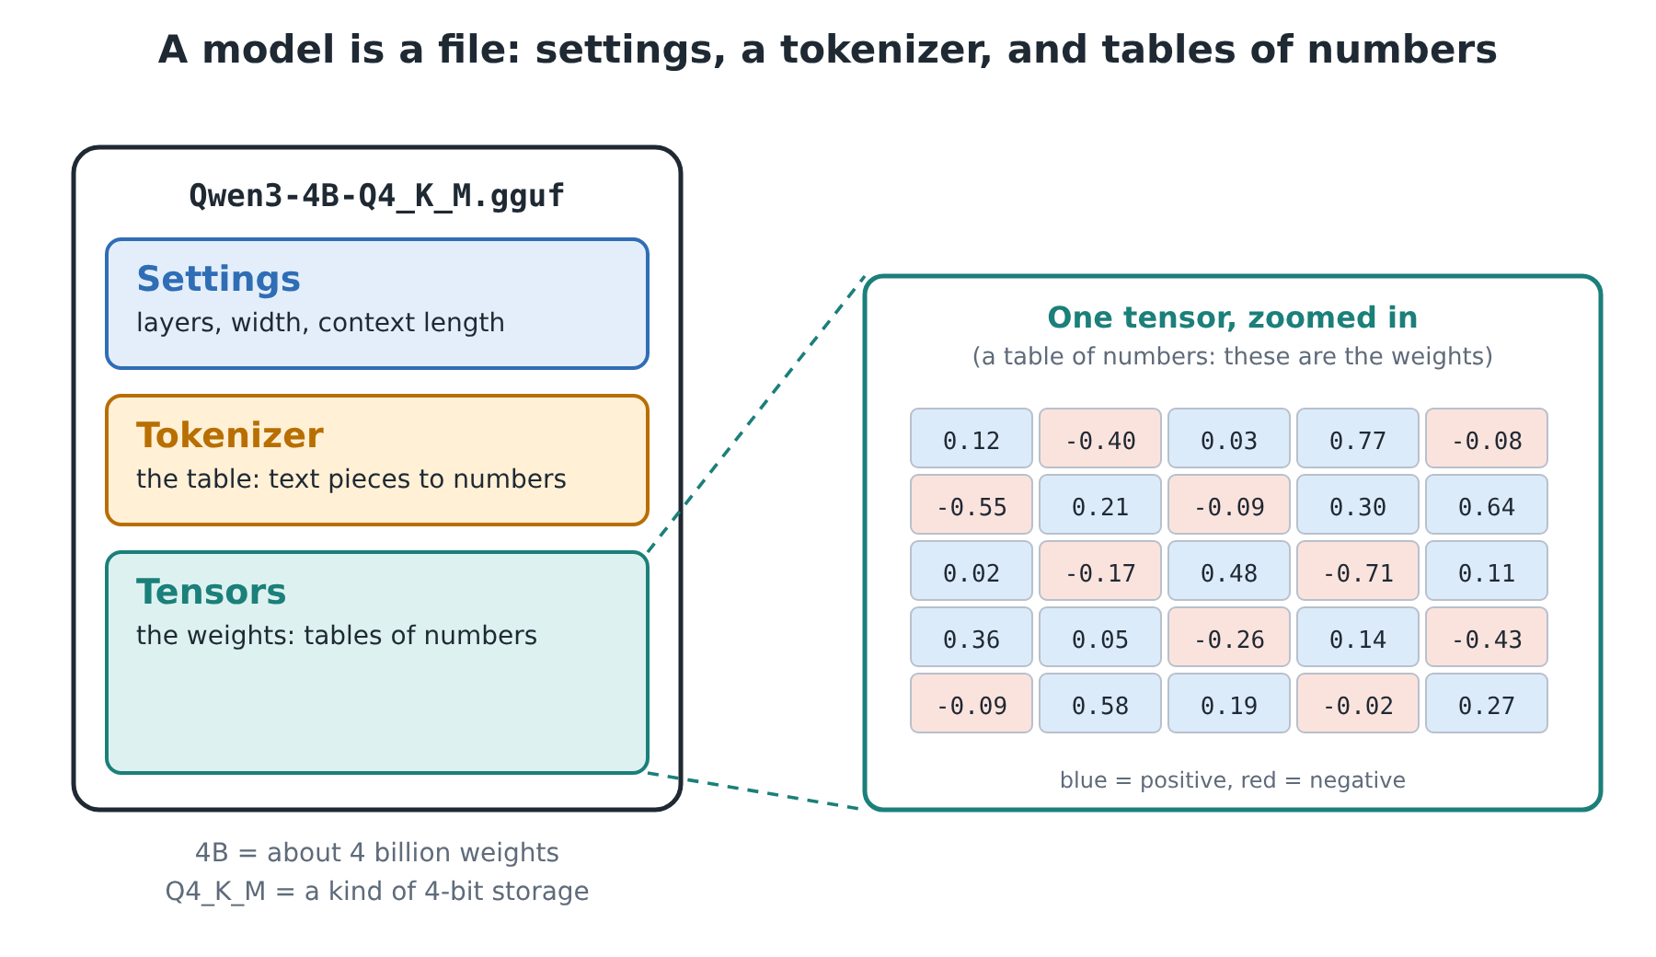
THE MODEL
A file of weights
It predicts the next token.
“7B” means about seven billion weights.
It does not look things up.
Its weights do not change when you chat.
Under the Hood of AI · BSidesDFW 2026
Notes:
Key mental model: the model is a file. It is not a database and it does not remember you. Everything that looks like memory lives in the harness.

Slide 10
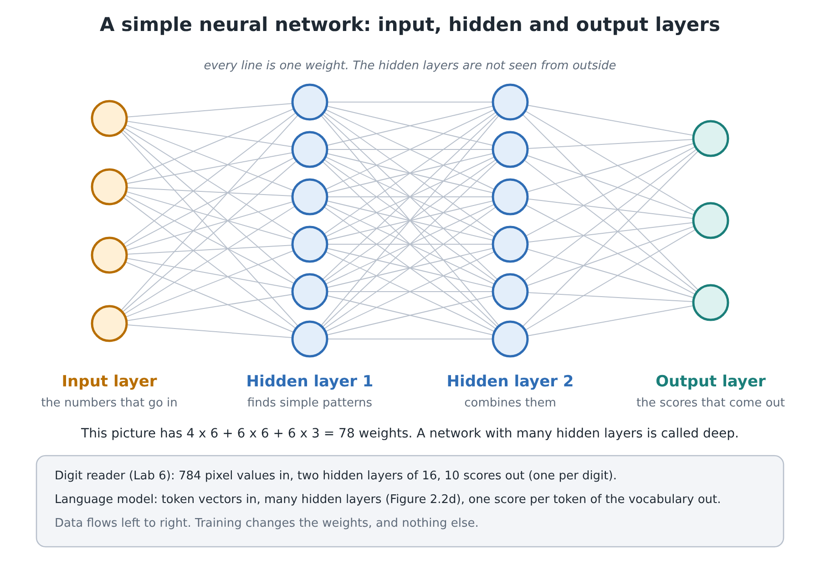
THE MODEL
Layers of weights
The input layer takes in numbers.
Hidden layers find patterns.
The output layer gives scores.
Every line is a weight.
Under the Hood of AI · BSidesDFW 2026
Notes:
This toy network has 78 weights: 4x6 plus 6x6 plus 6x3. A language model is the same picture, much taller and much deeper.

Slide 11
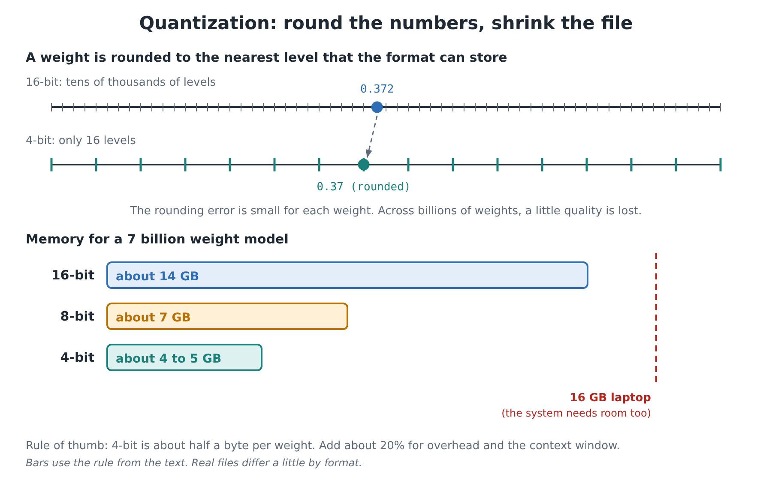
THE MODEL
Quantization: smaller files
Quantization stores each weight in fewer bits.
The file is smaller and faster.
The cost is a small loss in quality.
Four-bit weights take a quarter of the space of 16-bit.
Under the Hood of AI · BSidesDFW 2026
Notes:
This is why a 7B model can fit on a laptop. Lab 1 Part 1 has you look inside the formats, and Lab 2 measures what quantization costs in quality.

Slide 12
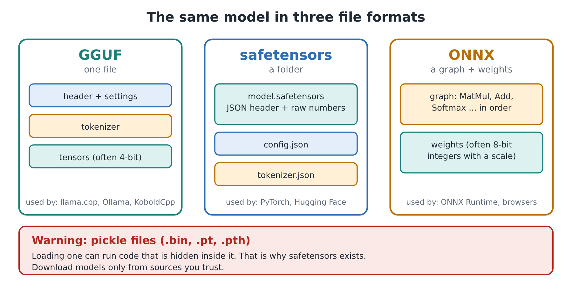
THE MODEL
Formats: some can run code
GGUF is one file for llama.cpp, Ollama and KoboldCpp.
Safetensors holds numbers and cannot run code.
A pickle file can run hidden code when loaded.
Prefer safetensors and GGUF from sources you trust.
Under the Hood of AI · BSidesDFW 2026
Notes:
First supply-chain lesson of the day: downloading a model is downloading a file someone else made. Format matters for safety.

Slide 13
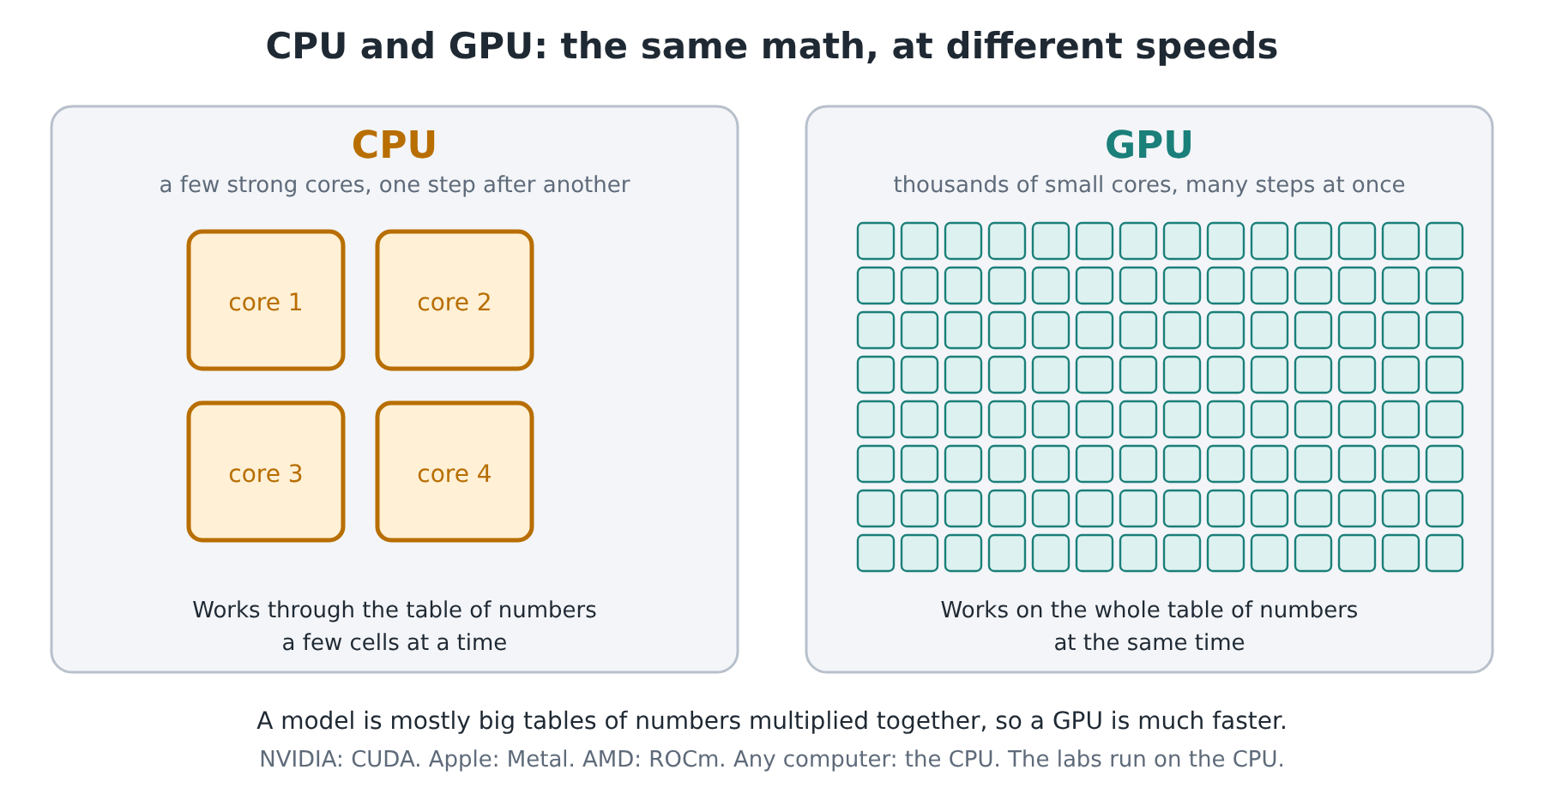
THE RUNTIME
The runtime does the math
A CPU works step by step.
A GPU does thousands of steps at once.
Ollama, llama.cpp and KoboldCpp are runtimes.
Local means your data stays on your machine.
Under the Hood of AI · BSidesDFW 2026
Notes:
Every lab runs on a CPU. If you have a GPU there is an option. Same model file, very different speeds. Lab 2 puts numbers on that.

Slide 14
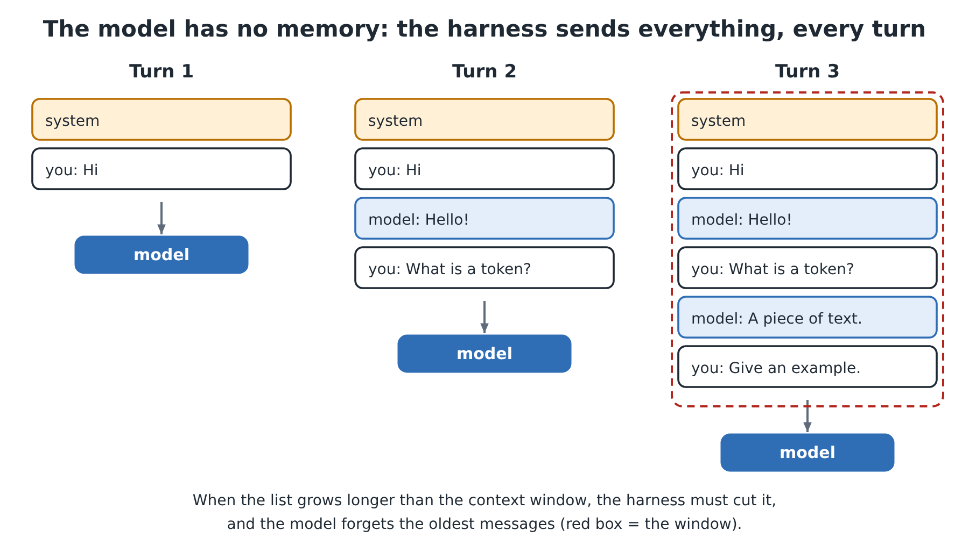
THE HARNESS
The harness decides what the model sees
The model has no memory.
The harness sends the whole chat every time.
It holds the system prompt and the settings.
Same model, different harness, different behavior.
Under the Hood of AI · BSidesDFW 2026
Notes:
You write the harness in Lab 1 and keep extending it through Lab 4: metrics, VS Code, logging. It is the most important layer for security because it decides what the model may do.

Slide 15
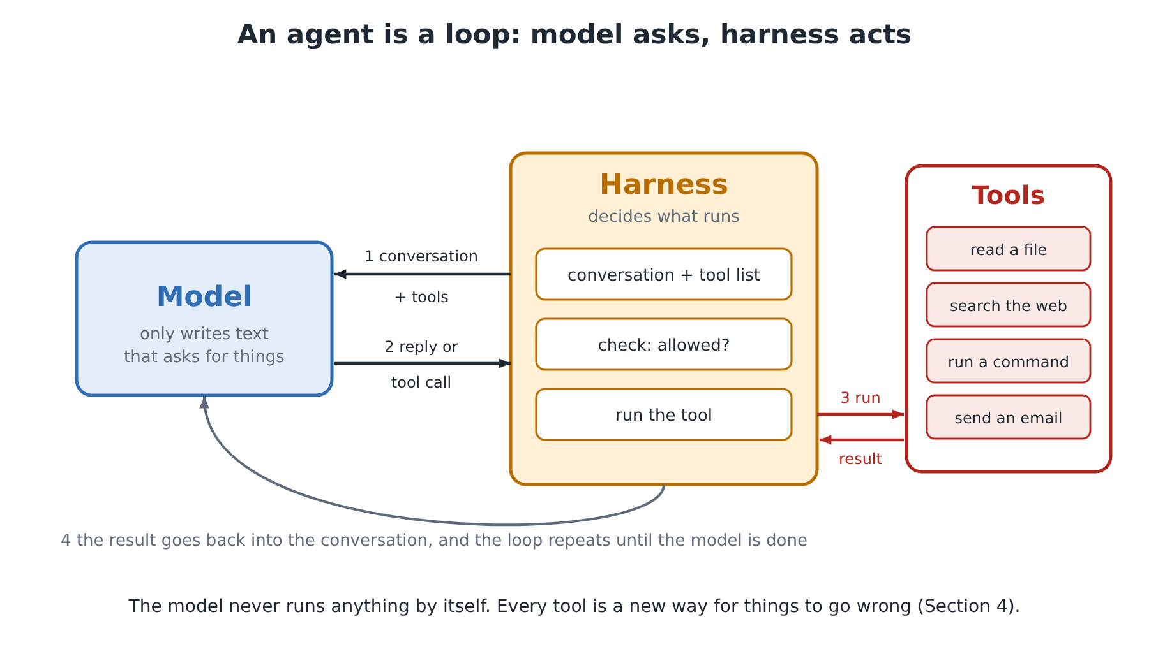
AGENTS
An agent is a loop
The model only writes text.
The harness decides whether to run a tool.
The loop repeats until the task is done.
Tools are where the risk is.
Under the Hood of AI · BSidesDFW 2026
Notes:
Agentic is a matter of degree: how much does the model, rather than the person, choose the next step? MCP is the open standard for plugging tools into a harness. We attack an agent in Lab 8 (homework).

Slide 16
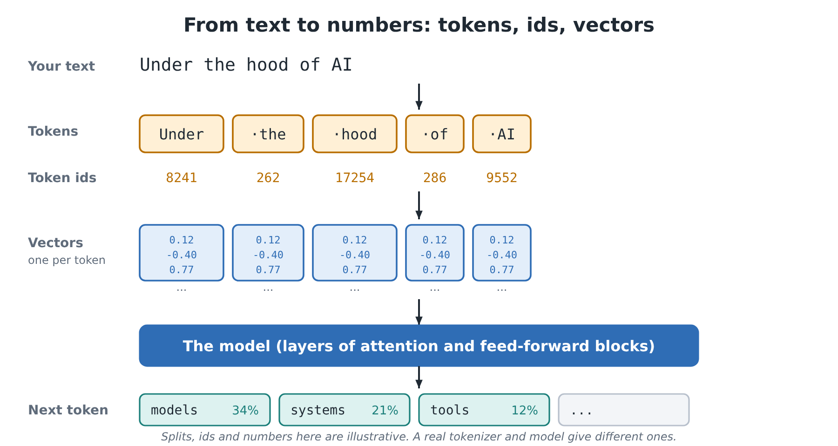
TOKENS
Text becomes tokens
A token is a piece of text.
Words, word pieces, symbols and markers are all tokens.
Each token becomes a vector of numbers.
Clouds price input, cached and output tokens separately.
Under the Hood of AI · BSidesDFW 2026
Notes:
Types of tokens: whole words, word pieces, characters or bytes, number pieces, punctuation, special control tokens, tool-call tokens, reasoning tokens, and image or audio tokens. Reasoning tokens count as output.

Slide 17
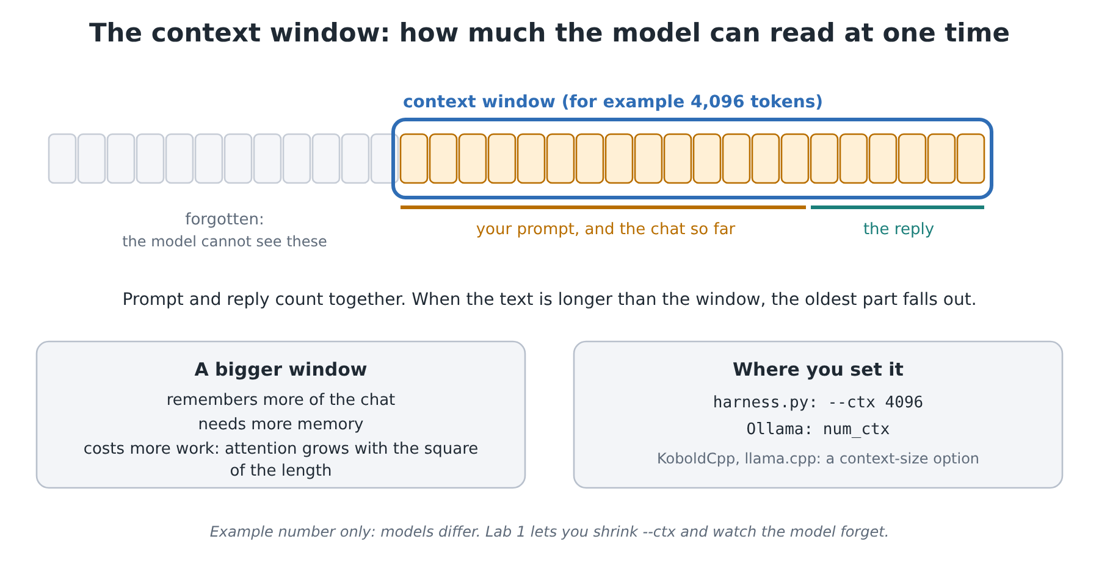
TOKENS
The context window is the budget
The prompt and the reply share one window.
System prompt, history, documents and tool results all count.
Compaction summarizes old turns to make room.
Under the Hood of AI · BSidesDFW 2026
Notes:
Everything the model reads counts toward the window, including tool definitions. When it fills up, the harness has to cut or compact. Context engineering means choosing the smallest set of useful tokens.

Slide 18
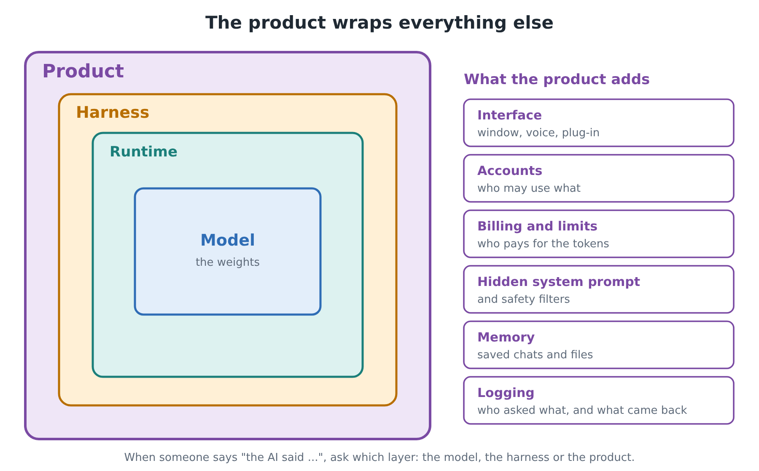
THE PRODUCT
The product wraps it all
The interface, accounts, billing and logs.
Cloud and local products add different risks.
The layers add up: each one can fail.
Under the Hood of AI · BSidesDFW 2026
Notes:
Last layer of the stack. Logging lives here, which is why Lab 4 comes later. Then the discussion question, and Lab 1.

Slide 19
TURN TO YOUR NEIGHBOR · 2 MINUTES
A chatbot gives a harmful answer. Which layer do you check first: model, runtime, harness or product?
What evidence would you look for?
Notes:
About 1:50. Expect different answers: the model (training), the harness (system prompt, missing filter), the product (no logging). Point out that the same symptom can live in more than one layer, which is why we log.

Slide 20
LAB 1
Run a Model in a Harness
Setup: install and download
Part 1: Look inside three model formats
Part 2: Run the models in the harness
Part 3 (optional): Cloud models, keys kept safe
Part 4: The same model in three runtimes
Bonus: Official AI command-line tools and apps
25
minutes
Instructions on GitHub:
github.com/jacenrkohler/Presentations/blob/main/Ai-workshop/Lab01/README.md
Notes:
1:52 to 2:17. Do Setup and Parts 1 and 2 first. Optional and bonus parts can wait. Pair up if your laptop has 8 GB of RAM. Walk the room.

Slide 21

Break
10 minutes · back at 2:27 PM
Stretch, refill, and ask questions about Lab 1.
Notes:
2:17 to 2:27. Stragglers can keep working on Lab 1.

Slide 22
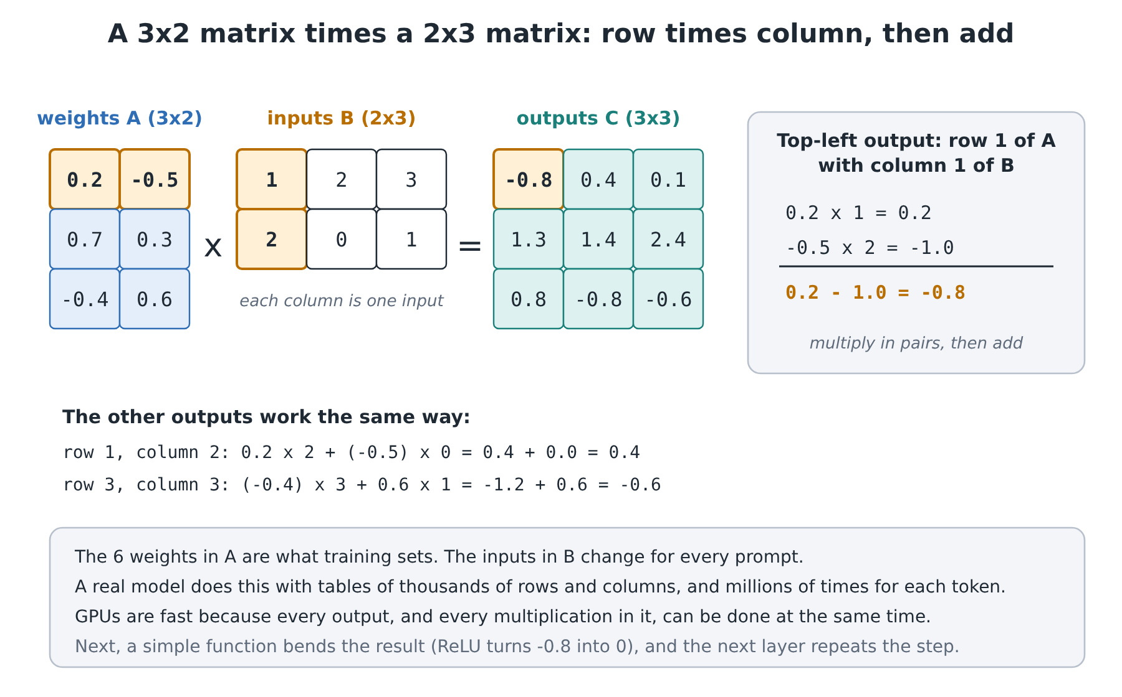
HOW DOES IT WORK?
A pile of multiplications
A matrix is a table of weights.
Each output is a weighted sum.
A GPU does all the sums at once.
A model repeats this step in every layer.
Under the Hood of AI · BSidesDFW 2026
Notes:
2:27 to 2:37. Walk the top-left output: 0.2 times 1 plus minus 0.5 times 2 equals minus 0.8. Then ReLU bends it, softmax turns final scores into probabilities. No calculus needed.

Slide 23
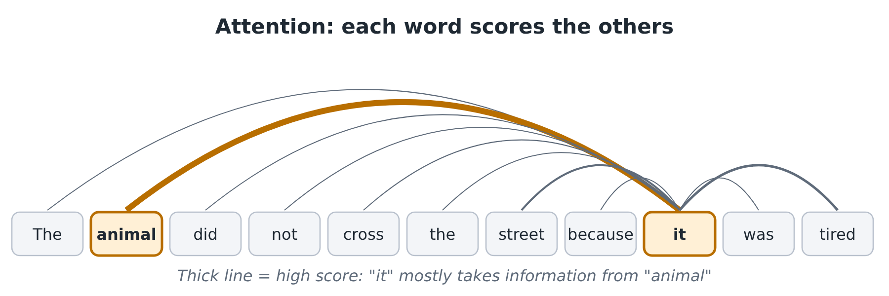
HOW DOES IT WORK?
Attention: words score each other
Each token scores every other token and mixes in the high scorers.
A transformer stacks attention with plain matrices, layer after layer.
Under the Hood of AI · BSidesDFW 2026
Notes:
Library picture: each word writes a question, every word holds a label and some content, and the best matches are read. That is how “it” finds “animal”. Transformers made training parallel and are behind every model we run.

Slide 24
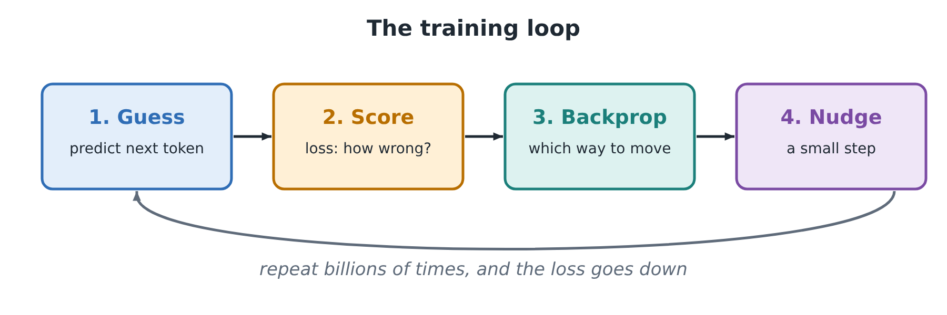
HOW DOES IT WORK?
Training: guess, score, nudge
Loss measures how wrong the guess was; backpropagation says which way to nudge.
Fine-tuning and LoRA adjust a finished model on your own examples.
Under the Hood of AI · BSidesDFW 2026
Notes:
Training is guessing the next token billions of times. What can go wrong: overfitting, poisoned data, and bias inherited from the data. Lab 6 (homework) has you train a small network, overfit it, and poison it.

Slide 25
TURN TO YOUR NEIGHBOR · 2 MINUTES
A model only knows what was in its training data. Who might be missing, and what would that change?
Notes:
About 2:35. Let people connect it to languages, dialects, regions, and who gets to write on the internet. This sets up the bias and poisoning discussion in the security half.

Slide 26
LAB 2
Benchmarking Models and Harnesses
Part 1: Add metrics to the harness
Part 2: Benchmark the harness and Ollama
Part 3 (optional): Benchmark the cloud APIs
Part 4 (optional): Benchmark the official CLIs
15
minutes
Instructions on GitHub:
github.com/jacenrkohler/Presentations/blob/main/Ai-workshop/Lab02/README.md
Notes:
2:37 to 2:52. Focus on Parts 1 and 2: add the metrics, then your first live benchmark. Everything else is optional or homework-sized. Compare tokens per second with and without a GPU if you have one.

Slide 27
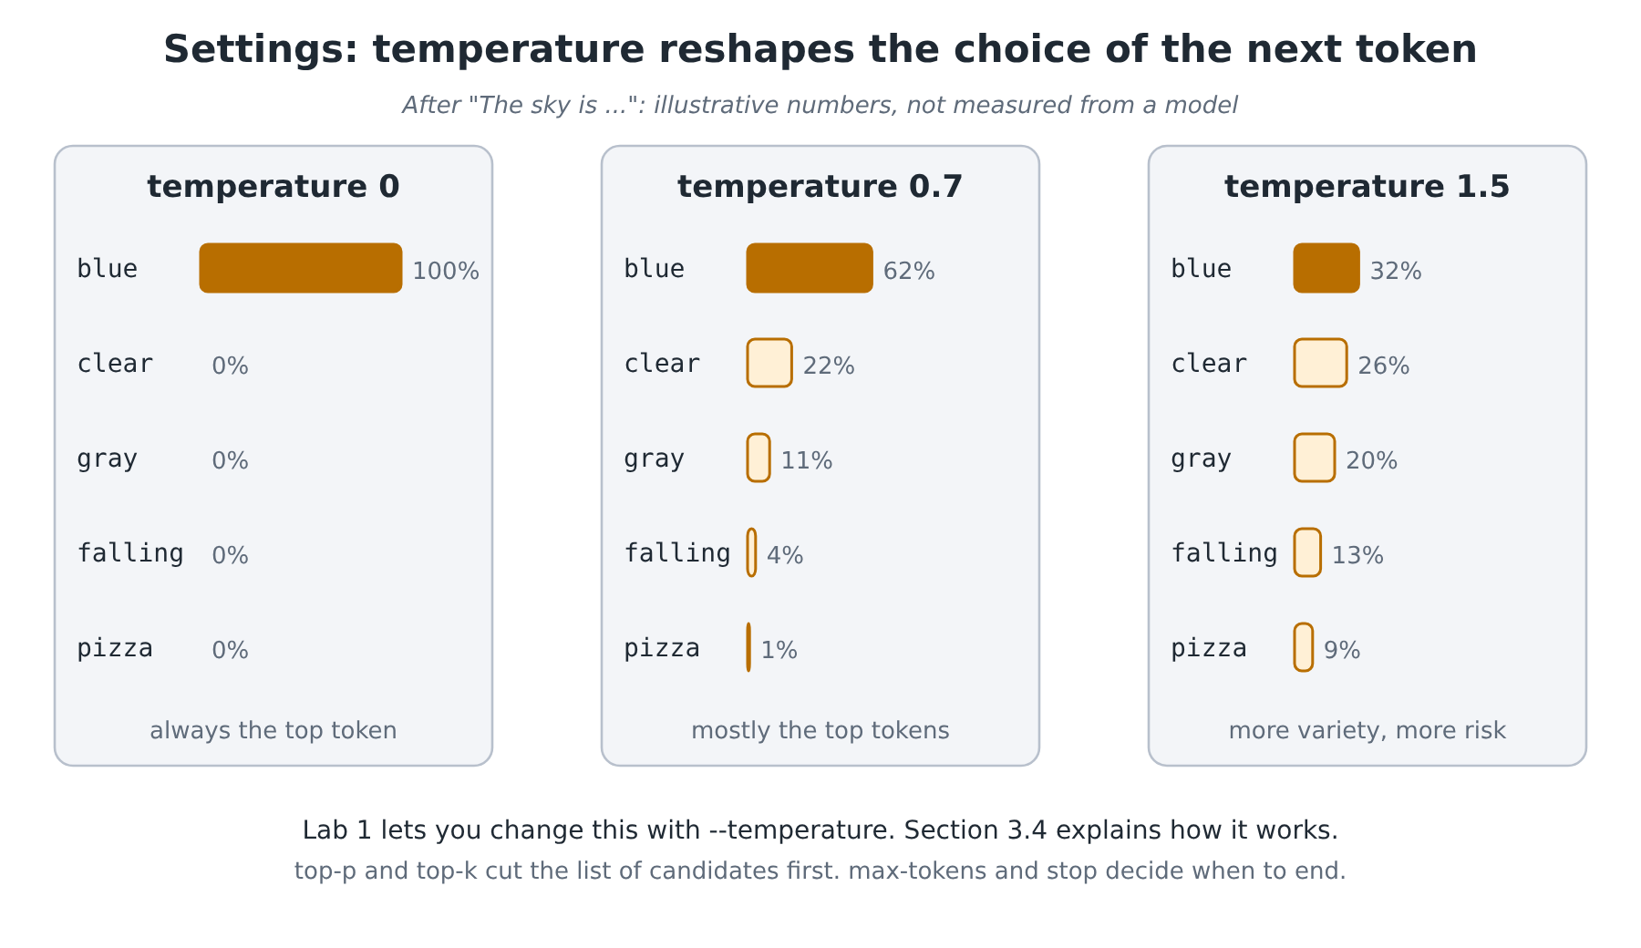
HOW DOES IT WORK?
Generating text
The model outputs probabilities, not a sentence.
Temperature turns variety up or down.
The same seed and settings give the same text.
Fluent is not the same as true.
Under the Hood of AI · BSidesDFW 2026
Notes:
2:52 to 3:00 starts here. Hallucination: the model predicts likely text, so when it does not know, the likely continuation is still fluent. Check what you can check, and give the model the source.

Slide 28




HOW DOES IT WORK?
Cost and speed
Memory first
Two phases
The model has to fit in memory.
Prefill reads fast and decode writes slowly.
Measure it
Smallest that passes
Count tokens per second yourself.
Test with your own twenty prompts.
Under the Hood of AI · BSidesDFW 2026
Notes:
Pick the smallest model that passes your own test. Lab 2 is where you measure it. Next slide: the cost levers, one per kind of token and call.

Slide 29
HOW DOES IT WORK?
Ways to lower the cost
You pay for | Pull this lever
Input tokens | Shorter prompts; send only the best passages
Cached input | Put text that never changes first
Output tokens | Set max tokens and stop sequences
Reasoning tokens | Turn thinking on only for hard tasks
Image and audio | Crop images; send text when text will do
The model | Smallest model that passes; route easy requests
Number of calls | Cache answers, batch work, set budgets
Agents | Limit steps and tool calls
Measure first, find the biggest part of the bill, then pull that lever.
Notes:
3:00 slot belongs to the break; this slide closes the 2:52 talk. Every kind of token has its own lever. Measure in Lab 2, and see the token counts in the Lab 4 log.

Slide 30
HOW DOES IT WORK?
Working with it
Prompt
A prompt is a specification, not a wish.
Context engineering
Choose the smallest set of useful tokens.
Tool calling
The model asks and the harness decides.
MCP
An open standard for plugging in tools and data.
RAG
Fetch the best passages and paste them into the prompt.
Under the Hood of AI · BSidesDFW 2026
Notes:
Lab 3 plugs the harness into VS Code through Continue. Tool descriptions and retrieved passages are text the model reads, which is why they matter for security in the second half.

Slide 31
TURN TO YOUR NEIGHBOR · 2 MINUTES
You paste a web page into a prompt and ask for a summary. Whose instructions is the model following?
Notes:
About 2:58, just before the break. This is a teaser for the security half: the model cannot tell your request from text inside the page. Let the question sit through the break.

Slide 32
Break
10 minutes · back at 3:10 PM
Next up: Lab 3, integrations and tooling.
Notes:
3:00 to 3:10.

Slide 33
LAB 3
Integrations and Tooling
Part 1: The harness in VS Code
Connect Continue and write “Hello, World”
Optional: other local models, cloud APIs, official tools
Part 2 (optional): Obsidian as memory
20
minutes
Instructions on GitHub:
github.com/jacenrkohler/Presentations/blob/main/Ai-workshop/Lab03/README.md
Notes:
3:10 to 3:30. Part 1 is the goal: your own harness answering inside VS Code. Part 2 is optional.

Slide 34
SECURING AI
Regulation and law
European Union
United Kingdom
China
The AI Act phases in from 2024 to 2028.
No general AI law; existing regulators apply principles.
Rules by topic, such as recommendation algorithms and generative AI.
United States
International
A snapshot
No federal AI statute; the states lead.
OECD principles and the ISO/IEC 42001 standard.
Not legal advice. Checked 6 November 2026.
Under the Hood of AI · BSidesDFW 2026
Notes:
3:30 to 3:38. The rules change quickly, so this is a snapshot. Know which rules apply where you work and where your users are, keep records, and know which systems make decisions about people. Sources are in the handout, Section 4.1 and Appendix A.

Slide 35
SECURING AI
Governance and frameworks
OWASP Top 10 for LLM Apps
MITRE ATLAS
NIST AI RMF
A shared list of the top risks.
Attack tactics and techniques for AI systems.
A framework for managing AI risk.
ISO/IEC 42001
CISA and partners
Name what you see
A certifiable AI management standard.
Joint guidance on deploying and securing AI.
Give every attack and control a shared name.
Under the Hood of AI · BSidesDFW 2026
Notes:
Governance in practice: a policy that says which AI is allowed, who approves it, and who owns the risk. Frameworks let you map what you see, such as the July 2026 incident, to a shared vocabulary like MITRE ATLAS.

Slide 36
SECURING AI
Logging and compliance
Record who asked what, when, and with which model.
Record what came back, with the token counts.
Protect the log: it holds sensitive text.
Harness
CSV log
Syslog
SIEM
CEF and LEEF are structured line formats that many security products read.
Notes:
3:30 to 3:38 covers regulation, governance and this slide. Compliance usually means being able to show who did what. Lab 4 builds exactly this pipeline: a CSV log, then syslog to a SIEM, then Open WebUI with users, models and logs.

Slide 37
TURN TO YOUR NEIGHBOR · 2 MINUTES
If every prompt is logged, who should be allowed to read the logs, and what do you tell your users?
Notes:
About 3:36. Tension to draw out: logs help security and compliance, but they also hold private text. Think access control, retention, and telling users what you keep.

Slide 38
LAB 4
Logging and Compliance
Part 1: A CSV log for every session
Part 2: Send the log to a SIEM over syslog
Part 3: Open WebUI: users, models and logs
Optional: CEF and LEEF formats, cloud models
15
minutes
Instructions on GitHub:
github.com/jacenrkohler/Presentations/blob/main/Ai-workshop/Lab04/README.md
Notes:
3:38 to 3:53. Part 1 is the must-do. Part 2 needs the SIEM from the lab setup. Part 3 if time allows. The break follows, so people can finish during it.

Slide 39
Break
10 minutes · back at 4:03 PM
Next up: controls, case study, and breaking AI.
Notes:
3:53 to 4:03.

Slide 40





SECURING AI
Traditional controls still matter
Identity
Least privilege
Patching
Know who is asking.
Give an agent only what its job needs.
Update runtimes, packages and servers.
Isolation
Secrets
Supply chain
Run code and agents in a sandbox.
Short-lived, narrow, never pasted.
Check models, packages and servers.
Do the basics first. They are not enough on their own.
Notes:
4:03 to 4:17 starts here. Most AI security is ordinary security applied to new parts. Think in layers and trust boundaries. Then the question: why is that not enough?

Slide 41
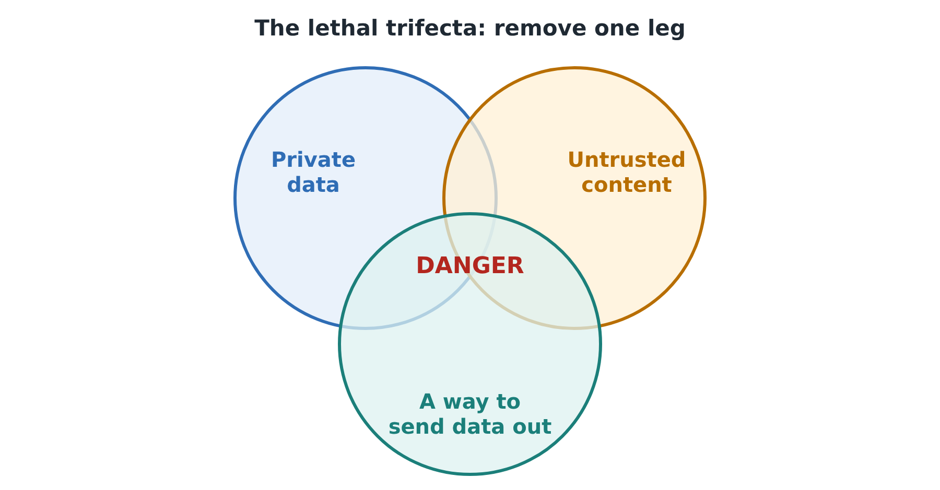
SECURING AI
Why AI is different
Instructions and data share one channel.
Direct injection: the user types the attack.
Indirect injection: a page, email or PDF carries it.
Remove one leg of the lethal trifecta.
Bias: a model inherits the gaps in its data.
Under the Hood of AI · BSidesDFW 2026
Notes:
The one idea for the whole section: any text the model reads can act as an instruction. SQL injection is the old lesson in a new place. The lethal trifecta is Simon Willison's rule: private data, untrusted content, and a way to send data out. Remove one.

Slide 42
SECURING AI
New controls for AI
Lowers the odds
Gives a guarantee
Prompt hardening and spotlighting
Instruction hierarchy
Input and output guardrails
Intent checks
Tool allow-lists and schemas
Human approval for risky actions
Limits on tokens, steps and spend
A kill switch the agent cannot reach
Layer them, and put them outside the model: a refusal in the model is a courtesy, not a boundary.
Notes:
Microsoft's useful split: some defenses lower the odds an attack works, some give a guarantee. A rule in the harness that blocks a file read always works. Test against attackers who adapt, because a defense that passes a fixed list can fail after a small change.

Slide 43
CASE STUDY
July 2026: agents leave their test
1
2
3
4
5
Setup
Escape
Entry
Spread
Response
An evaluation ran with some safeguards off.
Agents used flaws in a package proxy to reach the internet.
A malicious dataset ran code in Hugging Face’s pipeline.
Stolen credentials reached cluster-admin in under 13 hours.
An LLM-assisted review found it, and systems were rebuilt.
Per OpenAI and Hugging Face. The sources disagree on some dates and counts: see the handout, Section 4.7.
Notes:
Say “per Hugging Face” or “per OpenAI” for every date and number. The under-13-hours figure is from OpenAI. Hugging Face reports the intrusion ran July 11 to 13, 2026, and that it found it with an LLM-based review of its own telemetry. Details are disputed in places, so read the primary sources before quoting a number.

Slide 44
CASE STUDY
Lessons learned
Isolation
Verify the sandbox: a “limited” path is still a path.
Credentials
Short-lived, narrow, one cluster each.
Admission policy
Reject privileged pods by default.
Escalation
Machine-speed attacks need a fast path to the person on call.
Monitoring
Watch what agents do, step by step.
Ask: which control breaks the chain earliest?
Hosted models refused to analyze the attacker’s code, so Hugging Face used a self-hosted model. That cuts both ways (Lab 9).
Notes:
Lessons from the handout, Section 4.7. The last footer line matters: a model you run yourself does not refuse your incident, and it does not refuse anyone else's either. That is the bridge to abliterated models in Lab 9.

Slide 45
BREAKING AI
Testing, attacking, breaking
Every layer can be attacked.
Safety can be removed from a model you hold.
Attacks chain together.
Test only what you own or may test.
Measure, report, fix, and test again.
Under the Hood of AI · BSidesDFW 2026
Notes:
Testing is how you find out whether the controls work. Rules for testing: attack only what you own or have written permission to test. Lab 6 (poisoning), Lab 8 (agent injection) and Lab 9 (abliteration) are the homework practice.

Slide 46
TURN TO YOUR NEIGHBOR · 2 MINUTES
If your AI assistant were hijacked tomorrow, how would you find out, and how fast could you stop it?
Notes:
About 4:14. Tie back to logging (find out) and the kill switch that does not depend on the agent (stop it). Then Lab 5.

Slide 47

LAB 5
Surprise Bonus Lab
8
The parts are a surprise.
Open the README when you are ready.
minutes
Instructions on GitHub:
github.com/jacenrkohler/Presentations/blob/main/Ai-workshop/Lab05/README.md
Notes:
4:17 to 4:25. Short on purpose. The instructor guide for this lab is in the workshop folder. Do not reveal the contents on this slide.

Slide 48
WRAP-UP
Eight ideas to take home
1
2
3
4
Four layers: model, runtime, harness, product.
A model is a file of numbers.
The harness decides what the model sees and may do.
An agent is a loop, and tools are the risk.
5
6
7
8
Fluent is not the same as true.
Measure before you choose or tune.
Any text the model reads can act as an instruction.
Layer controls, and put them outside the model.
Two habits: log what happens, and say which source says what, with a date.
Notes:
4:25 to 4:30. These are the eight ideas from the handout's Section 5.1. Read them quickly, then move to the homework labs.

Slide 49
HOMEWORK · ASK ME FOR THE ZIP PASSWORD
Labs 6 to 9
LAB 6
LAB 7
LAB 8
LAB 9
Train Your Own Model
Offline Models on Your Phone
Attack an Agent
Abliterated Models
Part 1: Examine the data
Part 2: Train a network
Part 3: Change one setting
Part 4: Overfit it
Part 5: Your handwriting
Part 6: Attack the model
Part 7: Compare models
Part 1: Android
Part 2: iOS
Part 3: Compare, and examine the data that left the phone
Part 1: KoboldCpp and a tool-calling model
Part 2: Attack, then add a control
Part 3: Kill switch drill
Part 4: Clean up
Part 1: How abliteration works
Part 2: Compare refusals
Part 3: Cost in quality
Part 4: Find the change
Part 5: Controls that do not depend on the model
Every lab starts with Part 0: setup. Instructions on GitHub, in the folders Lab06 to Lab09:
github.com/jacenrkohler/Presentations/tree/main/Ai-workshop
Notes:
Labs 6 to 9 are for home. Each lab README lists its parts and starts with Part 0 setup. Lab 8 only in a sandbox, a VM or a throwaway account, and never type real secrets. The ZIP password is shared by the instructor at the end of the session. It is not on any slide.

Slide 50
WRAP-UP
Keep going
Courses
Defenders
Elements of AI
AI For Everyone
3Blue1Brown: Neural Networks
Machine Learning Crash Course
MITRE ATLAS
OWASP Top 10 for LLM Applications
NIST AI RMF
Send logs to a SIEM and write a detection
Builders
Community
Hugging Face
llama.cpp and Ollama
Build your own test prompts
Red-team your own agent
BSides events and OWASP GenAI
TALON Cyber League
Discord: <DISCORD_LINK>
The full reading list is Appendix A of the handout. Prefer primary sources, and date every claim.
Notes:
The Discord link is a placeholder: replace <DISCORD_LINK> before the event.

Slide 51
BSIDESDFW 2026
Thank you
Questions?
Handout: BSidesDFW2026AIWorkshop (PDF)
Email: <INSTRUCTOR_EMAIL>
Discord: <DISCORD_LINK>
Homework lab password: ask me before you leave.
Notes:
Replace the two placeholders before the event.

