Slide 1
Analyzing Bicycle and Pedestrian Collisions in L.A. County
Jacquie Guerra

Slide 2
Vision Zero and L.A
Los Angeles has an annual average of 6.27 traffic deaths per 100,000 residents, the highest of major city in the U.S.
In 2015, Vision Zero was launched in Los Angeles with a goal of eliminating traffic related deaths by 2025
Initiative originating in Sweden that has had success in Europe and New York
Traffic related deaths in NY dropped by 33% after Vision Zero started in 2014
Action plans of Vision Zero:
Reprioritize street design away from speed efficiency and more towards safety for vulnerable parties
Wider sidewalks, added bike lanes, reduced/narrowed car lanes, plastic posts on street corners, repaint crosswalks, adjust signal timing
Focus efforts on the deadliest streets in Los Angeles
6% of LA streets are responsible for 65% of all traffic related deaths/severe injuries

Slide 3
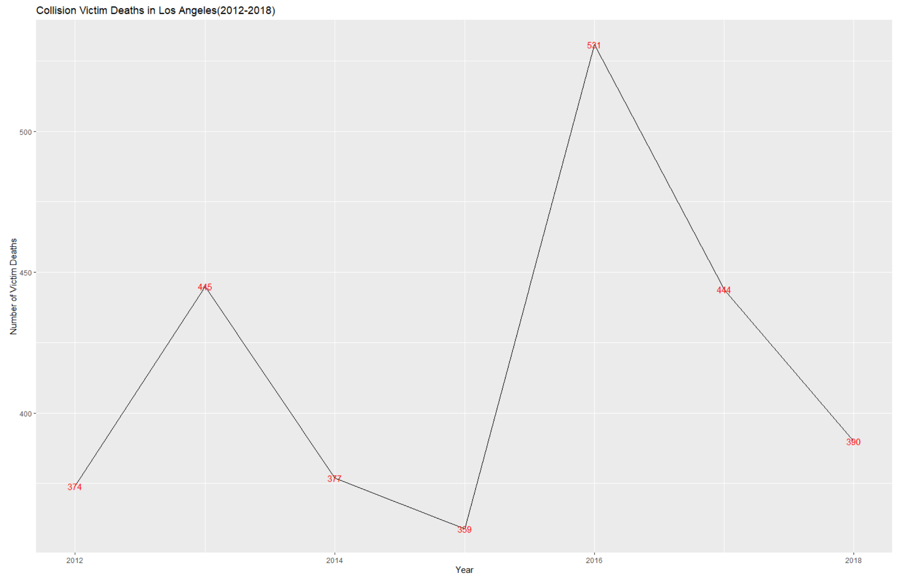
After 3 years - has Vision Zero been successful?

Slide 4
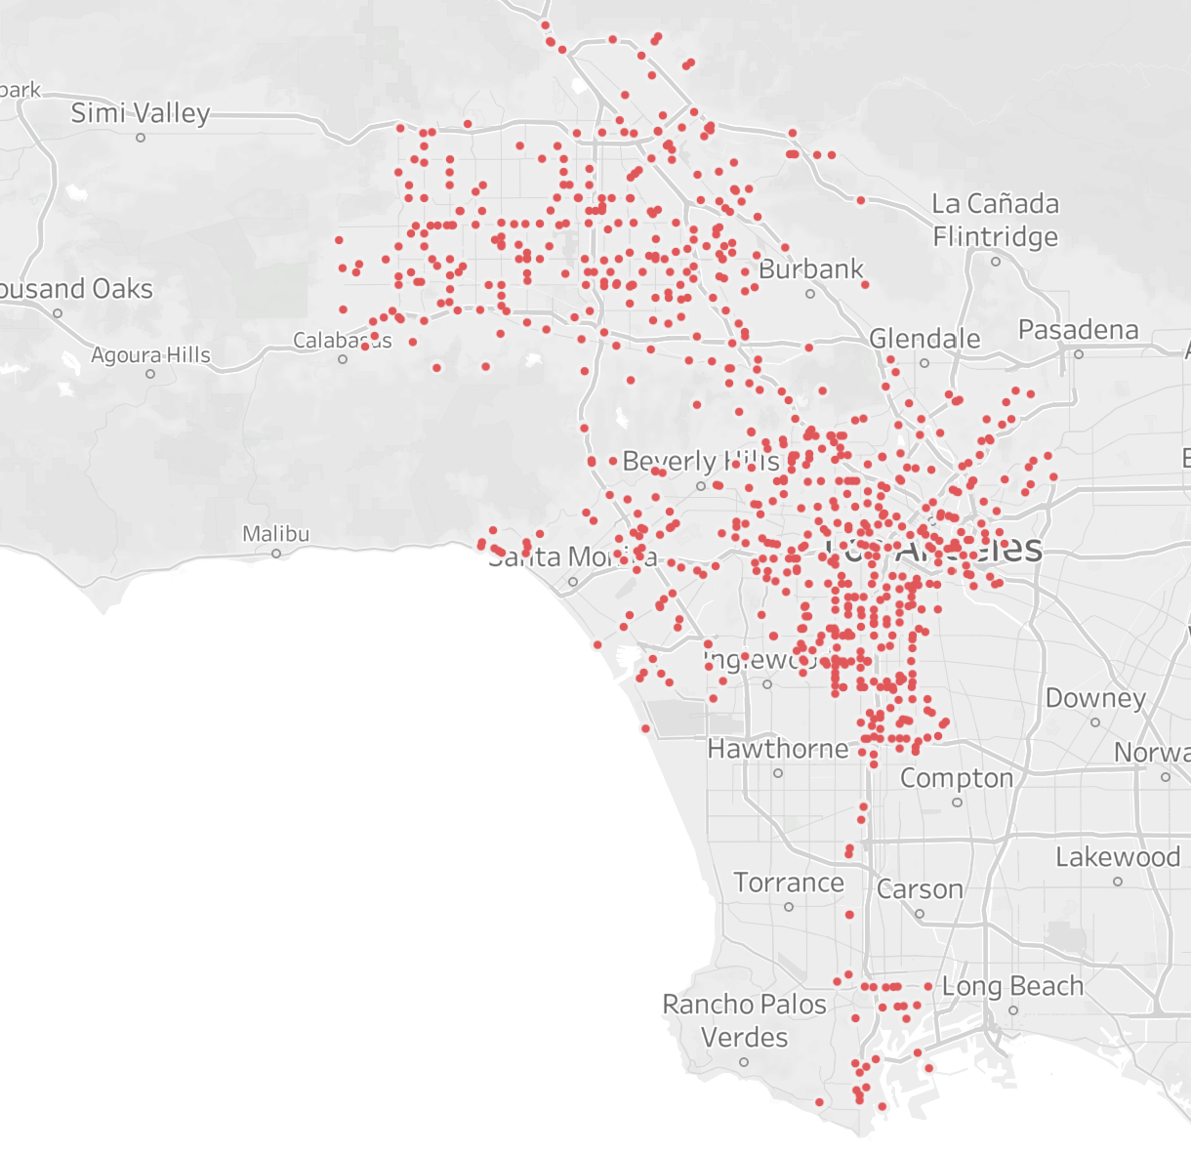
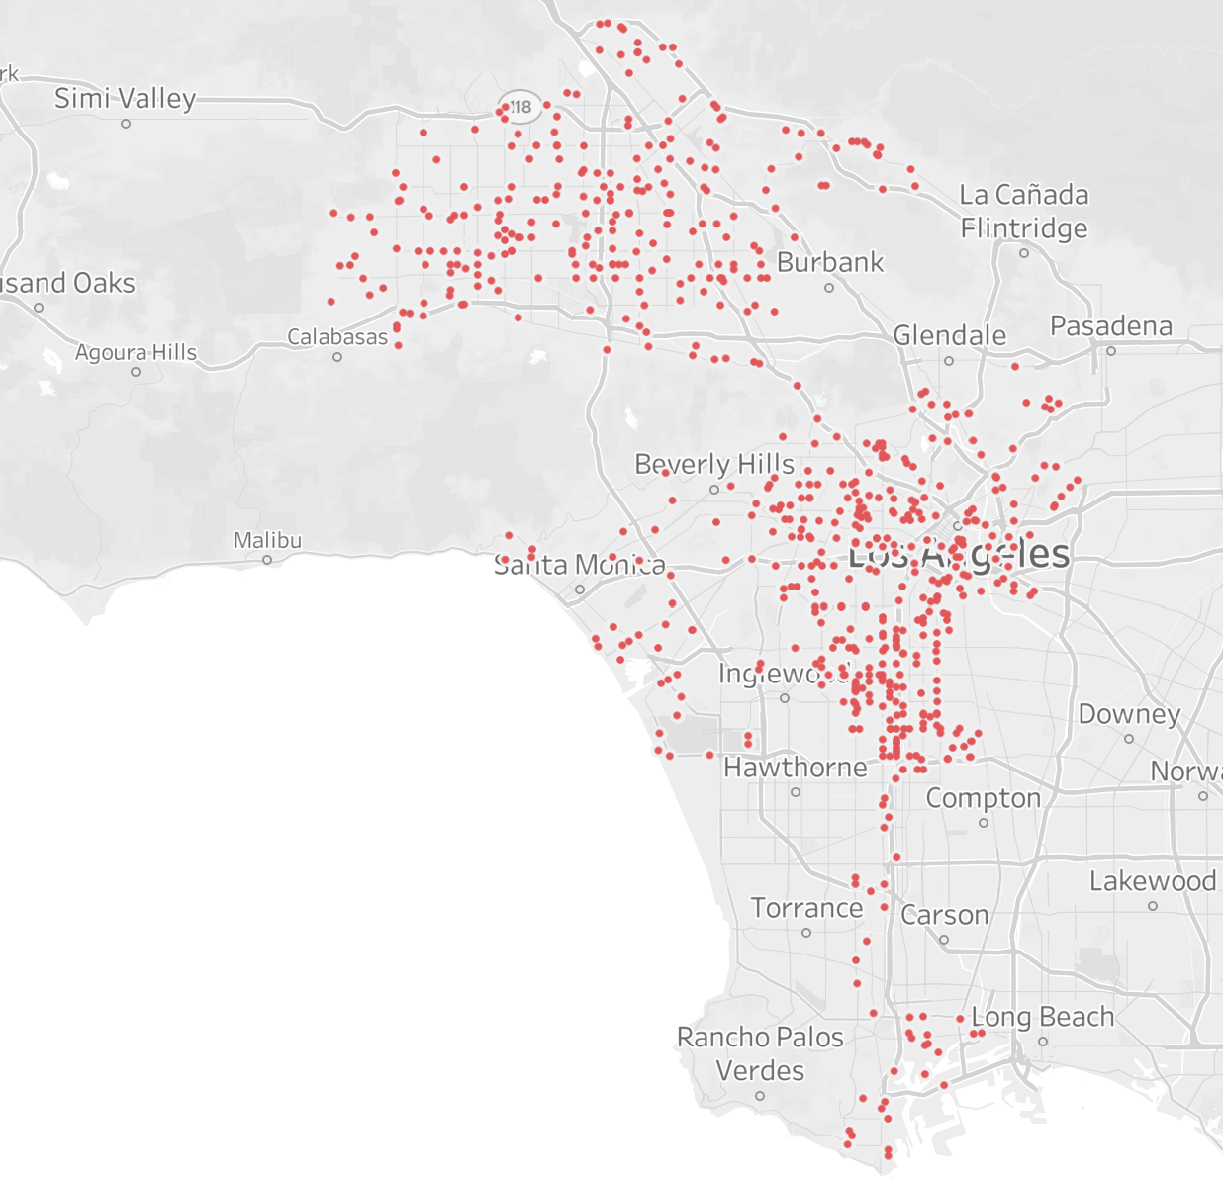
Pre Vision Zero (2012-2015)
Post Vision Zero (2016-2018)

Slide 5


Data Sets
Collisions 2012-2018
91 variables, 472,000 observations
Victims 2012-2018
13 variables, 315,000 observations
Collisions + Victims
27 variables, 315,000 observations

Slide 6
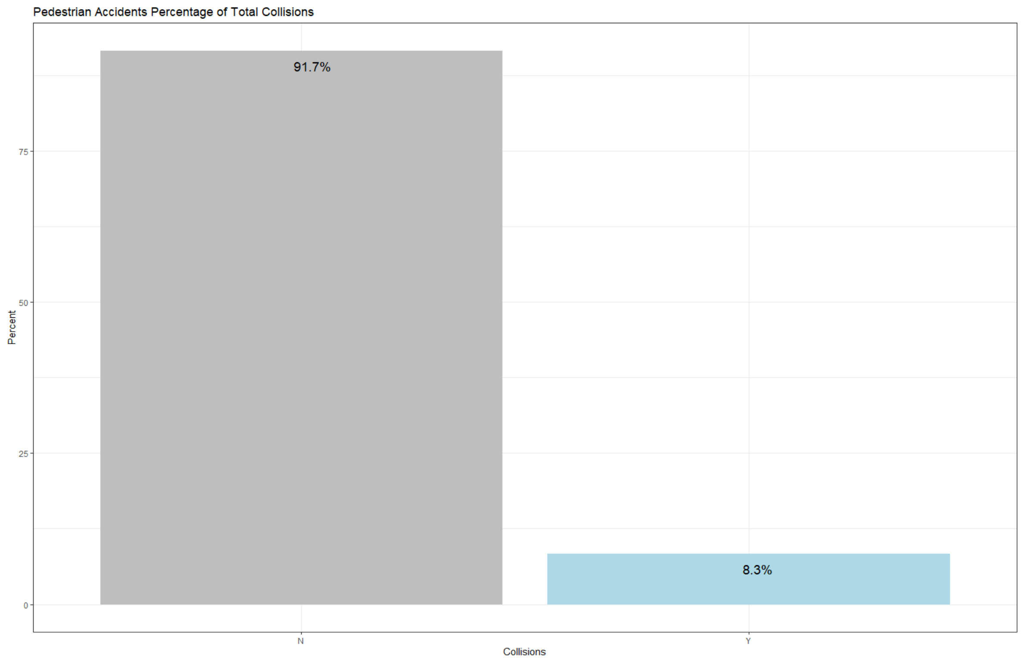
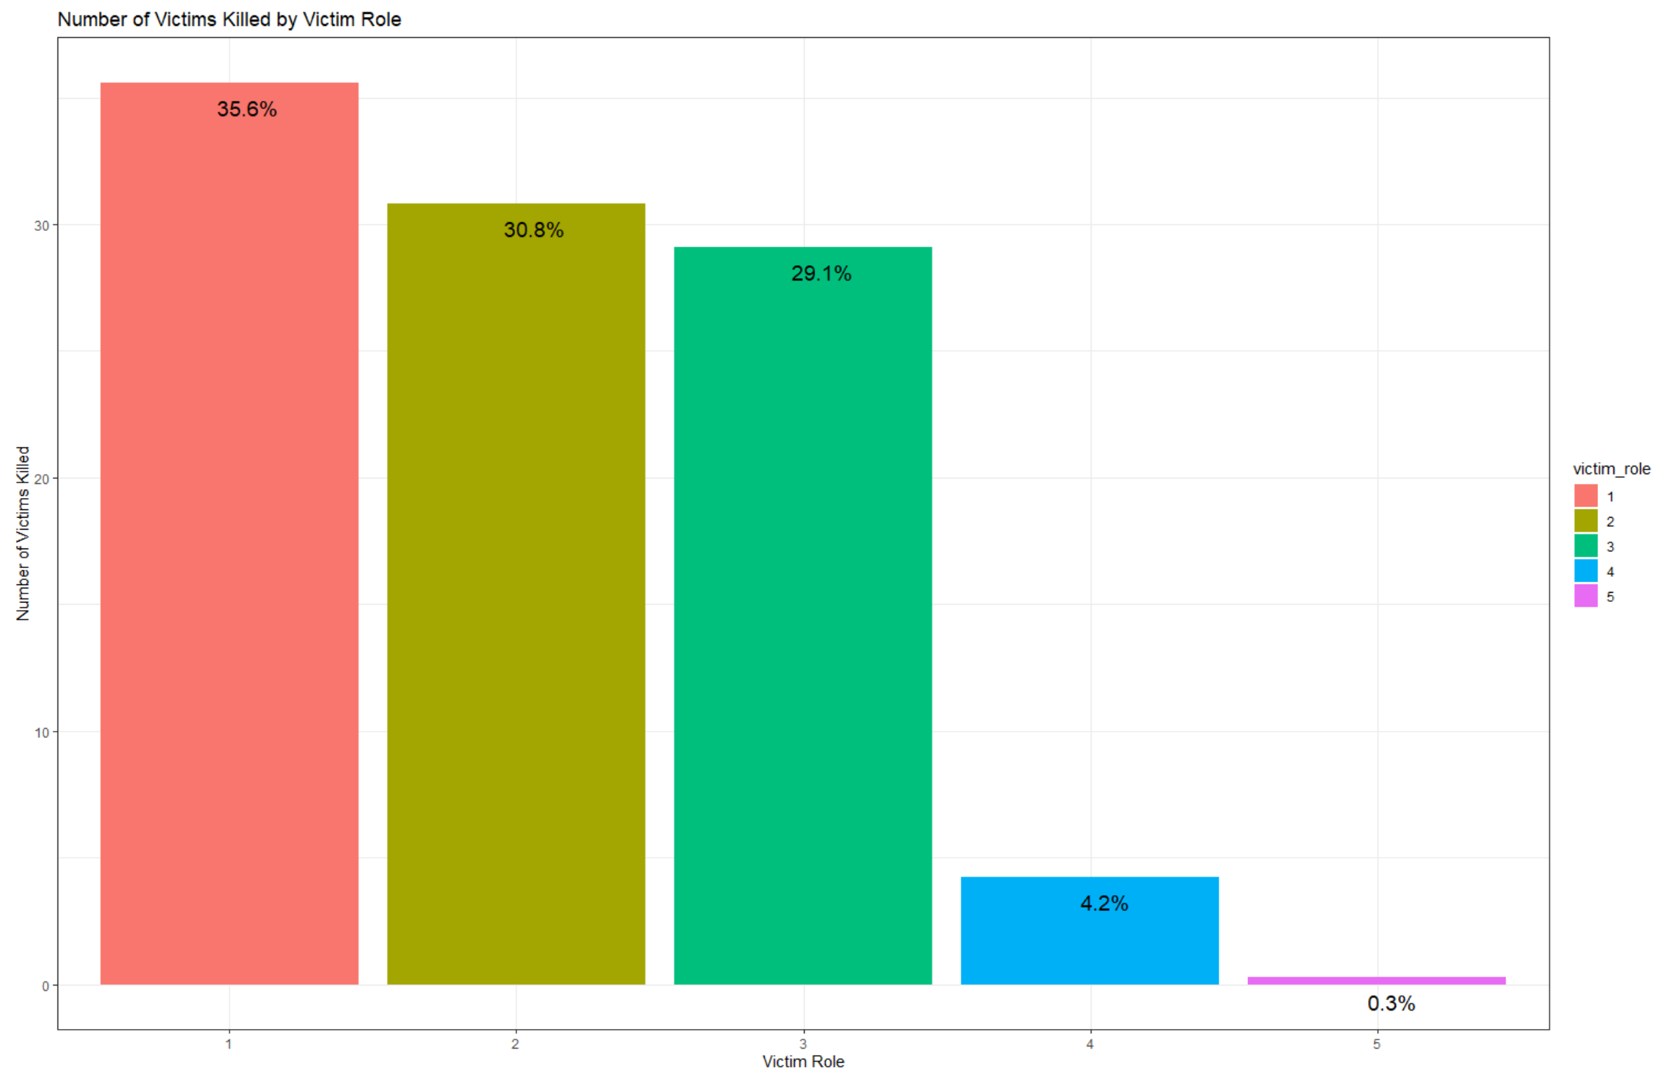
Why are pedestrians the focus?

Slide 7
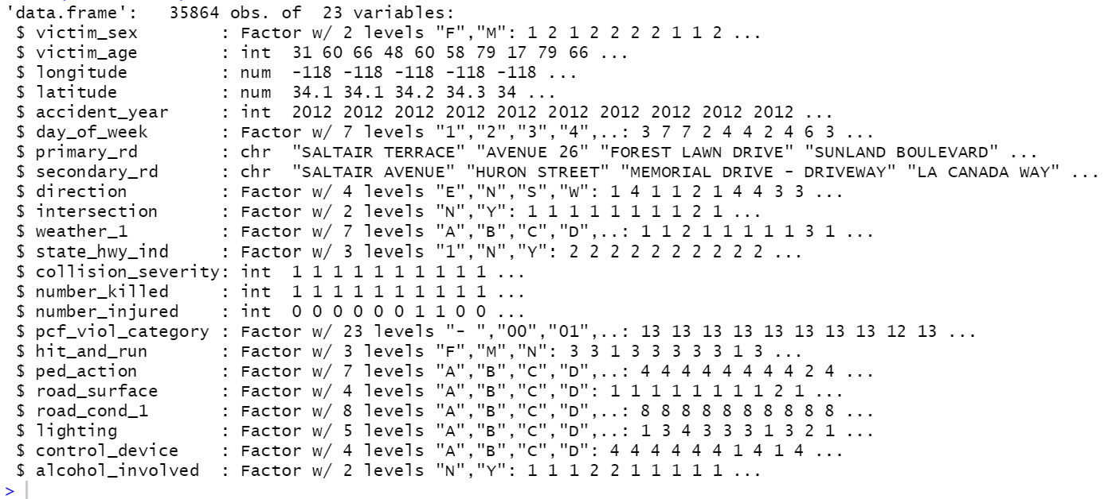
Filtered data and removed variables specific to ped/bike

Slide 8
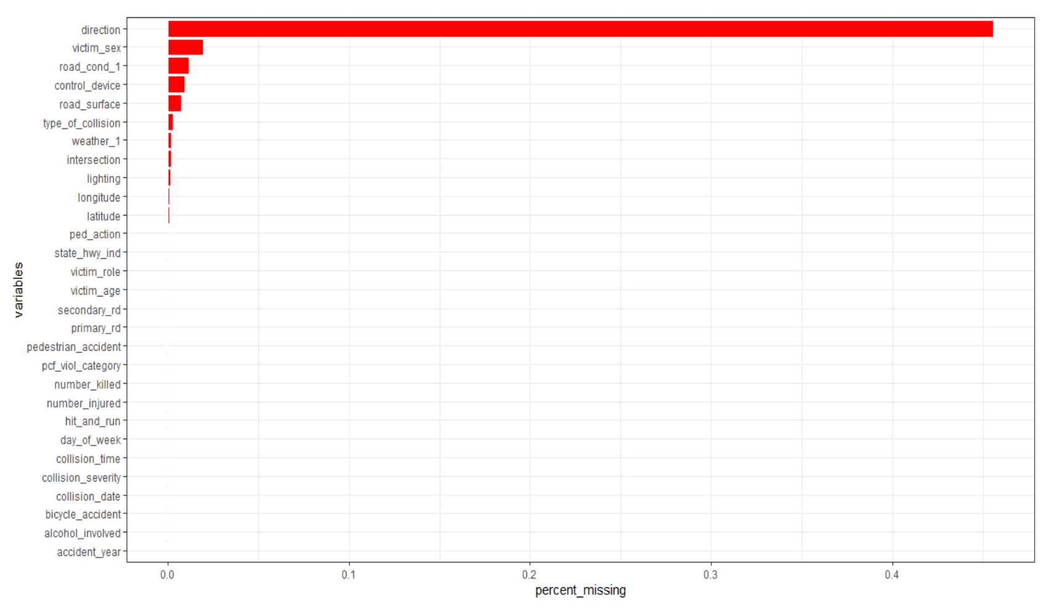
Data Cleaning: NAs
No NA’s present in the data set
Blanks and dashes instead
Removed direction variable and omitted remaining NA rows (~5% of data set)

Slide 9
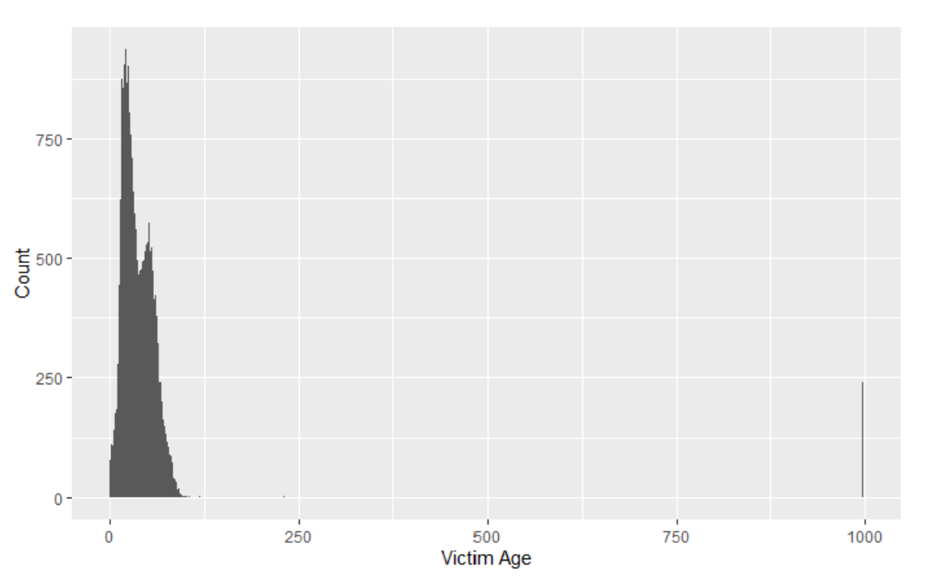
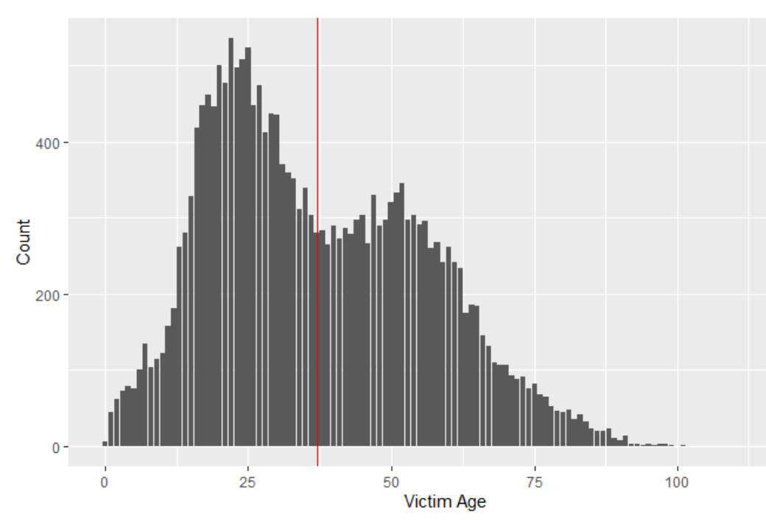
Data Cleaning: Numericals
Median=37

Slide 10
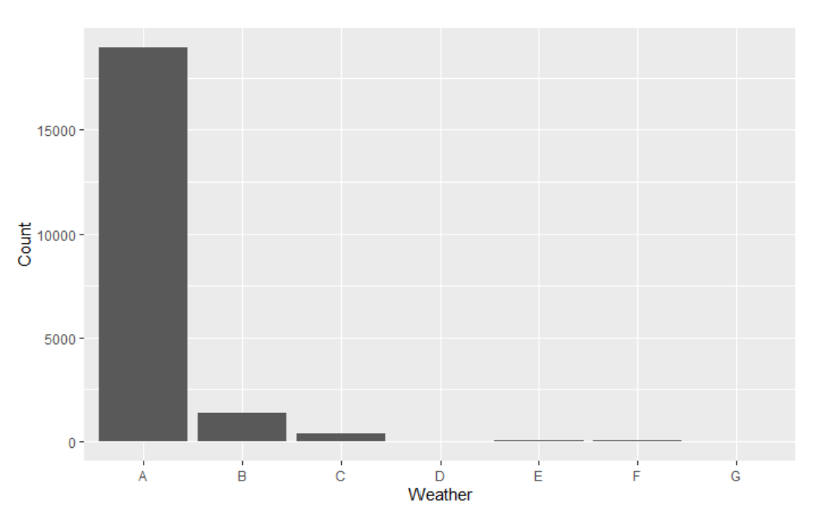
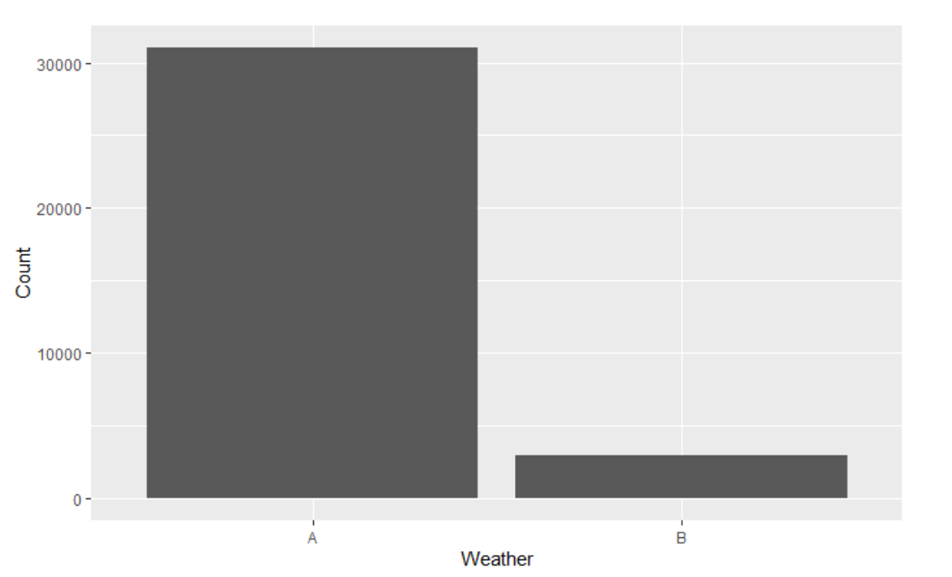
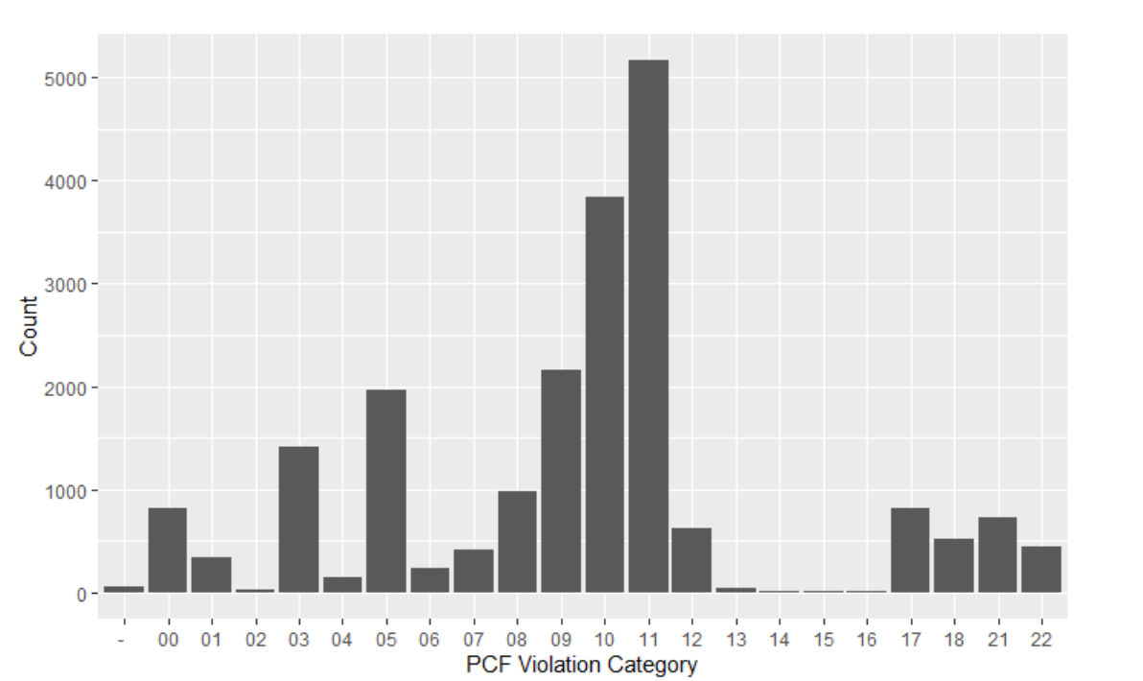
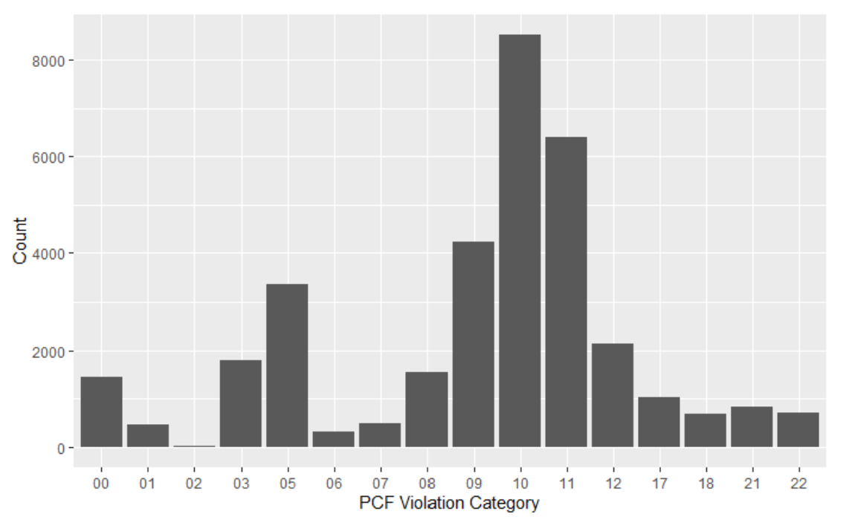
Data Cleaning - Factors
Combined all inclement weather into one factor level
Combined unknowns in PCF violation category
Moved other low levels into “Other Equipment” or “Other Hazardous Violation”

Slide 11
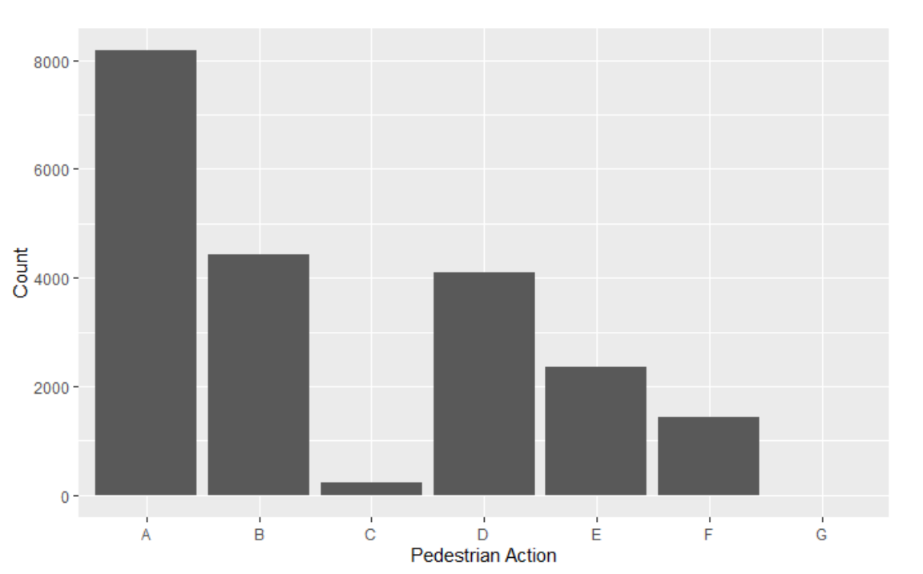
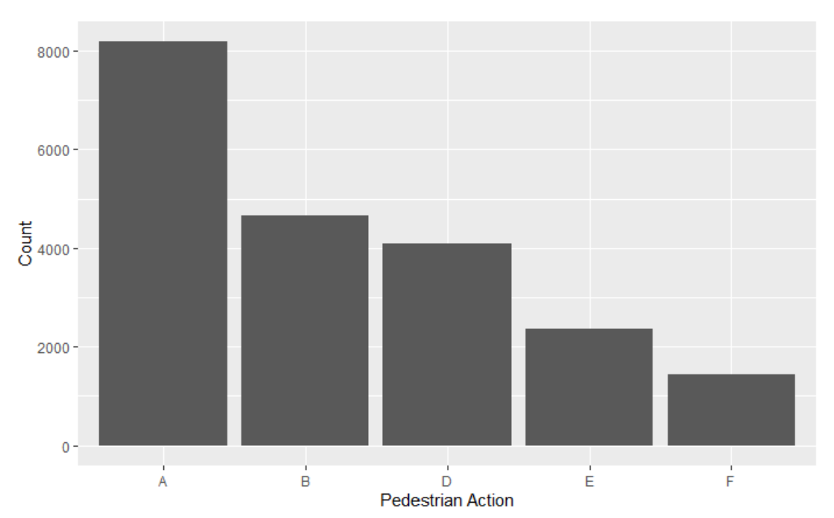
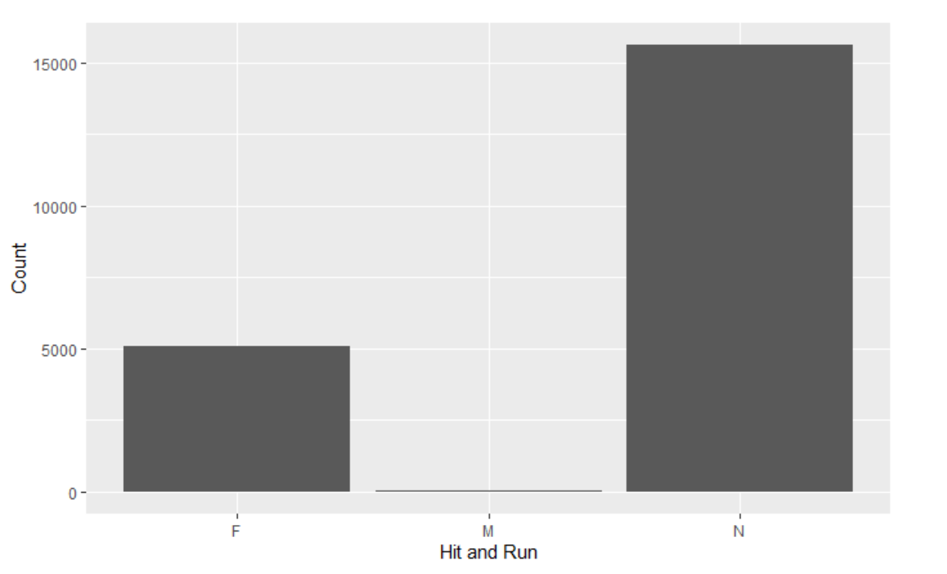
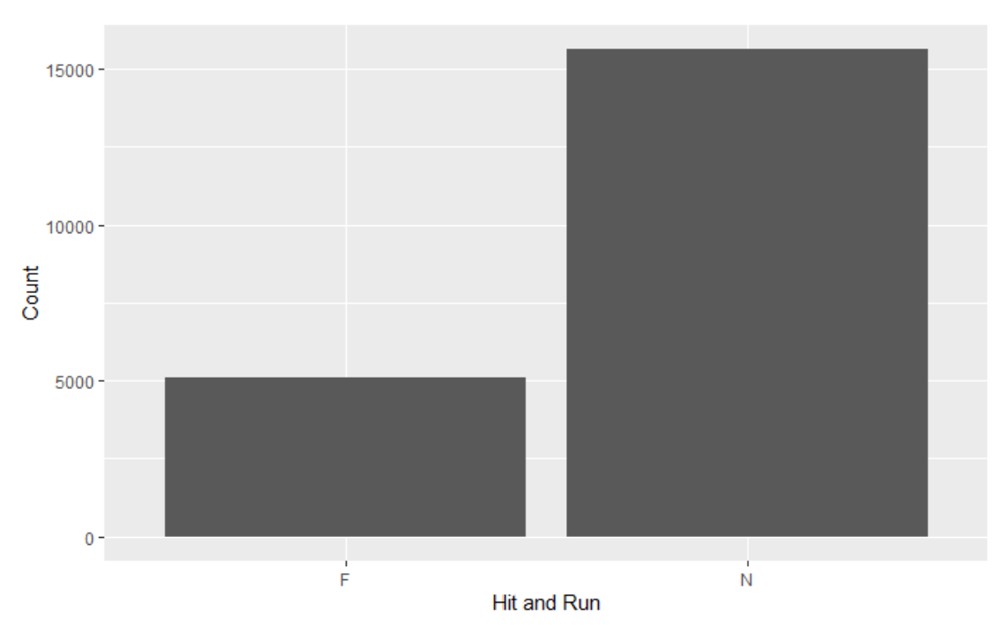
Data Cleaning - Factors
Combined all crossing not in cross walk levels
Combined felony and misdemeanor hit and run

Slide 12
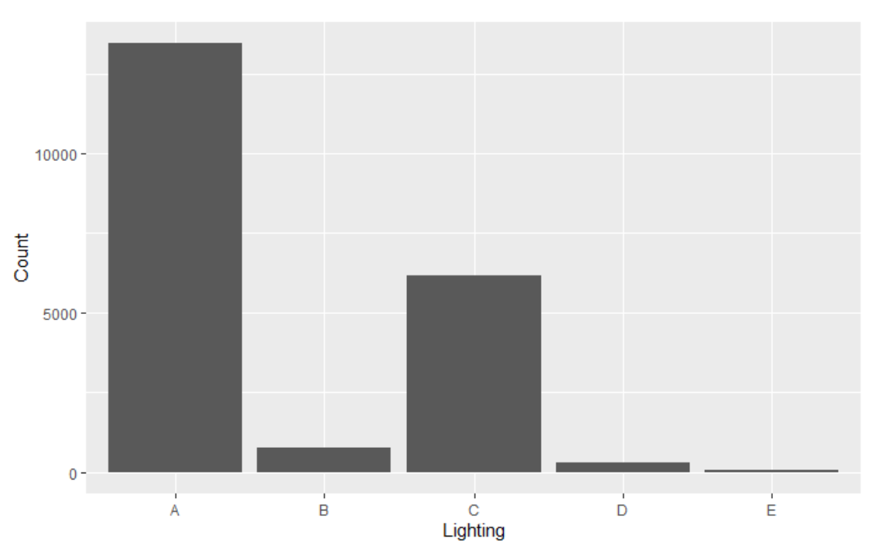
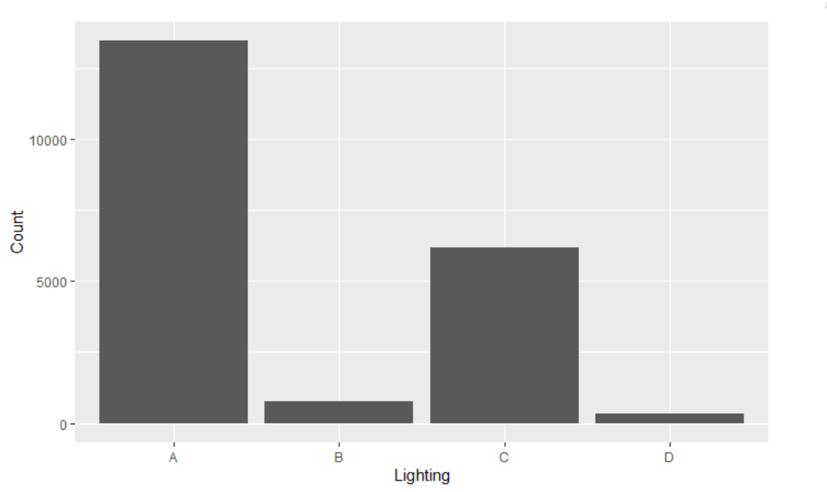
Data Cleaning - Factors
Combined street lights not functioning and no street lights into one factor level

Slide 13
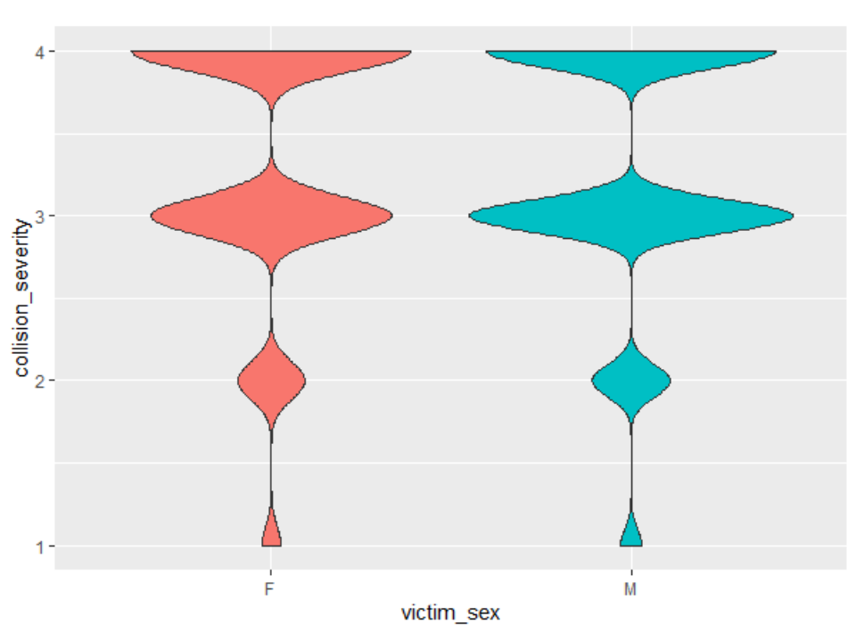
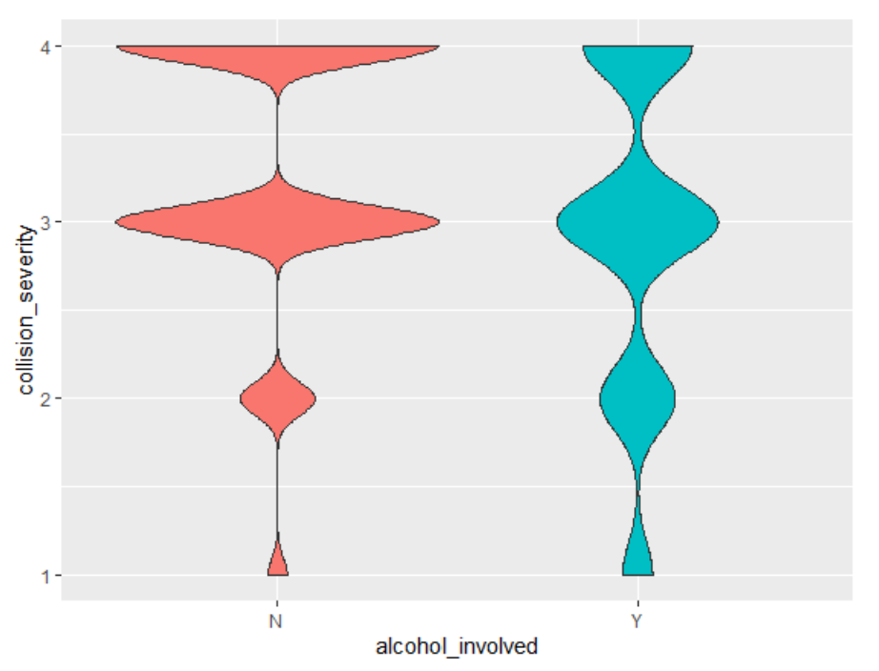
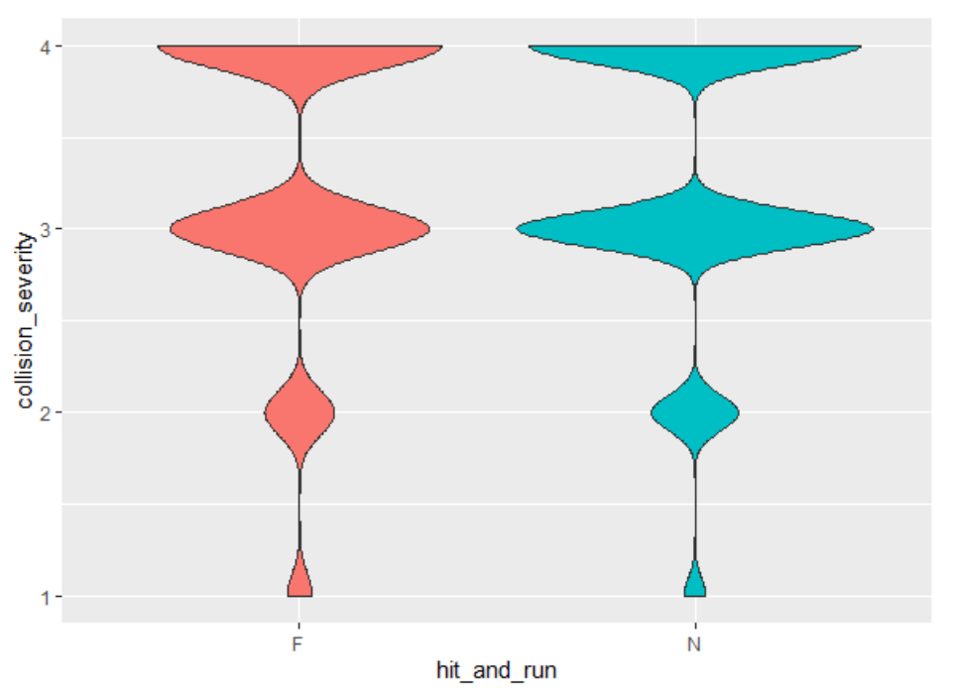
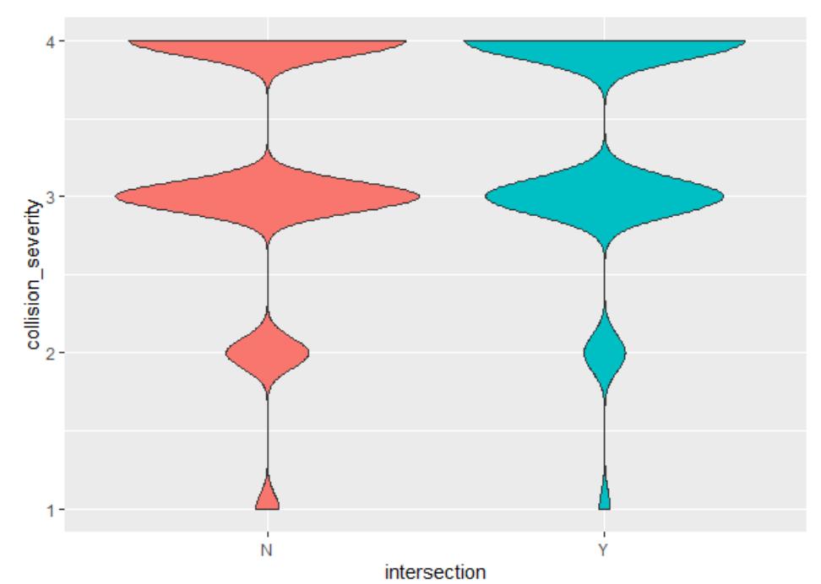
EDAs
If alcohol is involved there is a higher chance of death or severe injury
Death and severe injury rate slightly higher if collision is not in the intersection

Slide 14
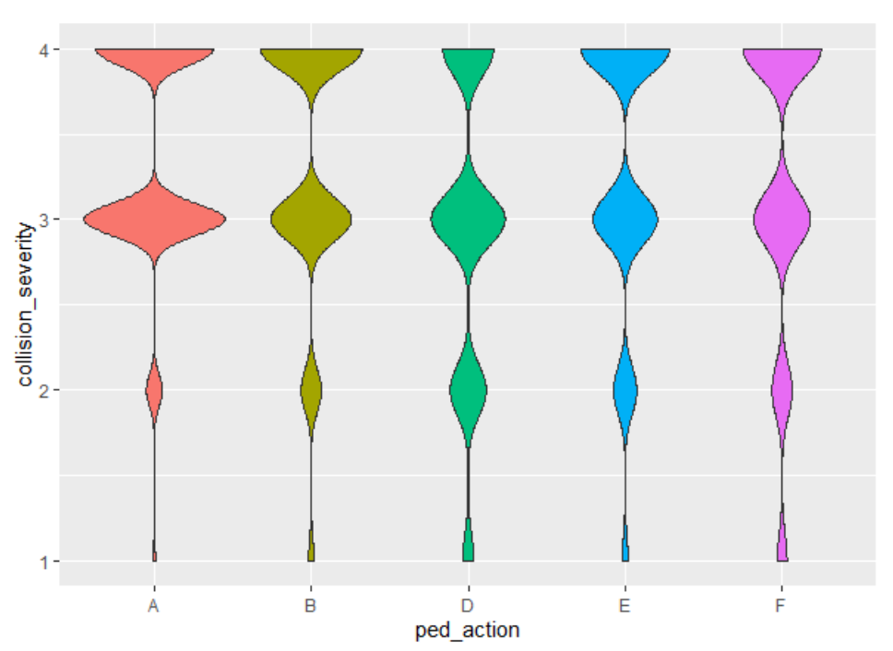
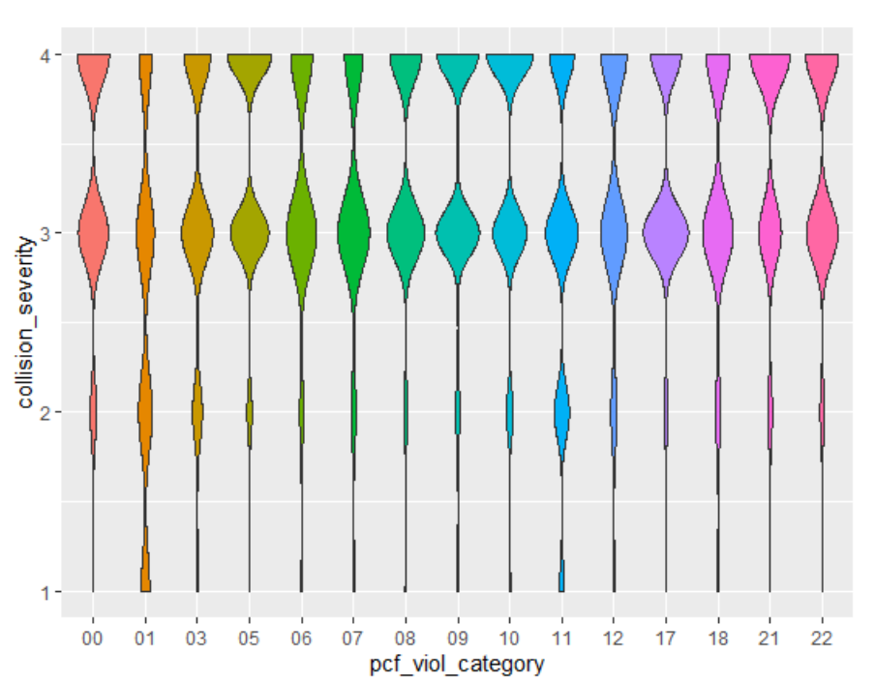
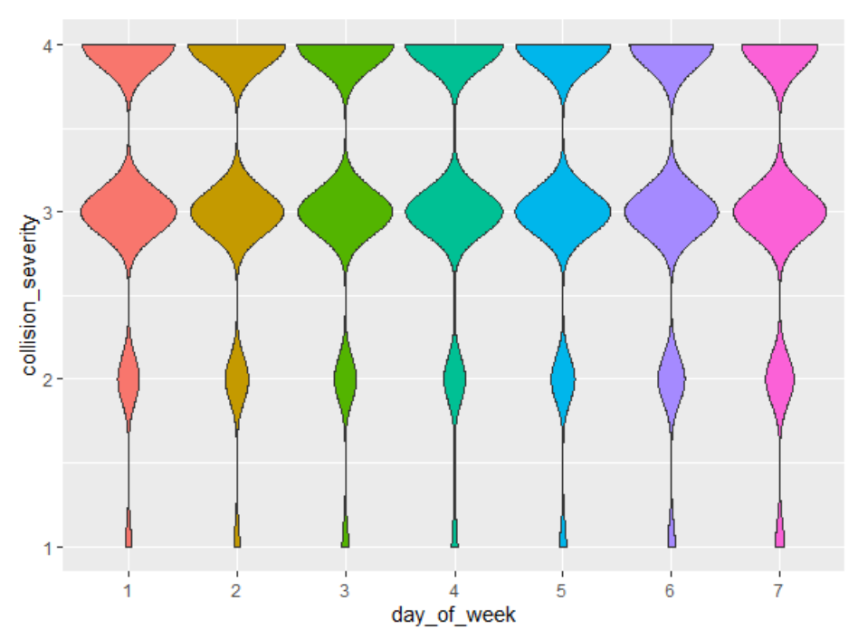
EDAs
Crossing not in crosswalk is the deadliest pedestrian action
Collisions not involving pedestrians cause less serious injuries
Biking/driving under the influence and pedestrian violation are most likely to result in death
Day of the week does not vary

Slide 15
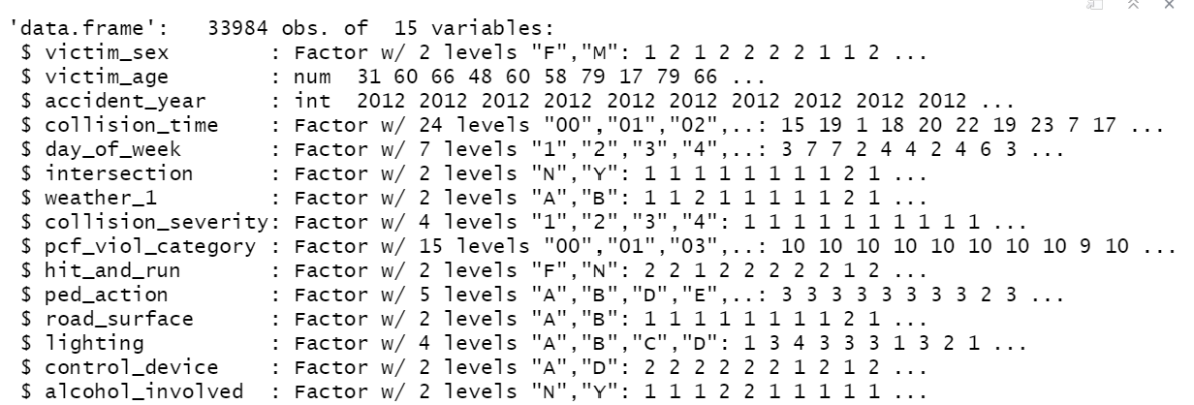
Ordered Logistic regression
order1 = polr(collision_severity~., data = collision_5, Hess=TRUE)

Slide 16
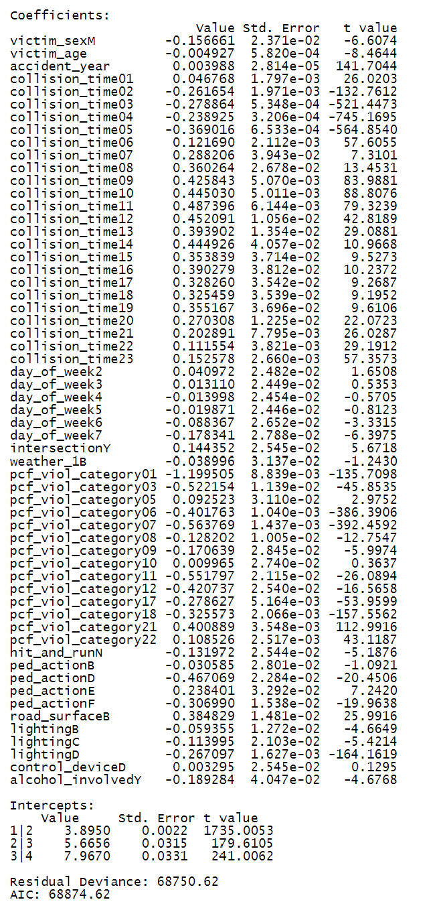
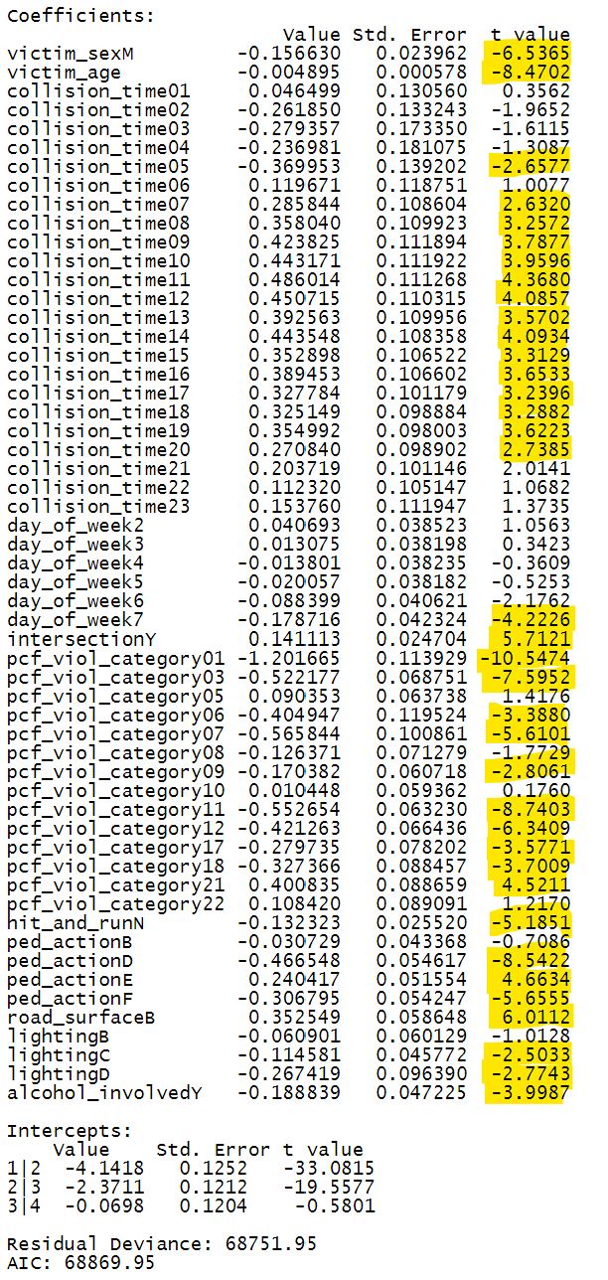
Regression results After Stepwise AIC ran model again and removed accident year, weather, and control device
After Stepwise AIC

Slide 17
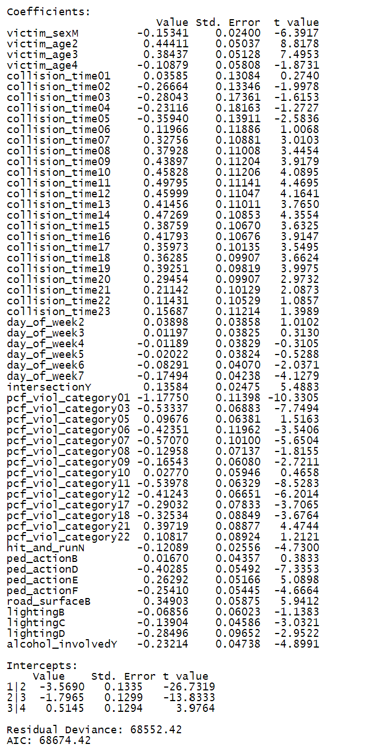
Regression results The lowest AIC was attained when age was grouped into 4 factor levels based on number of collisions

Slide 18
Conclusions
Adding lights to darker streets can help reduce deaths, but nighttime will always be more dangerous
Work to reduce drunk driving/bicycling
Continue to focus on reducing speed
Focus efforts in areas where younger people walk – schools, universities
Pedestrians also play a role – work to reduce crossing without a crosswalk perhaps by adding more or giving out more jaywalking tickets

