Slide 1




CMSC 125: Operating Systems
Instructor: Joseph Anthony C. Hermocilla
Email: jchermocilla@up.edu.ph
Web: https://jachermocilla.org

Slide 2
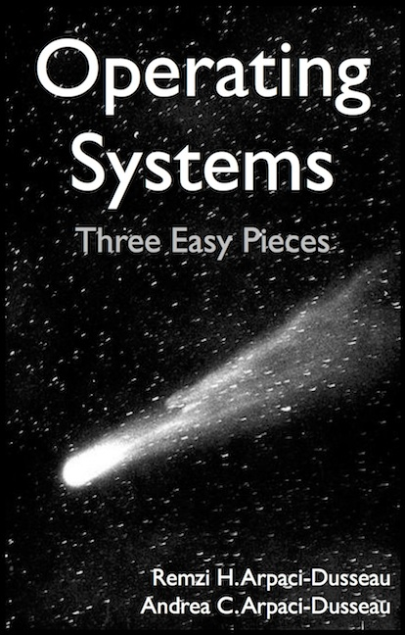
Resources
Book: https://pages.cs.wisc.edu/~remzi/OSTEP/
Slides Template:
https://pages.cs.wisc.edu/~remzi/OSTEP/Educators-Slides/Youjip/

Slide 3
Acknowledgement
This lecture slide set was initially developed for Operating System course in Computer Science Dept. at Hanyang University. This lecture slide set is for OSTEP book written by Remzi and Andrea at University of Wisconsin.

Slide 4
18. Paging: Introduction
Operating System: Three Easy Pieces

Slide 5
Concept of Paging
Split virtual address space into fixed-size units called a page
Unlike in segmentation where sizes for each logical segments/sections (code, stack, heap, etc.) are variable
Split physical memory into fixed-size units page frames
A page table per process is needed to translate the virtual address to physical address

Slide 6
Advantages Of Paging
Flexibility: Supporting the abstraction of address space effectively
Don’t need assumptions how heap and stack grow and are used
Simplicity: ease of free-space management
The page in virtual address space and the page frame in physical memory are the same size
Easy to allocate and maintain a free list

Slide 7
Example: A Simple Paging
128-byte physical memory with 16-byte page frames
64-byte virtual address space with 16-byte pages
0
page frame 0 of physical memory
reserved for OS
16
(unused)
page frame 1
0
32
(page 0 of the address space)
page 3 of AS
page frame 2
16
48
(page 1)
page 0 of AS
page frame 3
32
64
(page 2)
(unused)
page frame 4
48
(page 3)
80
page 2 of AS
page frame 5
64
A Simple 64-byte Virtual Address Space(AS)
96
(unused)
page frame 6
112
page 1 of AS
page frame 7
128
64-Byte Virtual Address Space Placed In Physical Memory

Slide 8
Address Translation
Two components in the virtual address
VPN: virtual page number
Offset: offset within the page
Example: virtual address 21 in 64-byte address space
VPN
offset
Va5
Va4
Va3
Va2
Va1
Va0
VPN
offset
0
1
0
1
0
1

Slide 9
Example: Address Translation
The virtual address 21 in 64-byte address space
VPN
offset
Virtual
Address
0
1
0
1
0
1
Address Translation
Physical
Address
1
1
1
0
1
0
1
PFN
offset

Slide 10
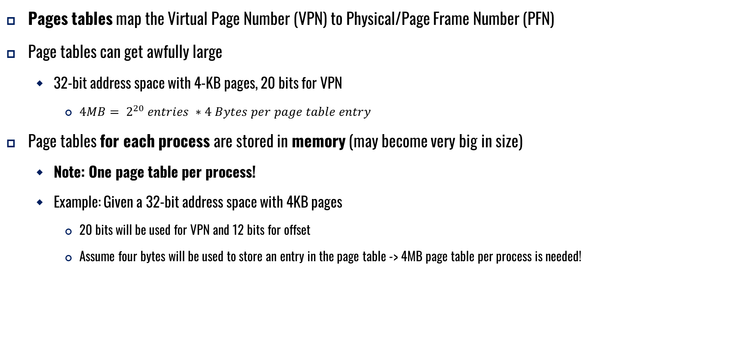
Where Are Page Tables Stored?
Pages tables map the Virtual Page Number (VPN) to Physical/Page Frame Number (PFN)
Page tables can get awfully large
32-bit address space with 4-KB pages, 20 bits for VPN
${4MB= 2}^{20} entries ∗4 Bytes per page table entry$
Page tables for each process are stored in memory (may become very big in size)
Note: One page table per process!
Example: Given a 32-bit address space with 4KB pages
20 bits will be used for VPN and 12 bits for offset
Assume four bytes will be used to store an entry in the page table -> 4MB page table per process is needed!

Slide 11
Example: Page Table in Kernel Physical Memory
0
page table
3 7 5 2
page frame 0 of physical memory
16
(unused)
page frame 1
32
page 3 of AS
page frame 2
48
page 0 of AS
page frame 3
64
(unused)
page frame 4
80
page 2 of AS
page frame 5
96
(unused)
page frame 6
112
page 1 of AS
page frame 7
128
Physical Memory

Slide 12
What Is In The Page Table?
The page table is just a data structure that is used to map the virtual address to physical address
Simplest form: a linear page table (an array)
The OS indexes the array(page table) by VPN, and looks up the page table entry (PTE)

Slide 13
Common Flags Of Page Table Entry
Valid Bit: Indicating whether the particular translation is valid
Protection Bit: Indicating whether the page could be read from, written to, or executed from
Present Bit: Indicating whether this page is in physical memory or on disk(swapped out)
Dirty Bit: Indicating whether the page has been modified since it was brought into memory
Reference Bit(Accessed Bit): Indicating that a page has been accessed

Slide 14
Example: x86 Page Table Entry
P: present
R/W: read/write bit
U/S: supervisor
A: accessed bit
D: dirty bit
PFN: the page frame number
31 | 30 | 29 | 28 | 27 | 26 | 25 | 24 | 23 | 22 | 21 | 20 | 19 | 18 | 17 | 16 | 15 | 14 | 13 | 12 | 11 | 10 | 9 | 8 | 7 | 6 | 5 | 4 | 3 | 2 | 1 | 0
PFN
G
PAT
D
A
PCD
PWT
U/S
R/W
P
An x86 Page Table Entry(PTE)

Slide 15
Paging: Too Slow
To find a location of the desired PTE, the starting location of the page table is needed
For every memory reference, paging requires the OS to perform one extra memory reference
Address of the start of page table is stored in a Page Table Base Register (PTBR)

Slide 16
Accessing Memory With Paging
1 // Extract the VPN from the virtual address
2 VPN = (VirtualAddress & VPN_MASK) >> SHIFT
3
4 // Form the address of the page-table entry (PTE)
5 PTEAddr = PTBR + (VPN * sizeof(PTE))
6
7 // Fetch the PTE
8 PTE = AccessMemory(PTEAddr)
9
10 // Check if process can access the page
11 if (PTE.Valid == False)
12 RaiseException(SEGMENTATION_FAULT)
13 else if (CanAccess(PTE.ProtectBits) == False)
14 RaiseException(PROTECTION_FAULT)
15 else
16 // Access is OK: form physical address and fetch it
17 offset = VirtualAddress & OFFSET_MASK
18 PhysAddr = (PTE.PFN << PFN_SHIFT) | offset
19 Register = AccessMemory(PhysAddr)

Slide 17
A Memory Trace
Example: A Simple Memory Access
Compile and execute
Resulting Assembly code
int array[1000];
...
for (i = 0; i < 1000; i++)
array[i] = 0;
prompt> gcc –o array array.c –Wall –o
prompt>./array
0x1024 movl $0x0,(%edi,%eax,4)
0x1028 incl %eax
0x102c cmpl $0x03e8,%eax
0x1030 jne 0x1024

Slide 18
A Memory Trace: Some Assumptions
Virtual Address Space Size: 64KB
Page Size: 1 KB
Linear Page Table (array-based) located at physical address 1KB(1024)
Contents of Page Table
Code: Assume VPN 1 -> PFN 4
Array:
4000 bytes (1000*sizeof(int))
Assume at virtual address 40000 to 44000
VPN 39 -> PFN 7
VPN 40 -> PFN 8
VPN 41 -> PFN 9
VPN 42 -> PFN 10

Slide 19
A Virtual(And Physical) Memory Trace: First 5 iterations
Page Table[39]
Each instruction fetch generates two memory references:
one to the page table and
another to the actual location of the instruction
The mov instruction will also require two memory references:
one to the page table and
another to the array element itself
1224
1174
Page Table(PA)
Page Table[1]
1124
1074
1024
Array(VA)
40100
mov
7132
Array(PA)
40050
7282
40000
7232
Code(VA)
1124
mov
inc
cmp
jne
4196
Code(PA)
1074
4146
1024
4096
0
10
20
30
40
50
Memory Access

