Slide 1




CMSC 125: Operating Systems
Instructor: Joseph Anthony C. Hermocilla
Email: jchermocilla@up.edu.ph
Web: https://jachermocilla.org

Slide 2
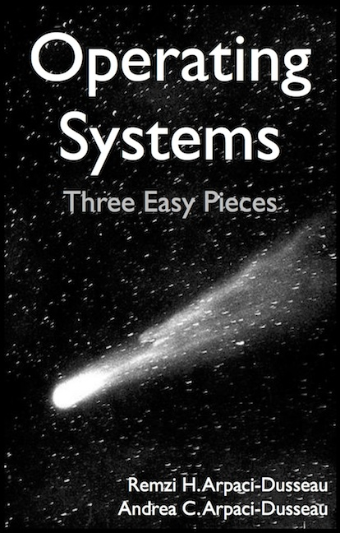
Resources
Book: https://pages.cs.wisc.edu/~remzi/OSTEP/
Slides Template:
https://pages.cs.wisc.edu/~remzi/OSTEP/Educators-Slides/Youjip/

Slide 3
Acknowledgement
This lecture slide set was initially developed for Operating System course in Computer Science Dept. at Hanyang University. This lecture slide set is for OSTEP book written by Remzi and Andrea at University of Wisconsin.

Slide 4
19. Translation Lookaside Buffers
Operating System: Three Easy Pieces

Slide 5
TLB
Part of the chip’s memory-management unit(MMU)
A hardware cache of popular virtual-to-physical address translation
TLB
Lookup
MMU
Logical
Address
TLB Hit
Physical
Address
TLB
popular v to p
TLB Miss
CPU
Page Table
all v to p entries
Page 0
Page 1
Page 2
…
Page n
Address Translation with MMU
Physical Memory
Notes:
말그대로 파풀러한 애들을 캐시해주는 거니까 그림이 잘못됬음.

Slide 6
TLB Basic Algorithms
1: VPN = (VirtualAddress & VPN_MASK ) >> SHIFT
2: (Success , TlbEntry) = TLB_Lookup(VPN)
3: if(Success == True){ // TLB Hit
4: if(CanAccess(TlbEntry.ProtectBit) == True ){
5: offset = VirtualAddress & OFFSET_MASK
6: PhysAddr = (TlbEntry.PFN << SHIFT) | Offset
7: AccessMemory( PhysAddr )
8: }else RaiseException(PROTECTION_ERROR)
(1 lines) extract the virtual page number(VPN)
(2 lines) check if the TLB holds the transalation for this VPN
(5-8 lines) extract the page frame number from the relevant TLB entry, and forms the desired physical address and access memory

Slide 7
TLB Basic Algorithms (Cont.)
11: }else{ //TLB Miss
12: PTEAddr = PTBR + (VPN * sizeof(PTE))
13: PTE = AccessMemory(PTEAddr)
14: (…)
15:
16: TLB_Insert( VPN , PTE.PFN , PTE.ProtectBits)
17: RetryInstruction()
18: }
19:}
(11-12 lines) The hardware accesses the page table to find the translation
(16 lines) updates the TLB with the translation

Slide 8
Example: Accessing An Array
Assumptions: 8-bit virtual address space, 16-byte pages, thus 4-bit VPN and 4-bit offset, array a is loaded starting at virtual address 100 (01100100b)
How a TLB can improve its performance
OFFSET 00 04 08 12 16
VPN = 00
VPN = 01
VPN = 03
VPN = 04
VPN = 05
VPN = 06 |  | a[0] | a[1] | a[2]
VPN = 07 | a[3] | a[4] | a[5] | a[6]
VPN = 08 | a[7] | a[8] | a[9]
VPN = 09
VPN = 10
VPN = 11
VPN = 12
VPN = 13
VPN = 14
VPN = 15
0: int sum = 0 ;
1: for( i=0; i<10; i++){
2: sum+=a[i];
3: }
The TLB improves performance
due to spatial locality
miss,hit,hit,
miss,hit,hit,hit
miss,hit,hit
3 misses and 7 hits
TLB hit rate is 70%!

Slide 9
Locality
Temporal Locality
An instruction or data item that has been recently accessed will likely be re-accessed soon in the future
Spatial Locality
If a program accesses memory at address x, it will likely soon access memory near x.
1st access is page1
2nd access is also page1
Page 6
…
Page 1
Page 7
Page 2
Page 3
Page 4
Page 5
Page n
Virtual Memory
1st access is page1
2nd access is nearby page1
Page 1
Page 2
Page 3
Page 4
Page 5
…
Page n
Virtual Memory

Slide 10
Who Handles The TLB Miss?
Hardware handle the TLB miss entirely on CISC
The hardware has to know exactly where the page tables are located in memory
The hardware would “walk” the page table, find the correct page table entry and extract the desired translation, update and retry instruction
hardware-managed TLB

Slide 11
Who Handles The TLB Miss? (Cont.)
RISC have what is known as a software-managed TLB
On a TLB miss, the hardware raises exception( trap handler )
Trap handler is code within the OS that is written with the express purpose of handling TLB miss

Slide 12
TLB Control Flow algorithm(OS Handled)
1: VPN = (VirtualAddress & VPN_MASK) >> SHIFT
2: (Success, TlbEntry) = TLB_Lookup(VPN)
3: if (Success == True) // TLB Hit
4: if (CanAccess(TlbEntry.ProtectBits) == True)
5: Offset = VirtualAddress & OFFSET_MASK
6: PhysAddr = (TlbEntry.PFN << SHIFT) | Offset
7: Register = AccessMemory(PhysAddr)
8: else
9: RaiseException(PROTECTION_FAULT)
10: else // TLB Miss
11: RaiseException(TLB_MISS)

Slide 13
TLB Entry
TLB is fully associative
A typical TLB might have 32, 64, or 128 entries
Hardware searches the entire TLB in parallel to find the desired translation
Other bits: valid bits , protection bits, address-space identifier, dirty bit
VPN
PFN
Other bits
Typical TLB entry looks like this

Slide 14
TLB Issue: Context Switching
Page 0
Page 1
Process 1
Page 2
Insert TLB Entry
access VPN10
…
Page n
TLB Table
Virtual Memory
VPN | PFN | valid | prot
10 | 100 | 1 | rwx
- | - | - | -
- | - | - | -
- | - | - | -
Page 0
Process 2
Page 1
Page 2
…
Page n
Virtual Memory
Notes:
현재 프로세스 A, B의 주소공간을 가상공간으로 변경 예정

Slide 15
TLB Issue: Context Switching
Page 0
Page 1
Process 1
Page 2
…
Page n
TLB Table
Virtual Memory
VPN | PFN | valid | prot
10 | 100 | 1 | rwx
- | - | - | -
10 | 170 | 1 | rwx
- | - | - | -
Context
Switching
Page 0
Process 2
access VPN10
Page 1
Page 2
Insert TLB Entry
…
Page n
Virtual Memory
Notes:
현재 프로세스 A, B의 주소공간을 가상공간으로 변경 예정

Slide 16
TLB Issue: Context Switching
Page 0
Page 1
Process 1
Page 2
…
Page n
TLB Table
Virtual Memory
VPN | PFN | valid | prot
10 | 100 | 1 | rwx
- | - | - | -
10 | 170 | 1 | rwx
- | - | - | -
Page 0
Process 2
Page 1
Page 2
…
Can’t Distinguish which entry is
meant for which process
Page n
Virtual Memory
Notes:
현재 프로세스 A, B의 주소공간을 가상공간으로 변경 예정

Slide 17
To Solve Problem
Provide an address space identifier(ASID) field in the TLB
Page 0
Page 1
Process 1
Page 2
…
TLB Table
Page n
VPN | PFN | valid | prot | ASID
10 | 100 | 1 | rwx | 1
- | - | - | - | -
10 | 170 | 1 | rwx | 2
- | - | - | - | -
Virtual Memory
Page 0
Process 2
Page 1
Page 2
…
Page n
Virtual Memory

Slide 18
Another Case
Two processes share a page frame
Process 1 is sharing physical page frame 101 with Process 2
P1 maps this physical page frame into the 10th page of its virtual address space
P2 maps this physical page frame into the 50th page of its virtual address space
VPN | PFN | valid | prot | ASID
10 | 101 | 1 | rwx | 1
- | - | - | - | -
50 | 101 | 1 | rwx | 2
- | - | - | - | -
Sharing of pages is useful as it reduces the number of physical page frames in use

Slide 19
Issue: TLB Replacement Policy
Objective is to minimize TLB miss rate
LRU(Least Recently Used)
Evict an entry that has not recently been used
Take advantage of locality in the memory reference stream
Reference Row
7
0
1
2
0
3
0
4
2
3
0
3
2
1
2
0
1
7
7
7
2
7
4
7
7
0
1
1
Physical Page Frame:
0
0
0
0
0
0
3
3
3
0
1
1
3
3
2
2
2
2
2
Total 11 TLB miss

Slide 20
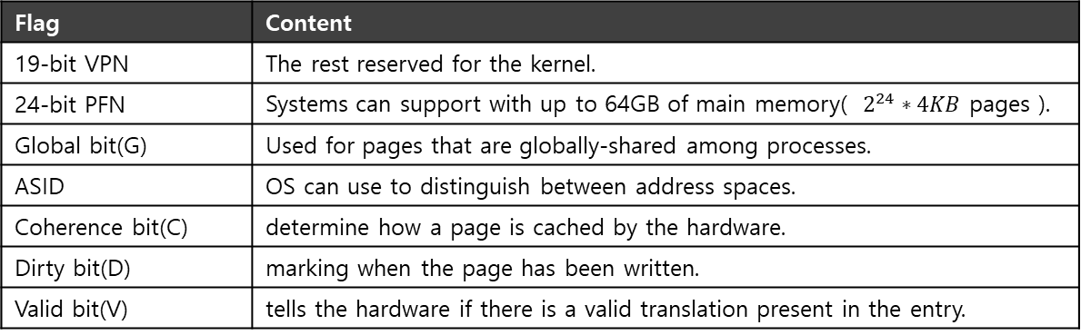
A Real TLB Entry
All 64 bits of this TLB entry(example of MIPS R4000)
0 1 2 3 4 5 6 7 8 9
10 11 … 19 … 31
VPN
G
ASID
PFN
C
D
V
Flag | Content
19-bit VPN | The rest reserved for the kernel.
24-bit PFN | Systems can support with up to 64GB of main memory( $2^{24}∗4KB$ pages ).
Global bit(G) | Used for pages that are globally-shared among processes.
ASID | OS can use to distinguish between address spaces.
Coherence bit(C) | determine how a page is cached by the hardware.
Dirty bit(D) | marking when the page has been written.
Valid bit(V) | tells the hardware if there is a valid translation present in the entry.

