Slide 1




CMSC 125: Operating Systems
Instructor: Joseph Anthony C. Hermocilla
Email: jchermocilla@up.edu.ph
Web: https://jachermocilla.org

Slide 2
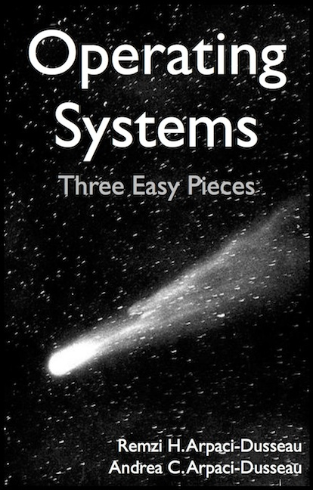
Resources
Book: https://pages.cs.wisc.edu/~remzi/OSTEP/
Slides Template:
https://pages.cs.wisc.edu/~remzi/OSTEP/Educators-Slides/Youjip/

Slide 3
Acknowledgement
This lecture slide set was initially developed for Operating System course in Computer Science Dept. at Hanyang University. This lecture slide set is for OSTEP book written by Remzi and Andrea at University of Wisconsin.

Slide 4
7. Scheduling: Introduction
Operating System: Three Easy Pieces

Slide 5

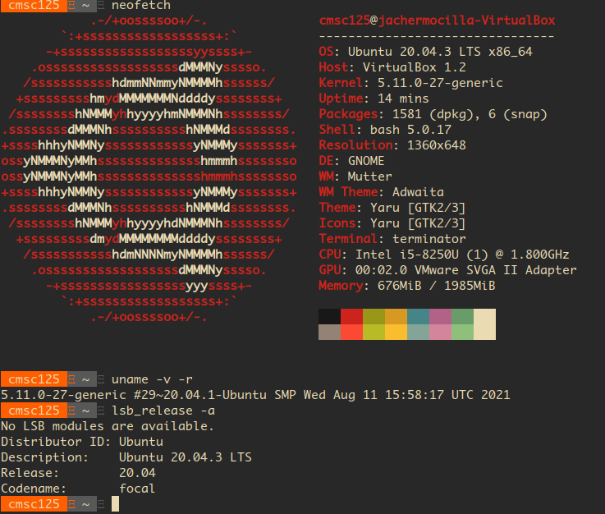
What constitutes an OS? Kernel + other components
A privileged/kernel process running in kernel mode(as controlled by the hardware)
Loaded by bootloader(GRUB or custom) at boot time
Will run until the device is turned off
Enables a user process to run on the CPU in a limited direct execution fashion via a context switch
Performs privileged operations on behalf of user processes through system calls invoked via a trap instruction
https://www.techrepublic.com

Slide 6
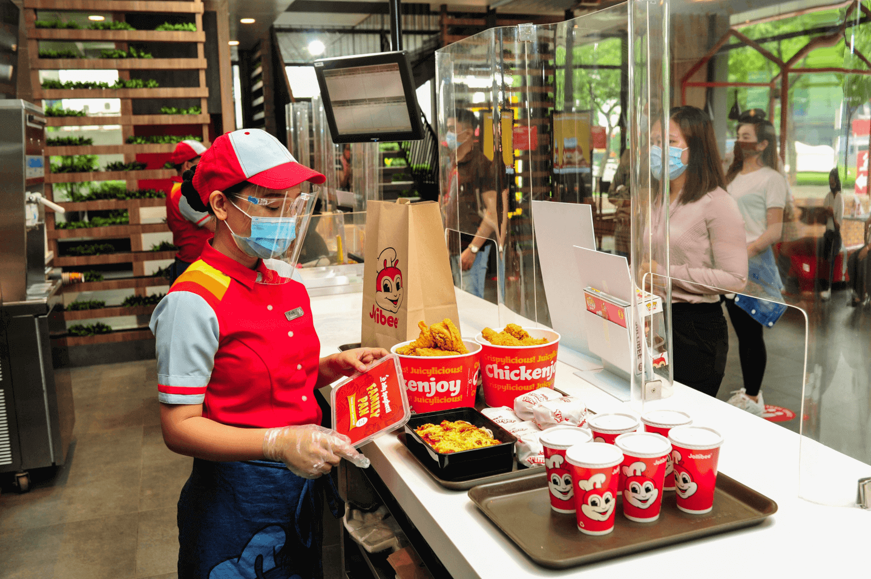
Developing a Scheduling Policy
How do we select which user process to run on the CPU?
What are key assumptions? – about the workload, etc.
What metrics are important?
What are some historical approaches?
https://www.jollibee.com.ph/

Slide 7
Workload assumptions for now (simplified, unrealistic)
Each process runs for the same amount of time
All processes arrive at the same time
Once started, each process runs to completion
All processes only use the CPU (i.e., they perform no I/O)
The run-time of each process is known
We will relax these assumptions as we go along.

Slide 8

Scheduling Metrics (for Comparing Policies)
Turnaround Time – a performance metric
The time at which the process completes minus the time at which the process arrived in the system
For now, T_{arrival} = 0, since we assumed that all processes arrived at the same time
We are usually interested in the Average Turnaround Time(ATT) for a given set of processes
Fairness
Each process has “fair chance” to run on the CPU
Performance and fairness are often at odds in scheduling
$$T_{turnaround}=T_{completion}−T_{arrival}$$

Slide 9

Policy #1: First In, First Out (FIFO)
First Come, First Served (FCFS)
Very simple and easy to implement
Example:
A arrived just before B which arrived just before C.
Each job runs for 10 seconds.
A
B
C
0
20
40
60
80
100
120
Time (Second)
$$Average turnaround time=\frac{10+20+30}{3}=20 sec$$

Slide 10
Policy #1: First In, First Out (FIFO) (Cont.)
Why FIFO is not that great?
Let’s relax assumption 1: Each process now no longer runs for the same amount of time.
It suffers from the Convoy Effect – short-burst processes wait for long-burst processes, drastically affecting the ATT
Example:
A arrived just before B which arrived just before C.
A runs for 100 seconds, B and C run for 10 each.
A
B
C
0
20
40
60
80
100
120
Time (Second)
$$Average turnaround time=\frac{100+110+120}{3}=110 sec$$

Slide 11

Policy #2: Shortest Job First (SJF)
Run the shortest process first, then the next shortest, and so on
A non-preemptive scheduling approach – runs processes to completion without interruption (opposite is called preemptive which is used by modern systems)
Example 1:
A arrived just before B which arrived just before C.
A runs for 100 seconds, B and C run for 10 each.
B
C
A
0
20
40
60
80
100
120
Time (Second)
$$Average turnaround time=\frac{10+20+120}{3}=50 sec$$

Slide 12
Policy #2: Shortest Job First (SJF) (Cont.)
Let’s relax assumption 2: Processes can now arrive at any time.
Results to a Convoy Effect due to non-preemption
Example (SJF with Late Arrivals):
A arrives at t=0 and needs to run for 100 seconds.
B and C arrive at t=10 and each need to run for 10 seconds
[B,C arrive]
A
B
C
0
20
40
60
80
100
120
Time (Second)
$$Average turnaround time=\frac{100+\left(110−10\right)+(120−10)}{3}=103.33 sec$$

Slide 13
Policy #3: Shortest Time-to-Completion First (STCF)
Let’s relax assumption 3: Processes now need not run to completion
Adds preemption to SJF
Also knows as Preemptive Shortest Job First (PSJF)
A new process arrives to the system:
Determine of the remaining times of existing processes and the new process
Schedule the process which has the least time left
Note that the decision point happens upon a new process arrival or the timer interrupts

Slide 14
Policy #3: Shortest Time-to-Completion First (STCF) (Cont.)
Example:
A arrives at t=0 and needs to run for 100 seconds.
B and C arrive at t=10 and each need to run for 10 seconds
[B,C arrive]
A
B
C
A
0
20
40
60
80
100
120
Time (Second)
$$Average turnaround time=\frac{(120−0)+\left(20−10\right)+(30−10)}{3}=50 sec$$

Slide 15

A New Scheduling Metric
Response Time – introduced in timesharing and interactive systems
Policies described previously mostly apply to batch processing systems
The time from when the process arrives to the first time it is scheduled (or produce the first output).
STCF and related policies are not particularly good for response time.
We are again interested in the Average Response Time(ART) given a set of processes
$$T_{response}=T_{firstrun}−T_{arrival}$$
How can we build a scheduler that is
sensitive to response time?

Slide 16
Policy #4: Round Robin (RR)
Aka Time-Slicing Scheduling
Run a process for a time slice (or quantum denoted by q) and then switch to the next process in the run queue
It repeatedly does so until the processed exited
The time slice must be a multiple of the timer-interrupt period.
Example: If timer interrupts every 10ms, q must be 10ms, 20ms, etc.
RR is fair, but performs poorly on metrics
such as turnaround time

Slide 17


Policy #4: Round Robin (RR) (Cont.)
Example:
A, B and C arrive at the same time
They each wish to run for 5 seconds
A
B
C
$$T_{average response}=\frac{0+5+10}{3}=5sec$$
0
5
10
15
20
25
30
Time (Second)
SJF (Bad for Response Time)
A
B
A
B
A
B
A
B
A
C
C
C
C
B
C
$$T_{average response}=\frac{0+1+2}{3}=1sec$$
0
5
10
15
20
25
30
Time (Second)
RR with a time slice of 1sec (Good for Response Time)

Slide 18
Policy #4: Round Robin (RR) (Cont.)
The length of the time slice is critical
Shorter time slice
Better response time
Cost of context switching will dominate overall performance
Longer time slice
Worsens response time
Amortizes the cost of context switching – less context switching
Note: Cost of context switching is not just due to the copying of registers but also to other architectural aspects like caches, TLBs, etc.
Deciding on the length of the time slice presents
a trade-off to a system designer.
How about the ATT in RR?

Slide 19
Incorporating I/O
Let’s relax assumption 4: All processes can now perform I/O
When a process initiates an I/O request
The process state is set to blocked/waiting (process waiting for I/O completion)
The scheduler should schedule another process on the CPU, otherwise the CPU will be idle
When the I/O completes
An interrupt is generated and control is transferred to the kernel
The kernel changes the state of the process that requested the I/O back to ready state
The scheduler may n schedule this process on the CPU now

Slide 20
Incorporating I/O (Cont.)
Example:
A and B need 50ms of CPU time each
A runs for 10ms and then issues an I/O request
I/Os each take 10ms
B simply uses the CPU for 50ms and performs no I/O
The scheduler runs A first, then B after

Slide 21
Incorporating I/O (Cont.)
A
A
A
A
A
B
B
B
B
B
CPU
Disk
0
20
40
60
80
100
120
140
Time (msec)
Poor Use of Resources
A
B
A
B
A
B
A
B
A
B
CPU
Maximizes the
CPU utilization
Disk
0
20
40
60
80
100
120
140
Time (msec)
Overlap Allows Better Use of Resources

Slide 22
No More Oracle
Let’s relax assumption 5: The scheduler now does not know the run-time of the processes
More realistic but how can this be achieved? – MLFQ

