Slide 1




CMSC 125: Operating Systems
Instructor: Joseph Anthony C. Hermocilla
Email: jchermocilla@up.edu.ph
Web: https://jachermocilla.org

Slide 2

Resources
Book: https://pages.cs.wisc.edu/~remzi/OSTEP/
Slides Template:
https://pages.cs.wisc.edu/~remzi/OSTEP/Educators-Slides/Youjip/

Slide 3
Acknowledgement
This lecture slide set was initially developed for Operating System course in Computer Science Dept. at Hanyang University. This lecture slide set is for OSTEP book written by Remzi and Andrea at University of Wisconsin.

Slide 4
30. Condition Variables
Operating System: Three Easy Pieces

Slide 5
Condition Variables
There are many cases where a thread wishes to check whether a condition is true before continuing its execution
Example:
A parent thread might wish to check whether a child thread has completed
This is often called a join()

Slide 6
Condition Variables (Cont.)
A Parent Waiting For Its Child
1 void *child(void *arg) {
2 printf("child\n");
3 // XXX how to indicate we are done?
4 return NULL;
5 }
6
7 int main(int argc, char *argv[]) {
8 printf("parent: begin\n");
9 pthread_t c;
10 Pthread_create(&c, NULL, child, NULL); // create child
11 // XXX how to wait for child?
12 printf("parent: end\n");
13 return 0;
14 }
What we would like to see here is:
parent: begin
child
parent: end

Slide 7
Parent waiting fore child: Spin-based Approach
This is hugely inefficient as the parent spins and wastes CPU time.
1 volatile int done = 0;
2
3 void *child(void *arg) {
4 printf("child\n");
5 done = 1;
6 return NULL;
7 }
8
9 int main(int argc, char *argv[]) {
10 printf("parent: begin\n");
11 pthread_t c;
12 Pthread_create(&c, NULL, child, NULL); // create child
13 while (done == 0)
14 ; // spin
15 printf("parent: end\n");
16 return 0;
17 }

Slide 8
How to wait for a condition
Condition variable
Waiting on the condition
An explicit queue that threads can put themselves on when some state of execution is not as desired
Signaling on the condition
Some other thread, when it changes said state, can wake one of those waiting threads and allow them to continue

Slide 9
Definition and Routines
Declare condition variable
Proper initialization is required
Operation (the POSIX calls)
The wait() call takes a mutex as a parameter(assumed to be locked) because
The wait() call release the lock and put the calling thread to sleep.
When the thread wakes up, it must re-acquire the lock.
pthread cond t c;
pthread_cond_wait(pthread_cond_t *c, pthread_mutex_t *m); // wait()
pthread_cond_signal(pthread_cond_t *c); // signal()

Slide 10
Parent waiting for Child: Use a condition variable
1 int done = 0;
2 pthread_mutex_t m = PTHREAD_MUTEX_INITIALIZER;
3 pthread_cond_t c = PTHREAD_COND_INITIALIZER;
4
5 void thr_exit() {
6 Pthread_mutex_lock(&m);
7 done = 1;
8 Pthread_cond_signal(&c);
9 Pthread_mutex_unlock(&m);
10 }
11
12 void *child(void *arg) {
13 printf("child\n");
14 thr_exit();
15 return NULL;
16 }
17
18 void thr_join() {
19 Pthread_mutex_lock(&m);
20 while (done == 0)
21 Pthread_cond_wait(&c, &m);
22 Pthread_mutex_unlock(&m);
23 }
24

Slide 11
Parent waiting for Child: Use a condition variable
(cont.)
25 int main(int argc, char *argv[]) {
26 printf("parent: begin\n");
27 pthread_t p;
28 Pthread_create(&p, NULL, child, NULL);
29 thr_join();
30 printf("parent: end\n");
31 return 0;
32 }

Slide 12
Parent waiting for Child: Use a condition variable
Parent:
Create the child thread and continues running itself
Call into thr_join() to wait for the child thread to complete
Acquire the lock
Check if the child is done
Put itself to sleep by calling wait()
Release the lock
Child:
Print the message “child”
Call thr_exit() to wake the parent thread
Grab the lock
Set the state variable done
Signal the parent thus waking it

Slide 13
The importance of the state variable done
Imagine the case where the child runs immediately.
The child will signal, but there is no thread asleep on the condition
When the parent runs, it will call wait and be stuck
No thread will ever wake it
1 void thr_exit() {
2 Pthread_mutex_lock(&m);
3 Pthread_cond_signal(&c);
4 Pthread_mutex_unlock(&m);
5 }
6
7 void thr_join() {
8 Pthread_mutex_lock(&m);
9 Pthread_cond_wait(&c, &m);
10 Pthread_mutex_unlock(&m);
11 }
thr_exit() and thr_join() without variable done

Slide 14
Another poor implementation
1 void thr_exit() {
2 done = 1;
3 Pthread_cond_signal(&c);
4 }
5
6 void thr_join() {
7 if (done == 0)
8 Pthread_cond_wait(&c);
9 }
The issue here is a subtle race condition
The parent calls thr_join()
The parent checks the value of done
It will see that it is 0 and try to go to sleep
Just before it calls wait to go to sleep, the parent is interrupted and the child runs
The child changes the state variable done to 1 and signals
But no thread is waiting and thus no thread is woken
When the parent runs again, it sleeps forever

Slide 15
The Producer / Consumer (Bounded Buffer) Problem
Producer
Produce data items
Wish to place data items in a buffer
Consumer
Grab data items out of the buffer consume them in some way
Example: Multi-threaded web server
A producer puts HTTP requests into a work queue
Consumer threads take requests out of this queue and process them

Slide 16
Bounded buffer
A bounded buffer is used when you pipe the output of one program into another
Example: grep foo file.txt | wc –l
The grep process is the producer
The wc process is the consumer
Between them is an in-kernel bounded buffer
Bounded buffer is Shared resource → Synchronized access is required

Slide 17
The Put and Get Routines (Version 1)
Only put data into the buffer when count is zero
i.e., when the buffer is empty
Only get data from the buffer when count is one
i.e., when the buffer is full
1 int buffer;
2 int count = 0; // initially, empty
3
4 void put(int value) {
5 assert(count == 0);
6 count = 1;
7 buffer = value;
8 }
9
10 int get() {
11 assert(count == 1);
12 count = 0;
13 return buffer;
14 }

Slide 18
Producer/Consumer Threads (Version 1)
Producer puts an integer into the shared buffer loops number of times
Consumer gets the data out of that shared buffer
1 void *producer(void *arg) {
2 int i;
3 int loops = (int) arg;
4 for (i = 0; i < loops; i++) {
5 put(i);
6 }
7 }
8
9 void *consumer(void *arg) {
10 int i;
11 while (1) {
12 int tmp = get();
13 printf("%d\n", tmp);
14 }
15 }

Slide 19
Producer/Consumer: Single CV and If Statement
A single condition variable cond and associated lock mutex
1 cond_t cond;
2 mutex_t mutex;
3
4 void *producer(void *arg) {
5 int i;
6 for (i = 0; i < loops; i++) {
7 Pthread_mutex_lock(&mutex); // p1
8 if (count == 1) // p2
9 Pthread_cond_wait(&cond, &mutex); // p3
10 put(i); // p4
11 Pthread_cond_signal(&cond); // p5
12 Pthread_mutex_unlock(&mutex); // p6
13 }
14 }
15
16 void *consumer(void *arg) {
17 int i;
18 for (i = 0; i < loops; i++) {
19 Pthread_mutex_lock(&mutex); // c1

Slide 20
Producer/Consumer: Single CV and If Statement
p1-p3: A producer waits for the buffer to be empty
c1-c3: A consumer waits for the buffer to be full
With just a single producer and a single consumer, the code works
20 if (count == 0) // c2
21 Pthread_cond_wait(&cond, &mutex); // c3
22 int tmp = get(); // c4
23 Pthread_cond_signal(&cond); // c5
24 Pthread_mutex_unlock(&mutex); // c6
25 printf("%d\n", tmp);
26 }
27 }
If we have more than one of producer and consumer?

Slide 21
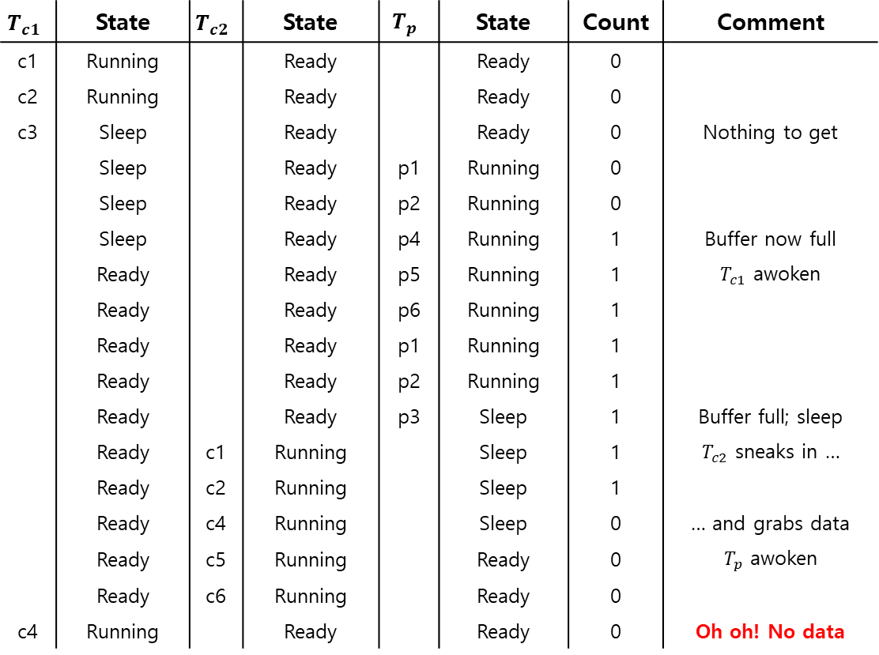
Thread Trace: Broken Solution (Version 1)
$$T_{c1}$$ | State | $$T_{c2}$$ | State | $$T_{p}$$ | State | Count | Comment
c1 | Running |  | Ready |  | Ready | 0
c2 | Running |  | Ready |  | Ready | 0
c3 | Sleep |  | Ready |  | Ready | 0 | Nothing to get
 | Sleep |  | Ready | p1 | Running | 0
 | Sleep |  | Ready | p2 | Running | 0
 | Sleep |  | Ready | p4 | Running | 1 | Buffer now full
 | Ready |  | Ready | p5 | Running | 1 | $T_{c1}$ awoken
 | Ready |  | Ready | p6 | Running | 1
 | Ready |  | Ready | p1 | Running | 1
 | Ready |  | Ready | p2 | Running | 1
 | Ready |  | Ready | p3 | Sleep | 1 | Buffer full; sleep
 | Ready | c1 | Running |  | Sleep | 1 | $T_{c2}$ sneaks in …
 | Ready | c2 | Running |  | Sleep | 1
 | Ready | c4 | Running |  | Sleep | 0 | … and grabs data
 | Ready | c5 | Running |  | Ready | 0 | $T_{p}$ awoken
 | Ready | c6 | Running |  | Ready | 0
c4 | Running |  | Ready |  | Ready | 0 | Oh oh! No data

Slide 22
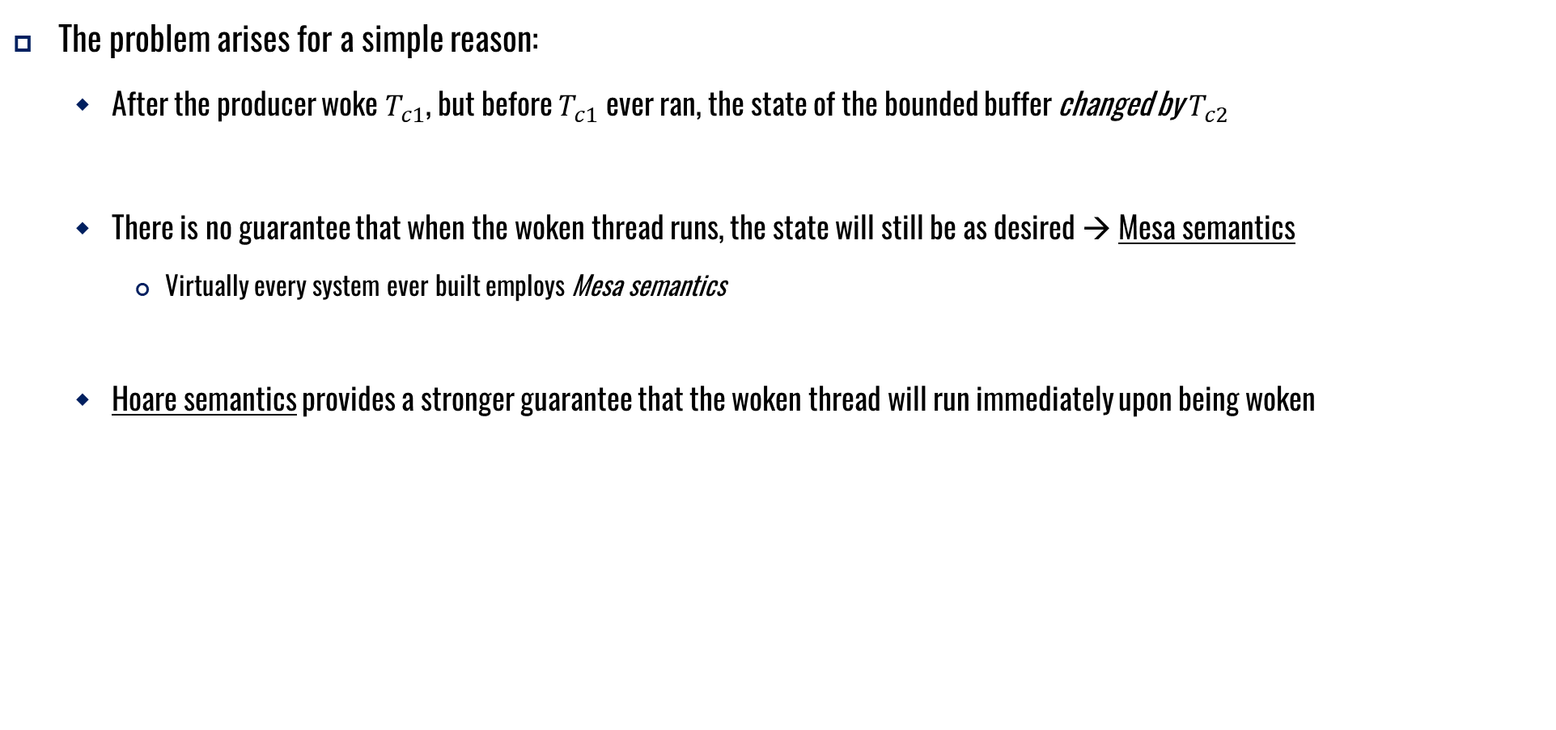
Thread Trace: Broken Solution (Version 1)
The problem arises for a simple reason:
After the producer woke $T_{c1}$, but before $T_{c1}$ ever ran, the state of the bounded buffer changed by $T_{c2}$
There is no guarantee that when the woken thread runs, the state will still be as desired → Mesa semantics
Virtually every system ever built employs Mesa semantics
Hoare semantics provides a stronger guarantee that the woken thread will run immediately upon being woken

Slide 23

Producer/Consumer: Single CV and While
Consumer $T_{c1}$ wakes up and re-checks the state of the shared variable
If the buffer is empty, the consumer simply goes back to sleep
1 cond_t cond;
2 mutex_t mutex;
3
4 void *producer(void *arg) {
5 int i;
6 for (i = 0; i < loops; i++) {
7 Pthread_mutex_lock(&mutex); // p1
8 while (count == 1) // p2
9 Pthread_cond_wait(&cond, &mutex); // p3
10 put(i); // p4
11 Pthread_cond_signal(&cond); // p5
12 Pthread_mutex_unlock(&mutex); // p6
13 }
14 }
15

Slide 24
Producer/Consumer: Single CV and While
A simple rule to remember with condition variables is to always use while loops
However, this code still has a bug (next page)
(Cont.)
16 void *consumer(void *arg) {
17 int i;
18 for (i = 0; i < loops; i++) {
19 Pthread_mutex_lock(&mutex); // c1
20 while (count == 0) // c2
21 Pthread_cond_wait(&cond, &mutex); // c3
22 int tmp = get(); // c4
23 Pthread_cond_signal(&cond); // c5
24 Pthread_mutex_unlock(&mutex); // c6
25 printf("%d\n", tmp);
26 }
27 }

Slide 25
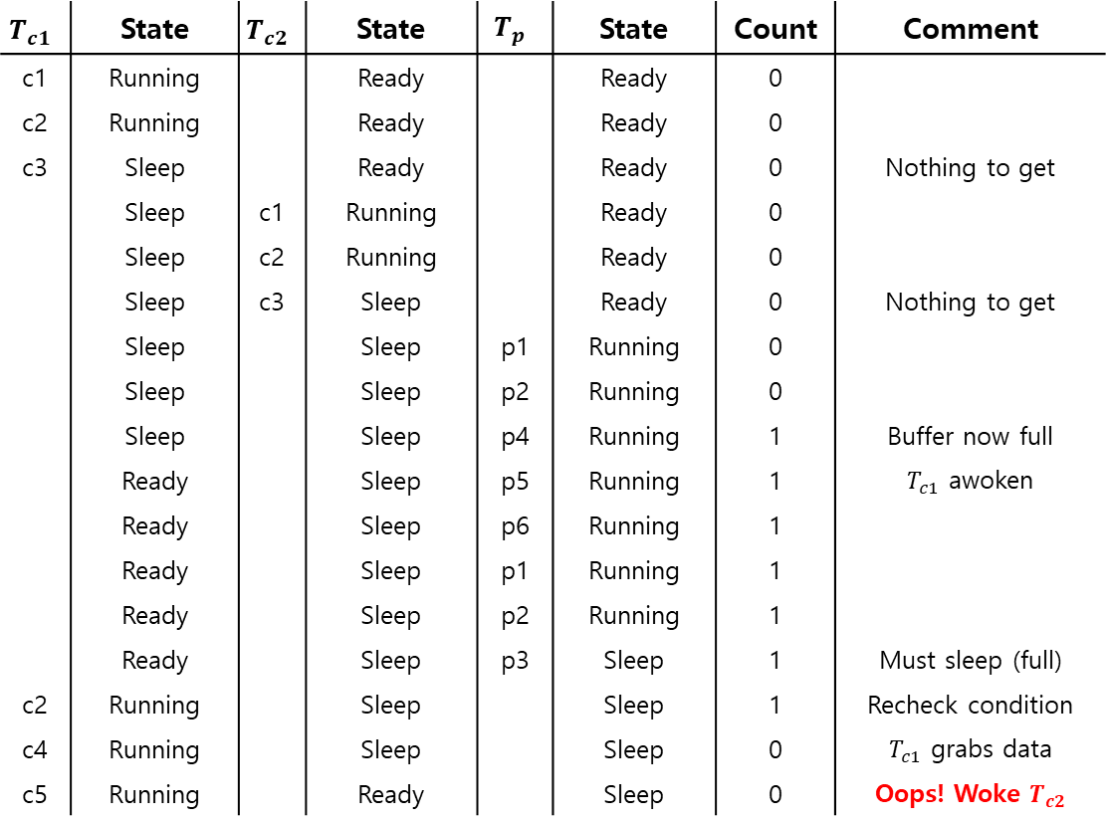
Thread Trace: Broken Solution (Version 2)
$$T_{c1}$$ | State | $$T_{c2}$$ | State | $$T_{p}$$ | State | Count | Comment
c1 | Running |  | Ready |  | Ready | 0
c2 | Running |  | Ready |  | Ready | 0
c3 | Sleep |  | Ready |  | Ready | 0 | Nothing to get
 | Sleep | c1 | Running |  | Ready | 0
 | Sleep | c2 | Running |  | Ready | 0
 | Sleep | c3 | Sleep |  | Ready | 0 | Nothing to get
 | Sleep |  | Sleep | p1 | Running | 0
 | Sleep |  | Sleep | p2 | Running | 0
 | Sleep |  | Sleep | p4 | Running | 1 | Buffer now full
 | Ready |  | Sleep | p5 | Running | 1 | $T_{c1}$ awoken
 | Ready |  | Sleep | p6 | Running | 1
 | Ready |  | Sleep | p1 | Running | 1
 | Ready |  | Sleep | p2 | Running | 1
 | Ready |  | Sleep | p3 | Sleep | 1 | Must sleep (full)
c2 | Running |  | Sleep |  | Sleep | 1 | Recheck condition
c4 | Running |  | Sleep |  | Sleep | 0 | $T_{c1}$ grabs data
c5 | Running |  | Ready |  | Sleep | 0 | Oops! Woke $T_{c2}$

Slide 26
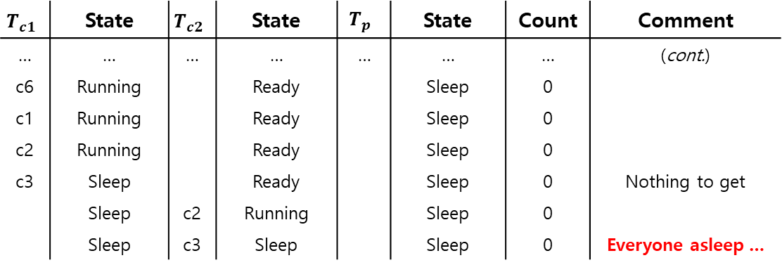
Thread Trace: Broken Solution (Version 2) (Cont.)
A consumer should not wake other consumers, only producers, and vice-versa
$$T_{c1}$$ | State | $$T_{c2}$$ | State | $$T_{p}$$ | State | Count | Comment
… | … | … | … | … | … | … | (cont.)
c6 | Running |  | Ready |  | Sleep | 0
c1 | Running |  | Ready |  | Sleep | 0
c2 | Running |  | Ready |  | Sleep | 0
c3 | Sleep |  | Ready |  | Sleep | 0 | Nothing to get
 | Sleep | c2 | Running |  | Sleep | 0
 | Sleep | c3 | Sleep |  | Sleep | 0 | Everyone asleep …

Slide 27
The single Buffer Producer/Consumer Solution
Use two condition variables and while
Producer threads wait on the condition empty, and signals fill
Consumer threads wait on fill and signal empty
1 cond_t empty, fill;
2 mutex_t mutex;
3
4 void *producer(void *arg) {
5 int i;
6 for (i = 0; i < loops; i++) {
7 Pthread_mutex_lock(&mutex);
8 while (count == 1)
9 Pthread_cond_wait(&empty, &mutex);
10 put(i);
11 Pthread_cond_signal(&fill);
12 Pthread_mutex_unlock(&mutex);
13 }
14 }
15

Slide 28
The single Buffer Producer/Consumer Solution
(Cont.)
16 void *consumer(void *arg) {
17 int i;
18 for (i = 0; i < loops; i++) {
19 Pthread_mutex_lock(&mutex);
20 while (count == 0)
21 Pthread_cond_wait(&fill, &mutex);
22 int tmp = get();
23 Pthread_cond_signal(&empty);
24 Pthread_mutex_unlock(&mutex);
25 printf("%d\n", tmp);
26 }
27 }

Slide 29
The Final Producer/Consumer Solution
More concurrency and efficiency → Add more buffer slots
Allow concurrent production or consuming to take place
Reduce context switches
1 int buffer[MAX];
2 int fill = 0;
3 int use = 0;
4 int count = 0;
5
6 void put(int value) {
7 buffer[fill] = value;
8 fill = (fill + 1) % MAX;
9 count++;
10 }
11
12 int get() {
13 int tmp = buffer[use];
14 use = (use + 1) % MAX;
15 count--;
16 return tmp;
17 }
The Final Put and Get Routines

Slide 30
The Final Producer/Consumer Solution (Cont.)
1 cond_t empty, fill;
2 mutex_t mutex;
3
4 void *producer(void *arg) {
5 int i;
6 for (i = 0; i < loops; i++) {
7 Pthread_mutex_lock(&mutex); // p1
8 while (count == MAX) // p2
9 Pthread_cond_wait(&empty, &mutex); // p3
10 put(i); // p4
11 Pthread_cond_signal(&fill); // p5
12 Pthread_mutex_unlock(&mutex); // p6
13 }
14 }
15
16 void *consumer(void *arg) {
17 int i;
18 for (i = 0; i < loops; i++) {
19 Pthread_mutex_lock(&mutex); // c1
20 while (count == 0) // c2
21 Pthread_cond_wait(&fill, &mutex); // c3
22 int tmp = get(); // c4

Slide 31
The Final Producer/Consumer Solution (Cont.)
p2: A producer only sleeps if all buffers are currently filled
c2: A consumer only sleeps if all buffers are currently empty
(Cont.)
23 Pthread_cond_signal(&empty); // c5
24 Pthread_mutex_unlock(&mutex); // c6
25 printf("%d\n", tmp);
26 }
27 }
The Final Working Solution (Cont.)

Slide 32
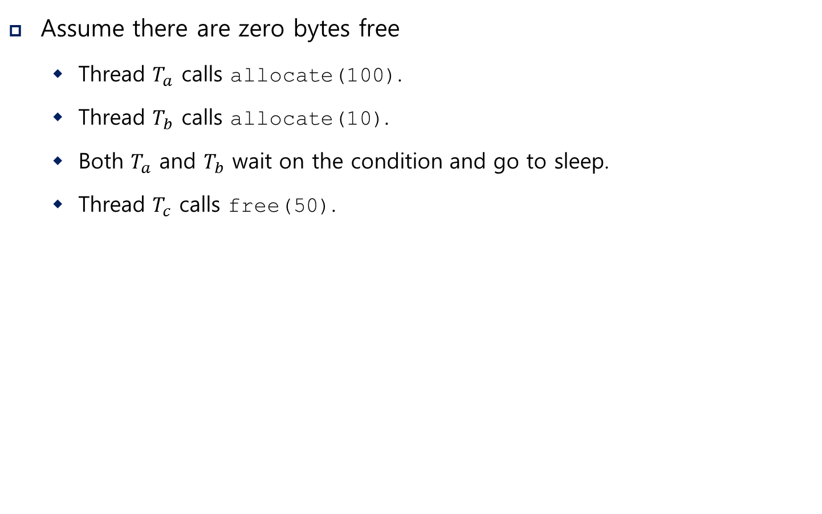
Covering Conditions
Assume there are zero bytes free
Thread $T_{a}$ calls allocate(100).
Thread $T_{b}$ calls allocate(10).
Both $T_{a}$ and $T_{b}$ wait on the condition and go to sleep.
Thread $T_{c}$ calls free(50).
Which waiting thread should be woken up?

Slide 33
Covering Conditions (Cont.)
1 // how many bytes of the heap are free?
2 int bytesLeft = MAX_HEAP_SIZE;
3
4 // need lock and condition too
5 cond_t c;
6 mutex_t m;
7
8 void *
9 allocate(int size) {
10 Pthread_mutex_lock(&m);
11 while (bytesLeft < size)
12 Pthread_cond_wait(&c, &m);
13 void *ptr = ...; // get mem from heap
14 bytesLeft -= size;
15 Pthread_mutex_unlock(&m);
16 return ptr;
17 }
18
19 void free(void *ptr, int size) {
20 Pthread_mutex_lock(&m);
21 bytesLeft += size;
22 Pthread_cond_signal(&c); // whom to signal??
23 Pthread_mutex_unlock(&m);
24 }

Slide 34
Covering Conditions (Cont.)
Solution (Suggested by Lampson and Redell)
Replace pthread_cond_signal() with pthread_cond_broadcast()
pthread_cond_broadcast()
Wake up all waiting threads
Cost: too many threads might be woken
Threads that shouldn’t be awake will simply wake up, re-check the condition, and then go back to sleep

