Slide 1




CMSC 125: Operating Systems
Instructor: Joseph Anthony C. Hermocilla
Email: jchermocilla@up.edu.ph
Web: https://jachermocilla.org

Slide 2
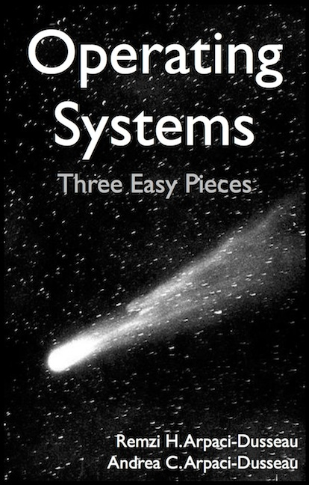
Resources
Book: https://pages.cs.wisc.edu/~remzi/OSTEP/
Slides Template:
https://pages.cs.wisc.edu/~remzi/OSTEP/Educators-Slides/Youjip/

Slide 3
Acknowledgement
This lecture slide set was initially developed for Operating System course in Computer Science Dept. at Hanyang University. This lecture slide set is for OSTEP book written by Remzi and Andrea at University of Wisconsin.

Slide 4
26. Concurrency: An Introduction
Operating System: Three Easy Pieces

Slide 5
Thread
A new abstraction for a single running process
Multi-threaded program
A multi-threaded program has more than one path of execution
Multiple PCs (Program Counter)
They share the same address space

Slide 6
Context switch between threads
Each thread has its own program counter and set of registers
One or more thread control blocks(TCBs) are needed to store the state of each thread
When switching from running one (T1) to running the other (T2)
The register state of T1 be saved
The register state of T2 restored
The address space remains the same

Slide 7
The stack of the relevant thread
There will be one stack per thread
0KB
The code section:
where instructions live
0KB
Program Code
Program Code
1KB
1KB
Heap
The heap section: contains malloc’d data dynamic data structures (it grows downward)
Heap
2KB
2KB
(free)
(free)
Stack (2)
(it grows upward)
The stack section: contains local variables arguments to routines, return values, etc.
(free)
15KB
15KB
Stack (1)
Stack (1)
16KB
16KB
A Single-Threaded
Address Space
Two-Threaded
Address Space

Slide 8
Why Use Threads?
Parallelism
Speeds up computations
Avoid blocking a process’ progress due to slow I/O
Enables the overlap of I/O and computations within a process
Ex. Spell-checking using a background thread in a word processor

Slide 9
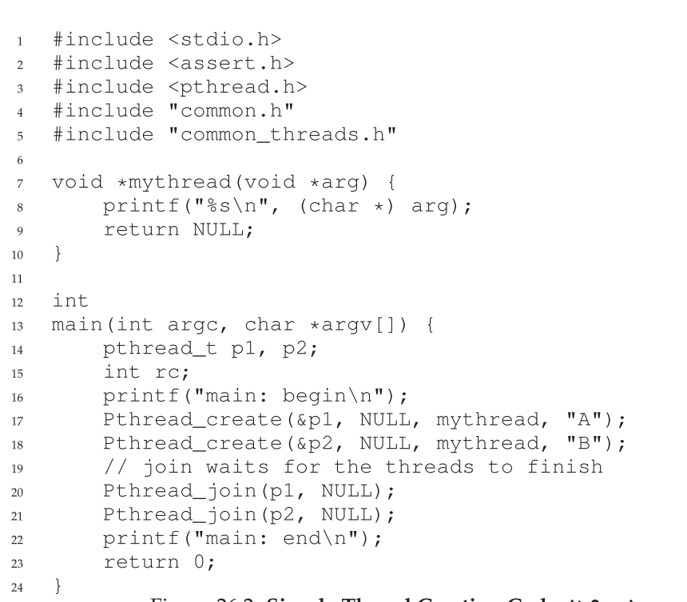
Thread Creation Example

Slide 10
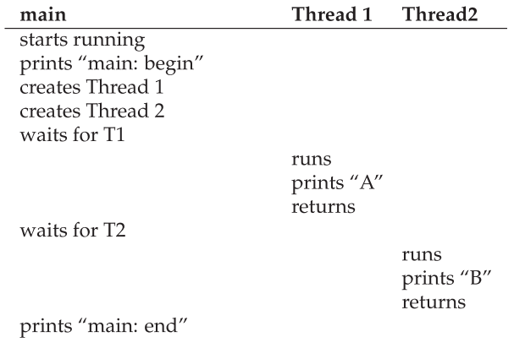
Thread Creation Example: Possible Execution Path 1

Slide 11
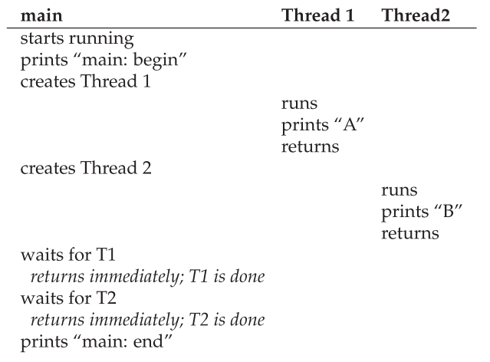
Thread Creation Example: Possible Execution Path 2

Slide 12
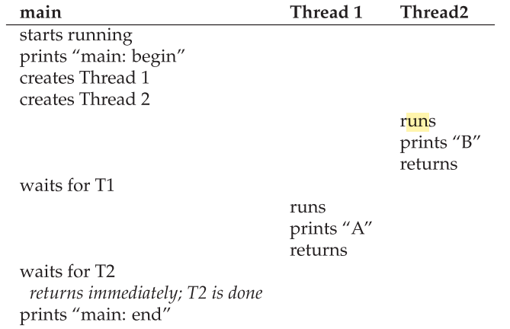
Thread Creation Example: Possible Execution Path 3

Slide 13
Why So Many Possible Execution Paths?
Depends on the thread scheduler!

Slide 14
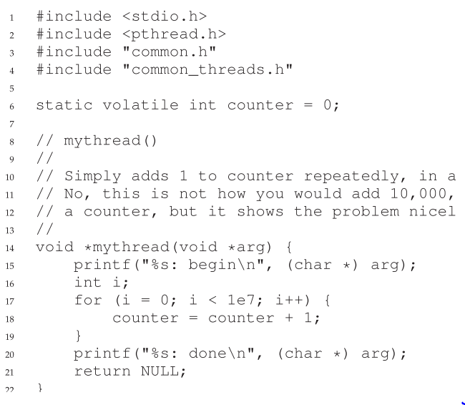

Shared Data Example
Further complicates things because data inconsistencies can happen
Critical Section

Slide 15
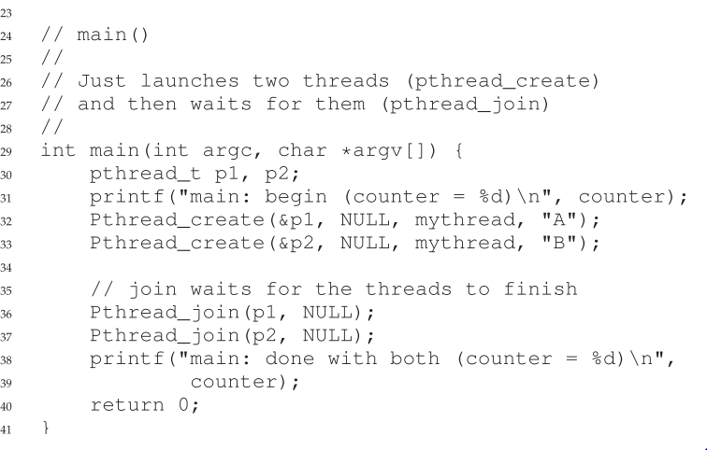
Shared Data (Cont..)

Slide 16
Race Condition
The result depends on the execution path
Example with two threads
counter = counter + 1 (initial is 50)
We expect the result is 52. However,
Part of thread state
(after instruction)
OS
Thread1
Thread2
PC
%eax
counter
before critical section
mov 0x8049a1c, %eax
add $0x1, %eax
100
105
108
0
50
51
50
50
50
interrupt
save T1’s state
restore T2’s state
100
105
108
113
0
50
51
51
50
50
50
51
mov 0x8049a1c, %eax
add $0x1, %eax
mov %eax, 0x8049a1c
interrupt
save T2’s state
restore T1’s state
108
113
51
51
50
51
mov %eax, 0x8049a1c

Slide 17
Critical Section
A piece of code that accesses a shared variable and must not be concurrently executed by more than one thread because executing it might result to a race condition and thus to incorrect results
Solution: Need to support atomicity(all instruction executions in the critical section will not be preempted) for critical section access (mutual exclusion)
Will need special hardware instructions and OS support

Slide 18
Locks
Another abstraction such that a thread will not be able to execute in the critical section unless it holds a lock
Ensure that any such critical section executes as if it were a single atomic instruction (execute a series of instructions atomically).
1 lock_t mutex;
2 . . .
3 lock(&mutex);
4 balance = balance + 1;
5 unlock(&mutex);
Critical section

Slide 19
Condition Variables
Some problems will require “waiting for another thread” – Synchronization
Ex. Threads for I/O processing
Other synchronization problems: Bounded-Buffer, Producer-Consumer, Readers-Writers, Dining Philosophers Problem

