Slide 1
Distributed Systems
(4th edition, version 01)
Chapter 05: Coordination

Slide 2
Physical clocks
Coordination Clock synchronization
Problem
Sometimes we simply need the exact time, not just an ordering.
Solution: Universal Coordinated Time (UTC)
Based on the number of transitions per second of the cesium 133 atom (pretty accurate).
At present, the real time is taken as the average of some 50 cesium clocks around the world.
Introduces a leap second from time to time to compensate that days are getting longer.
Note
UTC is broadcast through short-wave radio and satellite. Satellites can give an accuracy of about ±0.5 ms.
Physical clocks

Slide 3
Clock synchronization
Coordination Clock synchronization
Precision
The goal is to keep the deviation between two clocks on any two machines within a specified bound, known as the precision π:
∀t, ∀p, q : |C_{p} (t ) −C_{q} (t )| ≤ π
with C_{p} (t ) the computed clock time of machine p at UTC time t .
Accuracy
In the case of accuracy, we aim to keep the clock bound to a value α:
∀t, ∀p : |C_{p} (t ) −t| ≤ α
Synchronization
Internal synchronization: keep clocks precise
External synchronization: keep clocks accurate
Clock synchronization algorithms

Slide 4
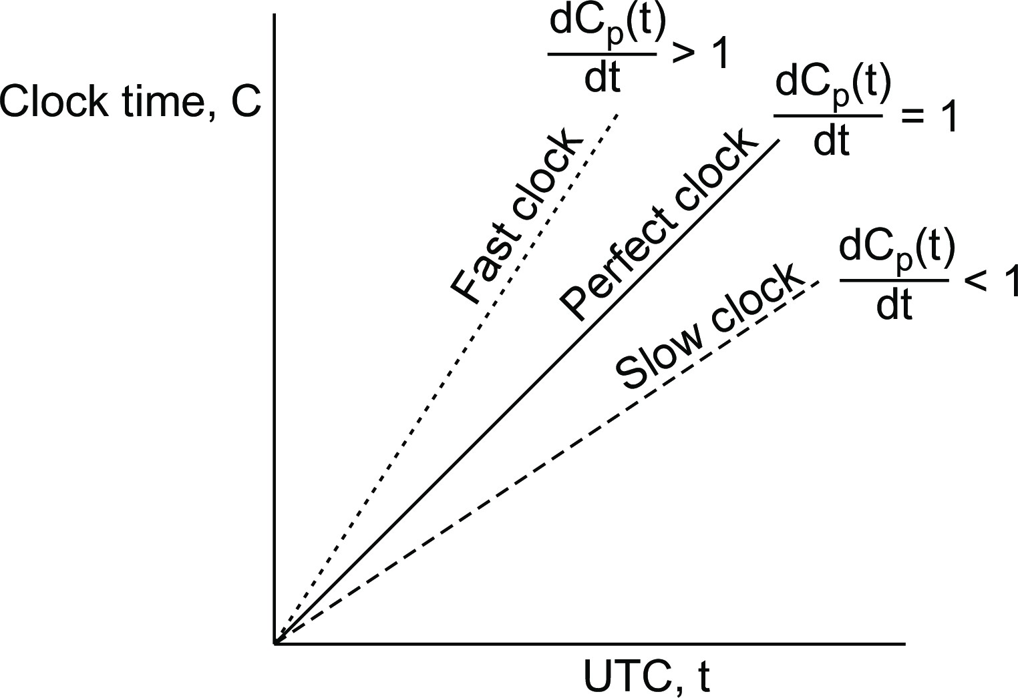
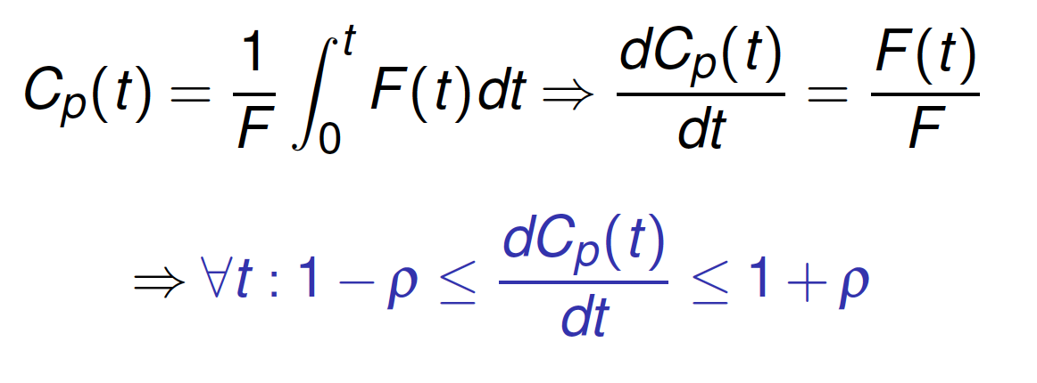
Clock drift
Coordination Clock synchronization
Clock specifications
A clock comes specified with its maximum clock drift rate ρ.
F (t ) denotes oscillator frequency of the hardware clock at time t
F is the clock’s ideal (constant) frequency ⇒ living up to specifications:
F (t )
∀t : (1 −ρ) ≤ ≤ (1 + ρ)
F
Observation
By using hardware interrupts we couple a software clock to the hardware clock, and thus also its clock drift rate:
Fast, perfect, slow clocks
Clock synchronization algorithms

Slide 5
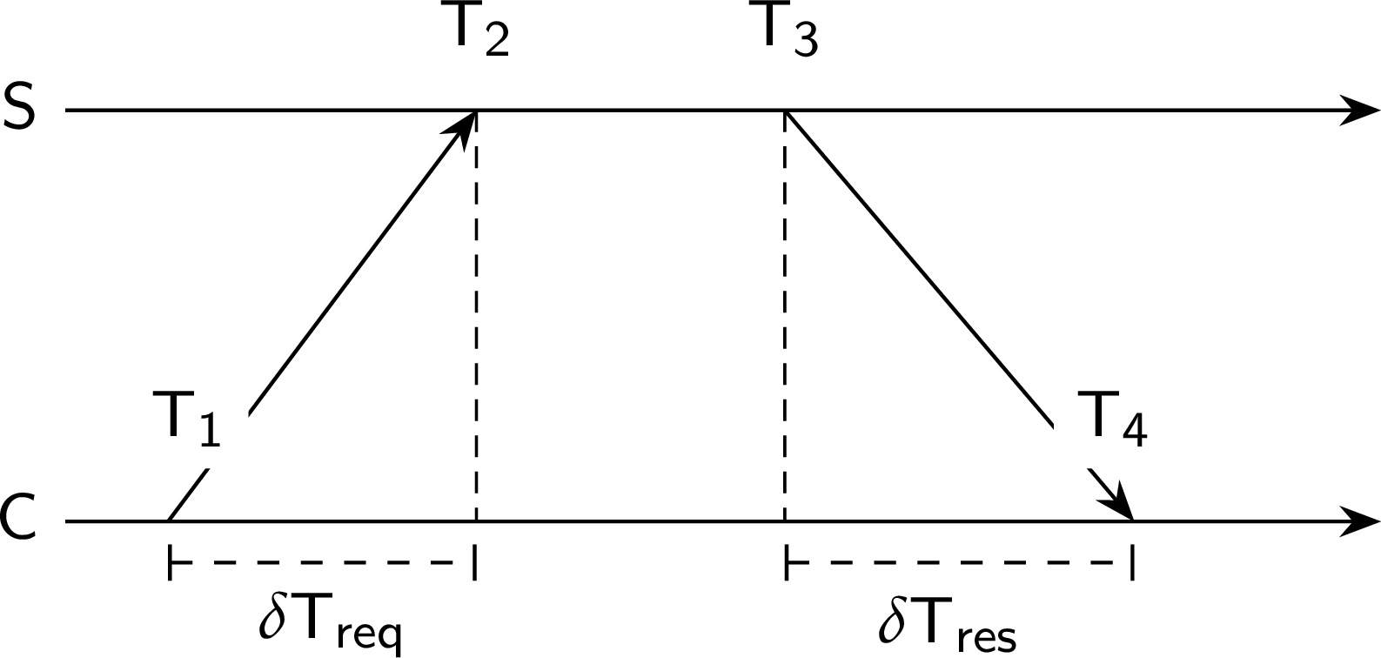
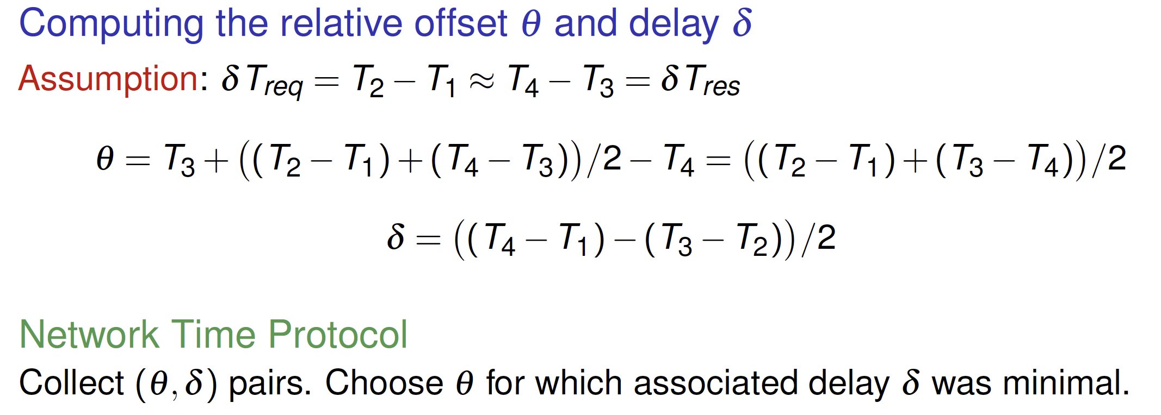
Coordination
Clock synchronization
Detecting and adjusting incorrect times
Getting the current time from a timeserver
Clock synchronization algorithms

Slide 6
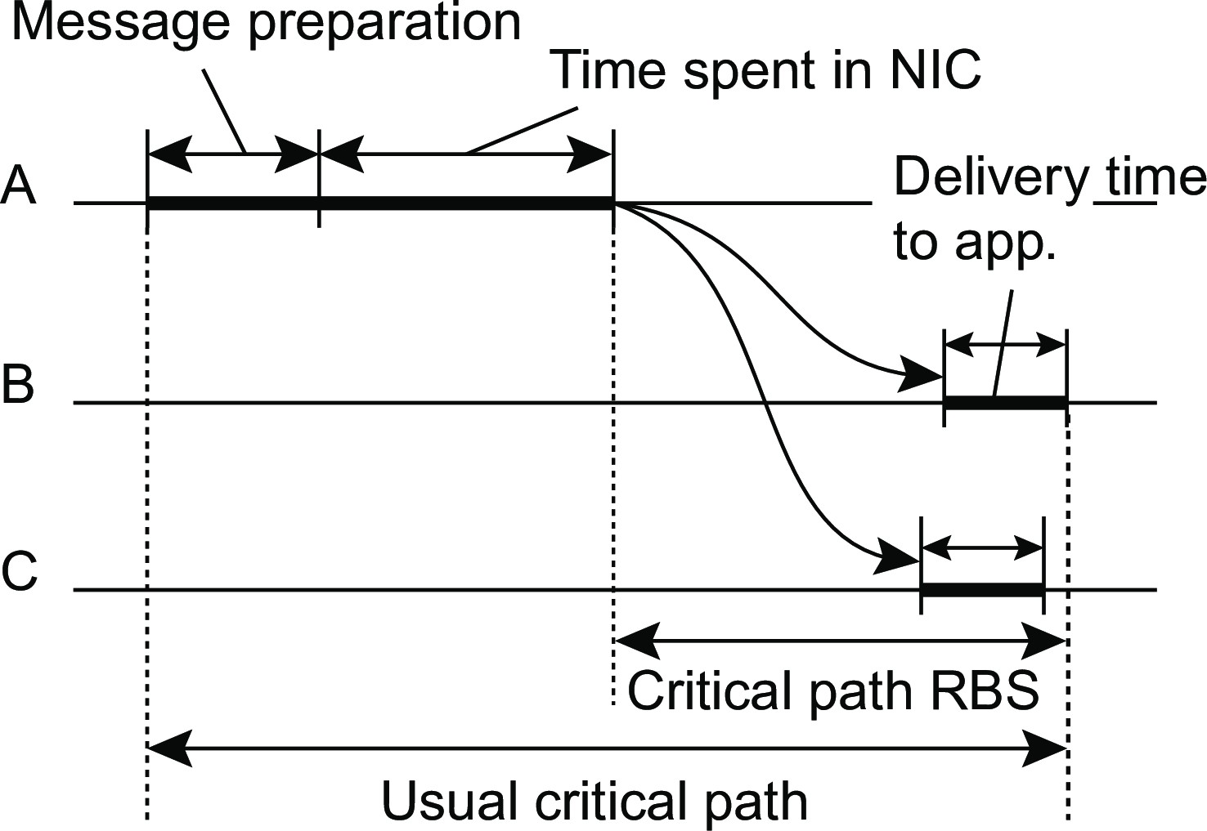
Reference broadcast synchronization
Coordination Clock synchronization
Essence
A node broadcasts a reference message m ⇒ each receiving node p
records the time T_{p,m} that it received m.
Note: T_{p,m} is read from p’s local clock.
Problem: averaging will not capture RBS minimizes critical path drift ⇒ use linear regression
NO: Offset[p, q](t ) =
∑
M
k =1
(T −T )
p,k q,k
M
YES: Offset[p, q](t ) = αt + β
Clock synchronization algorithms

Slide 7
The Happened-before relationship
Coordination Logical clocks
Issue
What usually matters is not that all processes agree on exactly what time it is, but that they agree on the order in which events occur. Requires a notion of ordering.
Lamport’s logical clocks

Slide 8
The Happened-before relationship
Coordination Logical clocks
Issue
What usually matters is not that all processes agree on exactly what time it is, but that they agree on the order in which events occur. Requires a notion of ordering.
The happened-before relation
If a and b are two events in the same process, and a comes before b, then a → b.
If a is the sending of a message, and b is the receipt of that message, then a → b
If a → b and b → c, then a → c
Note
This introduces a partial ordering of events in a system with concurrently operating processes.
Lamport’s logical clocks

Slide 9
Coordination
Logical clocks
Logical clocks
Problem
How do we maintain a global view of the system’s behavior that is consistent with the happened-before relation?
Lamport’s logical clocks

Slide 10
Coordination
Logical clocks
Logical clocks
Problem
How do we maintain a global view of the system’s behavior that is consistent with the happened-before relation?
Attach a timestamp C(e) to each event e, satisfying the following properties:
P1 If a and b are two events in the same process, and a → b, then we demand that C(a) < C(b).
P2 If a corresponds to sending a message m, and b to the receipt of that message, then also C(a) < C(b).
Lamport’s logical clocks

Slide 11
Coordination
Logical clocks
Logical clocks
Problem
How do we maintain a global view of the system’s behavior that is consistent with the happened-before relation?
Attach a timestamp C(e) to each event e, satisfying the following properties:
P1 If a and b are two events in the same process, and a → b, then we demand that C(a) < C(b).
P2 If a corresponds to sending a message m, and b to the receipt of that message, then also C(a) < C(b).
Problem
How to attach a timestamp to an event when there’s no global clock ⇒
maintain a consistent set of logical clocks, one per process.
Lamport’s logical clocks

Slide 12
Logical clocks: solution
Coordination Logical clocks
Each process P_{i} maintains a local counter C_{i} and adjusts this counter
For each new event that takes place within P_{i} , C_{i} is incremented by 1.
Each time a message m is sent by process P_{i} , the message receives a timestamp ts(m) = C_{i} .
Whenever a message m is received by a process P_{j} , P_{j} adjusts its local counter C_{j} to max{C_{j} , ts(m)}; then executes step 1 before passing m to the application.
Notes
Property P1 is satisfied by (1); Property P2 by (2) and (3).
It can still occur that two events happen at the same time. Avoid this by breaking ties through process IDs.
Lamport’s logical clocks

Slide 13
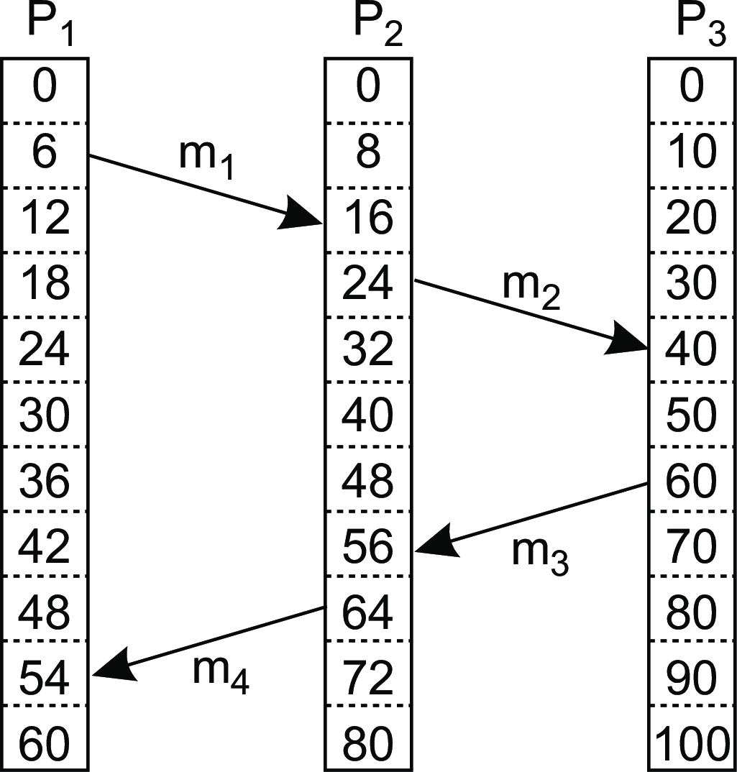
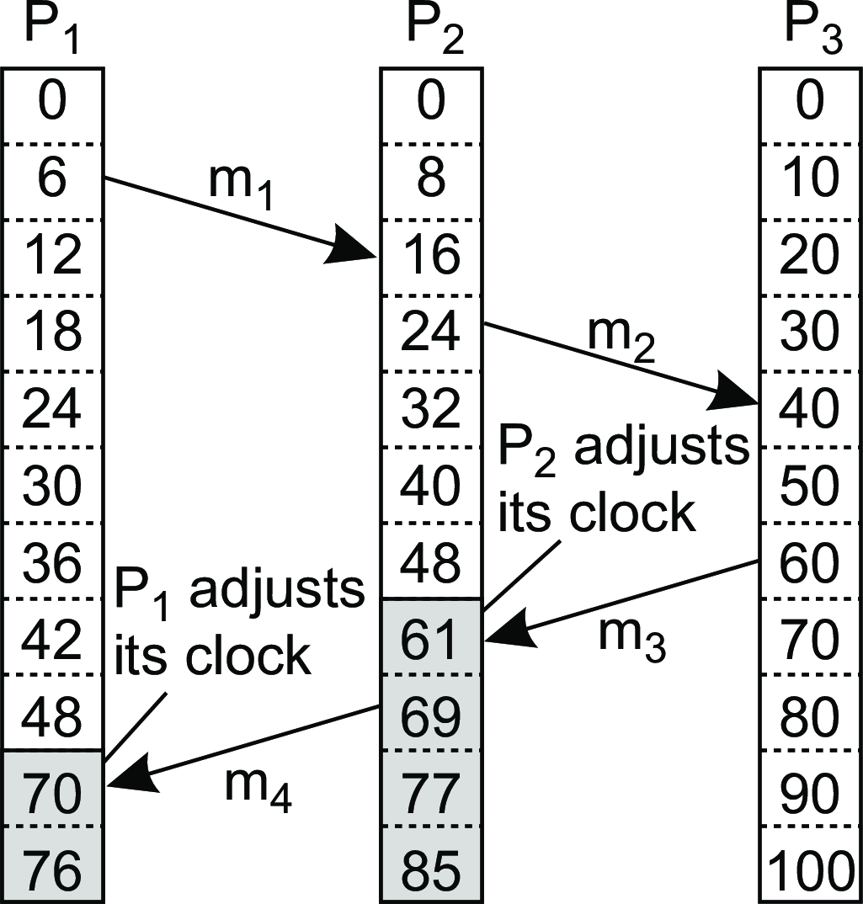
Coordination
Logical clocks
Logical clocks: example
Consider three processes with event counters operating at different rates
Lamport’s logical clocks

Slide 14
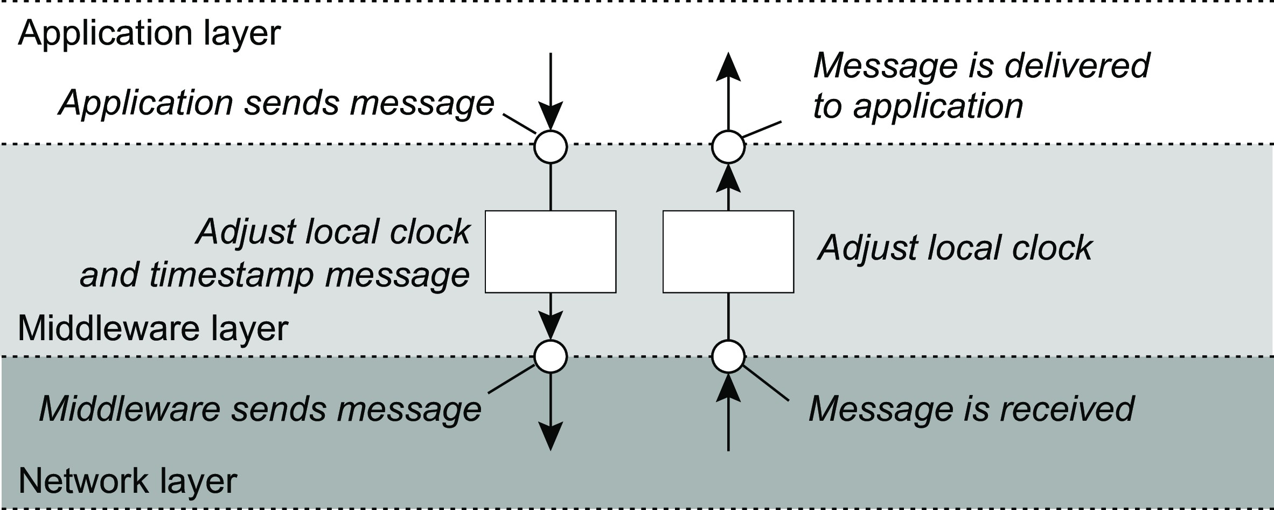
Coordination
Logical clocks
Logical clocks: where implemented
Adjustments implemented in middleware
Lamport’s logical clocks

Slide 15
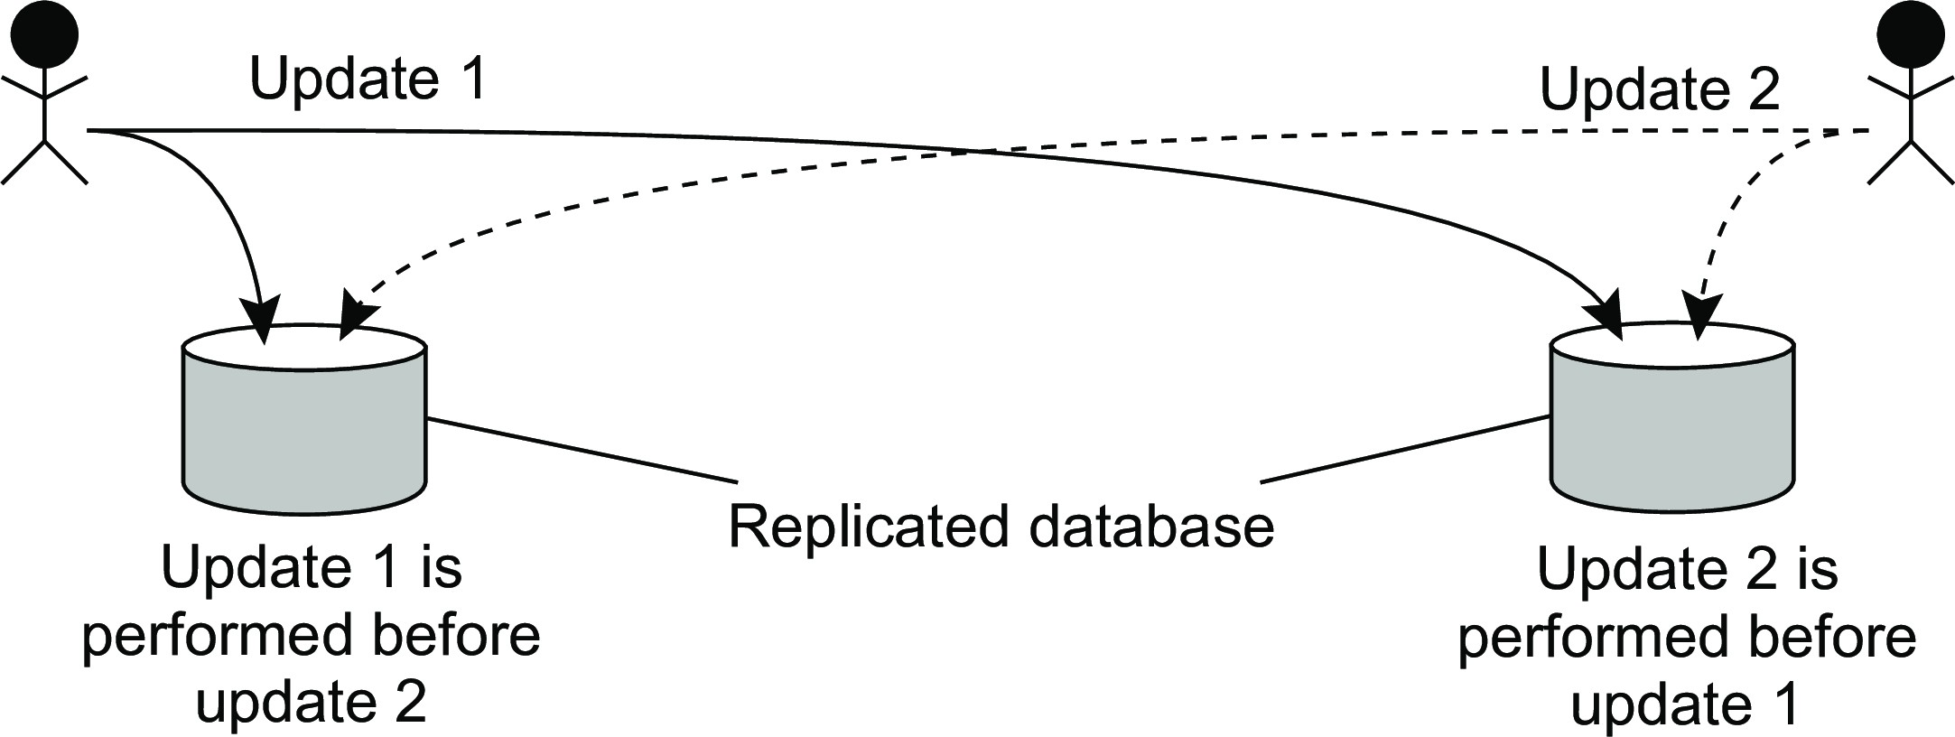
Coordination
Logical clocks
Example: Totally ordered multicast
Concurrent updates on a replicated database are seen in the same order everywhere
P₁ adds $100 to an account (initial value: $1000)
P₂ increments account by 1%
There are two replicas
Result
In absence of proper synchronization:
replica #1 ← $1111, while replica #2 ← $1110.
Lamport’s logical clocks

Slide 16
Example: Totally ordered multicast
Coordination Logical clocks
Solution
Process P_{i} sends timestamped message m_{i} to all others. The message itself is put in a local queue queue_{i} .
Any incoming message at P_{j} is queued in queue_{j} , according to its timestamp, and acknowledged to every other process.
Lamport’s logical clocks

Slide 17
Example: Totally ordered multicast
Coordination Logical clocks
Solution
Process P_{i} sends timestamped message m_{i} to all others. The message itself is put in a local queue queue_{i} .
Any incoming message at P_{j} is queued in queue_{j} , according to its timestamp, and acknowledged to every other process.
P_{j} passes a message m_{i} to its application if:
m_{i} is at the head of queue_{j}
for each process P_{k} , there is a message m_{k} in queue_{j} with a larger timestamp.
Lamport’s logical clocks

Slide 18
Example: Totally ordered multicast
Coordination Logical clocks
Solution
Process P_{i} sends timestamped message m_{i} to all others. The message itself is put in a local queue queue_{i} .
Any incoming message at P_{j} is queued in queue_{j} , according to its timestamp, and acknowledged to every other process.
P_{j} passes a message m_{i} to its application if:
m_{i} is at the head of queue_{j}
for each process P_{k} , there is a message m_{k} in queue_{j} with a larger timestamp.
Note
We are assuming that communication is reliable and FIFO ordered.
Lamport’s logical clocks

Slide 19
Coordination
Logical clocks
Lamport’s clocks for mutual exclusion
1 class Process:
2
3
4
5
6
7
8
9
10
11
12
13
14
15
16
17
18
19
20
21
22
23
24
25
26
27
def init (self, chanID, procID, procIDSet): self.chan.join(procID)
self.procID = int(procID)
self.otherProcs.remove(self.procID)
self.queue = []
# The request queue
# The current logical clock
self.clock = 0
def requestToEnter(self): self.clock = self.clock + 1
# Increment clock value
self.queue.append((self.clock, self.procID, ENTER)) # Append request to q
self.cleanupQ() # Sort the queue
self.chan.sendTo(self.otherProcs, (self.clock, self.procID, ENTER)) # Send request
def ackToEnter(self, requester):
self.clock = self.clock + 1 # Increment clock value
self.chan.sendTo(requester, (self.clock, self.procID, ACK)) # Permit other
def release(self):
tmp = [r for r in self.queue[1:] if r[2] == ENTER] # Remove all ACKs
self.queue = tmp
self.clock = self.clock + 1
# and copy to new queue # Increment clock value
self.chan.sendTo(self.otherProcs, (self.clock, self.procID, RELEASE)) # Release
def allowedToEnter(self):
commProcs = set([req[1] for req in self.queue[1:]]) # See who has sent a message
return (self.queue[0][1] == self.procID and len(self.otherProcs) == len(commProcs))
Lamport’s logical clocks

Slide 20
Coordination
Logical clocks
Lamport’s clocks for mutual exclusion
1
2
3
4
5
6
7
8
9
10
11
12
def receive(self):
msg = self.chan.recvFrom(self.otherProcs)[1] self.clock = max(self.clock, msg[0]) self.clock = self.clock + 1
if msg[2] == ENTER:
self.queue.append(msg) self.ackToEnter(msg[1])
elif msg[2] == ACK:
self.queue.append(msg)
elif msg[2] == RELEASE:
del(self.queue[0]) self.cleanupQ()
# Pick up any message
# Adjust clock value... # ...and increment
# Append an ENTER request
# and unconditionally allow
# Append a received ACK
# Just remove first message # And sort and cleanup
Lamport’s logical clocks

Slide 21
Lamport’s clocks for mutual exclusion
Coordination Logical clocks
Analogy with totally ordered multicast
With totally ordered multicast, all processes build identical queues, delivering messages in the same order
Mutual exclusion is about agreeing in which order processes are allowed to enter a critical region
Lamport’s logical clocks

Slide 22
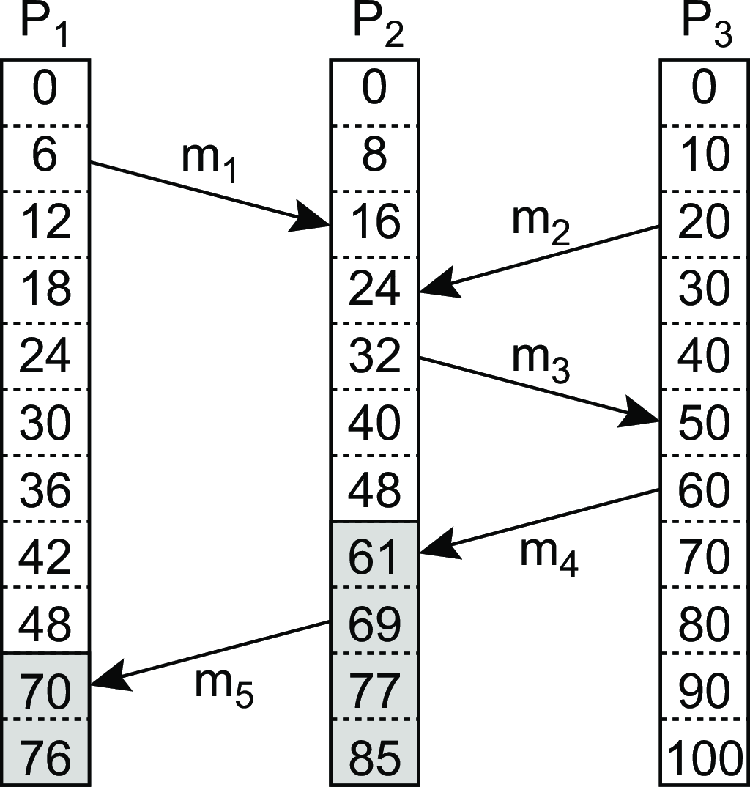
Coordination
Logical clocks
Vector clocks
Observation
Lamport’s clocks do not guarantee that if C(a) < C(b) that a causally preceded b.
Concurrent message transmission using logical clocks
Observation
Event a: m₁ is received at T = 16; Event b: m₂ is sent at T = 20.
Vector clocks

Slide 23
Coordination
Logical clocks
Vector clocks
Observation
Lamport’s clocks do not guarantee that if C(a) < C(b) that a causally preceded b.
Concurrent message transmission using logical clocks
Observation
Event a: m₁ is received at T = 16; Event b: m₂ is sent at T = 20.
Note
We cannot conclude that a causally precedes b.
Vector clocks

Slide 24
Coordination
Logical clocks
Causal dependency
Definition
We say that b may causally depend on a if ts(a) < ts(b), with:
for all k , ts(a)[k ] ≤ ts(b)[k ] and
there exists at least one index k′ for which ts(a)[k′] < ts(b)[k′]
Precedence vs. dependency
We say that a causally precedes b.
b may causally depend on a, as there may be information from a that is propagated into b.
Vector clocks

Slide 25
Coordination
Logical clocks
Capturing potential causality
Solution: each P_{i} maintains a vector VC_{i}
VC_{i} [i ] is the local logical clock at process P_{i} .
If VC_{i} [j ] = k then P_{i} knows that k events have occurred at P_{j} .
Maintaining vector clocks
Before executing an event, P_{i} executes VC_{i} [i ] ← VC_{i} [i ] + 1.
When process P_{i} sends a message m to P_{j} , it sets m’s (vector) timestamp ts(m) equal to VC_{i} after having executed step 1.
Upon the receipt of a message m, process P_{j} sets
VC_{j} [k ] ← max{VC_{j} [k ], ts(m)[k ]} for each k , after which it executes step 1 and then delivers the message to the application.
Vector clocks

Slide 26
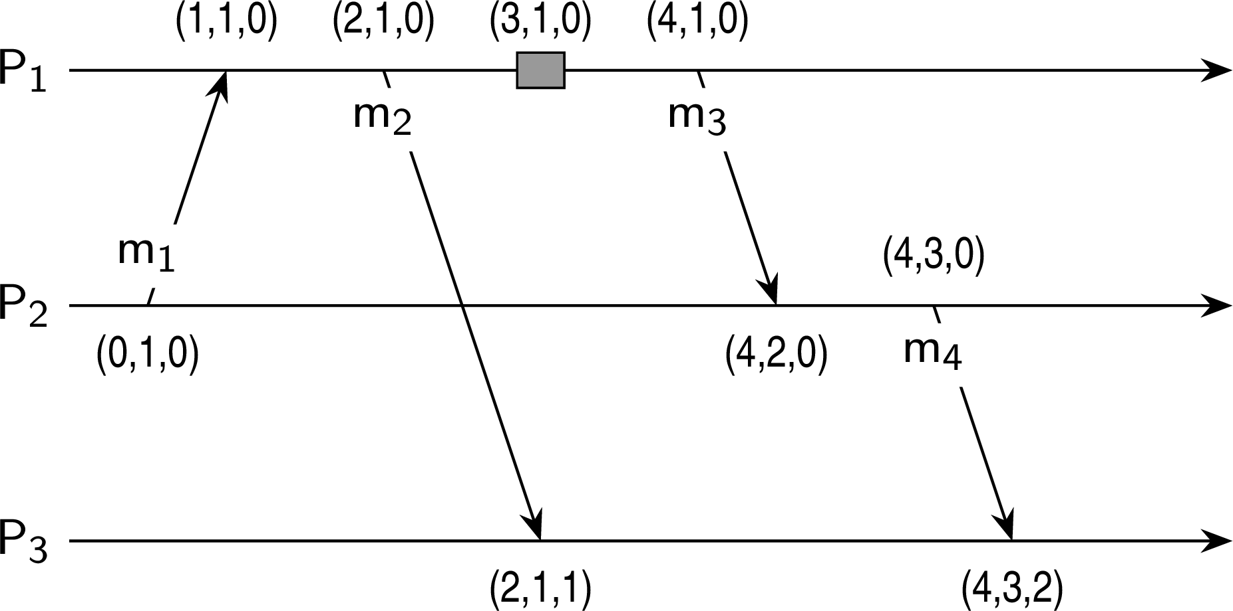
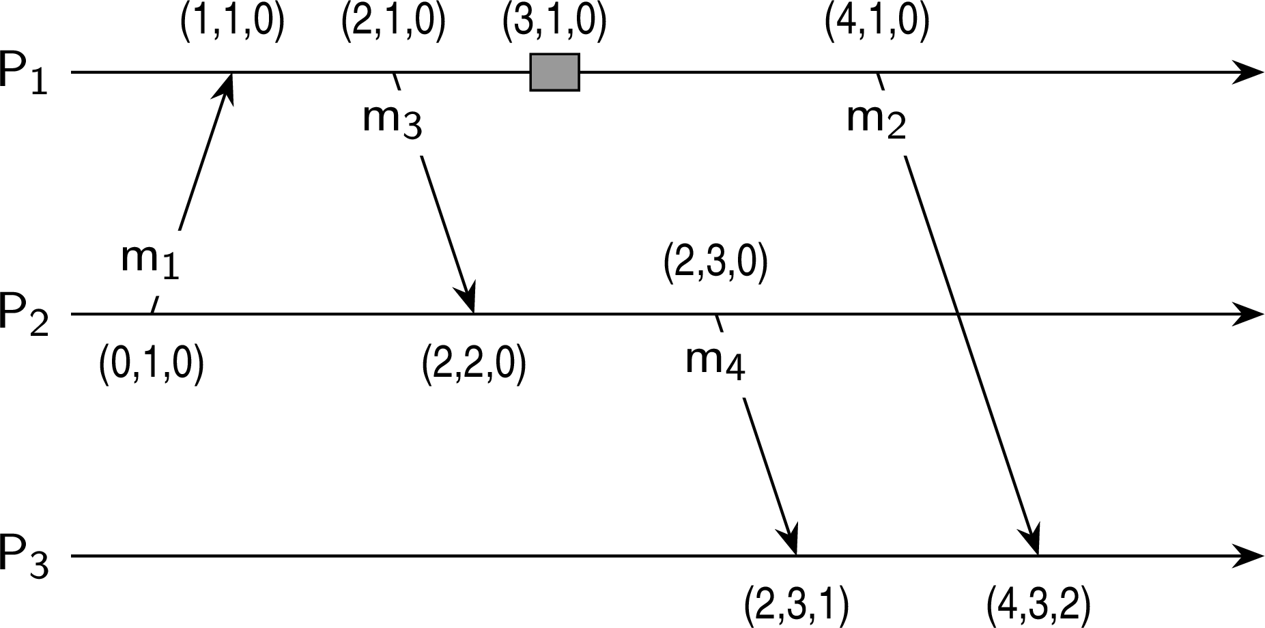
Coordination
Logical clocks
Vector clocks: Example
Capturing potential causality when exchanging messages
(a)
(b)
Analysis
Situation | ts(m₂ ) | ts(m₄ ) | ts(m₂ ) < ts(m₄ ) | ts(m₂ ) > ts(m₄ ) | Conclusion
(a) | (2, 1, 0) | (4, 3, 0) | Yes | No | m₂ may causally precede m₄
(b) | (4, 1, 0) | (2, 3, 0) | No | No | m₂ and m₄ may conflict
Vector clocks

Slide 27
Causally ordered multicasting
Coordination Logical clocks
Observation
We can now ensure that a message is delivered only if all causally preceding messages have already been delivered.
Adjustment
P_{i} increments VC_{i} [i ] only when sending a message, and P_{j} “adjusts” VC_{j}
when receiving a message (i.e., effectively does not change VC_{j} [j ]).
Vector clocks

Slide 28
Causally ordered multicasting
Coordination Logical clocks
Observation
We can now ensure that a message is delivered only if all causally preceding messages have already been delivered.
Adjustment
P_{i} increments VC_{i} [i ] only when sending a message, and P_{j} “adjusts” VC_{j}
when receiving a message (i.e., effectively does not change VC_{j} [j ]).
P_{j} postpones delivery of m until:
ts(m)[i ] = VC_{j} [i ] + 1
ts(m)[k ] ≤ VC_{j} [k ] for all k ̸= i
Vector clocks

Slide 29
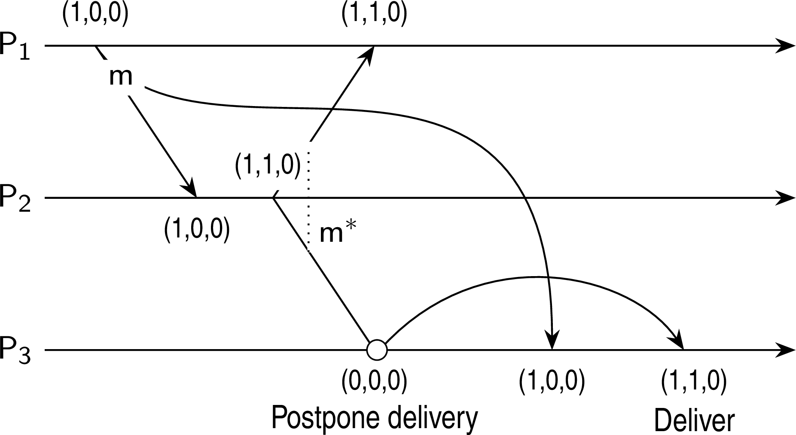
Coordination
Logical clocks
Causally ordered multicasting
Enforcing causal communication
Vector clocks

Slide 30
Coordination
Logical clocks
Causally ordered multicasting
Enforcing causal communication
Example
Take VC₃ = [0, 2, 2], ts(m) = [1, 3, 0] from P₁. What information does P₃ have, and what will it do when receiving m (from P₁)?
Vector clocks

Slide 31
Mutual exclusion
Coordination Mutual exclusion
Problem
Several processes in a distributed system want exclusive access to some resource.
Basic solutions
Permission-based: A process wanting to enter its critical region, or access a resource, needs permission from other processes.
Token-based: A token is passed between processes. The one who has the token may proceed in its critical region, or pass it on when not interested.
Overview

Slide 32
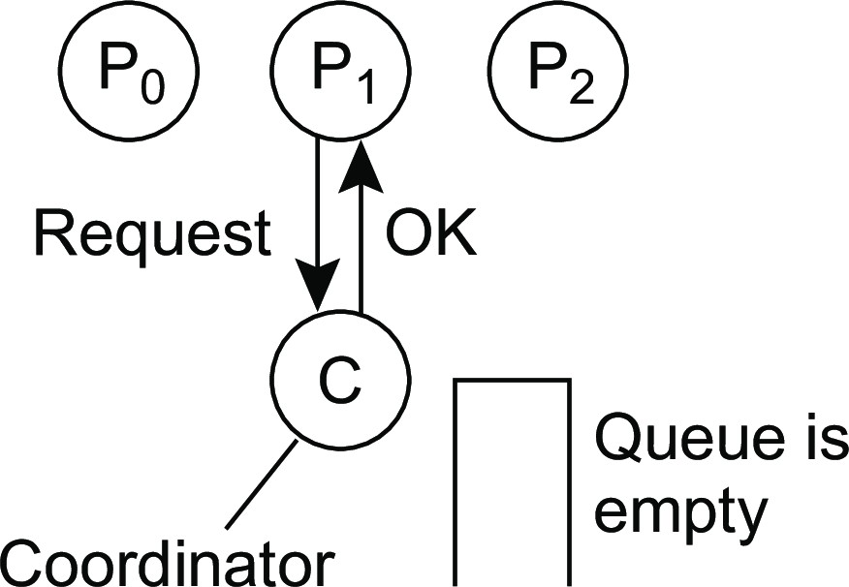
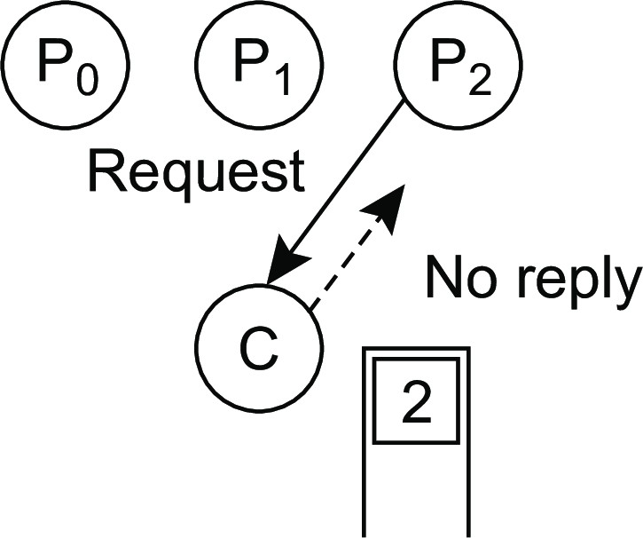
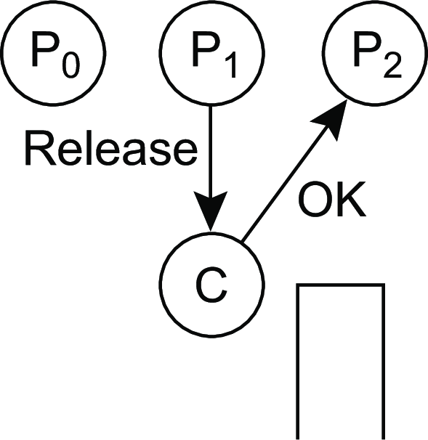
Coordination
Mutual exclusion
Permission-based, centralized
Simply use a coordinator
(a) (b) (c)
Process P₁ asks the coordinator for permission to access a shared resource. Permission is granted.
Process P₂ then asks permission to access the same resource. The coordinator does not reply.
When P₁ releases the resource, it tells the coordinator, which then replies to P₂ .
A centralized algorithm

Slide 33
Mutual exclusion: Ricart & Agrawala
Coordination Mutual exclusion
The same as Lamport except that acknowledgments are not sent
Return a response to a request only when:
The receiving process has no interest in the shared resource; or
The receiving process is waiting for the resource, but has lower priority (known through comparison of timestamps).
In all other cases, reply is deferred, implying some more local administration.
A distributed algorithm

Slide 34
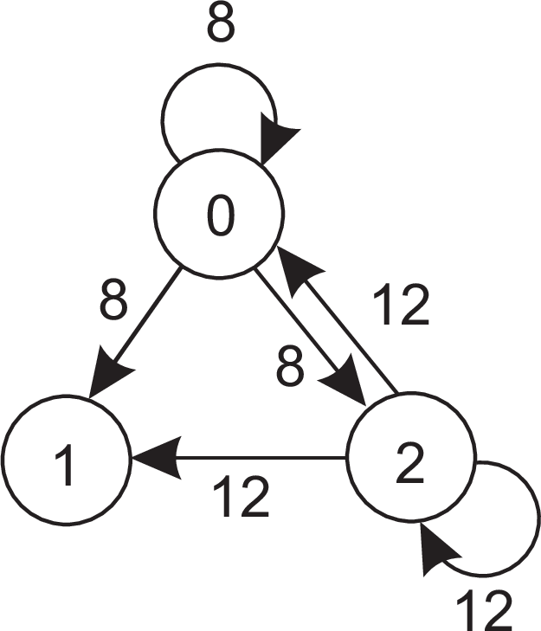
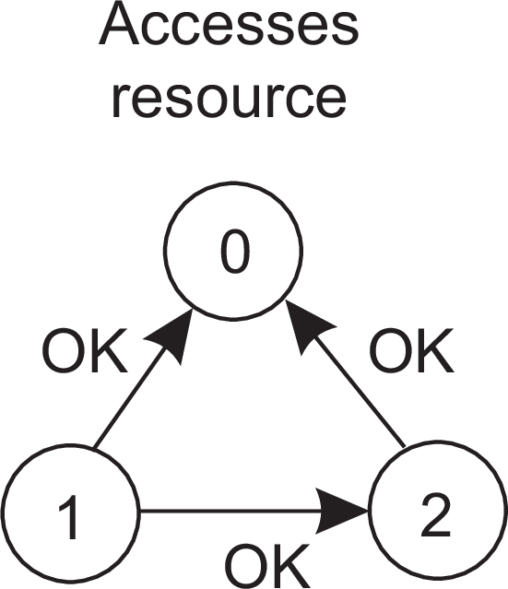
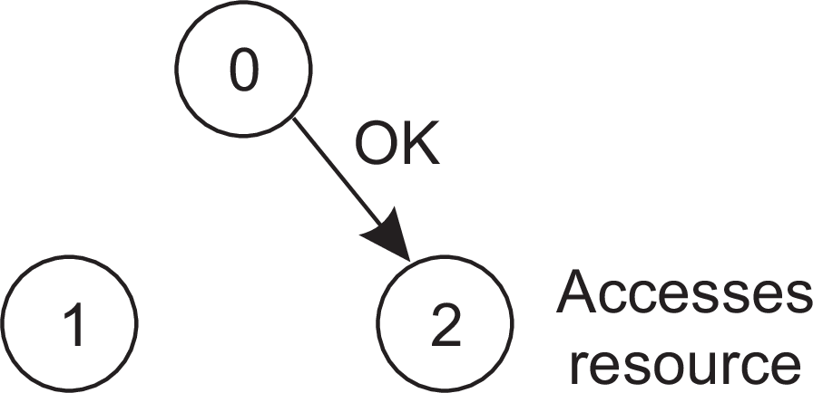
Coordination
Mutual exclusion
Mutual exclusion: Ricart & Agrawala
Example with three processes
(a) (b) (c)
Two processes want to access a shared resource at the same moment.
P₀ has the lowest timestamp, so it wins.
When process P₀ is done, it sends an OK also, so P₂ can now go ahead.
A distributed algorithm

Slide 35
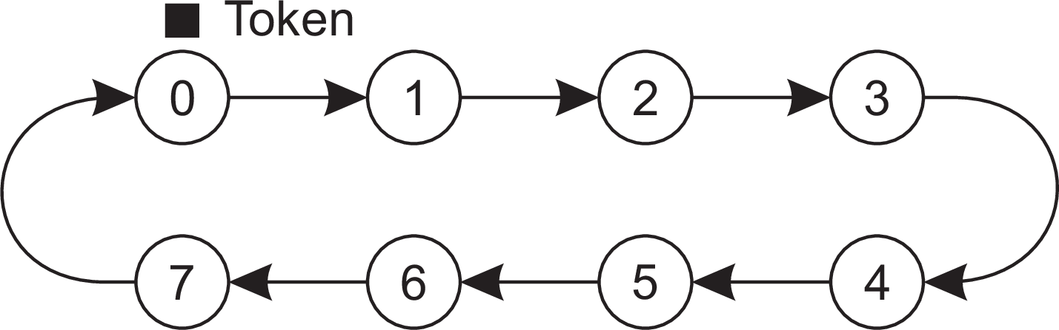
Mutual exclusion: Token ring algorithm
Coordination Mutual exclusion
Essence
Organize processes in a logical ring, and let a token be passed between them. The one that holds the token is allowed to enter the critical region (if it wants to).
An overlay network constructed as a logical ring with a circulating token
A token-ring algorithm

Slide 36
Decentralized mutual exclusion
Coordination Mutual exclusion
Principle
Assume every resource is replicated N times, with each replica having its own coordinator ⇒ access requires a majority vote from m > N/2 coordinators. A coordinator always responds immediately to a request.
Assumption
When a coordinator crashes, it will recover quickly, but will have forgotten about permissions it had granted.
A decentralized algorithm

Slide 37
Decentralized mutual exclusion
Coordination Mutual exclusion
How robust is this system?
Let p = ∆t/T be the probability that a coordinator resets during a time interval ∆t , while having a lifetime of T .
A decentralized algorithm

Slide 38
Decentralized mutual exclusion
Coordination Mutual exclusion
How robust is this system?
Let p = ∆t/T be the probability that a coordinator resets during a time interval ∆t , while having a lifetime of T .
The probability P[k ] that k out of m coordinators reset during the same interval is
t )
m
k m−k
P[k ] = p (1 −p)
k
A decentralized algorithm

Slide 39
Decentralized mutual exclusion
Coordination Mutual exclusion
How robust is this system?
Let p = ∆t/T be the probability that a coordinator resets during a time interval ∆t , while having a lifetime of T .
The probability P[k ] that k out of m coordinators reset during the same interval is
t )
m
k m−k
P[k ] = p (1 −p)
k
f coordinators reset ⇒ correctness is violated when there is only a minority of nonfaulty coordinators: when N − (m −f ) ≥ m, or, f ≥ 2m −N.
A decentralized algorithm

Slide 40
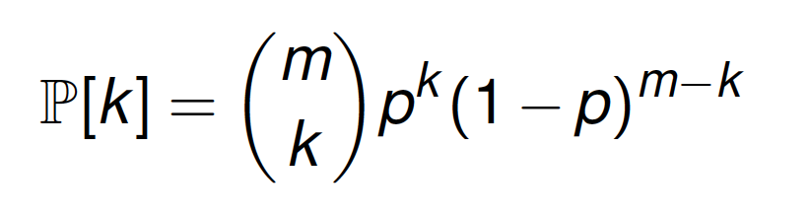
Decentralized mutual exclusion
Coordination Mutual exclusion
How robust is this system?
Let p = ∆t/T be the probability that a coordinator resets during a time interval ∆t , while having a lifetime of T .
The probability P[k ] that k out of m coordinators reset during the same interval is
f coordinators reset ⇒ correctness is violated when there is only a minority of nonfaulty coordinators: when N − (m −f ) ≥ m, or, f ≥ 2m −N.
The probability of a violation is ∑^{m} P[k ].
k =2m−N
A decentralized algorithm

Slide 41
Coordination
Mutual exclusion
Decentralized mutual exclusion
Violation probabilities for various parameter values
N | m | p | Violation |  | N | m | p | Violation
8 | 5 | 3 sec/hour | < 10⁻⁵ |  | 8 | 5 | 30 sec/hour | < 10⁻³
8 | 6 | 3 sec/hour | _{< 10}−11 |  | 8 | 6 | 30 sec/hour | < 10⁻⁷
16 | 9 | 3 sec/hour | < 10⁻⁴ |  | 16 | 9 | 30 sec/hour | < 10⁻²
16 | 12 | 3 sec/hour | _{< 10}−21 |  | 16 | 12 | 30 sec/hour | _{< 10}−13
32 | 17 | 3 sec/hour | < 10⁻⁴ |  | 32 | 17 | 30 sec/hour | < 10⁻²
32 | 24 | 3 sec/hour | _{< 10}−43 |  | 32 | 24 | 30 sec/hour | _{< 10}−27
A decentralized algorithm

Slide 42
Coordination
Mutual exclusion
Decentralized mutual exclusion
Violation probabilities for various parameter values
N | m | p | Violation |  | N | m | p | Violation
8 | 5 | 3 sec/hour | < 10⁻⁵ |  | 8 | 5 | 30 sec/hour | < 10⁻³
8 | 6 | 3 sec/hour | _{< 10}−11 |  | 8 | 6 | 30 sec/hour | < 10⁻⁷
16 | 9 | 3 sec/hour | < 10⁻⁴ |  | 16 | 9 | 30 sec/hour | < 10⁻²
16 | 12 | 3 sec/hour | _{< 10}−21 |  | 16 | 12 | 30 sec/hour | _{< 10}−13
32 | 17 | 3 sec/hour | < 10⁻⁴ |  | 32 | 17 | 30 sec/hour | < 10⁻²
32 | 24 | 3 sec/hour | _{< 10}−43 |  | 32 | 24 | 30 sec/hour | _{< 10}−27
So....
What can we conclude?
A decentralized algorithm

Slide 43
Coordination
Mutual exclusion
Mutual exclusion: comparison
Algorithm | Messages per entry/exit | Delay before entry (in message times)
Centralized | 3 | 2
Distributed | 2(N − 1) | 2(N − 1)
Token ring | 1,..., ∞ | 0,..., N − 1
Decentralized | 2kN +(k − 1)N/2 + N, k = 1, 2,... | 2kN +(k − 1)N/2
A decentralized algorithm

Slide 44
Example: ZooKeeper
Coordination Mutual exclusion
Basics (and keeping it simple)
Centralized server setup
All client-server communication is nonblocking: a client immediately gets a response
ZooKeeper maintains a tree-based namespace, akin to that of a filesystem
Clients can create, delete, or update nodes, as well as check existence.
Example: Simple locking with ZooKeeper

Slide 45
ZooKeeper race condition
Coordination Mutual exclusion
Note
ZooKeeper allows a client to be notified when a node, or a branch in the tree, changes. This may easily lead to race conditions.
Consider a simple locking mechanism
A client C₁ creates a node /lock .
A client C₂ wants to acquire the lock but is notified that the associated node already exists.
Before C₂ subscribes to a notification, C₁ releases the lock, i.e., deletes
/lock .
Client C₂ subscribes to changes to /lock and blocks locally.
Solution
Use version numbers
Example: Simple locking with ZooKeeper

Slide 46
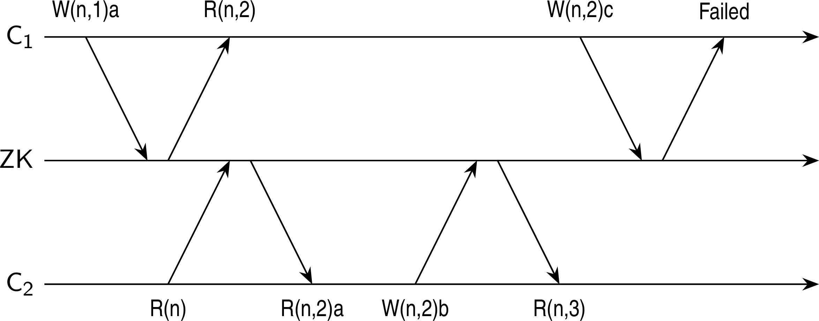
Coordination
Mutual exclusion
ZooKeeper versioning
Notations
W (n, k )a: request to write a to node n, assuming current version is k .
R(n, k ): current version of node n is k .
R(n): client wants to know the current value of node n
R(n, k )a: value a from node n is returned with its current version k .
Example: Simple locking with ZooKeeper

Slide 47
ZooKeeper locking protocol
Coordination Mutual exclusion
It is now very simple
lock: A client C₁ creates a node /lock .
lock: A client C₂ wants to acquire the lock but is notified that the associated node already exists ⇒ C₂ subscribes to notification on changes of /lock .
unlock: Client C₁ deletes node /lock ⇒ all subscribers to changes are notified.
Example: Simple locking with ZooKeeper

Slide 48
Election algorithms
Coordination Election algorithms
Principle
An algorithm requires that some process acts as a coordinator. The question is how to select this special process dynamically.
Note
In many systems, the coordinator is chosen manually (e.g., file servers). This leads to centralized solutions ⇒ single point of failure.

Slide 49
Election algorithms
Coordination Election algorithms
Principle
An algorithm requires that some process acts as a coordinator. The question is how to select this special process dynamically.
Note
In many systems, the coordinator is chosen manually (e.g., file servers). This leads to centralized solutions ⇒ single point of failure.
Teasers
If a coordinator is chosen dynamically, to what extent can we speak about a centralized or distributed solution?
Is a fully distributed solution, i.e. one without a coordinator, always more robust than any centralized/coordinated solution?

Slide 50
Coordination
Election algorithms
Basic assumptions
All processes have unique id’s
All processes know id’s of all processes in the system (but not if they are up or down)
Election means identifying the process with the highest id that is up

Slide 51
Election by bullying
Coordination Election algorithms
Principle
Consider N processes {P₀ , . . . , P_{N−1}} and let id (P_{k} ) = k . When a process P_{k} notices that the coordinator is no longer responding to requests, it initiates an election:
P_{k} sends an ELECTION message to all processes with higher identifiers:
P_{k +1}, P_{k +2} , . . . , P_{N−1}.
If no one responds, P_{k} wins the election and becomes coordinator.
If one of the higher-ups answers, it takes over and P_{k} ’s job is done.
The bully algorithm

Slide 52
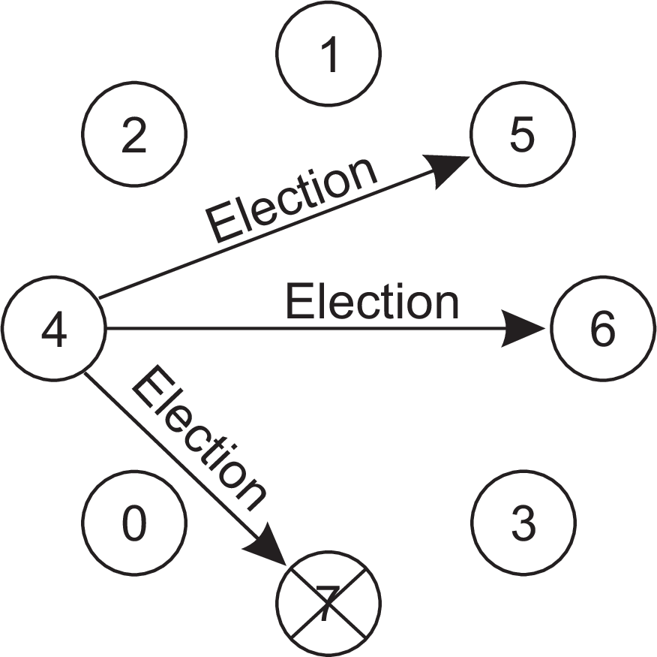
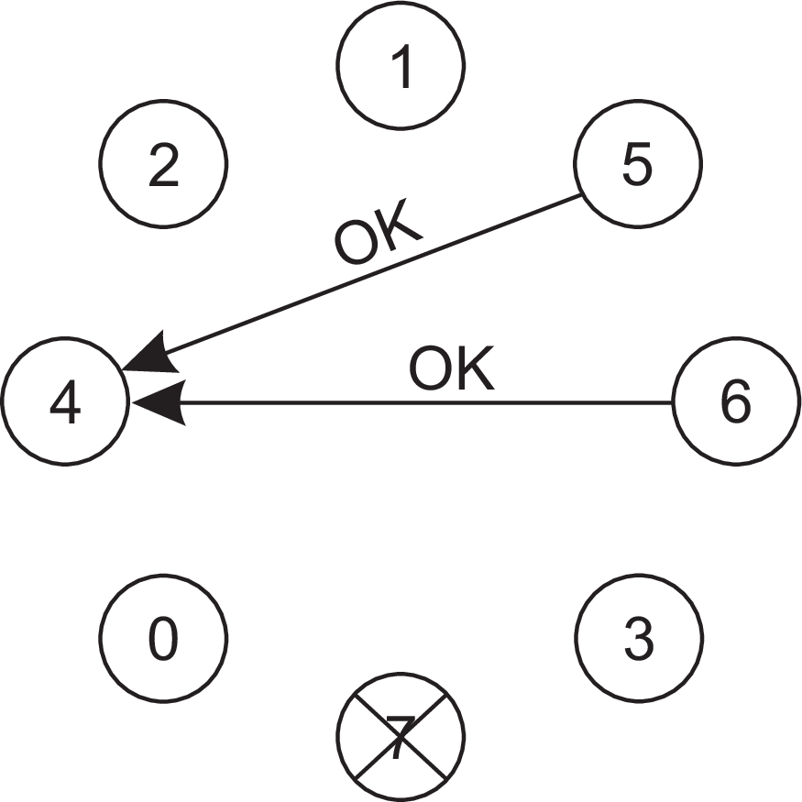
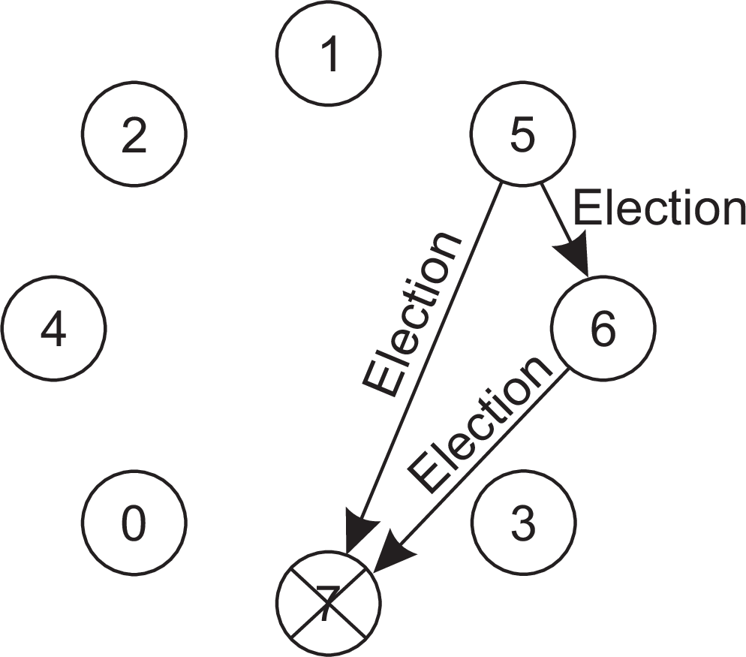
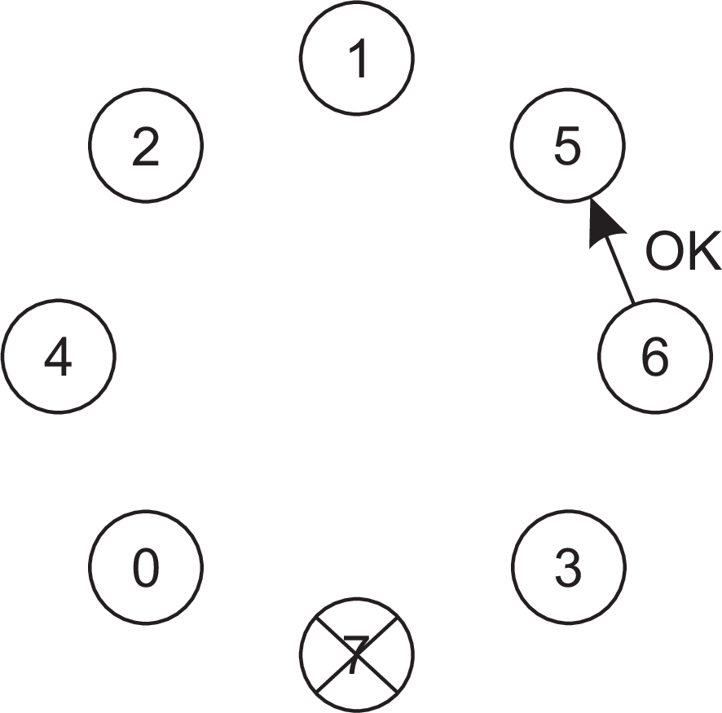
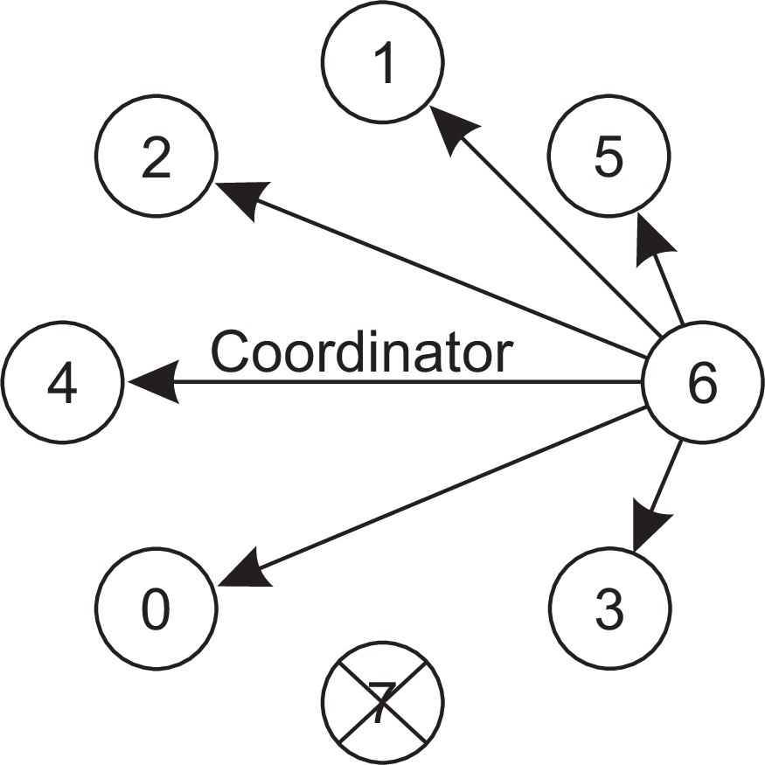
Coordination
Election algorithms
Election by bullying
The bully election algorithm
The bully algorithm

Slide 53
Election in a ring
Coordination Election algorithms
Principle
Process priority is obtained by organizing processes into a (logical) ring. The process with the highest priority should be elected as coordinator.
Any process can start an election by sending an election message to its successor. If a successor is down, the message is passed on to the next successor.
If a message is passed on, the sender adds itself to the list. When it gets back to the initiator, everyone had a chance to make its presence known.
The initiator sends a coordinator message around the ring containing a list of all living processes. The one with the highest priority is elected as coordinator.
A ring algorithm

Slide 54
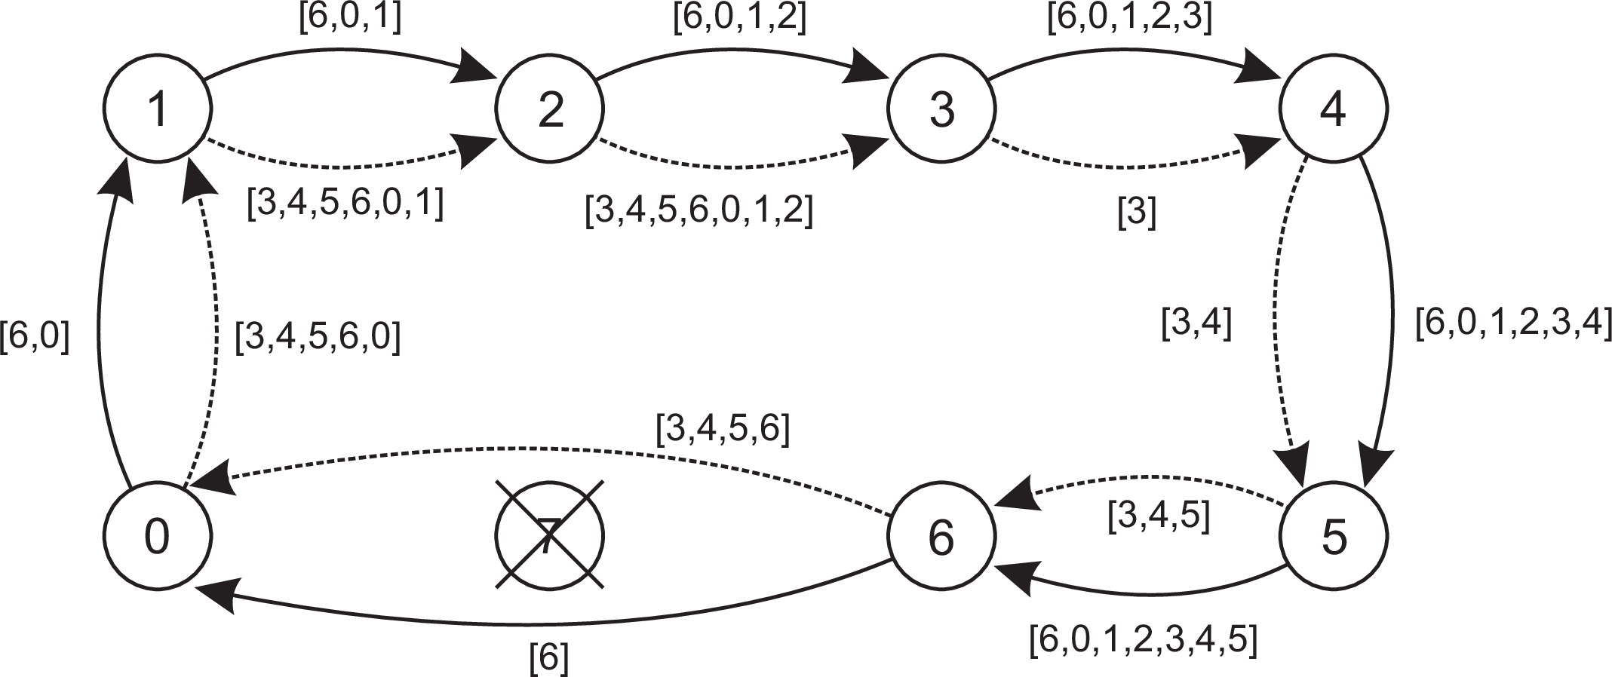
Coordination
Election algorithms
Election in a ring
Election algorithm using a ring
The solid line shows the election messages initiated by P₆
The dashed one, the messages by P₃
A ring algorithm

Slide 55
Example: Leader election in ZooKeeper server group
Coordination Election algorithms
Basics
Each server s in the server group has an identifier id(s)
Each server has a monotonically increasing counter tx(s) of the latest transaction it handled (i.e., series of operations on the namespace).
When follower s suspects leader crashed, it broadcasts an ELECTION
message, along with the pair (voteID,voteTX ). Initially,
voteID ← id(s)
voteTX ← tx(s)
Each server s maintains two variables:
leader(s): records the server that s believes may be final leader. Initially, leader(s) ← id(s).
lastTX(s): what s knows to be the most recent transaction. Initially, lastTX(s) ← tx(s).
Example: Leader election in ZooKeeper

Slide 56
Example: Leader election in ZooKeeper server group
Coordination Election algorithms
When s∗ receives (voteID,voteTX )
If lastTX(s∗) < voteTX , then s∗ just received more up-to-date information on the most recent transaction, and sets
leader(s∗) ← voteID
lastTX(s∗) ← voteTX
If lastTX(s∗) = voteTX and leader(s∗) < voteID, then s∗ knows as much about the most recent transaction as what it was just sent, but its perspective on which server will be the next leader needs to be updated:
leader(s∗) ← voteID
Note
When s∗ believes it should be the leader, it broadcasts ⟨id(s∗), tx(s∗)⟩. Essentially, we’re bullying.
Example: Leader election in ZooKeeper

Slide 57
Coordination
Election algorithms
Example: Leader election in Raft
Basics
We have a (relatively small) group of servers
A server is in one of three states: follower , candidate, or leader
The protocol works in terms, starting with term 0
Each server starts in the follower state.
A leader is to regularly broadcast messages (perhaps just a simple heartbeat)
Example: Leader election in Raft

Slide 58
Example: Leader election in Raft
Coordination Election algorithms
Selecting a new leader
When follower s∗ hasn’t received anything from the alleged leader s for some time, s∗ broadcasts that it volunteers to be the next leader, increasing the term by 1. s∗ enters the candidate state. Then:
If leader s receives the message, it responds by acknowledging that it is still the leader. s∗ returns to the follower state.
If another follower s∗∗ gets the election message from s∗, and it is the first election message during the current term, s∗∗ votes for s∗. Otherwise, it simply ignores the election message from s∗. When s∗ has collected a majority of votes, a new term starts with a new leader.
Example: Leader election in Raft

Slide 59
Example: Leader election in Raft
Coordination Election algorithms
Selecting a new leader
When follower s∗ hasn’t received anything from the alleged leader s for some time, s∗ broadcasts that it volunteers to be the next leader, increasing the term by 1. s∗ enters the candidate state. Then:
If leader s receives the message, it responds by acknowledging that it is still the leader. s∗ returns to the follower state.
If another follower s∗∗ gets the election message from s∗, and it is the first election message during the current term, s∗∗ votes for s∗. Otherwise, it simply ignores the election message from s∗. When s∗ has collected a majority of votes, a new term starts with a new leader.
Observation
By slightly differing the timeout values per follower for deciding when to start an election, we can avoid concurrent elections, and the election will rapidly converge.
Example: Leader election in Raft

Slide 60
Elections by proof of work
Coordination Election algorithms
Basics
Consider a potentially large group of processes
Each process is required to solve a computational puzzle
When a process solves the puzzle, it broadcasts its victory to the group
We assume there is a conflict resolution procedure when more than one process claims victory
Solving a computational puzzle
Make use of a secure hashing function H(m):
m is some data; H(m) returns a fixed-length bit string
computing h = H(m) is computationally efficient
finding a function H⁻¹ such that m = H⁻¹(H(m)) is computationally extremely difficult
Practice: finding H⁻¹ boils down to an extensive trial-and-error procedure
Elections in large-scale systems

Slide 61
Elections by proof of work
Coordination Election algorithms
Controlled race
Assume a globally known secure hash function H∗. Let H_{i} be the hash function used by process P_{i} .
Task: given a bit string h = H_{i} (m), find a bit string h˜ such that
h∗ = H∗(H_{i} (h˜ ⊙h)) where:
h∗ is a bit string with K leading zeroes
h˜ ⊙h denotes some predetermined bitwise operation on h˜ and h
Elections in large-scale systems

Slide 62
Elections by proof of work
Coordination Election algorithms
Controlled race
Assume a globally known secure hash function H∗. Let H_{i} be the hash function used by process P_{i} .
Task: given a bit string h = H_{i} (m), find a bit string h˜ such that
h∗ = H∗(H_{i} (h˜ ⊙h)) where:
h∗ is a bit string with K leading zeroes
h˜ ⊙h denotes some predetermined bitwise operation on h˜ and h
Observation
By controlling K , we control the difficulty of finding h˜. If p is the probability that a random guess for h˜ will suffice: p = (1/2)^{K} .
Elections in large-scale systems

Slide 63
Elections by proof of work
Coordination Election algorithms
Controlled race
Assume a globally known secure hash function H∗. Let H_{i} be the hash function used by process P_{i} .
Task: given a bit string h = H_{i} (m), find a bit string h˜ such that
h∗ = H∗(H_{i} (h˜ ⊙h)) where:
h∗ is a bit string with K leading zeroes
h˜ ⊙h denotes some predetermined bitwise operation on h˜ and h
Observation
By controlling K , we control the difficulty of finding h˜. If p is the probability that a random guess for h˜ will suffice: p = (1/2)^{K} .
Current practice
In many PoW-based blockchain systems, K = 64
With K = 64, it takes about 10 minutes on a supercomputer to find h˜
With K = 64, it takes about 100 years on a laptop to find h˜
Elections in large-scale systems

Slide 64
Coordination
Election algorithms
Elections by proof of stake
Basics
We assume a blockchain system in which N secure tokens are used:
Each token has a unique owner
Each token has a uniquely associated index 1 ≤ k ≤ N
A token cannot be modified or copied without this going unnoticed
Principle
Draw a random number k ∈ {1,..., N}
Look up the process P that owns the token with index k . P is the next leader.
Observation
The more tokens a process owns, the higher the probability it will be selected as leader.
Elections in large-scale systems

Slide 65
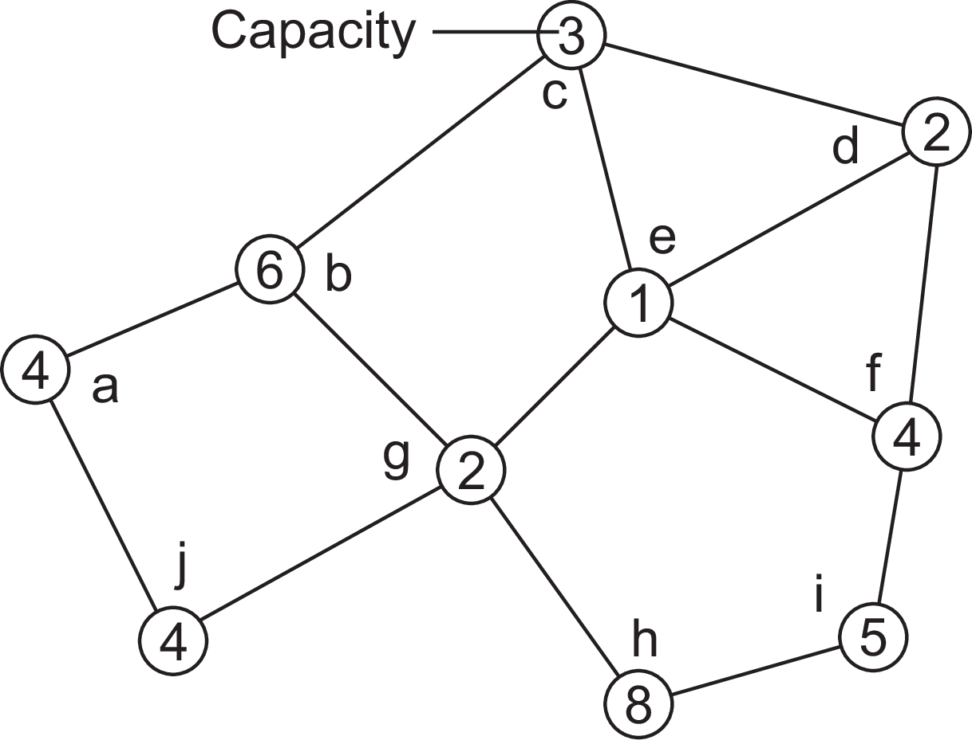
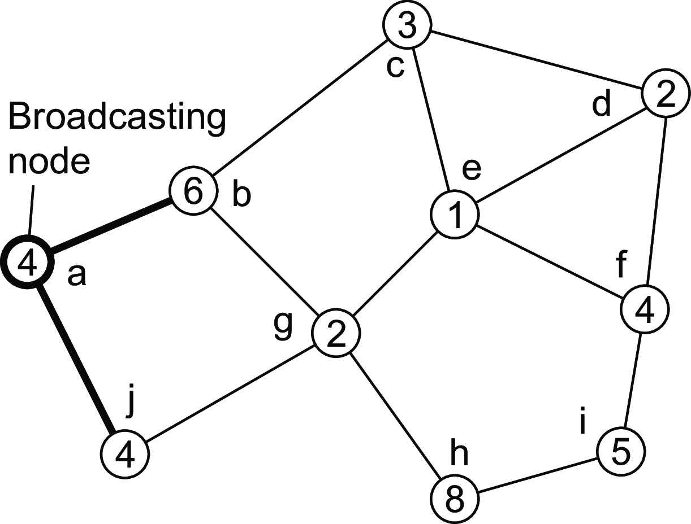
Coordination
Election algorithms
A solution for wireless networks
A sample network
Essence
Find the node with the highest capacity to select as the next leader.
Elections in wireless environments

Slide 66
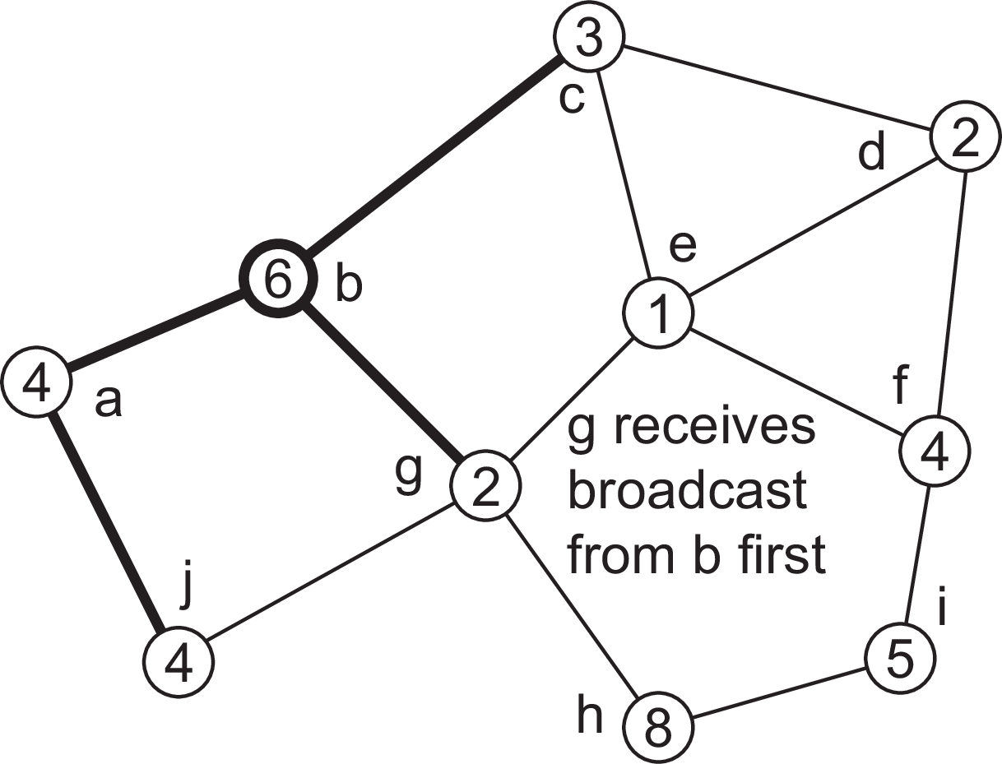
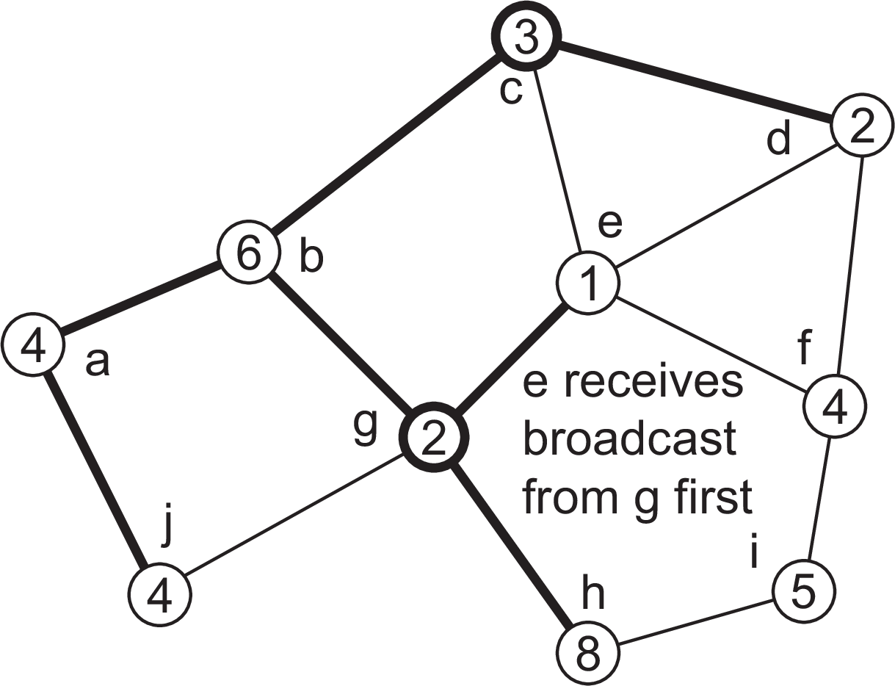
Coordination
Election algorithms
A solution for wireless networks
A sample network
Elections in wireless environments

Slide 67
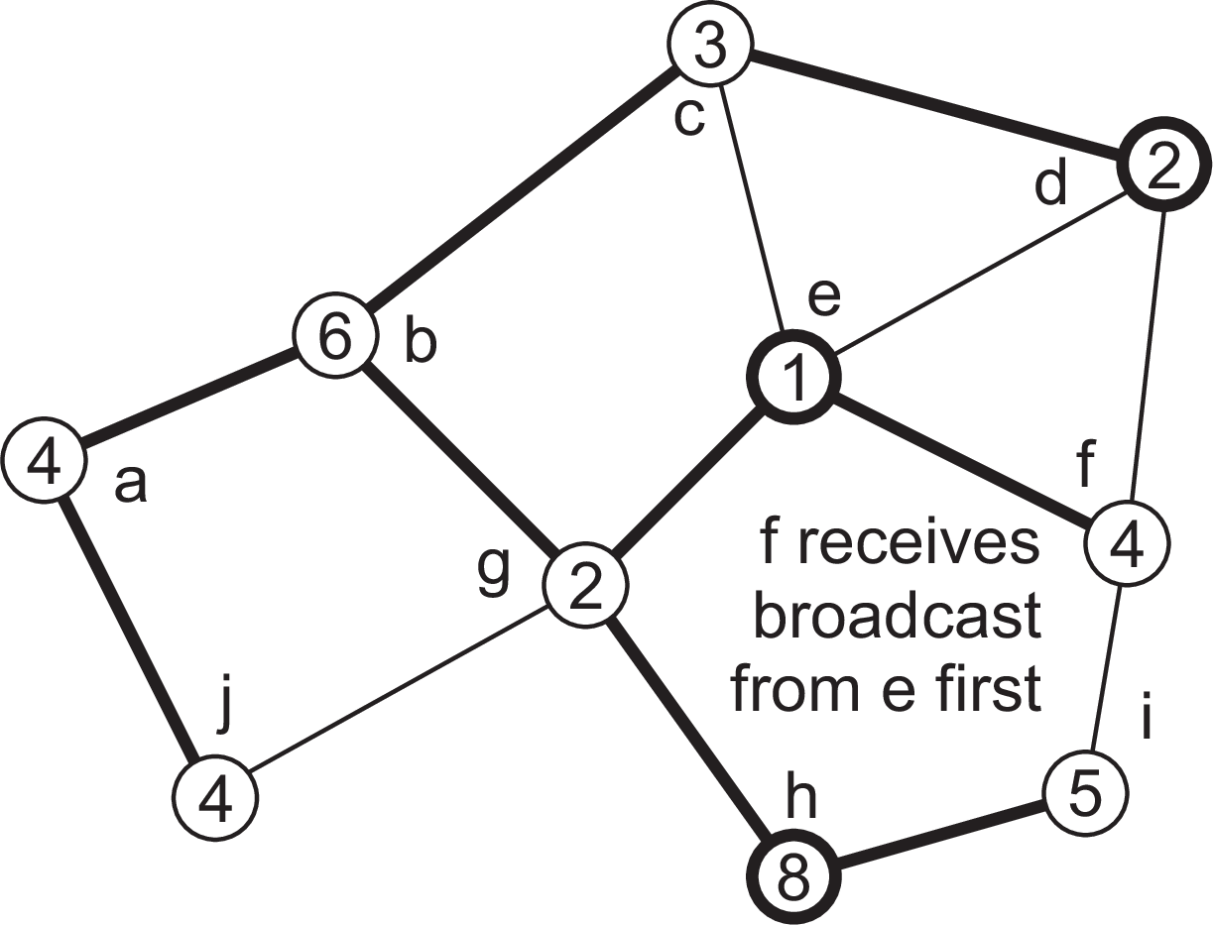
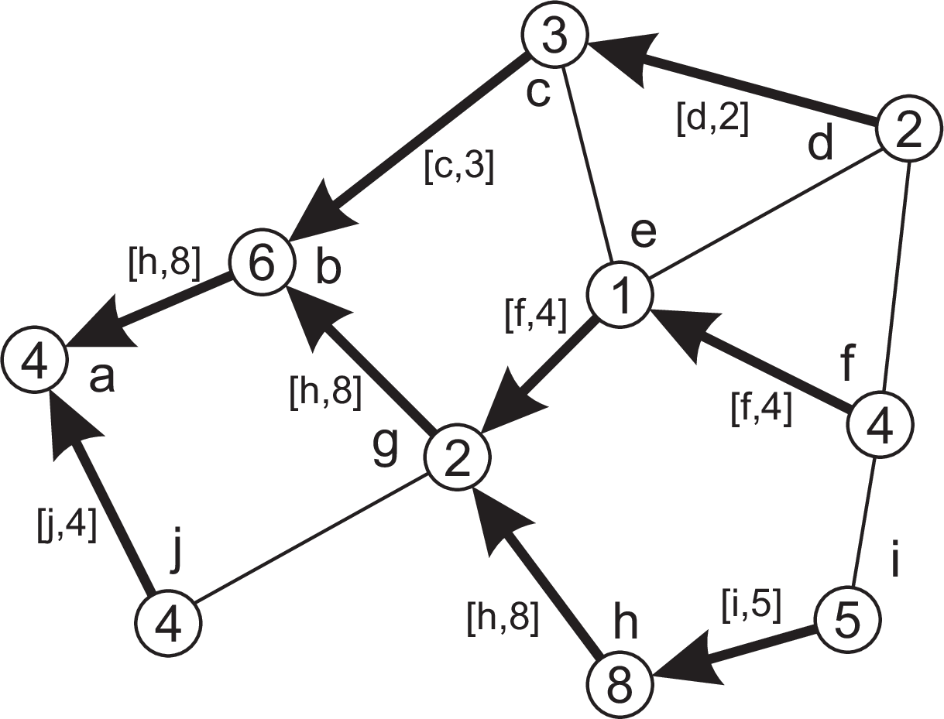
Coordination
Election algorithms
A solution for wireless networks
A sample network
Essence
A node reports back only the node that it found to have the highest capacity.
Elections in wireless environments

Slide 68
Gossip-based coordination: aggregation
Coordination Gossip-based coordination
Typical apps
Data dissemination: Perhaps the most important one. Note that there are many variants of dissemination.
Aggregation: Let every node P_{i} maintain a variable v_{i} . When two nodes gossip, they each reset their variable to
v_{i} , v_{j} ← (v_{i} + v_{j} )/2
Result: in the end each node will have computed the average v¯ = ∑_{i} v_{i} /N.
Aggregation

Slide 69
Gossip-based coordination: aggregation
Coordination Gossip-based coordination
Typical apps
Data dissemination: Perhaps the most important one. Note that there are many variants of dissemination.
Aggregation: Let every node P_{i} maintain a variable v_{i} . When two nodes gossip, they each reset their variable to
v_{i} , v_{j} ← (v_{i} + v_{j} )/2
Result: in the end each node will have computed the average v¯ = ∑_{i} v_{i} /N.
What happens in the case that initially v_{i} = 1 and v_{j} = 0, j ̸= i ?
Aggregation

Slide 70
Gossip-based coordination: peer sampling
Coordination Gossip-based coordination
Problem
For many gossip-based applications, you need to select a peer uniformly at random from the entire network. In principle, this means you need to know all other peers. Impossible?
Basics
Each node maintains a list of c references to other nodes
Regularly, pick another node at random (from the list), and exchange roughly c/2 references
When the application needs to select a node at random, it also picks a random one from from its local list.
Observation
Statistically, it turns out that the selection of a peer from the local list is indistinguishable from selecting uniformly at random peer from the entire network
A peer-sampling service

Slide 71
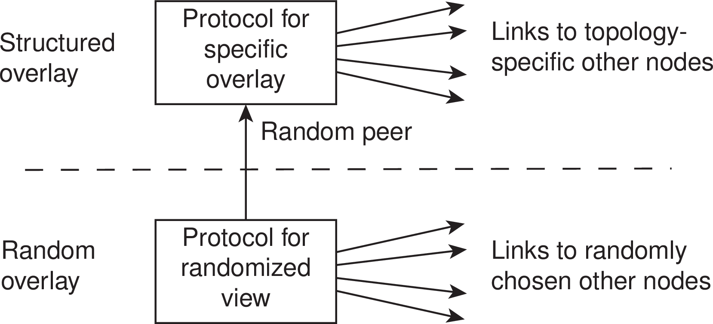
Gossip-based overlay construction
Coordination Gossip-based coordination
Essence
Maintain two local lists of neighbors. The lowest is used for providing a peer-sampling service; the highest list is used to carefully select application-dependent neighbors.
Gossip-based overlay construction

Slide 72



Gossip-based overlay construction: a 2D torus
Coordination Gossip-based coordination
Consider a logical N ×N grid, with a node on each point of the grid.
Every node must maintain a list of c nearest neighbors
Distance between node at (a₁, a₂) and (b₁, b₂) is d₁ + d₂, with
d_{i} = min(N −|a_{i} −b_{i} |, |a_{i} −b_{i} |)
Every node picks a random other node from its lowest-level list, and keeps only the closest one in its top-level list.
Once every node has picked and selected a random node, we move to the next round
start (N = 50)
after 5 rounds
after 20 rounds
Gossip-based overlay construction

Slide 73
Coordination
Gossip-based coordination
A gossip-based 2D torus in Python (outline)
1 def maintainViews():
2
3
4
5
6
7
8
9
10
11
12
13
14
15
16
17
18
19
20
21
22
23
24
25
26
27
28
29
for viewType in [viewOverlay, viewPSS]: # For each view, do the same
peer[viewType] = None
if time to maintain viewType: # This viewType needs to be updated
peer[viewType] = selectPeer(viewType) # Select a peer
links = selectLinks(viewType, peer[viewType]) # Select links
sendTo(peer[viewType], Request[viewType], links) # Send links asynchronously
while True:
block = (peer[viewOverlay] != None) or (peer[viewPSS] != None)
sender, msgType, msgData = recvFromAny(block) # Block if expecting something
if msg == None: # All work has been done, simply return from the call
return
for viewType in [viewOverlay, viewPSS]: # For each view, do the same
if msgType == Response[viewType]: # Response to previously sent links
updateOwnView(viewType, msgData) # Just update the own view
elif msgType == Request[viewType]: # Request for exchanging links
if peer[viewType] == None: # No outstanding exchange request links = selectLinks(viewType, sender) # Select links sendTo(sender, Response[viewType], links) # Send them asynchronously
updateOwnView(viewType,msgData) # Update own view
else: # This node already has a pending exchange request, ignore this one
sendTo(sender, IgnoreRequest[viewType])
elif msgType == IgnoreRequest[viewType]: # Request has been denied, give up
peer[viewType] = None
Gossip-based overlay construction

Slide 74
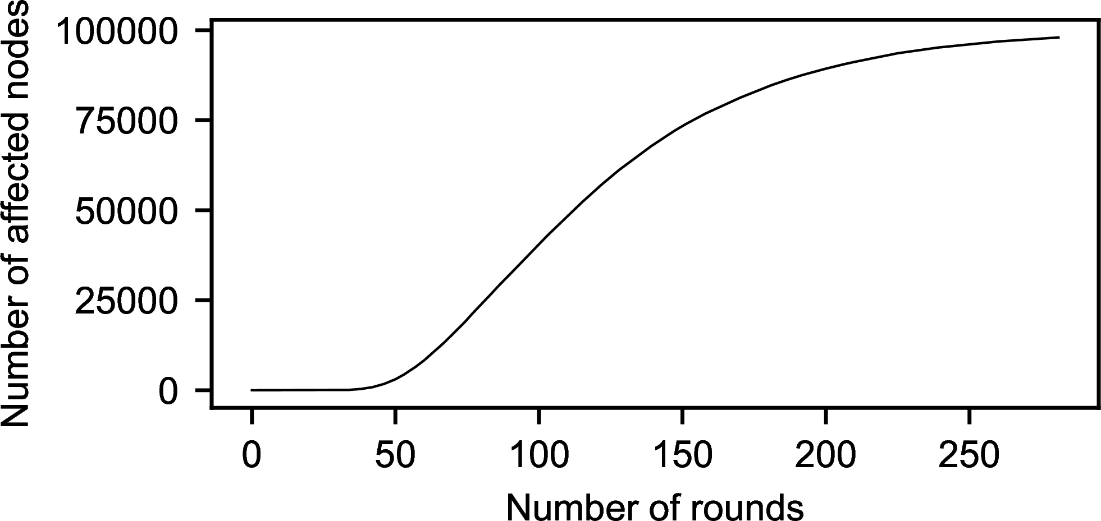
Secure gossiping
Coordination Gossip-based coordination
Dramatic attack
Consider when exchanging references, a set of colluding nodes systematically returns links only to each other ⇒ we are dealing with hub attack.
Situation
A network with 100,000 nodes, a local list size c = 30, and only 30 attackers. The y-axis shows the number of nodes with links only to the attackers. After less than 300 rounds, the attackers have full control.
Secure gossiping

Slide 75
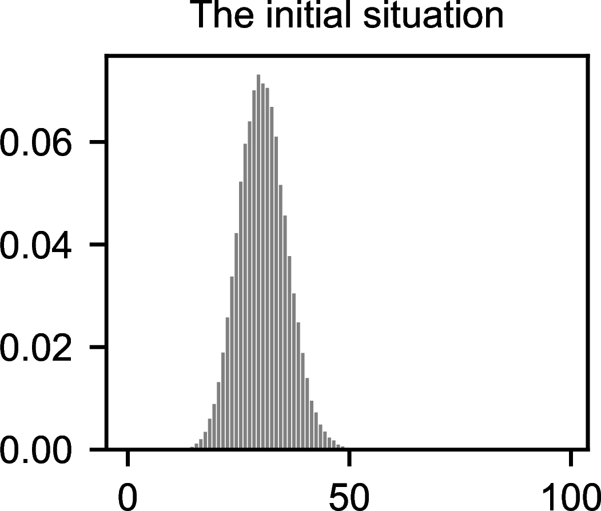
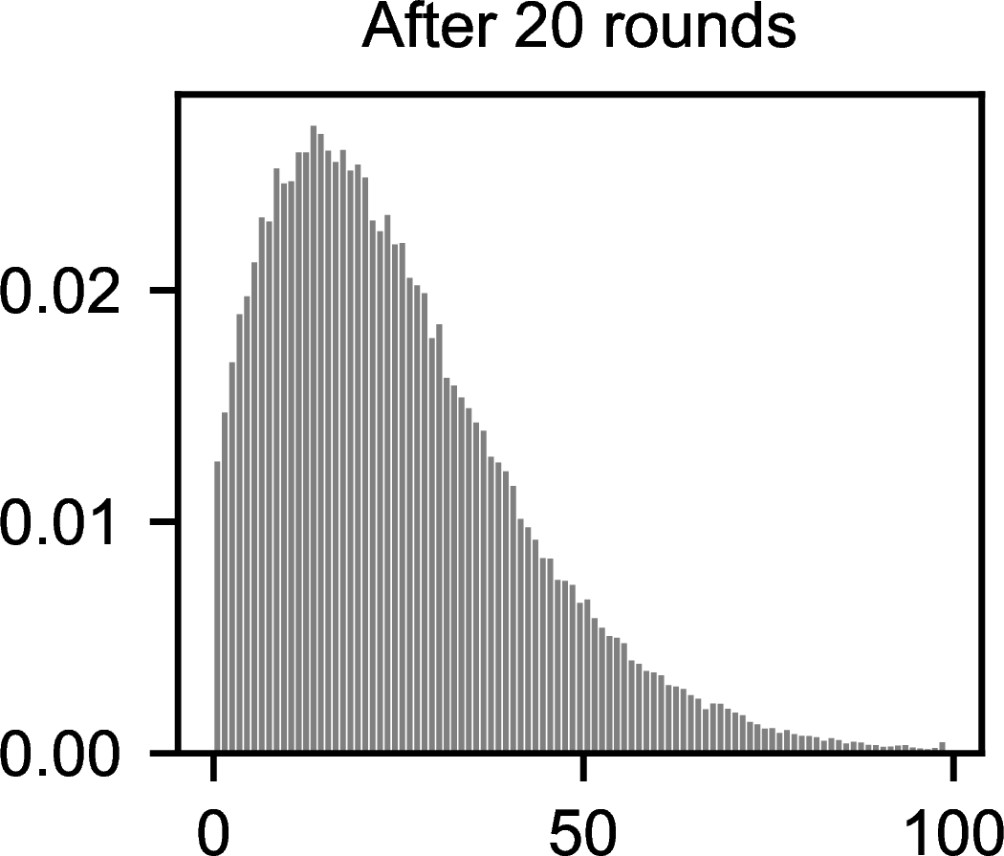
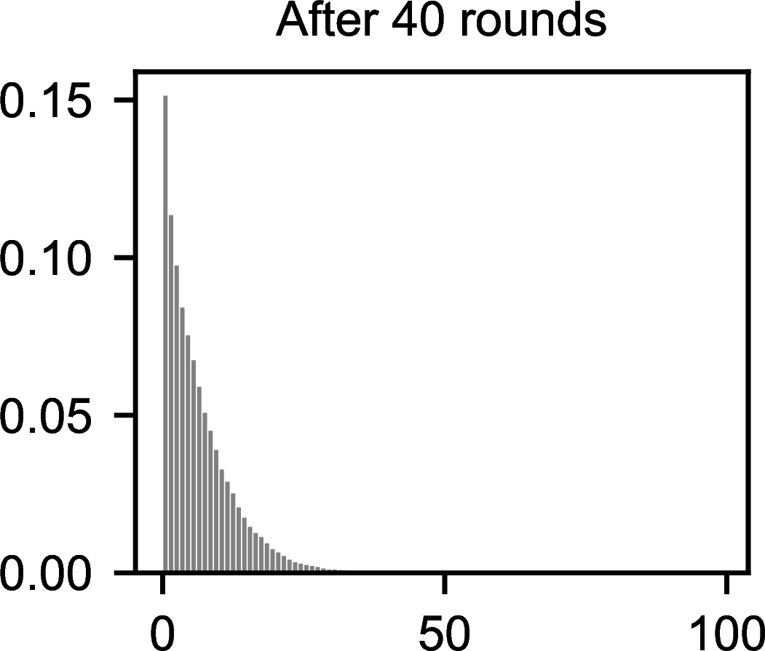
A solution: gathering statistics
Coordination Gossip-based coordination
This is what measuring indegree distributions tells us: which fraction of nodes (y-axis) have how many other nodes pointing to them (x-axis)?
Basic approach
When a benign node initiates an exchange, it may either use the result for gathering statistics, or for updating its local list. An attacker is in limbo: will its response be used for statistical purposes or for functional purposes?
Secure gossiping

Slide 76
A solution: gathering statistics
Coordination Gossip-based coordination
This is what measuring indegree distributions tells us: which fraction of nodes (y-axis) have how many other nodes pointing to them (x-axis)?
Basic approach
When a benign node initiates an exchange, it may either use the result for gathering statistics, or for updating its local list. An attacker is in limbo: will its response be used for statistical purposes or for functional purposes?
Observation
When gathering statistics may reveal colluders, a colluding node will be forced to behave according to the protocol.
Secure gossiping

Slide 77
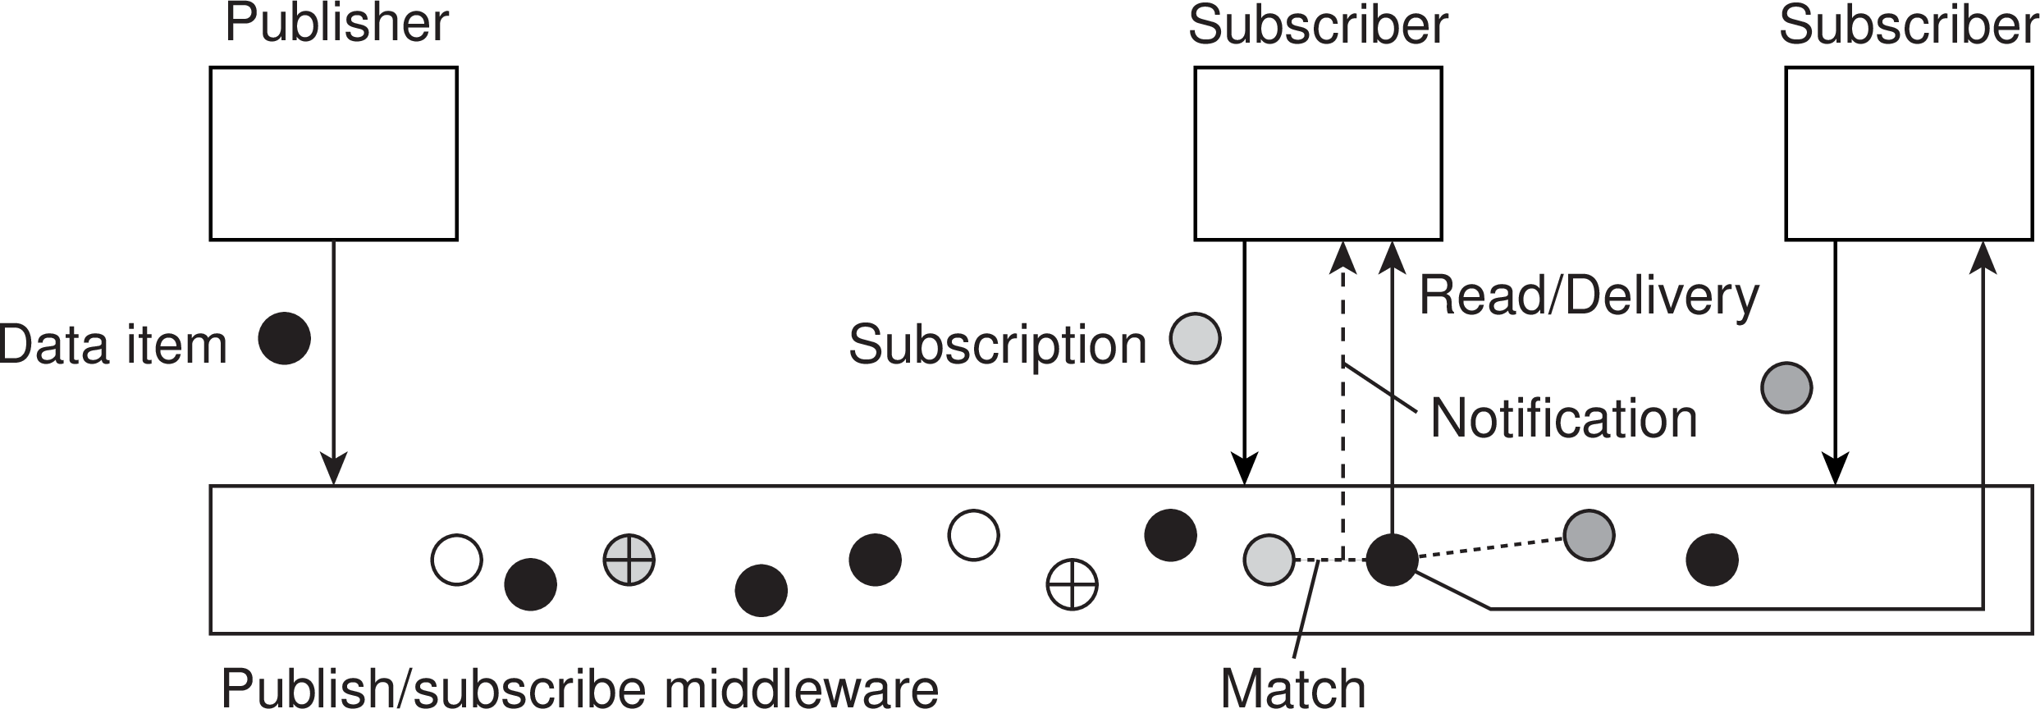
Coordination
Distributed event matching
Distributed event matching
Principle
A process specifies in which events it is interested (subscription S)
When a process publishes a notification N we need to see whether S
matches N.

Slide 78
Coordination
Distributed event matching
Distributed event matching
Principle
A process specifies in which events it is interested (subscription S)
When a process publishes a notification N we need to see whether S
matches N.
Hard part
Implementing the match function in a scalable manner.

Slide 79
General approach
Coordination Distributed event matching
What is needed
sub2node(S): map a subscription S to a nonempty subset S of servers
not2node(N): map a notification N to a nonempty subset N of servers Make sure that S ∩ N ̸= emptyset
Observations
Centralized solution is simple: S = N = {s}, i.e. a single server.
Topic-based publish-subscribe is also simple: each S and N is tagged with a single topic; each topic is handled by a single server (a rendezevous node). Several topics may be handled by same server).
Content-based publish-subscribe is tough: a subscription takes the form (attribute, value) pair, with example values:
range: “1 ≤ x < 10”
containment: “x ∈ {red, blue}”
prefix and suffix expressions: “url.startswith("https")”
Centralized implementations

Slide 80
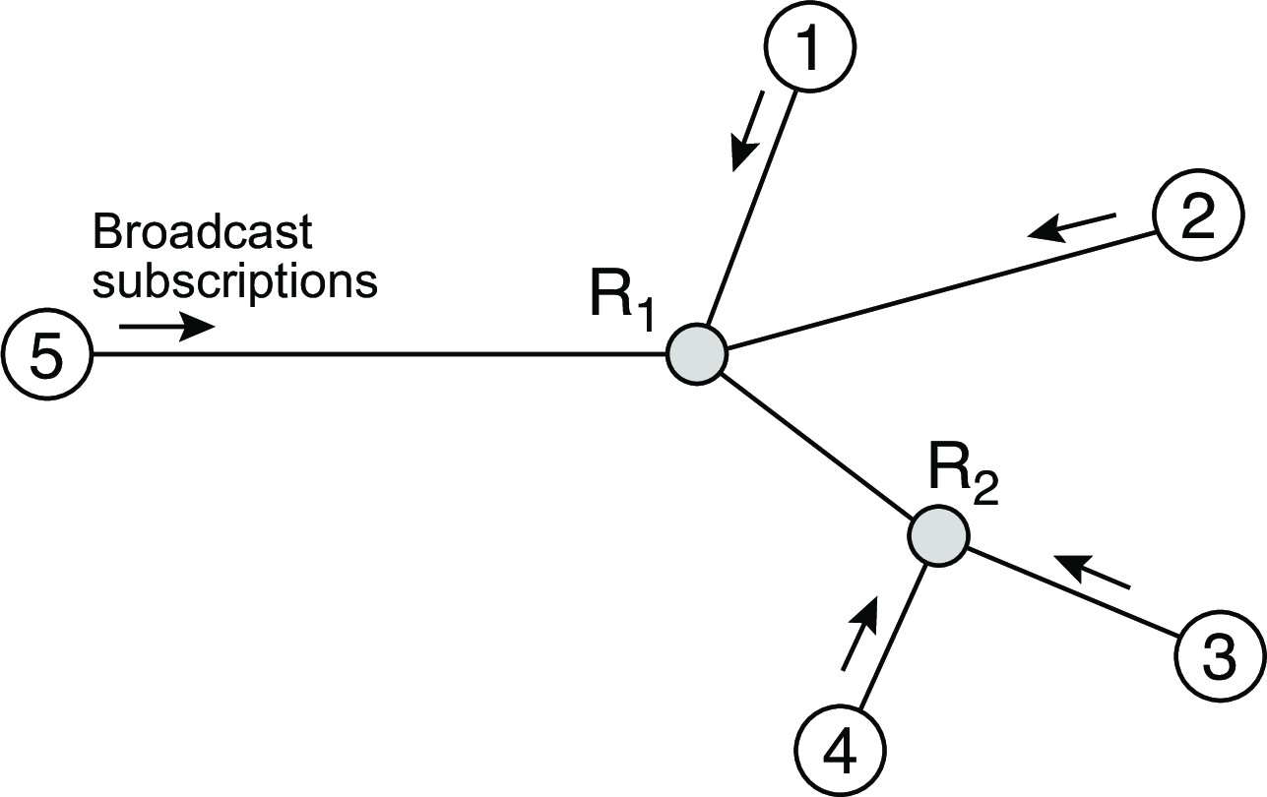
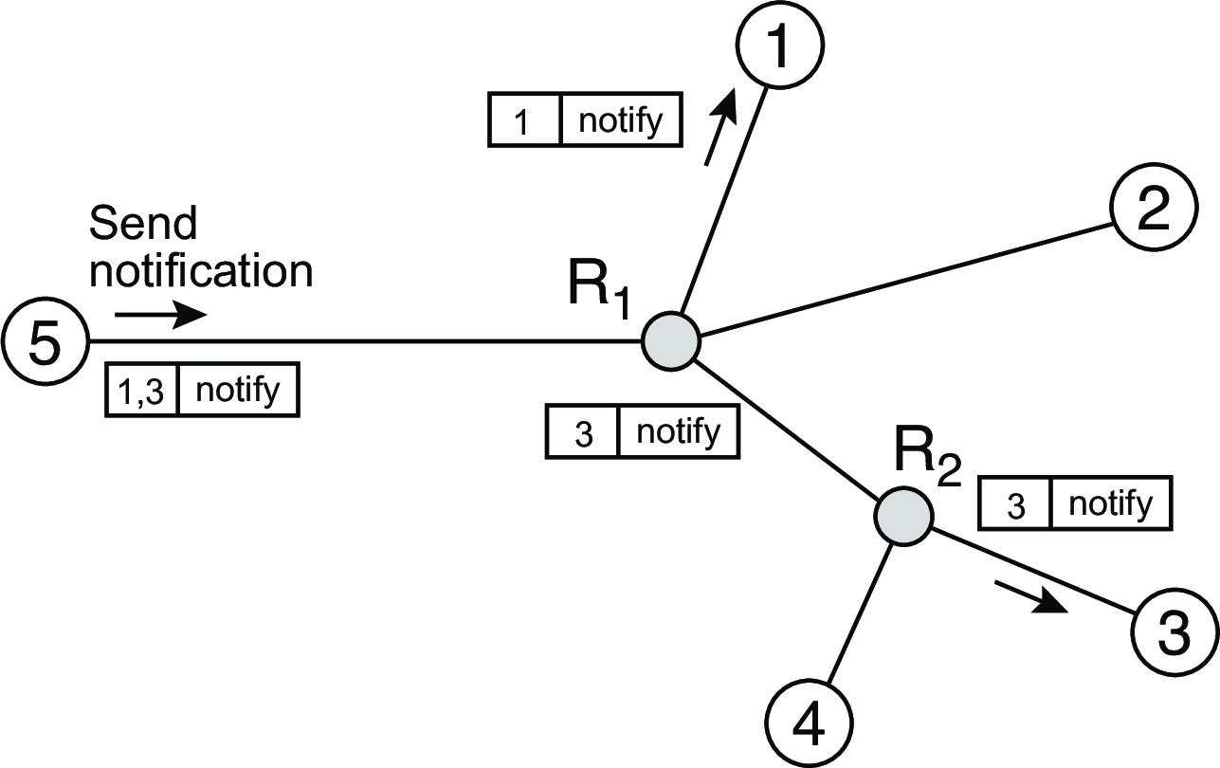
Coordination
Distributed event matching
Selective routing
(a)
(a) first broadcast subscriptions
(b)
(b) forward notifications only to relevant rendezvous nodes
Centralized implementations

Slide 81
Coordination
Distributed event matching
Selective routing
(a)
(a) first broadcast subscriptions
(b)
(b) forward notifications only to relevant rendezvous nodes
Example of a (partially filled) routing table
Interface | Filter
To node 3 | a ∈ [0, 3]
To node 4 | a ∈ [2, 5]
Toward router R₁ | (unspecified)
Centralized implementations

Slide 82
Gossiping: Sub-2-Sub
Coordination Distributed event matching
Basics
Goal: To realize scalability, make sure that subscribers with the same interests form just a single group
Model: There are N attributes a₁,..., a_{N} . An attribute value is always (mappable to) a floating-point number.
Subscription: Takes forms such as S = ⟨a₁ → 3.0, a₄ → [0.0, 0.5)⟩: a₁ should be 3.0; a₄ should lie between 0.0 and 0.5; other attribute values don’t matter.
Observations
A subscription S_{i} specifies a subset S_{i} in a N-dimensional space.
We are interested only in notifications that fall into S = ∪S_{i}.
Centralized implementations

Slide 83
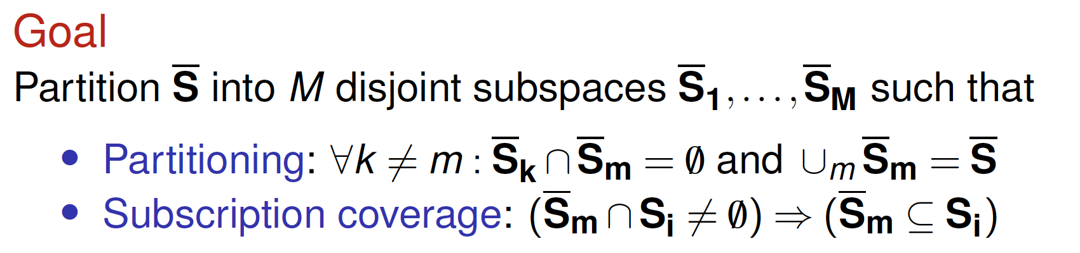
Gossiping: Sub-2-Sub
Coordination Distributed event matching
Basics
Goal: To realize scalability, make sure that subscribers with the same interests form just a single group
Model: There are N attributes a₁,..., a_{N} . An attribute value is always (mappable to) a floating-point number.
Subscription: Takes forms such as S = ⟨a₁ → 3.0, a₄ → [0.0, 0.5)⟩: a₁ should be 3.0; a₄ should lie between 0.0 and 0.5; other attribute values don’t matter.
Observations
A subscription S_{i} specifies a subset S_{i} in a N-dimensional space.
We are interested only in notifications that fall into S = ∪S_{i}.
Centralized implementations

Slide 84
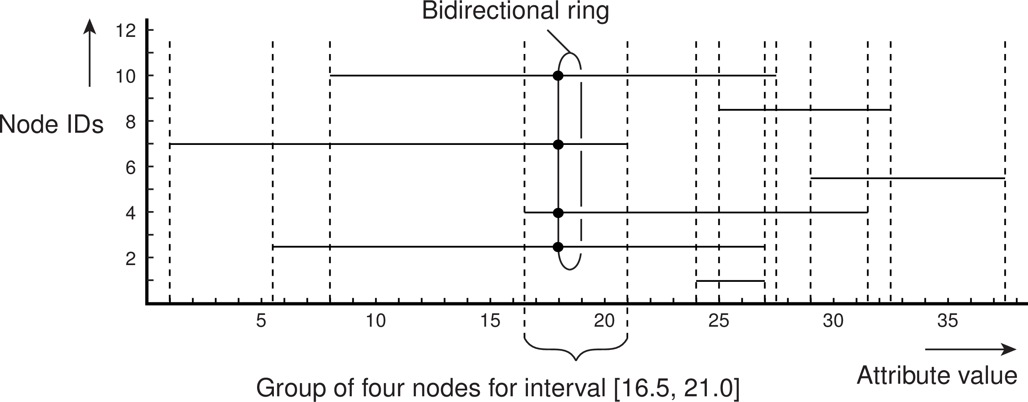
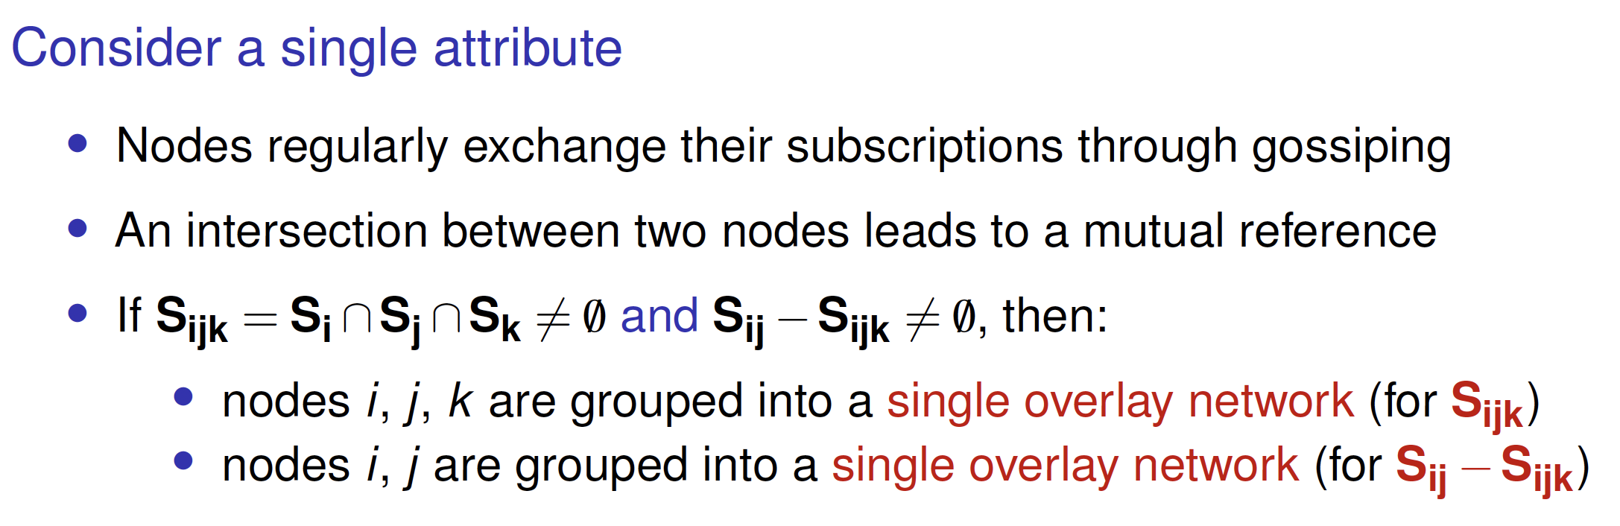
Coordination
Distributed event matching
Gossiping: Sub-2-Sub
Centralized implementations

Slide 85
Secure publish-subscribe
Coordination Distributed event matching
We are facing nasty dilemma’s
Referential decoupling: messages should be able to flow from a publisher to subscribers while guaranteeing mutual anonymity ⇒ we cannot set up a secure channel.
Not knowing where messages come from imposes integrity problems.
Assuming a trusted broker may easily be practically impossible, certainly when dealing with sensitive information ⇒ we now have a routing problem.
Secure publish-subscribe solutions

Slide 86
Secure publish-subscribe
Coordination Distributed event matching
We are facing nasty dilemma’s
Referential decoupling: messages should be able to flow from a publisher to subscribers while guaranteeing mutual anonymity ⇒ we cannot set up a secure channel.
Not knowing where messages come from imposes integrity problems.
Assuming a trusted broker may easily be practically impossible, certainly when dealing with sensitive information ⇒ we now have a routing problem.
Solution
Allow for searching (and matching) on encrypted data, without the need for decryption.
PEKS: accompany encryptyed messages with a collection of (again encrypted) keywords and search for matches on keywords.
Secure publish-subscribe solutions

Slide 87
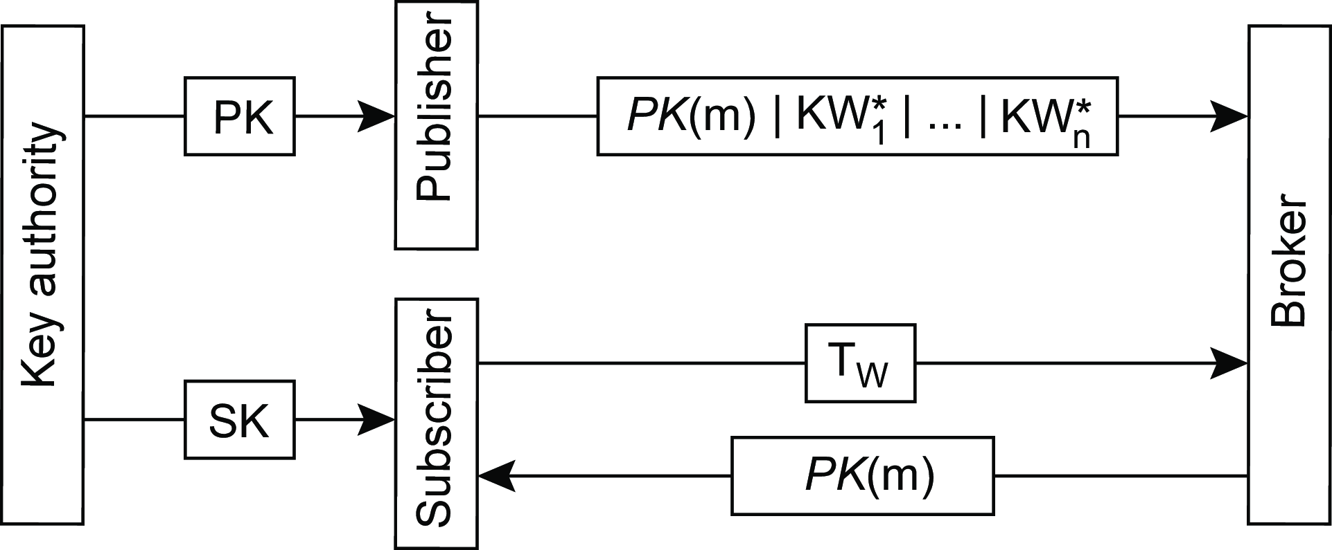
Public-Key Encryption with Keyword Search (PEKS)
Coordination Distributed event matching
Basics
Use a public key PK , message m and its n keywords KW₁,..., KW_{n} are stored at a server as the message m∗:
m∗ =[PK (m)|PEKS(PK, KW₁)|PEKS(PK, KW₂ )|···|PEKS(PK, KW_{n} )]
A subscriber gets the accompanying secret key.
For each keyword KW_{i} , a trapdoor T_{KWi} is generated: T_{W} (m∗) will return
true iff W ∈ {KW₁,..., KW_{n}}.
KW∗ = PEKS(PK, KW_{i} )
i
Secure publish-subscribe solutions

Slide 88
Positioning nodes
Coordination Location systems
Issue
In large-scale distributed systems in which nodes are dispersed across a wide-area network, we often need to take some notion of proximity or distance into account ⇒ it starts with determining a (relative) location of a node.

Slide 89
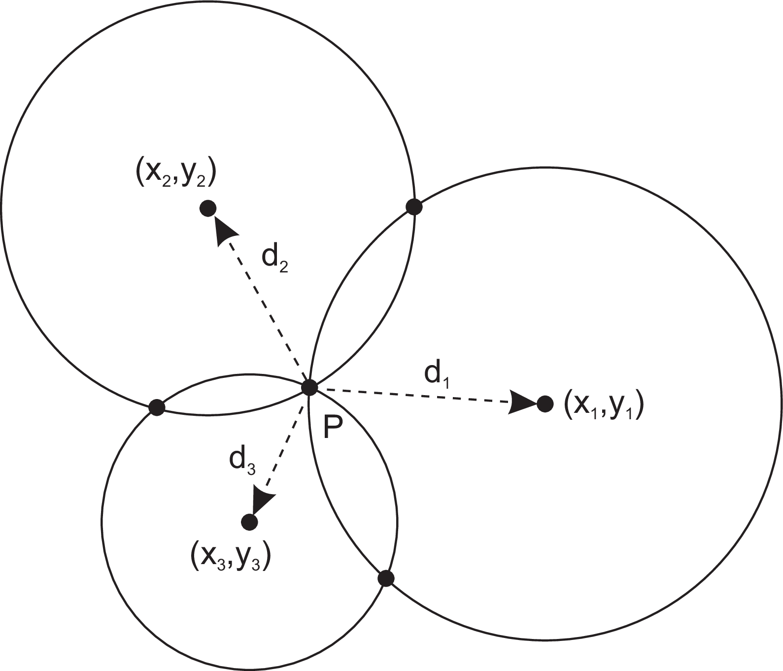
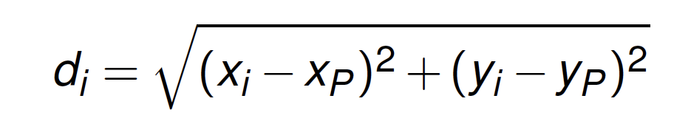
Coordination
Location systems
Computing position
Observation
A node P needs d + 1 landmarks to compute its own position in a
d -dimensional space. Consider two-dimensional case.
Computing a position in 2D
Solution
P needs to solve three equations in two unknowns (x_{P} ,y_{P} ):
GPS: Global Positioning System

Slide 90
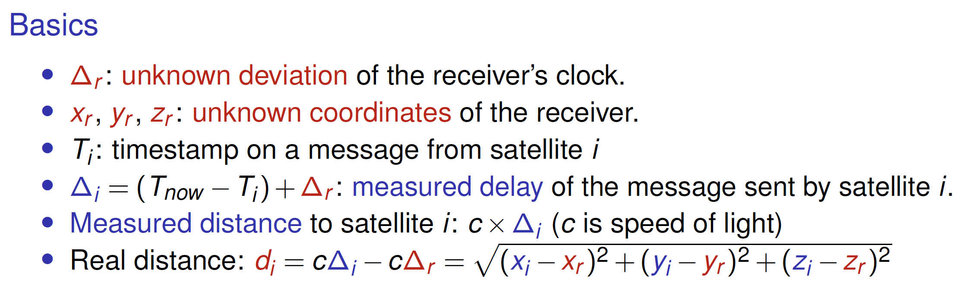
Coordination
Location systems
Global Positioning System
Assuming that the clocks of the satellites are accurate and synchronized
It takes a while before a signal reaches the receiver
The receiver’s clock is definitely out of sync with the satellite
Observation
4 satellites ⇒ 4 equations in 4 unknowns (with ∆_{r} as one of them)
GPS: Global Positioning System

Slide 91
Coordination
Location systems
WiFi-based location services
Basic idea
Assume we have a database of known access points (APs) with coordinates
Assume we can estimate distance to an AP
Then: with 3 detected access points, we can compute a position.
War driving: locating access points
Use a WiFi-enabled device along with a GPS receiver, and move through an area while recording observed access points.
Compute the centroid: assume an access point AP has been detected at
N different locations {x⃗₁, x⃗₂, . . . , x⃗_{N} }, with known GPS location.
∑^{N} ⃗x_{i}
Compute location of AP as ⃗x_{AP} = .
i =1
N
Problems
Limited accuracy of each GPS detection point ⃗x_{i}
An access point has a nonuniform transmission range
Number of sampled detection points N may be too low.
When GPS is not an option

Slide 92
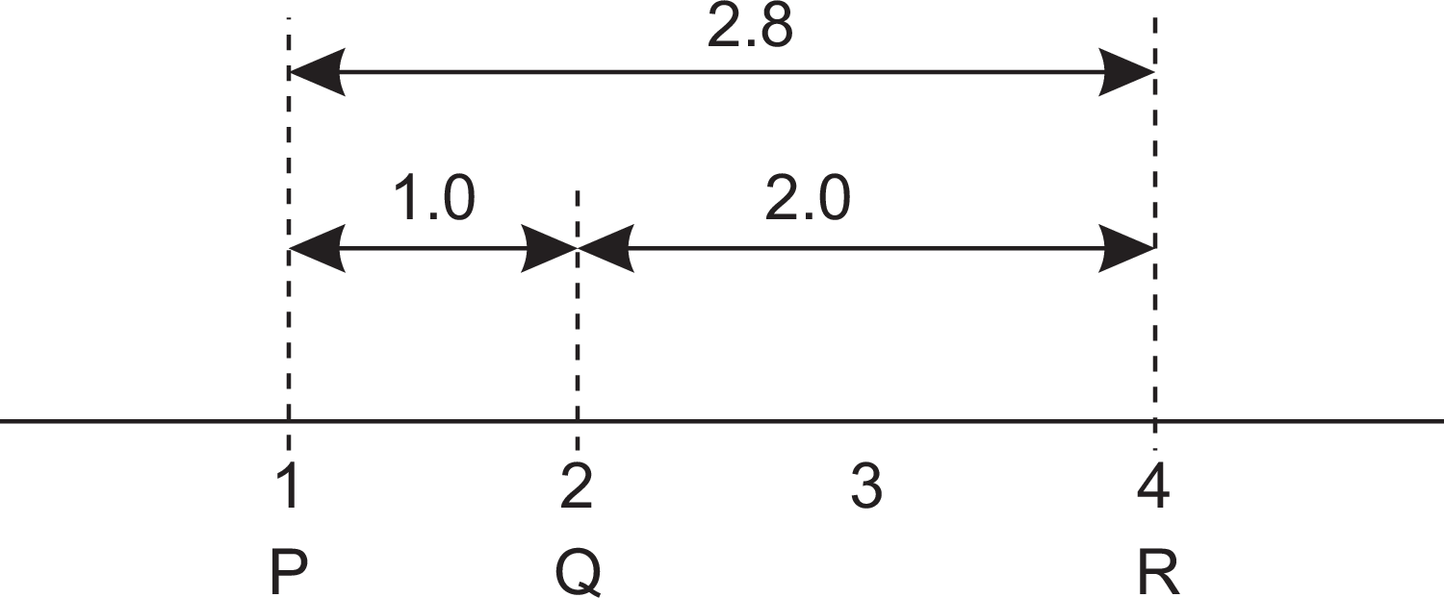

Coordination
Location systems
Computing position
Problems
Measured latencies to landmarks fluctuate
Computed distances will not even be consistent
Inconsistent distances in 1D space
Solution: minimize errors
Use N special landmark nodes L₁,..., L_{N} .
Landmarks measure their pairwise latencies d˜(L_{i} , L_{j} )
A central node computes the coordinates for each landmark, minimizing:
where d^{ˆ}(L_{i} , L_{j} ) is distance after nodes L_{i} and L_{j} have been positioned.
Logical positioning of nodes

Slide 93

Computing position
Coordination Location systems
Choosing the dimension m
The hidden parameter is the dimension m with N > m. A node P measures its distance to each of the N landmarks and computes its coordinates by
minimizing
Observation
Practice shows that m can be as small as 6 or 7 to achieve latency estimations within a factor 2 of the actual value.
Logical positioning of nodes

Slide 94

Vivaldi
Coordination Location systems
Logical positioning of nodes

