Slide 1
Distributed Systems
(4th edition, version 01)
Chapter 06: Naming

Slide 2
Naming
Naming Names, identifiers, and addresses
Essence
Names are used to denote entities in a distributed system. To operate on an entity, we need to access it at an access point. Access points are entities that are named by means of an address.
Note
A location-independent name for an entity E , is independent of the addresses of the access points offered by E .

Slide 3
Identifiers
Naming Names, identifiers, and addresses
Pure name
A name that has no meaning at all; it is just a random string. Pure names can be used for comparison only.
Identifier: A name having some specific properties
An identifier refers to at most one entity.
Each entity is referred to by at most one identifier.
An identifier always refers to the same entity (i.e., it is never reused).
Observation
An identifier need not necessarily be a pure name, i.e., it may have content.

Slide 4
Naming
Flat naming
Broadcasting
Broadcast the ID, requesting the entity to return its current address
Can never scale beyond local-area networks
Requires all processes to listen to incoming location requests
Address Resolution Protocol (ARP)
To find out which MAC address is associated with an IP address, broadcast the query “who has this IP address”?
Simple solutions

Slide 5
Naming
Flat naming
Forwarding pointers
When an entity moves, it leaves behind a pointer to its next location
Dereferencing can be made entirely transparent to clients by simply following the chain of pointers
Update a client’s reference when present location is found
Geographical scalability problems (for which separate chain reduction mechanisms are needed):
Long chains are not fault tolerant
Increased network latency at dereferencing
Simple solutions

Slide 6
Naming
Flat naming
Home-based approaches
Single-tiered scheme: Let a home keep track of where the entity is
Entity’s home address registered at a naming service
The home registers the foreign address of the entity
Client contacts the home first, and then continues with foreign location
Home-based approaches

Slide 7
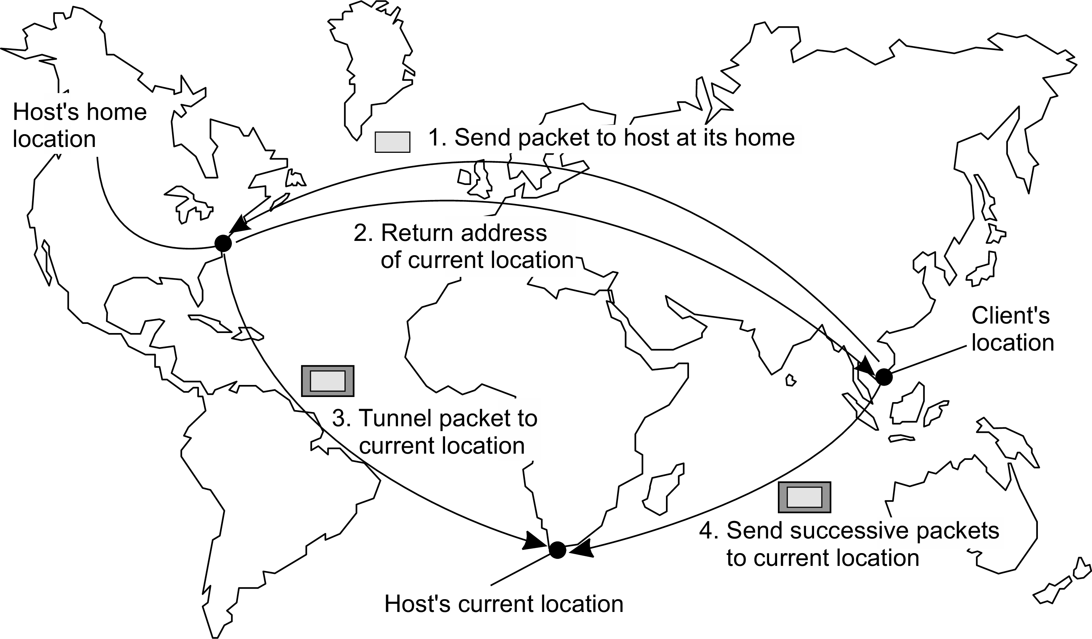
Naming
Flat naming
The principle of mobile IP
Home-based approaches

Slide 8
Naming
Flat naming
Home-based approaches
Problems with home-based approaches
Home address has to be supported for entity’s lifetime
Home address is fixed ⇒ unnecessary burden when the entity permanently moves
Poor geographical scalability (entity may be next to client)
Note
Permanent moves may be tackled with another level of naming (DNS)
Home-based approaches

Slide 9
Naming
Flat naming
Illustrative: Chord
Consider the organization of many nodes into a logical ring
Each node is assigned a random m-bit identifier.
Every entity is assigned a unique m-bit key.
Entity with key k falls under jurisdiction of node with smallest id ≥ k
(called its successor succ(k )).
Nonsolution
Let each node keep track of its neighbor and start linear search along the ring.
Notation
We will speak of node p as the node have identifier p
Distributed hash tables

Slide 10
Naming
Flat naming
Chord finger tables
Principle
Each node p maintains a finger table FT_{p} [] with at most m entries:
FT_{p} [i ] = succ(p + 2^{i−1})
Note: the i -th entry points to the first node succeeding p by at least 2^{i−1}.
Distributed hash tables

Slide 11
Naming
Flat naming
Chord finger tables
Principle
Each node p maintains a finger table FT_{p} [] with at most m entries:
FT_{p} [i ] = succ(p + 2^{i−1})
Note: the i -th entry points to the first node succeeding p by at least 2^{i−1}.
To look up a key k , node p forwards the request to node with index j
satisfying
q = FT_{p} [j ] ≤ k < FT_{p} [j + 1]
Distributed hash tables

Slide 12
Naming
Flat naming
Chord finger tables
Principle
Each node p maintains a finger table FT_{p} [] with at most m entries:
FT_{p} [i ] = succ(p + 2^{i−1})
Note: the i -th entry points to the first node succeeding p by at least 2^{i−1}.
To look up a key k , node p forwards the request to node with index j
satisfying
q = FT_{p} [j ] ≤ k < FT_{p} [j + 1]
If p < k < FT_{p} [1], the request is also forwarded to FT_{p} [1]
Distributed hash tables

Slide 13
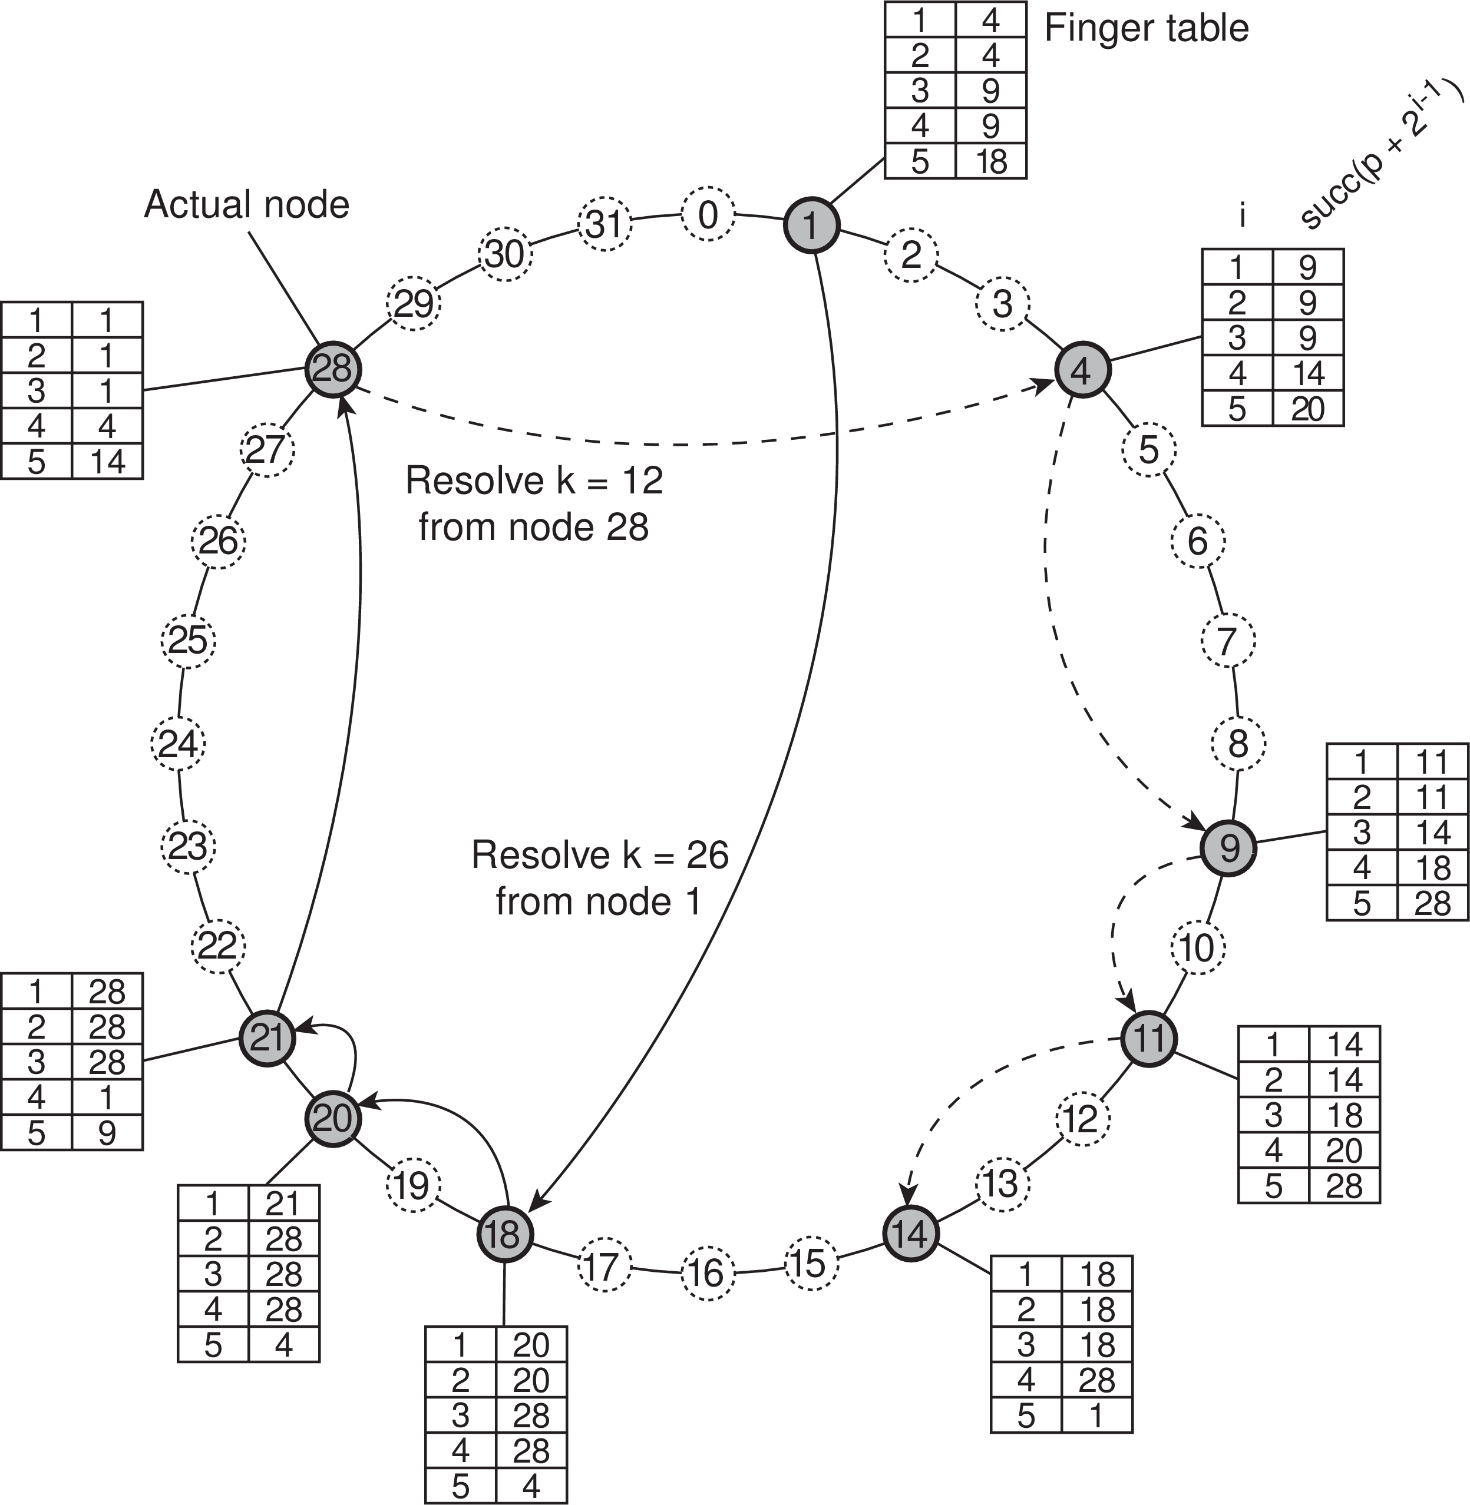
Naming
Flat naming
Chord lookup example
Resolving key 26 from node 1 and key 12 from node 28
Distributed hash tables

Slide 14
Naming
Flat naming
Chord in Python
1 class ChordNode:
2
3
4
5
6
7
8
9
10
11
12
13
14
15
16
17
18
19
20
21
22
23
24
25
26
def succNode(self, key):
if (key <= self.nodeSet[0] or
key > self.nodeSet[len(self.nodeSet)-1]): # key is in segment for which
return self.nodeSet[0]
for i in range(1,len(self.nodeSet)): if (key <= self.nodeSet[i]):
return self.nodeSet[i]
# this node is responsible
# key is in segment for which
# node (i+1) may be responsible
def finger(self, i):
return self. succNode((self.nodeID + pow(2,i-1)) % self.MAXPROC) # succ(p+2ˆ(i-1))
def recomputeFingerTable(self):
self.FT[0] = self.nodeSet[(self.nodeInd - 1)%len(self.nodeSet)] # Predecessor self.FT[1:] = [self. finger(i) for i in range(1,self.nBits+1)] # Successors self.FT.append(self.nodeID) # This node
def localSuccNode(self, key):
if self. inbetween(key, self.FT[0]+1, self.nodeID+1): # key in (pred,self]
return self.nodeID # this node is responsible
elif self. inbetween(key, self.nodeID+1, self.FT[1]): # key in (self,FT[1]]
return self.FT[1]
# successor responsible
for i in range(1, self.nBits+2): # go through rest of FT
if self. inbetween(key, self.FT[i], self.FT[(i+1)]): # key in [FT[i],FT[i+1])
return self.FT[i]
# FT[i] is responsible
Distributed hash tables

Slide 15
Naming
Flat naming
Exploiting network proximity
Problem
The logical organization of nodes in the overlay may lead to erratic message transfers in the underlying Internet: node p and node succ(p + 1) may be very far apart.
Solutions
Distributed hash tables

Slide 16
Naming
Flat naming
Exploiting network proximity
Problem
The logical organization of nodes in the overlay may lead to erratic message transfers in the underlying Internet: node p and node succ(p + 1) may be very far apart.
Solutions
Topology-aware node assignment: When assigning an ID to a node, make sure that nodes close in the ID space are also close in the network. Can be very difficult.
Distributed hash tables

Slide 17
Naming
Flat naming
Exploiting network proximity
Problem
The logical organization of nodes in the overlay may lead to erratic message transfers in the underlying Internet: node p and node succ(p + 1) may be very far apart.
Solutions
Topology-aware node assignment: When assigning an ID to a node, make sure that nodes close in the ID space are also close in the network. Can be very difficult.
Proximity routing: Maintain more than one possible successor, and forward to the closest.
Example: in Chord FT_{p} [i ] points to first node in
INT = [p + 2^{i−1}, p + 2^{i} − 1]. Node p can also store pointers to other nodes in INT .
Distributed hash tables

Slide 18
Naming
Flat naming
Exploiting network proximity
Problem
The logical organization of nodes in the overlay may lead to erratic message transfers in the underlying Internet: node p and node succ(p + 1) may be very far apart.
Solutions
Topology-aware node assignment: When assigning an ID to a node, make sure that nodes close in the ID space are also close in the network. Can be very difficult.
Proximity routing: Maintain more than one possible successor, and forward to the closest.
Example: in Chord FT_{p} [i ] points to first node in
INT = [p + 2^{i−1}, p + 2^{i} − 1]. Node p can also store pointers to other nodes in INT .
Proximity neighbor selection: When there is a choice of selecting who your neighbor will be (not in Chord), pick the closest one.
Distributed hash tables

Slide 19
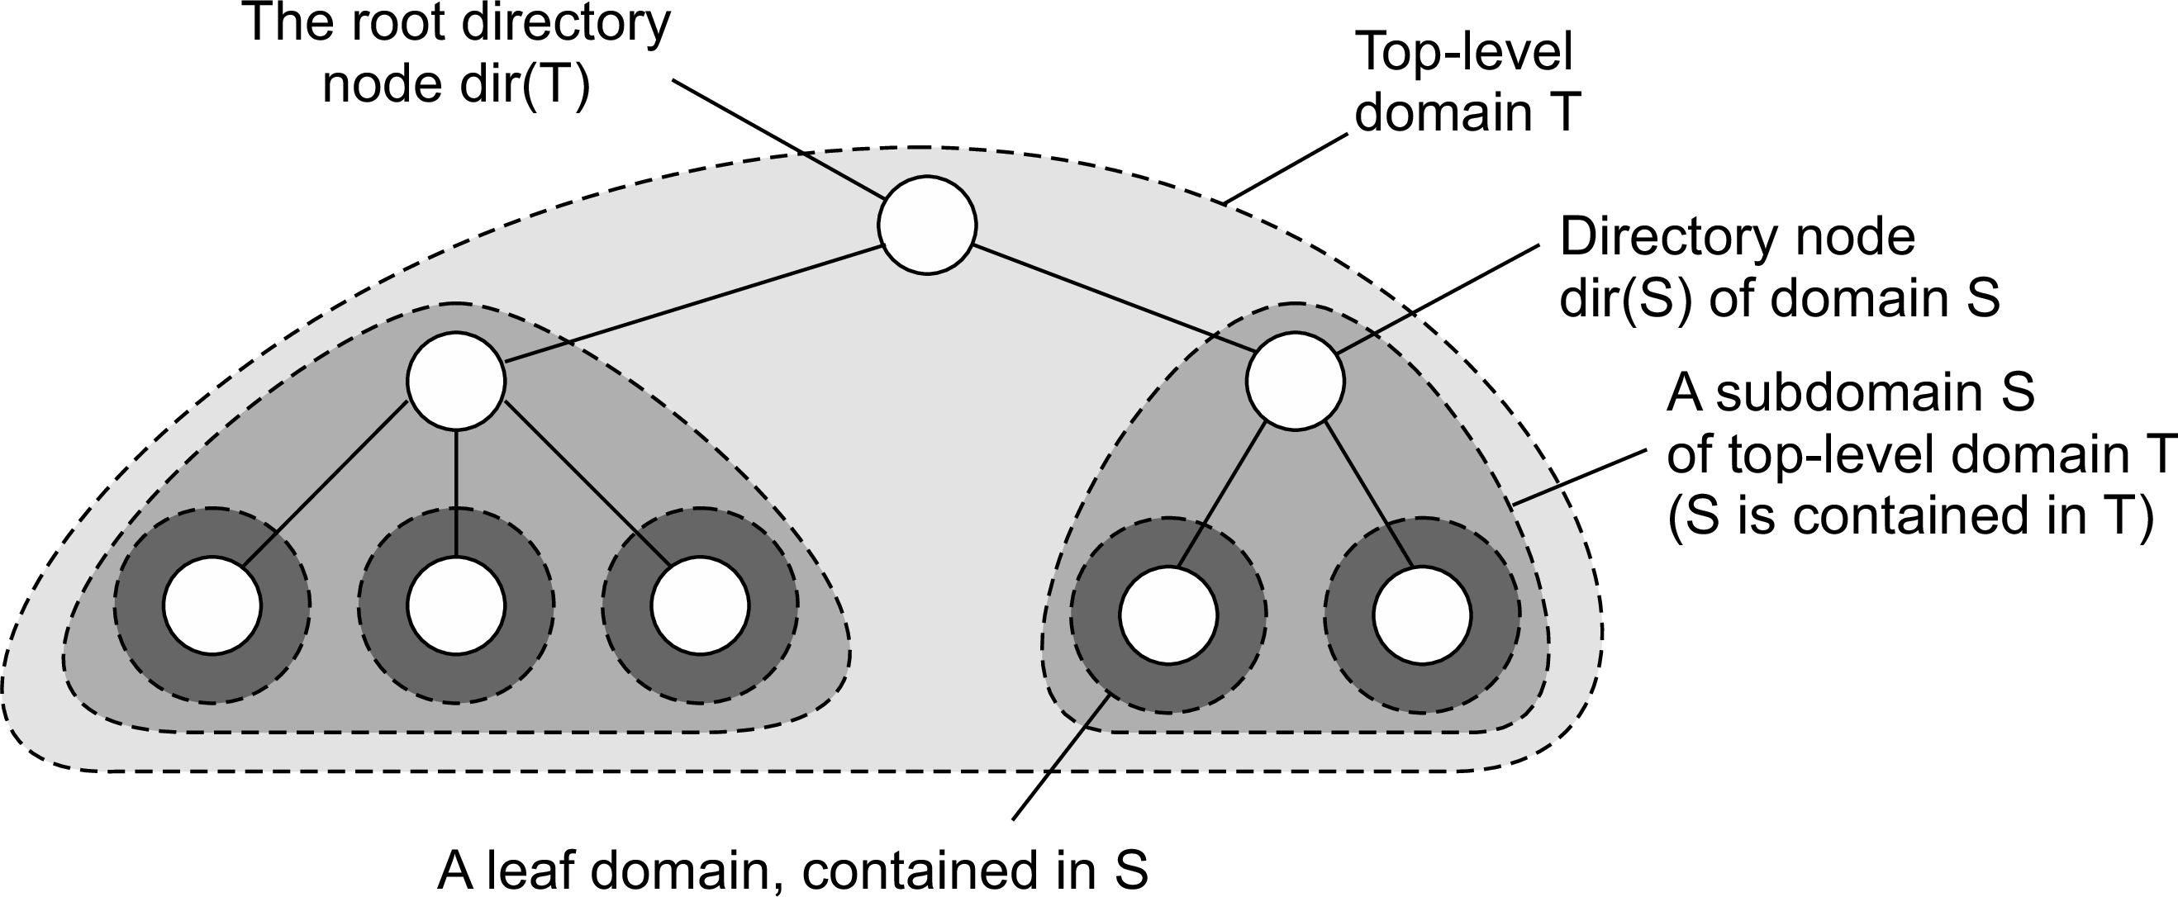
Naming
Flat naming
Hierarchical Location Services (HLS)
Basic idea
Build a large-scale search tree for which the underlying network is divided into hierarchical domains. Each domain is represented by a separate directory node.
Principle
Hierarchical approaches

Slide 20
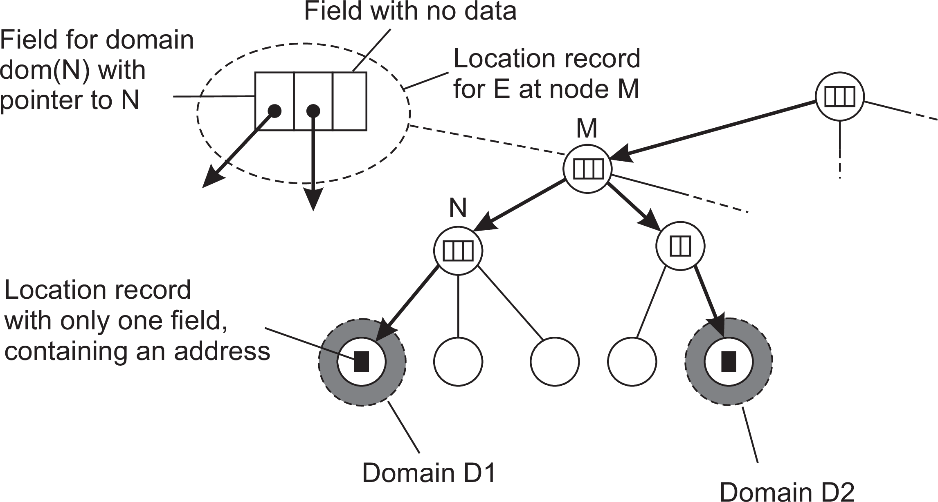
Naming
Flat naming
HLS: Tree organization
Invariants
Address of entity E is stored in a leaf or intermediate node
Intermediate nodes contain a pointer to a child if and only if the subtree rooted at the child stores an address of the entity
The root knows about all entities
Storing information of an entity having two addresses in different leaf domains
Hierarchical approaches

Slide 21
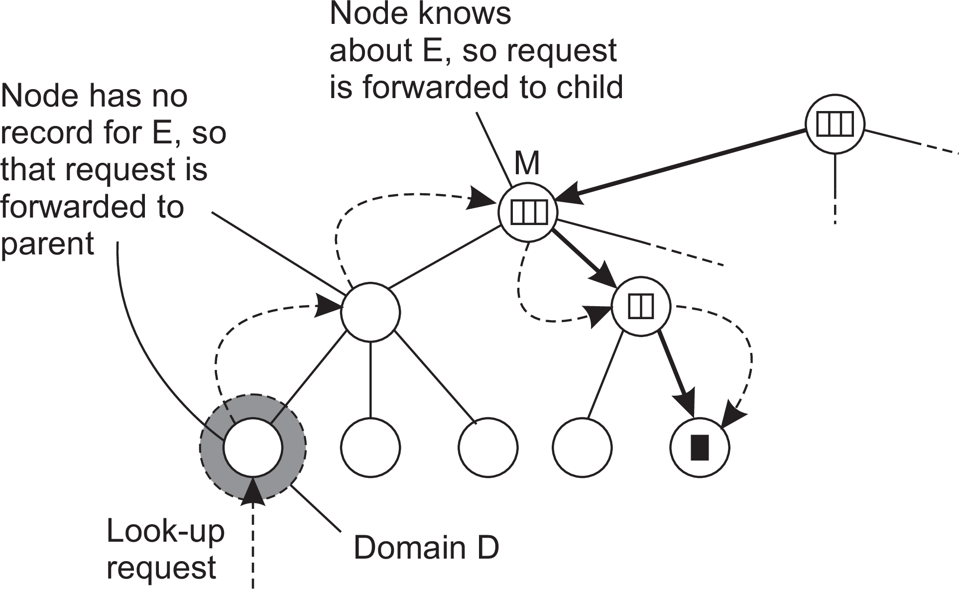
Naming
Flat naming
HLS: Lookup operation
Basic principles
Start lookup at local leaf node
Node knows about E ⇒ follow downward pointer, else go up
Upward lookup always stops at root
Looking up a location
Hierarchical approaches

Slide 22
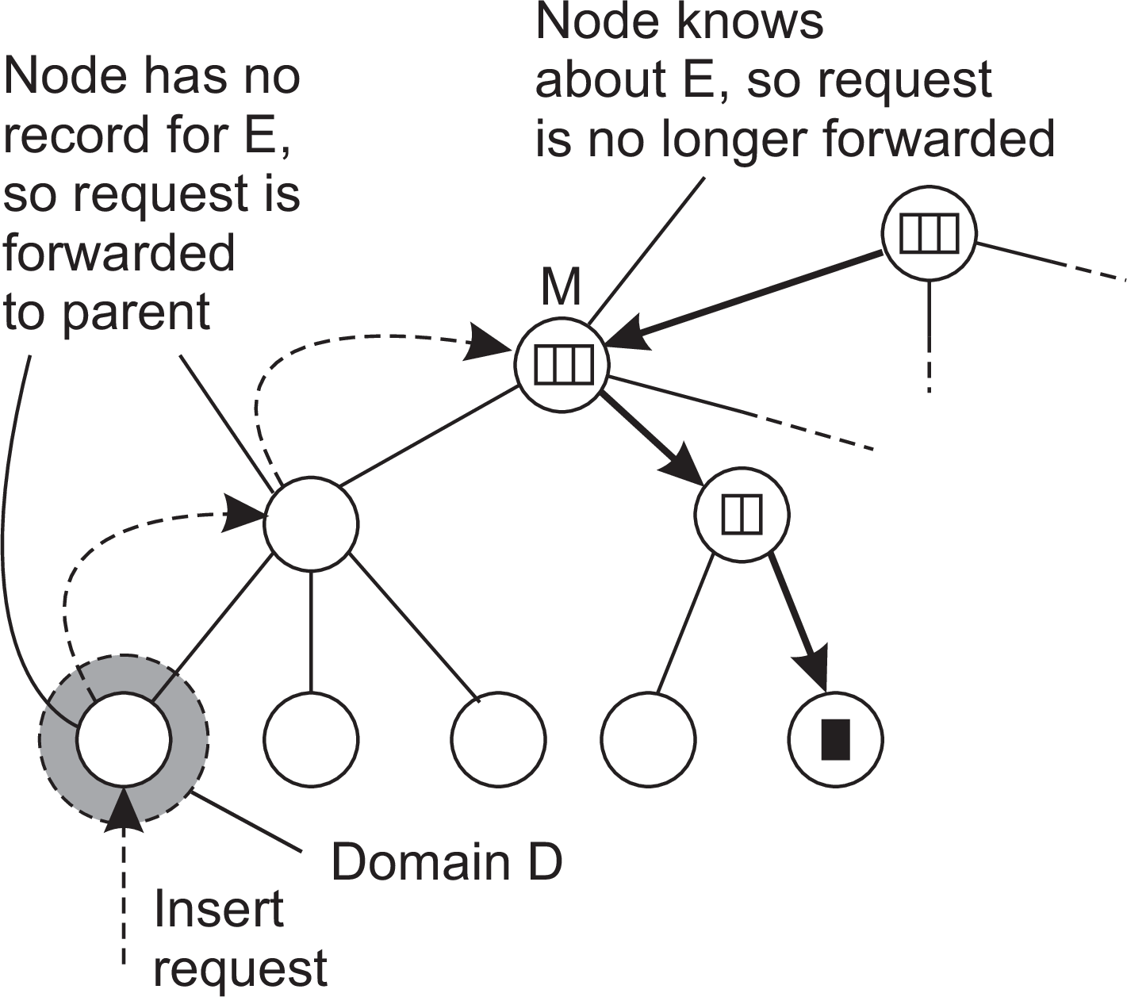
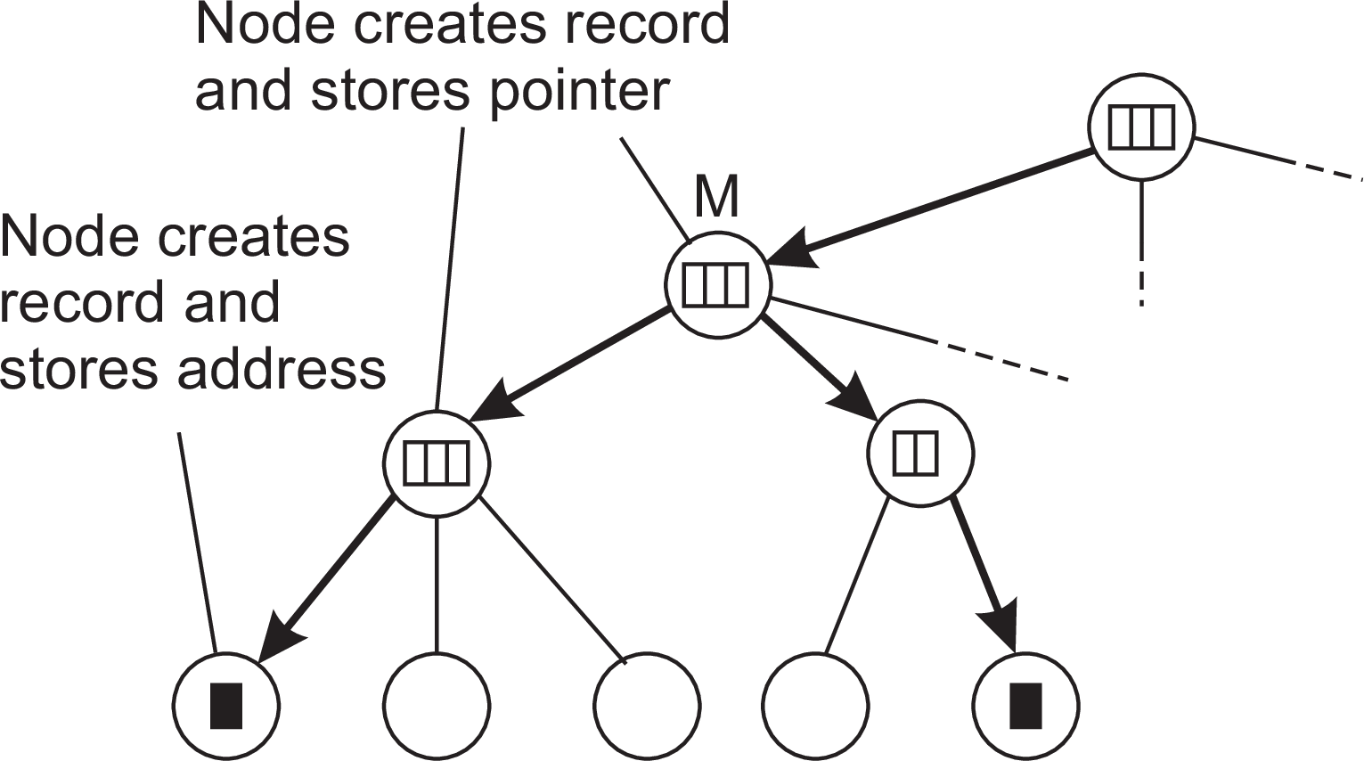
Naming
Flat naming
HLS: Insert operation
(a) An insert request is forwarded to the first node that knows about entity E . (b) A chain of forwarding pointers to the leaf node is created
(a)
(b)
Hierarchical approaches

Slide 23
Naming
Flat naming
Can an HLS scale?
Observation
A design flaw seems to be that the root node needs to keep track of all identifiers ⇒ make a distinction between a logical design and its physical implementation.
Notation
Assume there are a total of N physical hosts {H₁, H₂ , . . . , H_{N} }. Each host is capable of running one or more location servers.
D_{k} (A) denotes the domain at level k that contains address A; k = 0 denotes the root domain.
LS_{k} (E, A) denotes the unique location server in D_{k} (A) responsible for keeping track of entity E .
Hierarchical approaches

Slide 24
Naming
Flat naming
Can an HLS scale?
Basic idea for scaling
Choose different physical servers for the logical name servers on a per-entity basis
(at root level, but also intermediate)
Implement a mapping of entities to physical servers such that the load of storing records will be distributed
Hierarchical approaches

Slide 25
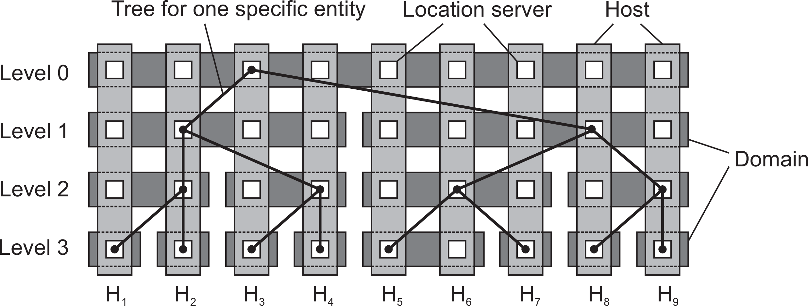
Naming
Flat naming
Can an HLS scale?
Solution
D_{k} = {D_{k,1}, D_{k,2} , . . . , D_{k,Nk} } denotes the N_{k} domains at level k
Note: N₀ = |D₀| = 1.
For each level k , the set of hosts is partitioned into N_{k} subsets, with each host running a location server representing exactly one of the domains D_{k,i} from D_{k} .
Principle of distributing logical location servers
Hierarchical approaches

Slide 26
Naming
Flat naming
Security in flat naming
Basics
Without special measures, we need to trust that the name-resolution process to return what is associated with a flat name. Two approaches to follow:
Secure the identifier-to-entity association
Secure the name-resolution process
Self-certifying names
Use a value derived from the associated entity and make it (part of) the flat name:
id(entity) = hash(data associated with the entity)
when dealing with read-only entities, otherwise
id(entity) = public key(entity)
in which case additional data is returned, such as a verifiable digital signature.
Securing the name-resolution process
Much more involved: discussion deferred until discussing secure DNS.
Secure flat naming

Slide 27
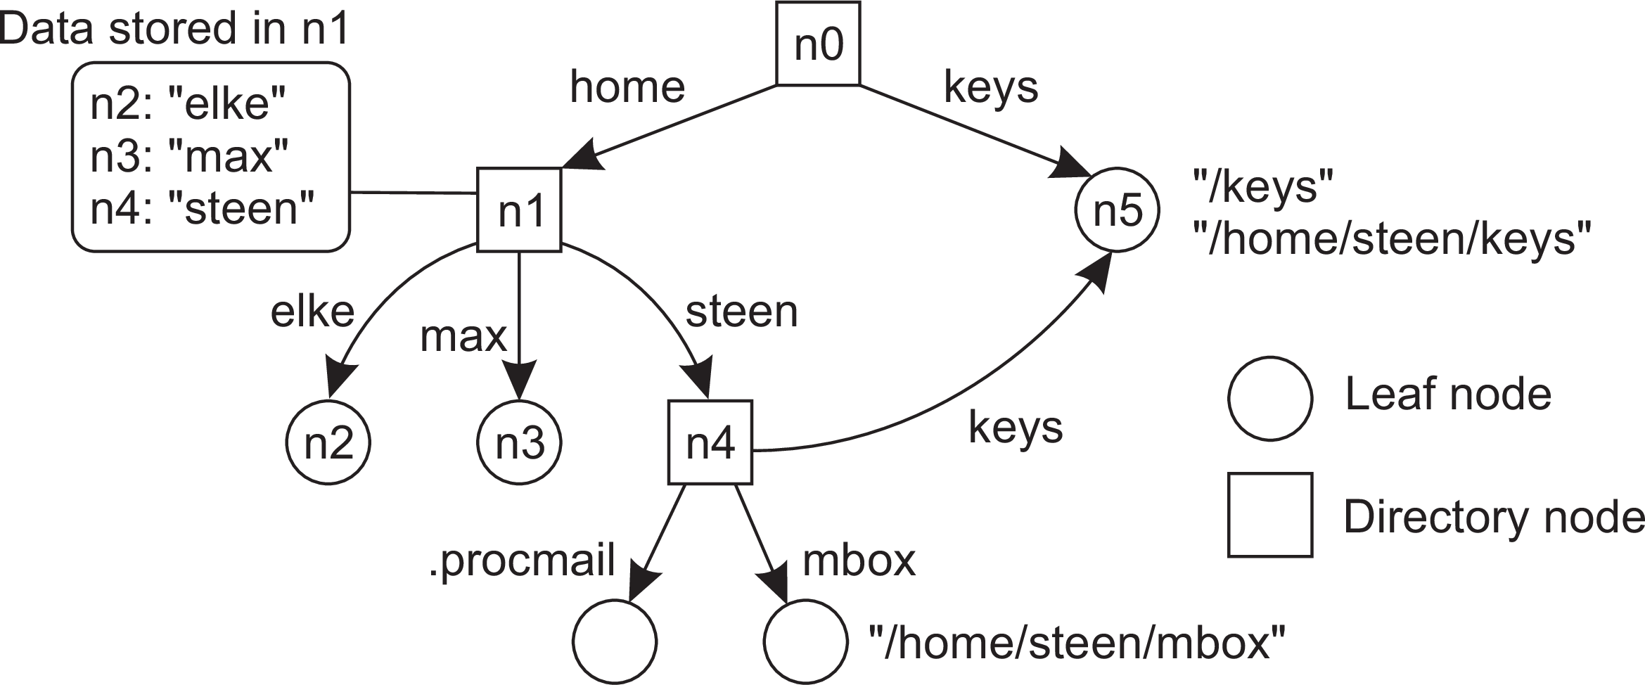
Name space
Naming Structured naming
Naming graph
A graph in which a leaf node represents a (named) entity. A directory node is an entity that refers to other nodes.
A general naming graph with a single root node
Note
A directory node contains a table of (node identifier, edge label) pairs.
Name spaces

Slide 28
Naming
Structured naming
Name space
We can easily store all kinds of attributes in a node
Type of the entity
An identifier for that entity
Address of the entity’s location
Nicknames
...
Name spaces

Slide 29
Naming
Structured naming
Name space
We can easily store all kinds of attributes in a node
Type of the entity
An identifier for that entity
Address of the entity’s location
Nicknames
...
Note
Directory nodes can also have attributes, besides just storing a directory table with (identifier, label) pairs.
Name spaces

Slide 30
Name resolution
Naming Structured naming
Problem
To resolve a name, we need a directory node. How do we actually find that (initial) node?
Name resolution

Slide 31
Name resolution
Naming Structured naming
Problem
To resolve a name, we need a directory node. How do we actually find that (initial) node?
Closure mechanism: The mechanism to select the implicit context from which to start name resolution
www.distributed-systems.net: start at a DNS name server
/home/maarten/mbox: start at the local NFS file server (possible recursive search)
0031 20 598 7784: dial a phone number
77.167.55.6: route message to a specific IP address
Name resolution

Slide 32
Name resolution
Naming Structured naming
Problem
To resolve a name, we need a directory node. How do we actually find that (initial) node?
Closure mechanism: The mechanism to select the implicit context from which to start name resolution
www.distributed-systems.net: start at a DNS name server
/home/maarten/mbox: start at the local NFS file server (possible recursive search)
0031 20 598 7784: dial a phone number
77.167.55.6: route message to a specific IP address
Note
You cannot have an explicit closure mechanism – how would you start?
Name resolution

Slide 33
Name linking
Naming Structured naming
Hard link
What we have described so far as a path name: a name that is resolved by following a specific path in a naming graph from one node to another.
Soft link: Allow a node N to contain a name of another node
First resolve N’s name (leading to N)
Read the content of N, yielding name
Name resolution continues with name
Name resolution

Slide 34
Name linking
Naming Structured naming
Hard link
What we have described so far as a path name: a name that is resolved by following a specific path in a naming graph from one node to another.
Soft link: Allow a node N to contain a name of another node
First resolve N’s name (leading to N)
Read the content of N, yielding name
Name resolution continues with name
Observations
The name resolution process determines that we read the content of a node, in particular, the name in the other node that we need to go to.
One way or the other, we know where and how to start name resolution given name
Name resolution

Slide 35
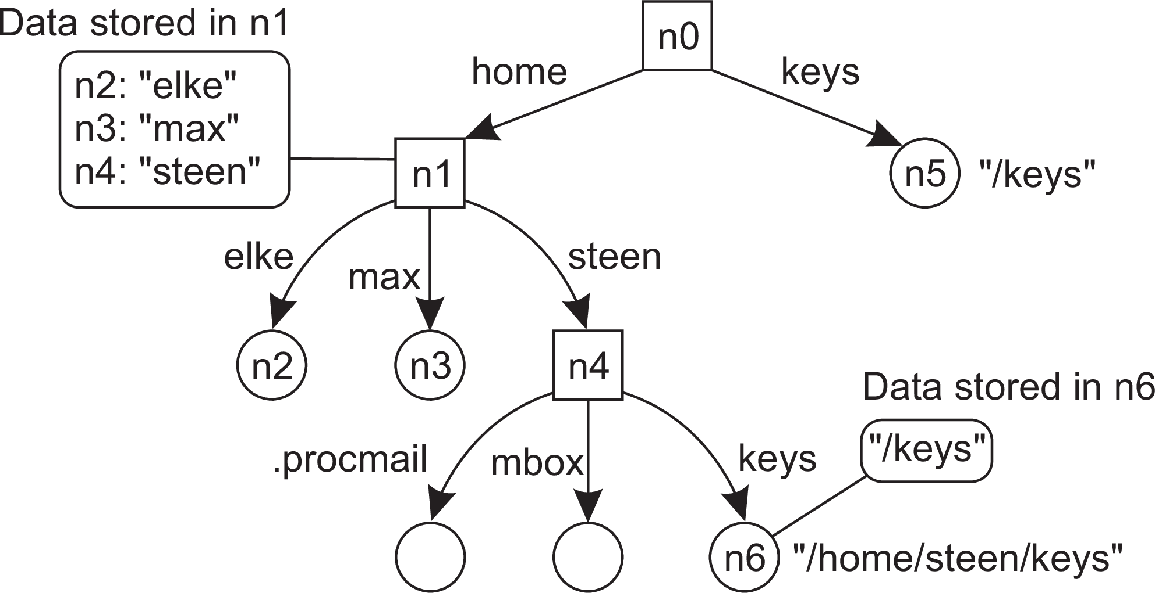
Naming
Structured naming
Name linking
The concept of a symbolic link explained in a naming graph
Observation
Node n5 has only one name
Name resolution

Slide 36
Mounting
Naming Structured naming
Issue
Name resolution can also be used to merge different name spaces transparently through mounting: associating a node identifier of another name space with a node in a current name space.
Terminology
Foreign name space: the name space that needs to be accessed
Mount point: the node in the current name space containing the node identifier of the foreign name space
Mounting point: the node in the foreign name space where to continue name resolution
Mounting across a network
The name of an access protocol.
The name of the server.
The name of the mounting point in the foreign name space.
Name resolution

Slide 37
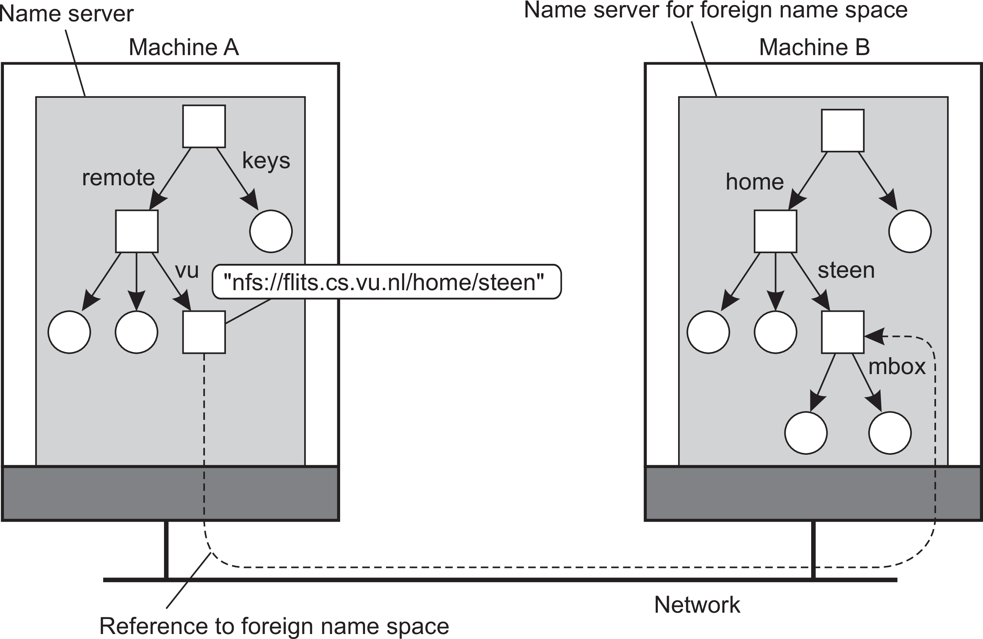
Naming
Structured naming
Mounting in distributed systems
Mounting remote name spaces through a specific access protocol
Name resolution

Slide 38
Name-space implementation
Naming Structured naming
Basic issue
Distribute the name resolution process as well as name space management across multiple machines, by distributing nodes of the naming graph.
The implementation of a name space

Slide 39
Name-space implementation
Naming Structured naming
Basic issue
Distribute the name resolution process as well as name space management across multiple machines, by distributing nodes of the naming graph.
Distinguish three levels
The implementation of a name space

Slide 40
Name-space implementation
Naming Structured naming
Basic issue
Distribute the name resolution process as well as name space management across multiple machines, by distributing nodes of the naming graph.
Distinguish three levels
Global level: Consists of the high-level directory nodes. Main aspect is that these directory nodes have to be jointly managed by different administrations
The implementation of a name space

Slide 41
Name-space implementation
Naming Structured naming
Basic issue
Distribute the name resolution process as well as name space management across multiple machines, by distributing nodes of the naming graph.
Distinguish three levels
Global level: Consists of the high-level directory nodes. Main aspect is that these directory nodes have to be jointly managed by different administrations
Administrational level: Contains mid-level directory nodes that can be grouped in such a way that each group can be assigned to a separate administration.
The implementation of a name space

Slide 42
Name-space implementation
Naming Structured naming
Basic issue
Distribute the name resolution process as well as name space management across multiple machines, by distributing nodes of the naming graph.
Distinguish three levels
Global level: Consists of the high-level directory nodes. Main aspect is that these directory nodes have to be jointly managed by different administrations
Administrational level: Contains mid-level directory nodes that can be grouped in such a way that each group can be assigned to a separate administration.
Managerial level: Consists of low-level directory nodes within a single administration. Main issue is effectively mapping directory nodes to local name servers.
The implementation of a name space

Slide 43
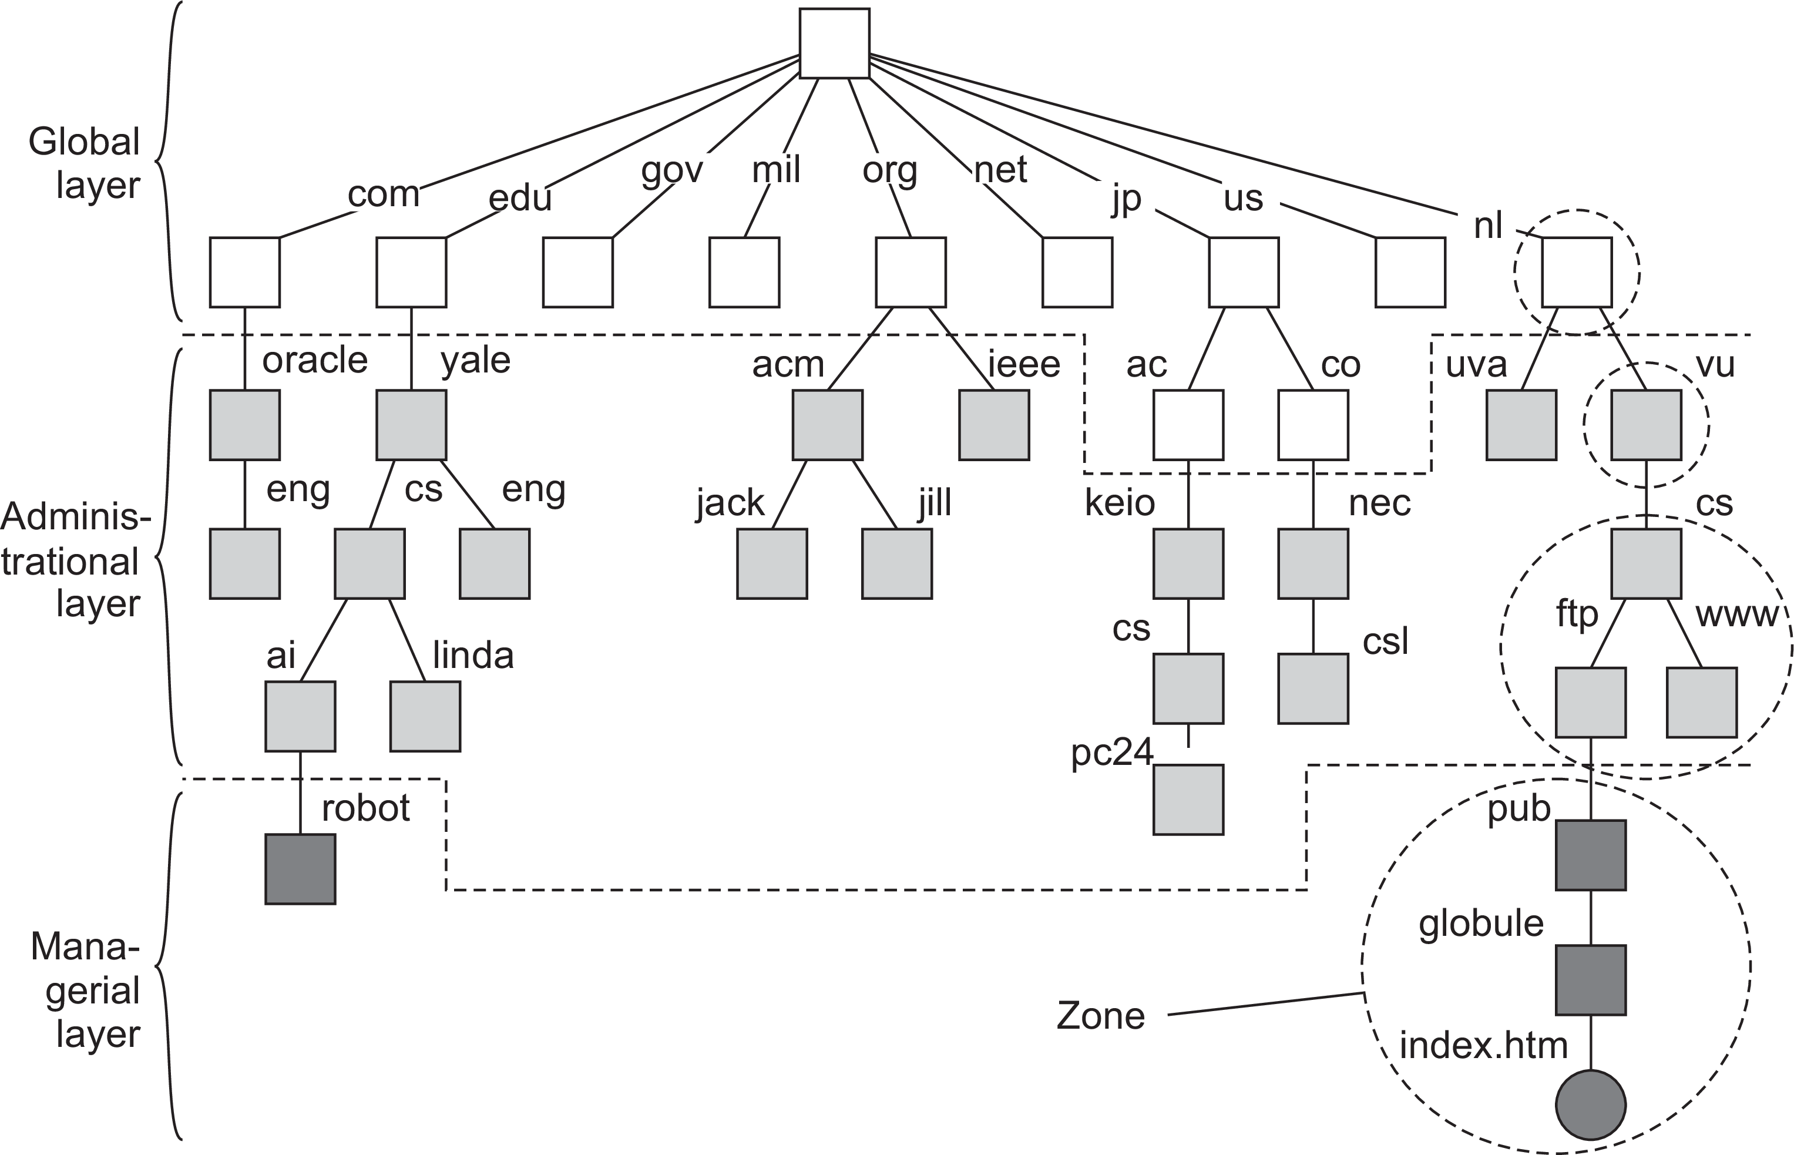
Name-space implementation
Naming Structured naming
An example partitioning of the DNS name space, including network files
The implementation of a name space

Slide 44
Naming
Structured naming
Name-space implementation
A comparison between name servers for implementing nodes in a name space
Item | Global | Administrational | Managerial
1 | Worldwide | Organization | Department
2 | Few | Many | Vast numbers
3 | Seconds | Milliseconds | Immediate
4 | Lazy | Immediate | Immediate
5 | Many | None or few | None
6 | Yes | Yes | Sometimes
1: Geographical scale 2: # Nodes 3: Responsiveness |  | 4: Update propagation 5: # Replicas 6: Client-side caching?
The implementation of a name space

Slide 45
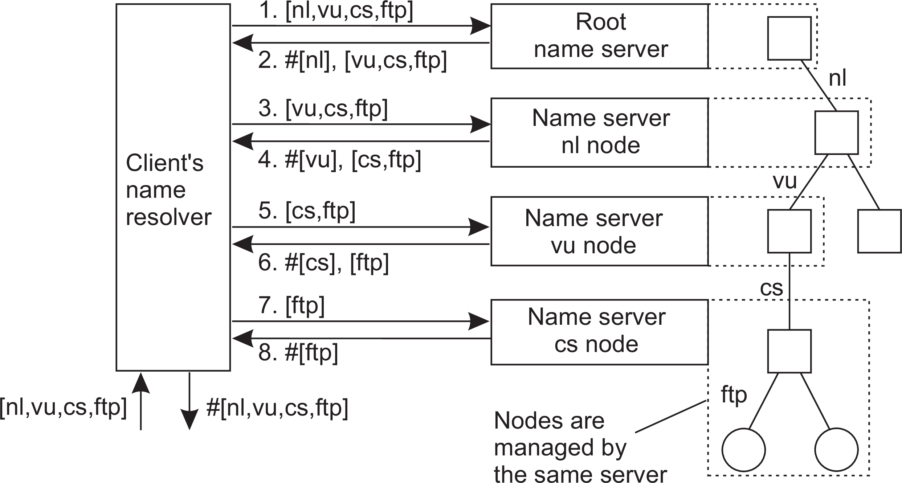
Iterative name resolution
Naming Structured naming
Principle
resolve(dir, [name₁,..., name_{K} ]) sent to Server₀ responsible for dir
Server₀ resolves resolve(dir, name₁) → dir₁, returning the identification (address) of Server₁, which stores dir₁.
Client sends resolve(dir₁, [name₂ , ..., name_{K} ]) to Server₁, etc.
The implementation of a name space

Slide 46
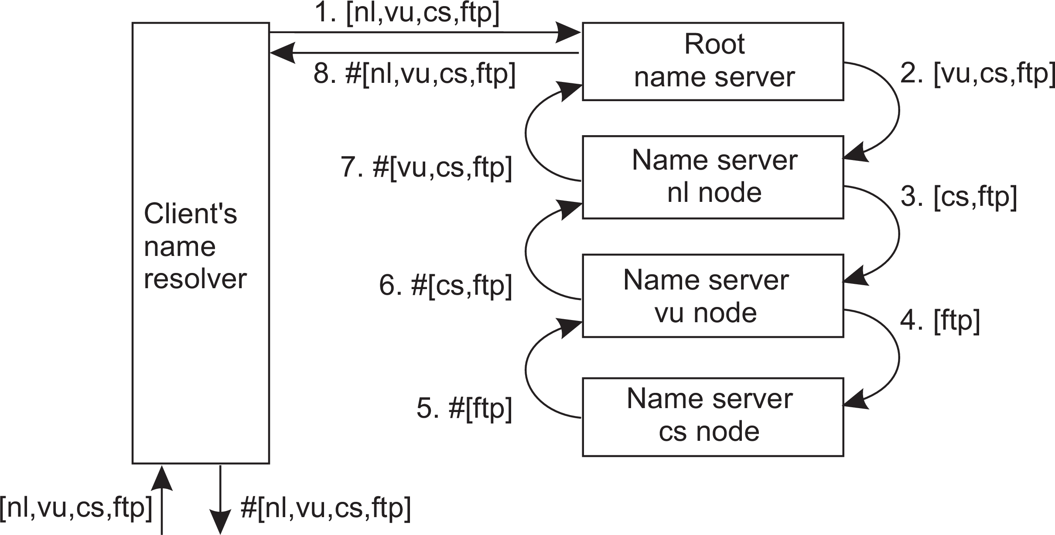
Naming
Structured naming
Recursive name resolution
Principle
resolve(dir, [name₁,..., name_{K} ]) sent to Server₀ responsible for dir
Server₀ resolves resolve(dir, name₁) → dir₁, and sends
resolve(dir₁, [name₂ , ..., name_{K} ]) to Server₁, which stores dir₁.
Server₀ waits for result from Server₁, and returns it to client.
The implementation of a name space

Slide 47
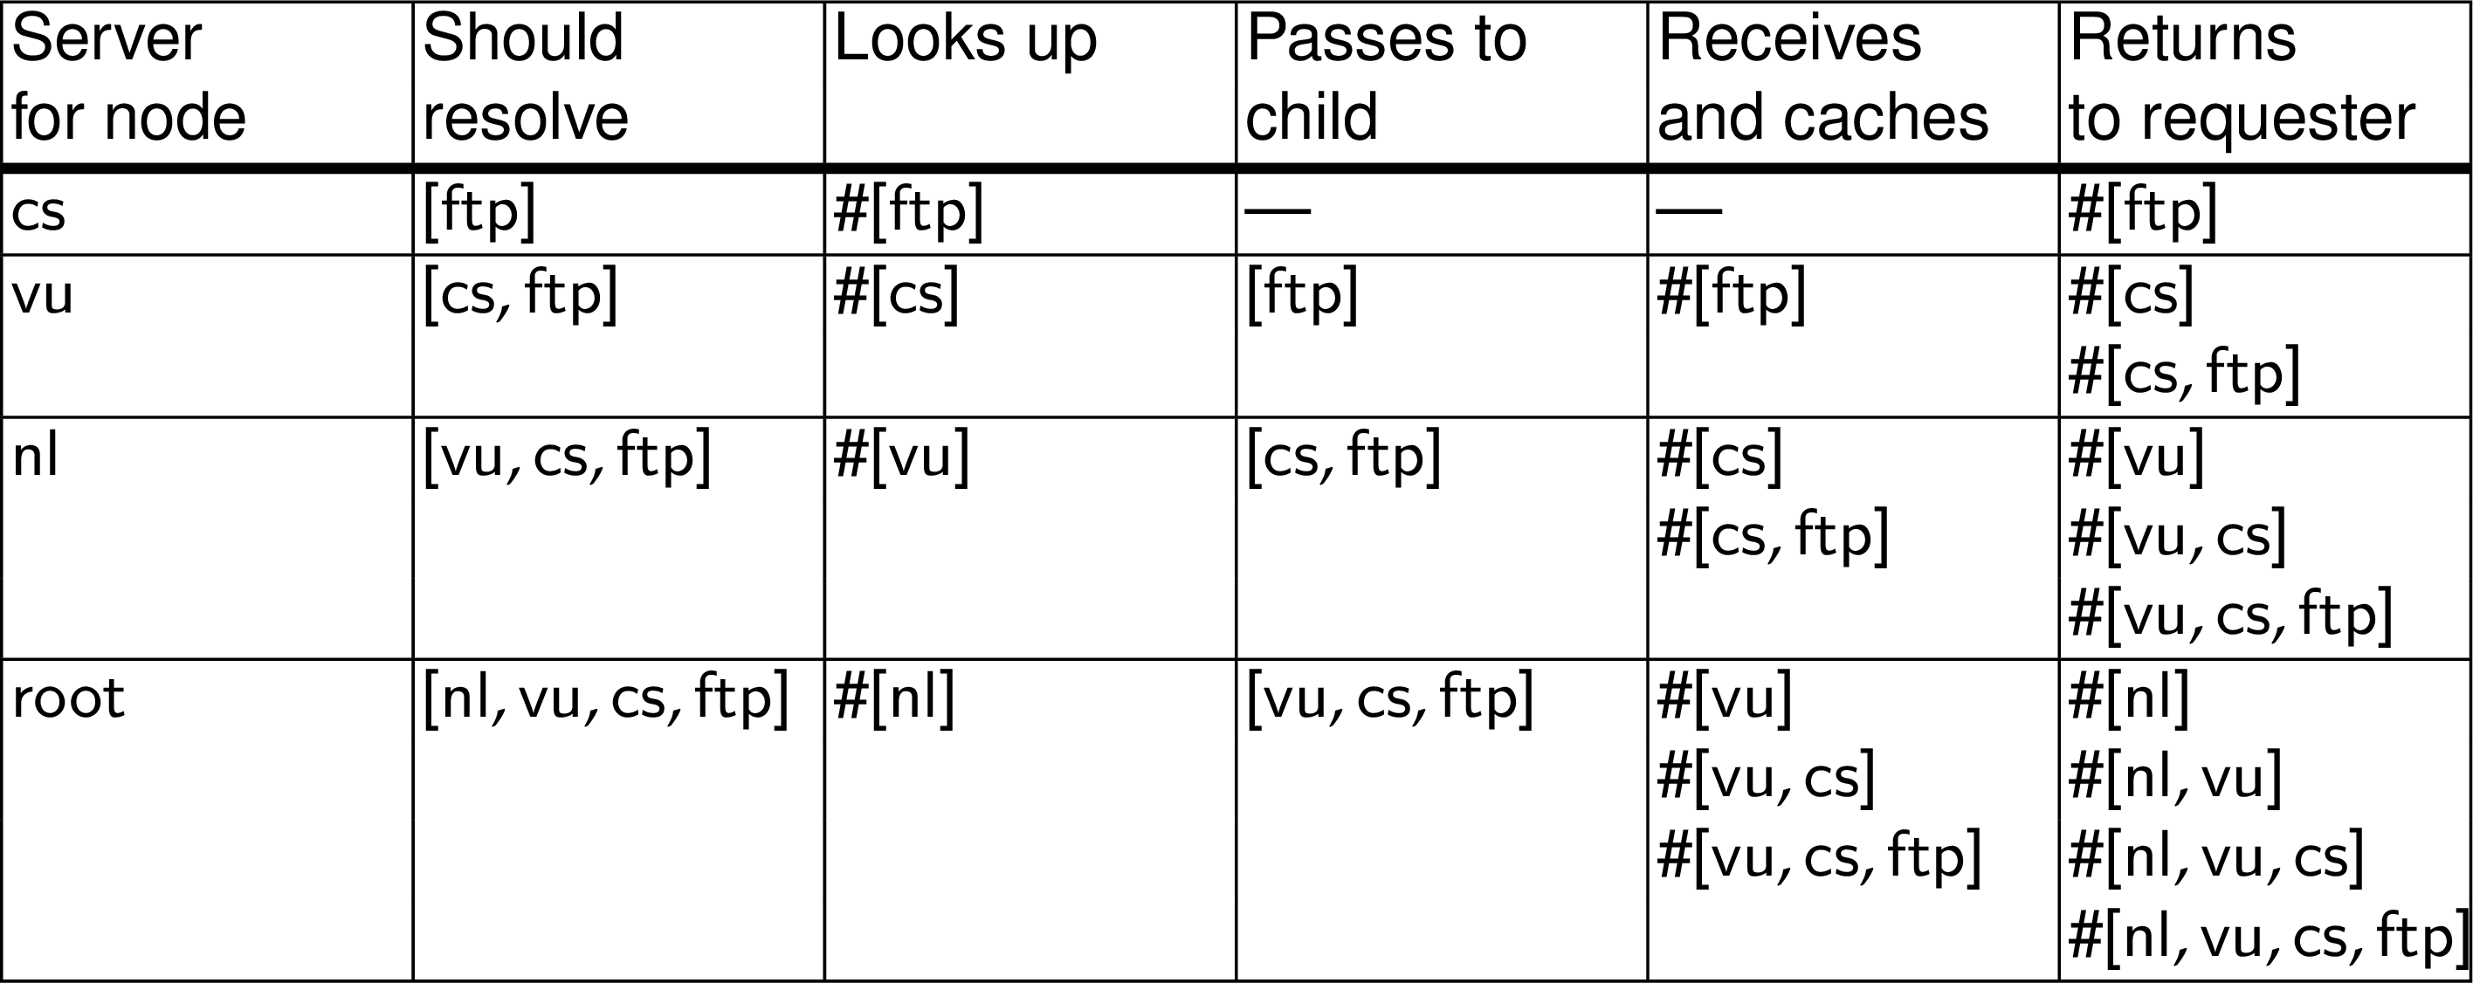
Naming
Structured naming
Caching in recursive name resolution
The implementation of a name space

Slide 48
Scalability issues
Naming Structured naming
Size scalability
We need to ensure that servers can handle a large number of requests per time unit ⇒ high-level servers are in big trouble.
The implementation of a name space

Slide 49
Scalability issues
Naming Structured naming
Size scalability
We need to ensure that servers can handle a large number of requests per time unit ⇒ high-level servers are in big trouble.
Solution
Assume (at least at global and administrational level) that content of nodes hardly ever changes. We can then apply extensive replication by mapping nodes to multiple servers, and start name resolution at the nearest server.
The implementation of a name space

Slide 50
Scalability issues
Naming Structured naming
Size scalability
We need to ensure that servers can handle a large number of requests per time unit ⇒ high-level servers are in big trouble.
Solution
Assume (at least at global and administrational level) that content of nodes hardly ever changes. We can then apply extensive replication by mapping nodes to multiple servers, and start name resolution at the nearest server.
Observation
An important attribute of many nodes is the address where the represented entity can be contacted. Replicating nodes makes large-scale traditional name servers unsuitable for locating mobile entities.
The implementation of a name space

Slide 51
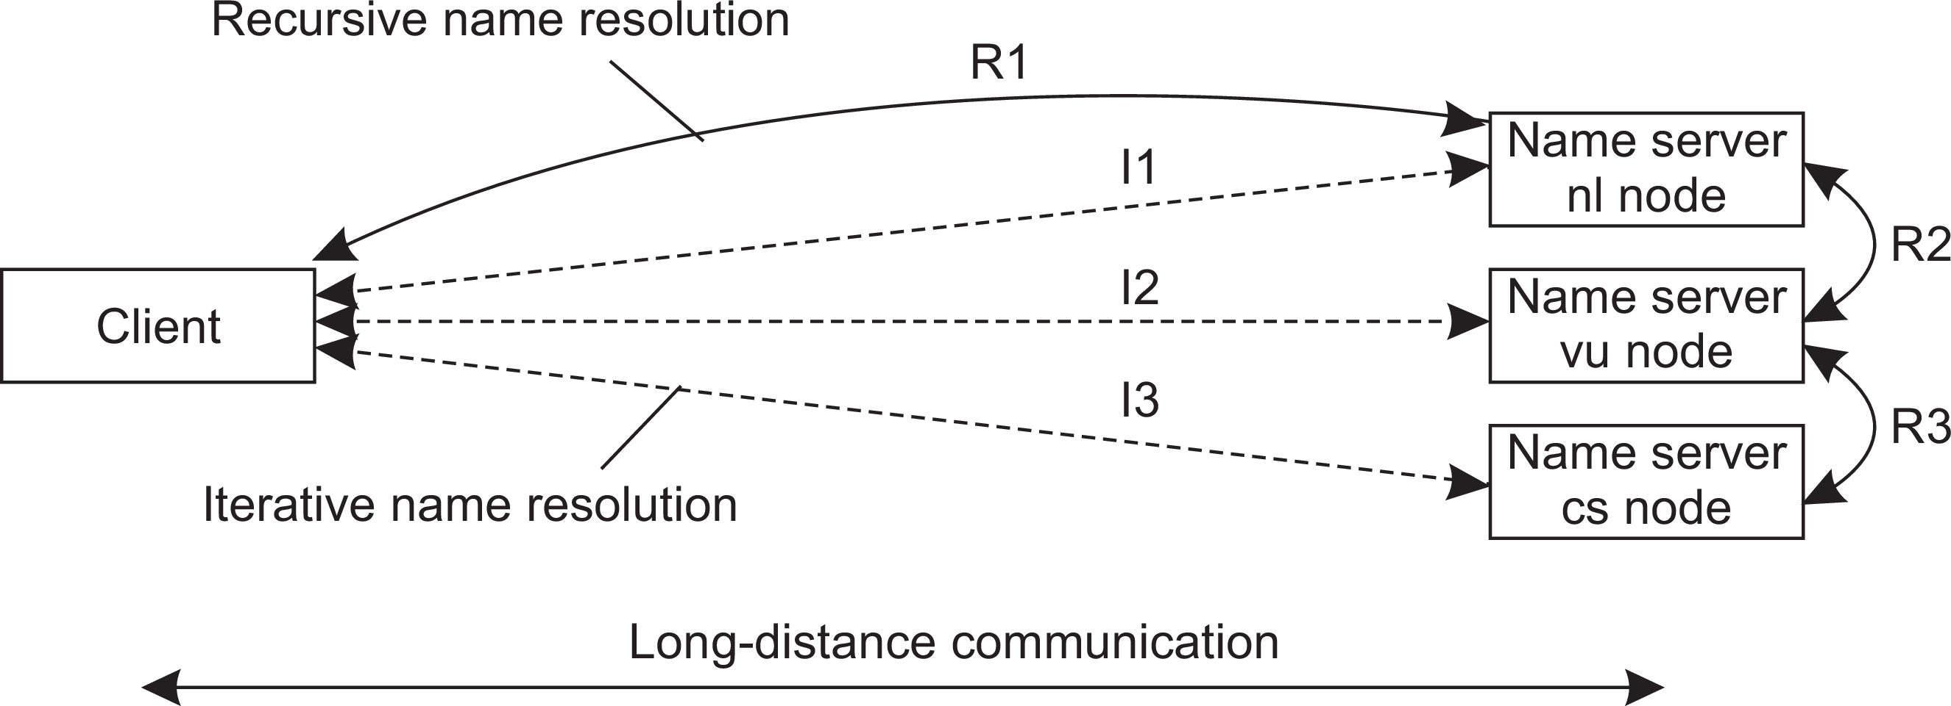
Scalability issues
Naming Structured naming
We need to ensure that the name resolution process scales across large geographical distances
Problem
By mapping nodes to servers that can be located anywhere, we introduce an implicit location dependency.
The implementation of a name space

Slide 52
Naming Structured naming
DNS
Essence
Hierarchically organized name space with each node having exactly one incoming edge ⇒ edge label = node label.
domain: a subtree
domain name: a path name to a domain’s root node.
Information in a node
Type | Refers to | Description
SOA | Zone | Holds info on the represented zone
A | Host | IP addr. of host this node represents
MX | Domain | Mail server to handle mail for this node
SRV | Domain | Server handling a specific service
NS | Zone | Name server for the represented zone
CNAME | Node | Symbolic link
PTR | Host | Canonical name of a host
HINFO | Host | Info on this host
TXT | Any kind | Any info considered useful
Example: The Domain Name System

Slide 53
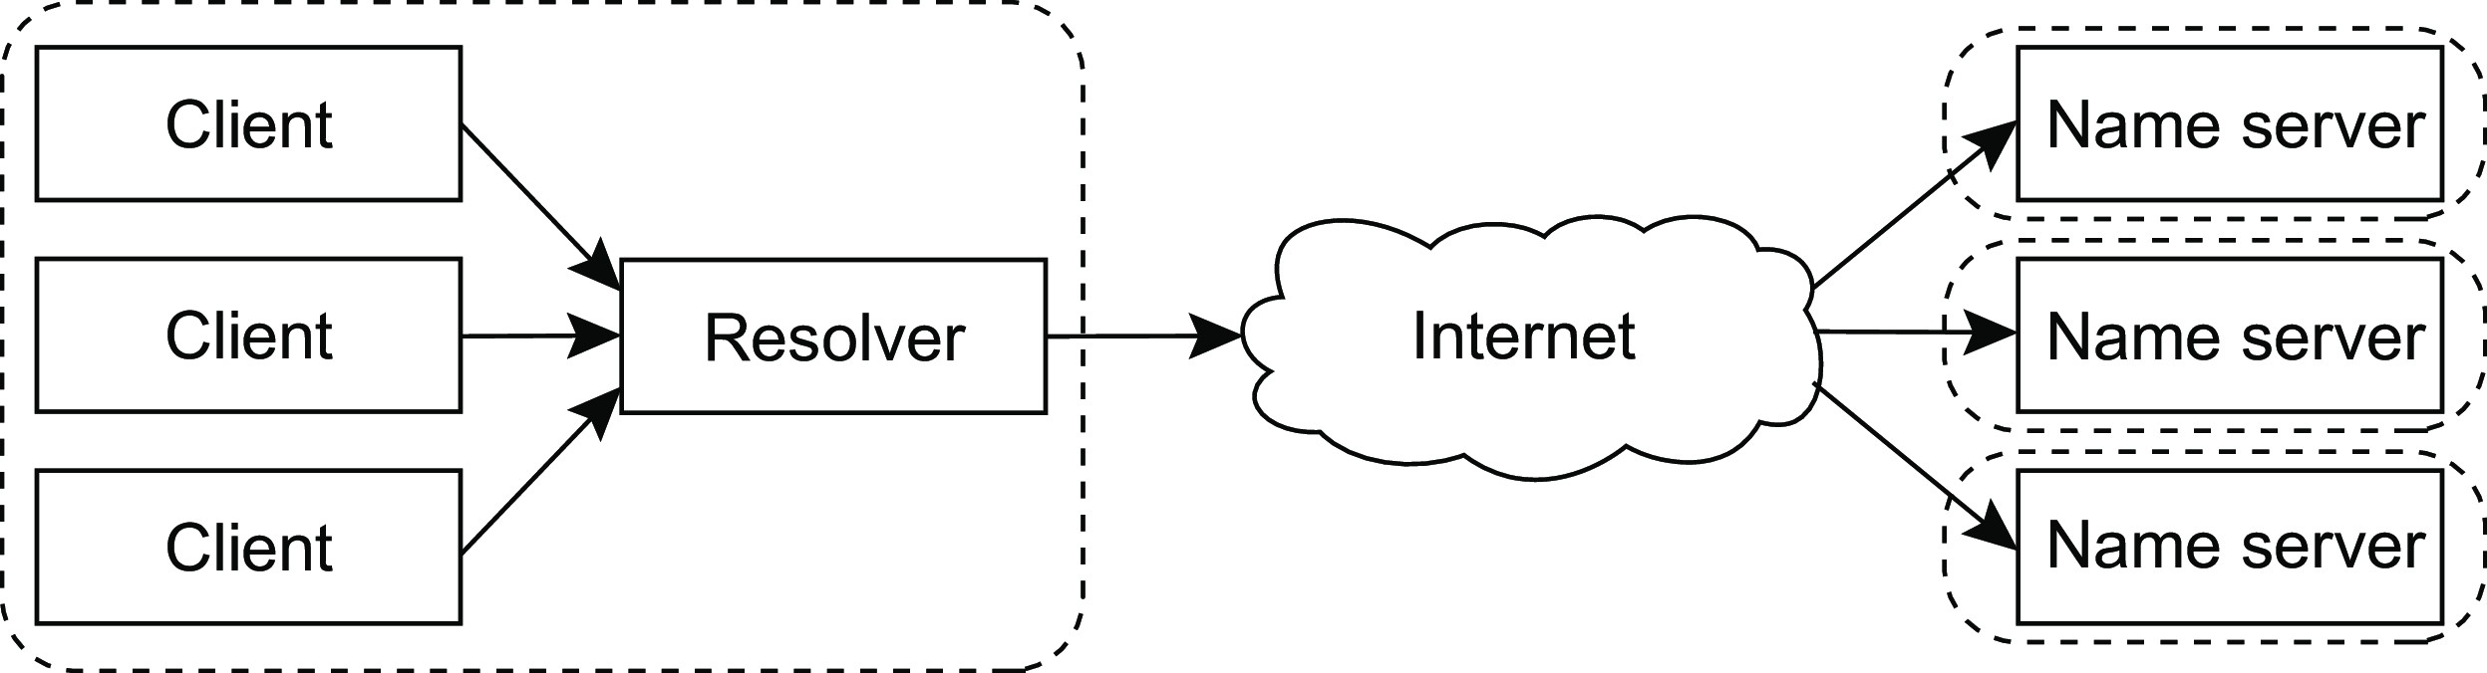
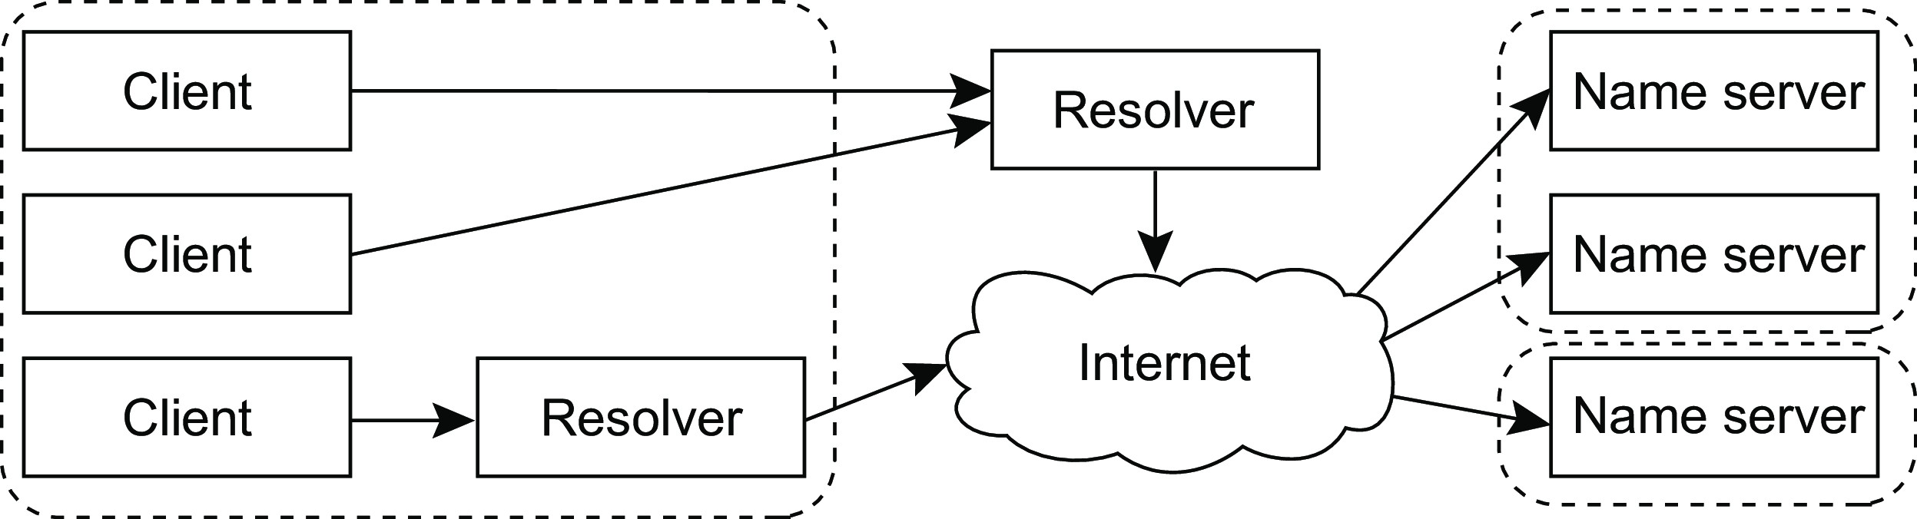
Naming
Structured naming
Modern DNS
The traditional organization of the implementation of DNS
The modern organization of DNS
Example: The Domain Name System

Slide 54
Secure DNS
Naming Structured naming
Basic approach
Resource records of the same type are grouped into a signed set, per zone. Examples:
A set with all the IPv4 addresses of a zone
A set with all the IPv6 addresses of a zone
A set with the name servers of a zone
The public key associated with the secret key used for signing a set of resource records is added to a zone, called a zone-signing key.
Trusting the signatures
All zone-signing keys are grouped again into a separate set, which is signed using another secret key. The public key of the latter is the key-signing key.
The hash of the key-signing key is stored at, and signed by, the parent zone
Example: The Domain Name System

Slide 55
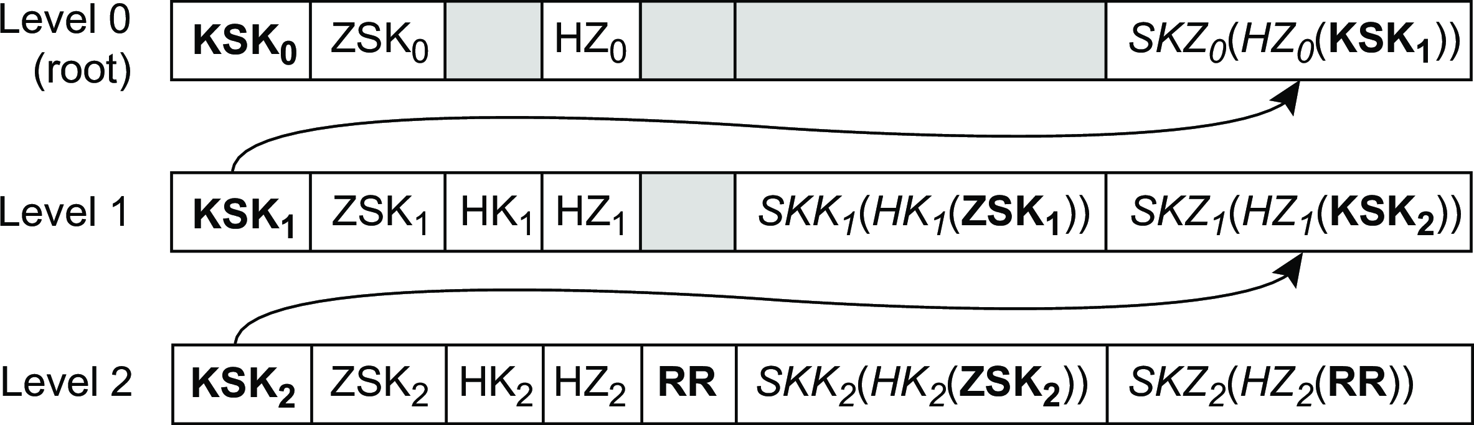
Naming
Structured naming
Secure DNS
Building a trust chain
Consider a single set of resource records RR, hashed with HZ_{k} and signed with SKZ_{k}
SZK_{k} has associated public key ZSK_{k}
(Set of) ZSK_{k} is hashed with HK_{k} and signed with SKK_{k}
SKK_{k} has associated public key KSK_{k}
A client can verify signature SKZ₂(HZ₂(RR)) by checking
?
ZSK₂(SKZ₂(HZ₂(RR))) = HZ (RR)
2
Example: The Domain Name System

Slide 56
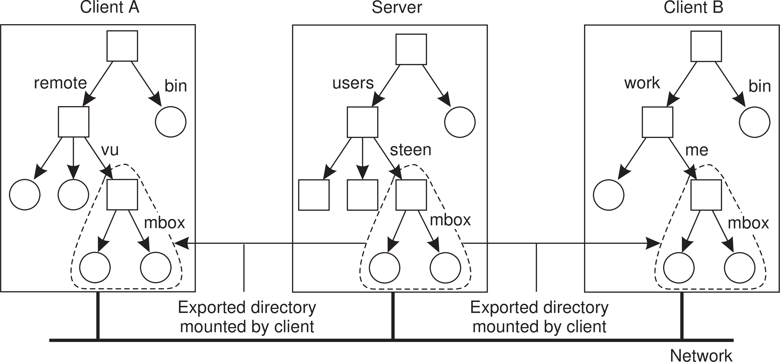
Naming
Structured naming
Naming in NFS
Observation
A server may export (a part of) its filesystem, which can then be imported by different clients by mounting. Note that different clients will have different (nonsharable) namespaces!
Example: The Network File System

Slide 57
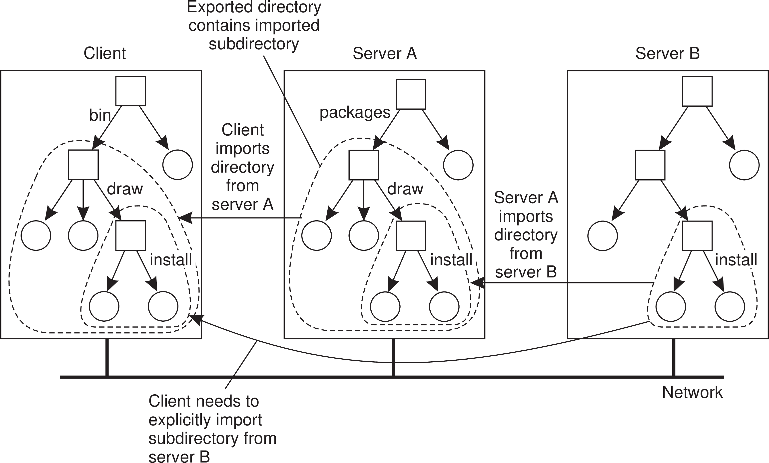
Naming
Structured naming
Mounting nested directories
Example: The Network File System

Slide 58
Attribute-based naming
Naming Attribute-based naming
Observation
In many cases, it is much more convenient to name, and look up entities through their attributes ⇒ traditional directory services (aka yellow pages).
Directory services

Slide 59
Attribute-based naming
Naming Attribute-based naming
Observation
In many cases, it is much more convenient to name, and look up entities through their attributes ⇒ traditional directory services (aka yellow pages).
Problem
Lookup operations can be expensive, as they require matching requested attribute values, against actual attribute values ⇒ inspect all entities (in principle).
Directory services

Slide 60
Implementing directory services
Naming Attribute-based naming
Solution for scalable searching
Implement basic directory service as database, and combine with traditional structured naming system.
Lightweight Directory Access Protocol (LDAP)
Each directory entry consists of (attribute, value) pairs, and is uniquely named to ease lookups.
Attribute | Abbr. | Value
Country | C | NL
Locality | L | Amsterdam
Organization | O | VU University
OrganizationalUnit | OU | Computer Science
CommonName | CN | Main server
Mail Servers | – | 137.37.20.3, 130.37.24.6, 137.37.20.10
FTP Server | – | 130.37.20.20
WWW Server | – | 130.37.20.20
Hierarchical implementations: LDAP

Slide 61
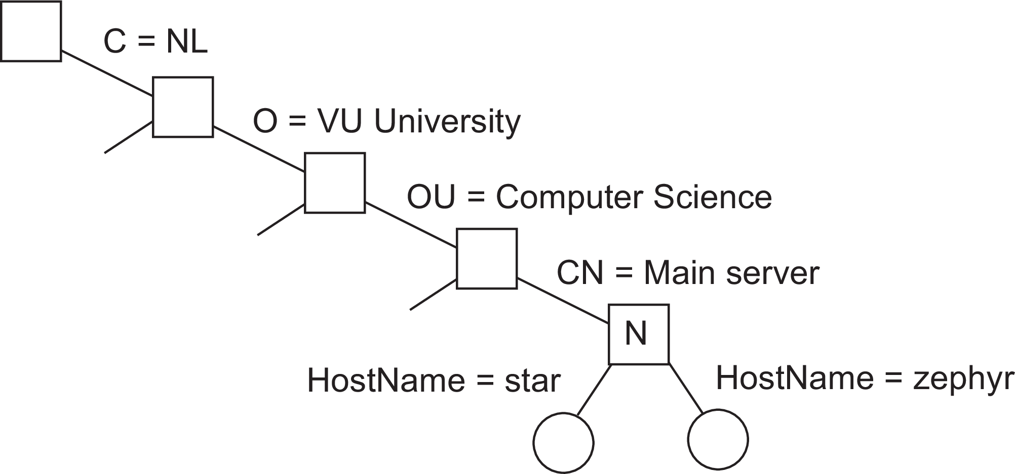
LDAP
Naming Attribute-based naming
Essence
Directory Information Base: collection of all directory entries in an LDAP service.
Each record is uniquely named as a sequence of naming attributes (called Relative Distinguished Name), so that it can be looked up.
Directory Information Tree: the naming graph of an LDAP directory service; each node represents a directory entry.
Part of a directory information tree
Hierarchical implementations: LDAP

Slide 62
Naming
Attribute-based naming
LDAP
Two directory entries having HostName as RDN
Attribute | Value | Attribute | Value
Locality | Amsterdam | Locality | Amsterdam
Organization | VU University | Organization | VU University
OrganizationalUnit | Computer Science | OrganizationalUnit | Computer Science
CommonName | Main server | CommonName | Main server
HostName | star | HostName | zephyr
HostAddress | 192.31.231.42 | HostAddress | 137 .37 .20.10
Result of search("(C=NL)(O=VU University)(OU=*)(CN=Main server)")
Hierarchical implementations: LDAP

Slide 63
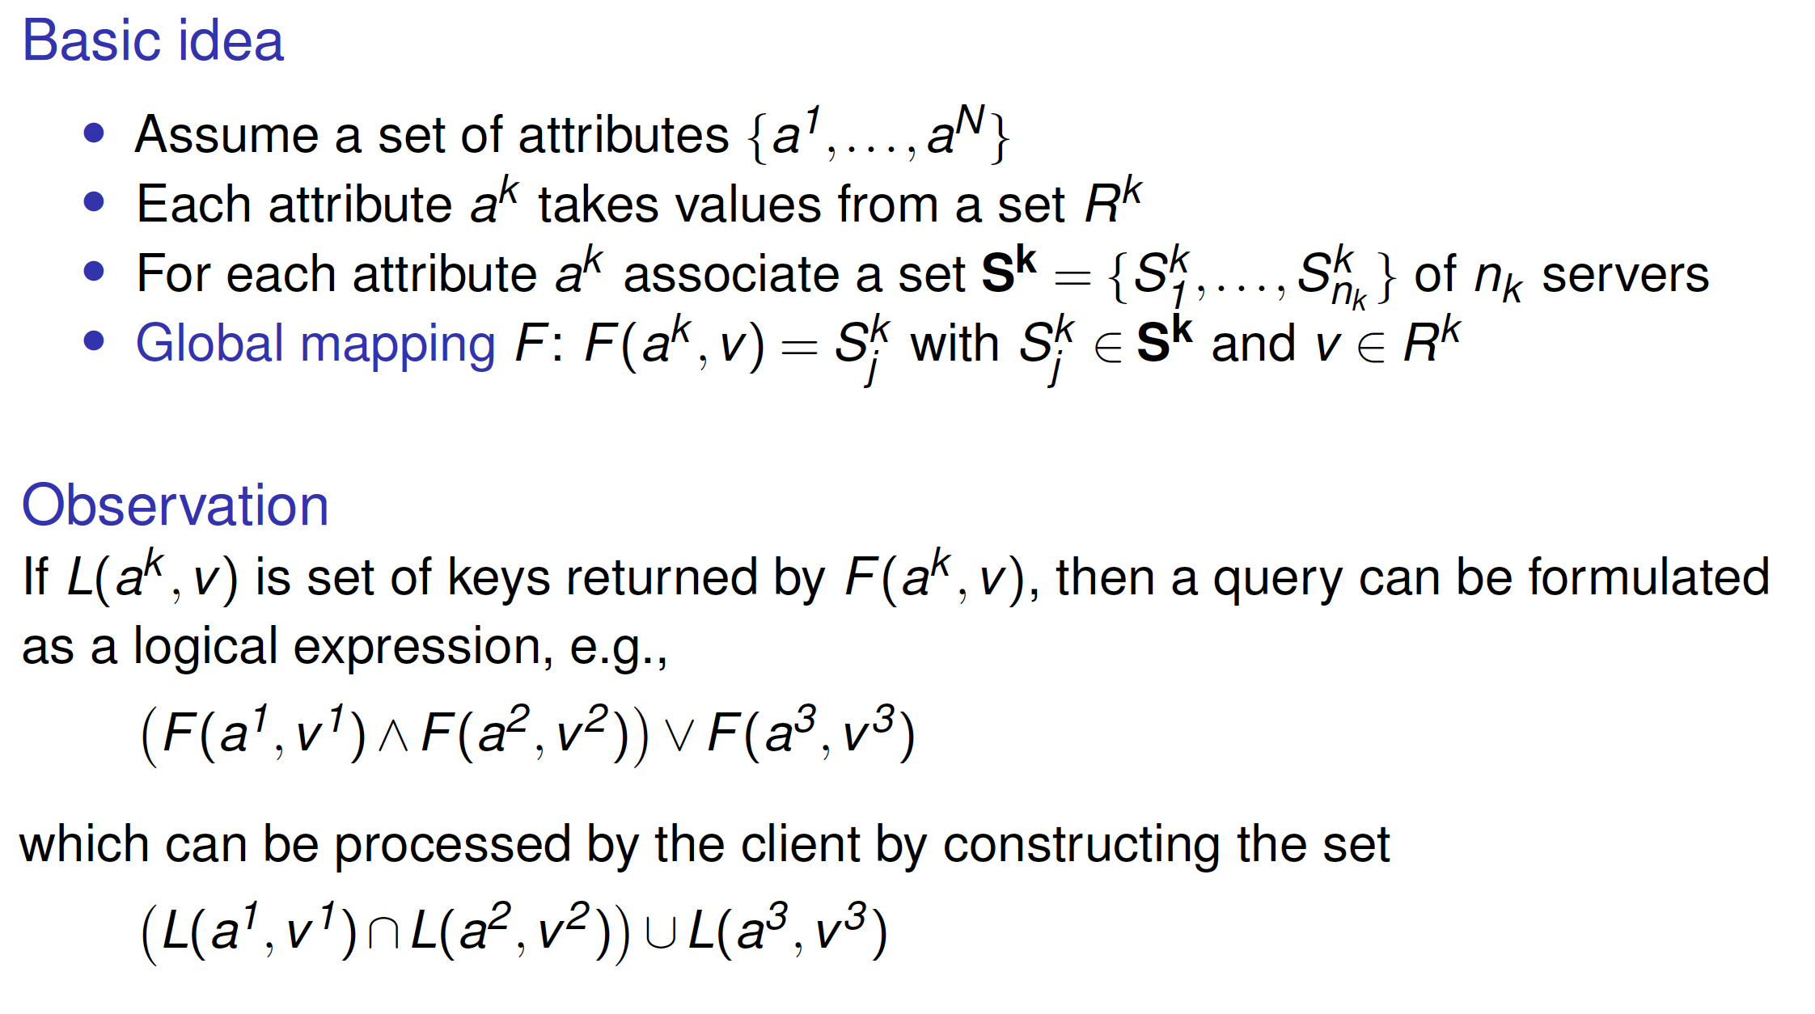
Naming
Attribute-based naming
Distributed index
Decentralized implementations

Slide 64
Drawbacks of distributed index
Naming Attribute-based naming
Quite a few
A query involving k attributes requires contacting k servers
Imagine looking up “lastName = Smith ∧firstName = Pheriby ”: the client may need to process many files as there are so many people named “Smith.”
No (easy) support for range queries, such as “price = [1000 − 2500].”
Decentralized implementations

Slide 65
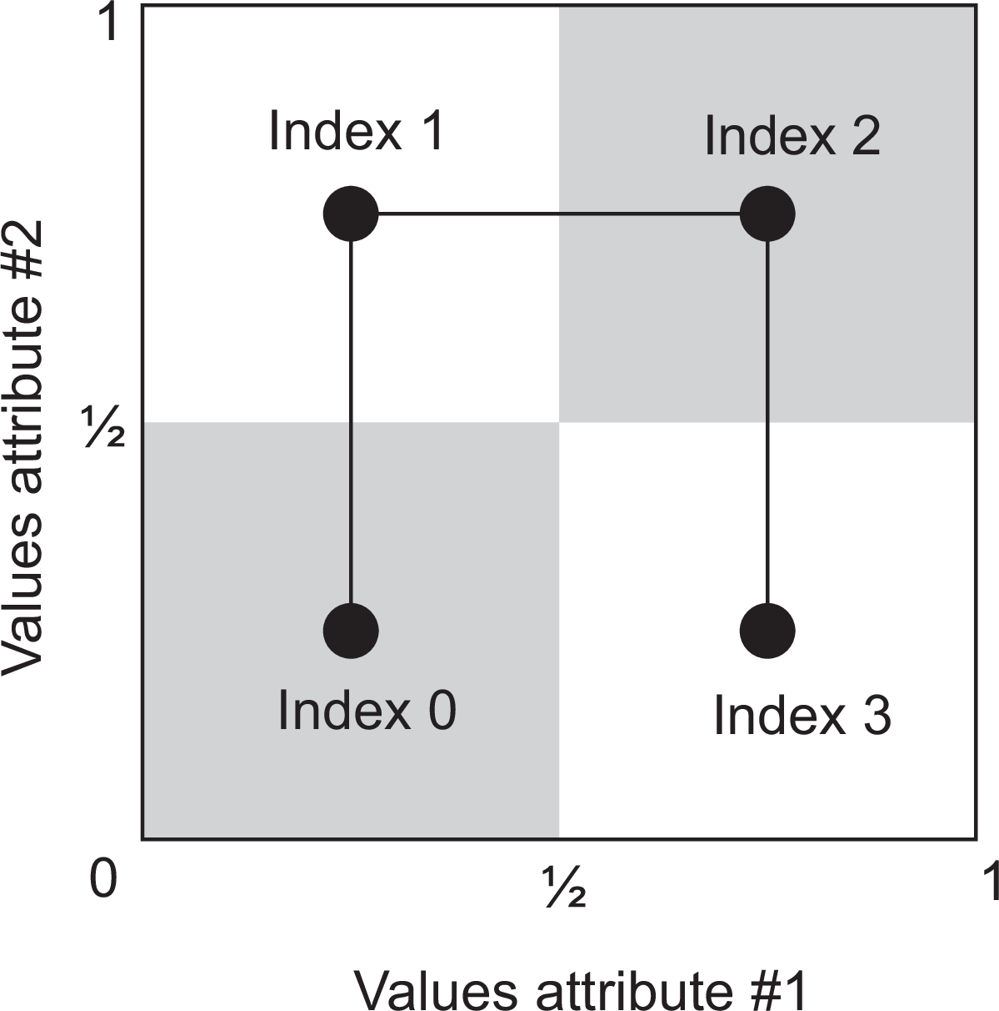
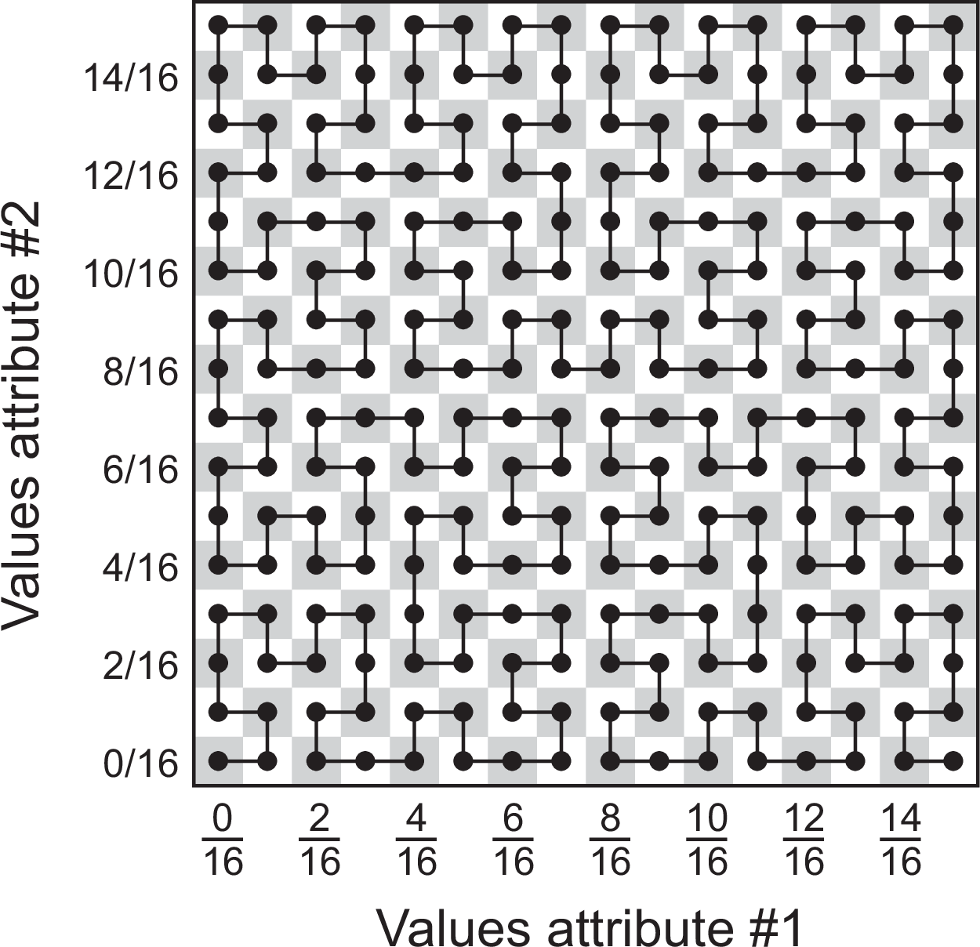
Alternative: map all attributes to 1 dimension and then index
Naming Attribute-based naming
Space-filling curves: principle
Map the N-dimensional space covered by the N attributes {a¹,..., a^{N} }
into a single dimension
Hashing values in order to distribute the 1-dimensional space among index servers.
Hilbert space-filling curve of (a) order 1, and (b) order 4
(a)
(b)
Decentralized implementations

Slide 66
Space-filling curve
Naming Attribute-based naming
Once the curve has been drawn
Consider the two-dimensional case
a Hilbert curve of order k connects 2^{2k} subsquares ⇒ has 2^{2k} indices.
A range query corresponds to a rectangle R in the 2-dimensional case
R intersects with a number of subsquares, each one corresponding to an index ⇒ we now have a series of indices associated with R.
Getting to the entities
Each index is to be mapped to a server, who keeps a reference to the associated entity. One possible solution: use a DHT.
Decentralized implementations

Slide 67
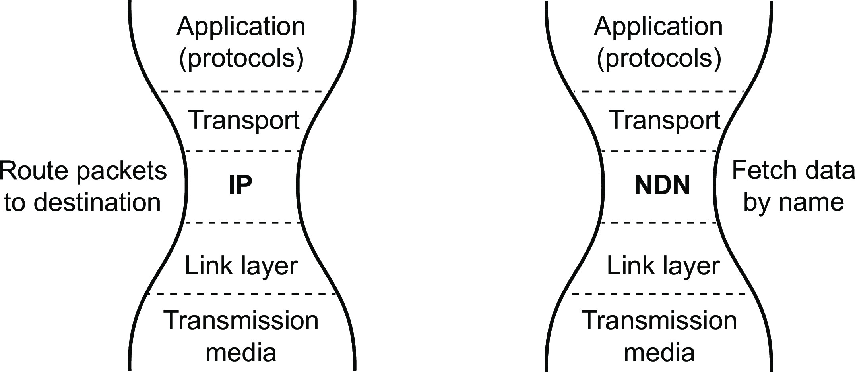
Naming
Named-data networking
Named-data networking
Basics
Retrieve an entity from the network by using that entity’s name and not address.
The network takes that name as input, and routes a request to a location where the entity is stored.
NDN takes over the role of IP in a future architecture of the Internet,
Example name
/distributed-systems.net/books/Distributed Systems/4/01/Naming
Basics

Slide 68
Routing
Naming Named-data networking
Question
Is there really a difference in attempting to route a request such as
distributed-systems.net/books/Distributed Systems/4/01/Naming
from the IPv6 address
2001:610:508:108:192:87:108:15
Key observation
Theres is no fundamental difference. We decide which part of a name or address (i.e., a prefix) should be announced within a global routing substrate, just as with IPv4 addresses with BGP routers.
Routing

Slide 69
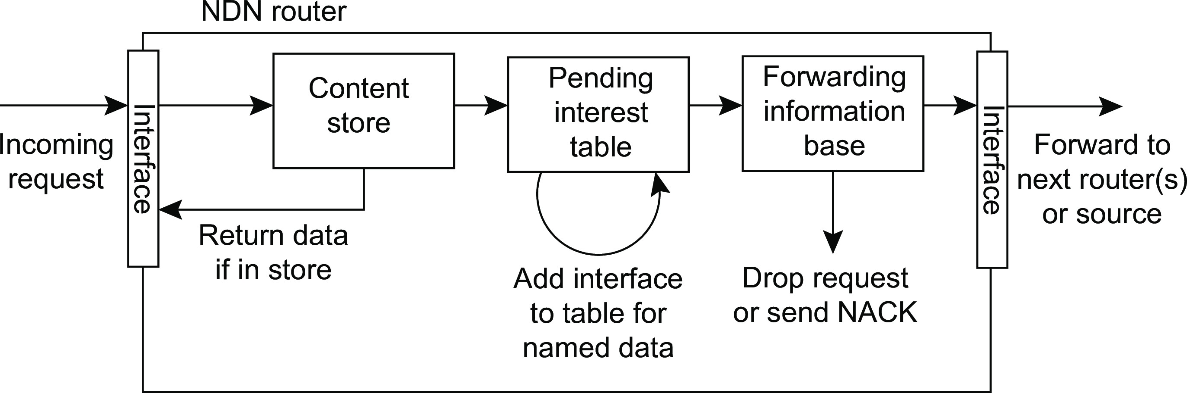
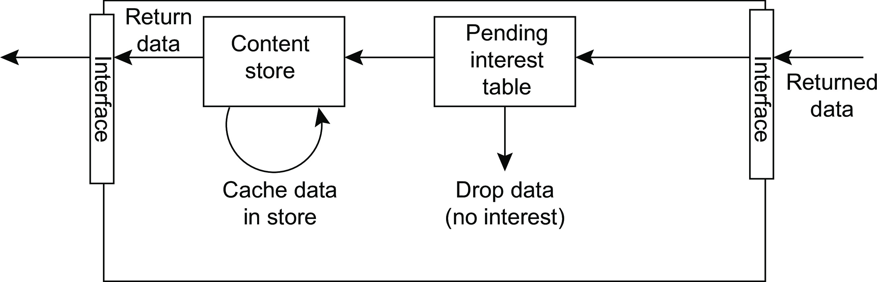
Naming
Named-data networking
Routing
Forwarding a request to (a next router on the way to) its destination
Returning the request (to a router) on the path toward requester
Routing

