Slide 1
Distributed Systems
(4th edition, version 01)
Chapter 09: Security

Slide 2
Dependability
Security Introduction to security
Basics
A dependable system provides availability, reliability, safety, maintainability, confidentiality, and integrity.
Confidentiality: refers to the property that information is disclosed only to authorized parties.
Integrity: alterations to a system’s assets can be made only in an authorized way, ensuring accuracy and completeness.
Security threats, policies, and mechanisms

Slide 3
Dependability
Security Introduction to security
Basics
A dependable system provides availability, reliability, safety, maintainability, confidentiality, and integrity.
Confidentiality: refers to the property that information is disclosed only to authorized parties.
Integrity: alterations to a system’s assets can be made only in an authorized way, ensuring accuracy and completeness.
Alternative
We attempt to protect against security threats:
Unauthorized information disclosure (confidentiality)
Unauthorized information modification (integrity)
Unauthorized denial of use (availability)
Security threats, policies, and mechanisms

Slide 4
Security mechanisms
Security Introduction to security
Encryption: transform data to something an attacker cannot understand, or that can be checked for modificatons.
Authentication: verify a claimed identity.
Authorization: check an authenticated entity whether it has the proper rights to access resources.
Monitoring and auditing: (continuously) trace access to resources
Security threats, policies, and mechanisms

Slide 5
Security principles
Security Introduction to security
Fail-safe defaults: defaults should already provide good protection. Infamous example: the default “admin,admin” for edge devices.
Open design: do not apply security by obscurity: every aspect of a distributed system is open for review.
Separation of privilege: ensure that critical aspects of a system can never be fully controlled by just a single entity.
Least privilege: a process should operate with the fewest possible privileges.
Least common mechanism: if multiple components require the same mechanism, then they should all be offered the same implementation of that mechanism.
Design issues

Slide 6
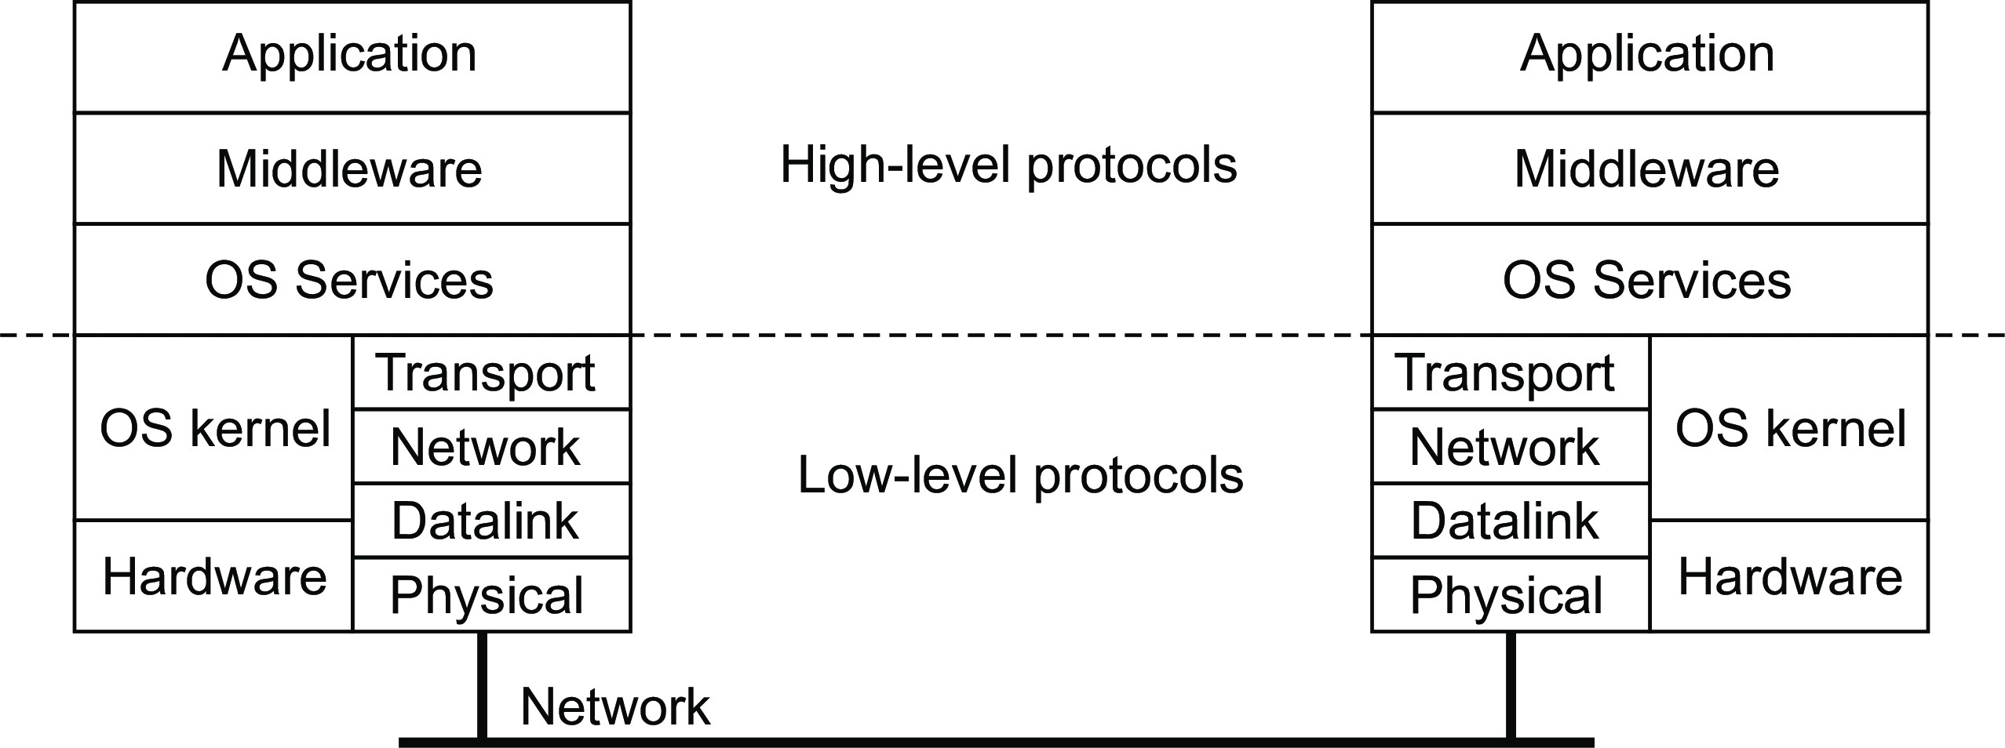
Security
Introduction to security
Where to implement security mechanisms?
Observation
We are increasingly seeing end-to-end security, meaning that mechanisms are implemented at the level of applications.
Design issues

Slide 7
Security
Introduction to security
Where to implement security mechanisms?
Observation
We are increasingly seeing end-to-end security, meaning that mechanisms are implemented at the level of applications.
Issue: which layer do we trust?
Trusted Computing Base: The set of all security mechanisms in a (distributed) computer system that are necessary and sufficient to enforce a security policy.
Design issues

Slide 8
On privacy
Security Introduction to security
Observation
Privacy and confidentiality are closely related, yet are different. Privacy can be invaded, whereas confidentiality can be breached ⇒ ensuring confidentiality is not enough to guarantee privacy.
Design issues

Slide 9
On privacy
Security Introduction to security
Observation
Privacy and confidentiality are closely related, yet are different. Privacy can be invaded, whereas confidentiality can be breached ⇒ ensuring confidentiality is not enough to guarantee privacy.
Right to privacy
The right to privacy is about “a right to appropriate flow of personal information.” Control who gets to see what, when, and how ⇒ a person should be able to stop and revoke a flow of personal information.
Design issues

Slide 10
On privacy
Security Introduction to security
Observation
Privacy and confidentiality are closely related, yet are different. Privacy can be invaded, whereas confidentiality can be breached ⇒ ensuring confidentiality is not enough to guarantee privacy.
Right to privacy
The right to privacy is about “a right to appropriate flow of personal information.” Control who gets to see what, when, and how ⇒ a person should be able to stop and revoke a flow of personal information.
General Data Protection Regulation (GDPR)
The GDPR is a comprehensive set of regulations aiming to protect personal data.
Design issues

Slide 11
Security
Introduction to security
GDPR: Database perspective
GDPR regulation | Impact on database systems
 | Attributes | Actions
Collect data for explicit purposes | Purpose | Metadata indexing
Do not store data indefinitely | TTL | Timely deletion
Inform customers about GDPR metadata associated with their data | Purpose, TTL, Origin, Sharing | Metadata indexing
Allow customers to access their data | Person id | Metadata indexing
Allow customers to erase their data | TTL | Timely deletion
Do not use data for objected reasons | Objections | Metadata indexing
Allow customers to withdraw from algorithmic decision-making | Automated decisions | Metadata indexing
Safeguard and restrict access to data |  | Access control
Do not grant unlimited access to data |  | Access control
Audit operations on personal data | Audit trail | Monitor and log
Implement appropriate data security |  | Encryption
Share audit trails from affected systems | Audit trail | Monitor and log
Design issues

Slide 12
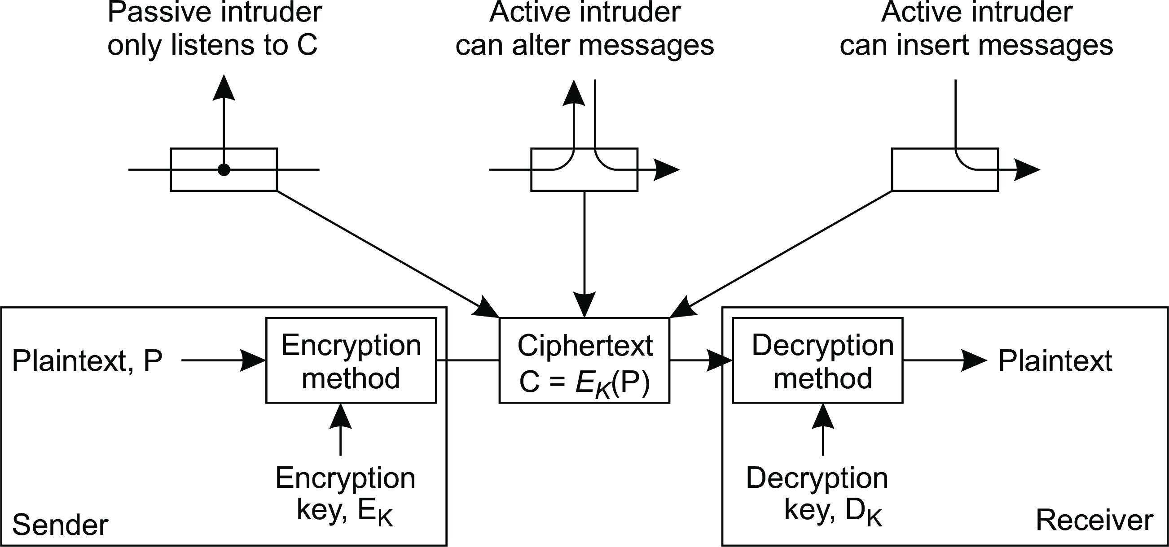
Security
Cryptography
Cryptography
Basic concepts
Plaintext: the original message or data (P)
Ciphertext: the encrypted version of the the plaintext (C)
Encryption key: input E_{K} to a function for encryption: C = E_{K} (P)
Decryption key: input D_{K} to a function for decryption: P = D_{K} (C)
Basics

Slide 13
Cryptosystems
Security Cryptography
Symmetric : if P = D_{K} (E_{K} (P)) then D_{K} = E_{K} .
Asymmetric : if P = D_{K} (E_{K} (P)) then D_{K} ̸= E_{K} .
Also called public-key systems with a publicly known key PK and secret key SK
Examples
Let PK_{X} denote public key of X and SK_{X} the associated secret key.
Confidential message : if m is to be kept private: C = PK_{receiver} (m).
Authenticated message : if m is to be authenticated: C = SK_{sender} (m).
Homomorphic encryption
Mathematical operations on plaintext can be performed on the corresponding ciphertext: if x and y are two numbers, then
E_{K} (x ) ⋆E_{K} (y ) = E_{K} (x ⋆y )
Symmetric and asymmetric cryptosystems

Slide 14
Security
Cryptography
Hash functions
Description
A hash function H takes a message m of arbitrary length as input and produces a bit string h having a fixed length as output:
h = H(m) with length of h fixed.
Example: digital signature
Alice computes a digest from m; encrypts the digest with her private key; encrypted digest is sent along with m to Bob:
Alice: send [m, sig] with sig = SK_{A}(H(m)).
Bob decrypts digest with Alice’s public key; separately calculates the message digest. If both match, Bob knows the message has been signed by Alice:
Bob: receive [m, sig], compute h′ = H(m) and verify h′ = PK_{A}(sig).
Hash functions

Slide 15
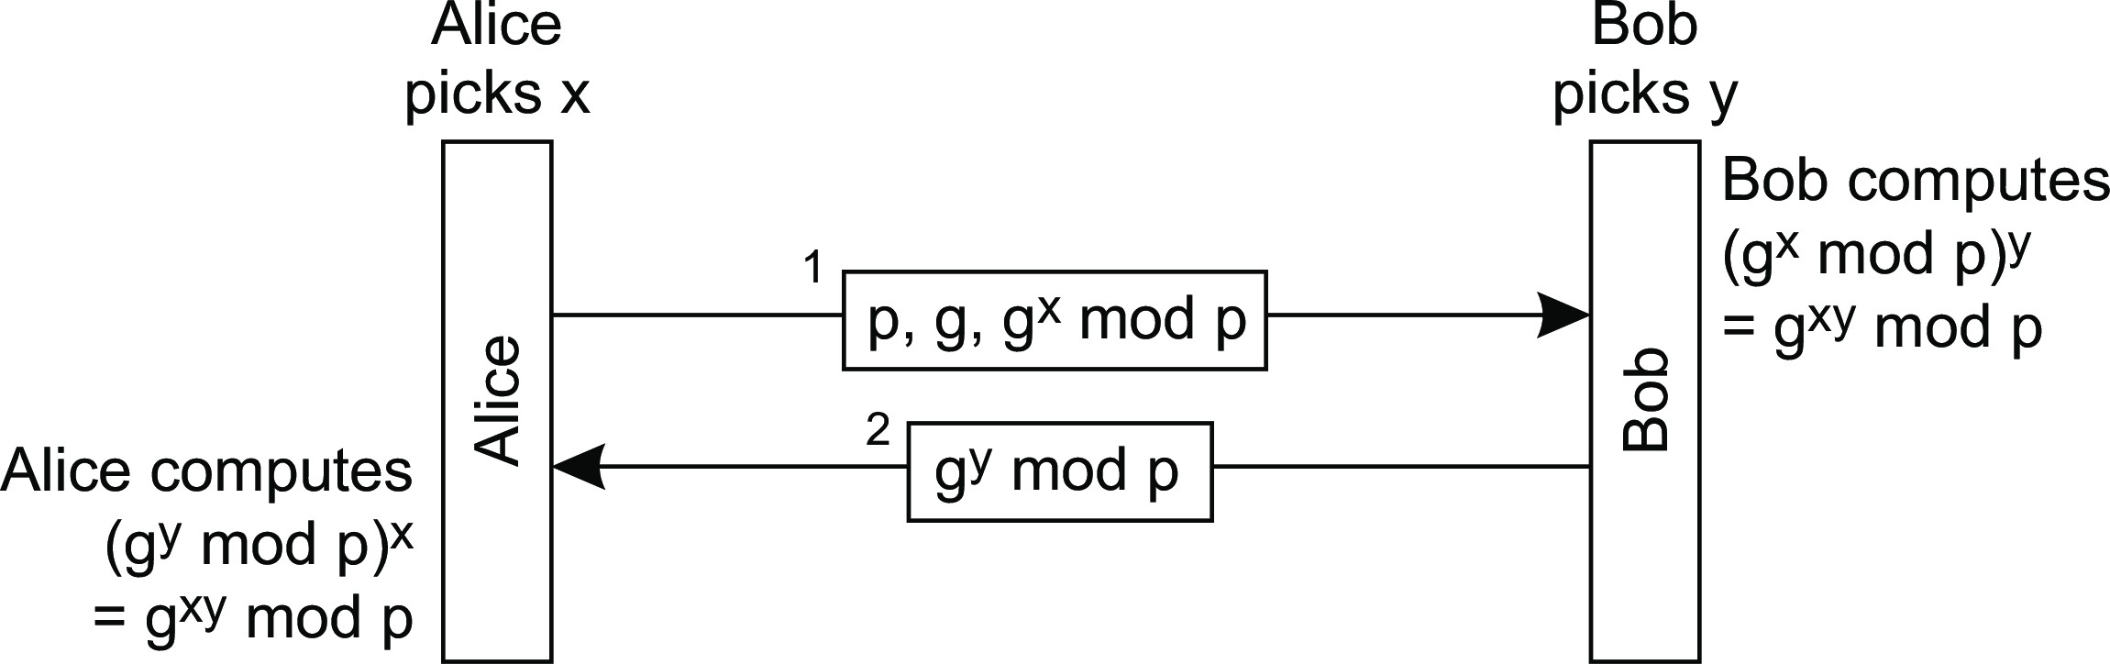
Key management
Security Cryptography
Essence
How do Alice and Bob get the correct (often shared) keys so that they can set up secure channels?
Diffie-Hellman key exchange
Assume two large, nonsecret numbers p and g (with specific mathematical properties):
Key management

Slide 16
Security
Cryptography
DH key exchange: example
Multiparty computation
Can we protect private data while computing statistics? Who has the highest salary without revealing salaries? Can we compute the number of votes cast for a specific candidate without revealing who voted for whom?
Key management

Slide 17
Security
Cryptography
DH key exchange: example
Multiparty computation
Can we protect private data while computing statistics? Who has the highest salary without revealing salaries? Can we compute the number of votes cast for a specific candidate without revealing who voted for whom?
Oblivious transfer
Alice has n secret messages m₁,..., m_{n} . Bob is interested (and allowed) to know only message m_{i} . Which message he wants to know should be kept secret to Alice; all messages m_{j} ̸= m_{i} should be kept secret to Bob.
Key management

Slide 18
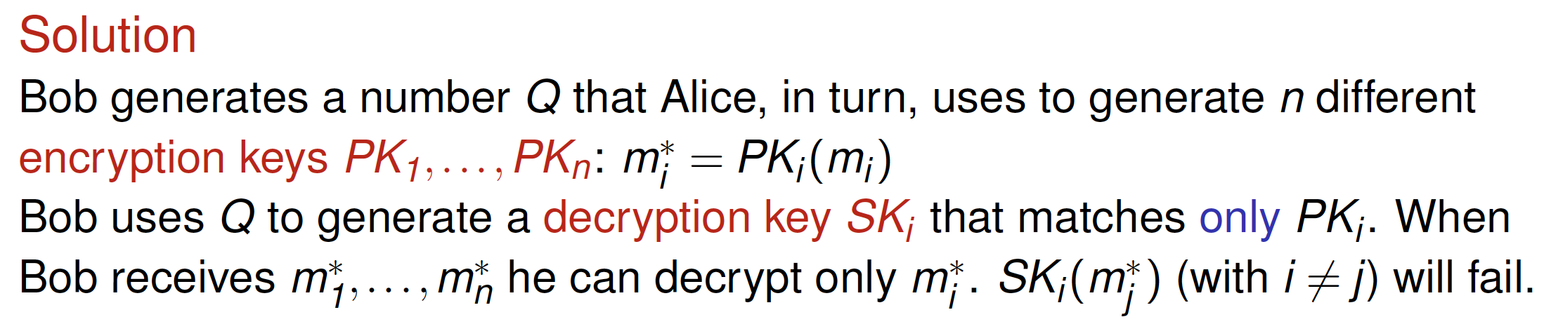
Security
Cryptography
DH key exchange: example
Multiparty computation
Can we protect private data while computing statistics? Who has the highest salary without revealing salaries? Can we compute the number of votes cast for a specific candidate without revealing who voted for whom?
Oblivious transfer
Alice has n secret messages m₁,..., m_{n} . Bob is interested (and allowed) to know only message m_{i} . Which message he wants to know should be kept secret to Alice; all messages m_{j} ̸= m_{i} should be kept secret to Bob.
Key management

Slide 19
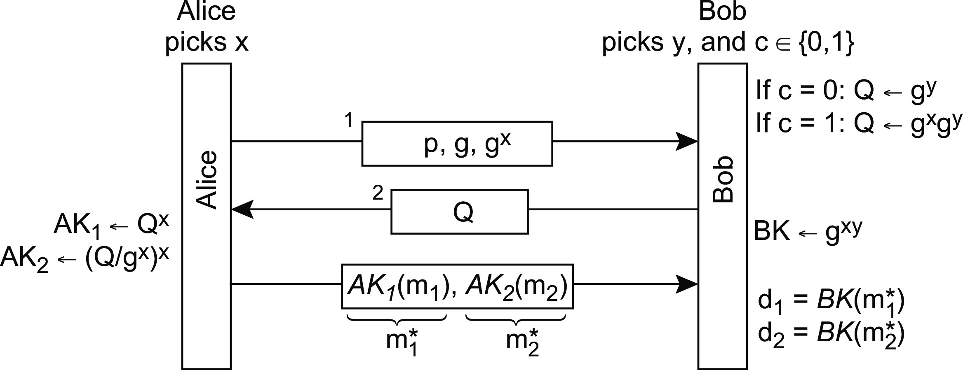
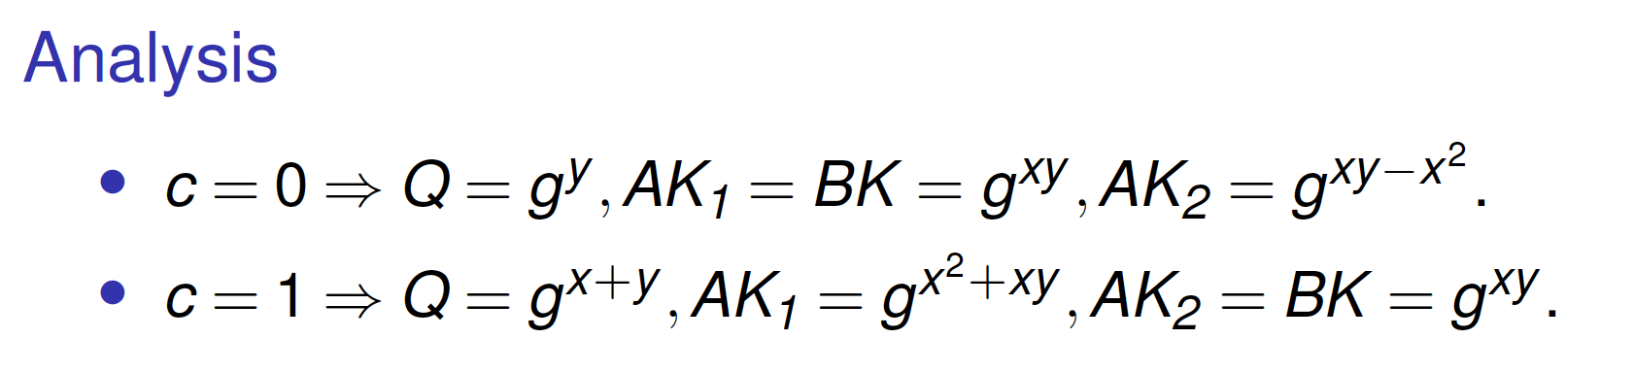
Security
Cryptography
1-out-of-2 oblivious transfer
Key management

Slide 20
Security
Cryptography
Example, continued
Preliminaries
P₁ and P₂ need to compute F (a, b).
Parameter a is secret and known only to P₁; secret b known only to P₂ .
a ∈ X and b ∈ Y; X and Y are finite.
Construct a |X|×|Y| matrix F.
F[i, j ] = F (x_{i} , y_{j} ) for each pair (x_{i} , y_{j} ) ∈ X × Y.
Solution
P₁ generates |X| · |Y| unique key pairs (K_{i} , K_{j} )
Construct F∗[i, j ] = K_{i} (K_{j} (F (x_{i} , x_{j} ))). Assume a = x_{i} ).
P₁ permutes F∗ and sends it along with K_{i} to P₂
P₁ sends Q using a 1-out-of-|Y| oblivious transfer.
Assume b = y_{j} . Using Q, P₂ can construct K_{j} , and only K_{j}
P₂ decrypts F∗[i, j ], corresponding to F (a, b).
Key management

Slide 21
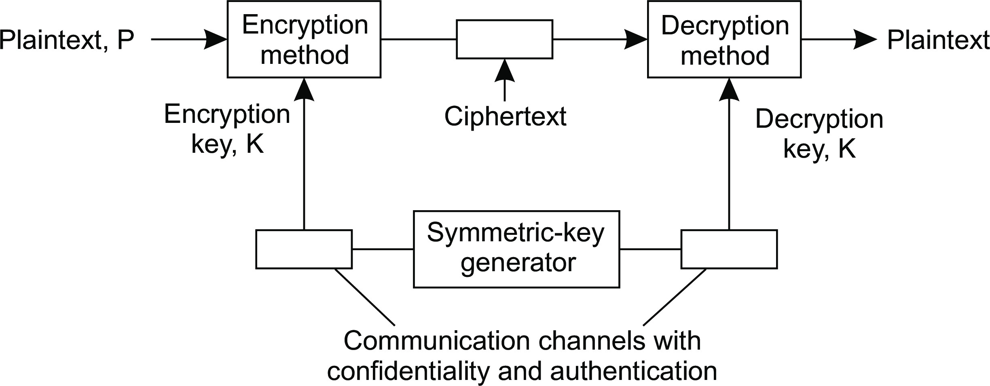
Security
Cryptography
What is needed to distribute keys
Symmetric-key distribution
Observation
In general, we will need a secure channel to distribute the secret key to the communicating parties.
Key management

Slide 22
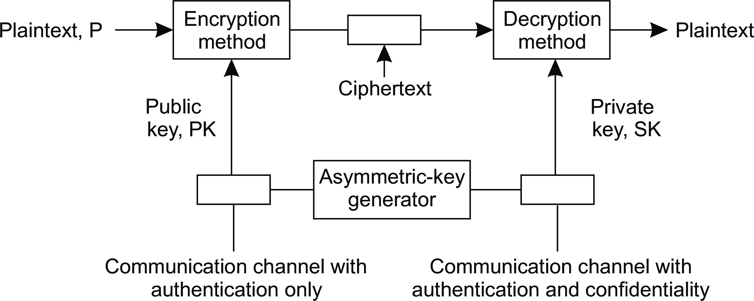
Security
Cryptography
What is needed to distribute keys
Public-key distribution
Observation
No need for a scure channel in the case of the public key, but you do need to know that the key is authentic ⇒ have the public key be signed by a certification authority. Note, we do need to trust that authority, or otherwise make sure that its signature can be verified as well.
Key management

Slide 23
Authentication
Security Authentication
Essence
Verifying the claimed identity of a person, a software component, a device, and so on.
Means of authentication
Based on what a client knows, such as a password or a personal identification number.
Based on what a client has, such as an ID card, cell phone, or software token.
Based on what a client is, i.e., static biometrics such as a fingerprint or facial characteristics.
Based on what a client does, i.e., dynamic biometrics such as voice patterns or typing patterns.
Introduction to authentication

Slide 24
Authentication versus message integrity
Security Authentication
Observation
Authentication without integrity (and vice versa) is meaningles:
Consider a system that supports authentication but no mechanisms to ensure message integrity. Bob may know for sure that Alice sent m, but how useful is that if he doesn’t know that m may have been modified?
Consider a system that guarantees message integrity, but does not provide authentication. Can Bob be happy with a guaranteed unmodified message that states he just won $1,000,000?
Authentication protocols

Slide 25
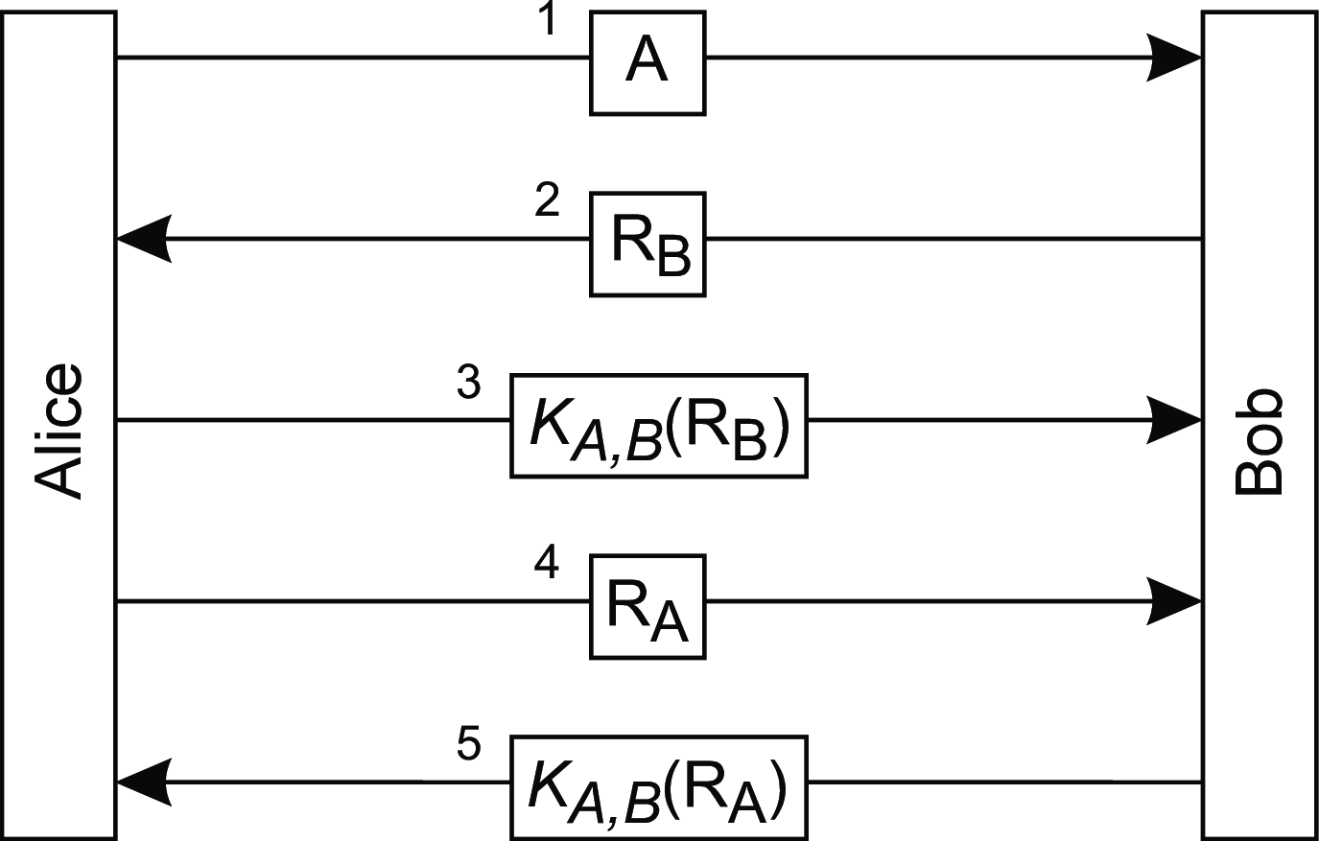
Security
Authentication
Using a shared secret key
Steps
Alice announces she wants to talk to Bob.
Bob returns a nonce.
Alice encrypts the nonce with the shared key K_{A,B} , thus proving that she owns K_{A,B} ⇒ Bob knows he’s talking to Alice.
Alice sends a nonce to Bob.
Bob returns proof that he owns the shared secret key as well ⇒ Alice knows she’s talking to Bob.
Authentication protocols

Slide 26
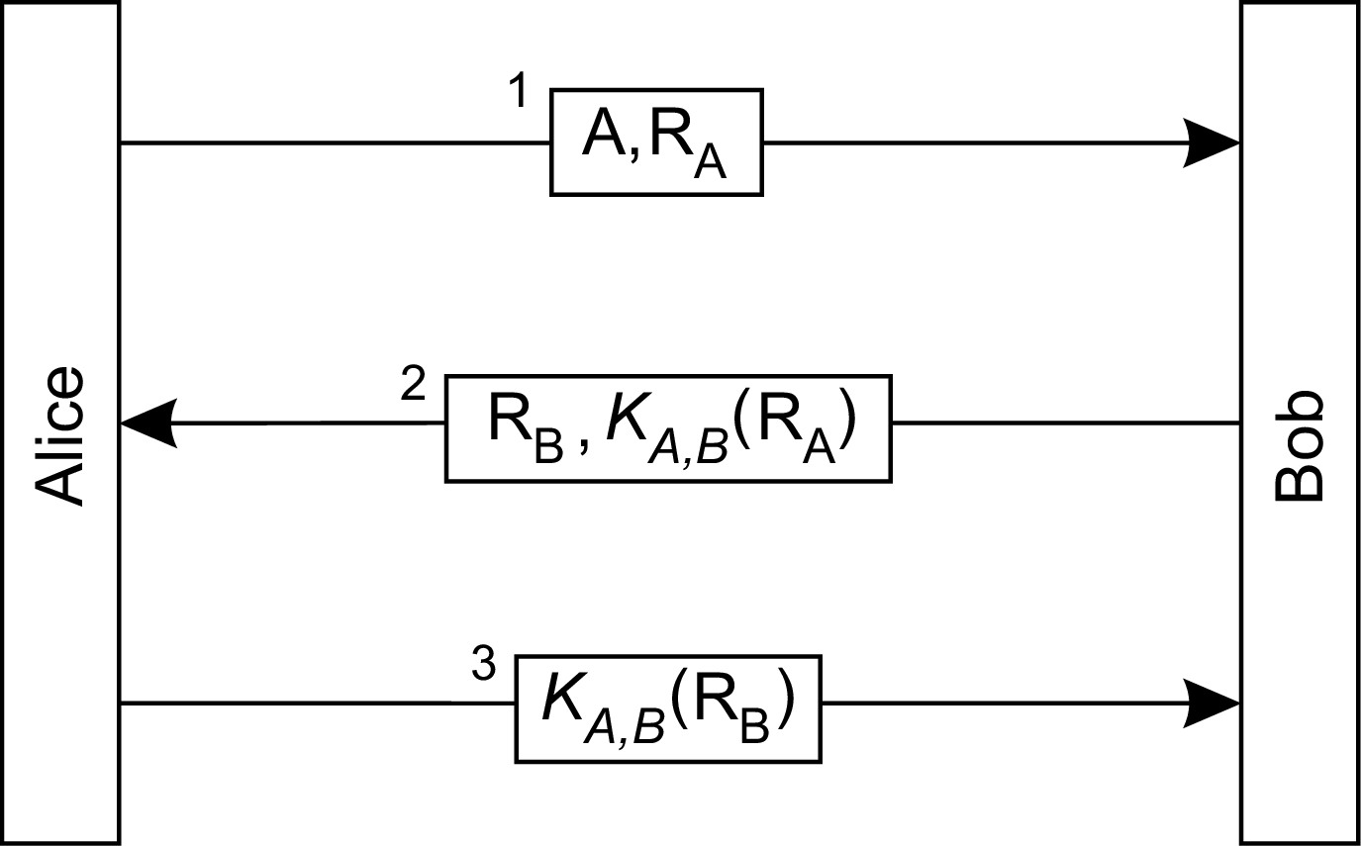
Security
Authentication
About optimizations
Let’s reduce the num- ber of messages
Authentication protocols

Slide 27
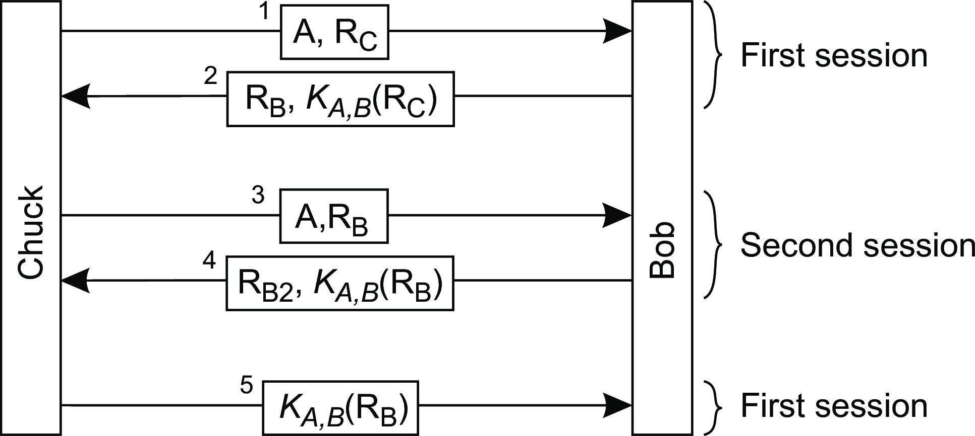
Security
Authentication
About optimizations
Let’s reduce the num- ber of messages
We just broke the pro- tocol
Authentication protocols

Slide 28
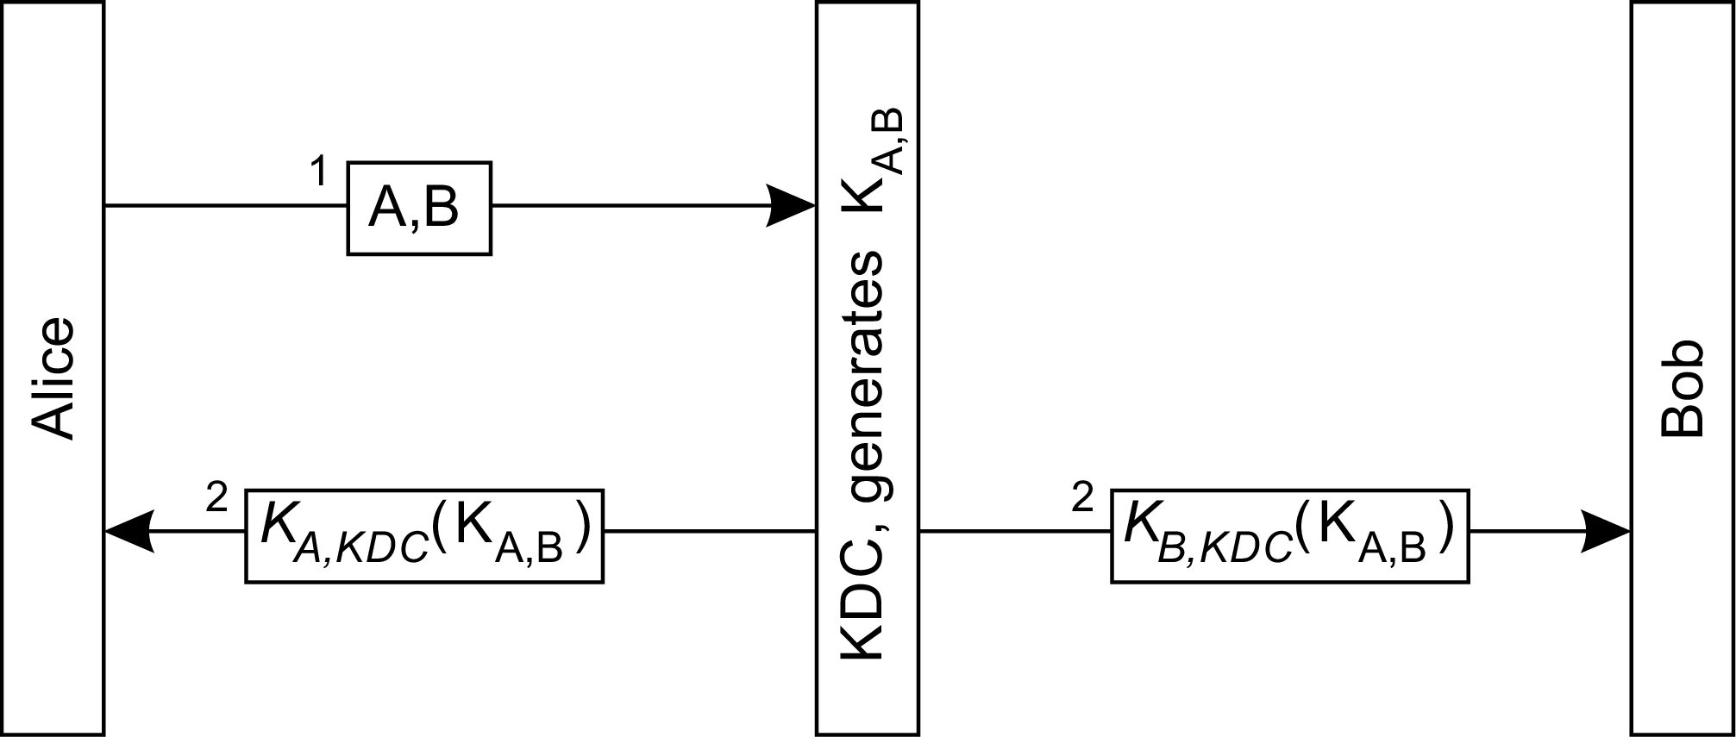
Security
Authentication
Using a Key Distribution Center
Basics
Every client has a secret key shared with the KDC.
Alice tells the KDC that she wants to talk to Bob
The KDC sends a fresh secret key, shared by Alice and Bob
Authentication protocols

Slide 29
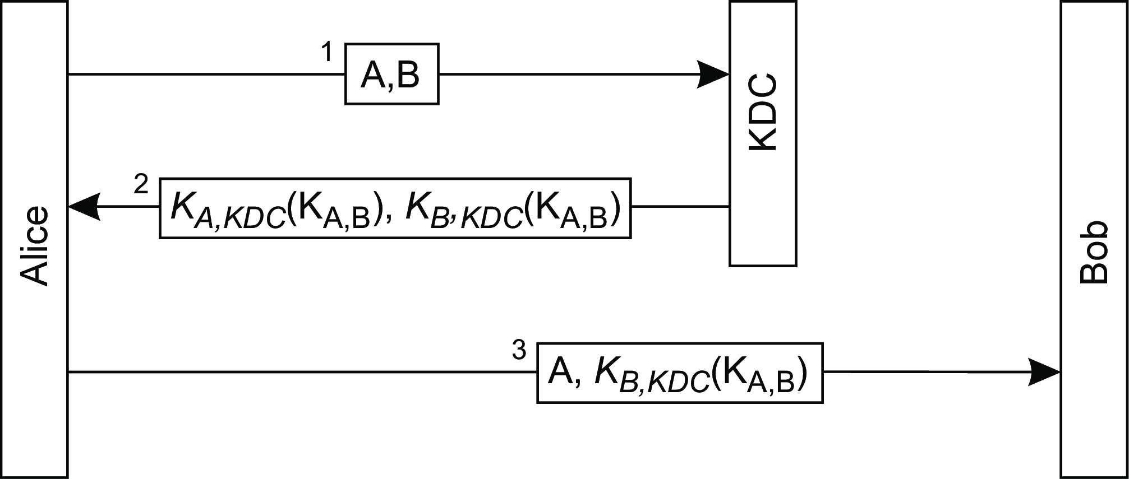
Security
Authentication
Using a Key Distribution Center
Basics
Using a ticket is practically better:
Alice tells the KDC that she wants to talk to Bob
The KDC sends a fresh secret key, shared by Alice and Bob
Alice tells Bob that she wants to talk, along with the key to be used.
Authentication protocols

Slide 30
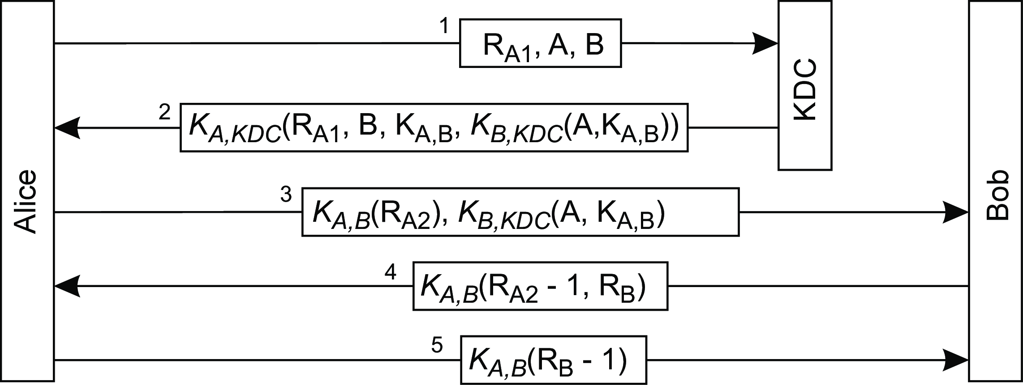
Security
Authentication
The Needham-Schroeder protocol
Important observation
In the case of request-response messages, you want to make sure that the received response, is associated with the sent request. Mitigates replay attacks.
General principle
Use nonces to relate any combination of request-response messages.
Authentication protocols

Slide 31
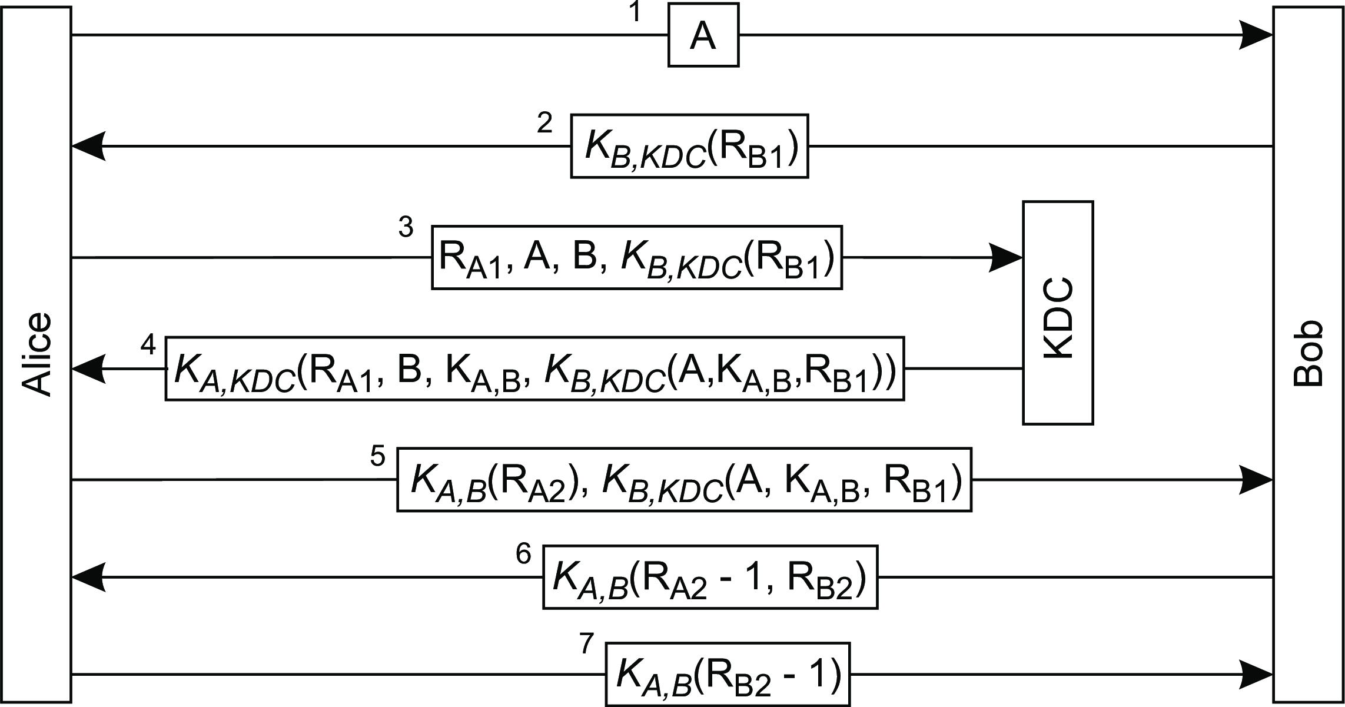
Security
Authentication
Mitigate against reuse of keys
Some observations
Note how B1 ties message #2 to #5
Note that by returning R_{A2} − 1 in #6, Bob proves he knows K_{A,B}
And, likewise, in the case of Alice in #6 (by modifying R_{B2} ).
Authentication protocols

Slide 32
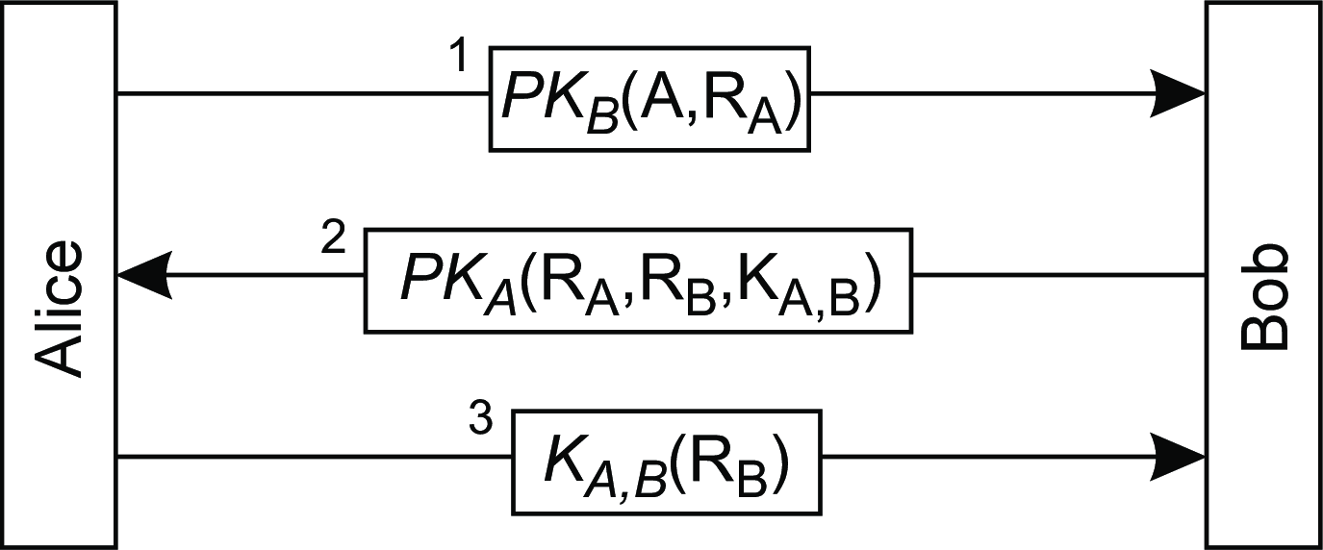
Security
Authentication
Using public keys
Steps
Alice tells Bob she wants to talk, sending a nonce R_{A}, and encrypting the message with Bob’s public key.
Bob generates a shared secret session key K_{A,B} , proves he is the owner of PK_{B} by decrypting R_{A}, and challenges Alice to prove she owns PK_{A}.
Alice decrypts the response, and proves to Bob that she is Alice by then sending Bob’s nonce back encrypted with the generated session key ^{K}A,B .
Authentication protocols

Slide 33
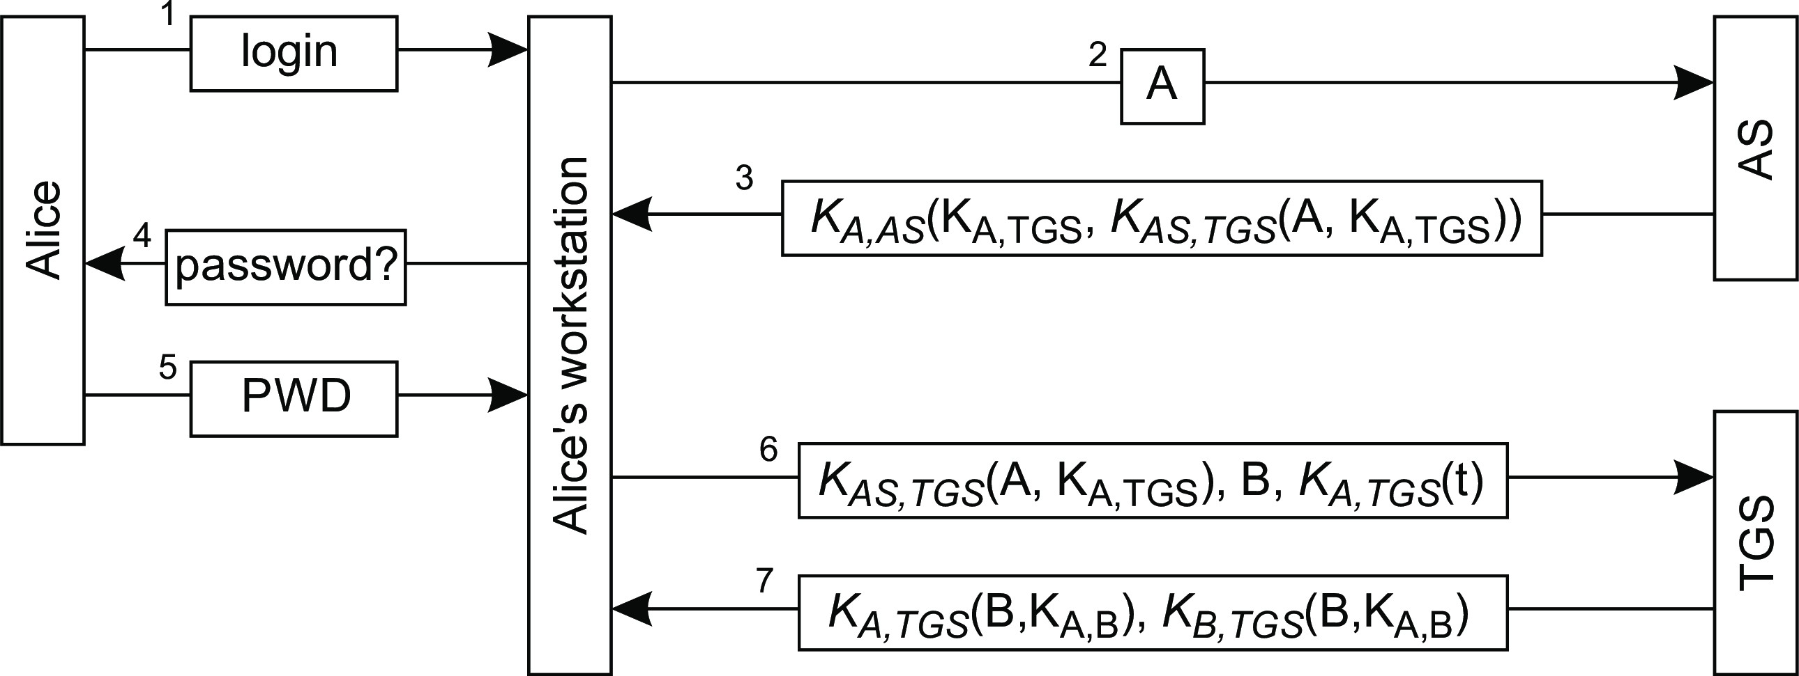
Security
Authentication
Practical example: Kerberos
Essence
1,2 Alice types in her login name.
3 The Authentication Service returns a ticket K_{AS,TGS} (A, K_{A,TGS} ) that she can use with the Ticket Granting Service.
4,5 To be able to decrypt the message, Alice must type in her password. She is then logged in. Using the AS in this way, we have a single sign-on system.
6,7 Alice wants to talk to Bob, and requests the TGS for a session key.
Authentication protocols

Slide 34
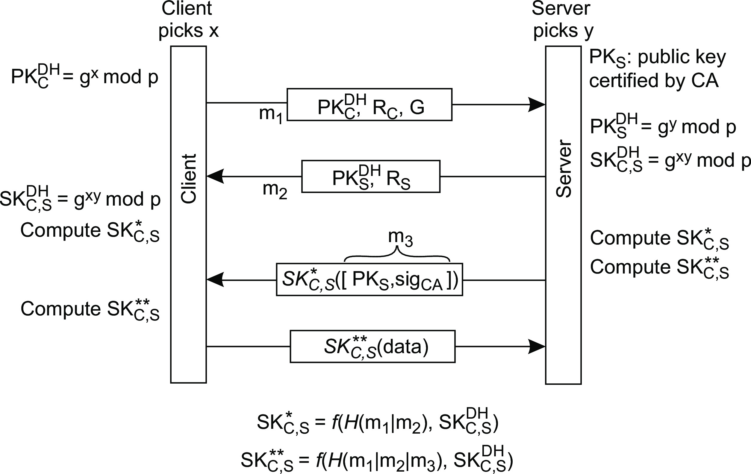
Security
Authentication
Transport Layer Security
G denotes a specific set of parameter settings, called a group (e.g., values for p and g).
Authentication protocols

Slide 35
Security
Authentication
Transport Layer Security
The client uses a nonce R_{C} ; the server uses R_{S}
•
H(m₁|m₂ ) denotes the hash over the concatenation of m₁ and m₂
Authentication protocols

Slide 36
On trust
Security Trust in distributed systems
Definition
Trust is the assurance that one entity holds that another will perform
particular actions according to a specific expectation.
Important observation
Expectations have been made explicit ⇒ no need to talk about trust?
Example: Consider a Byzantine fault-tolerant process group of size n
Specificiation: the group can tolerate that at most k ≤(n −1)/3 processes go rogue.
Realisation: for example PBFT.
Consequence: if more than k processes fail, all bets are simply off.
Consequence: it’s not about trust, it’s all about meeting specifications.
Observation: if a process group often does not meet its specifications, one may start to doubt its reliability, but this is something else than (dis)trusting the system.
Trust in the face of Byzantine failures

Slide 37
Sybil attack
Security Trust in distributed systems
Essence: Just create multiple identities, but owned by one entity
In the case of a peer-to-peer network:
1 H = set of honest nodes
2 S = set of Sybil nodes
3 A = Attacker node
4 d = minimal fraction of Sybil nodes needed for an attack
5
6 while True:
7
8
9
10
11
12
13
14
s = A.createNode() S.add(s)
# create a Sybil node # add it to the set S
h = random.choice(H) s.connectTo(h)
# pick an arbitrary honest node
# connect the new sybil node to h
if len(S) / len(H) > d: # enough sybil nodes for...
A.attack() # ...an attack
Trusting an identity

Slide 38
Sybil attack
Security Trust in distributed systems
Essence: Just create multiple identities, but owned by one entity
In the case of a peer-to-peer network:
1 H = set of honest nodes
2 S = set of Sybil nodes
3 A = Attacker node
4 d = minimal fraction of Sybil nodes needed for an attack
5
6 while True:
7
8
9
10
11
12
13
14
s = A.createNode() S.add(s)
# create a Sybil node # add it to the set S
h = random.choice(H) s.connectTo(h)
# pick an arbitrary honest node
# connect the new sybil node to h
if len(S) / len(H) > d: # enough sybil nodes for...
A.attack() # ...an attack
In the case of a Web-of-trust:
Endorse a public key without an out-of-band check.
Bob checks with k > 1 others that they have endorsed Alice’s key.
Alice creates k > 1 identities each stating her key is valid.
Trusting an identity

Slide 39
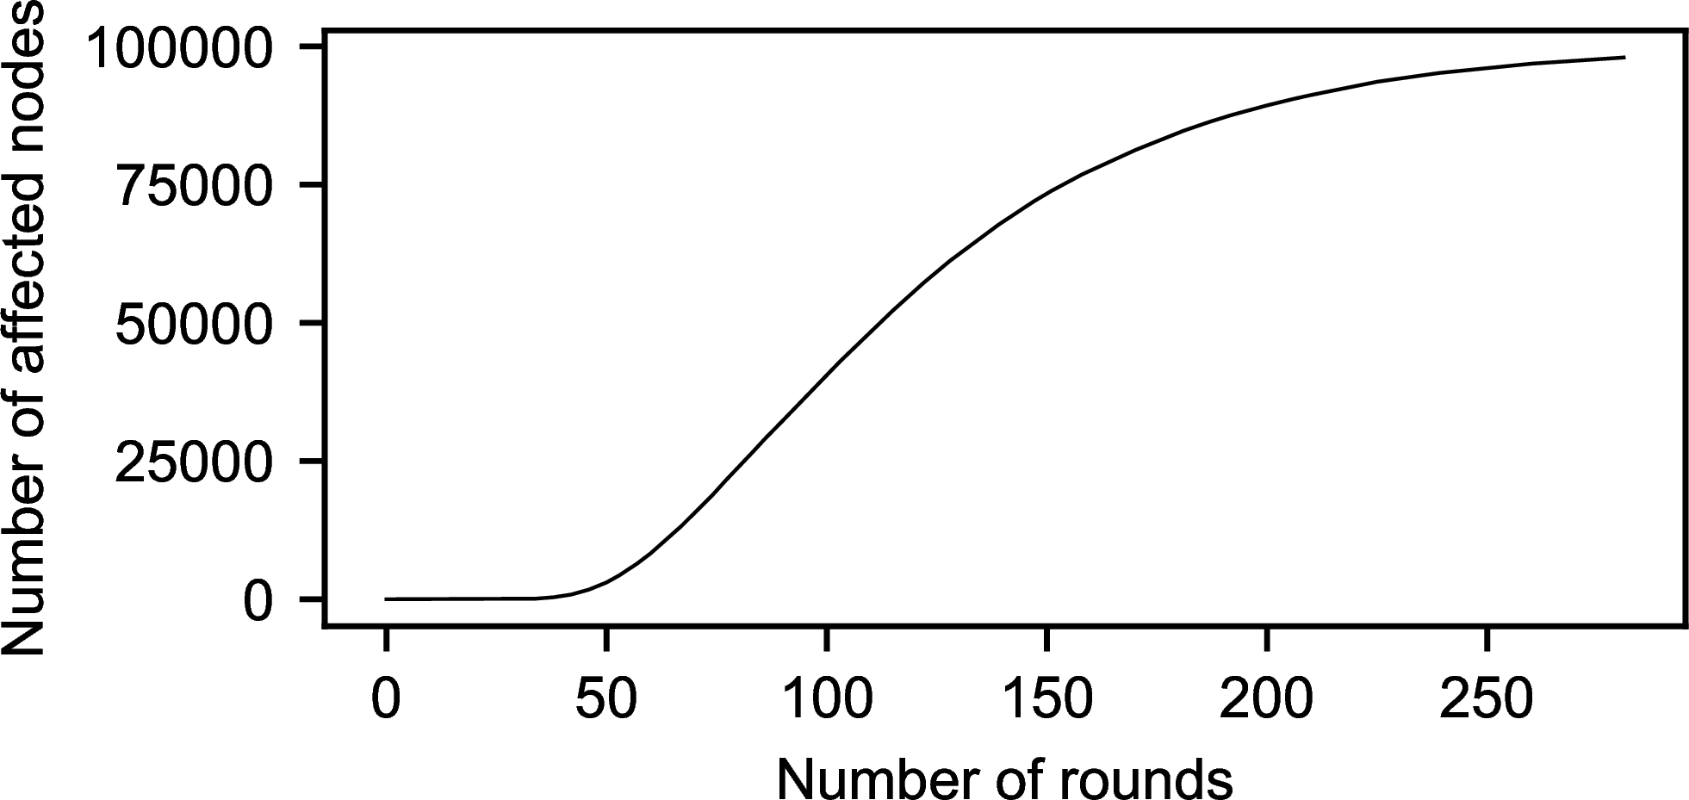
Eclipse attack
Security Trust in distributed systems
Essence: Try to isolate a node from the network
Example: a hub attack in the case of a gossip-based service. In this case, when exchanging links to other peers, a colluding node returns links only to other colluders.
Affected node: has links only to colluders.
General solution
Use a centralized certification authority.
Trusting an identity

Slide 40
Preventing Sybil attacks: Blockchain solutions
Security Trust in distributed systems
Essence: creating an identity comes at a cost
In the case of permissionless blockchains:
Proof-of-Work: Let validators run a computational race. This approach requires considerable computational resources
Proof-of-Stake: Pick a validator as a function of the number of tokens it owns. This approach requires risking loss of tokens.
Trusting an identity

Slide 41
Preventing Sybil attacks: Decentralized accounting
Security Trust in distributed systems
A simple example
Each node P maintains a list of nodes interested in doing work for P: the choice set of P (choice(P)).
Selecting Q ∈ choice(P) depends on Q’s work for others (i.e., its reputation).
P maintains a (subjective) view on reputations. Of course, P knows precisely what it has done for others, and what others have done for P.
P can compute a capacity (cap(Q):
cap(Q) = max{MF (Q, P) −MF (P, Q), 0}
with MF (P, Q) the amount of work that P has, or could have contributed to work done for Q, including the work done by others.
Trusting an identity

Slide 42
Preventing Sybil attacks: Decentralized accounting
Security Trust in distributed systems
Essence: Keep track of work that nodes do for each other
Assume R directly contributed 3 units of work for Q, and R had processed 7 units for P ⇒ P may have contributed 3 units of work for Q, through R.
Reasoning: R may never have been able to work for Q, if it had not worked for P.
Trusting an identity

Slide 43
Security
Trust in distributed systems
Preventing Sybil attacks: Decentralized accounting
How Sybil attacks are prevented
Let Q ∈ choice(P) create n Sybil nodes Q∗,..., Q∗; Q = Q∗
1 n 0
For work by Q∗ for Q∗ to increase cap(Q∗):
i j i
1. Q∗ needs to have worked for some node R
j
2. R needs to have worked for P
In other words: Q can successfully attack only if it had worked for honest nodes. Also, honest nodes have to work for Q: the total capacity Tcap(Q) of the Sybils must grow, with
n
∑
∗
Tcap(Q) = cap(Q )
k
k =0
Assume that P works 1 unit for Q∗ ⇒ MF (P, Q∗) increases by 1 unit ⇒
i i
cap(Q∗) drops by 1 unit, and so does Tcap(Q).
i
As soon as Tcap(Q) drops to 0, P will look at other nodes.
Trusting an identity

Slide 44
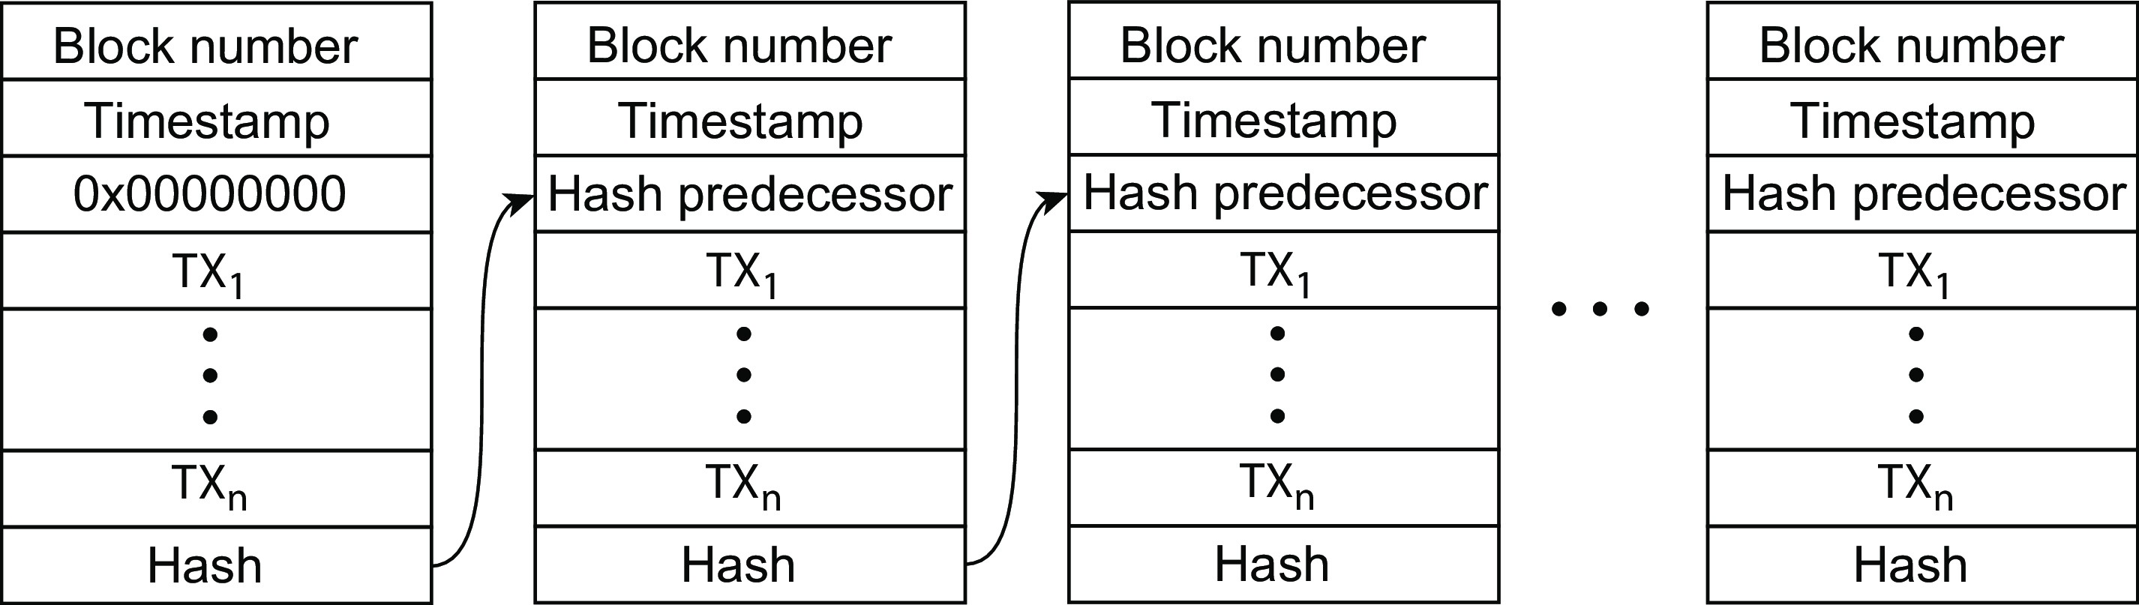
Trusting a system: Blockchains
Security Trust in distributed systems
Essence
One needs to know for sure that the information in a blockchain has not been tampered with: data integrity assurance. Solution: make sure that no change can go unnoticed (recall: a blockchain is an append-only data structure).
Observation
Any change of block B_{k} , will affect its hash value, and thus that of B_{k +1}, which would then also need to be changed, in turn affecting the hash value of B_{k +2} , and so on.
Trusting a system

Slide 45
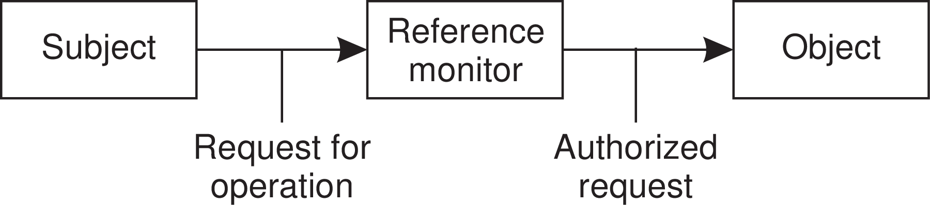
Access control: General model
Security Authorization
Authorization
Making sure that authenticated entities have only access to specific resources.
Observation
The reference monitor needs to be tamperproof: it is generally implemented under full control of the operating system, or a secure server.
General issues in access control

Slide 46
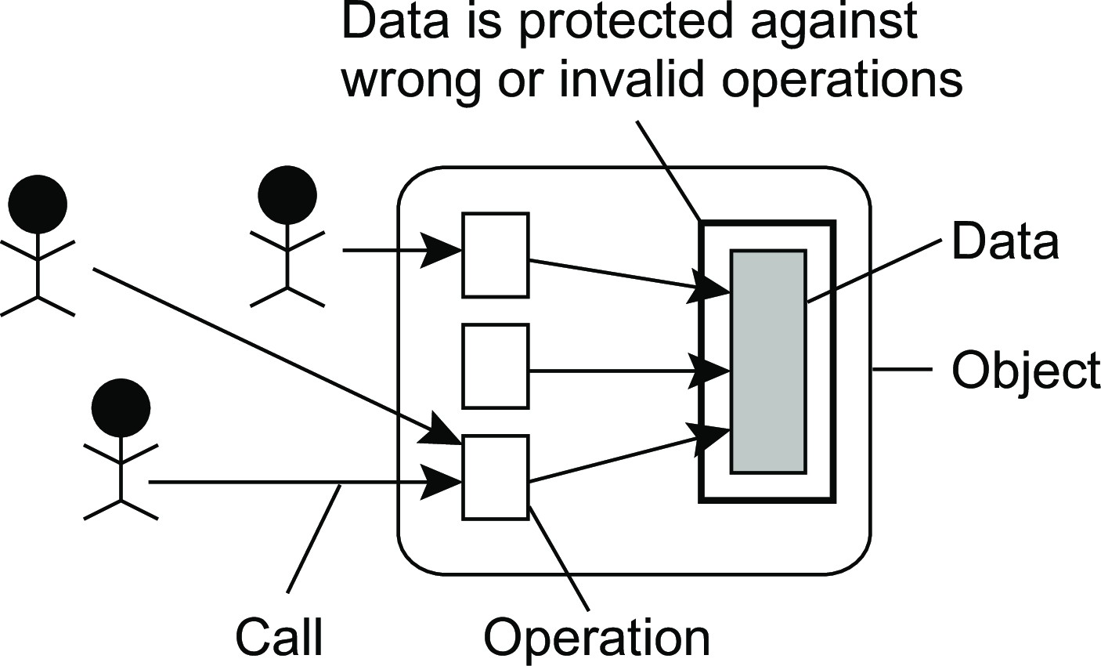
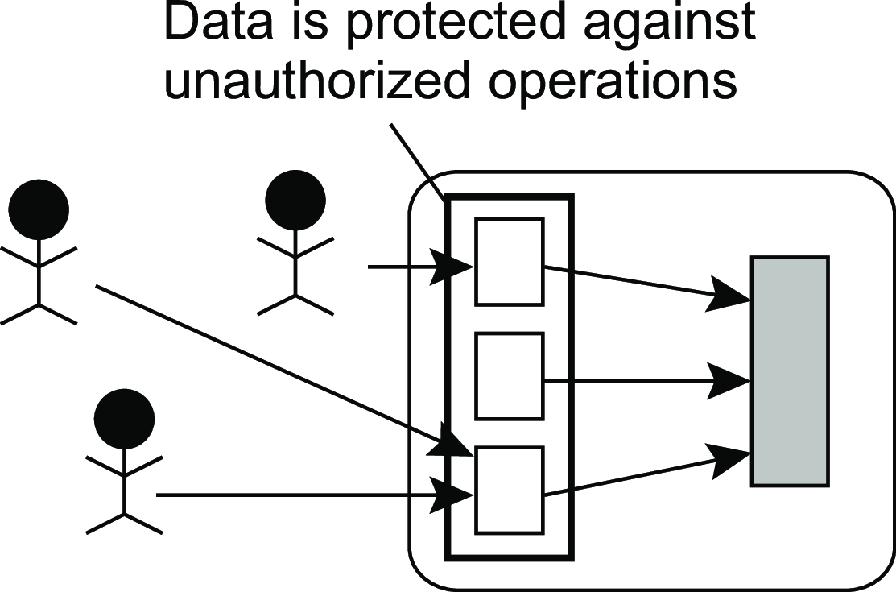
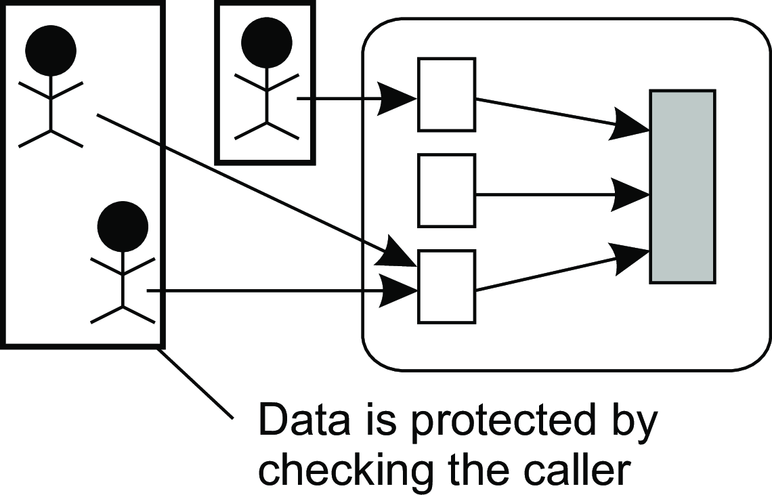
Security
Authorization
Protection
...against invalid operations
...against unauthorized access
...against unauthorized invokers
General issues in access control

Slide 47
Access control policies
Security Authorization
Mandatory access control: A central administration defines who gets access to what.
Discretionary access control: The owner of an object can change access rights, but also who may have access to that object.
Role-based access control: Users are not authorized based on their identity, but based on the role they have within an organization.
Attribute-based access control: Attributes of users and of objects they want to access are considered for deciding on a specific access rule.
General issues in access control

Slide 48
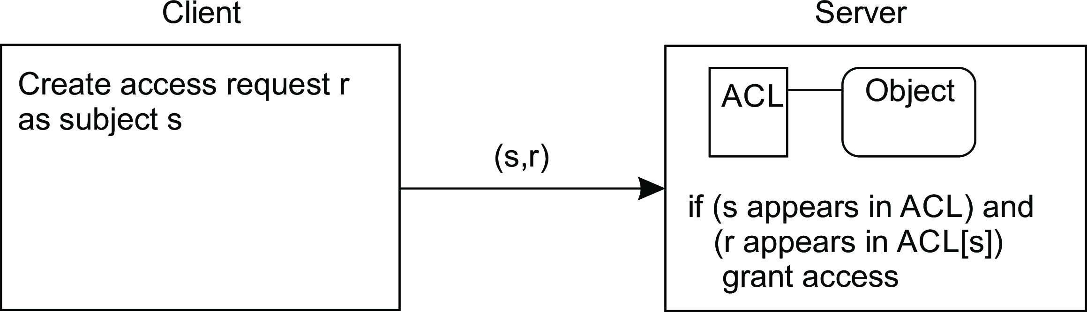
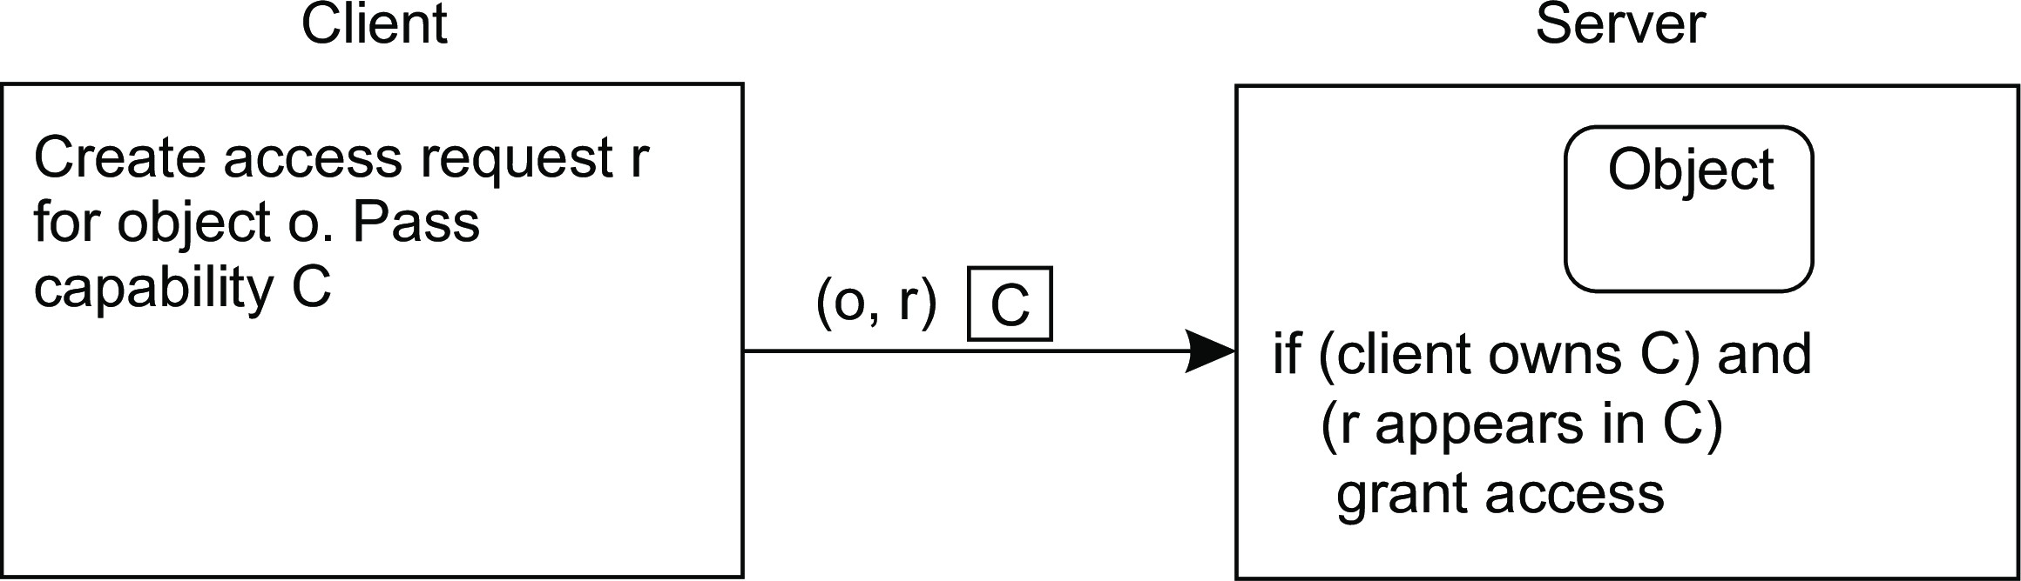
Access control matrix
Security Authorization
Theory
Construct a matrix in which M[s, o] describes the access rights subject s has with respect to object o. Impractical, so use access control lists or capabilities.
Access control list
Capabilities
General issues in access control

Slide 49
Special case: Attribute-based Access Control
Security Authorization
Distinguish different classes of attributes:
User attributes: name, data of birth, current roles, home address, department, qualifiers obtained, contract status, etc. May also depend on role (e.g., teacher or student).
Object attributes: anything – creator, last-modified time, version number, file type, file size, but also information related to its content.
Environmental attributes: describe the current state of the system, e.g., date and time, current workload, maintenance status, storage properties, available services, etc.
Connection attributes provide information on the current session, e.g., IP address, session duration, available bandwidth and latency estimates, type and strength of security used.
Administrative attributes: reflect global policies, e.g., minimal security settings, general access regulations, and maximum session durations.
Attribute-based access control

Slide 50
Example: the Policy Machine
Security Authorization
Essence
A server maintains sets of (atrribute,value) pairs, distinguishing users, applications, operations, and objects. At the core, we formulate access control rules.
Access control rules
Assignment: A user u can be assigned to an attribute ua: u → ua. An object to an attribute: o → oa; an attribute to an attribute: ua₁ → ua₂ (meaning that if u → ua₁, then u → ua₂ . Leads to rules like allowed(ua, ops, oa): users assigned to ua are allowed to execute operations in ops on objects assigned to oa.
Prohibition: explicitly state what is not allowed, such as denied(u, ops, os). Also: denied(u, ops, ¬os), meaning denial when u wants to perform o assigned to ops on an object not in os.
Obligation: automated action upon an event, such as denying copying of information:
when u reads f ∈ fs then denied(u,{write}, ¬fs).
Attribute-based access control

Slide 51
Delegation
Security Authorization
What’s the issue?
Alice makes use of an e-mail service provider who stores her mailbox. She is required to log in to the provider to access her mail. Alice wants to use her own local mail client. How to allow that mail client to act on behalf of Alice? How to delegate Alice’s access rights to her mail client?
Observation
It is not a good idea to hand over all user credentials to an application: why would the application or the machine be trusted? ⇒ use a security proxy.
Delegation

Slide 52
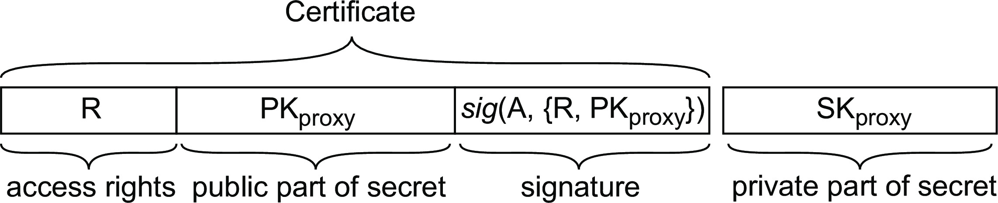
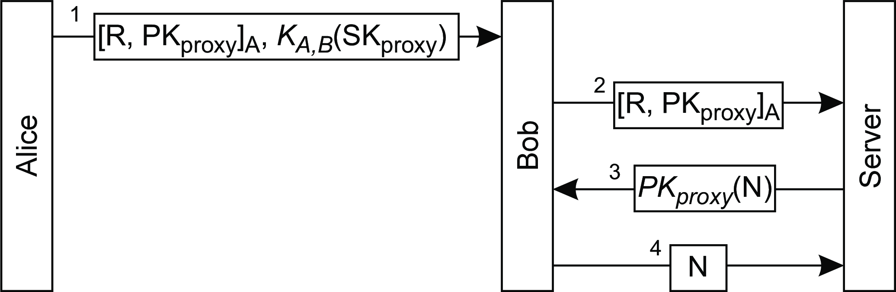
Security
Authorization
Security proxy
How it works
Alice passes some rights R to Bob, together with a secret key SK_{proxy}
When Bob wants to exercise his rights, he passes the certificate
The server wants Bob to prove he knows the secret key
Bob proves he does, and thus that Alice had delegated R.
Delegation

Slide 53
Example: Open Authorization (OAuth)
Security Authorization
Four different roles
Resource owner: typically an end user.
Client: an application that one would like to act on behalf of the resource owner,
Resource server: An interface through which a person would normally access the resource.
Authorization server: an entity handing out certificates to a client on behalf of a resource owner.
Initial steps
The client application registers itself at the authorization server and receives its own identifier, cid .
Alice wants to delegate a list R of rights ⇒
Client: send [cid, R,H(S)]
with a hash of a temporary secret S
Delegation

Slide 54
Completing the process
Security Authorization
Final steps
Alice is required to log in and confirm delegation R to the client.
Server sends a temporary authorization code AC to client.
Client requests a final access token:
Client: sends [cid, AC, S].
Sending S to the authorization server allows the latter to verify the identity of the client (by computing H(S).
The authorization server has now (1) verified that Alice wants to delegate access rights to the client, and (2) has verified the identity of the client ⇒ it returns an access token to the client.
Delegation

Slide 55
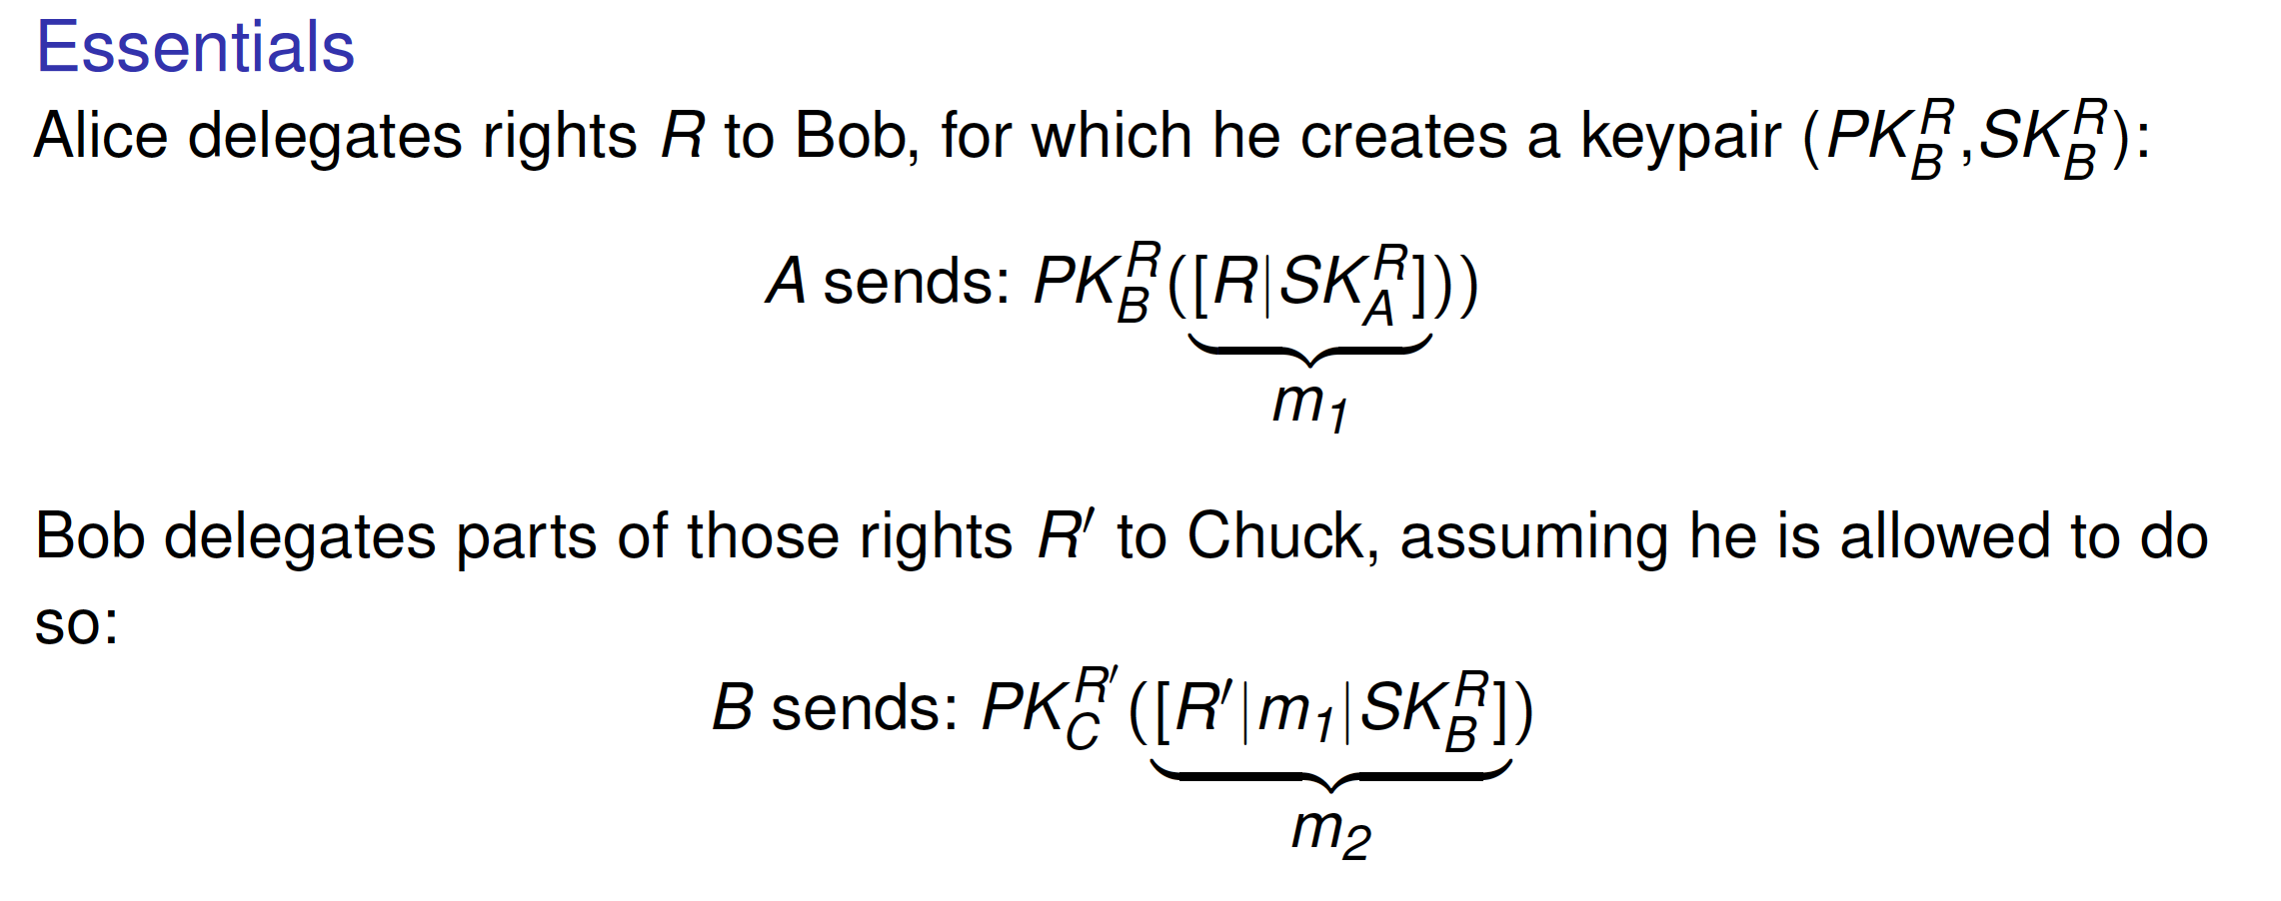
Example: decentralized authorization
Security Authorization
WAVE (and keeping it very simple)
Essence: Alice delegates rights to Bob, Bob delegates some of those rights to Chuck.
When Check wants to exercise his rights, there should be no need for Alice or Bob to be online.
No one but Alice, Bob, and Chuck need to be aware of the delegation.
Decentralized authorization: an example

Slide 56
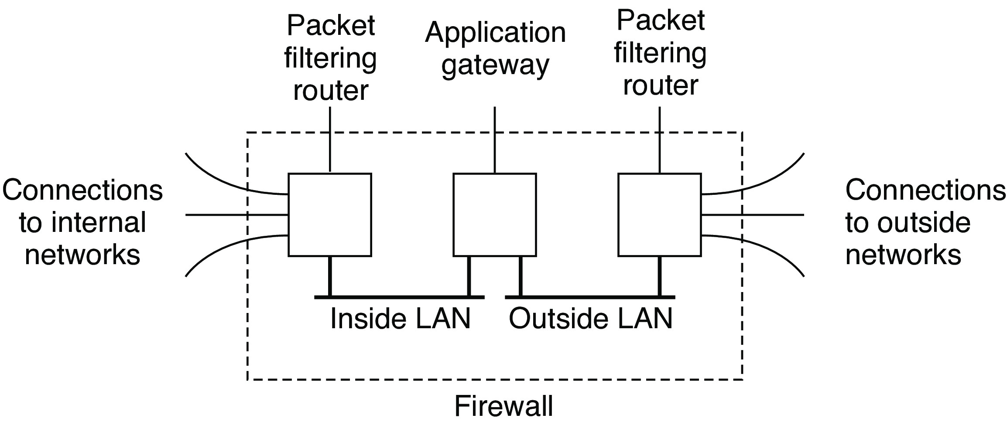
Security
Monitoring
Firewalls
Essence
Simply prevent anything nasty coming in, but also preventing unwanted outbound traffic.
Different types of firewalls
Packet-filtering gateway: operates as a router and makes filters packets based on source and destination address.
Application-level gateway: inspects the content of an incoming or
outgoing message (e.g., gateways filtering spam e-mail).
Proxy gateway: works as a front end to an application, filtering like an application-level gateway (e.g., Web proxies).
Firewalls

Slide 57
Security
Monitoring
Intrusion detection systems
Two flavors
Signature-based: matches against patterns of known network-level intrusions. Problematic when series of packets need to be matched, or when new attacks take place.
Anomaly-based: assumes that we can model or extract typical behavior to subsequently detect nontypical, or anomalous behavior. Relies heavily on modern artificial-intelligence technologies.
Intrusion detection: basics

Slide 58
Security
Monitoring
Intrusion detection systems
Two flavors
Signature-based: matches against patterns of known network-level intrusions. Problematic when series of packets need to be matched, or when new attacks take place.
Anomaly-based: assumes that we can model or extract typical behavior to subsequently detect nontypical, or anomalous behavior. Relies heavily on modern artificial-intelligence technologies.
Using sensors
Key idea is to manage false and true positives (FP/TP) as well as false and true negatives (FN/TN). Maximize accuracy and precision:
TP + TN TP + TN + FP +FN
Accuracy:
TP TP + FP
Precision:
Intrusion detection: basics

