Slide 1




CMSC 125: Operating Systems
Instructor: Joseph Anthony C. Hermocilla
Email: jchermocilla@up.edu.ph
Web: https://jachermocilla.org

Slide 2
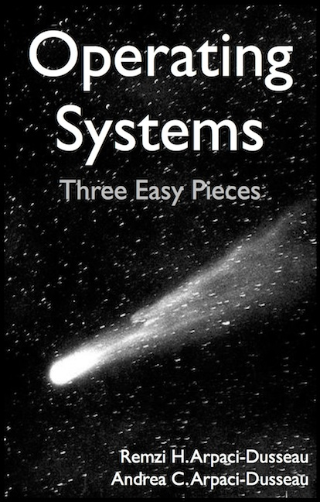
Resources
Book: https://pages.cs.wisc.edu/~remzi/OSTEP/
Slides Template:
https://pages.cs.wisc.edu/~remzi/OSTEP/Educators-Slides/Youjip/

Slide 3
Acknowledgement
This lecture slide set was initially developed for Operating System course in Computer Science Dept. at Hanyang University. This lecture slide set is for OSTEP book written by Remzi and Andrea at University of Wisconsin.

Slide 4
16. Segmentation
Operating System: Three Easy Pieces

Slide 5
Inefficiency of the Base and Bounds Registers Approach
0KB
Program Code
Big chunk of “free” space
“free” space takes up physical memory.
Hard to run when an address space does not fit into physical memory
1KB
2KB
3KB
4KB
5KB
Heap
6KB
(free)
14KB
15KB
Stack
16KB

Slide 6
Segmentation: Generalized Base and Bounds
Motivation: Why not have a base and bounds registers for each logical section in a process’ address space?
A segment is just a contiguous portion of the address space of a particular length
Logically-different segment: code, stack, heap
Each segment can be placed in different part of physical memory
Base and Bounds registers exist per segment

Slide 7
Placing Segments In Physical Memory
0KB
Operating System
16KB
(not in use)
Segment Base Size
Code 32K 2K
Heap 34K 2K
Stack 28K 2K
Stack
(not in use)
32KB
Code
Heap
(not in use)
48KB
64KB
Physical Memory

Slide 8
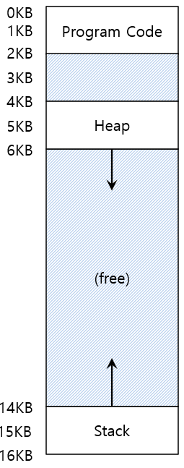

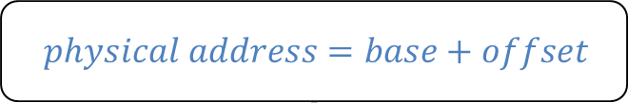
Segmentation: Address Translation Example
Assume a reference to virtual address 100 (in code section)
Since code section starts at 0 in address space, offset is 100
$$physical address=base+offset$$
Segment Base Size
Code 32K 2K
16KB
(not in use)
0KB
32KB
$32K+100= 32868$ is the desired physical address
100
Program Code
Code
instruction
2KB
34KB
Heap
4KB
(not in use)

Slide 9
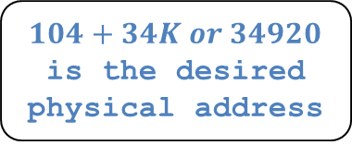
Segmentation: Address Translation Example (Cont.)
Assume a reference to virtual address 4200 (in head section)
The heap section starts at virtual address 4096(4KB) in address space, offset=4200-4096=104
$Virtual address+base$ is not the correct physical address.
Segment Base Size
Heap 34K 2K
(not in use)
32KB
Code
4KB
34KB
$104+34K or 34920$ is the desired physical address
4200
Heap
Heap
data
6KB
36KB
(not in use)
Address Space
Physical Memory

Slide 10
Segmentation Fault or Segmentation Violation
If an illegal address, such as 7KB, which is beyond the end of heap is referenced, the OS generates segmentation fault.
The hardware detects that address is out of bounds.
4KB
Heap
6KB
7KB
(not in use)
8KB
Address Space

Slide 11
Referring to a Segment(Cont.)
Given just a virtual address, how does the hardware determine the segment and offset?
Explicit approach
Chop up the address space into segments based on the top few bits of virtual address
Example: virtual address: 4200 (01000001101000)
13
12
11
10
9
8
7
6
5
4
3
2
1
0
Segment
Offset
Segment bits
Code 00
Heap 01
Stack 10
- 11
13
12
11
10
9
8
7
6
5
4
3
2
1
0
0
1
0
0
0
0
0
1
1
0
1
0
0
0
Segment
Offset

Slide 12
Referring to a Segment(Cont.)
1 // get top 2 bits of 14-bit VA
2 Segment = (VirtualAddress & SEG_MASK) >> SEG_SHIFT
3 // now get offset
4 Offset = VirtualAddress & OFFSET_MASK
5 if (Offset >= Bounds[Segment])
6 RaiseException(PROTECTION_FAULT)
7 else
8 PhysAddr = Base[Segment] + Offset
9 Register = AccessMemory(PhysAddr)
SEG_MASK = 0x3000(11000000000000)
SEG_SHIFT = 12
OFFSET_MASK = 0xFFF (00111111111111)
Disadvantages of explicit approach using top 2 bits
If only 3 sections, then 2 bits to store segment is wasteful
Limits a segment size, ex. max segment size is 4KB
Implicit approach – determines segment based on how the virtual address was generated, ex. if from program counter, then code segment

Slide 13
Referring to Stack Segment
Stack grows backward!
Extra hardware support is needed
The hardware checks which way the segment grows.
1: positive direction, 0: negative direction
Segment Register(with Negative-Growth Support)
(not in use)
Segment Base Size Grows Positive?
Code 32K 2K 1
Heap 34K 2K 1
Stack 28K 2K 0
26KB
Stack
28KB
(not in use)
Physical Memory

Slide 14
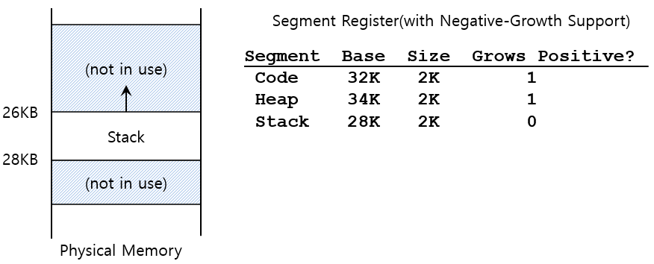
Referring to Stack Segment(Cont.)
Example: reference to virtual address 15KB = 11 1100 0000 0000 = 0x3C00
Segment=0x3(3), Offset=0xC00 (3KB)
Negative Offset = Offset - Max Segment Size = 3KB - 4KB = -1KB
Physical Address = Negative Offset + Stack Base
Physical Address = -1KB + 28KB = 27KB

Slide 15
Support for Sharing
Segment can be shared between address space
Code sharing is still in use in systems today
by using extra hardware support
Extra hardware support is needed: Protection Bits
A few more bits per segment to indicate permissions of read, write and execute
Segment Register Values(with Protection)
Segment Base Size Grows Positive? Protection
Code 32K 2K 1 Read-Execute
Heap 34K 2K 1 Read-Write
Stack 28K 2K 0 Read-Write

Slide 16
Fine-Grained and Coarse-Grained Segmentation
Coarse-Grained means segmentation in a small number
e.g., code, heap, stack
Fine-Grained segmentation allows more flexibility for address space in some early system
To support many segments, hardware support with a segment table is required

Slide 17
OS Support for Segmentation
What should the OS do during context switch?
What should the OS do when a segment grows?
How should the free space in memory be managed?
There are variable segment sizes

Slide 18
OS Support for Segmentation: Managing Fragmentation
External Fragmentation: little holes of free space in physical memory that make it difficulty to allocate new segments
There is 24KB free, but not in one contiguous segment
The OS cannot satisfy a 20KB request
Compaction: rearranging the existing segments in physical memory
Compaction is costly
Stop running process.
Copy data to somewhere
Change segment register value
Better to use a free-list management algorithm
Keep large extends of memory available for allocation
Approaches: best-fit, worst-fit, buddy-algorithm

Slide 19
Memory Compaction
Not compacted
Compacted
0KB
Operating System
0KB
Operating System
8KB
8KB
16KB
16KB
(not in use)
Allocated
24KB
24KB
Allocated
32KB
32KB
(not in use)
40KB
Allocated
40KB
(not in use)
48KB
(not in use)
48KB
56KB
56KB
Allocated
64KB
64KB

