Slide 1

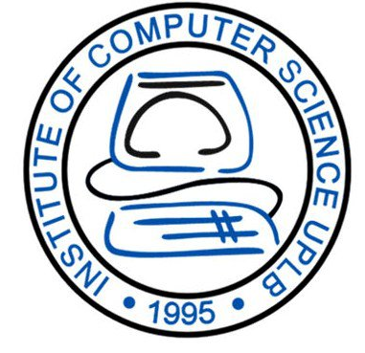


CMSC 125: Operating Systems
Instructor: Joseph Anthony C. Hermocilla
Email: jchermocilla@up.edu.ph
Web: https://jachermocilla.org

Slide 2
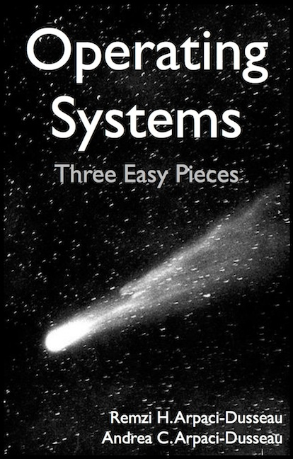
Resources
Book: https://pages.cs.wisc.edu/~remzi/OSTEP/
Slides Template:
https://pages.cs.wisc.edu/~remzi/OSTEP/Educators-Slides/Youjip/

Slide 3
Acknowledgement
This lecture slide set was initially developed for Operating System course in Computer Science Dept. at Hanyang University. This lecture slide set is for OSTEP book written by Remzi and Andrea at University of Wisconsin.

Slide 4
2. Introduction to Operating Systems
Operating System: Three Easy Pieces

Slide 5
What a happens when a program runs?
A running program executes instructions.
The processor fetches an instruction from memory.
Decode: Figure out which instruction this is
Execute: i.e., add two numbers, access memory, check a condition, jump to function, and so forth.
The processor moves on to the next instruction and so on (until completion).
This is the Von Neumann model of computing.

Slide 6
Operating System (OS)
Responsible for
Making it easy to run programs
Allowing programs to share memory
Enabling programs to interact with devices
OS is in charge of making sure the system operates correctly, efficiently, and in an easy-to-use manner.

Slide 7
Virtualization
The primary way to realize the goals presented in the previous slide is through virtualization.
The OS takes a physical resource and transforms it into a virtual form of itself.
Physical resource: Processor, Memory, Disk …
The virtual form is more general, powerful and easy-to-use.
Sometimes, we refer to the OS as a virtual machine.

Slide 8
System calls
System calls allow user to tell the OS what to do
The OS provides some interface (APIs, standard library).
A typical OS exports a few hundred system calls for tasks such as the following:
Run programs
Access memory
Access devices files
Notes:
View syscall list: man 2 syscalls
demo code using strace
Interfaces in CMSC 22

Slide 9
The OS as a resource manager
The OS manages resources such as CPU, memory, and disk.
The OS allows
Many programs to run → Sharing the CPU
Many programs to concurrently access their own instructions and data → Sharing memory
Many programs to access devices → Sharing disks
Management goals: fairness, efficiency, etc.

Slide 10
Examples

Slide 11
Virtualizing the CPU
A system can have a single processor (CPU)..
But can have a very large number of virtual CPUs.
Turning a single CPU into a seemingly infinite number of CPUs.
Allowing many programs to seemingly run at once → Virtualizing the CPU

Slide 12
Virtualizing the CPU (Cont.)
1 #include <stdio.h>
2 #include <stdlib.h>
3 #include <sys/time.h>
4 #include <assert.h>
5 #include "common.h"
6
7 int
8 main(int argc, char *argv[])
9 {
10 if (argc != 2) {
11 fprintf(stderr, "usage: cpu <string>\n");
12 exit(1);
13 }
14 char *str = argv[1];
15 while (1) {
16 Spin(1); // Repeatedly checks the time and returns once it has run for a second
17 printf("%s\n", str);
18 }
19 return 0;
20 }
Simple Example(cpu.c): Code That Loops and Prints

Slide 13
Virtualizing the CPU (Cont.)
Execution result 1.
prompt> gcc -o cpu cpu.c -Wall
prompt> ./cpu "A"
A
A
A
ˆC
prompt>
Run forever; Only by pressing “Control-c” can we halt the program

Slide 14
Virtualizing the CPU (Cont.)
Execution result 2.
prompt> ./cpu A & ; ./cpu B & ; ./cpu C & ; ./cpu D &
[1] 7353
[2] 7354
[3] 7355
[4] 7356
A
B
D
C
A
B
D
C
A
C
B
D
...
Even though we have only one processor, all four of programs seem to be running at the same time!
Notes:
There should be a way to start and stop programs as you’ve observed

Slide 15
Policies and Mechanisms
As a resource manager, an OS needs to implement mechanisms and enforce policies
Mechanism
Example: How do we allow multiple programs to run at once given that we only have a single processor?
timer
Policy
Example: Which program should run first? Which should run next?
round-robin, shortest job first

Slide 16
Virtualizing Memory
The physical memory is an array of bytes.
Each location(slot) has an address
A program keeps all of its data structures in memory which is accessed through various instructions
Read memory (load instruction):
Specify an address to be able to access the data
Write memory (store instruction):
Specify the data to be written to the given address
Important: Instruction/code that manipulate data structures are also in memory!

Slide 17
Virtualizing Memory (Cont.)
A program that Accesses Memory (mem.c)
1 #include <unistd.h>
2 #include <stdio.h>
3 #include <stdlib.h>
4 #include "common.h"
5
6 int
7 main(int argc, char *argv[])
8 {
9 int *p = malloc(sizeof(int)); // a1: allocate some memory
10 assert(p != NULL);
11 printf("(%d) address of p: %08x\n",
12 getpid(), (unsigned) p); // a2: print out the address of the memmory
13 *p = 0; // a3: put zero into the first slot of the memory
14 while (1) {
15 Spin(1);
16 *p = *p + 1;
17 printf("(%d) p: %d\n", getpid(), *p); // a4
18 }
19 return 0;
20 }

Slide 18
Virtualizing Memory (Cont.)
The output of the program mem.c
The newly allocated memory is at address 0x200000.
It updates the value and prints out the result.
Note: Disable Address Space Layout Randomization(ASLR) first before running.
In linux:
#echo 0 > /proc/sys/kernel/randomize_va_space
prompt> ./mem 0
(2134) memory address of p: 0x200000
(2134) p: 1
(2134) p: 2
(2134) p: 3
(2134) p: 4
(2134) p: 5
ˆC

Slide 19
Virtualizing Memory (Cont.)
Running mem.c multiple times
It is as if each running program has its own private memory.
Each running program has allocated memory at the same address.
Each seems to be updating the value at 0x200000 independently.
prompt> ./mem &; ./mem &
[1] 24113
[2] 24114
(24113) memory address of p: 0x200000
(24114) memory address of p: 0x200000
(24113) p: 1
(24114) p: 1
(24114) p: 2
(24113) p: 2
(24113) p: 3
(24114) p: 3
...

Slide 20
Virtualizing Memory (Cont.)
Each process accesses its own private virtual address space.
The OS maps (virtual) address space onto the physical memory.
A memory reference within one running program does not affect the address space of other processes.
As far as a running program is concerned, it has physical memory all to itself!
Physical memory is a shared resource, managed by the OS.

Slide 21
Problems brought about by Concurrency
The OS is juggling many things at once, first running one process, then another, and so forth.
Will this lead to data inconsistencies and incorrect operation? It surely will!
Also, modern multi-threaded programs also exhibit the concurrency problem.
Such as client-server applications, banking and finance applications, games

Slide 22
Concurrency Example
A Multi-threaded Program (thread.c)
1 #include <stdio.h>
2 #include <stdlib.h>
3 #include "common.h"
4
5 volatile int counter = 0;
6 int loops;
7
8 void *worker(void *arg) {
9 int i;
10 for (i = 0; i < loops; i++) {
11 counter++;
12 }
13 return NULL;
14 }
15
16 int
17 main(int argc, char *argv[])
18 {
19 if (argc != 2) {
20 fprintf(stderr, "usage: threads <value>\n");
21 exit(1);
22 }

Slide 23
Concurrency Example
A Multi-threaded Program (thread.c)
1 #include <stdio.h>
2 #include <stdlib.h>
3 #include "common.h"
4
5 volatile int counter = 0;
6 int loops;
7
8 void *worker(void *arg) {
9 int i;
10 for (i = 0; i < loops; i++) {
11 counter++;
12 }
13 return NULL;
}
...

Slide 24
Concurrency Example (Cont.)
16 int
17 main(int argc, char *argv[])
18 {
19 if (argc != 2) {
20 fprintf(stderr, "usage: threads <value>\n");
21 exit(1);
22 }
23 loops = atoi(argv[1]);
24 pthread_t p1, p2;
25 printf("Initial value : %d\n", counter);
26
27 Pthread_create(&p1, NULL, worker, NULL);
28 Pthread_create(&p2, NULL, worker, NULL);
29 Pthread_join(p1, NULL);
30 Pthread_join(p2, NULL);
31 printf("Final value : %d\n", counter);
32 return 0;
33 }
The main program creates two threads.
Thread: a function running within the same memory/address space. Each thread start running in a routine called worker().
worker(): increments a counter

Slide 25
Concurrency Example (Cont.)
loops determines how many times each of the two workers will increment the shared counter in a loop.
loops: 1000.
loops: 100000.
prompt> gcc -o thread thread.c -Wall -pthread
prompt> ./thread 1000
Initial value : 0
Final value : 2000
prompt> ./thread 100000
Initial value : 0
Final value : 143012 // huh??
prompt> ./thread 100000
Initial value : 0
Final value : 137298 // what the??

Slide 26
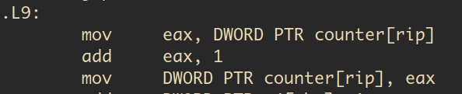
Why is this happening?
Increment a shared counter (counter++) → takes three instructions.
Load the value of the counter from memory into register.
Increment it
Store it back into memory
These three instructions do not execute atomically(all at once) → concurrency problem occurs.
Important: The threads here are in the same program’s address space, thus sharing access to the same data (counter). This is different from the previous discussion on virtualizing memory.

Slide 27
Persistence
Devices such as DRAM store values in a volatile manner – lost when power is removed
Hardware and software are both needed to store data persistently.
Hardware: I/O device such as a hard drive(HDD), solid-state drives(SSDs)
Software:
File system manages the disk.
File system is responsible for storing any files the user creates.
The OS does not create a private, virtualized disk for each program/application
Assumes that files will be shared across programs or users
Example: Your C source code is used by the text editor and the compiler

Slide 28
Persistence (Cont.)
Create a file (/tmp/file) that contains the string “hello world”
1 #include <stdio.h>
2 #include <unistd.h>
3 #include <assert.h>
4 #include <fcntl.h>
5 #include <sys/types.h>
6
7 int
8 main(int argc, char *argv[])
9 {
10 int fd = open("/tmp/file", O_WRONLY | O_CREAT | O_TRUNC, S_IRWXU);
11 assert(fd > -1);
12 int rc = write(fd, "hello world\n", 13);
13 assert(rc == 13);
14 close(fd);
15 return 0;
16 }
open(), write(), and close() system calls are routed to the part of OS called the file system, which handles the requests

Slide 29
Persistence (Cont.)
What OS does in order to write to disk?
Figure out where on disk this new data will reside
Issue I/O requests to the underlying storage device (via a device driver)
File system handles system crashes during write
Journaling or copy-on-write
Carefully ordering writes to disk to get back to a usable state after failed writes – during brownouts!
Efficiency is also important
I/O is slower than main memory access
Employs different data structures (lists, B-trees)

Slide 30
Design Goals
Build up some abstractions
To make the system convenient and easy to use.
Provide high performance
Minimize the overhead of the OS.
OS must strive to provide virtualization without excessive overhead.
Overhead sources: Extra time and extra space
Protection between applications and OS
Isolation: Bad behavior of one does not harm other and the OS itself.

Slide 31
Design Goals (Cont.)
High degree of reliability
The OS must also run non-stop.
Other issues
Energy-efficiency
Security
Mobility

Slide 32
Some History

Slide 33
Early Operating Systems: Just Libraries
Just a library of commonly used functions (ex. Low-level I/O)
Old mainframes run one program at a time controlled by a human operator
batch processing – jobs run by “batch”
Non-interactive

Slide 34
Beyond Libraries: Protection
Realized that code run on behalf of the OS is “special”
OS code can be treated differently than application code
More privileged
Systems call was invented/introduced by the Atlas Computing System
Added special pair of hardware instructions and hardware state
Makes the transition into the OS a more formal, controlled process
A system call differs from an ordinary procedure call in that it simultaneously raises the hardware privilege level when control is transferred (during jumps) – via a trap instruction
Changes the execution state to a more privileged level called the Kernel mode
User mode – restricted/limited execution

Slide 35
Multiprogramming Era
Introduction of the minicomputer
Increased developer activity as more and more people have access to hardware
Multiprogramming – OS loads a number of jobs into memory and switch rapidly between them
Improves CPU utilization
Switch to another job when one job is waiting for I/O operation to complete
Concept of memory protection and concurrency problems were introduced
Introduction of the UNIX operating system

Slide 36
Modern Era
Introduction of the personal computer
Disk Operating System (DOS) was introduced – very limited and poorly-designed
No protection, single-user
During the late 90’s and early 2000’s - has forgotten the lessons during the minicomputer era
Has improved now!
Introduction of Linux
Improvements in Windows and Mac OS
Mobile Devices and Networks

