Slide 1




CMSC 125: Operating Systems
Instructor: Joseph Anthony C. Hermocilla
Email: jchermocilla@up.edu.ph
Web: https://jachermocilla.org

Slide 2

Resources
Book: https://pages.cs.wisc.edu/~remzi/OSTEP/
Slides Template:
https://pages.cs.wisc.edu/~remzi/OSTEP/Educators-Slides/Youjip/

Slide 3
Acknowledgement
This lecture slide set was initially developed for Operating System course in Computer Science Dept. at Hanyang University. This lecture slide set is for OSTEP book written by Remzi and Andrea at University of Wisconsin.

Slide 4
29. Lock-based Concurrent Data Structures
Operating System: Three Easy Pieces

Slide 5
Lock-based Concurrent Data structure
Adding locks to a data structure makes the structure thread safe.
How locks are added determine both the correctness and performance of the data structure.

Slide 6
Example: Concurrent Counters without Locks
Simple but not scalable
1 typedef struct __counter_t {
2 int value;
3 } counter_t;
4
5 void init(counter_t *c) {
6 c->value = 0;
7 }
8
9 void increment(counter_t *c) {
10 c->value++;
11 }
12
13 void decrement(counter_t *c) {
14 c->value--;
15 }
16
17 int get(counter_t *c) {
18 return c->value;
19 }

Slide 7
Example: Concurrent Counters with Locks
Add a single lock
The lock is acquired when calling a routine that manipulates the data structure
1 typedef struct __counter_t {
2 int value;
3 pthread_lock_t lock;
4 } counter_t;
5
6 void init(counter_t *c) {
7 c->value = 0;
8 Pthread_mutex_init(&c->lock, NULL);
9 }
10
11 void increment(counter_t *c) {
12 Pthread_mutex_lock(&c->lock);
13 c->value++;
14 Pthread_mutex_unlock(&c->lock);
15 }
16

Slide 8
Example: Concurrent Counters with Locks (Cont.)
(Cont.)
17 void decrement(counter_t *c) {
18 Pthread_mutex_lock(&c->lock);
19 c->value--;
20 Pthread_mutex_unlock(&c->lock);
21 }
22
23 int get(counter_t *c) {
24 Pthread_mutex_lock(&c->lock);
25 int rc = c->value;
26 Pthread_mutex_unlock(&c->lock);
27 return rc;
28 }

Slide 9
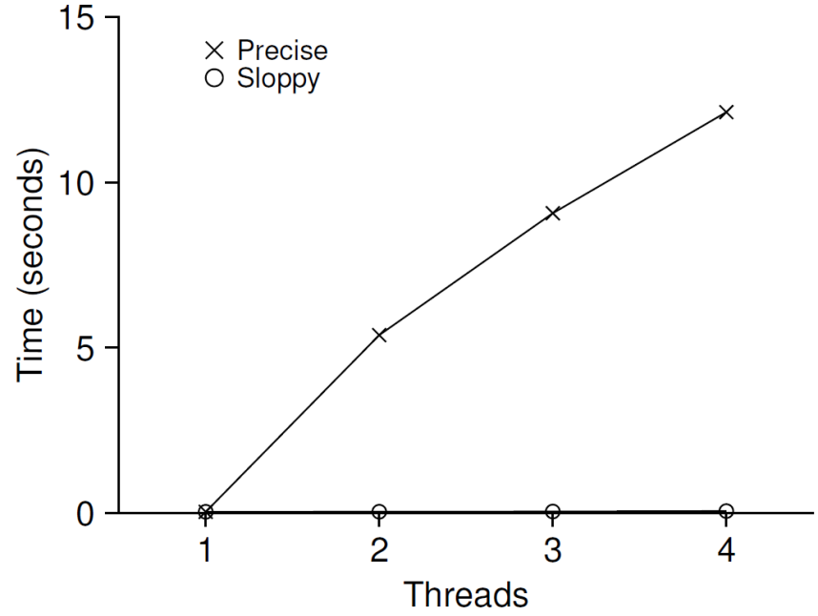
The performance costs of the simple approach
Each thread updates a single shared counter
Each thread updates the counter one million times
iMac with four Intel 2.7GHz i5 CPUs
Performance of
Traditional vs. Sloppy Counters
(Threshold of Sloppy, S, is set to 1024)
Synchronized counter scales poorly.

Slide 10
Perfect Scaling
Even though more work is done, it is done in parallel
The time taken to complete the task is not increased

Slide 11
Sloppy counter
The sloppy counter works by representing …
A single logical counter via numerous local physical counters, on per CPU core
A single global counter
There are locks:
One fore each local counter and one for the global counter
Example: on a machine with four CPUs
Four local counters
One global counter

Slide 12
The basic idea of sloppy counting
When a thread running on a core wishes to increment the counter
It increment its local counter
Each CPU has its own local counter:
Threads across CPUs can update local counters without contention
Thus counter updates are scalable
The local values are periodically transferred to the global counter
Acquire the global lock
Increment it by the local counter’s value
The local counter is then reset to zero

Slide 13
The basic idea of sloppy counting (Cont.)
How often the local-to-global transfer occurs is determined by a threshold, S (sloppiness)
The smaller S:
The more the counter behaves like the non-scalable counter
The bigger S:
The more scalable the counter
The further off the global value might be from the actual count

Slide 14
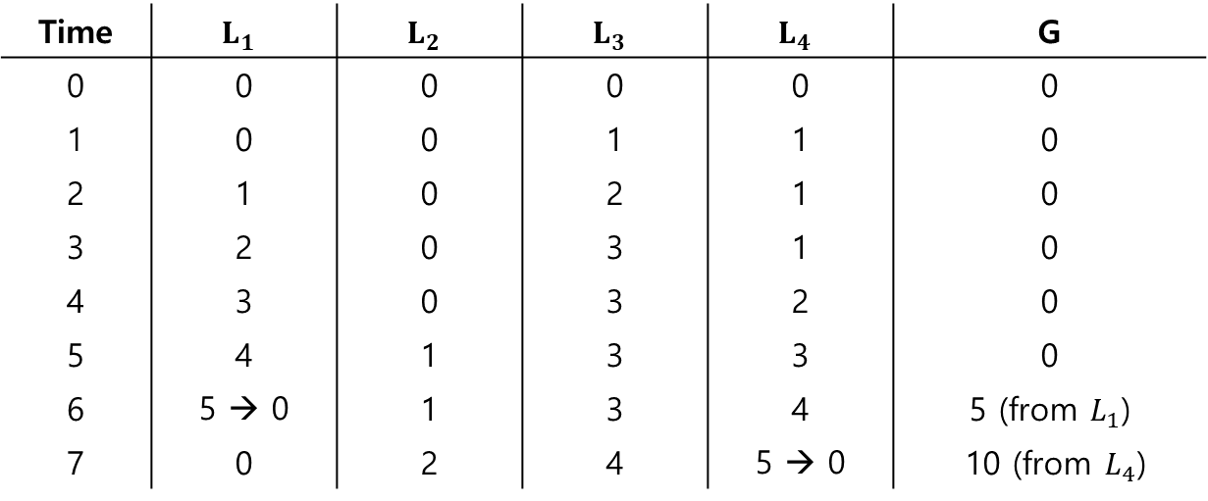

Sloppy counter example
Tracing the Sloppy Counters
The threshold S is set to 5
There are threads on each of four CPUs
Each thread updates their local counters $L_{1}$… $L_{4}$
Time | $$L_{1}$$ | $$L_{2}$$ | $$L_{3}$$ | $$L_{4}$$ | G
0 | 0 | 0 | 0 | 0 | 0
1 | 0 | 0 | 1 | 1 | 0
2 | 1 | 0 | 2 | 1 | 0
3 | 2 | 0 | 3 | 1 | 0
4 | 3 | 0 | 3 | 2 | 0
5 | 4 | 1 | 3 | 3 | 0
6 | 5 → 0 | 1 | 3 | 4 | 5 (from $L_{1}$)
7 | 0 | 2 | 4 | 5 → 0 | 10 (from $L_{4}$)

Slide 15
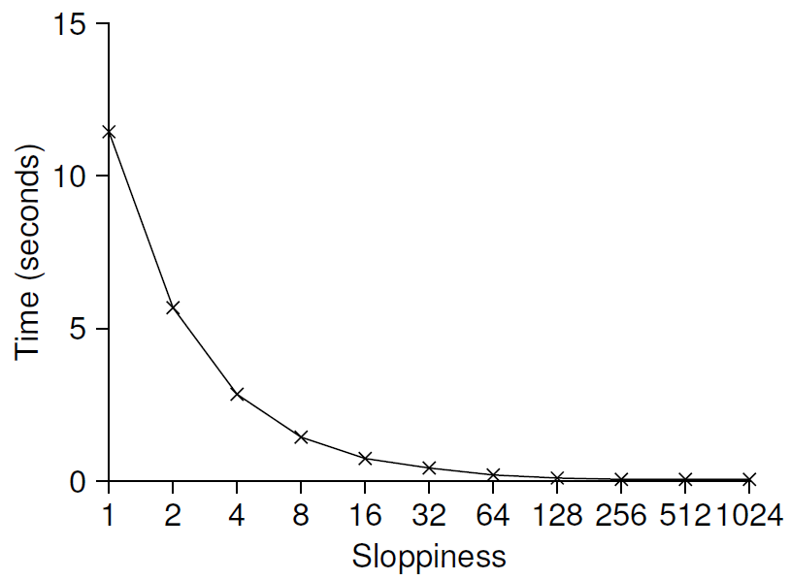
Importance of the threshold value S
Each four threads increments a counter 1 million times on four CPUs
Low S → Performance is poor, The global count is always quire accurate
High S → Performance is excellent, The global count lags
Scaling Sloppy Counters

Slide 16
Sloppy Counter Implementation
1 typedef struct __counter_t {
2 int global; // global count
3 pthread_mutex_t glock; // global lock
4 int local[NUMCPUS]; // local count (per cpu)
5 pthread_mutex_t llock[NUMCPUS]; // ... and locks
6 int threshold; // update frequency
7 } counter_t;
8
9 // init: record threshold, init locks, init values
10 // of all local counts and global count
11 void init(counter_t *c, int threshold) {
12 c->thres hold = threshold;
13
14 c->global = 0;
15 pthread_mutex_init(&c->glock, NULL);
16
17 int i;
18 for (i = 0; i < NUMCPUS; i++) {
19 c->local[i] = 0;
20 pthread_mutex_init(&c->llock[i], NULL);
21 }
22 }
23

Slide 17
Sloppy Counter Implementation (Cont.)
(Cont.)
24 // update: usually, just grab local lock and update local amount
25 // once local count has risen by ’threshold’, grab global
26 // lock and transfer local values to it
27 void update(counter_t *c, int threadID, int amt) {
28 pthread_mutex_lock(&c->llock[threadID]);
29 c->local[threadID] += amt; // assumes amt > 0
30 if (c->local[threadID] >= c->threshold) { // transfer to global
31 pthread_mutex_lock(&c->glock);
32 c->global += c->local[threadID];
33 pthread_mutex_unlock(&c->glock);
34 c->local[threadID] = 0;
35 }
36 pthread_mutex_unlock(&c->llock[threadID]);
37 }
38
39 // get: just return global amount (which may not be perfect)
40 int get(counter_t *c) {
41 pthread_mutex_lock(&c->glock);
42 int val = c->global;
43 pthread_mutex_unlock(&c->glock);
44 return val; // only approximate!
45 }

Slide 18
Concurrent Linked Lists
1 // basic node structure
2 typedef struct __node_t {
3 int key;
4 struct __node_t *next;
5 } node_t;
6
7 // basic list structure (one used per list)
8 typedef struct __list_t {
9 node_t *head;
10 pthread_mutex_t lock;
11 } list_t;
12
13 void List_Init(list_t *L) {
14 L->head = NULL;
15 pthread_mutex_init(&L->lock, NULL);
16 }
17
(Cont.)

Slide 19
Concurrent Linked Lists
(Cont.)
18 int List_Insert(list_t *L, int key) {
19 pthread_mutex_lock(&L->lock);
20 node_t *new = malloc(sizeof(node_t));
21 if (new == NULL) {
22 perror("malloc");
23 pthread_mutex_unlock(&L->lock);
24 return -1; // fail
26 new->key = key;
27 new->next = L->head;
28 L->head = new;
29 pthread_mutex_unlock(&L->lock);
30 return 0; // success
31 }
(Cont.)

Slide 20
Concurrent Linked Lists (Cont.)
(Cont.)
32
32 int List_Lookup(list_t *L, int key) {
33 pthread_mutex_lock(&L->lock);
34 node_t *curr = L->head;
35 while (curr) {
36 if (curr->key == key) {
37 pthread_mutex_unlock(&L->lock);
38 return 0; // success
39 }
40 curr = curr->next;
41 }
42 pthread_mutex_unlock(&L->lock);
43 return -1; // failure
44 }

Slide 21
Concurrent Linked Lists (Cont.)
The code acquires a lock in the insert routine upon entry
The code releases the lock upon exit
If malloc() happens to fail, the code must also release the lock before failing the insert
This kind of exceptional control flow has been shown to be quite error prone
Solution: The lock and release only surround the actual critical section in the insert code

Slide 22
Concurrent Linked List: Rewritten
1 void List_Init(list_t *L) {
2 L->head = NULL;
3 pthread_mutex_init(&L->lock, NULL);
4 }
5
6 void List_Insert(list_t *L, int key) {
7 // synchronization not needed
8 node_t *new = malloc(sizeof(node_t));
9 if (new == NULL) {
10 perror("malloc");
11 return;
12 }
13 new->key = key;
14
15 // just lock critical section
16 pthread_mutex_lock(&L->lock);
17 new->next = L->head;
18 L->head = new;
19 pthread_mutex_unlock(&L->lock);
20 }
21

Slide 23
Concurrent Linked List: Rewritten (Cont.)
(Cont.)
22 int List_Lookup(list_t *L, int key) {
23 int rv = -1;
24 pthread_mutex_lock(&L->lock);
25 node_t *curr = L->head;
26 while (curr) {
27 if (curr->key == key) {
28 rv = 0;
29 break;
30 }
31 curr = curr->next;
32 }
33 pthread_mutex_unlock(&L->lock);
34 return rv; // now both success and failure
35 }

Slide 24
Scaling Linked List
Hand-over-hand locking (lock coupling)
Add a lock per node of the list instead of having a single lock for the entire list
When traversing the list,
First grabs the next node’s lock
And then releases the current node’s lock
Enable a high degree of concurrency in list operations
However, in practice, the overheads of acquiring and releasing locks for each node of a list traversal is prohibitive

Slide 25
Michael and Scott Concurrent Queues
There are two locks
One for the head of the queue
One for the tail
The goal of these two locks is to enable concurrency of enqueue and dequeue operations
Add a dummy node
Allocated in the queue initialization code
Enable the separation of head and tail operations

Slide 26
Concurrent Queues (Cont.)
1 typedef struct __node_t {
2 int value;
3 struct __node_t *next;
4 } node_t;
5
6 typedef struct __queue_t {
7 node_t *head;
8 node_t *tail;
9 pthread_mutex_t headLock;
10 pthread_mutex_t tailLock;
11 } queue_t;
12
13 void Queue_Init(queue_t *q) {
14 node_t *tmp = malloc(sizeof(node_t));
15 tmp->next = NULL;
16 q->head = q->tail = tmp;
17 pthread_mutex_init(&q->headLock, NULL);
18 pthread_mutex_init(&q->tailLock, NULL);
19 }
20
(Cont.)

Slide 27
Concurrent Queues (Cont.)
(Cont.)
21 void Queue_Enqueue(queue_t *q, int value) {
22 node_t *tmp = malloc(sizeof(node_t));
assert(tmp != NULL);
24
25 tmp->value = value;
26 tmp->next = NULL;
27
28 pthread_mutex_lock(&q->tailLock);
29 q->tail->next = tmp;
30 q->tail = tmp;
31 pthread_mutex_unlock(&q->tailLock);
32 }
(Cont.)

Slide 28
Concurrent Queues (Cont.)
(Cont.)
33 int Queue_Dequeue(queue_t *q, int *value) {
34 pthread_mutex_lock(&q->headLock);
35 node_t *tmp = q->head;
36 node_t *newHead = tmp->next;
37 if (newHead == NULL) {
38 pthread_mutex_unlock(&q->headLock);
39 return -1; // queue was empty
40 }
41 *value = newHead->value;
42 q->head = newHead;
43 pthread_mutex_unlock(&q->headLock);
44 free(tmp);
45 return 0;
46 }

Slide 29
Concurrent Hash Table
Focus on a simple hash table
The hash table does not resize
Built using the concurrent lists
It uses a lock per hash bucket each of which is represented by a list

Slide 30
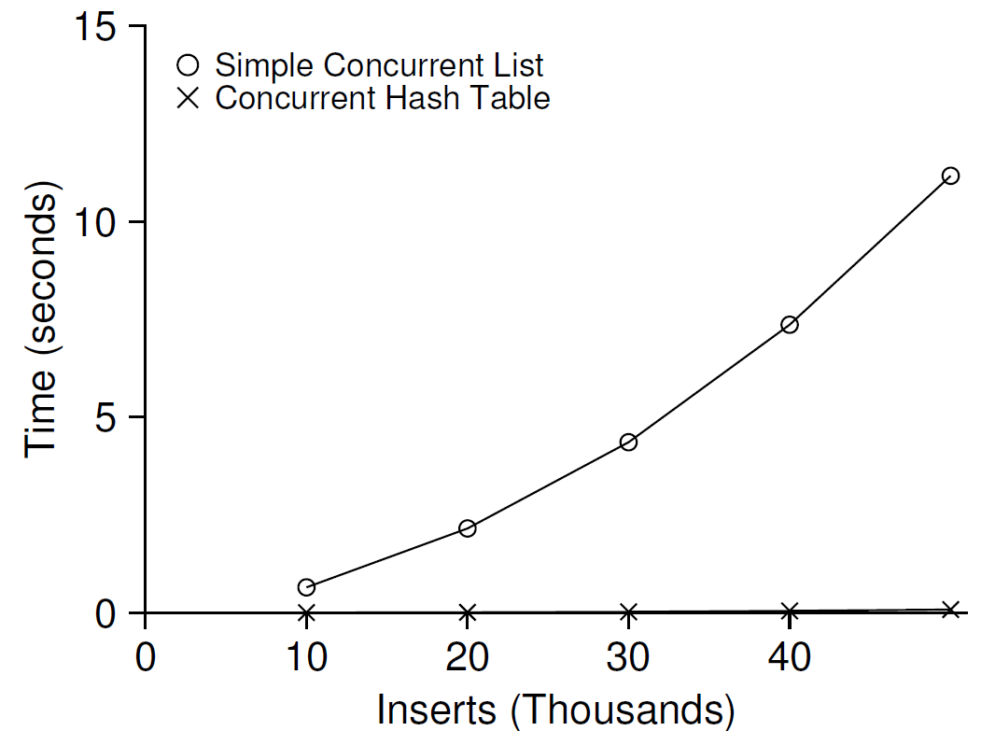
Performance of Concurrent Hash Table
From 10,000 to 50,000 concurrent updates from each of four threads
iMac with four Intel 2.7GHz i5 CPUs
The simple concurrent hash table scales magnificently.

Slide 31
Concurrent Hash Table
1 #define BUCKETS (101)
2
3 typedef struct __hash_t {
4 list_t lists[BUCKETS];
5 } hash_t;
6
7 void Hash_Init(hash_t *H) {
8 int i;
9 for (i = 0; i < BUCKETS; i++) {
10 List_Init(&H->lists[i]);
11 }
12 }
13
14 int Hash_Insert(hash_t *H, int key) {
15 int bucket = key % BUCKETS;
16 return List_Insert(&H->lists[bucket], key);
17 }
18
19 int Hash_Lookup(hash_t *H, int key) {
20 int bucket = key % BUCKETS;
21 return List_Lookup(&H->lists[bucket], key);
22 }

