Slide 1

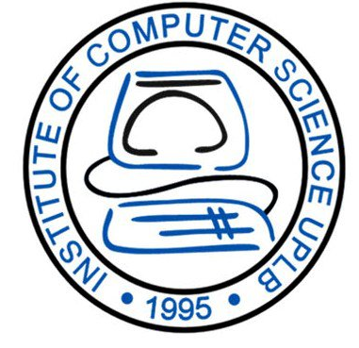


CMSC 125: Operating Systems
Instructor: Joseph Anthony C. Hermocilla
Email: jchermocilla@up.edu.ph
Web: https://jachermocilla.org

Slide 2
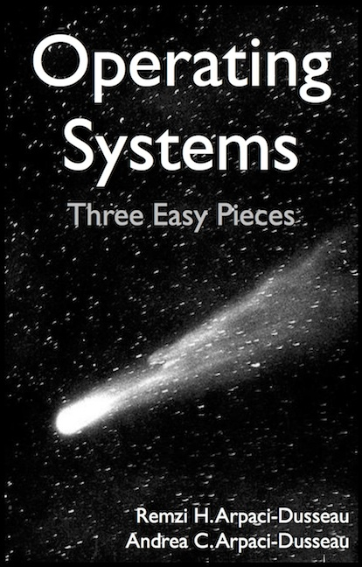
Resources
Book: https://pages.cs.wisc.edu/~remzi/OSTEP/
Slides Template:
https://pages.cs.wisc.edu/~remzi/OSTEP/Educators-Slides/Youjip/

Slide 3
Acknowledgement
This lecture slide set was initially developed for Operating System course in Computer Science Dept. at Hanyang University. This lecture slide set is for OSTEP book written by Remzi and Andrea at University of Wisconsin.

Slide 4
13. The Abstraction: Address Space
Operating System: Three Easy Pieces

Slide 5
Memory Virtualization
What is memory virtualization?
OS virtualizes its physical memory
OS provides an illusion memory space per process
It seems to be seen like each process uses the whole memory

Slide 6
Benefits of Memory Virtualization
Ease of use in programming
Memory efficiency in terms of time and space
The guarantee of isolation for processes as well as OS
Protection from errant accesses of other processes

Slide 7
OS in early systems
OS is just a library
Load only one process in memory
Executes until completion
Poor CPU utilization and memory efficiency
CPU is idle when process is doing I/O
Other processes can fit in memory
0KB
Operating System
(code, data, etc.)
64KB
Current
Program
(code, data, etc.)
max
Physical Memory

Slide 8
Multiprogramming and Time Sharing
Load multiple processes in memory
Execute one for a short while
Switch between processes in memory
Result: Increases CPU utilization and memory efficiency
Systems became more interactive compared to doing just batch-processing
Introduces an important protection issue
What if a user process accesses another user process, or the kernel??!!
0KB
Operating System
(code, data, etc.)
64KB
Free
128KB
Process C
(code, data, etc.)
192KB
Process B
(code, data, etc.)
256KB
Free
320KB
Process A
(code, data, etc.)
384KB
Free
448KB
Free
512KB
Physical Memory

Slide 9
Abstraction: Address Space
OS creates an abstraction of physical memory
The address space/mapping contains information all about a running process
A running program’s(process) own view of memory, its memory state
Important: may not be actual locations in physical memory!!
Typically consists of program code, heap, stack, etc.
0KB
Program Code
1KB
Heap
2KB
(free)
15KB
Stack
16KB
Address Space (16KB in total)

Slide 10
Abstraction: Address Space(Cont.)
Code
Where instructions live
Heap
Dynamically allocate memory
malloc() in C language
new in object-oriented language
Stack
Stores return addresses during function calls or return values
Contains local variables, actual parameters to functions
Program Code
Heap
(free)
Stack
Address Space

Slide 11
The Virtual Address
Every address in a running program(a process) is virtual!!
OS translates the virtual address to physical address
#include <stdio.h>
#include <stdlib.h>
int main(int argc, char *argv[]){
printf("location of code : %p\n", (void *) main);
printf("location of heap : %p\n", (void *) malloc(1));
int x = 3;
printf("location of stack : %p\n", (void *) &x);
return x;
}
A simple program that prints out virtual addresses

Slide 12
Virtual Address(Cont.)
The output in 64-bit Linux machine
Address Space
0x400000
Code
(Text)
location of code : 0x40057d
location of heap : 0xcf2010
location of stack : 0x7fff9ca45fcc
0x401000
Data
0xcf2000
Heap
0xd13000
(free)
heap
stack
0x7fff9ca28000
Stack
0x7fff9ca49000

Slide 13
Goals for a Virtual Memory system
Transparency
implementation should be invisible to a process
Process behaves as if it has its own private physical memory
Efficiency
In terms of time(not make processes run slowly) and space(not much overhead in memory use)
Will need to rely on hardware support (TLBs, etc)
Protection and Isolation
Prevent a user process from accessing other user processes, or the kernel

