Slide 1




CMSC 125: Operating Systems
Instructor: Joseph Anthony C. Hermocilla
Email: jchermocilla@up.edu.ph
Web: https://jachermocilla.org

Slide 2
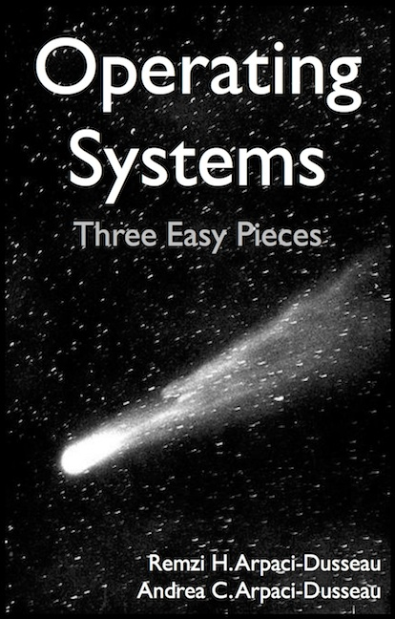
Resources
Book: https://pages.cs.wisc.edu/~remzi/OSTEP/
Slides Template:
https://pages.cs.wisc.edu/~remzi/OSTEP/Educators-Slides/Youjip/

Slide 3
Acknowledgement
This lecture slide set was initially developed for Operating System course in Computer Science Dept. at Hanyang University. This lecture slide set is for OSTEP book written by Remzi and Andrea at University of Wisconsin.

Slide 4
5. Interlude: Process API
Operating System: Three Easy Pieces

Slide 5
The fork() System Call
Create a new process
The newly-created process has its own copy of the address space, registers, and PC.
p1.c
#include <stdio.h>
#include <stdlib.h>
#include <unistd.h>
int main(int argc, char *argv[]){
printf("hello world (pid:%d)\n", (int) getpid());
int rc = fork();
if (rc < 0) { // fork failed; exit
fprintf(stderr, "fork failed\n");
exit(1);
} else if (rc == 0) { // child (new process)
printf("hello, I am child (pid:%d)\n", (int) getpid());
} else { // parent goes down this path (main)
printf("hello, I am parent of %d (pid:%d)\n",
rc, (int) getpid());
}
return 0;
}

Slide 6
Calling fork() example (Cont.)
Result (Not deterministic)
prompt> ./p1
hello world (pid:29146)
hello, I am parent of 29147 (pid:29146)
hello, I am child (pid:29147)
prompt>
or
prompt> ./p1
hello world (pid:29146)
hello, I am child (pid:29147)
hello, I am parent of 29147 (pid:29146)
prompt>

Slide 7
The wait() System Call
This system call won’t return until the child has run and exited.
p2.c
#include <stdio.h>
#include <stdlib.h>
#include <unistd.h>
#include <sys/wait.h>
int main(int argc, char *argv[]){
printf("hello world (pid:%d)\n", (int) getpid());
int rc = fork();
if (rc < 0) { // fork failed; exit
fprintf(stderr, "fork failed\n");
exit(1);
} else if (rc == 0) { // child (new process)
printf("hello, I am child (pid:%d)\n", (int) getpid());
} else { // parent goes down this path (main)
int wc = wait(NULL);
printf("hello, I am parent of %d (wc:%d) (pid:%d)\n",
rc, wc, (int) getpid());
}
return 0;
}

Slide 8
The wait() System Call (Cont.)
Result (Deterministic)
prompt> ./p2
hello world (pid:29266)
hello, I am child (pid:29267)
hello, I am parent of 29267 (wc:29267) (pid:29266)
prompt>

Slide 9
The exec() System Call
Run a program that is different from the calling program
p3.c
#include <stdio.h>
#include <stdlib.h>
#include <unistd.h>
#include <string.h>
#include <sys/wait.h>
int main(int argc, char *argv[]){
printf("hello world (pid:%d)\n", (int) getpid());
int rc = fork();
if (rc < 0) { // fork failed; exit
fprintf(stderr, "fork failed\n");
exit(1);
} else if (rc == 0) { // child (new process)
printf("hello, I am child (pid:%d)\n", (int) getpid());
char *myargs[3];
myargs[0] = strdup("wc"); // program: "wc" (word count)
myargs[1] = strdup("p3.c"); // argument: file to count
myargs[2] = NULL; // marks end of array
…

Slide 10
The exec() System Call (Cont.)
p3.c (Cont.)
…
execvp(myargs[0], myargs); // runs word count
printf("this shouldn’t print out");
} else { // parent goes down this path (main)
int wc = wait(NULL);
printf("hello, I am parent of %d (wc:%d) (pid:%d)\n",
rc, wc, (int) getpid());
}
return 0;
}
Result
prompt> ./p3
hello world (pid:29383)
hello, I am child (pid:29384)
29 107 1030 p3.c
hello, I am parent of 29384 (wc:29384) (pid:29383)
prompt>

Slide 11
All of the above with redirection
p4.c
#include <stdio.h>
#include <stdlib.h>
#include <unistd.h>
#include <string.h>
#include <fcntl.h>
#include <sys/wait.h>
int
main(int argc, char *argv[]){
int rc = fork();
if (rc < 0) { // fork failed; exit
fprintf(stderr, "fork failed\n");
exit(1);
} else if (rc == 0) { // child: redirect standard output to a file
close(STDOUT_FILENO);
open("./p4.output", O_CREAT|O_WRONLY|O_TRUNC, S_IRWXU);
…

Slide 12
All of the above with redirection (Cont.)
p4.c
…
// now exec "wc"...
char *myargs[3];
myargs[0] = strdup("wc"); // program: "wc" (word count)
myargs[1] = strdup("p4.c"); // argument: file to count
myargs[2] = NULL; // marks end of array
execvp(myargs[0], myargs); // runs word count
} else { // parent goes down this path (main)
int wc = wait(NULL);
}
return 0;
}
Result
prompt> ./p4
prompt> cat p4.output
32 109 846 p4.c
prompt>

