Slide 1




CMSC 125: Operating Systems
Instructor: Joseph Anthony C. Hermocilla
Email: jchermocilla@up.edu.ph
Web: https://jachermocilla.org

Slide 2
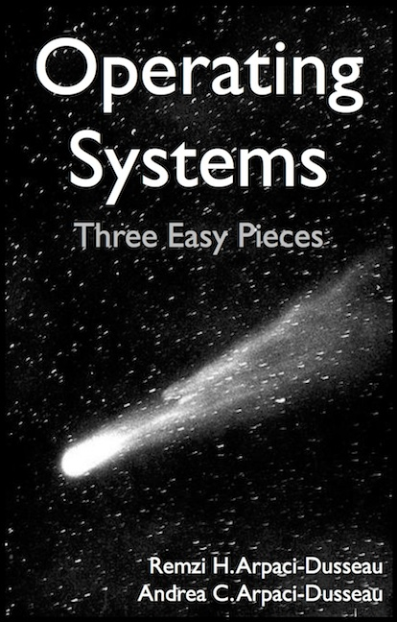
Resources
Book: https://pages.cs.wisc.edu/~remzi/OSTEP/
Slides Template:
https://pages.cs.wisc.edu/~remzi/OSTEP/Educators-Slides/Youjip/

Slide 3
Acknowledgement
This lecture slide set was initially developed for Operating System course in Computer Science Dept. at Hanyang University. This lecture slide set is for OSTEP book written by Remzi and Andrea at University of Wisconsin.

Slide 4
6. Mechanism: Limited Direct Execution
Operating System: Three Easy Pieces

Slide 5
How to efficiently virtualize the CPU with control?
The OS needs to share the physical CPU by time sharing.
Issue
Performance: How can we implement virtualization without adding excessive overhead to the system?
Control: How can we run processes efficiently while retaining control over the CPU?

Slide 6
Direct Execution
Just run the program directly on the CPU.
OS | Program
1. Create entry for process list 2. Allocate memory for program 3. Load program into memory 4. Set up stack with argc / argv 5. Clear registers 6. Execute call main() 9. Free memory of process 10. Remove from process list | 7. Run main() 8. Execute return from main()
Without limits on running programs,
the OS wouldn’t be in control of anything and
thus would be “just a library”

Slide 7
Problem 1: Restricted Operation
What if a process wishes to perform some kind of restricted operation such as …
Issuing an I/O request to a disk
Gaining access to more system resources such as CPU or memory
Solution: Using protected control transfer
User mode: Applications do not have full access to hardware resources.
Kernel mode: The OS has access to the full resources of the machine

Slide 8
System Call
Allow the kernel to carefully expose certain key pieces of functionality to user program, such as …
Accessing the file system
Creating and destroying processes
Communicating with other processes
Allocating more memory

Slide 9
System Call (Cont.)
Trap instruction
Jump into the kernel
Raise the privilege level to kernel mode
Return-from-trap instruction
Return into the calling user program
Reduce the privilege level back to user mode

Slide 10
Limited Direction Execution Protocol
OS @ boot
(kernel mode)
Hardware
initialize trap table
remember address of …
syscall handler
OS @ run
(kernel mode)
Hardware
Program
(user mode)
Create entry for process list
Allocate memory for program
Load program into memory
Setup user stack with argv
Fill kernel stack with reg/PC
return-from -trap
restore regs from kernel stack
move to user mode
jump to main
Run main()
…
Call system
trap into OS

Slide 11
Limited Direction Execution Protocol (Cont.)
OS @ run
(kernel mode)
Hardware
Program
(user mode)
(Cont.)
save regs to kernel stack
move to kernel mode
jump to trap handler
Handle trap
Do work of syscall
return-from-trap
restore regs from kernel stack
move to user mode
jump to PC after trap
…
return from main
trap (via exit())
Free memory of process
Remove from process list

Slide 12
Problem 2: Switching Between Processes
How can the OS regain control of the CPU so that it can switch between processes?
A cooperative Approach: Wait for system calls
A Non-Cooperative Approach: The OS takes control

Slide 13
A cooperative Approach: Wait for system calls
Processes periodically give up the CPU by making system calls such as yield.
The OS decides to run some other task.
Application also transfer control to the OS when they do something illegal.
Divide by zero
Try to access memory that it shouldn’t be able to access
Ex) Early versions of the Macintosh OS, The old Xerox Alto system
A process gets stuck in an infinite loop.
→ Reboot the machine

Slide 14
A Non-Cooperative Approach: OS Takes Control
A timer interrupt
During the boot sequence, the OS start the timer.
The timer raise an interrupt every so many milliseconds.
When the interrupt is raised :
The currently running process is halted.
Save enough of the state of the program
A pre-configured interrupt handler in the OS runs.
A timer interrupt gives OS the ability to
run again on a CPU.

Slide 15
Saving and Restoring Context
Scheduler makes a decision:
Whether to continue running the current process, or switch to a different one.
If the decision is made to switch, the OS executes context switch.

Slide 16
Context Switch
A low-level piece of assembly code
Save a few register values for the current process onto its kernel stack
General purpose registers
PC
kernel stack pointer
Restore a few for the soon-to-be-executing process from its kernel stack
Switch to the kernel stack for the soon-to-be-executing process

Slide 17
Limited Direction Execution Protocol (Timer interrupt)
OS @ boot
(kernel mode)
Hardware
initialize trap table
remember address of …
syscall handler
timer handler
start interrupt timer
start timer
interrupt CPU in X ms
OS @ run
(kernel mode)
Hardware
Program
(user mode)
Process A
…
timer interrupt
save regs(A) to k-stack(A)
move to kernel mode
jump to trap handler

Slide 18
Limited Direction Execution Protocol (Timer interrupt)
OS @ run
(kernel mode)
Hardware
Program
(user mode)
(Cont.)
Handle the trap
Call switch() routine
save regs(A) to proc-struct(A)
restore regs(B) from proc-struct(B)
switch to k-stack(B)
return-from-trap (into B)
restore regs(B) from k-stack(B)
move to user mode
jump to B’s PC
Process B
…

Slide 19
The xv6 Context Switch Code
1 # void swtch(struct context **old, struct context *new);
2 #
3 # Save current register context in old
4 # and then load register context from new.
5 .globl swtch
6 swtch:
7 # Save old registers
8 movl 4(%esp), %eax # put old ptr into eax
9 popl 0(%eax) # save the old IP
10 movl %esp, 4(%eax) # and stack
11 movl %ebx, 8(%eax) # and other registers
12 movl %ecx, 12(%eax)
13 movl %edx, 16(%eax)
14 movl %esi, 20(%eax)
15 movl %edi, 24(%eax)
16 movl %ebp, 28(%eax)
17
18 # Load new registers
19 movl 4(%esp), %eax # put new ptr into eax
20 movl 28(%eax), %ebp # restore other registers
21 movl 24(%eax), %edi
22 movl 20(%eax), %esi
23 movl 16(%eax), %edx
24 movl 12(%eax), %ecx
25 movl 8(%eax), %ebx
26 movl 4(%eax), %esp # stack is switched here
27 pushl 0(%eax) # return addr put in place
28 ret # finally return into new ctxt

Slide 20
Worried About Concurrency?
What happens if, during interrupt or trap handling, another interrupt occurs?
OS handles these situations:
Disable interrupts during interrupt processing
Use a number of sophisticate locking schemes to protect concurrent access to internal data structures.

