Slide 1




CMSC 125: Operating Systems
Instructor: Joseph Anthony C. Hermocilla
Email: jchermocilla@up.edu.ph
Web: https://jachermocilla.org

Slide 2
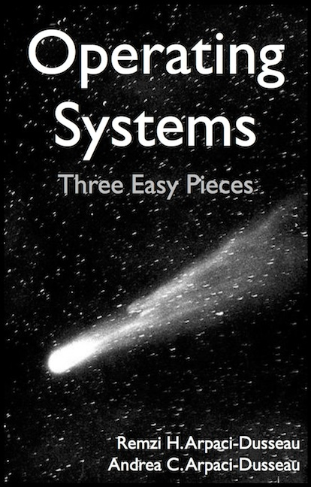
Resources
Book: https://pages.cs.wisc.edu/~remzi/OSTEP/
Slides Template:
https://pages.cs.wisc.edu/~remzi/OSTEP/Educators-Slides/Youjip/

Slide 3
Acknowledgement
This lecture slide set was initially developed for Operating System course in Computer Science Dept. at Hanyang University. This lecture slide set is for OSTEP book written by Remzi and Andrea at University of Wisconsin.

Slide 4
7. Scheduling: Introduction
Operating System: Three Easy Pieces

Slide 5
Scheduling: Introduction
Workload assumptions:
Each job runs for the same amount of time.
All jobs arrive at the same time.
All jobs only use the CPU (i.e., they perform no I/O).
The run-time of each job is known.

Slide 6

Scheduling Metrics
Performance metric: Turnaround time
The time at which the job completes minus the time at which the job arrived in the system.
Another metric is fairness.
Performance and fairness are often at odds in scheduling.
$$T_{turnaround}=T_{completion}−T_{arrival}$$

Slide 7

First In, First Out (FIFO)
First Come, First Served (FCFS)
Very simple and easy to implement
Example:
A arrived just before B which arrived just before C.
Each job runs for 10 seconds.
A
B
C
0
20
40
60
80
100
120
Time (Second)
$$Average turnaround time=\frac{10+20+30}{3}=20 sec$$

Slide 8
Why FIFO is not that great? – Convoy effect
Let’s relax assumption 1: Each job no longer runs for the same amount of time.
Example:
A arrived just before B which arrived just before C.
A runs for 100 seconds, B and C run for 10 each.
A
B
C
0
20
40
60
80
100
120
Time (Second)
$$Average turnaround time=\frac{100+110+120}{3}=110 sec$$

Slide 9

Shortest Job First (SJF)
Run the shortest job first, then the next shortest, and so on
Non-preemptive scheduler
Example:
A arrived just before B which arrived just before C.
A runs for 100 seconds, B and C run for 10 each.
B
C
A
0
20
40
60
80
100
120
Time (Second)
$$Average turnaround time=\frac{10+20+120}{3}=50 sec$$

Slide 10
SJF with Late Arrivals from B and C
Let’s relax assumption 2: Jobs can arrive at any time.
Example:
A arrives at t=0 and needs to run for 100 seconds.
B and C arrive at t=10 and each need to run for 10 seconds
[B,C arrive]
A
B
C
0
20
40
60
80
100
120
Time (Second)
$$Average turnaround time=\frac{100+\left(110−10\right)+(120−10)}{3}=103.33 sec$$

Slide 11
Shortest Time-to-Completion First (STCF)
Add preemption to SJF
Also knows as Preemptive Shortest Job First (PSJF)
A new job enters the system:
Determine of the remaining jobs and new job
Schedule the job which has the lest time left

Slide 12
Shortest Time-to-Completion First (STCF)
Example:
A arrives at t=0 and needs to run for 100 seconds.
B and C arrive at t=10 and each need to run for 10 seconds
[B,C arrive]
A
B
C
A
0
20
40
60
80
100
120
Time (Second)
$$Average turnaround time=\frac{(120−0)+\left(20−10\right)+(30−10)}{3}=50 sec$$

Slide 13

New scheduling metric: Response time
The time from when the job arrives to the first time it is scheduled.
STCF and related disciplines are not particularly good for response time.
$$T_{response}=T_{firstrun}−T_{arrival}$$
How can we build a scheduler that is
sensitive to response time?

Slide 14
Round Robin (RR) Scheduling
Time slicing Scheduling
Run a job for a time slice and then switch to the next job in the run queue until the jobs are finished.
Time slice is sometimes called a scheduling quantum.
It repeatedly does so until the jobs are finished.
The length of a time slice must be a multiple of the timer-interrupt period.
RR is fair, but performs poorly on metrics
such as turnaround time

Slide 15


RR Scheduling Example
A, B and C arrive at the same time.
They each wish to run for 5 seconds.
A
B
C
$$T_{average response}=\frac{0+5+10}{3}=5sec$$
0
5
10
15
20
25
30
Time (Second)
SJF (Bad for Response Time)
A
B
A
B
A
B
A
B
A
C
C
C
C
B
C
$$T_{average response}=\frac{0+1+2}{3}=1sec$$
0
5
10
15
20
25
30
Time (Second)
RR with a time-slice of 1sec (Good for Response Time)

Slide 16
The length of the time slice is critical.
The shorter time slice
Better response time
The cost of context switching will dominate overall performance.
The longer time slice
Amortize the cost of switching
Worse response time
Deciding on the length of the time slice presents
a trade-off to a system designer

Slide 17
Incorporating I/O
Let’s relax assumption 3: All programs perform I/O
Example:
A and B need 50ms of CPU time each.
A runs for 10ms and then issues an I/O request
I/Os each take 10ms
B simply uses the CPU for 50ms and performs no I/O
The scheduler runs A first, then B after

Slide 18
Incorporating I/O (Cont.)
A
A
A
A
A
B
B
B
B
B
0
20
40
60
80
100
120
140
Time (msec)
Poor Use of Resources
A
B
A
B
A
B
A
B
A
B
Maximize the
CPU utilization
0
20
40
60
80
100
120
140
Time (msec)
Overlap Allows Better Use of Resources

Slide 19
Incorporating I/O (Cont.)
When a job initiates an I/O request.
The job is blocked waiting for I/O completion.
The scheduler should schedule another job on the CPU.
When the I/O completes
An interrupt is raised.
The OS moves the process from blocked back to the ready state.

