Slide 1




CMSC 125: Operating Systems
Instructor: Joseph Anthony C. Hermocilla
Email: jchermocilla@up.edu.ph
Web: https://jachermocilla.org

Slide 2
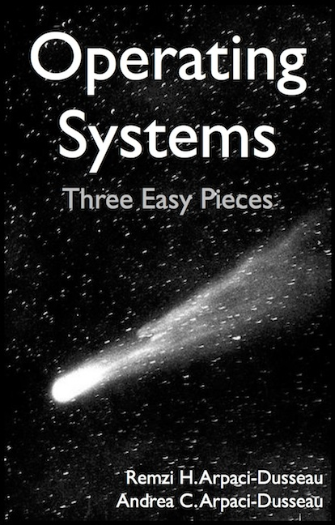
Resources
Book: https://pages.cs.wisc.edu/~remzi/OSTEP/
Slides Template:
https://pages.cs.wisc.edu/~remzi/OSTEP/Educators-Slides/Youjip/

Slide 3
Acknowledgement
This lecture slide set was initially developed for Operating System course in Computer Science Dept. at Hanyang University. This lecture slide set is for OSTEP book written by Remzi and Andrea at University of Wisconsin.

Slide 4
9: Scheduling: Proportional Share
Operating System: Three Easy Pieces

Slide 5
Proportional Share Scheduler
Fair-share scheduler
Guarantee that each job obtain a certain percentage of CPU time.
Not optimized for turnaround or response time

Slide 6
Basic Concept
Tickets
Represent the share of a resource that a process should receive
The percent of tickets represents its share of the system resource in question.
Example
There are two processes, A and B.
Process A has 75 tickets → receive 75% of the CPU
Process B has 25 tickets → receive 25% of the CPU

Slide 7
Lottery scheduling
The scheduler picks a winning ticket.
Load the state of that winning process and runs it.
Example
There are 100 tickets
Process A has 75 tickets: 0 ~ 74
Process B has 25 tickets: 75 ~ 99
Scheduler’s winning tickets:
63 85 70 39 76 17 29 41 36 39 10 99 68 83 63
Resulting scheduler:
A
B
A
A
B
A
A
A
A
A
A
B
A
B
A
The longer these two jobs compete,
The more likely they are to achieve the desired percentages.

Slide 8
Ticket Mechanisms
Ticket currency
A user allocates tickets among their own jobs in whatever currency they would like.
The system converts the currency into the correct global value.
Example
There are 200 tickets (Global currency)
Process A has 100 tickets
Process B has 100 tickets
User A → 500 (A’s currency) to A1 → 50 (global currency)
→ 500 (A’s currency) to A2 → 50 (global currency)
User B → 10 (B’s currency) to B1 → 100 (global currency)

Slide 9
Ticket Mechanisms (Cont.)
Ticket transfer
A process can temporarily hand off its tickets to another process.
Ticket inflation
A process can temporarily raise or lower the number of tickets is owns.
If any one process needs more CPU time, it can boost its tickets.

Slide 10
Implementation
Example: There are there processes, A, B, and C.
Keep the processes in a list:
Job:A
Tix:100
Job:B
Tix:50
Job:C
Tix:250
head
NULL
1 // counter: used to track if we’ve found the winner yet
2 int counter = 0;
3
4 // winner: use some call to a random number generator to
5 // get a value, between 0 and the total # of tickets
6 int winner = getrandom(0, totaltickets);
7
8 // current: use this to walk through the list of jobs
9 node_t *current = head;
10
11 // loop until the sum of ticket values is > the winner
12 while (current) {
13 counter = counter + current->tickets;
14 if (counter > winner)
15 break; // found the winner
16 current = current->next;
17 }
18 // ’current’ is the winner: schedule it...

Slide 11
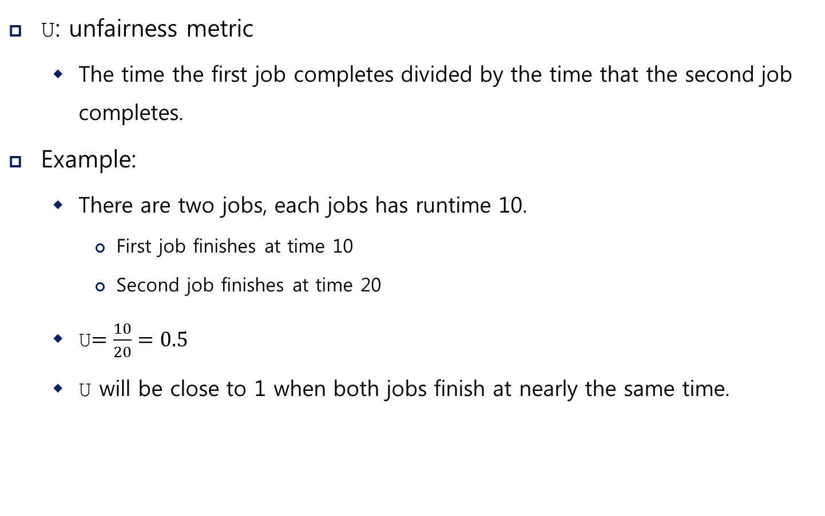
Implementation (Cont.)
U: unfairness metric
The time the first job completes divided by the time that the second job completes.
Example:
There are two jobs, each jobs has runtime 10.
First job finishes at time 10
Second job finishes at time 20
U$=\frac{10}{20}=0.5$
U will be close to 1 when both jobs finish at nearly the same time.

Slide 12
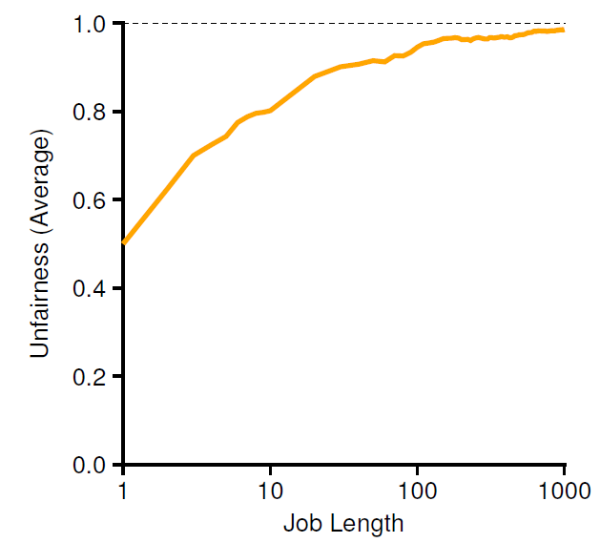
Lottery Fairness Study
There are two jobs.
Each jobs has the same number of tickets (100).
When the job length is not very long,
average unfairness can be quite severe.

Slide 13
Stride Scheduling
Stride of each process
(A large number) / (the number of tickets of the process)
Example: A large number = 10,000
Process A has 100 tickets → stride of A is 100
Process B has 50 tickets → stride of B is 200
A process runs, increment a counter(=pass value) for it by its stride.
Pick the process to run that has the lowest pass value
current = remove_min(queue); // pick client with minimum pass
schedule(current); // use resource for quantum
current->pass += current->stride; // compute next pass using stride
insert(queue, current); // put back into the queue
A pseudo code implementation

Slide 14
Stride Scheduling Example
Pass(A)
(stride=100)
Pass(B)
(stride=200)
Pass(C)
(stride=40)
Who Runs?
0
100
100
100
100
100
200
200
200
0
0
200
200
200
200
200
200
200
0
0
0
40
80
120
120
160
200
A
B
C
C
C
A
C
C
…
If new job enters with pass value 0,
It will monopolize the CPU!

