Slide 1




CMSC 125: Operating Systems
Instructor: Joseph Anthony C. Hermocilla
Email: jchermocilla@up.edu.ph
Web: https://jachermocilla.org

Slide 2
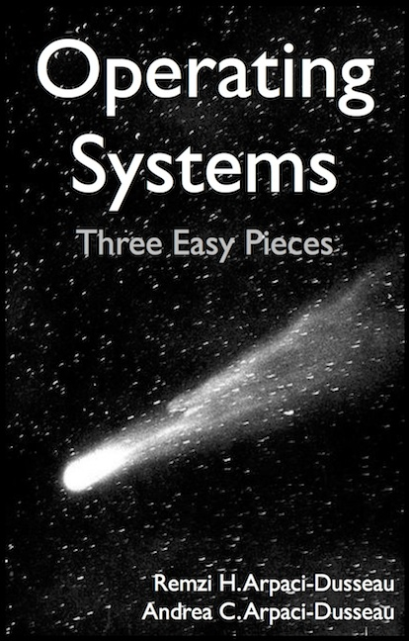
Resources
Book: https://pages.cs.wisc.edu/~remzi/OSTEP/
Slides Template:
https://pages.cs.wisc.edu/~remzi/OSTEP/Educators-Slides/Youjip/

Slide 3
Acknowledgement
This lecture slide set was initially developed for Operating System course in Computer Science Dept. at Hanyang University. This lecture slide set is for OSTEP book written by Remzi and Andrea at University of Wisconsin.

Slide 4
13. The Abstraction: Address Space
Operating System: Three Easy Pieces

Slide 5
Memory Virtualization
What is memory virtualization?
OS virtualizes its physical memory.
OS provides an illusion memory space per each process.
It seems to be seen like each process uses the whole memory .

Slide 6
Benefit of Memory Virtualization
Ease of use in programming
Memory efficiency in terms of times and space
The guarantee of isolation for processes as well as OS
Protection from errant accesses of other processes

Slide 7
OS in The Early System
Load only one process in memory.
Poor utilization and efficiency
0KB
Operating System
(code, data, etc.)
64KB
Current
Program
(code, data, etc.)
max
Physical Memory

Slide 8
Multiprogramming and Time Sharing
Load multiple processes in memory.
Execute one for a short while.
Switch processes between them in memory.
Increase utilization and efficiency.
Cause an important protection issue.
Errant memory accesses from other processes
0KB
Operating System
(code, data, etc.)
64KB
Free
128KB
Process C
(code, data, etc.)
192KB
Process B
(code, data, etc.)
256KB
Free
320KB
Process A
(code, data, etc.)
384KB
Free
448KB
Free
512KB
Physical Memory

Slide 9
Address Space
OS creates an abstraction of physical memory.
The address space contains all about a running process.
That is consist of program code, heap, stack and etc.
0KB
Program Code
1KB
Heap
2KB
(free)
15KB
Stack
16KB
Address Space

Slide 10
Address Space(Cont.)
Code
Where instructions live
Heap
Dynamically allocate memory.
malloc in C language
new in object-oriented language
Stack
Store return addresses or values.
Contain local variables arguments to routines.
Program Code
Heap
(free)
Stack
Address Space

Slide 11
Virtual Address
Every address in a running program is virtual.
OS translates the virtual address to physical address
#include <stdio.h>
#include <stdlib.h>
int main(int argc, char *argv[]){
printf("location of code : %p\n", (void *) main);
printf("location of heap : %p\n", (void *) malloc(1));
int x = 3;
printf("location of stack : %p\n", (void *) &x);
return x;
}
A simple program that prints out addresses

Slide 12
Virtual Address(Cont.)
The output in 64-bit Linux machine
Address Space
0x400000
Code
(Text)
location of code : 0x40057d
location of heap : 0xcf2010
location of stack : 0x7fff9ca45fcc
0x401000
Data
0xcf2000
Heap
0xd13000
(free)
heap
stack
0x7fff9ca28000
Stack
0x7fff9ca49000

