Slide 1




CMSC 125: Operating Systems
Instructor: Joseph Anthony C. Hermocilla
Email: jchermocilla@up.edu.ph
Web: https://jachermocilla.org

Slide 2
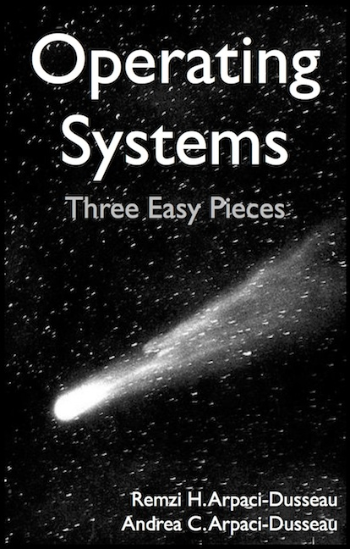
Resources
Book: https://pages.cs.wisc.edu/~remzi/OSTEP/
Slides Template:
https://pages.cs.wisc.edu/~remzi/OSTEP/Educators-Slides/Youjip/

Slide 3
Acknowledgement
This lecture slide set was initially developed for Operating System course in Computer Science Dept. at Hanyang University. This lecture slide set is for OSTEP book written by Remzi and Andrea at University of Wisconsin.

Slide 4
16. Segmentation
Operating System: Three Easy Pieces

Slide 5
Inefficiency of the Base and Bound Approach
0KB
Program Code
Big chunk of “free” space
“free” space takes up physical memory.
Hard to run when an address space does not fit into physical memory
1KB
2KB
3KB
4KB
5KB
Heap
6KB
(free)
14KB
15KB
Stack
16KB

Slide 6
Segmentation
Segment is just a contiguous portion of the address space of a particular length.
Logically-different segment: code, stack, heap
Each segment can be placed in different part of physical memory.
Base and bounds exist per each segment.

Slide 7
Placing Segment In Physical Memory
0KB
Operating System
16KB
(not in use)
Segment Base Size
Code 32K 2K
Heap 34K 2K
Stack 28K 2K
Stack
(not in use)
32KB
Code
Heap
(not in use)
48KB
64KB
Physical Memory

Slide 8

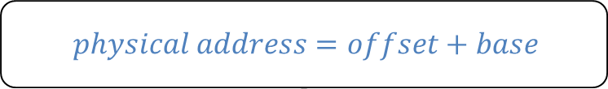
Address Translation on Segmentation
The offset of virtual address 100 is 100.
The code segment starts at virtual address 0 in address space.
$$physical address=offset+base$$
Segment Base Size
Code 32K 2K
16KB
(not in use)
0KB
32KB
$100+32K or 32868$ is the desired physical address
100
Program Code
Code
instruction
2KB
34KB
Heap
4KB
(not in use)

Slide 9
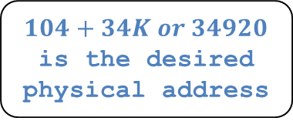
Address Translation on Segmentation(Cont.)
The offset of virtual address 4200 is 104.
The heap segment starts at virtual address 4096 in address space.
$Virtual address+base$ is not the correct physical address.
Segment Base Size
Heap 34K 2K
(not in use)
32KB
Code
4KB
34KB
$104+34K or 34920$ is the desired physical address
4200
Heap
Heap
data
6KB
36KB
(not in use)
Address Space
Physical Memory

Slide 10
Segmentation Fault or Violation
If an illegal address such as 7KB which is beyond the end of heap is referenced, the OS occurs segmentation fault.
The hardware detects that address is out of bounds.
4KB
Heap
6KB
7KB
(not in use)
8KB
Address Space

Slide 11
Referring to Segment
Explicit approach
Chop up the address space into segments based on the top few bits of virtual address.
Example: virtual address 4200 (01000001101000)
13
12
11
10
9
8
7
6
5
4
3
2
1
0
Segment
Offset
Segment bits
Code 00
Heap 01
Stack 10
- 11
13
12
11
10
9
8
7
6
5
4
3
2
1
0
0
1
0
0
0
0
0
1
1
0
1
0
0
0
Segment
Offset

Slide 12
Referring to Segment(Cont.)
SEG_MASK = 0x3000(11000000000000)
SEG_SHIFT = 12
OFFSET_MASK = 0xFFF (00111111111111)
1 // get top 2 bits of 14-bit VA
2 Segment = (VirtualAddress & SEG_MASK) >> SEG_SHIFT
3 // now get offset
4 Offset = VirtualAddress & OFFSET_MASK
5 if (Offset >= Bounds[Segment])
6 RaiseException(PROTECTION_FAULT)
7 else
8 PhysAddr = Base[Segment] + Offset
9 Register = AccessMemory(PhysAddr)

Slide 13
Referring to Stack Segment
Stack grows backward.
Extra hardware support is need.
The hardware checks which way the segment grows.
1: positive direction, 0: negative direction
Segment Register(with Negative-Growth Support)
(not in use)
Segment Base Size Grows Positive?
Code 32K 2K 1
Heap 34K 2K 1
Stack 28K 2K 0
26KB
Stack
28KB
(not in use)
Physical Memory

Slide 14
Support for Sharing
Segment can be shared between address space.
Code sharing is still in use in systems today.
by extra hardware support.
Extra hardware support is need for form of Protection bits.
A few more bits per segment to indicate permissions of read, write and execute.
Segment Register Values(with Protection)
Segment Base Size Grows Positive? Protection
Code 32K 2K 1 Read-Execute
Heap 34K 2K 1 Read-Write
Stack 28K 2K 0 Read-Write

Slide 15
Fine-Grained and Coarse-Grained
Coarse-Grained means segmentation in a small number.
e.g., code, heap, stack.
Fine-Grained segmentation allows more flexibility for address space in some early system.
To support many segments, Hardware support with a segment table is required.

Slide 16
OS support: Fragmentation
External Fragmentation: little holes of free space in physical memory that make difficulty to allocate new segments.
There is 24KB free, but not in one contiguous segment.
The OS cannot satisfy the 20KB request.
Compaction: rearranging the exiting segments in physical memory.
Compaction is costly.
Stop running process.
Copy data to somewhere.
Change segment register value.

Slide 17
Memory Compaction
Not compacted
Compacted
0KB
Operating System
0KB
Operating System
8KB
8KB
16KB
16KB
(not in use)
Allocated
24KB
24KB
Allocated
32KB
32KB
(not in use)
40KB
Allocated
40KB
(not in use)
48KB
(not in use)
48KB
56KB
56KB
Allocated
64KB
64KB

