Slide 1




CMSC 125: Operating Systems
Instructor: Joseph Anthony C. Hermocilla
Email: jchermocilla@up.edu.ph
Web: https://jachermocilla.org

Slide 2
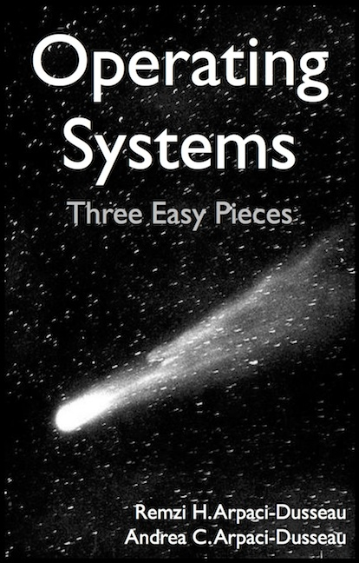
Resources
Book: https://pages.cs.wisc.edu/~remzi/OSTEP/
Slides Template:
https://pages.cs.wisc.edu/~remzi/OSTEP/Educators-Slides/Youjip/

Slide 3
Acknowledgement
This lecture slide set was initially developed for Operating System course in Computer Science Dept. at Hanyang University. This lecture slide set is for OSTEP book written by Remzi and Andrea at University of Wisconsin.

Slide 4
18. Paging: Introduction
Operating System: Three Easy Pieces

Slide 5
Concept of Paging
Paging splits up address space into fixed-zed unit called a page.
Segmentation: variable size of logical segments(code, stack, heap, etc.)
With paging, physical memory is also split into some number of pages called a page frame.
Page table per process is needed to translate the virtual address to physical address.

Slide 6
Advantages Of Paging
Flexibility: Supporting the abstraction of address space effectively
Don’t need assumption how heap and stack grow and are used.
Simplicity: ease of free-space management
The page in address space and the page frame are the same size.
Easy to allocate and keep a free list

Slide 7
Example: A Simple Paging
128-byte physical memory with 16 bytes page frames
64-byte address space with 16 bytes pages
0
page frame 0 of physical memory
reserved for OS
16
(unused)
page frame 1
0
32
(page 0 of the address space)
page 3 of AS
page frame 2
16
48
(page 1)
page 0 of AS
page frame 3
32
64
(page 2)
(unused)
page frame 4
48
(page 3)
80
page 2 of AS
page frame 5
64
A Simple 64-byte Address Space
96
(unused)
page frame 6
112
page 1 of AS
page frame 7
128
64-Byte Address Space Placed In Physical Memory

Slide 8
Address Translation
Two components in the virtual address
VPN: virtual page number
Offset: offset within the page
Example: virtual address 21 in 64-byte address space
VPN
offset
Va5
Va4
Va3
Va2
Va1
Va0
VPN
offset
0
1
0
1
0
1

Slide 9
Example: Address Translation
The virtual address 21 in 64-byte address space
VPN
offset
Virtual
Address
0
1
0
1
0
1
Address Translation
Physical
Address
1
1
1
0
1
0
1
PFN
offset

Slide 10
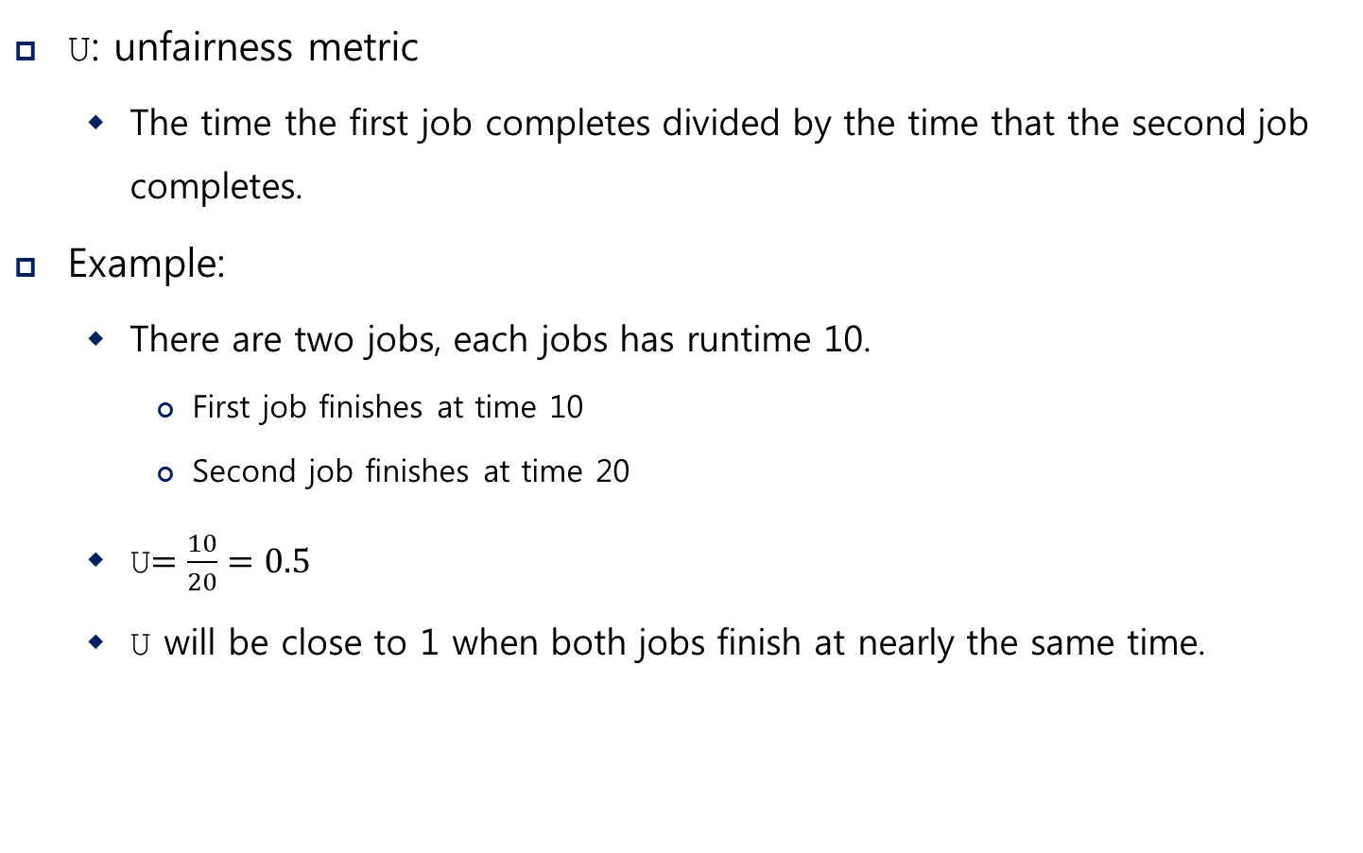
Where Are Page Tables Stored?
Page tables can get awfully large
32-bit address space with 4-KB pages, 20 bits for VPN
${4MB= 2}^{20} entries ∗4 Bytes per page table entry$
Page tables for peach process are stored in memory.

Slide 11
Example: Page Table in Kernel Physical Memory
0
page table
3 7 5 2
page frame 0 of physical memory
16
(unused)
page frame 1
32
page 3 of AS
page frame 2
48
page 0 of AS
page frame 3
64
(unused)
page frame 4
80
page 2 of AS
page frame 5
96
(unused)
page frame 6
112
page 1 of AS
page frame 7
128
Physical Memory

Slide 12
What Is In The Page Table?
The page table is just a data structure that is used to map the virtual address to physical address.
Simplest form: a linear page table, an array
The OS indexes the array by VPN, and looks up the page-table entry.

Slide 13
Common Flags Of Page Table Entry
Valid Bit: Indicating whether the particular translation is valid.
Protection Bit: Indicating whether the page could be read from, written to, or executed from
Present Bit: Indicating whether this page is in physical memory or on disk(swapped out)
Dirty Bit: Indicating whether the page has been modified since it was brought into memory
Reference Bit(Accessed Bit): Indicating that a page has been accessed

Slide 14
Example: x86 Page Table Entry
P: present
R/W: read/write bit
U/S: supervisor
A: accessed bit
D: dirty bit
PFN: the page frame number
31 | 30 | 29 | 28 | 27 | 26 | 25 | 24 | 23 | 22 | 21 | 20 | 19 | 18 | 17 | 16 | 15 | 14 | 13 | 12 | 11 | 10 | 9 | 8 | 7 | 6 | 5 | 4 | 3 | 2 | 1 | 0
PFN
G
PAT
D
A
PCD
PWT
U/S
R/W
P
An x86 Page Table Entry(PTE)

Slide 15
Paging: Too Slow
To find a location of the desired PTE, the starting location of the page table is needed.
For every memory reference, paging requires the OS to perform one extra memory reference.

Slide 16
Accessing Memory With Paging
1 // Extract the VPN from the virtual address
2 VPN = (VirtualAddress & VPN_MASK) >> SHIFT
3
4 // Form the address of the page-table entry (PTE)
5 PTEAddr = PTBR + (VPN * sizeof(PTE))
6
7 // Fetch the PTE
8 PTE = AccessMemory(PTEAddr)
9
10 // Check if process can access the page
11 if (PTE.Valid == False)
12 RaiseException(SEGMENTATION_FAULT)
13 else if (CanAccess(PTE.ProtectBits) == False)
14 RaiseException(PROTECTION_FAULT)
15 else
16 // Access is OK: form physical address and fetch it
17 offset = VirtualAddress & OFFSET_MASK
18 PhysAddr = (PTE.PFN << PFN_SHIFT) | offset
19 Register = AccessMemory(PhysAddr)

Slide 17
A Memory Trace
Example: A Simple Memory Access
Compile and execute
Resulting Assembly code
int array[1000];
...
for (i = 0; i < 1000; i++)
array[i] = 0;
prompt> gcc –o array array.c –Wall –o
prompt>./array
0x1024 movl $0x0,(%edi,%eax,4)
0x1028 incl %eax
0x102c cmpl $0x03e8,%eax
0x1030 jne 0x1024

Slide 18
A Virtual(And Physical) Memory Trace
Page Table[39]
1224
1174
Page Table(PA)
Page Table[1]
1124
1074
1024
Array(VA)
40100
mov
7132
Array(PA)
40050
7282
40000
7232
Code(VA)
1124
mov
inc
cmp
jne
4196
Code(PA)
1074
4146
1024
4096
0
10
20
30
40
50
Memory Access

