Slide 1




CMSC 125: Operating Systems
Instructor: Joseph Anthony C. Hermocilla
Email: jchermocilla@up.edu.ph
Web: https://jachermocilla.org

Slide 2
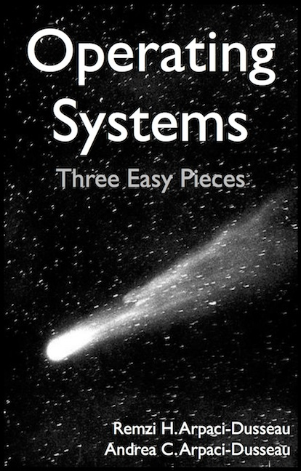
Resources
Book: https://pages.cs.wisc.edu/~remzi/OSTEP/
Slides Template:
https://pages.cs.wisc.edu/~remzi/OSTEP/Educators-Slides/Youjip/

Slide 3
Acknowledgement
This lecture slide set was initially developed for Operating System course in Computer Science Dept. at Hanyang University. This lecture slide set is for OSTEP book written by Remzi and Andrea at University of Wisconsin.

Slide 4
22. Swaping: Policies
Operating System: Three Easy Pieces

Slide 5
Beyond Physical Memory: Policies
Memory pressure forces the OS to start paging out pages to make room for actively-used pages.
Deciding which page to evict is encapsulated within the replacement policy of the OS.

Slide 6
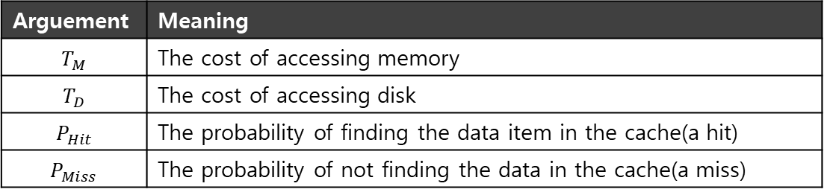

Cache Management
Goal in picking a replacement policy for this cache is to minimize the number of cache misses.
The number of cache hits and misses let us calculate the average memory access time(AMAT).
$$AMAT=\left(P_{Hit}∗T_{M}\right)+(P_{Miss}∗T_{D})$$
Arguement | Meaning
$$T_{M}$$ | The cost of accessing memory
$$T_{D}$$ | The cost of accessing disk
$$P_{Hit}$$ | The probability of finding the data item in the cache(a hit)
$$P_{Miss}$$ | The probability of not finding the data in the cache(a miss)

Slide 7
The Optimal Replacement Policy
Leads to the fewest number of misses overall
Replaces the page that will be accessed furthest in the future
Resulting in the fewest-possible cache misses
Serve only as a comparison point, to know how close we are to perfect

Slide 8

Tracing the Optimal Policy
Reference Row
0
1
2
0
1
3
0
3
1
2
1
Access | Hit/Miss? | Evict | Resulting Cache State
0 | Miss |  | 0
1 | Miss |  | 0,1
2 | Miss |  | 0,1,2
0 | Hit |  | 0,1,2
1 | Hit |  | 0,1,2
3 | Miss | 2 | 0,1,3
0 | Hit |  | 0,1,3
3 | Hit |  | 0,1,3
1 | Hit |  | 0,1,3
2 | Miss | 3 | 0,1,2
1 | Hit |  | 0,1,2
Hit rate is $\frac{Hits}{Hits+Misses}=54.6\%$
Future is not known.

Slide 9
A Simple Policy: FIFO
Pages were placed in a queue when they enter the system.
When a replacement occurs, the page on the tail of the queue(the “First-in” pages) is evicted.
It is simple to implement, but can’t determine the importance of blocks.

Slide 10

Tracing the FIFIO Policy
Reference Row
0
1
2
0
1
3
0
3
1
2
1
Access | Hit/Miss? | Evict | Resulting Cache State
0 | Miss |  | 0
1 | Miss |  | 0,1
2 | Miss |  | 0,1,2
0 | Hit |  | 0,1,2
1 | Hit |  | 0,1,2
3 | Miss | 0 | 1,2,3
0 | Miss | 1 | 2,3,0
3 | Hit |  | 2,3,0
1 | Miss |  | 3,0,1
2 | Miss | 3 | 0,1,2
1 | Hit |  | 0,1,2
Hit rate is $\frac{Hits}{Hits+Misses}=36.4\%$
Even though page 0 had been accessed a number of times, FIFO still kicks it out.

Slide 11
BELADY’S ANOMALY
We would expect the cache hit rate to increase when the cache gets larger. But in this case, with FIFO, it gets worse.
Reference Row
1
2
3
4
1
2
5
1
2
3
4
5

Slide 12
Another Simple Policy: Random
Picks a random page to replace under memory pressure.
It doesn’t really try to be too intelligent in picking which blocks to evict.
Random does depends entirely upon how lucky Random gets in its choice.
Access | Hit/Miss? | Evict | Resulting Cache State
0 | Miss |  | 0
1 | Miss |  | 0,1
2 | Miss |  | 0,1,2
0 | Hit |  | 0,1,2
1 | Hit |  | 0,1,2
3 | Miss | 0 | 1,2,3
0 | Miss | 1 | 2,3,0
3 | Hit |  | 2,3,0
1 | Miss | 3 | 2,0,1
2 | Hit |  | 2,0,1
1 | Hit |  | 2,0,1

Slide 13
Random Performance
Sometimes, Random is as good as optimal, achieving 6 hits on the example trace.
Random Performance over 10,000 Trials

Slide 14
Using History
Lean on the past and use history.
Two type of historical information.
Historical Information | Meaning | Algorithms
recency | The more recently a page has been accessed, the more likely it will be accessed again | LRU
frequency | If a page has been accessed many times, It should not be replcaed as it clearly has some value | LFU

Slide 15
Using History : LRU
Replaces the least-recently-used page.
Reference Row
0
1
2
0
1
3
0
3
1
2
1
Access | Hit/Miss? | Evict | Resulting Cache State
0 | Miss |  | 0
1 | Miss |  | 0,1
2 | Miss |  | 0,1,2
0 | Hit |  | 1,2,0
1 | Hit |  | 2,0,1
3 | Miss | 2 | 0,1,3
0 | Hit |  | 1,3,0
3 | Hit |  | 1,0,3
1 | Hit |  | 0,3,1
2 | Miss | 0 | 3,1,2
1 | Hit |  | 3,2,1

Slide 16
Workload Example : The No-Locality Workload
Each reference is to a random page within the set of accessed pages.
Workload accesses 100 unique pages over time.
Choosing the next page to refer to at random
The No-Locality Workload
100%
80%
When the cache is large enough to fit the entire workload,
it also doesn’t matter which policy you use.
60%
Hit Rate
OPT
LRU
40%
FIFO
RAND
20%
20
40
60
80
100
Cache Size (Blocks)

Slide 17
Workload Example : The 80-20 Workload
Exhibits locality: 80% of the reference are made to 20% of the page
The remaining 20% of the reference are made to the remaining 80% of the pages.
The 80-20 Workload
100%
80%
LRU is more likely to
hold onto the hot pages.
60%
Hit Rate
OPT
LRU
40%
FIFO
RAND
20%
20
40
60
80
100
Cache Size (Blocks)

Slide 18
Workload Example : The Looping Sequential
Refer to 50 pages in sequence.
Starting at 0, then 1, … up to page 49, and then we Loop, repeating those accesses, for total of 10,000 accesses to 50 unique pages.
The Looping-Sequential Workload
100%
80%
60%
Hit Rate
OPT
LRU
40%
FIFO
RAND
20%
20
40
60
80
100
Cache Size (Blocks)

Slide 19
Implementing Historical Algorithms
To keep track of which pages have been least-and-recently used, the system has to do some accounting work on every memory reference.
Add a little bit of hardware support.

Slide 20
Approximating LRU
Require some hardware support, in the form of a use bit
Whenever a page is referenced, the use bit is set by hardware to 1.
Hardware never clears the bit, though; that is the responsibility of the OS
Clock Algorithm
All pages of the system arranges in a circular list.
A clock hand points to some particular page to begin with.

Slide 21
Clock Algorithm
The algorithm continues until it finds a use bit that is set to 0.
A
H
B
Use bit | Meaning
0 | Evict the page
1 | Clear Use bit and advance hand
G
C
F
D
E
The Clock page replacement algorithm
When a page fault occurs, the page the hand is pointing to is inspected. The action taken depends on the Use bit

Slide 22
Workload with Clock Algorithm
Clock algorithm doesn’t do as well as perfect LRU, it does better then approach that don’t consider history at all.
The 80-20 Workload
100%
80%
60%
Hit Rate
OPT
LRU
40%
Clock
FIFO
RAND
20%
20
40
60
80
100
Cache Size (Blocks)

Slide 23
Considering Dirty Pages
The hardware include a modified bit (a.k.a dirty bit)
Page has been modified and is thus dirty, it must be written back to disk to evict it.
Page has not been modified, the eviction is free.

Slide 24
Page Selection Policy
The OS has to decide when to bring a page into memory.
Presents the OS with some different options.

Slide 25
Prefetching
The OS guess that a page is about to be used, and thus bring it in ahead of time.
Page 1 is brought into memory
Page 3
Page 4
Page 5
…
Page n
Physical Memory
Page 2
…
Page 1
Page 3
Page 4
Secondary
Storage
Page 2 likely soon be accessed and
thus should be brought into memory too

Slide 26
Clustering, Grouping
Collect a number of pending writes together in memory and write them to disk in one write.
Perform a single large write more efficiently than many small ones.
Pending writes
Page 1
Page 2
Page 3
Page 4
Page 5
…
Page n
Physical Memory
write in one write
Page 2
…
Page 1
Page 3
Page 4
Secondary
Storage

Slide 27
Thrashing
Memory is oversubscribed and the memory demands of the set of running processes exceeds the available physical memory.
Decide not to run a subset of processes.
Reduced set of processes working sets fit in memory.
CPU
Utilization
Trashing
Degree of multiprogramming

