Slide 1




CMSC 125: Operating Systems
Instructor: Joseph Anthony C. Hermocilla
Email: jchermocilla@up.edu.ph
Web: https://jachermocilla.org

Slide 2
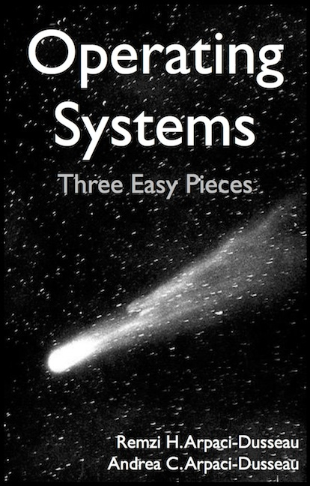
Resources
Book: https://pages.cs.wisc.edu/~remzi/OSTEP/
Slides Template:
https://pages.cs.wisc.edu/~remzi/OSTEP/Educators-Slides/Youjip/

Slide 3
Acknowledgement
This lecture slide set was initially developed for Operating System course in Computer Science Dept. at Hanyang University. This lecture slide set is for OSTEP book written by Remzi and Andrea at University of Wisconsin.

Slide 4
37. Hard Disk Drives
Operating System: Three Easy Pieces

Slide 5
Hard Disk Driver
Hard disk driver have been the main form of persistent data storage in computer systems for decades.
The drive consists of a large number of sectors (512-byte blocks).
Address Space :
We can view the disk with n sectors as an array of sectors; 0 to n-1.

Slide 6
Interface
The only guarantee is that a single 512-byte write is atomic.
Multi-sector operations are possible.
Many file systems will read or write 4KB at a time.
Torn write:
If an untimely power loss occurs, only a portion of a larger write may complete.
Accessing blocks in a contiguous chunk is the fastest access mode.
A sequential read or write
Much faster than any more random access pattern.

Slide 7
Basic Geometry
Platter (Aluminum coated with a thin magnetic layer)
A circular hard surface
Data is stored persistently by inducing magnetic changes to it.
Each platter has 2 sides, each of which is called a surface.
spindle
A Disk with Just A Single Track (12 sectors)

Slide 8
Basic Geometry (Cont.)
Spindle
Spindle is connected to a motor that spins the platters around.
The rate of rotations is measured in RPM (Rotations Per Minute).
Typical modern values : 7,200 RPM to 15,000 RPM.
E.g., 10000 RPM : A single rotation takes about 6 ms.
Track
Concentric circles of sectors
Data is encoded on each surface in a track.
A single surface contains many thousands and thousands of tracks.

Slide 9
A Simple Disk Drive
Rotates this way
Disk head (One head per surface of the drive)
The process of reading and writing is accomplished by the disk head.
Attached to a single disk arm, which moves across the surface.
head
spindle
arm
A Single Track Plus A Head

Slide 10
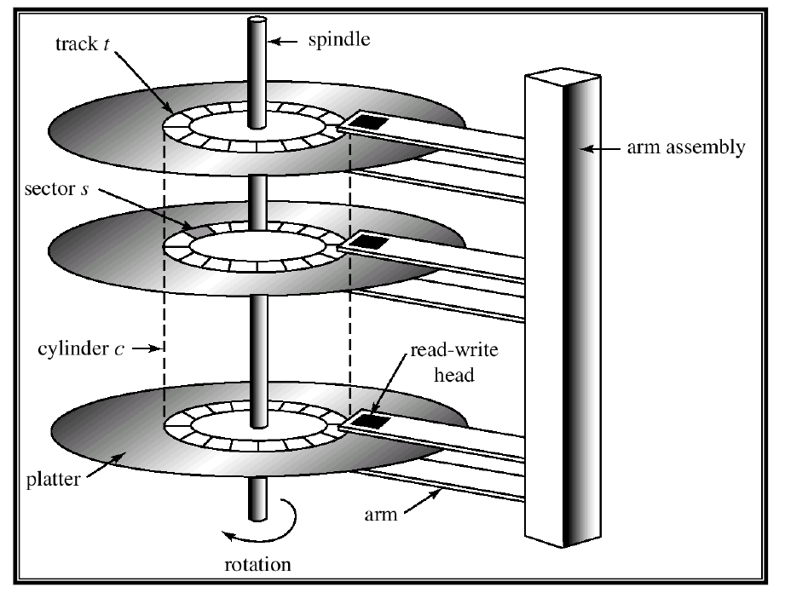
Example of a Disk

Slide 11
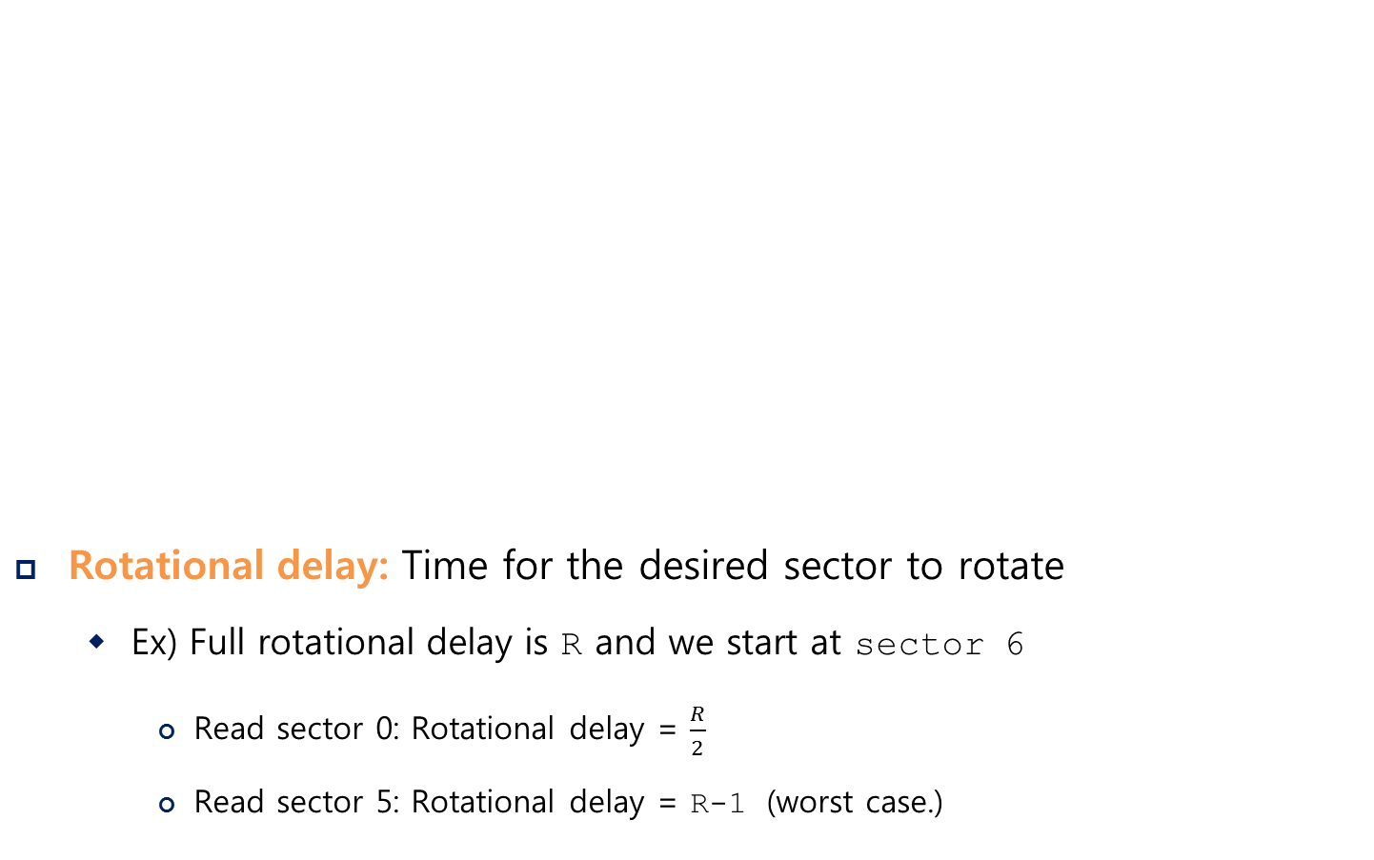
Single-track Latency: The Rotational Delay
Rotational delay: Time for the desired sector to rotate
Ex) Full rotational delay is R and we start at sector 6
Read sector 0: Rotational delay = $\frac{R}{2}$
Read sector 5: Rotational delay = R-1 (worst case.)
Rotates this way
head
spindle
arm
A Single Track Plus A Head

Slide 12
Multiple Tracks: Seek Time
Rotates this way
Rotates this way
Remaining rotation
seek
spindle
spindle
Three Tracks Plus A Head (Right: With Seek)
(e.g., read to sector 11)
Seek: Move the disk arm to the correct track
Seek time: Time to move head to the track contain the desired sector.
One of the most costly disk operations.

Slide 13
Phases of Seek
Acceleration → Coasting → Deceleration → Settling
Acceleration: The disk arm gets moving.
Coasting: The arm is moving at full speed.
Deceleration: The arm slows down.
Settling: The head is carefully positioned over the correct track.
The settling time is often quite significant, e.g., 0.5 to 2ms.

Slide 14
Transfer
The final phase of I/O
Data is either read from or written to the surface.
Complete I/O time:
Seek
Waiting for the rotational delay
Transfer

Slide 15
Track Skew
Make sure that sequential reads can be properly serviced even when crossing track boundaries.
Without track skew, the head would be moved to the next track but the desired next block would have already rotated under the head.
Rotates this way
9
8
19
10
18
20
7
28
29
30
11
17
21
27
31
Spindle
6
16
26
32
22
0
25
33
5
15
24
34
23
35
1
14
12
4
13
2
3
Three Tracks: Track Skew Of 2

Slide 16
Cache (Track Buffer)
Hold data read from or written to the disk
Allow the drive to quickly respond to requests.
Small amount of memory (usually around 8 or 16 MB)

Slide 17
Write on cache
Writeback (Immediate reporting)
Acknowledge a write has completed when it has put the data in its memory.
faster but dangerous
Write through
Acknowledge a write has completed after the write has actually been written to disk.

Slide 18

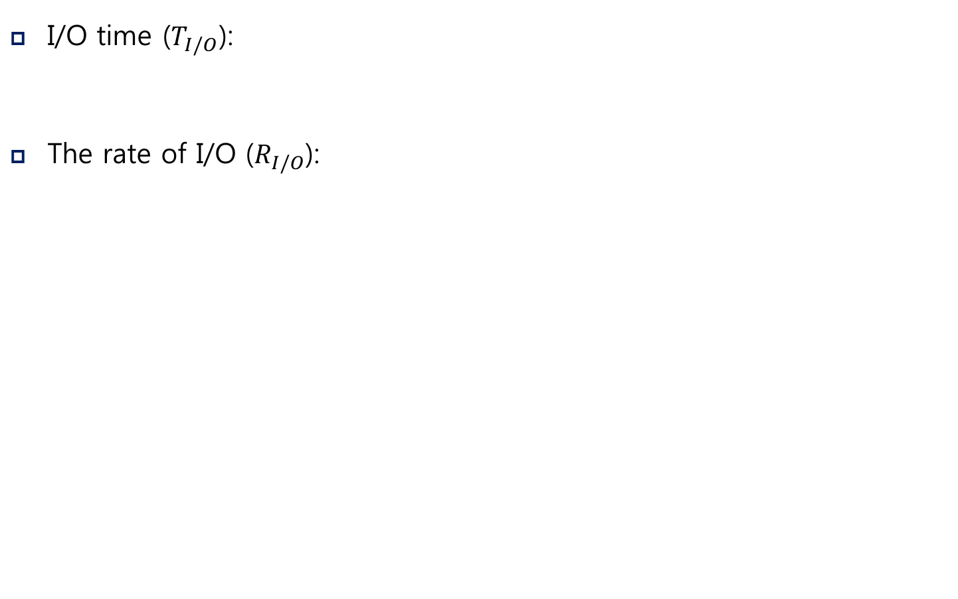
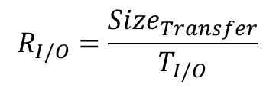
I/O Time: Doing The Math
I/O time ($T_{I/O}$):
The rate of I/O ($R_{I/O}$):
$$T_{I/O}=T_{seek}+T_{rotation}+T_{transfer}$$
$$R_{I/O}=\frac{{Size}_{Transfer}}{T_{I/O}}$$
 | Cheetah 15K.5 | Barracuda
Capacity | 300 GB | 1 TB
RPM | 15,000 | 7,200
Average Seek | 4 ms | 9 ms
Max Transfer | 125 MB/s | 105 MB/s
Platters | 4 | 4
Cache | 16 MB | 16/32 MB
Connects Via | SCSI | SATA
Disk Drive Specs: SCSI Versus SATA

Slide 19
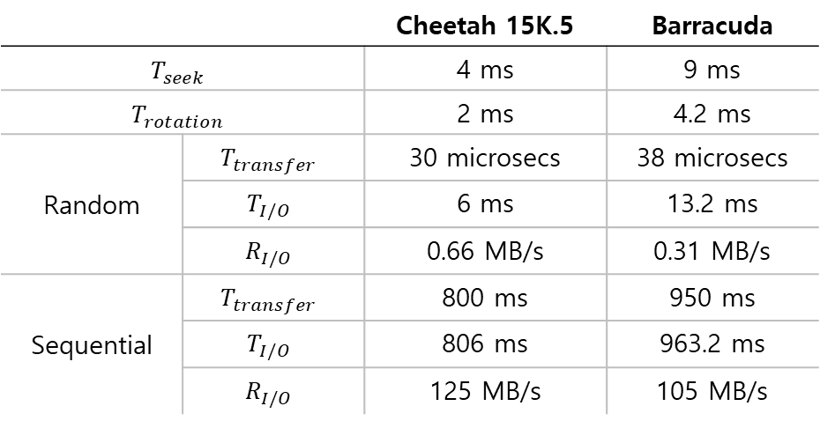
I/O Time Example
Random workload: Issue 4KB read to random locations on the disk
Sequential workload: Read 100MB consecutively from the disk
 |  | Cheetah 15K.5 | Barracuda
$$T_{seek}$$ |  | 4 ms | 9 ms
$$T_{rotation}$$ |  | 2 ms | 4.2 ms
Random | $$T_{transfer}$$ | 30 microsecs | 38 microsecs
 | $$T_{I/O}$$ | 6 ms | 13.2 ms
 | $$R_{I/O}$$ | 0.66 MB/s | 0.31 MB/s
Sequential | $$T_{transfer}$$ | 800 ms | 950 ms
 | $$T_{I/O}$$ | 806 ms | 963.2 ms
 | $$R_{I/O}$$ | 125 MB/s | 105 MB/s
Disk Drive Performance: SCSI Versus SATA
There is a huge gap in drive performance
between random and sequential workloads

Slide 20
Disk Scheduling
Disk Scheduler decides which I/O request to schedule next.
SSTF (Shortest Seek Time First)
Order the queue of I/O request by track
Pick requests on the nearest track to complete first
Rotates this way
9
8
21
10
20
22
7
32
33
34
11
19
23
SSTF: Scheduling Request 21 and 2
Issue the request to 21 → issue the request to 2
31
35
Spindle
6
18
30
24
12
0
29
25
5
17
28
26
13
27
1
16
14
4
15
2
3

Slide 21
SSTF is not a panacea.
Problem 1: The drive geometry is not available to the host OS
Solution: OS can simply implement Nearest-block-first (NBF)
Problem 2: Starvation
If there were a steady stream of request to the inner track, request to other tracks would then be ignored completely.

Slide 22
Elevator (a.k.a. SCAN or C-SCAN)
Move across the disk servicing requests in order across the tracks.
Sweep: A single pass across the disk
If a request comes for a block on a track that has already been services on this sweep of the disk, it is queued until the next sweep.
F-SCAN
Freeze the queue to be serviced when it is doing a sweep
Avoid starvation of far-away requests
C-SCAN (Circular SCAN)
Sweep from outer-to-inner, and then inner-to-outer, etc.

Slide 23
How to account for Disk rotation costs?
Rotates this way
If rotation is faster than seek : request 16 → request 8
If seek is faster than rotation : request 8 → request 16
9
8
21
10
20
22
7
32
33
34
11
19
23
31
35
Spindle
6
18
30
24
12
0
29
25
5
17
28
26
13
27
1
16
14
4
15
2
3
SSTF: Sometimes Not Good Enough
On modern drives, both seek and rotation are roughly equivalent:
Thus, SPTF (Shortest Positioning Time First) is useful.

Slide 24
I/O merging
Reduce the number of request sent to the disk and lowers overhead
E.g., read blocks 33, then 8, then 34:
The scheduler merge the request for blocks 33 and 34 into a single two-block request.

