Slide 1




CMSC 125: Operating Systems
Instructor: Joseph Anthony C. Hermocilla
Email: jchermocilla@up.edu.ph
Web: https://jachermocilla.org

Slide 2
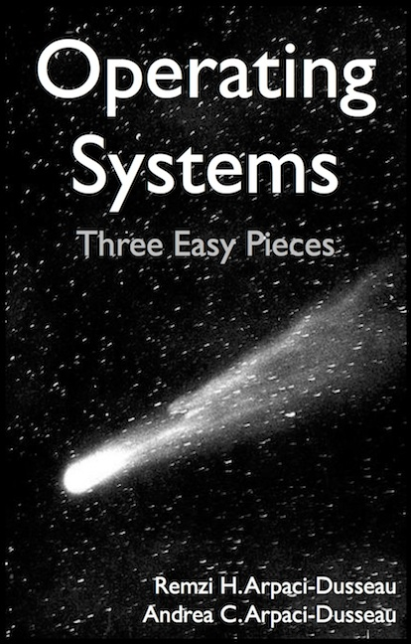
Resources
Book: https://pages.cs.wisc.edu/~remzi/OSTEP/
Slides Template:
https://pages.cs.wisc.edu/~remzi/OSTEP/Educators-Slides/Youjip/

Slide 3
Acknowledgement
This lecture slide set was initially developed for Operating System course in Computer Science Dept. at Hanyang University. This lecture slide set is for OSTEP book written by Remzi and Andrea at University of Wisconsin.

Slide 4
38. RAID
Operating System: Three Easy Pieces

Slide 5
RAID (Redundant Array of Inexpensive Disks)
Use multiple disks in concert to build a faster, bigger, and more reliable disk system.
RAID just looks like a big disk to the host system.
Advantage
Performance & Capacity: Using multiple disks in parallel
Reliability: RAID can tolerate the loss of a disk.
RAIDs provide these advantages transparently
to systems that use them.

Slide 6
RAID Interface
When a RAID receives I/O request,
The RAID calculates which disk to access.
The RAID issue one or more physical I/Os to do so.
RAID example: A mirrored RAID system
Keep two copies of each block (each one on a separate disk)
Perform two physical I/Os for every one logical I/O it is issued.

Slide 7
RAID Internals
A microcontroller
Run firmware to direct the operation of the RAID
Volatile memory (such as DRAM)
Buffer data blocks
Non-volatile memory
Buffer writes safely
Specialized logic to perform parity calculation

Slide 8
Fault Model
RAIDs are designed to detect and recover from certain kinds of disk faults.
Fail-stop fault model
A disk can be in one of two states: Working or Failed.
Working: all blocks can be read or written.
Failed: the disk is permanently lost.
RAID controller can immediately observe when a disk has failed.

Slide 9
How to evaluate a RAID
Capacity
How much useful capacity is available to systems?
Reliability
How many disk faults can the given design tolerate?
Performance

Slide 10
RAID Level 0: Striping
RAID Level 0 is the simplest form as striping blocks.
Spread the blocks across the disks in a round-robin fashion.
No redundancy
Excellent performance and capacity
Disk 0 | Disk 1 | Disk 2 | Disk 3
0 | 1 | 2 | 3
4 | 5 | 6 | 7
8 | 9 | 10 | 11
12 | 13 | 14 | 15
Stripe
(The blocks in the same row)
RAID-0: Simple Striping
(Assume here a 4-disk array)

Slide 11
RAID Level 0 (Cont.)
Example) RAID-0 with a bigger chunk size
Chunk size : 2 blocks (8 KB)
A Stripe: 4 chunks (32 KB)
Disk 0 | Disk 1 | Disk 2 | Disk 3
0 | 2 | 4 | 6
1 | 3 | 5 | 7
8 | 10 | 12 | 14
9 | 11 | 13 | 15
chunk size:
2blocks
Striping with a Bigger Chunk Size

Slide 12
Chunk Sizes
Chunk size mostly affects performance of the array
Small chunk size
Increasing the parallelism
Increasing positioning time to access blocks
Big chunk size
Reducing intra-file parallelism
Reducing positioning time
Determining the “best” chunk size is hard to do.
Most arrays use larger chunk sizes (e.g., 64 KB)

Slide 13

RAID Level 0 Analysis
$N$: the number of disks
Capacity → RAID-0 is perfect.
Striping delivers N disks worth of useful capacity.
Performance of striping → RAID-0 is excellent.
All disks are utilized often in parallel.
Reliability → RAID-0 is bad.
Any disk failure will lead to data loss.

Slide 14
Evaluating RAID Performance
Consider two performance metrics
Single request latency
Steady-state throughput
Workload
Sequential: access 1MB of data (block (B) ~ block (B + 1MB))
Random: access 4KB at random logical address
A disk can transfer data at
S MB/s under a sequential workload
R MB/s under a random workload

Slide 15
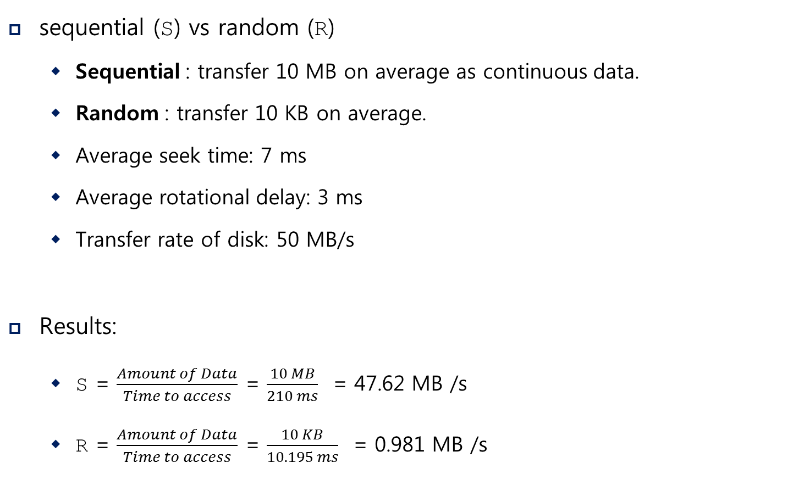
Evaluating RAID Performance Example
sequential (S) vs random (R)
Sequential : transfer 10 MB on average as continuous data.
Random : transfer 10 KB on average.
Average seek time: 7 ms
Average rotational delay: 3 ms
Transfer rate of disk: 50 MB/s
Results:
S = $\frac{Amount of Data}{Time to access}$ = $\frac{10 MB}{210 ms}$ = 47.62 MB /s
R = $\frac{Amount of Data}{Time to access}$ = $\frac{10 KB}{10.195 ms}$ = 0.981 MB /s

Slide 16
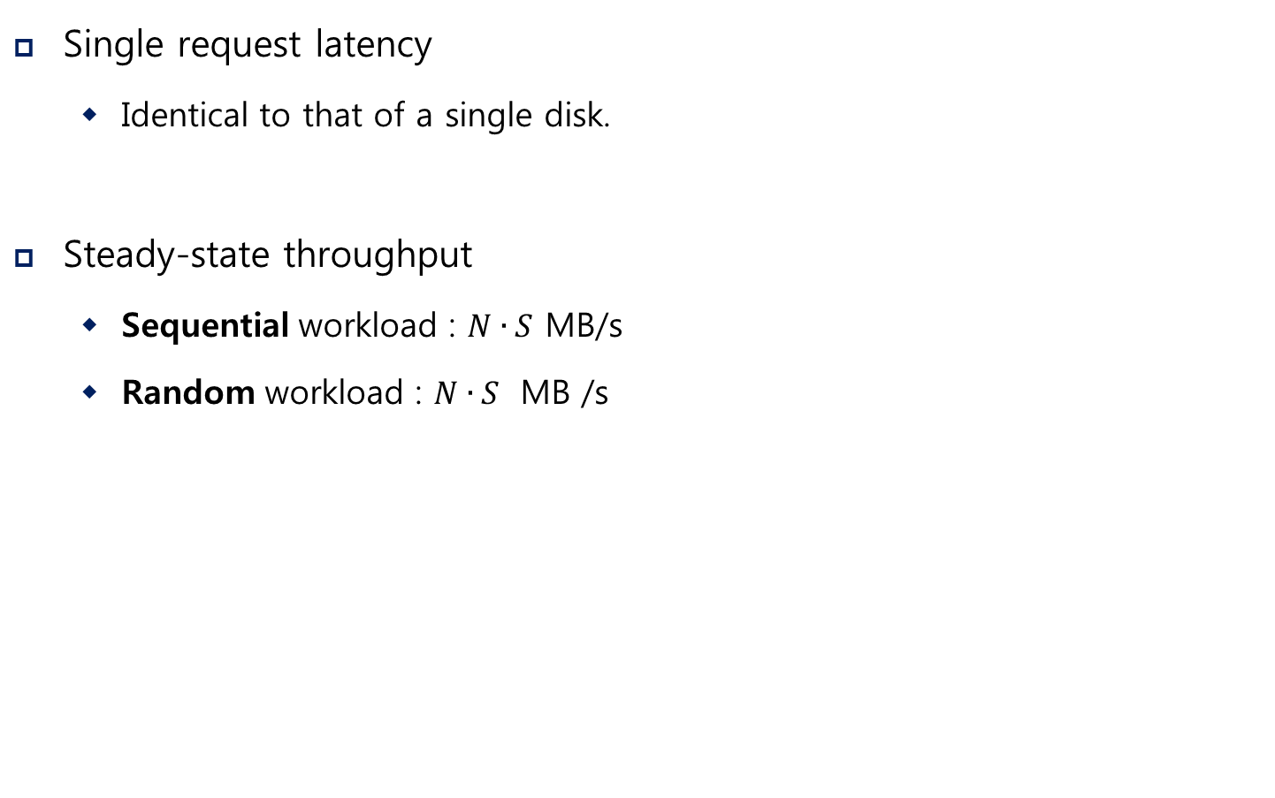
Evaluating RAID-0 Performance
$N$: the number of disks
Single request latency
Identical to that of a single disk.
Steady-state throughput
Sequential workload : $N∙S$ MB/s
Random workload : $N∙S$ MB /s

Slide 17
RAID Level 1 : Mirroring
RAID Level 1 tolerates disk failures.
Copy more than one of each block in the system.
Copy block places on a separate disk.
RAID-10 (RAID 1+0) : mirrored pairs and then stripe
RAID-01 (RAID 0+1) : contain two large striping arrays, and then mirrors
Disk 0 | Disk 1 | Disk 2 | Disk 3
0 | 0 | 1 | 1
2 | 2 | 3 | 3
4 | 4 | 5 | 5
6 | 6 | 7 | 7
Simple RAID-1: Mirroring (Keep two physical copies)

Slide 18

RAID-1 Analysis
$N$: the number of disks
Capacity: RAID-1 is Expensive
The useful capacity of RAID-1 is N/2.
Reliability: RAID-1 does well.
It can tolerate the failure of any one disk (up to N/2 failures depending on which disk fail).

Slide 19
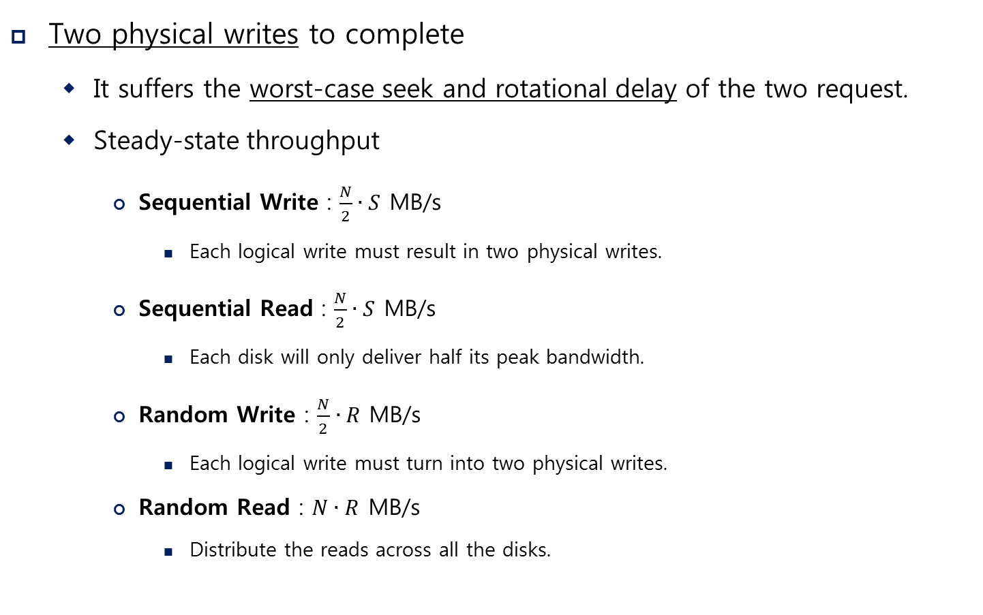
Performance of RAID-1
Two physical writes to complete
It suffers the worst-case seek and rotational delay of the two request.
Steady-state throughput
Sequential Write : $\frac{N}{2}∙S$ MB/s
Each logical write must result in two physical writes.
Sequential Read : $\frac{N}{2}∙S$ MB/s
Each disk will only deliver half its peak bandwidth.
Random Write : $\frac{N}{2}∙R$ MB/s
Each logical write must turn into two physical writes.
Random Read : $N∙R$ MB/s
Distribute the reads across all the disks.

Slide 20
RAID Level 4 : Saving Space With Parity
Add a single parity block
A Parity block stores the redundant information for that stripe of blocks.
* P: Parity
Disk 0 | Disk 1 | Disk 2 | Disk 3 | Disk 4
0 | 0 | 1 | 1 | P0
2 | 2 | 3 | 3 | P1
4 | 4 | 5 | 5 | P2
6 | 6 | 7 | 7 | P3
Five-disk RAID-4 system layout

Slide 21
RAID Level 4 (Cont.)
Compute parity : the XOR of all of bits
Recover from parity
Imagine the bit of the C2 in the first row is lost.
Reading the other values in that row : 0, 0, 1
The parity bit is 0 → even number of 1’s in the row
What the missing data must be: a 1.
C0 | C1 | C2 | C3 | P
0 | 0 | 1 | 1 | XOR(0,0,1,1)=0
0 | 1 | 0 | 0 | XOR(0,1,0,0)=1

Slide 22
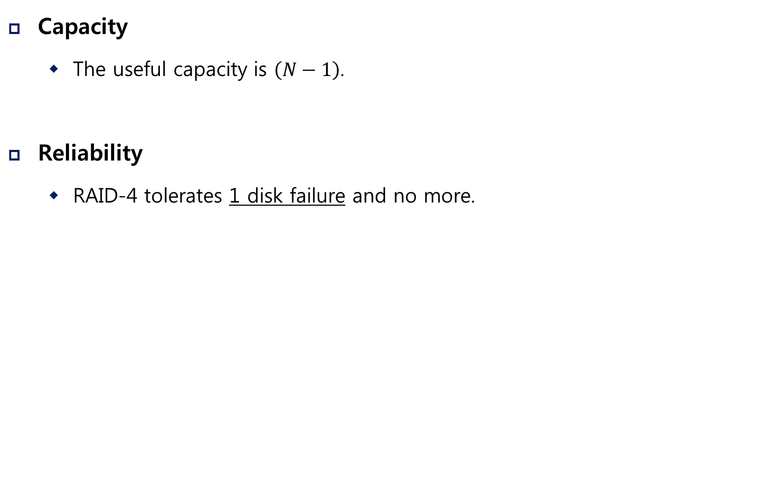
RAID-4 Analysis
$N$: the number of disks
Capacity
The useful capacity is $\left(N−1\right)$.
Reliability
RAID-4 tolerates 1 disk failure and no more.

Slide 23
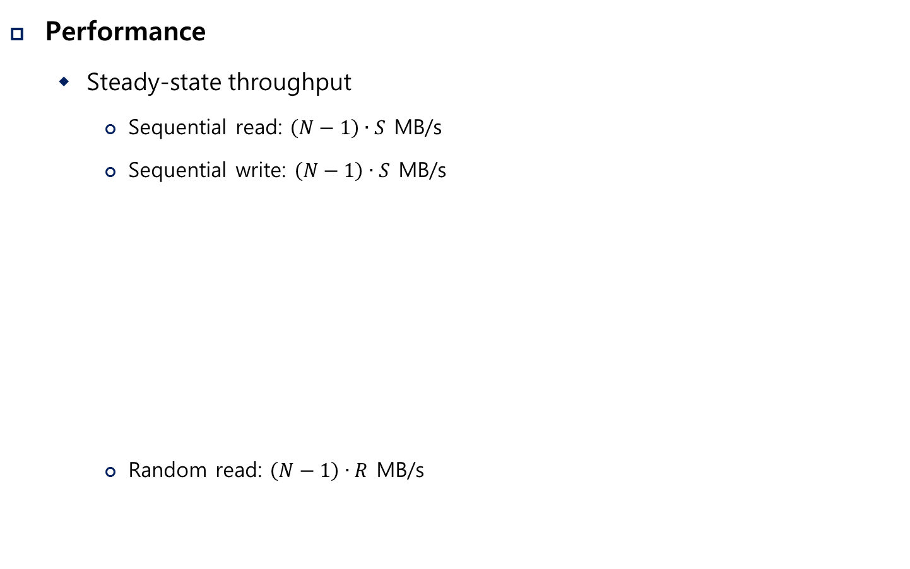
RAID-4 Analysis (Cont.)
Performance
Steady-state throughput
Sequential read: $\left(N−1\right)∙S$ MB/s
Sequential write: $\left(N−1\right)∙S$ MB/s
Random read: $\left(N−1\right)∙R$ MB/s
Disk 0 | Disk 1 | Disk 2 | Disk 3 | Disk 4
0 | 1 | 2 | 3 | P0
4 | 5 | 6 | 7 | P1
8 | 9 | 10 | 11 | P2
12 | 13 | 14 | 15 | P3
Full-stripe Writes In RAID-4

Slide 24
Random write performance for RAID-4
Overwrite a block + update the parity
Method 1: additive parity
Read in all of the other data blocks in the stripe
XOR those blocks with the new block (1)
Problem: the performance scales with the number of disks

Slide 25
Random write performance for RAID-4 (Cont.)
Method 2: subtractive parity
Update C2(old) → C2(new)
Read in the old data at C2 (C2(old)=1) and the old parity (P(old)=0)
Calculate P(new):
If C2(new)==C2(old) → P(new)==P(old)
If C2(new)!=C2(old) → Flip the old parity bit
C0 | C1 | C2 | C3 | P
0 | 0 | 1 | 1 | XOR(0,0,1,1)=0
$$P\left(new\right)=\left(C2\left(old\right) XOR C2\left(new\right)\right) XOR P(old)$$

Slide 26
Small-write problem
The parity disk can be a bottleneck.
Example: update blocks 4 and 13 (marked with *)
Disk 0 and Disk 1 can be accessed in parallel.
Disk 4 prevents any parallelism.
Disk 0 | Disk 1 | Disk 2 | Disk 3 | Disk 4
0 | 1 | 2 | 3 | P0
*4 | 5 | 6 | 7 | +P1
8 | 9 | 10 | 11 | P2
12 | *13 | 14 | 15 | +P3
Writes To 4, 13 And Respective Parity Blocks.
RAID-4 throughput under random small writes is $(\frac{R}{2})$ MB/s (terrible).

Slide 27
A I/O latency in RAID-4
A single read
Equivalent to the latency of a single disk request.
A single write
Two reads and then two writes
Data block + Parity block
The reads and writes can happen in parallel.
Total latency is about twice that of a single disk.

Slide 28
RAID Level 5: Rotating Parity
RAID-5 is solution of small write problem.
Rotate the parity blocks across drives.
Remove the parity-disk bottleneck for RAID-4
Disk 0 | Disk 1 | Disk 2 | Disk 3 | Disk 4
0 | 1 | 2 | 3 | P0
5 | 6 | 7 | P1 | 4
10 | 11 | P2 | 8 | 9
15 | P3 | 12 | 13 | 14
P4 | 16 | 17 | 18 | 19
RAID-5 With Rotated Parity

Slide 29
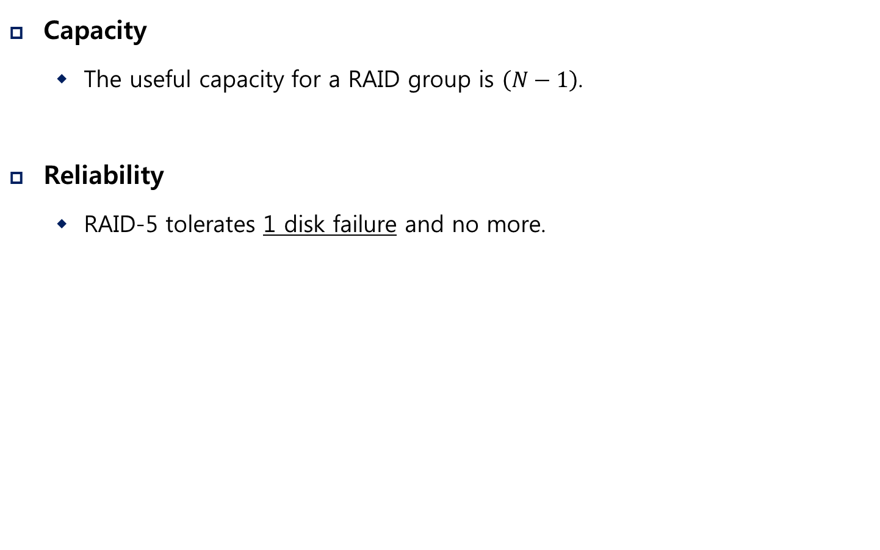
RAID-5 Analysis
$N$: the number of disks
Capacity
The useful capacity for a RAID group is $\left(N−1\right)$.
Reliability
RAID-5 tolerates 1 disk failure and no more.

Slide 30
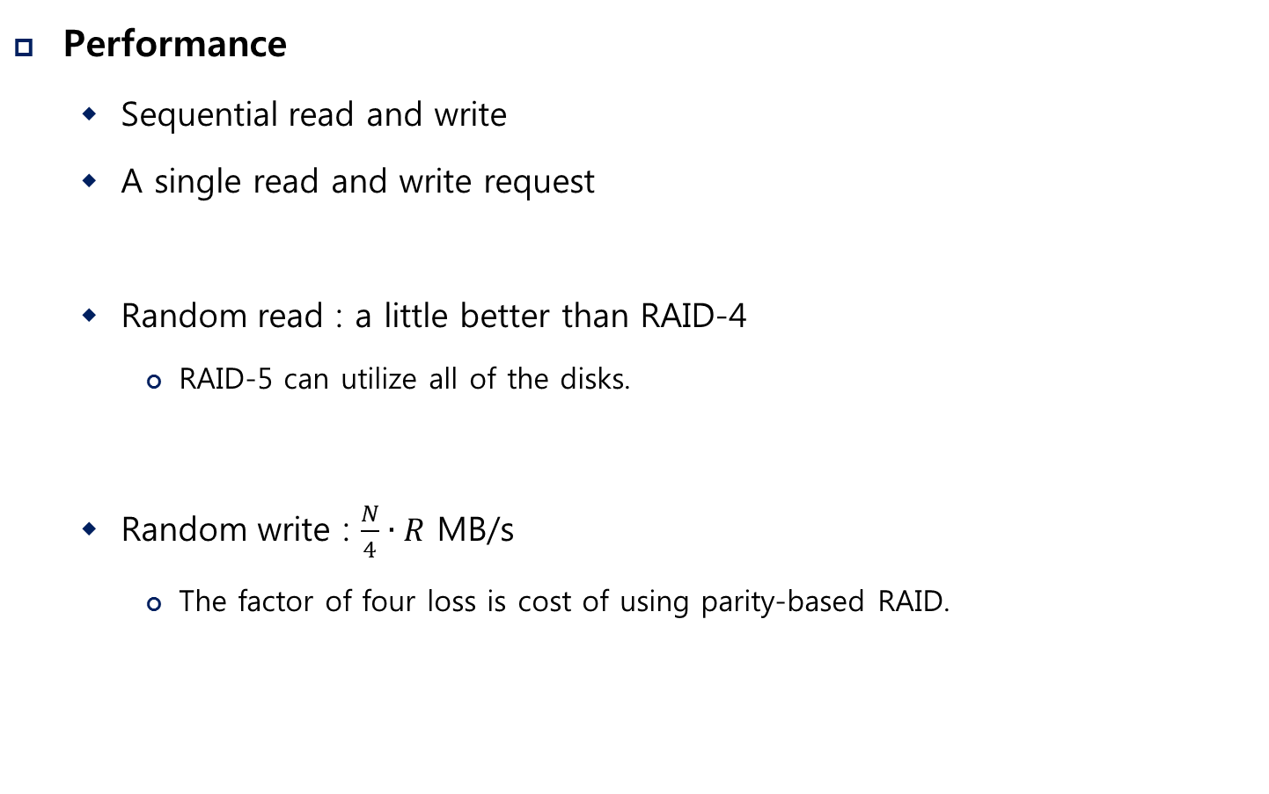
RAID-5 Analysis (Cont.)
$N$: the number of disks
Performance
Sequential read and write
A single read and write request
Random read : a little better than RAID-4
RAID-5 can utilize all of the disks.
Random write : $\frac{N}{4}∙R$ MB/s
The factor of four loss is cost of using parity-based RAID.
Same as RAID-4

Slide 31
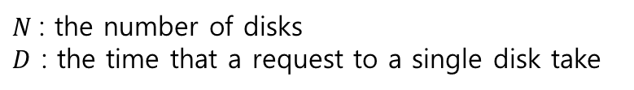
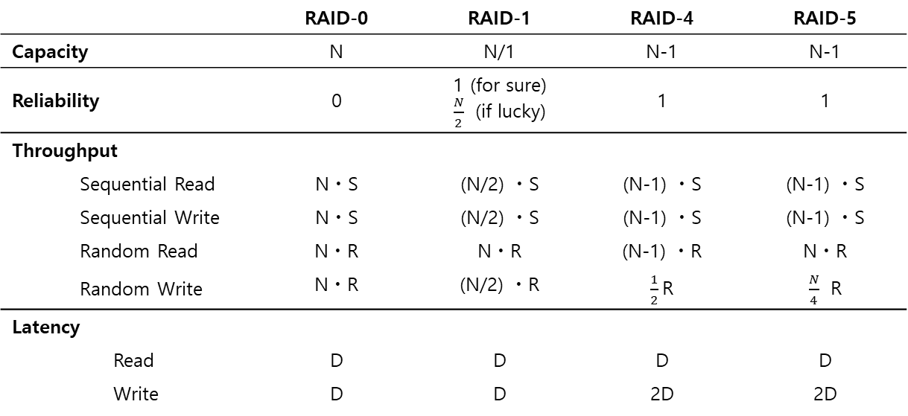
RAID Comparison: A Summary
$N$: the number of disks
$D$ : the time that a request to a single disk take
 |  |  | RAID-0 | RAID-1 | RAID-4 | RAID-5
Capacity |  |  | N | N/1 | N-1 | N-1
Reliability |  |  | 0 | 1 (for sure) $\frac{N}{2}$ (if lucky) | 1 | 1
Throughput
 | Sequential Read |  | NㆍS | (N/2) ㆍS | (N-1) ㆍS | (N-1) ㆍS
 | Sequential Write |  | NㆍS | (N/2) ㆍS | (N-1) ㆍS | (N-1) ㆍS
 | Random Read |  | NㆍR | NㆍR | (N-1) ㆍR | NㆍR
 | Random Write |  | NㆍR | (N/2) ㆍR | $\frac{1}{2}$R | $\frac{N}{4}$ R
Latency
 |  | Read | D | D | D | D
 |  | Write | D | D | 2D | 2D
RAID Capacity, Reliability, and Performance

Slide 32
RAID Comparison: A Summary
Performance and do not care about reliability → RAID-0 (Striping)
Random I/O performance and Reliability → RAID-1 (Mirroring)
Capacity and Reliability → RAID-5
Sequential I/O and Maximize Capacity → RAID-5

