Slide 1




CMSC 125: Operating Systems
Instructor: Joseph Anthony C. Hermocilla
Email: jchermocilla@up.edu.ph
Web: https://jachermocilla.org

Slide 2

Resources
Book: https://pages.cs.wisc.edu/~remzi/OSTEP/
Slides Template:
https://pages.cs.wisc.edu/~remzi/OSTEP/Educators-Slides/Youjip/

Slide 3
Acknowledgement
This lecture slide set was initially developed for Operating System course in Computer Science Dept. at Hanyang University. This lecture slide set is for OSTEP book written by Remzi and Andrea at University of Wisconsin.

Slide 4
41. Locality and The Fast File System
Operating System: Three Easy Pieces

Slide 5
Unix operating system
The Good Thing
Simple and supports the basic abstractions.
Easy to use file system.
The Problem
Terrible performance
S | Inodes | Data
Data structures

Slide 6
Problem of Unix operating system
Unix file system treated the disk as a random-access memory.
Example of random-access blocks with Four files.
Data blocks for each file can accessed by going back and forth the disk, because they are are contiguous.
File b and d is deleted.
File E is created with free blocks. (spread across the block)
Other Problem is the original block size was too small(512 bytes)
A1 | A2 | B1 | B2 | C1 | C2 | D1 | D2
A1 | A2 |  |  | C1 | C2
A1 | A2 | E1 | E2 | C1 | C2 | E3 | E4

Slide 7
FFS: Disk Awareness is the solution
FFS is Fast File system designed by a group at Berkeley.
The design of FFS is that file system structures and allocation polices to be “disk aware” and improve performance.
Keep same API with file system. (open(), read(), write(), etc)
Changing the internal implementation.

Slide 8
Organizing Structure: The Cylinder Group
FFS divides the disk into a bunch of groups. (Cylinder Group)
Modern file system call cylinder group as block group.
These groups are uses to improve seek performance.
By placing two files within the same group.
Accessing one after the other will not be long seeks across the disk.
FFS needs to allocate files and directories within each of these groups.
G0 | G1 | G2 | G3 | G4 | G5 | G6 | G7 | G8 | G9

Slide 9
Organizing Structure: The Cylinder Group (Cont.)
Data structure for each cylinder group.
A copy of the super block(S) for reliability reason.
inode bitmap(ib) and data bitmap(db) to track free inode and data block.
inodes and data block are same to the previous very-simple file system(VSFS).
S | ib | db | Inodes | Data

Slide 10
How To Allocate Files and Directories?
Policy is “keep related stuff together”
The placement of directories
Find the cylinder group with a low number of allocated directories and a high number of free inodes.
Put the directory data and inode in that group.
The placement of files.
Allocate data blocks of a file in the same group as its inode
It places all files in the same group as their directory

Slide 11
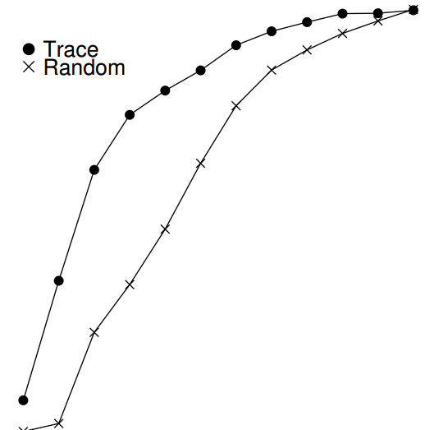
FFS Locality for SEER Traces.
How “far away” file accesses were from one another in the directory tree.
7% of file accesses to the same file
Nearly 40% of file accesses in the same directory
25% of file accesses were two distances
proc/src/foo.c
proc/src/bar.c
the distance of two file access is 1
proc/src/foo.c
proc/obj/foo.o
the distance of two file access is 2
100%
80%
60%
Cumulative Frequency
40%
Trace
20%
x
Random
0%
0
2
4
6
8
10
Path Difference

Slide 12
The Large-File Exception
General policy of file placement
Entierly fill the block group it is first place within
Hurt file-access locality from “related” file being placed
For large files, chunks are spread across the disk
Hurt performance, but it can be addressed by choosing chunk size
Amortization: reducing overhead by doing more work
G0 | G1 | G2 | G3 | G4 | G5 | G6 | G7 | G8 | G9
0 1 2 3 4 5 6 7 8 9
G: block group
G0 | G1 | G2 | G3 | G4 | G5 | G6 | G7 | G8 | G9
9 0
0 1
2 3
4 5
6 7

Slide 13
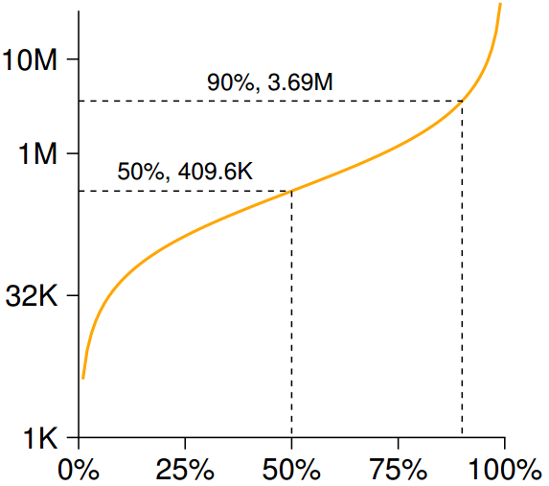
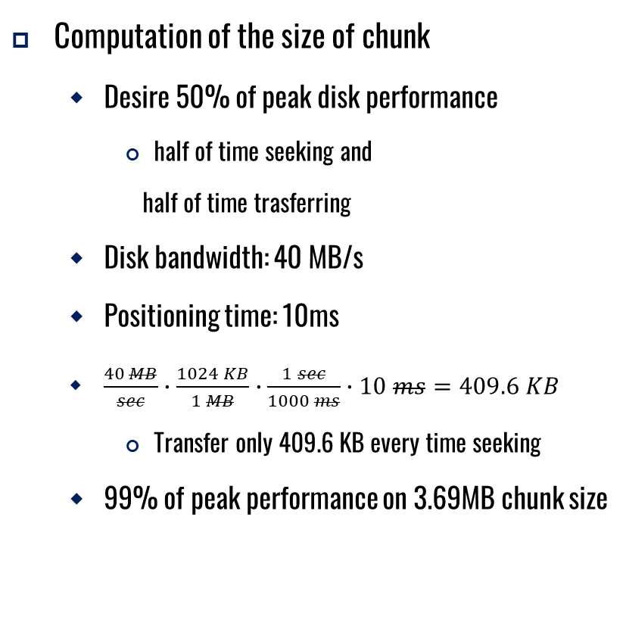
Amortization: How Big Do Chunks Have To Be?
Computation of the size of chunk
Desire 50% of peak disk performance
half of time seeking and
half of time trasferring
Disk bandwidth: 40 MB/s
Positioning time: 10ms
$\frac{40 MB}{sec}∙\frac{1024 KB}{1 MB}∙\frac{1 sec}{1000 ms}∙10 ms=409.6 KB$
Transfer only 409.6 KB every time seeking
99% of peak performance on 3.69MB chunk size
Log (Chunk Size Needed)
Percent Bandwidth (Desired)

Slide 14
The Large-File Exception in FSS
A simple approach based on the structure of inode
Each subsequent indirect blocks, and all the blocks it pointed to, placed in a different block group.
Every 1024 blocks (4MB) of the file in a separate group
S | ib | db | Inodes | Data
....
12 direct blocks
indirect blocks
inode
....
S | ib | db | Inodes | Data

Slide 15
A few other Things about FFS
Internal fragmentation
Sub-blocks
Ex) Create a file with 1 KB : use two sub-blocks, not an entire 4-KB blocks
Parameterization
Track buffer
Long file names
Enabling more expressive names in the file system
Symbolic link

