Slide 1




CMSC 125: Operating Systems
Instructor: Joseph Anthony C. Hermocilla
Email: jchermocilla@up.edu.ph
Web: https://jachermocilla.org

Slide 2
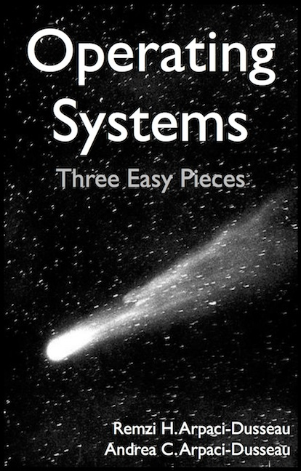
Resources
Book: https://pages.cs.wisc.edu/~remzi/OSTEP/
Slides Template:
https://pages.cs.wisc.edu/~remzi/OSTEP/Educators-Slides/Youjip/

Slide 3
Acknowledgement
This lecture slide set was initially developed for Operating System course in Computer Science Dept. at Hanyang University. This lecture slide set is for OSTEP book written by Remzi and Andrea at University of Wisconsin.

Slide 4
4. The Abstraction: The Process
Operating System: Three Easy Pieces

Slide 5

How to provide the illusion of many CPUs?
Users want to run many programs but we only have a limited of CPUs (ex. 8 cores)
CPU virtualization
The OS can promote the illusion that many virtual CPUs exist
How? By juggling programs
Time sharing: Running one process, then stopping it and running another
The potential cost is performance.
Via a mechanism called context-switch
http://clipart-library.com/clipart/203581.htm

Slide 6
Mechanisms and Policies.. Revisited
Mechanism
Low-level methods or protocols that implement a functionality
“how?”
Example: context-switch
Policy
Algorithms for making some kinds of decision within the OS
“which?”
Example: scheduling policy - deciding which program to run first?next?

Slide 7
A Process
A process is a running program.
A program itself is “lifeless” – just sits on the disk as bunch of instructions (and some data) aka program image
We can characterize a process by looking at the different data structures and systems resources it uses or accesses
What comprises a process? -the machine state which is composed of
Memory (address space – range of addresses that a process can access)
Instructions/Code
Data
Registers – high-speed storage for small data items (EAX, EBX, …)
Program counter (Instruction pointer) (RIP)
Stack pointer (RSP)
Frame/Base pointer (RBP)
I/O information – list of open files
Notes:
Show that .elf is a program
Example of this is debug

Slide 8
Process API
These APIs are available on any modern OS
Create
Create a new process to run a program – fork(), exec(), clone()
Destroy
Halt a runaway process – kill(pid, SIGTERM)
Wait
Wait for a process to stop running – wait(pid)
Miscellaneous Control
Some kind of method to suspend a process and then resume it – kill(pid, SIGSTOP), kill(pid, SIGCONT)
Status
Get some status info about a process – cat /proc/pid/status

Slide 9
Process Creation
Load a program code(and static data) into memory, into the address space of the process.
Programs initially reside on disk in executable format. (ELF, PE)
OS perform the loading process lazily.
Loading pieces of code or data only as they are needed during program execution. (some programs a big)
The program’s run-time stack is allocated.
Use the stack for local variables, function parameters, and return address.
Initialize the stack with arguments → argc and the argv array of main() function

Slide 10
Process Creation (Cont.)
The program’s heap is created (usually done lazily).
Used for explicitly requested dynamically allocated data.
Program request such space by calling malloc() and free it by calling free().
The OS does some other initialization tasks.
input/output (I/O) setup
Each process by default has three open file descriptors.
Standard input (STDIN=0), standard output(STDOUT=1), and standard error(STDERR=2)
Start the program running at the entry point, namely main().
The OS transfers control of the CPU to the newly-created process.

Slide 11
Loading: From Program To Process
CPU
Memory
code
static data
heap
stack
Process
Loading:
Takes on-disk program
and reads it into the address space of process
code
static data
Program
Disk

Slide 12
Process States
A process can be in one of three states.
Running
A process is running on a processor. Instructions are being executed
Ready
A process is ready to run but for some reason the OS has chosen not to run it at this given moment
Blocked
A process has performed some kind of operation and is waiting for the result
Example: When a process initiates an I/O request to a disk, it becomes blocked and thus some other process can use the processor
Additional states may be present depending on the OS
Initial
Final/Terminated

Slide 13
Process State Transitions
Decided by the
scheduler
module of the OS
Running
Ready
Descheduled
Scheduled
I/O: initiate
I/O: done
Blocked

Slide 14
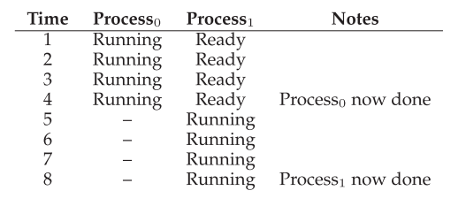
Tracing Process States: CPU Only
Assumes a single processor is available

Slide 15
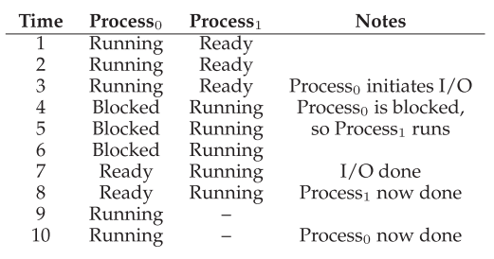
Tracing Process States: CPU and I/O
Assumes a single processor is available
At this point, Process₀ can start already start

Slide 16
Data Structures
The OS has some key data structures that track various relevant pieces of information.
Process/Tasks lists
Ready processes
Blocked processes
Currently running process
Register context
Will hold the values of the registers(copied to a data structure in memory) when a process is stopped/paused
Will be copied back to the actual registers during a context-switch to resume the stopped/paused process
The Process Control Block (PCB)/ Task Structure(Linux)
A C-structure that contains information about a process.

Slide 17
Example: The xv6 kernel register context structure and process states definitions
// the registers xv6 will save and restore
// to stop and subsequently restart a process
struct context {
int eip; // Index pointer register
int esp; // Stack pointer register
int ebx; // Called the base register
int ecx; // Called the counter register
int edx; // Called the data register
int esi; // Source index register
int edi; // Destination index register
int ebp; // Stack base pointer register
};
// the different states a process can be in
enum proc_state { UNUSED, EMBRYO, SLEEPING,
RUNNABLE, RUNNING, ZOMBIE };

Slide 18
Example: The xv6 kernel proc structure definition
// the information xv6 tracks about each process
// including its register context and state
struct proc {
char *mem; // Start of process memory
uint sz; // Size of process memory
char *kstack; // Bottom of kernel stack
// for this process
enum proc_state state; // Process state
int pid; // Process ID
struct proc *parent; // Parent process
void *chan; // If non-zero, sleeping on chan
int killed; // If non-zero, have been killed
struct file *ofile[NOFILE]; // Open files
struct inode *cwd; // Current directory
struct context context; // Switch here to run process
struct trapframe *tf; // Trap frame for the
// current interrupt
};

