Slide 1




CMSC 125: Operating Systems
Instructor: Joseph Anthony C. Hermocilla
Email: jchermocilla@up.edu.ph
Web: https://jachermocilla.org

Slide 2

Resources
Book: https://pages.cs.wisc.edu/~remzi/OSTEP/
Slides Template:
https://pages.cs.wisc.edu/~remzi/OSTEP/Educators-Slides/Youjip/

Slide 3
Acknowledgement
This lecture slide set was initially developed for Operating System course in Computer Science Dept. at Hanyang University. This lecture slide set is for OSTEP book written by Remzi and Andrea at University of Wisconsin.

Slide 4
20. Paging: Smaller Tables
Operating System: Three Easy Pieces

Slide 5

Paging: Linear Page Tables
We usually have one page table for every process in the system
Assume that 32-bit address space with 4KB pages and 4-byte page-table entry
4B
entry
4KB
Page 0
entry
entry
Page 1
…
Page 2
…
entry
Page n
Page Table of
Process A
Physical Memory
Page table size = $\frac{2^{32}}{2^{12}}∗4Byte=4MByte$
Page table are too big and thus consume too much memory.
Notes:
여백 감소 페이지 사이의 간격을 없애기.

Slide 6

Paging: Smaller Tables by using Bigger Pages
Page table are too big and thus consume too much memory
Assume that 32-bit address space with 16KB pages and 4-byte page-table entry
4B
entry
16KB
Page 0
entry
entry
Page 1
…
Page 2
…
entry
Page n
Page Table of
Process A
Physical Memory
$\frac{2^{32}}{2^{16}}∗4=1MB$ per page table
Big pages lead to internal fragmentation.
Notes:
여백 감소 페이지 사이의 간격을 없애기.

Slide 7
Problem
Single page table entries for a process’ address space
Physical Memory
Virtual Address
Space
0
1
2
3
4
5
6
7
8
9
10
11
12
13
14
15
16
17
18
19
20
21
22
23
24
25
PFN | valid | prot | present | dirty
10 | 1 | r-x | 1 | 0
- | 0 | - | - | -
- | 0 | - | - | -
- | 0 | - | - | -
15 | 1 | rw- | 1 | 1
… | … | … | … | …
- | 0 | - | - | -
3 | 1 | rw- | 1 | 1
23 | 1 | rw- | 1 | 1
code
 | 0
 | 1
 | 2
 | 3
 | 4
 | 5
 | 6
 | 7
 | 8
 | 9
 | 10
 | 11
 | 12
 | 13
 | 14 15
Allocate
heap
A Page Table For 16KB Address Space
stack
A 16KB Address Space with 1KB Pages

Slide 8
Problem
Most of the page table is unused, full of invalid entries
Physical Memory
Virtual Address
Space
0
1
2
3
4
5
6
7
8
9
10
11
12
13
14
15
16
17
18
19
20
21
22
23
24
25
PFN | valid | prot | present | dirty
10 | 1 | r-x | 1 | 0
- | 0 | - | - | -
- | 0 | - | - | -
- | 0 | - | - | -
15 | 1 | rw- | 1 | 1
… | … | … | … | …
- | 0 | - | - | -
3 | 1 | rw- | 1 | 1
23 | 1 | rw- | 1 | 1
code
 | 0
 | 1
 | 2
 | 3
 | 4
 | 5
 | 6
 | 7
 | 8
 | 9
 | 10
 | 11
 | 12
 | 13
 | 14 15
Allocate
heap
A Page Table For 16KB Address Space
stack
A 16KB Address Space with 1KB Pages

Slide 9
Hybrid Approach: Paging and Segments
In order to reduce the memory overhead of page tables
Using base not to point to the segment itself but rather to hold the physical address of the page table of that segment
The bounds register is used to indicate the end of the page table

Slide 10
Simple Example of Hybrid Approach
Each process has three page tables associated with it
When process is running, the base register for each of these segments contains the physical address of a linear page table for that segment
31 30 29 28 27 26 25 24 23 22 21 20 19 18 17 16 15 14 13 12 11 10 9 8 7 6 5 4 3 2 1 0
SN
VPN
Offset
32-bit Virtual address space with 4KB pages
SN value | Content
00 | unused segment
01 | code
10 | heap
11 | stack

Slide 11
TLB miss on Hybrid Approach (Hardware-managed TLB)
The hardware uses the segment bits(SN) to determine which base and bounds pair to use
The hardware then takes the physical address therein and combines it with the VPN as follows to form the address of the page table entry(PTE)
01: SN = (VirtualAddress & SEG_MASK) >> SN_SHIFT
02: VPN = (VirtualAddress & VPN_MASK) >> VPN_SHIFT
03: AddressOfPTE = Base[SN] + (VPN * sizeof(PTE))

Slide 12
Problems of Hybrid Approach
If we have a large but sparsely-used heap, we can still end up with a lot of page table waste
External fragmentation can arise again because page tables can be atbitrary in size

Slide 13
Multi-level Page Tables
Turns the linear page table into something like a tree
Chop up the page table into page-sized units
If an entire page of page-table entries is invalid, don’t allocate that page of the page table at all
To track whether a page of the page table is valid, use a new structure, called page directory

Slide 14
Multi-level Page Tables: Page directory
Linear Page Table
Multi-level Page Table
PTBR
201
PTBR
200
valid
prot
PFN
valid
valid
prot
PFN
PFN
1 | rx | 12
1 | rx | 13
0 | - | -
1 | rw | 100
0 | - | -
0 | - | -
0 | - | -
0 | - | -
0 | - | -
0 | - | -
1 | rw | 86
1 | rw | 15
1 | 201
0 | -
0 | -
1 | 203
1 | rx | 12
1 | rx | 13
0 | - | -
1 | rw | 100
PFN201
PFN200
PFN201
The Page Directory
[Page 1 of PT:Not Allocated]
PFN202
[Page 2 of PT: Not Allocated]
0 | - | -
0 | - | -
1 | rw | 86
1 | rw | 15
PFN203
PFN204
Linear (Left) And Multi-Level (Right) Page Tables

Slide 15
Multi-level Page Tables: Page directory entries
The page directory contains one entry per page of the page table
It consists of a number of page directory entries(PDE)
PDE has a valid bit and page frame number(PFN)

Slide 16
Multi-level Page Tables: Advantage & Disadvantage
Advantage
Only allocates page-table space in proportion to the amount of address space you are using
The OS can grab the next free page when it needs to allocate or grow a page table
Disadvantage
Multi-level page table is a small example of a time-space trade-off
Complexity

Slide 17
Multi-level Page Tables: Level of indirection
A multi-level structure can adjust level of indirection through use of the page directory
Indirection place page-table pages wherever we would like in physical memory

Slide 18
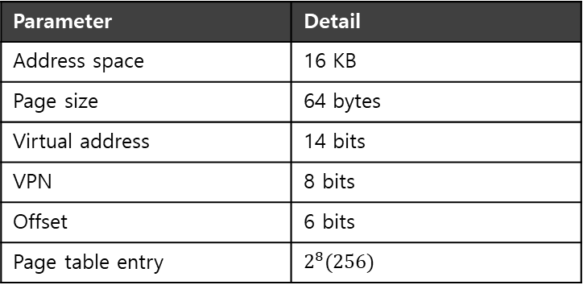
A Detailed Multi-Level Example
To understand the idea behind multi-level page tables better, let’s see an example
0000 0000
code
code
(free)
(free)
heap
heap
(free)
(free)
stack
stack
0000 0001
...
Parameter | Detail
Address space | 16 KB
Page size | 64 bytes
Virtual address | 14 bits
VPN | 8 bits
Offset | 6 bits
Page table entry | $$2^{8}(256)$$
0000 0100
...
0000 0101
...
1111 1111
A 16-KB Address Space With 64-byte Pages
13 | 12 | 11 | 10 | 9 | 8 | 7 | 6 | 5 | 4 | 3 | 2 | 1 | 0
VPN
Offset

Slide 19
A Detailed Multi-Level Example: Page Directory Idx
The page directory needs one entry per page of the page table
It has 16 entries
If the page-directory entry is invalid → Raise an exception (The access is invalid)
Page Directory Index
13 | 12 | 11 | 10 | 9 | 8 | 7 | 6 | 5 | 4 | 3 | 2 | 1 | 0
VPN
Offset
14-bits Virtual address

Slide 20
A Detailed Multi-Level Example: Page Table Idx
If the PDE is valid, we have more work to do
To fetch the page table entry(PTE) from the page of the page table pointed to by this page-directory entry
This page table index(PTIndex) can then be used to index into the page table itself
Thus: PTEAddr = (PDE.PFN << SHIFT) + (PTIndex * sizeof(PTE))
Page Directory Index
Page Table Index
13 | 12 | 11 | 10 | 9 | 8 | 7 | 6 | 5 | 4 | 3 | 2 | 1 | 0
VPN
Offset
14-bits Virtual address

Slide 21
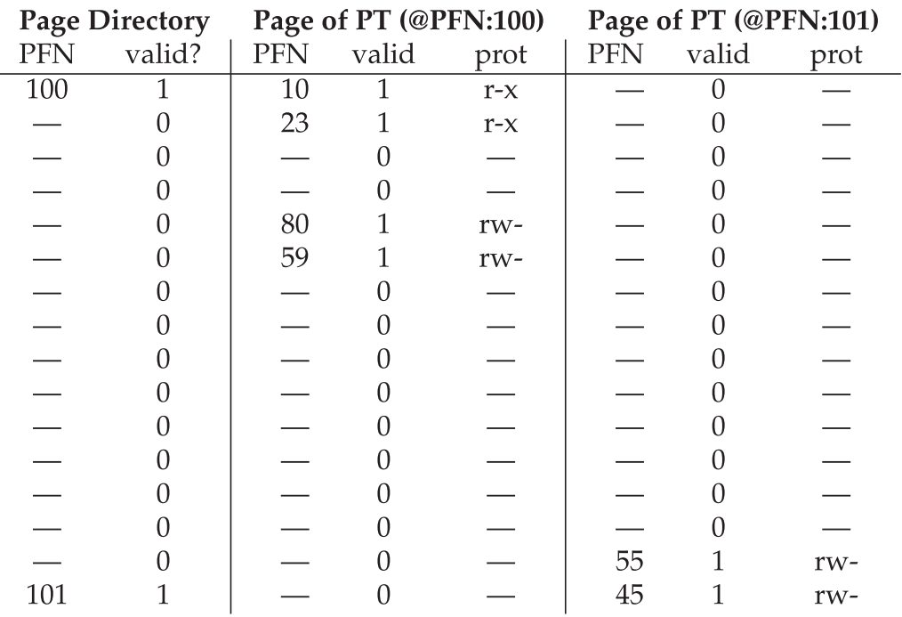
A Detailed Multi-Level Example: Memory Usage

Slide 22
A Detailed Multi-Level Example: Translation of virtual address 0x3F80
Binary = 11 1111 1000 0000
VPN = 11111110
Offset = 000000
Page Directory Index = 1111, we obtain a valid PFN = 101
Index into the page of PT @PFN:101 = 1110, we obtain a valid PFN = 55 = 0x37
Add offset after shifting to left 6 bits to obtain the physical address: 00 1101 1100 0000 = 0x0DC0

Slide 23
More than Two Level
In some cases, a deeper tree is possible
30 29 28 27 26 25 24 23 22 21 20 19 18 17 16 15 14 13 12 11 10 9 8 7 6 5 4 3 2 1 0
VPN
offset
Flag | Detail
Virtual address | 30 bit
Page size | 512 byte
VPN | 21 bit
Offset | 9 bit

Slide 24

More than Two Level : Page Table Index
In some cases, a deeper tree is possible
30 29 28 27 26 25 24 23 22 21 20 19 18 17 16 15 14 13 12 11 10 9 8 7 6 5 4 3 2 1 0
Page Directory Index
Page Table Index
VPN
offset
Flag | Detail
Virtual address | 30 bit
Page size | 512 byte
VPN | 21 bit
Offset | 9 bit
Page entry per page | 128 PTEs
$$\log_{2}{128=7}$$

Slide 25

More than Two Level : Page Directory
If our page directory has $2^{14}$entries, it spans not one page but 128
To remedy this problem, we build a further level of the tree, by splitting the page directory itself into multiple pages of the page directory
30 29 28 27 26 25 24 23 22 21 20 19 18 17 16 15 14 13 12 11 10 9 8 7 6 5 4 3 2 1 0
PD Index 0
PD Index 1
Page Table Index
VPN
offset

Slide 26
Multi-level Page Table Control Flow
01: VPN = (VirtualAddress & VPN_MASK) >> SHIFT
02: (Success,TlbEntry) = TLB_Lookup(VPN)
03: if(Success == True) //TLB Hit
04: if(CanAccess(TlbEntry.ProtectBits) == True)
05: Offset = VirtualAddress & OFFSET_MASK
06: PhysAddr = (TlbEntry.PFN << SHIFT) | Offset
07: Register = AccessMemory(PhysAddr)
08: else RaiseException(PROTECTION_FAULT);
09: else // perform the full multi-level lookup
(1 lines) extract the virtual page number(VPN)
(2 lines) check if the TLB holds the transalation for this VPN
(5-8 lines) extract the page frame number from the relevant TLB entry, and form the desired physical address and access memory

Slide 27
Multi-level Page Table Control Flow
11: else
12: PDIndex = (VPN & PD_MASK) >> PD_SHIFT
13: PDEAddr = PDBR + (PDIndex * sizeof(PDE))
14: PDE = AccessMemory(PDEAddr)
15: if(PDE.Valid == False)
16: RaiseException(SEGMENTATION_FAULT)
17: else // PDE is Valid: now fetch PTE from PT
(11 lines) extract the Page Directory Index(PDIndex)
(13 lines) get Page Directory Entry(PDE)
(15-17 lines) Check PDE valid flag. If valid flag is true, fetch Page Table entry from Page Table

Slide 28
The Translation Process: Remember the TLB
18: PTIndex = (VPN & PT_MASK) >> PT_SHIFT
19: PTEAddr = (PDE.PFN << SHIFT) + (PTIndex * sizeof(PTE))
20: PTE = AccessMemory(PTEAddr)
21: if(PTE.Valid == False)
22: RaiseException(SEGMENTATION_FAULT)
23: else if(CanAccess(PTE.ProtectBits) == False)
24: RaiseException(PROTECTION_FAULT);
25: else
26: TLB_Insert(VPN, PTE.PFN , PTE.ProtectBits)
27: RetryInstruction()

Slide 29
Inverted Page Tables
Keeping a single page table that has an entry for each physical page of the system
The entry tells us which process is using this page, and which virtual page of that process maps to this physical page
PowerPC uses inverted page tables

