Slide 1
Borrowed from: https://www.andrew.cmu.edu/course/14-848/applications/ln/sdn.ppt
Software Defined Networking (SDN)
Marco.Cello@unige.it
DITEN – Università di Genova
Talk @ IEIIT – Consiglio Nazionale delle Ricerche (CNR)
Genova 28 Marzo 2014
Material from:
Scott Shenker (UC Berkeley), “Software-Defined Networking at the Crossroads”, Standford, Colloquium on Computer Systems Seminar Series (EE380), 2013.
Scott Shenker (UC Berkeley), “A Gentle Introduction to Software Defined Networks”, Technion Computer Engineering Center, 2012. http://tce.technion.ac.il/files/2012/06/Scott-shenker.pdf
Scott Shenker (UC Berkeley), “The Future of Networking, and the Past of Protocols”, Open Network Summit, 2011. http://www.opennetsummit.org/archives/oct11/shenker-tue.pdf
Nick McKeown (Stanford), ITC Keynote, San Francisco, 2011. http://yuba.stanford.edu/~nickm/talks/ITC%20Keynote%20Sept%202011.ppt
Presented by Gregory Kesden in 14-848, Fall 2017

Slide 2
A Short History of SDN
~2004: Research on new management paradigms
  RCP, 4D [Princeton, CMU,….]
  SANE, Ethane [Stanford/Berkeley]
2008: Software-Defined Networking (SDN)
  NOX Network Operating System [Nicira]
  OpenFlow switch interface [Stanford/Nicira]
2011: Open Networking Foundation (~69 members)
  Board: Google, Yahoo, Verizon, DT, Microsoft, Facebook, NTT
  Members: Cisco, Juniper, HP, Dell, Broadcom, IBM,…..
2013: Latest Open Networking Summit
  1600 attendees, Google: SDN used for their WAN
  Commercialized, in production use (few places)

Slide 3
Why Was SDN Needed?
Networks are hard to manage
  Computation and storage have been virtualized
    Creating a more flexible and manageable infrastructure
  Networks are still notoriously hard to manage
    Network administrators large share of sysadmin staff
Networks are hard to evolve
  Ongoing innovation in systems software
    New languages, operating systems, etc.
  Networks are stuck in the past
    Routing algorithms change very slowly
    Network management extremely primitive
Networks design not based on formal principles
  OS courses teach fundamental principles
    Mutual exclusion and other synchronization primitives
    Files, file systems, threads, and other building blocks
  Networking courses teach a big bag of protocols
    No formal principles, just general design guidelines

Slide 4
Networks design not based on formal principles
Networks used to be simple
  Basic Ethernet/IP straightforward, easy to manage
New control requirements have led to complexity
  ACLs, VLANs, TE, Middleboxes, DPI,…
The infrastructure still works...
  Only because of our great ability to master complexity
Ability to master complexity both blessing and curse

Slide 5
How Programming Made the Transition
Machine languages: no abstractions
  Had to deal with low-level details
Higher-level languages: OS and other abstractions
  File system, virtual memory, abstract data types, ...
Modern languages: even more abstractions
  Object orientation, garbage collection,...
Abstractions simplify programming
Easier to write, maintain, reason about programs
Abstractions are the way we extracted simplicity
So, what role do abstractions play in networking?

Slide 6
The Two Networking “Planes”
Data plane: processing and delivery of packets with local forwarding state
  Forwarding state + packet header →forwarding decision
Control plane: compute the state in routers (forwarding state)
  Determines how and where packets are forwarded
  Routing, traffic engineering, firewall state, …
  Implemented with distributed protocols, manual configuration (and scripting) or centralized computation
These different planes require different abstractions

Slide 7
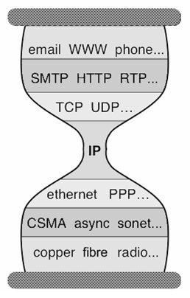
Data Plane Abstractions: Layers
Applications
…built on…
Reliable (or unreliable) transport
…built on…
Best-effort global packet delivery
…built on…
Best-effort local packet delivery
…built on…
Local physical transfer of bits

Slide 8
Control Plane Abstractions

Slide 9
(Too) Many Control Plane Mechanisms
Variety of goals:
  Routing: distributed routing algorithms
  Isolation: ACLs, VLANs, Firewalls,…
  Traffic engineering: adjusting weights, MPLS,…
No modularity, limited functionality
Control Plane: mechanism without abstraction
  Too many mechanisms, not enough functionality

Slide 10
What abstractions should we
apply to the control plane?

Slide 11
The Control Plane Problem
Control plane must compute forwarding state. To accomplish its task, the control plane must:
  Figure out what network looks like (topology)
  Figure out how to accomplish goal on given topology
  Tell the swtiches what to do (configure forwarding state)
We view this as a natural set of requirements....
  And we require each new protocol to solve all three
This is crazy!

Slide 12
Programming Analogy
What if you were told to write a program that must…
  Be aware of the hardware you were running on
  Specify where each bit was stored
Programmer would immediately define abstractions:
  Machine-independent interface
  Virtual memory interface
Programmers use abstractions to separate concerns
  Network designers should too!

Slide 13
The Control Plane Problem
Control plane must compute forwarding state. To accomplish its task, the control plane must:
  Figure out what network looks like (topology)
  Figure out how to accomplish goal on given topology
  Tell the swtiches what to do (configure forwarding state)
What components do we want to reuse?
  Determining the topology information
  3. Configuring forwarding state on routers/switches
You now know everthing you need about SDN:
  It is the use of those two control planes abstractions

Slide 14
SDN: Two Control Plane Abstractions
Abstraction: global network view
  Provides information about current network
  Implementation: “Network Operating System”
    Runs on servers in network (replicated for reliability)
Abstraction: forwarding model
  Provides standard way of defining forwarding state
  This is OpenFlow
    Specification of <match,action> flow entries

Slide 15









Network of Switches and/or Routers
SDN is “Layers” for Control Plane
Traditional Control Mechanisms
routing, access control, etc.
Control Program
Global Network View
Distributed algorithm running between neighbors
Network OS (e.g. NOX)
Complicated task-specific distributed algorithm
Forwarding Model

Slide 16
Example1: OSPF and Dijkstra
OSPF
  RFC 2328: 245 pages
Distributed System
  Builds consistent, up-to-date map of the network: 101 pages
Dijkstra’s Algorithm
  Operates on map: 4 pages

Slide 17
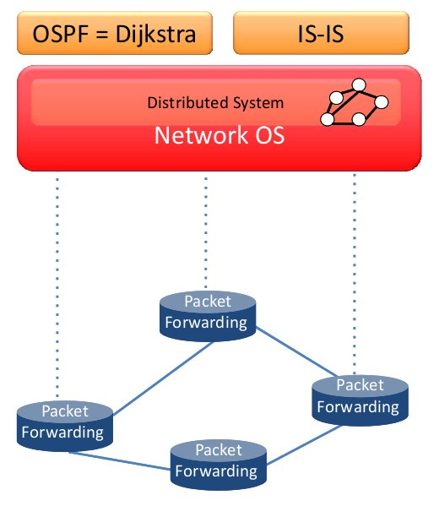
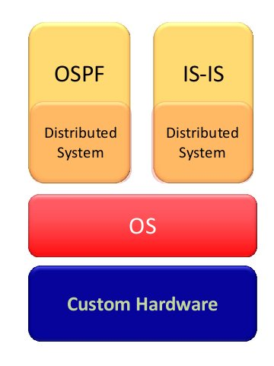

Example1: OSPF and Dijkstra

Slide 18
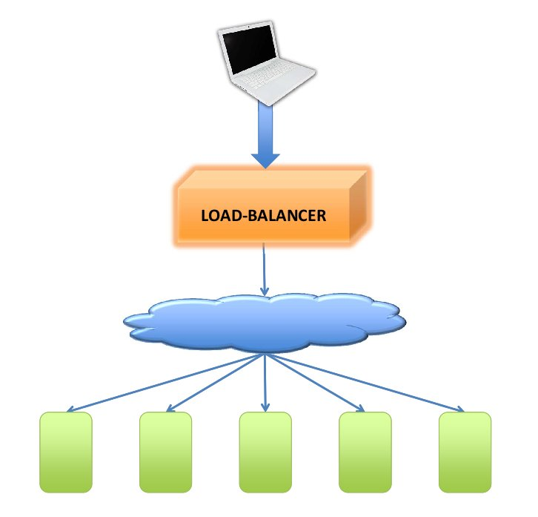
Example2: Load Balancing
Optimal Load Balancer: Ideally each HTTP request would be sent over a path which is lightly loaded to a server which is lightly loaded in order to minimize the request

Slide 19
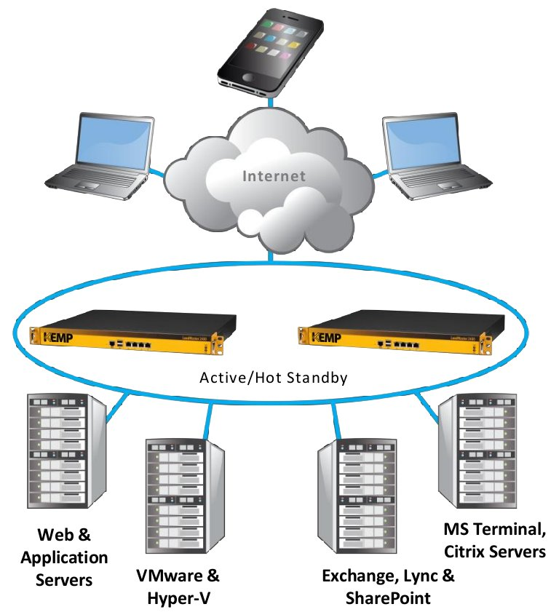
Example2: Load Balancing
Current Load Balancer: it can choose only the lightly loaded server
KEMP Technologies
LoadMasterTM 2400

Slide 20

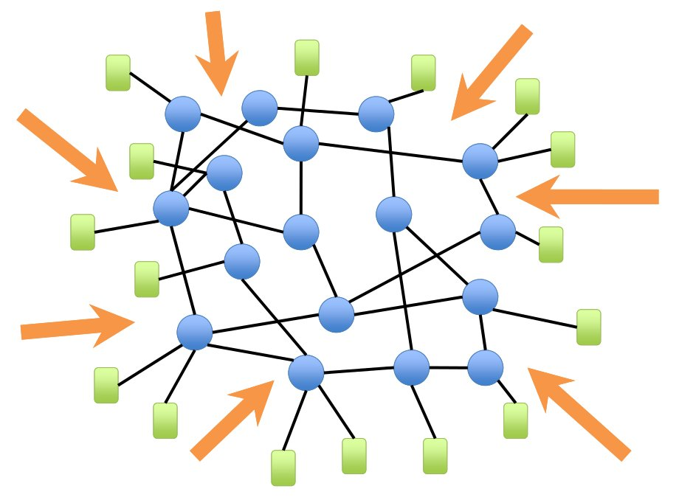
Example2: Load Balancing

Slide 21
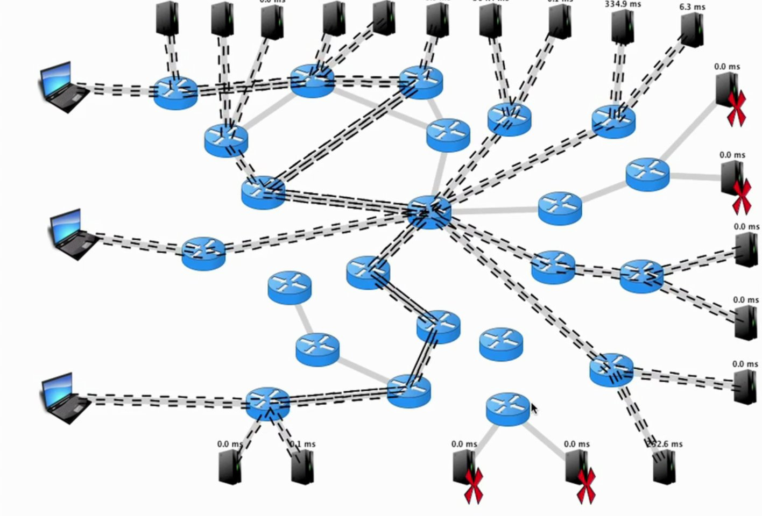
Example2: Load Balancing
N. Handigol, S. Seetharaman, M. Flajslik, R. Johari, and N. McKeown. Aster*x: Load-balancing as a network primitive. 9th GENI Engineering Conference (Plenary), November 2010

Slide 22
Specification Abstraction
Control program must express desired behavior
  Whether it be isolation, access control, or QoS
It should not be responsible for implementing that
behavior on physical network infrastructure
  Requires configuring the forwarding tables in each switch
Proposed abstraction: Virtual Topology of network
  Virtual Topology models only enough detail to specify goals
  Will depend on task semantics

Slide 23












Simple Example: Access Control
Operator’s goal: prevent A’s packets from reaching B
Control program does so with access control entries:
  Control program must respond to topology/routing changes
  Makes it hard to write correct control program
A
A→B drop
Global Network View
A→B drop
B

Slide 24
Network Virtualization
Introduce new abstraction and new SDN layer
Abstraction: Virtual Topology
  Allows operator to express requirements and policies
  Via a set of logical switches and their configurations
Layer: Network Hypervisor
  Translates those requirements into switch configurations
  “Compiler” for virtual topologies

Slide 25









Virtualization Simplifies Control Program
Abstract Network View
A
A→B drop
B
  Hypervisor then inserts flow entries as needed
A
A→B drop
Global Network View
A→B drop
B

Slide 26



Software Defined Network
Virtual Topology
Network Hypervisor
Control Program
Global Network View
Network OS

Slide 27
Clean Separation of Concerns
Control program: express goals on Virtual Topology
  Operator Requirements
  Configuration = Function(view)
  Not a distributed protocol, now just a graph algorithm
Network Hypervisor: Virtual Topology ⬅➔ Global Network View
Network OS: Global Network View ⬅➔ physical switches
  Gathers information for global network view
  Conveys configurations from control program to switches
Router/switches: merely follow orders from NOS
Clean separation of control and data planes
  Not packaged togheter in proprietary boxes
  Enables use of commodity hardware, 3rd party software
  Easier to write, maintain, verify, reason about, …

Slide 28
SDN: Layers for the Control Plane
Control Program
Abstract Network View
Network Virtualization
Global Network View
Network OS

Slide 29
Abstractions Don’t Eliminate Complexity
Every component of system is tractable
  NOS, Virtualization are still complicated pieces of code
SDN main achievements:
  Simplifies interface for control program (user-specific)
  Pushes complexity into reusable code (SDN platform)
Just like compilers….

Slide 30
Virtualization is Killer App for SDN
Consider a multi-tenant datacenter
  Want to allow each tenant to specify virtual topology
  This defines their individual policies and requirements
Datacenter’s network hypervisor compiles these virtual topologies into set of switch configurations
  Takes 1000s of individual tenant virtual topologies
  Computes configurations to implement all simultaneously
This is what people are paying money for….
  Enabled by SDN’s ability to virtualize the network
30

Slide 31
What Should I Remember About SDN?

Slide 32
Four Crucial Points
SDN is merely set of abstractions for control plane
  Not a specific set of mechanisms
  OpenFlow is least interesting aspect of SDN, technically
SDN involves computing a function….
  NOS handles distribution of state
…on an abstract network
  Can ignore actual physical infrastructure
Network virtualization is the “killer app”
  Already virtualized compute, storage; network is next

Slide 33
Does SDN have larger implications?
Aside from providing easier network management,
how will SDN change the world of networking?

Slide 34
Control/Data Planes Become Separate
Currently control plane tied to data plane
NOS runs on servers: observes/controls data plane
Changes the deployment and business models
  Can buy the control plane separately from the switches
  Enabling commodity hardware and 3rd party software
Changes the testing model
  Simulator to analyze large-scale control planes

Slide 35
Networking Becomes Edge-Oriented
Can implement most control functionality at edge
  Access control, QoS, mobility, migration, monitoring…
Network core merely delivers packets edge-to-edge
  Current protocols do a good job (mostly)
Let edge handle all complexity
  Complicated matching, actions
  “Overlay” networking via tunnels
This has two important implications

Slide 36
1. Makes SDN Incrementally Deployable
Host software often has OpenFlow switch
  Open vSwitch (OVS) in Linux, Xen,…
The edge becomes a software switch
  Core of network can be legacy hardware
Enables incremental deployment of SDN
  Might never need OpenFlow in hardware switches….

Slide 37
2. Networking Becomes Software-Oriented
All complicated forwarding done in software (edge)
And control plane is a program (on a server)…
  …not a protocol (on a closed proprietary switch/router)
We are programming the network, not designing it
  Focus on modularity and abstractions, not packet headers
Innovation at software, not hardware, speeds
Software lends itself to clean abstractions

Slide 38
SDN Vision: Networks Become “Normal”
Hardware: Cheap, interchangeable, Moore’s Law
Software: Frequent releases, decoupled from HW
Functionality: Mostly driven by SW
  Edge (software switch)
  Control program
Solid intellectual foundations

Slide 39























Recap - The network is changing
Feature
Feature
Network OS
Feature
Feature
OS
Feature
Feature
Custom Hardware
OS
Feature
Feature
Custom Hardware
OS
Feature
Feature
Custom Hardware
OS
Feature
Feature
Custom Hardware
OS
Custom Hardware

Slide 40



Recap - Software Defined Network (SDN)
3. Consistent, up-to-date global network view
2. At least one Network OS
probably many.
Open- and closed-source
Control Program 1
Control Program 2
Network OS
1. Open interface to packet forwarding
Packet
Forwarding
Packet
Forwarding
Packet
Forwarding
Packet
Forwarding
Packet
Forwarding

Slide 41



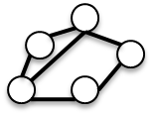
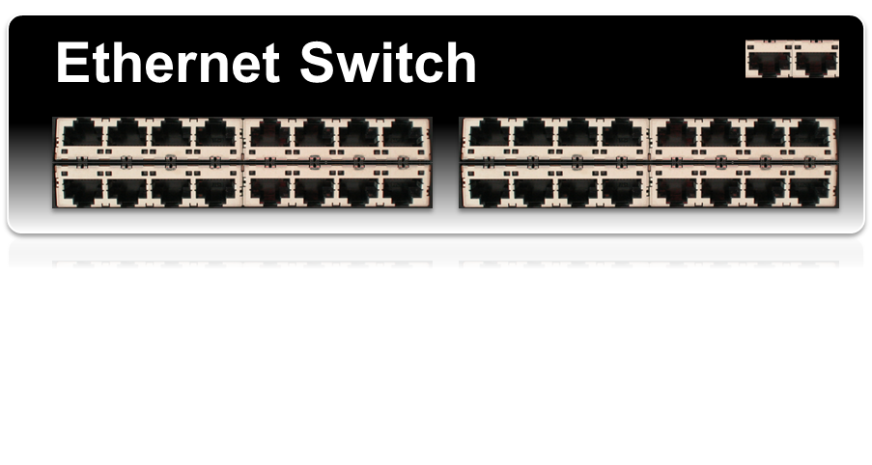
OpenFlow Basics
Control Program A
Control Program B
Network OS
OpenFlow Protocol
Control Path
OpenFlow
Data Path (Hardware)

Slide 42
Primitives <Match, Action>
Match arbitrary bits in headers:
  Match on any header, or new header
  Allows any flow granularity
Action
  Forward to port(s), drop, send to controller
  Overwrite header with mask, push or pop
  Forward at specific bit-rate
Header
Data
Match: 1000x01xx0101001x

Slide 43




OpenFlow Basics
Control Program A
Control Program B
Network OS
“If header = p, send to port 4”
Packet
Forwarding
“If header = q, overwrite header with r,
add header s, and send to ports 5,6”
“If header = ?, send to me”
Flow
Table(s)
Packet
Forwarding
Packet
Forwarding

Slide 44
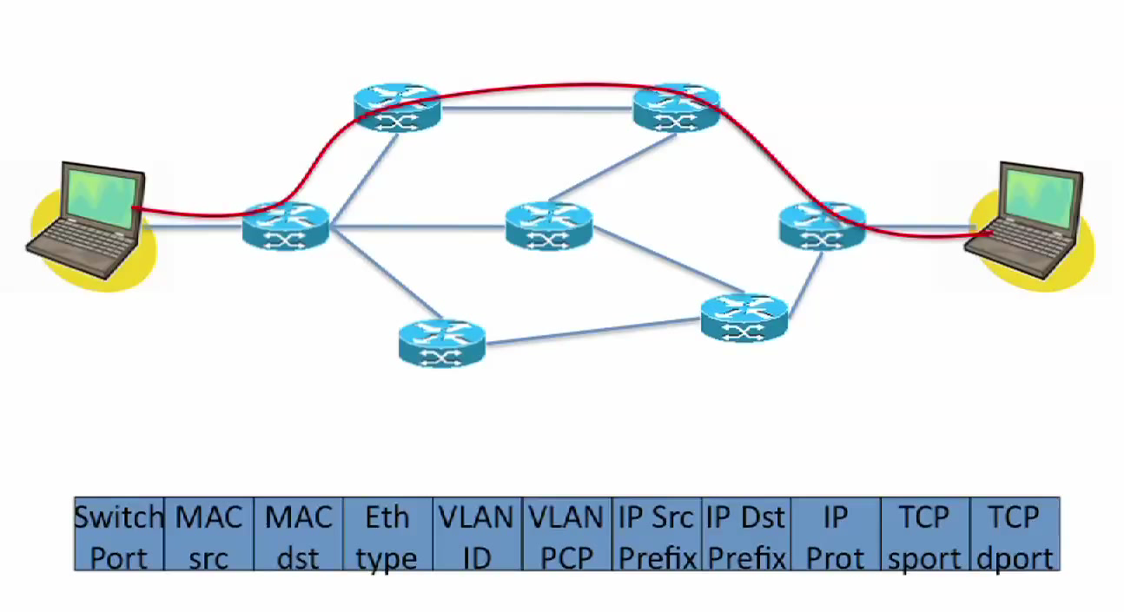
More sophisticated flow identification
Application level flow

Slide 45
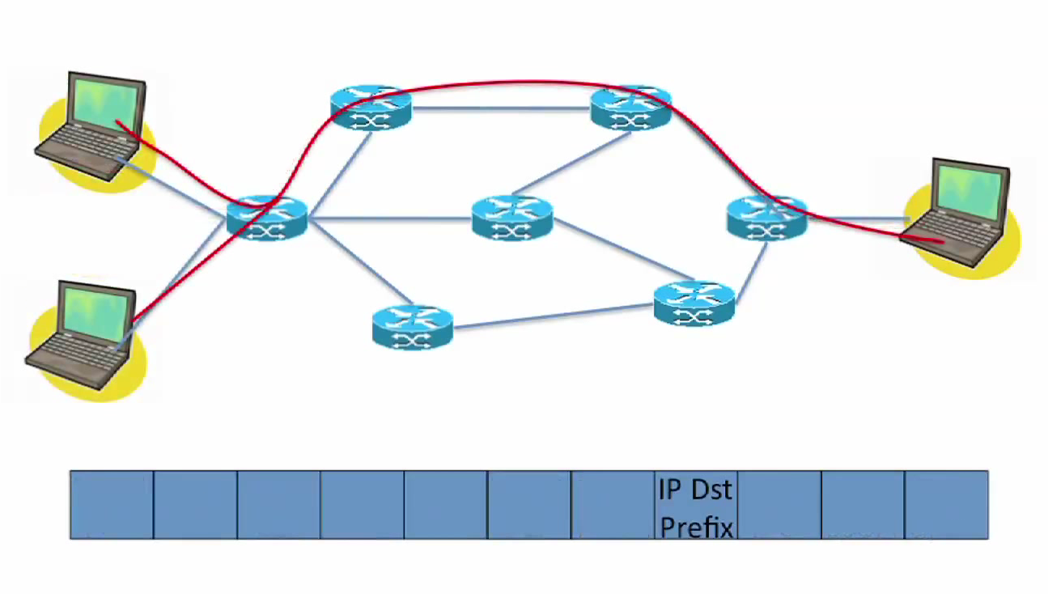
More sophisticated flow identification
IP flow

Slide 46
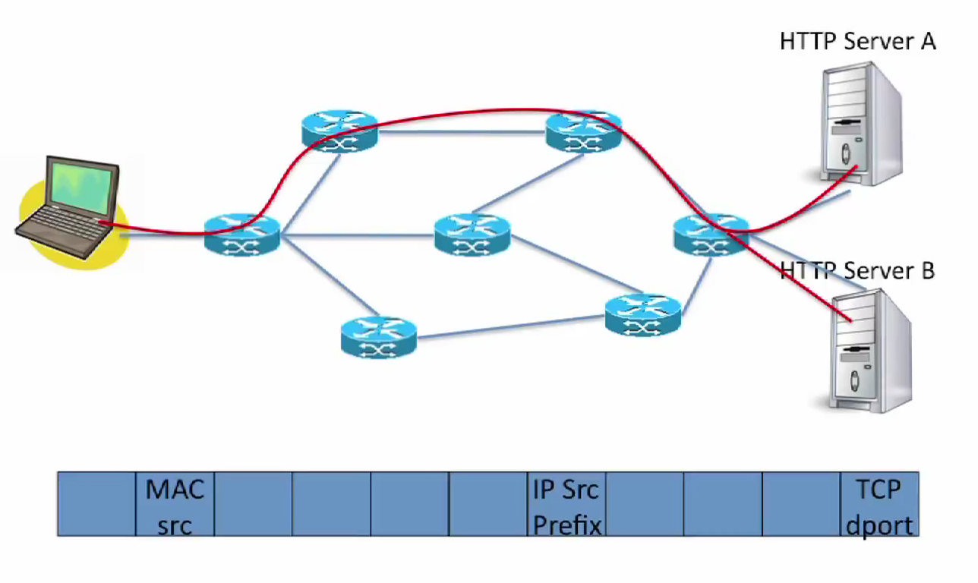
More sophisticated flow identification
Custom flow

Slide 47
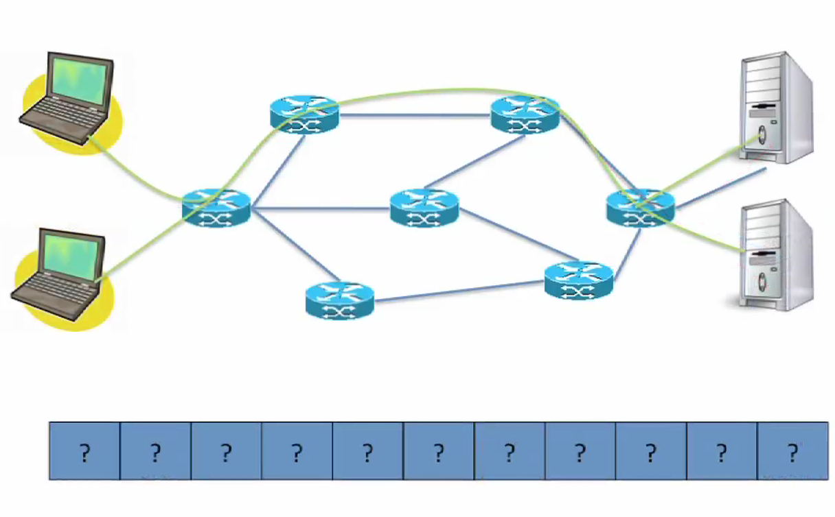
More sophisticated flow identification
My flow

Slide 48
SDN “Implementations” – Software/Hardware
Forwarding Model
  OpenFlow
  ForCES
Software Switches compliant with OpenFlow std.
  Open vSwitch
  Pantou/OpenWRT
  Ofsoftswitch13
  Indigo
Controller compliant with OpenFlow std.
  POX
  NOX
  MUL
  Maestro
Available Commodity Switches compliant with OpenFlow std.
  Hewlett-Packard 8200zl, 6600, 6200zl,
  Brocade 5400zl, and 3500/3500yl
  IBM NetIron CES 2000 Series
Bruno Astuto A. Nunes, Marc Mendonca, Xuan-Nam Nguyen, Katia Obraczka, and Thierry Turletti, “A Survey of Software-Defined Networking: Past, Present, and Future of Programmable Networks”, Technical Report, http://hal.inria.fr/hal-00825087/PDF/bare_jrnl.pdf

Slide 49
SDN Literature - Sources
Browsing on proceedings of:
  ACM Sigcomm;
  ACM Sigcomm Workshop HotSDN;
  ACM Sigcomm Workshop HotNets;
  ACM CoNEXT;
  USENIX NSDI;
  USENIX HotCloud;
  USENIX Hot-ICE;
  ONS;
SDN reading list: http://www.nec-labs.com/~lume/sdn-reading-list.html

Slide 50
SDN research areas
Controller scalability
  multi-controller
  reduce messages sent to controller
  switch/CPU design approaches
Network Updates
Programming
Testing/Debugging
Traffic Management/QoS
  flow scheduling
  Load balancing
  Transport protocol
Monitoring
Security
SDN applications
SDN architecture

