Slide 1




CMSC 125: Operating Systems
Instructor: Joseph Anthony C. Hermocilla
Email: jchermocilla@up.edu.ph
Web: https://jachermocilla.org

Slide 2
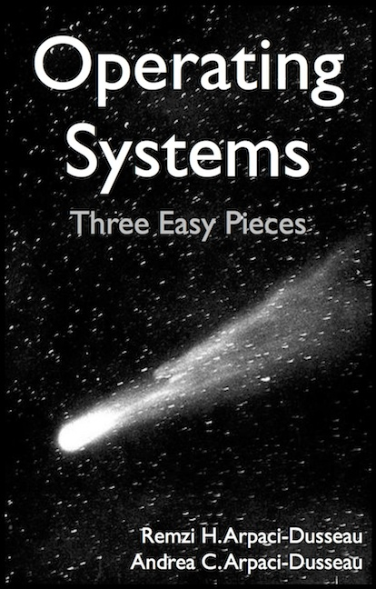
Resources
Book: https://pages.cs.wisc.edu/~remzi/OSTEP/
Slides Template:
https://pages.cs.wisc.edu/~remzi/OSTEP/Educators-Slides/Youjip/

Slide 3
Acknowledgement
This lecture slide set was initially developed for Operating System course in Computer Science Dept. at Hanyang University. This lecture slide set is for OSTEP book written by Remzi and Andrea at University of Wisconsin.

Slide 4
21. Swapping: Mechanisms
Operating System: Three Easy Pieces

Slide 5
Beyond Physical Memory: Mechanisms
Require an additional level in the memory hierarchy
OS need a place to stash away portions of address space that currently aren’t in great demand
In modern systems, this role is usually served by a hard disk drive
Registers
Cache
Main Memory
Mass Storage( hard disk, tape, etc...)
Memory Hierarchy in modern systems

Slide 6
Using a single large address for a process
Before programmer needs to first manually arrange for the code or data to be in memory when calling a function or accessing data
Easier for programmers – no need to manually manage/organize the memory used by a process
Beyond a single process
The addition of swap space allows the OS to support the illusion of a large virtual memory for multiple concurrently-running processes since early systems don’t have enough main memory

Slide 7
Swap Space
Reserve some space on the disk for moving pages back and forth
OS need to remember to the swap space, in page-sized unit
PFN 0
PFN 1
PFN 2
PFN 3
Proc 0 [VPN 0] | Proc 1 [VPN 2] | Proc 1 [VPN 3] | Proc 2 [VPN 0]
Physical
Memory
Block 1
Block 2
Block 3
Block 4
Block 5
Block 6
Block 0
Block 7
Swap
Space
Proc 0 [VPN 1] | Proc 0 [VPN 2] | [Free] | Proc 1 [VPN 0] | Proc 1 [VPN 1] | Proc 3 [VPN 0] | Proc 2 [VPN 1] | Proc 3 [VPN 1]
Physical Memory and Swap Space

Slide 8
Present Bit
Add some machinery higher up in the system in order to support swapping pages to and from the disk
When the hardware looks in the PTE, it may find that the page is not present in physical memory
Value | Meaning
1 | page is present in physical memory
0 | The page is not in memory but rather on disk.

Slide 9
What If Memory Is Full ?
The OS like to “page out” pages to make room for the new pages the OS is about to bring in
The process of picking a page to kick out, or replace is known as page-replacement policy

Slide 10
The Page Fault
Accessing page that is not in physical memory
If a page is not present and has been swapped out to disk, the OS need to swap the page into memory in order to service the page fault

Slide 11
Page Fault Control Flow
PTE is used for data such as the PFN of the page for a disk address
Operating System
3. Check storage whether page exists
Secondary Storage
1. Reference
2.Trap
Load M
 | i
6. reinstruction
Page Frame
Page Frame
Page Table
...
4. Get the page
5. Reset Page Table
Page Frame
Page Frame
Virtual Address
When the OS receives a page fault, it looks in the PTE and issues the request to disk.

Slide 12
Page Fault Control Flow – Hardware
1: VPN = (VirtualAddress & VPN_MASK) >> SHIFT
2: (Success, TlbEntry) = TLB_Lookup(VPN)
3: if (Success == True){ // TLB Hit
4: if (CanAccess(TlbEntry.ProtectBits) == True)
5: Offset = VirtualAddress & OFFSET_MASK
6: PhysAddr = (TlbEntry.PFN << SHIFT) | Offset
7: Register = AccessMemory(PhysAddr)
8: else RaiseException(PROTECTION_FAULT)

Slide 13
Page Fault Control Flow – Hardware
9: }else{ // TLB Miss
10: PTEAddr = PTBR + (VPN * sizeof(PTE))
11: PTE = AccessMemory(PTEAddr)
12: if (PTE.Valid == False)
13: RaiseException(SEGMENTATION_FAULT)
14: else
15: if (CanAccess(PTE.ProtectBits) == False)
16: RaiseException(PROTECTION_FAULT)
17: else if (PTE.Present == True)
18: // assuming hardware-managed TLB
19: TLB_Insert(VPN, PTE.PFN, PTE.ProtectBits)
20: RetryInstruction()
21: else if (PTE.Present == False)
22: RaiseException(PAGE_FAULT)

Slide 14
Page Fault Control Flow – Software
1: PFN = FindFreePhysicalPage()
2: if (PFN == -1) // no free page found
3: PFN = EvictPage() // run replacement algorithm
4: DiskRead(PTE.DiskAddr, pfn) // sleep (waiting for I/O)
5: PTE.present = True // update page table with present
6: PTE.PFN = PFN // bit and translation (PFN)
7: RetryInstruction() // retry instruction
The OS must find a physical frame for the soon-be-faulted-in page to reside within
If there is no such page, waiting for the replacement algorithm to run and kick some pages out of memory

Slide 15
When Replacements Really Occur
OS waits until memory is entirely full, and only then replaces a page to make room for some other page
This is a little bit unrealistic, and there are many reason for the OS to keep a small portion of memory free more proactively
Swap Daemon, Page Daemon
There are fewer than Low Watermark pages available, a background thread that is responsible for freeing memory runs
The thread evicts pages until there are High Watermark pages available

Slide 16
Useful Linux Commands
swapon --show --output-all
free -m
for file in /proc/*/status ; do awk '/VmSwap|Name/{printf $2 " " $3}END{ print ""}' $file; done | sort -k 2 -n -r | less
smem
top –p `pidof kswapd0`

