Slide 1




CMSC 125: Operating Systems
Instructor: Joseph Anthony C. Hermocilla
Email: jchermocilla@up.edu.ph
Web: https://jachermocilla.org

Slide 2
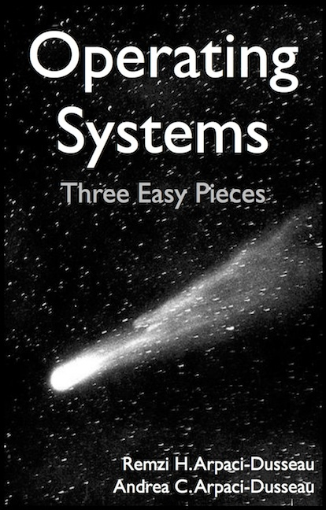
Resources
Book: https://pages.cs.wisc.edu/~remzi/OSTEP/
Slides Template:
https://pages.cs.wisc.edu/~remzi/OSTEP/Educators-Slides/Youjip/

Slide 3
Acknowledgement
This lecture slide set was initially developed for Operating System course in Computer Science Dept. at Hanyang University. This lecture slide set is for OSTEP book written by Remzi and Andrea at University of Wisconsin.

Slide 4
15. Address Translation
Operating System: Three Easy Pieces

Slide 5
Memory Virtualizing with Efficiency and Control + Flexibility
Memory virtualizing takes a similar strategy known as limited direct execution(LDE) for efficiency and control.
In memory virtualizing, efficiency and control are attained by hardware support.
e.g., registers, TLB(Translation Lookaside Buffer)s, page table
Also provide flexibility – allow processes to be able to use their address space in whatever way they like

Slide 6
Address Translation
Hardware transforms a virtual address to a physical address.
The desired information is actually stored in a physical address.
The OS must get involved at key points to set up the hardware
The OS must manage memory, to judiciously intervene
Current Assumptions:
User’s address space is placed contiguously in physical memory
Address space size is not too big, less than the size of the physical memory
Address space size for all processes are the same

Slide 7
Example: Address Translation
C - Language code
Load a value from memory
Increment it by three
Store the value back into memory
void func()
int x = 3000;
x = x + 3; // this is the line of code we are interested in
...

Slide 8
Example: Address Translation(Cont.)
Assembly
Presume that the address of ‘x’ has been place in ebx register.
Load the value at that address into eax register.
Add 3 to eax register.
Store the value in eax back into memory.
128 : movl 0x0(%ebx), %eax ; load 0+ebx into eax
132 : addl $0x03, %eax ; add 3 to eax register
135 : movl %eax, 0x0(%ebx) ; store eax back to mem

Slide 9
Example: Address Translation(Cont.)
0KB
128
132
135
Fetch instruction at address 128
Execute this instruction (load from address 15KB)
Fetch instruction at address 132
Execute this instruction (no memory reference)
Fetch the instruction at address 135
Execute this instruction (store to address 15 KB)
movl 0x0(%ebx),%eax
addl 0x03,%eax
movl %eax,0x0(%ebx)
Program Code
1KB
2KB
Heap
3KB
4KB
(free)
heap
stack
14KB
3000
Stack
15KB
16KB

Slide 10
Address Space Relocation
The process’ view of its virtual address space is from 0 to 16KB
It might be the case that this maps exactly to physical memory
Say, the OS wants to place the process somewhere else in physical memory, not at address 0?
Can this be done without changing the process’s view of its virtual address space?

Slide 11
A Single Relocated Process
0KB
0KB
Program Code
Operating System
Heap
16KB
(not in use)
(free)
32KB
Relocated Process
Code
Heap
heap
(allocated but not in use)
stack
48KB
Stack
(not in use)
Stack
64KB
16KB
Physical Memory
Virtual Address Space

Slide 12
Dynamic Relocation(Hardware-based): Using Base and Bounds Registers
0KB
0KB
Program Code
Operating System
Heap
16KB
(not in use)
base register
(free)
32KB
32KB
Code
Heap
heap
(allocated but not in use)
stack
48KB
Stack
(not in use)
Stack
bounds register
64KB
16KB
Physical Memory
16KB
Address Space

Slide 13
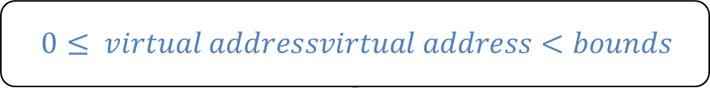
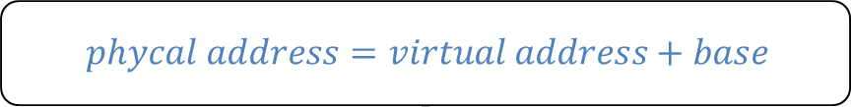
Dynamic Relocation(Hardware-based): Using Base and Bounds Registers (Cont..)
Program is written and compiled as if it is loaded at address zero(0)
When a program starts running, the OS decides where in physical memory a process should be loaded
Set the base register a value.
Every virtual address must not be greater than bound and not negative.
$$phycal address=virtual address+base$$
$$0≤ virtual addressvirtual address<bounds$$

Slide 14


Dynamic Relocation(Hardware-based): Using Base and Bounds Registers (Cont..)
Fetch instruction at address 128
Execute this instruction
Load from address 15KB
0KB
128
132
135
movl 0x0(%ebx),%eax
addl 0x03,%eax
movl %eax,0x0(%ebx)
128 : movl 0x0(%ebx), %eax
Program Code
1KB
2KB
Heap
3KB
$$32896=128+32KB(base)$$
4KB
(free)
heap
$$47KB=15KB+32KB(base)$$
stack
14KB
3000
Stack
15KB
16KB

Slide 15


Two ways to define the Bounds Register
0KB
0KB
Program Code
Operating System
Heap
16KB
(not in use)
(free)
32KB
Code
$$physical address of$$
$$the end of$$
$$address space$$
$$the size of$$
$$address spacee$$
Heap
(allocated but not in use)
bounds
bounds
16KB
48KB
Stack
48KB
(not in use)
Stack
64KB
Physical Memory
16KB
Address Space

Slide 16
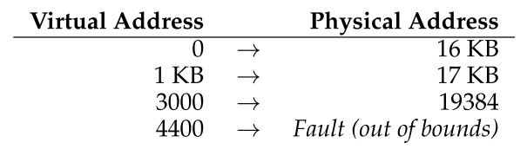
Example Translations
Given a process with:
Address Space Size = 4KB
Loaded at physical address 16KB
Sample address translations

Slide 17
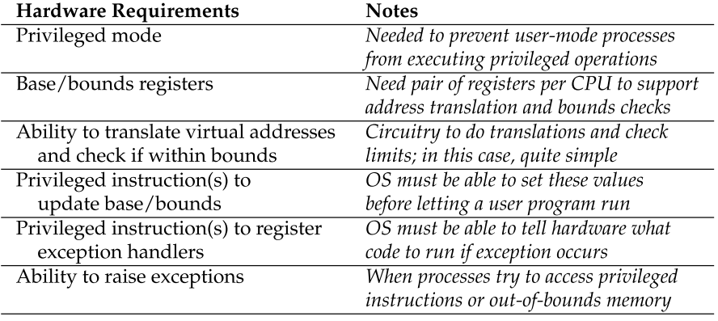
Summary of hardware support needed for Dynamic Relocation
Processor modes: Kernel Mode and User Mode determined through a processor status word
Memory Management Unit: Base Register and Bounds Register
Changing the base and bounds registers should be allowed only in Kernel Mode
When scheduler switches processes
Processor should be able to generate exceptions during illegal memory access

Slide 18
Issues that the OS must address for Dynamic Relocation
The OS must take action to implement base-and-bounds approach
Three critical junctures:
When a process starts running
Finding space for address space in physical memory, maintain a free list
When a process is terminated
Reclaiming the memory for use by other processes
When context switch occurs
Saving and storing the base-and-bounds register pair for each process since we only have one pair per core
When a process is blocked, it can easily be moved to a different location
At boot time, the OS must set exception handlers using privileged instructions

Slide 19
OS Issues: When a Process Starts Running
The OS must find a room for a new address space
free list : A list of the range of the physical memory which are not in use
0KB
Operating System
The OS lookup the free list
16KB
Free list
(not in use)
16KB
32KB
Code
Heap
(allocated but not in use)
48KB
Stack
48KB
(not in use)
64KB
Physical Memory

Slide 20
OS Issues: When a Process Is Terminated
The OS must put the memory back on the free list
Free list
0KB
Operating System
Free list
0KB
Operating System
16KB
16KB
16KB
16KB
(not in use)
(not in use)
32KB
32KB
Process A
32KB
(not in use)
48KB
48KB
48KB
(not in use)
(not in use)
48KB
64KB
64KB
Physical Memory
Physical Memory

Slide 21
OS Issues: When Context Switch Occurs
The OS must save and restore the base-and-bounds pair.
In process structure or process control block(PCB)
Process A PCB
…
base : 32KB
bounds : 48KB …
0KB
Operating System
0KB
Operating System
Context Switching
16KB
(not in use)
16KB
(not in use)
base
base
32KB
32KB
32KB
48KB
Process A
Currently Running
Process A
bounds
bounds
48KB
48KB
48KB
64KB
Process B
Process B
Currently Running
64KB
64KB
Physical Memory
Physical Memory

Slide 22
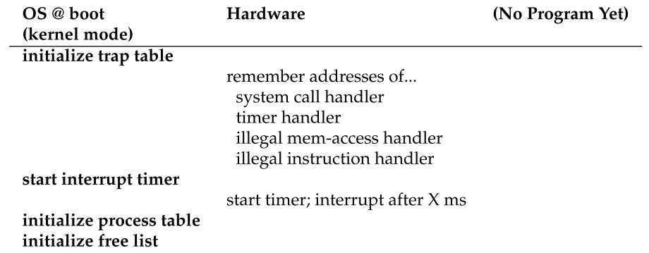
OS Issues: Limited Direct Execution with Dynamic Relocation at Boot Time

Slide 23
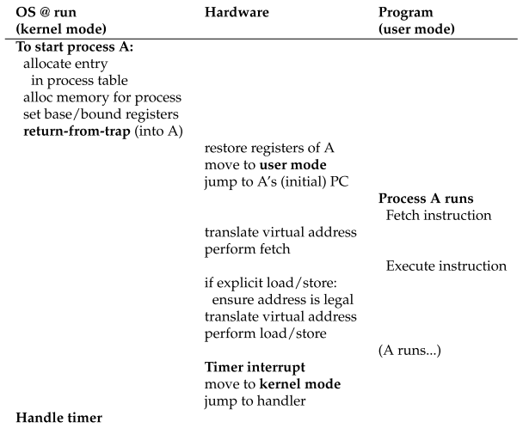
OS Issues: Limited Direct Execution with Dynamic Relocation at Runtime

Slide 24
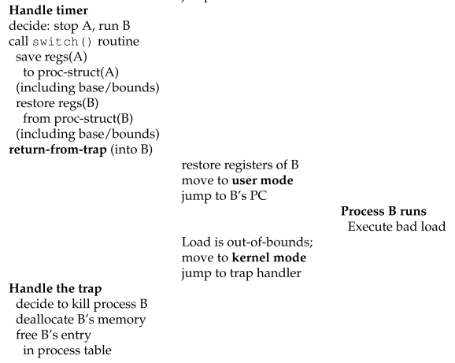
OS Issues: Limited Direct Execution with Dynamic Relocation at Runtime (Cont..)

Slide 25
Other Issues with Dynamic Relocation
Internal Fragmentation – not all allocated space is used

