Slide 1




CMSC 125: Operating Systems
Instructor: Joseph Anthony C. Hermocilla
Email: jchermocilla@up.edu.ph
Web: https://jachermocilla.org

Slide 2
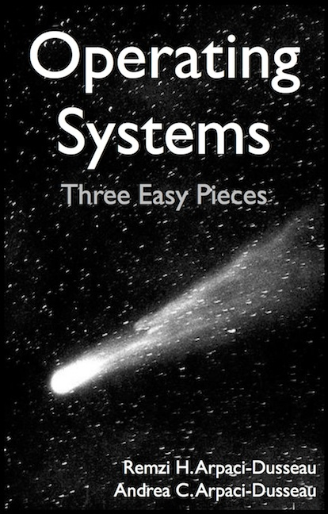
Resources
Book: https://pages.cs.wisc.edu/~remzi/OSTEP/
Slides Template:
https://pages.cs.wisc.edu/~remzi/OSTEP/Educators-Slides/Youjip/

Slide 3
Acknowledgement
This lecture slide set was initially developed for Operating System course in Computer Science Dept. at Hanyang University. This lecture slide set is for OSTEP book written by Remzi and Andrea at University of Wisconsin.

Slide 4
8: Scheduling:
The Multi-Level Feedback Queue
Operating System: Three Easy Pieces

Slide 5
Multi-Level Feedback Queue (MLFQ)
A Scheduler that learns from the past to predict the future.
Objective:
Optimize turnaround time → Run shorter jobs first
Minimize response time without a priori knowledge of job length.

Slide 6
MLFQ: Basic Rules
MLFQ has a number of distinct queues.
Each queues is assigned a different priority level.
A job that is ready to run is on a single queue.
A job on a higher queue is chosen to run.
Use round-robin scheduling among jobs in the same queue
Rule 1: If Priority(A) > Priority(B), A runs (B doesn’t).
Rule 2: If Priority(A) = Priority(B), A & B run in RR.

Slide 7
MLFQ: Basic Rules (Cont.)
MLFQ varies the priority of a job based on its observed behavior.
Example:
A job repeatedly relinquishes the CPU while waiting IOs → Keep its priority high
A job uses the CPU intensively for long periods of time → Reduce its priority.

Slide 8
MLFQ Example
[High Priority]
Q8
Q7
Q6
Q5
Q4
Q3
Q2
Q1
A
B
C
[Low Priority]
D

Slide 9
MLFQ: How to Change Priority
MLFQ priority adjustment algorithm:
Rule 3: When a job enters the system, it is placed at the highest priority
Rule 4a: If a job uses up an entire time slice while running, its priority is reduced (i.e., it moves down on queue).
Rule 4b: If a job gives up the CPU before the time slice is up, it stays at the same priority level
In this manner, MLFQ approximates SJF

Slide 10
Example 1: A Single Long-Running Job
A three-queue scheduler with time slice 10ms
Q2
Q1
Q0
0
50
100
150
200
Long-running Job Over Time (msec)

Slide 11
Example 2: Along Came a Short Job
Assumption:
Job A: A long-running CPU-intensive job
Job B: A short-running interactive job (20ms runtime)
A has been running for some time, and then B arrives at time T=100.
Q2
A:
Q1
B:
Q0
0
50
100
150
200
Along Came An Interactive Job (msec)

Slide 12
Example 3: What About I/O?
Assumption:
Job A: A long-running CPU-intensive job
Job B: An interactive job that need the CPU only for 1ms before performing an I/O
Q2
A:
Q1
B:
Q0
0
50
100
150
200
A Mixed I/O-intensive and CPU-intensive Workload (msec)
The MLFQ approach keeps an interactive job at the highest priority

Slide 13
Problems with the Basic MLFQ
Starvation
If there are “too many” interactive jobs in the system.
Lon-running jobs will never receive any CPU time.
Game the scheduler
After running 99% of a time slice, issue an I/O operation.
The job gain a higher percentage of CPU time.
A program may change its behavior over time.
CPU bound process → I/O bound process

Slide 14
The Priority Boost
Rule 5: After some time period S, move all the jobs in the system to the topmost queue.
Example:
A long-running job(A) with two short-running interactive job(B, C)
Q2
Q2
Q1
Q1
Q0
Q0
0
50
100
150
200
0
50
100
150
200
A:
B:
C:
Without(Left) and With(Right) Priority Boost

Slide 15
Better Accounting
How to prevent gaming of our scheduler?
Solution:
Rule 4 (Rewrite Rules 4a and 4b): Once a job uses up its time allotment at a given level (regardless of how many times it has given up the CPU), its priority is reduced(i.e., it moves down on queue).
Q2
Q2
Q1
Q1
Q0
Q0
0
50
100
150
200
0
50
100
150
200
Without(Left) and With(Right) Gaming Tolerance

Slide 16
Tuning MLFQ And Other Issues
The high-priority queues → Short time slices
E.g., 10 or fewer milliseconds
The Low-priority queue → Longer time slices
E.g., 100 milliseconds
Lower Priority, Longer Quanta
Q2
Q1
Q0
0
50
100
150
200
Example) 10ms for the highest queue, 20ms for the middle,
40ms for the lowest

Slide 17
The Solaris MLFQ implementation
For the Time-Sharing scheduling class (TS)
60 Queues
Slowly increasing time-slice length
The highest priority: 20msec
The lowest priority: A few hundred milliseconds
Priorities boosted around every 1 second or so.

Slide 18
MLFQ: Summary
The refined set of MLFQ rules:
Rule 1: If Priority(A) > Priority(B), A runs (B doesn’t).
Rule 2: If Priority(A) = Priority(B), A & B run in RR.
Rule 3: When a job enters the system, it is placed at the highest priority.
Rule 4: Once a job uses up its time allotment at a given level (regardless of how many times it has given up the CPU), its priority is reduced(i.e., it moves down on queue).
Rule 5: After some time period S, move all the jobs in the system to the topmost queue.

