Slide 1




CMSC 125: Operating Systems
Instructor: Joseph Anthony C. Hermocilla
Email: jchermocilla@up.edu.ph
Web: https://jachermocilla.org

Slide 2
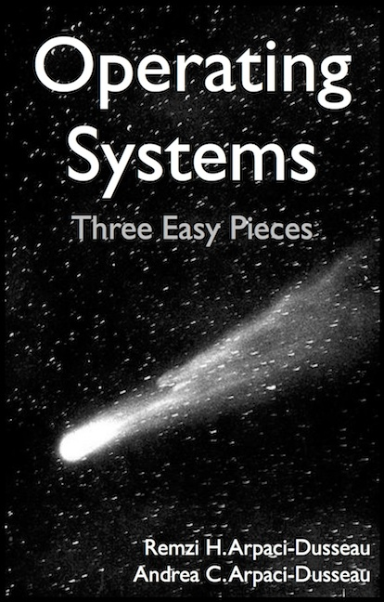
Resources
Book: https://pages.cs.wisc.edu/~remzi/OSTEP/
Slides Template:
https://pages.cs.wisc.edu/~remzi/OSTEP/Educators-Slides/Youjip/

Slide 3
Acknowledgement
This lecture slide set was initially developed for Operating System course in Computer Science Dept. at Hanyang University. This lecture slide set is for OSTEP book written by Remzi and Andrea at University of Wisconsin.

Slide 4
9: Scheduling: Proportional Share
Operating System: Three Easy Pieces

Slide 5
Proportional Share Scheduler
aka Fair-share scheduler
Guarantee that each process obtains a certain percentage of CPU time
Not necessarily optimizing for turnaround time or response time

Slide 6
Basic Concept: Hold a Lottery!
Tickets
Represent the share of a resource that a process(or user) should receive
The percent of tickets represents its share of the system resource in question
Example
There are two processes, A and B
Process A has 75 tickets → receive 75% of the CPU
Process B has 25 tickets → receive 25% of the CPU

Slide 7
Approach #1:Lottery Scheduling
Lottery can be held every time slice
The scheduler picks a winning ticket (probabilistically/randomized)
Run the process that holds the winning ticket
Example
There are 100 tickets
Process A has 75 tickets: 0 ~ 74
Process B has 25 tickets: 75 ~ 99
Scheduler’s winning tickets:
63 85 70 39 76 17 29 41 36 39 10 99 68 83 63
Resulting scheduler:
A
B
A
A
B
A
A
A
A
A
A
B
A
B
A
The longer these two jobs compete,
The more likely they are to achieve the desired percentages.

Slide 8
Aside: Why Random?
Random avoids strange corner-case behaviors
Random is lightweight
Per-process accounting is reduced
Random is fast
Generating a random number from a generator is typically fast (hardware-supported)

Slide 9
Ticket Mechanisms
#1: Ticket Currency
A user(in multiuser systems) allocates tickets among their own processes in whatever currency they would like( Local Currency)
The system converts the Local Currency into the correct Global Currency value
Example:
There are 200 tickets (Global Currency)
Process A has 100 tickets
Process B has 100 tickets
User A → 500 (A’s local currency) to A1 → 50 (global currency)
→ 500 (A’s local currency) to A2 → 50 (global currency)
User B → 10 (B’s local currency) to B1 → 100 (global currency)

Slide 10
Ticket Mechanisms (Cont.)
#2:Ticket Transfer
A process can temporarily hand off its tickets to another process
Useful in client-server applications with server doing tasks on behalf client
#3: Ticket Inflation
A process can temporarily raise or lower the number of tickets it owns
If any one process needs more CPU time, it can boost its tickets
Assumes that a group of processes trust each other to prevent abuse

Slide 11
Implementation
Example: There are three processes, A, B, and C. There are 400 tickets in total. Current draw returns winner=300.
Keep the processes in a list:
Job:A
Tix:100
Job:B
Tix:50
Job:C
Tix:250
head
NULL
1 // counter: used to track if we’ve found the winner yet
2 int counter = 0;
3
4 // winner: use some call to a random number generator to
5 // get a value, between 0 and the total # of tickets
6 int winner = getrandom(0, totaltickets);
7
8 // current: use this to walk through the list of jobs
9 node_t *current = head;
10
11 // loop until the sum of ticket values is > the winner
12 while (current) {
13 counter = counter + current->tickets;
14 if (counter > winner)
15 break; // found the winner
16 current = current->next;
17 }
18 // ’current’ is the winner: schedule it...
What optimizations can you think of?

Slide 12
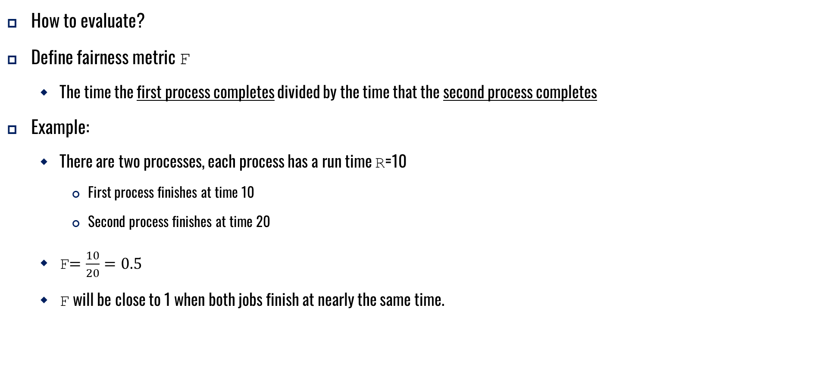
Implementation (Cont.)
How to evaluate?
Define fairness metric F
The time the first process completes divided by the time that the second process completes
Example:
There are two processes, each process has a run time R=10
First process finishes at time 10
Second process finishes at time 20
F$=\frac{10}{20}=0.5$
F will be close to 1 when both jobs finish at nearly the same time.

Slide 13
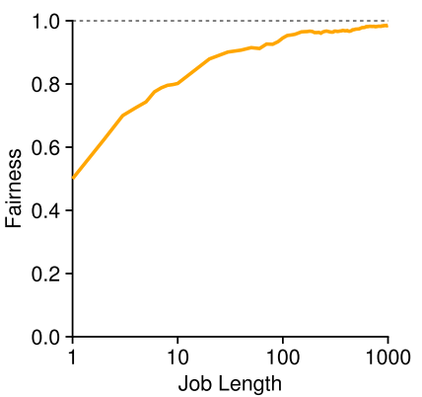
Lottery Fairness Study
Simulation Scenario:
Two processes with run time(job length) R ranging from 1 to 1000. Over thirty(30) trials
Each process has the same number of tickets (100)
When the runtime is not very long,
average fairness can be quite severe.

Slide 14
How to assign tickets?
One approach is to assume that users know best, thus let users assign tickets
Still an open problem though

Slide 15
Approach #2: Stride Scheduling
Randomness occasionally will not deliver good results especially for processes with short run times
A deterministic fair-share scheduler invented by Waldspurger
Stride of each process -
(Some large number) / (the number of tickets of the process)
Example(in the previous discussion): Some large number say 10000
Process A has 100 tickets → stride of A is (10000/100)=100
Process B has 50 tickets → stride of B is (10000/50)=200
When a process runs, increment a counter(aka Pass value) for it by its stride.
Pick the process to run that has the lowest pass value
current = remove_min(queue); // pick client with minimum pass
schedule(current); // use resource for quantum
current->pass += current->stride; // compute next pass using stride
insert(queue, current); // put back into the queue
Pseudocode for Stride Scheduling

Slide 16
Stride Scheduling Example
Pass(A)
(stride=100)
Pass(B)
(stride=200)
Pass(C)
(stride=40)
Who Runs?
Arbitrarily chosen at the start since all Pass are 0 initially
0
100
100
100
100
100
200
200
200
0
0
200
200
200
200
200
200
200
0
0
0
40
80
120
120
160
200
A
B
C
C
C
A
C
C
…
If new process enters with Pass value 0,
it will monopolize the CPU!
Lottery is still better since there is no global state to be maintained per process.

Slide 17
Approach #3: Linux Completely Fair Scheduler (CFS)
Goal: Fairly divide a CPU evenly among all competing processes
Uses a counting-based technique called virtual runtime (vruntime)
As a process runs, its vruntime increases (may increase at the same rate as physical time )
When scheduling decision time occurs, pick the process with the lowest vruntime
Uses a periodic timer interrupt – can only make decisions at fixed time intervals
Not affected if time slice is not a multiple of the interrupt timer interval time

Slide 18
Linux Completely Fair Scheduler (CFS) (Cont.)
Control parameters:
sched_latency – determines how long one process should run before considering a switch (typical values is 48ms)
time slice for a process = (sched_latency / n processes)
Example: Given n=4, time slice = 48/4 = 12ms
min_granularity – to address too many processes running (when n is very large, time slice becomes small)
Minimum time slice for a process despite a large n, typically set to 6ms

Slide 19
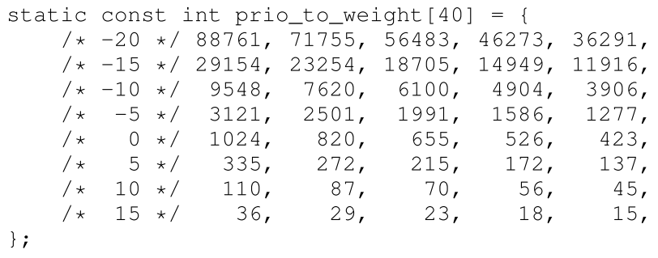
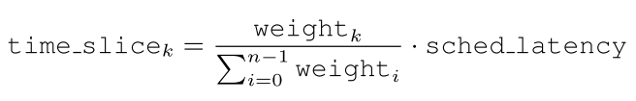
Linux Completely Fair Scheduler (CFS) (Cont.)
Weighting (Niceness) – allows users/admins to control process priority (nice and renice programs)
Nice values range: [-20, +19], (+) means lower priority, (-) means higher priority
Nice values maps to weights in table
Effective Time Slice

Slide 20

Linux Completely Fair Scheduler (CFS) (Cont.)
vruntime adjustment
Example:
Scenario: Process A with nice value of -5, Process B with nice value of 0
Time Slice
From table weight(A) = 3121, Time_Slice(A) = (3121/4145)*48 = 36ms
From table weight(B) = 1024, Time_Slice(B) = (1024/4145)*48 = 12ms
vruntime
vruntime(A) = vruntime(A) + (1024/3121)*run_time(A)
vruntime(B) = vruntime(A) + (1024/1024)*run_time(B)
Thus, vruntime(A) will accumulate at .33 the rate of vruntime(B) – A will have smaller vruntime and will have higher priority
Actual run time
accrued over time

Slide 21
Linux Completely Fair Scheduler (CFS) (Cont.)
How to efficiently (as quickly as possible) find the next process to run?
Red-Black Trees
Height-balanced tree – logarithmic search time compared to linear search time for lists
CFS places only running/runnable processes on the RB tree

Slide 22
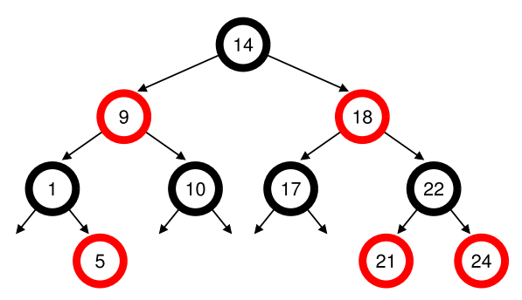
Linux Completely Fair Scheduler (CFS) (Cont.)
RB Tree Example
Given: There are 10 processes with vruntimes of 1, 5, 9, 10, 14, 18, 17, 21, 22, 24
If a sorted list is used, next process to run is simply the first element
Inserting a new process however will need the scan of all items in the sorted list, in the worst case
Use of RB tree(vruntimes as key) improves efficiency, most operations are logarithmic

Slide 23
Linux Completely Fair Scheduler (CFS) (Cont.)
How to deal with I/O and sleeping processes (long sleep)?
Awaken sleeping processes may monopolize CPU since its vruntime has not been updated for a while,thus small
Solution: Alter the vruntime of the newly awaken process by setting it to the minimum vruntime in the RB tree
Processes sleeping for short periods of time will not get fair share of CPU
Other fun stuff about CFS
Heuristics to improve performance
Handling multiple CPUs
Scheduling for process groups

Slide 24
Linux Commands
man sched
sysctl -A | grep "sched" | grep –v "domain"
sudo nice –-10 ./cpu.elf
ps -l -p `pidof cpu.elf`
cat /proc/sched_debug
cat /proc/schedstat
cat /proc/`pidof cpu.elf`/sched
sudo renice -n -20 -p `pidof cpu.elf`
sudo chrt -r -p 40 `pidof cpu.elf`
sudo chrt -o -p 0 `pidof cpu.elf`

