Slide 1
CMSC 128
  Introduction to Software Engineering
  Second Semester AY 2007-2008
  jachermocilla@uplb.edu.ph

Slide 2
Project Metrics
'When you can measure what you are speaking about and express it in numbers, you know something about it;'
--Lord Kelvin

Slide 3
Project Metrics
Measurements are used to improve the software process
  Estimation, quality control, productivity assessment, and project control
  Assessment of quality and tactical decision making
Concerns with productivity and quality metrics

Slide 4
Project Metrics
Productivity Metrics
  Measure of software development output as a function of effort and and time applied
Quality Metrics
  'fitness for use' of the work products produced
For estimation, historical data is needed

Slide 5
Definitions
Measure – quantitative indication of extent, amount, dimensions, capacity, or size of some attribute of a product or process
Measurement-act of determining a measure
Metric-a quantitative measure of the degree to which a system, component, or process possesses a given attribute

Slide 6
Definitions
Indicator-is a metric or combination of metrics that provide insight into the software process, a software project, or the product itself
  Errors found per person-hour expended
Process indicators
  Gain insight into the efficacy of an existing process

Slide 7
Definitions
Project indicators
  Assess the status of an ongoing project
  Track potential risks
  Uncover problem areas
  Adjust work flow or tasks
  Evaluate the project team's ability to control quality of SE work products

Slide 8
Process Improvement
Measure specific attributes of the process , develop a set of meaningful metrics based on attributes, use metrics as indicators that will lead to a strategy for improvement
Process is only one of the controllable factors in improving software quality and organizational performance

Slide 9
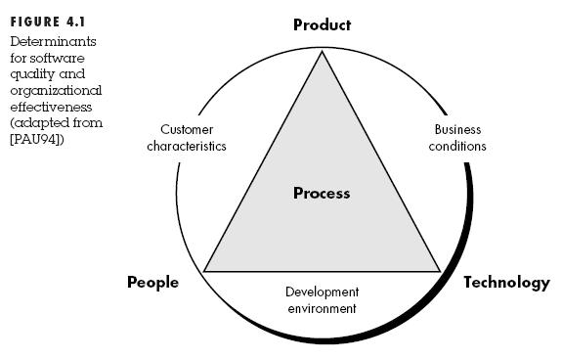
Process Improvement

Slide 10
Process Improvement
Efficacy of process is measured indirectly-metrics is based on outcome that can be derived from the process
  Errors uncovered, defects reported, work products, effort, calendar time, schedule conformance
Also, by measuring characteristics of SE tasks
  Time and effort for umbrella activities

Slide 11
Process Improvement
Private metrics
  private to the individual only
  Defect rate
Humphrey suggests a Personal Software Process approach-based on private metrics
  Software process improvement can and should begin at the individual level

Slide 12
Process Improvement
Some metrics are private to the software project team but public to all team members
  Defects reported for major software functions
  FP for module and function
Public metrics assimilate information that originally was private

Slide 13
Metrics Etiquette
Use common sense
Provide regular feedback
Don't use metrics to appraise individuals
Work with practitioners and teams
Don't use metrics to threaten individual or teams
Don't consider problem area metrics as negative
Don't use just a single metric

Slide 14
Process Improvement
Statistical Software Process Improvement
  Uses software failure analysis to collect information about all errors and defects
    Errors and defects are categorized
    Cost to correct error is recorded
    Errors for each category are counted and ordered
    Total cost of error in each category is computed
    Determine categories with highest cost
    Plans are developed to reduce highest cost categories

Slide 15
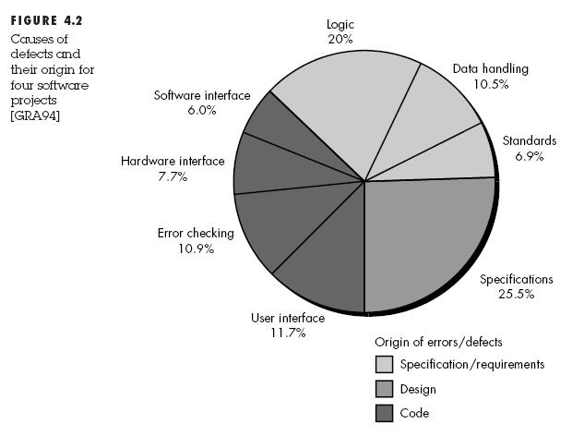
Process Improvement

Slide 16
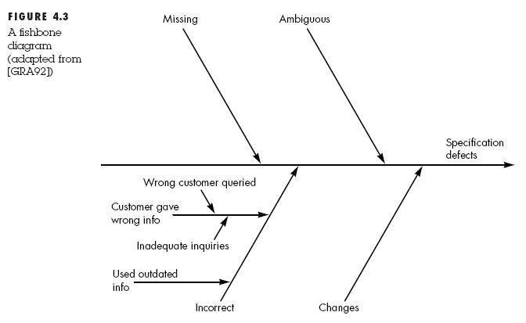
Process Improvement

Slide 17
Project Metrics
Project metrics are used to adapt workflow and technical activities
  Historical data is used for effort and time estimation
  Estimates are compared with actual measures of time and effort
  Other metrics: production rates, review hours, function points, etc

Slide 18
Project Metrics
Intent
  Minimize the development schedule by guiding the adjustments necessary to avoid delays and mitigate risks
  Used to assess product quality

Slide 19
Software Measurement
Direct
  Process: Cost and Effort
  Product: Lines of Code, execution speed, memory footprint, defects reported over some period of time
Indirect
  Product: Functionality, complexity, reliability
Metrics are normalized
  Measurements come from different projects

Slide 20
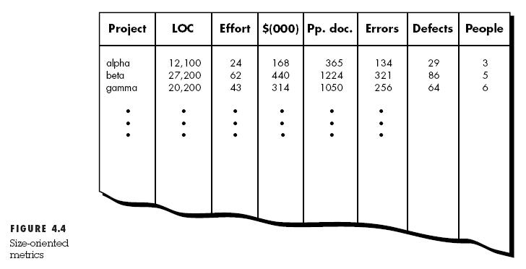
Software Measurement

Slide 21
Size-oriented metrics
Lines of Code (LOC)
  Errors per KLOC
  Defects per KLOC
  $ per KLOC
  Pages of documentation for KLOC
  errors/person-month
  LOC per person-month
  $/page of doc

Slide 22
Size-oriented metrics
Not universally accepted(LOC)
Proponents claim that LOC is an artifact of all software-easily measured
Opponents claim that LOC is programming language dependent

Slide 23
Function-Oriented Metrics
Functionality is an indirect measure
  Must be derived from other direct measures
Function Points (Albrecht)
  Derived using an empirical relationship based on countable measure of information domain and assessment of software complexity

Slide 24
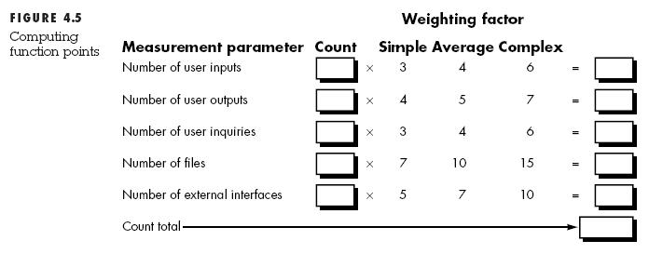
Function-Oriented Metrics

Slide 25
Function-Oriented Metrics

Slide 26
Summary

Slide 27
Reference
Roger S. Pressman.Software Engineering: A Practitioner's Approach, 4th Ed.McGraw-Hill,1997. Chapter 4

