Slide 1
Computer Networks and Security
Joseph Anthony C. Hermocilla
Email: jachermocilla@{uplb.edu.ph, gmail.com}

Slide 2
Outline
Objectives
Basic networking concepts
Basic security concepts
Threats
Defense
Conclusion

Slide 3
Objectives
Inform users of the threats to security and privacy when connecting to a network
Provide tips on how to protect security and privacy when connecting to a network

Slide 4
Computer Networks
What is a computer network?
  A computer network is a collection of computers and other devices (nodes) that use a common network protocol to share resources with each other over a network medium.(Gallo & Hancock, 2001)
The main idea is to communicate

Slide 5
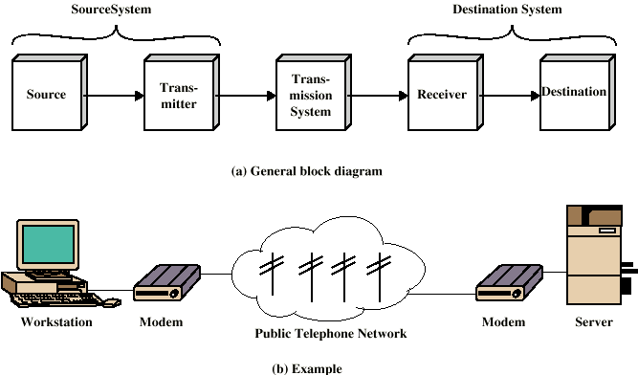
Simplified Communication Model

Slide 6
Local Area Network(LAN)

Slide 7
Wide Area Network (WAN)

Slide 8
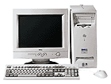
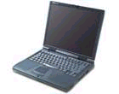
Packet Switched Networks
2
B| D1
A
1
B| D2
B| D5
B| D3
B| D4
3
B| D5
B| D4
4
5
6
B| D2
10
8
B| D1
7
B| D3
B
9

Slide 9
Protocols
Two entities must speak the same language in order to communicate
A protocol is a set of rules governing the exchage of data between two entities

Slide 10
Layered Network Architecture
Host 1
Host 2
Layer 5
layer 5 protocol
Layer 5
layer 4/5 interface
Layer 4
layer 4 protocol
Layer 4
layer 3/4 interface
Layer 3
layer 3 protocol
Layer 3
layer 2/3 interface
Layer 2
layer 2 protocol
Layer 2
layer 1/2 interface
Layer 1
layer 1 protocol
Layer 1
virtual
physical
Physical medium

Slide 11
OSI Reference Model
Host A (sending)
Host B (receiving)
AH
User data
Application
APDU
Application
AH
User data
PH
A-PDU
Presentation
PPDU
Presentation
PH
A-PDU
SH
P-PDU
Session
SPDU
Session
SH
P-PDU
TH
S-PDU
Transport
TPDU
Transport
TH
S-PDU
NH
T-PDU
Network
packets
Network
NH
T-PDU
LH
N-PDU
LT
Data link
frames
Data link
LH
N-PDU
LT
DL-PDU
Physical
bits
Physical
DL-PDU
Physical Medium

Slide 12
TCP/IP Protocol Suite
  Application layer
  Application layer
Host to host
or transport layer
Host to host
or transport layer
Internet layer
Internet layer
Network access layer
or link layer
Network Interface
  Physical layer

Slide 13
OSI and TCP/IP
SNMP
TFTP
NFS
DNS
BOOTP
FTP
Telnet
Finger
SMTP
POP
Application
Application
Presentation
Session
Host-to-Host
Transport
Transport
UDP
TCP
Network
IP
Internet
Data Link
Network Interface cards
Network Access
Network
Interface
Physical
Transmission media
Physical

Slide 14
Programming Network Services
There is no need to program every protocol for each layer
  Implemented as device drivers or kernel modules in the operating system
Client-Server Architecture
Uses sockets
Application layer protocols are implemented using sockets

Slide 15
Sockets
Steps
  Create a socket
  Connect to remote node using created socket
  Send/Receive data through the socket
  Close the socket
To create a socket, specify
  The IP address (ex. 202.92.144.1) of node to connect to
  The TCP/UDP port number (ex. 80)

Slide 16
Network Security
Goals
  Confidentiality
  Authentication
  Message Integrity
  Nonrepudiation
  Authorization
  Availability

Slide 17
Security Threats
Release of message contents
Passive Threats
Traffic analysis
Masquerade
Replay
Active Threats
Modification of message contents
Denial of service

Slide 18
Passive Threats
Eavesdropping for
  Instant Messaging accounts
  Email accounts
  Shell accounts
  Social Networking sites accounts
  Online game accounts
  Personal Information

Slide 19
Active Threats
ARP-cache poisoning
IP Address spoofing
DNS spoofing
Port scanning
Denial of Service
Online game cheats (item duping, speed/stats hack)
Defacing Websites

Slide 20
Automated Attacks (1)
Vulnerabilities in popular software can be exploited to launch automated attacks
  A vulnerability in a web server (a network service implementing the HTTP application layer protocol) can be exploited to get shell access
  A vulnerability in a web browser can be exploited to execute a program remotely to plant a keylogger, worm, or IRC bot

Slide 21
Automated Attacks (2)
Vulnerabilities in popular software can be exploited to launch automated attacks
  A vulnerability in a web application (banking system, or a forum) can be exploited to alter important information
  An open relay mail server (SMTP) can be exploited to send spam

Slide 22
Automated Attacks (3)
Automated tools exists to perform attacks
  Metasploit
  Abel
  Wireshark

Slide 23
Defense
Monitoring
Log auditing
Good password policy
Encryption
Periodic update of software
Packet filtering/Firewall
Host, user, and key authentication
Intrusion detection/prevention systems

Slide 24
Conclusion
Computer networks has become an indispensable tool in the modern era
Threats cannot be avoided when connecting to a network
An understanding of how network works allows one to take precautionary measures to ensure security and protect privacy

Slide 25
References
W. Stallings. Data and Computer Computer Communications.
http://www.milw0rm.com/
http://www.metasploit.com/

Slide 26
Thank you for listening.

