Slide 1
CMSC 128
  Introduction to Software Engineering
  Second Semester AY 2007-2008
  jachermocilla@uplb.edu.ph

Slide 2
Software Project Planning
Project planning marks the start of the project management process
Estimation is the first activity in project planning
When estimates are made, we look into the future and accept some degree of uncertainty
Estimation is both science and art
  Need not be conducted haphazardly

Slide 3
Software Project Planning
What to estimate?
  resources, cost, and schedule
Factors affecting estimation
  Project complexity
  Project size
  Structural uncertainty
  Availability of historical data

Slide 4
Software Project Planning
Objective
  Provide a framework that enables the manager to make reasonable estimates of resources, cost, and schedule within a limited time frame at the beginning of the project.
  Define best-case and worst-case scenarios so that outcomes can be bounded

Slide 5
Software Scope
Function and performance allocated to software during system engineering must be assessed to establish a project scope
Software scope describes function, performance, constraints, interfaces, and reliability
Software scope must be unambiguous and understandable at management and technical levels

Slide 6
Obtaining Info for Scope
First set of context-free questions
  Who is behind the request for this work?
  Who will use the solution?
  What will be the economic benefit of a successful solution?
  Is there another source for the solution?

Slide 7
Obtaining Info for Scope
Second set of context-free questions
  How would you characterize good output of the successful solution?
  What problems will this solution address?
  Can you show me the environment in which the solution will be used?
  Are there special performance issues that will affect the way solution is approached?

Slide 8
Obtaining Info for Scope
Third set of context-free questions
  Are your answers official?
  Are my questions relevant to the problem that you have?
  Am I asking too many questions?
  Is there anyone else who can provide additional information?
  Is there anything else that I should be asking you?

Slide 9
Resources
After defining the scope, resources must be estimated
Each resource is characterized by
  Description
  Statement of availability
  Chronological time that the resource will be required
  Duration of time that the resource will be applied

Slide 10
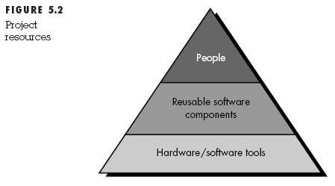
Resources

Slide 11
Resources
Human Resources
  Skills required are identified
  Both organizational and specialty positions are specified
Reusable Resources
  Off-the-shelf components
  Full-experience components
  Partial-experience components
  New components

Slide 12
Resources
Environmental Resources
  Supports the project: both hardware and software
  Software Engineering Environment

Slide 13
Estimation
Options to obtain reliable estimates

Slide 14
Summary

Slide 15
Reference
Roger S. Pressman.Software Engineering: A Practitioner's Approach, 4th Ed.McGraw-Hill,1997. Chapter 5

