Slide 1
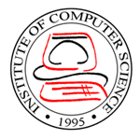



ICS-OS: A Kernel Programming Approach to Teaching Operating System Concepts
Joseph Anthony C. Hermocilla
Institute of Computer Science
College of Arts and Sciences
University of the Philippines Los Baños
7th National Conference on Information Technology Education
Capitol University, Cagayan de Oro City, Philippines
October 21-23, 2009

Slide 2
Outline
Introduction
Related Work
ICS-OS Overview
Teaching with ICS-OS
Results and Observations
Conclusion
Resources

Slide 3
Introduction
Traditional approaches to teaching operating system concepts
  Programming simulations
  Writing user space applications
Students are more interested in writing code that runs at kernel space
  Write an operating system from scratch
  Modify an actual operating system
Emulation and Virtualization
  Makes it easier to work with real-world operating systems

Slide 4
Related Work
Minix
  POSIX compliant
  Used in Tanenbaum's OS textbook
Nachos
  Kernel and simulator run as Unix processes
GeekOS
  Runs on real hardware
  Designed for simplicity
DEX-OS
  Runs on real hardware
  Based on an aspect-oriented design

Slide 5
ICS-OS Overview
A distribution based on the DEX-OS kernel
Kernel
  Memory-resident
  Process management
  Memory management
  etc.
User applications
Software development kit

Slide 6
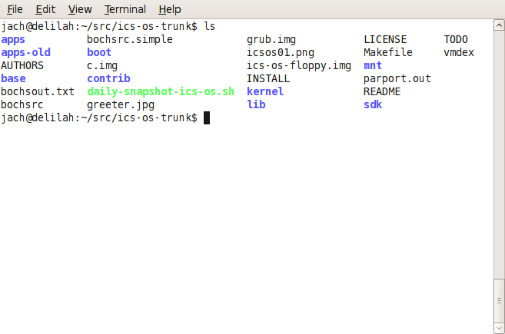
Teaching with ICS-OS
Development Environment
  Ubuntu
  GNU Make
  GCC/TCC
  NASM
  Bochs
  VirtualBox
  Subversion

Slide 7
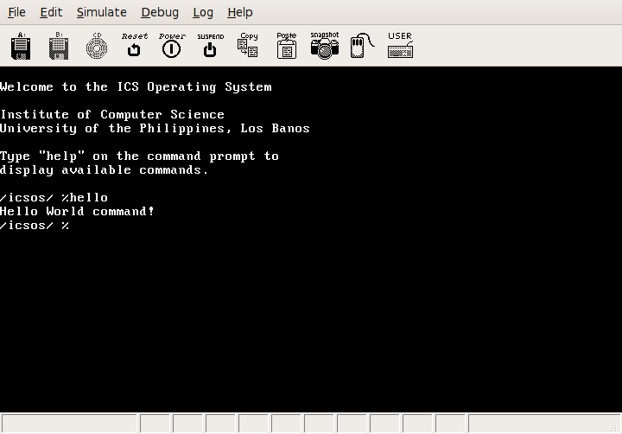
Teaching with ICS-OS
Add new shell command

Slide 8
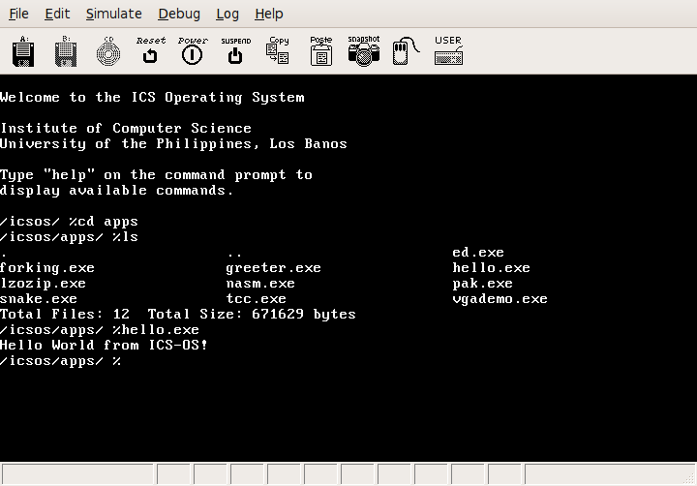
Teaching with ICS-OS
Develop user applications

Slide 9
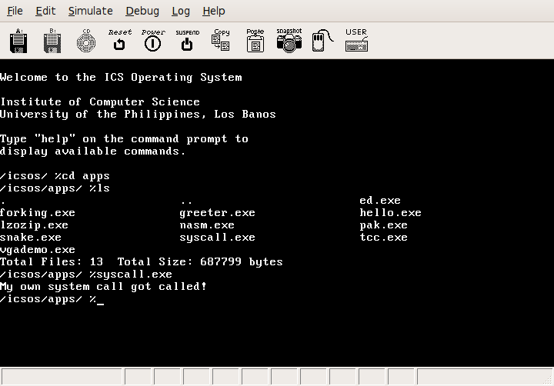
Teaching with ICS-OS
Add a new system call

Slide 10
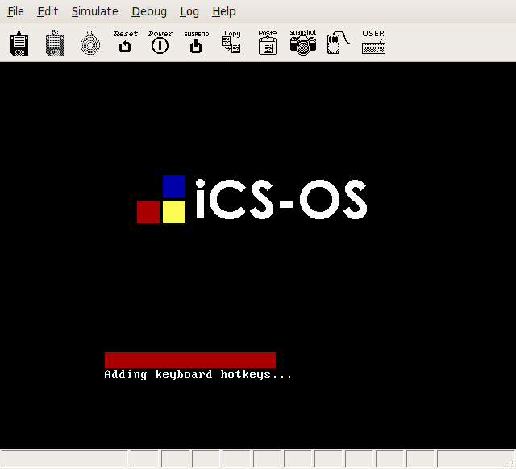
Teaching with ICS-OS
Student Projects
  Simple GUI
  Improved shell
  Text editor
  Archiving utilities
  Help system
  Time/Date utilities
  Disk utilities

Slide 11
Results and Observations
Students were able to appreciate how an operating system works internally with the use of ICS-OS
Not all students are fluent in the use of the C programming language
Some students proposed ambitious projects
Incomplete implementation of the C standard library

Slide 12
Results and Observations
Achieved objectives for students
  They learned how an operating system works from the bare metal
  They were able to see the big picture on how a computer system works
  They were able to understand the separation of kernel space and user space
  They were able to understand how programs are loaded and how processes are created and executed
  They were able to understand how system calls work and the importance and advantages of using application programming interfaces and software development kits

Slide 13
Conclusion
In this work, the author presented ICS-OS as an instructional operating system for teaching operating system concepts to undergraduate students through kernel programming
A high success rate in the students projects indicates that a kernel programming approach is better in making them understand how a real operating system works

Slide 14
Acknowledgments
Joseph Emmanuel DL. Dayo
Students of CMSC 125, Operating Systems, Second Semester AY 2008-2009

Slide 15
Resources
http://code.google.com/p/ics-os
http://sourceforge.net/projects/dex-os
http://ics.uplb.edu.ph
http://jachermocilla.org

Slide 16
Thank you!
Questions?

