Slide 1
CMSC 128
  Introduction to Software Engineering
  Second Semester AY 2007-2008
  jachermocilla@uplb.edu.ph

Slide 2
Project Metrics
'When you can measure what you are speaking about and express it in numbers, you know something about it;
--Lord Kelvin

Slide 3
Project Metrics
Measurements are used to improve the software process
  Estimation, quality control, productivity assessment, and project control
  Assessment of quality and tactical decision making
Concerns with productivity and quality metrics as well as historical measurements

Slide 4
Definitions
Measure – quantitative indication of extent, amount, dimensions, capacity, or size of some attribute of a product or process
Measurement-act of determining a measure
Metric-a quantitative measure of the degree to which a system, component, or process possesses a given attribute

Slide 5
Definitions
Indicator-is a metric or combination of metrics that provide insight into the software process, a software project, or the product itself
  Errors found per person-hour expended
Process indicators
  Gain insight into the efficacy of an existing process

Slide 6
Definitions
Project indicators
  Assess the status of an ongoing project
  Track potential risks
  Uncover problem areas
  Adjust work flow or tasks
  Evaluate the project team's ability to control quality of SE work products

Slide 7
Process Improvement
Measure specific attributes of the process , develop a set of meaningful metrics based on attributes, use metrics as indicators that will lead to a strategy for improvement
Process is only one of the controllable factors in improving software quality

Slide 8
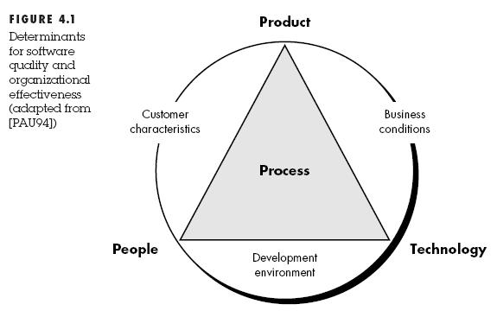
Process Improvement

Slide 9
Process Improvement
Efficacy of process is measured indirectly-metrics is based on outcome that can be derived from the process
  Errors uncovered, defects reported, work products, effort, calendar time, schedule conformance
By measuring characteristics of SE tasks
  Time and effort for umbrella activities

Slide 10
Process Improvement
Humphrey suggests a Personal Software Process approach
  Software process improvement can and should begin at the individual level
Some metrics are private to the software project team but public to all team members
Public metrics assimilate information that originally was private

Slide 11
Metrics Etiquette
Use common sense
Provide regular feedback
Don't use metrics to appraise individuals
Work with practitioners and teams
Don't use metrics to threaten individual or teams
Don't consider problem area metrics as negative
Don't use just a single metric

Slide 12
Summary

Slide 13
Reference
Roger S. Pressman.Software Engineering: A Practitioner's Approach, 4th Ed.McGraw-Hill,1997. Chapter 4

