Slide 1
CMSC 128
  Introduction to Software Engineering
  Second Semester AY 2007-2008
  jachermocilla@uplb.edu.ph

Slide 2
OO Analysis
Define all classes (and relationships and behavior) that are relevant to the problem to be solved – develop the Object Model
Major tasks
  Communicate requirements
  Identify classes
  Specify class hierarchies
  Represent object-object relationship
  Model object behavior

Slide 3
OOA vs SA
Structured Analysis (SA)
  Distinct input-process-output
  Data is separate from process
  Behavior tends to play a secondary role
  Makes heavy use of functional decomposition
OOA
  Data and operations (processes) are taken(encapsulated) as one
  Object behavior is important

Slide 4
OOA Landscape
Booch Method
  Micro and macro development process
  Micro consists of analysis tasks re-applied for each macro process
  Outline
    Identify classes and objects
    Identify semantics of classes and objects
    Identify relationships among classes and objects
    Conduct series of refinements
    Implement classes and objects

Slide 5
OOA Landscape
Coad and Yourdon Method
  Easiest to learn
  Outline
    Identify objects using 'what to look for' criteria
    Define a generalization-specification structure
    Define a whole-part structure
    Identify subjects
    Define attributes
    Define services

Slide 6
OOA Landscape
Jacobson Method
  Known as OOSE
  Heavy use of use case – a description or scenario that depicts how the user interacts with the product or system
  Outline
    Identify system users and their responsibilities
    Build a requirements model
    Build analysis model

Slide 7
OOA Landscape
Rambaugh Method
  Object Modeling Technique (OMT)
  Creates three models: object model(object,classes,hierarchies) , dynamic model (system behavior), functional model (DFD-like representation)
  Outline
    Develop statement of scope
    Build models: object model, dynamic model, functional model

Slide 8
Generic Steps in OOA
Obtain customer requirements
  Identify scenarios or use cases
  Build a requirements model
Select classes and objects
Identify attributes and operations for each object
Define structures and hierarchies that organize classes
Build an object-relationship model
Build an object-behavior model
Review the OO analysis model against use cases

Slide 9
Domain Analysis
Conducted when an organization wants to create a library of reusable classes (components) that will be broadly applicable to an entire category of applications
Identification, analysis, and specification of common requirements from a specific application domain

Slide 10
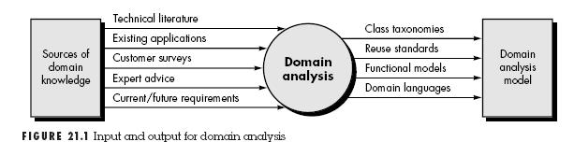
Domain Analysis

Slide 11
Domain Analysis Activities
Define the domain to be investigated
  Isolate business area, system type, or product category of interest
  OO and Non-OO items must be extracted
Categorize the items extracted from the domain
  Classification scheme is proposed and naming conventions for each item are defined
Collect representative samples of applications in the domain

Slide 12
Domain Analysis Activities
Analyze each application in the sample
  Identify candidate reusable objects
  Indicate reasons why object is candidate for reuse
  Define adaptations to the object that they may also be reusable
  Estimate percentage of applications in the domain that might make reuse of the object
  Identify object by name and use SCM to control them

Slide 13
Domain Analysis Activities
Develop an analysis model for the objects
  Will serve as basis for design and construction

Slide 14
Components of OOA Model
Static components
  Structural in nature
  Indicate characteristics that hold throughout the operational life of an application
Dynamic components
  Focus on control
  Sensitive to timing and event processing
  Define how one object interacts with other objects over time
  State transitions

Slide 15
Components of OOA Model
Identified components
  Static view of semantic classes
  Static view of attributes
  Static view of relationships
  Static view of behaviors
  Dynamic view of communication
  Dynamic view of control and time

Slide 16
OOA Process
OOA process begins with an understanding of the manner in which the system will be used
Several techniques are available

Slide 17
Use Cases
Scenarios in which the system will be used
First, identify actors (people, device, etc)
  Anything that communicates with the system or product and that is external to the system itself
  Primary or secondary
Describe the manner in which the actor interacts with the system
Narrative decription

Slide 18
Use Cases
Must answer the following
  What are the main tasks performed by actor?
  What system information will the actor acquire, produce, or change?
  Will the actor have to inform the system about changes in the external environment?
  What information does the actor desire from the system?
  Does the actor wish to be informed about unexpected changes?

Slide 19
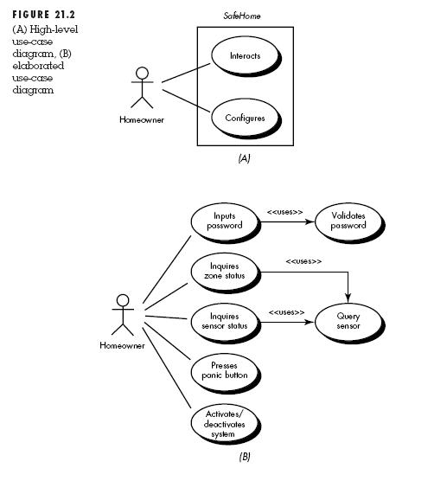
Use Cases

Slide 20
CRC
Class-Responsibility-Collaborator
Collection of index cards which is used to develop an organized representation of classes, responsibilities, and collaborators

Slide 21
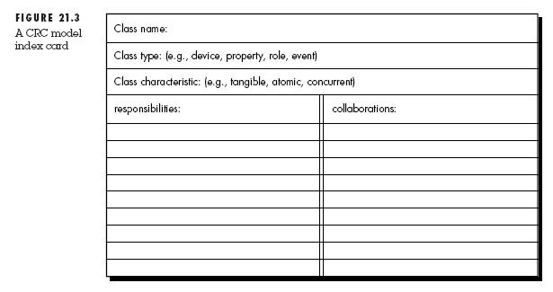
CRC

Slide 22
CRC
Identifying Classes
  Nouns in the grammatical parse
  Types
    Device classes – external entities (sensors)
    Property classes – represents an important property of the problem environment (credit rating)
    Interaction classes – model interactions that occur among objects (purchase or a license)

Slide 23
CRC
Identifying Classes
  Categories based on characteristics
    Tangibility – does the class represent a tangible thing
    Inclusiveness – is the class atomic or aggregate
    Sequentiality – is the class concurrent or sequential
    Persistence – is the class transient, temporary, permanent
    Integrity – is the class corruptible or guarded

Slide 24
CRC
Define Responsibilities
  Attributes and operations
  Five guidelines
    System intelligence should be evenly distributed
      No class should have a long list of responsibilities
    Each responsibility should be stated as generally as possible
      Must reside high in the hierarchy
    Properly encapsulated
    Localize information about one thing in one class
    Share responsibilities among related classes

Slide 25
CRC
Describe Collaborators
  Collaboration represents requests from a client to a server in fulfillment of a client responsibility
  Embodiment of a contract between the client and the server
  Identify relationship between classes
  If a class cannot perform a responsibility itself, it needs to interact with other classes

Slide 26
CRC
Collaborators
  Generic relationships between classes
    Is-part-of
      Aggregation
    Has-knowledge
      One class must acquire information from another
    Depends-upon
      Existence of an object of a class is dependent on another class
  Collaborator class name recorded in CRC
    How the responsibility will be realized
  Walk through the CRC

Slide 27
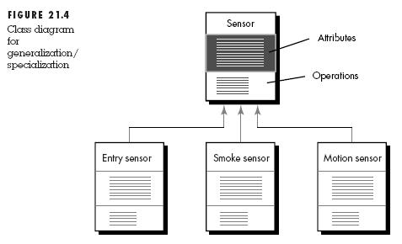
Structures and Hierarchies
Generalization-Specialization structure

Slide 28
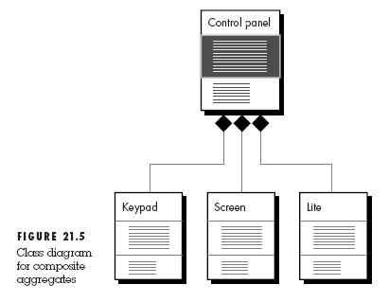
Structures and Hierarchies
Whole-Part Structure (composition)

Slide 29
Subjects and Subsystems
There may be many classes identified
Concise representation is needed
Subjects/Subsystems
  Subset of all classes that collaborate among themselves to accomplish a set of cohesive responsibilities
  Act as reference or pointer
  Black-box
  A separate card can be created

Slide 30
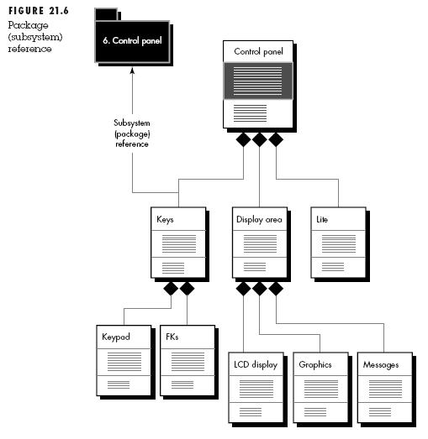
Subjects and Subsystems

Slide 31
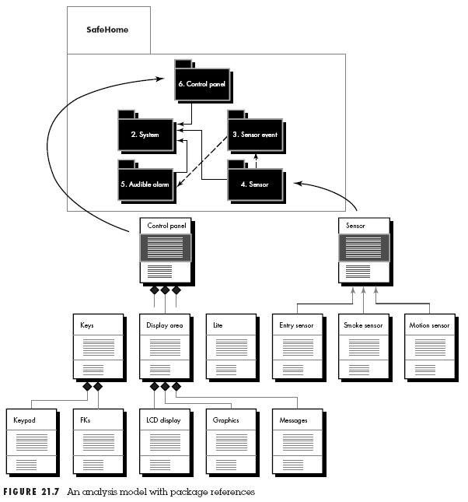
Subjects and Subsystems

Slide 32
Object-Relationship Model
Relationship exists between two connected classes
  Binary – between two classes
Perform grammatical parse
  Indicates physical location (next to, part of)
  Communications (transmits to, acquires from)
  Ownership (incorporated by, is composed of)
  Satisfaction of a condition (manages, coordinates, control)

Slide 33
Object-Relationship Model
Deriving object-relationship model (almost same as ER model)
  Using CRC cards, network of collaborators can be drawn. First objects are connected by unlabeled lines to indicate that relationship exists
  CRC cards are reviewed and unlabeled connected line is named
  Indicate cardinality of the relationship
Indicates message paths

Slide 34
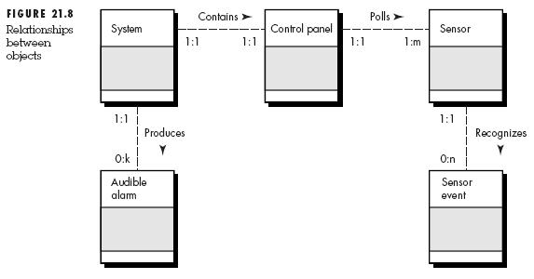
Object-Relationship Model

Slide 35
Object-Behavior Model
Models behavior – dynamic aspect of object model
Indicates how an OO system will respond to external events or stimuli
Steps
  Understand sequence of interaction-review use case
  Identify events that drive the interaction sequence
  Create an event trace
  Build an STD
  Review to verify accuracy and consistency

Slide 36
State Representations
Two difference characterizations of states
  State of each object as the system performs its functions
  State of the system as observed from the outside as the system performs its function
May be passive or active
  Passive – current status of all of an objects attributes
  Active – status of object as it undergoes a continuing process

Slide 37
State Representations
An event (trigger) must occur to force an object to make a transition from one active state to another
A guard condition is a boolean condition that must be satisfied for the transition to occur
  Depends on the passive state of object
An action occurs concurrently with the transition
  Involves one or more operations

Slide 38
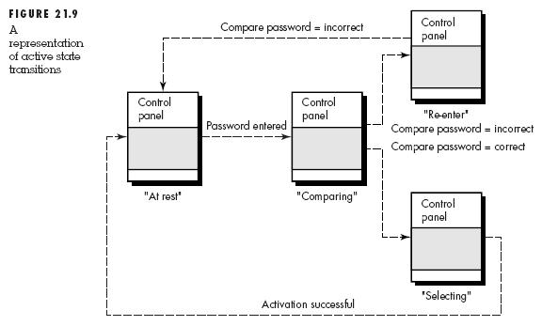
Object-Behavior Model

Slide 39
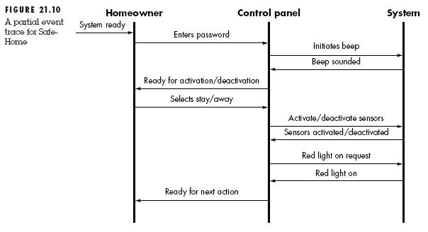
Object-Behavior Model

Slide 40
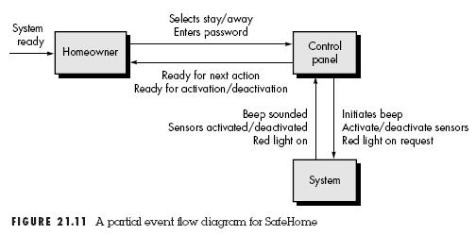
Object-Behavior Model

Slide 41
Summary
OOA models a problem using objects, attributes, and operations as primary modeling components
A wide variety of methods is available
Analysis for OO occurs at many levels of abstraction
OOA involves the use of Use Cases, CRC, class hierarchies, object-relationship model, and object-behavioral model

Slide 42
Reference
Roger S. Pressman.Software Engineering: A Practitioner's Approach, 4th Ed.McGraw-Hill,1997. Chapter 20

