Slide 1
CMSC 128
  Introduction to Software Engineering
  Second Semester AY 2007-2008
  jachermocilla@uplb.edu.ph

Slide 2
Project Management
Developing software requires project management
Majority of software development projects fail because of technical problems or poor project management
Project Management is an umbrella activity
Effective software project management depends on People, Problem, and Process

Slide 3
People
Software engineering work is an intensively human endeavor
Players in the software process
  Senior managers
  Project (technical) managers
  Practitioners
  Customers
  End users

Slide 4
Team Leaders
Team leaders attempt to maximize the skills and abilities of each person in the development team
How do we select a team leader?
  Motivation
  Organization
  Ideas or innovation

Slide 5
Team Leaders
Other traits of effective project manager
  Problem solving – diagnosing problems and providing solution
  Managerial identity – taking charge
  Achievement – rewarding accomplishments
  Influence and team building – 'reading' people

Slide 6
The Team
Options for applying human resources to a project that will require N people working for K years
  N individual to M different functional tasks
  N individual to M different functional tasks (M < N)
  N individuals into T teams to M different functional tasks
Project manager is responsible for the coordination

Slide 7
Team Organization
Democratic decentralized (DD)
  No permanent leader
  Assigns short term tasks coordinator
  Decision made by group consensus
  Horizontal communication
Controlled decentralized (CD)
  With a defined leader and secondary leaders
  Decision made by groups consensus
  Horizontal and vertical communication

Slide 8
Team Organization
Controlled Centralized (CC)
  Team leader manages problem solving and team coordination
  Vertical communication between team members and team leaders

Slide 9
Team Organization
Project factors that should be considered when planning team structure
  Difficulty of problem to solve
  Size of resultant program (LOC, FP)
  Team lifetime
  Modularity
  Required quality and reliability
  Rigidity of delivery date
  Communication required for project

Slide 10
Team Organization

Slide 11
Team Organization
The objective for every project manager is to help create a team that exhibits cohesiveness, regardless of the team organization
Team must have a common definition of success or any identifiable team spirit
The whole is greater than the sum of the parts
Establish momentum

Slide 12
Coordination and
Communication
Scale, uncertainty, and interoperability are key characteristics of modern software
Effective methods for coordinating people who do the work must be established
  establish mechanism for formal(impersonal) and informal(personal) communication among team members and between teams

Slide 13
Coordination Techniques
Formal, impersonal
  documents, deliverables, memos, schedules, change requests
Formal, interpersonal
  quality assurance procedures, status review meetings, design and code inspections
Informal, interpersonal
  information dissemination meetings, problem solving, collection of requirements

Slide 14
Coordination Techniques
Electronic
  email, electronic bulletin boards, web sites, video conferencing
Interpersonal network
  communication with those outside of project

Slide 15
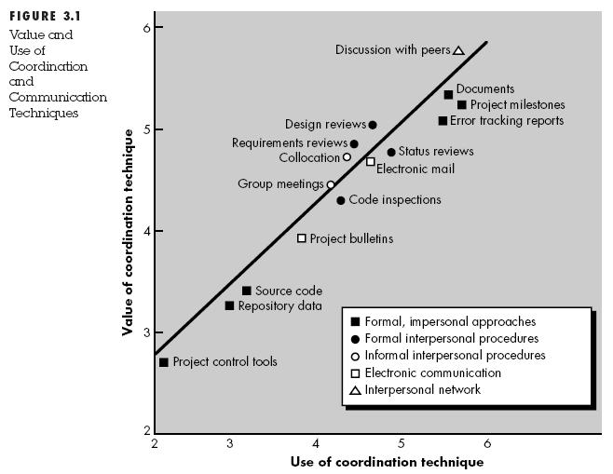
Coordination Techniques

Slide 16
Problem
At the start of project, quantitative estimates and plan are required but solid information is unavailable
Examine the problem at the very beginning of the project: scope must be established and bounded

Slide 17
Defining the Scope
Context
  How does the software to be built fit into a larger system or business context?What constraints are imposed as a result of the context?
Information objectives
  What customer-visible data objects are produced as output of software?What data objects are required as input?

Slide 18
Defining the Scope
Function and performance
  What function does the software perform to transform input data into output? Are any special performance characteristics to be addressed?

Slide 19
Scope
Must be unambiguous and understandable at management and technical levels
Must be bounded: quantitative data must be stated explicitly, constraints and limitations are noted, and mitigating factors(algorithms) are described

Slide 20
Problem Decomposition
also called partitioning, problem is divided into small manageable subproblems
no attempt to fully decompose problem during scoping activity, will be done in requirements analysis
performed on the functionality to be delivered and the process that will be used to deliver the product

Slide 21
Process
Generic phases apply: definition, development, and maintenance
Which software process model to use?
  linear sequential, prototyping, RAD, incremental, spiral, component assembly, etc
Project manager decides which model to use and creates a preliminary plan, process decomposition begins
  work tasks for framework activities are created

Slide 22
Melding Problem and Process
Framework activities are identified(ex: see spiral model)
Functions identified in the scoping activity are matched with the framework activities in a matrix
Top row contains the framework activities, second row contains the work tasks associated for each framework activity and the leftmost column the functions

Slide 23
Melding Problem and Process
The team needs to estimate resource requirements for each cell, start and end dates for each task, and work products to be produced in each cell

Slide 24
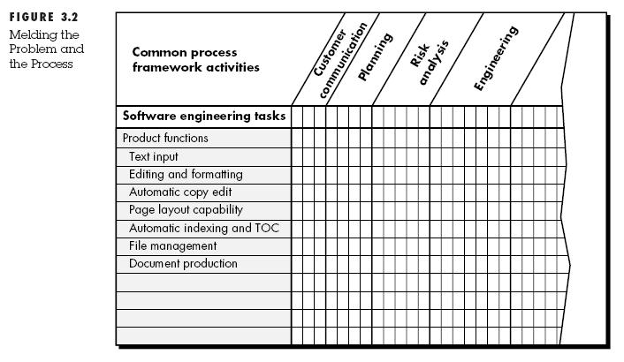
Melding Problem and Process

Slide 25
Process Decomposition
Software team should have significant flexibility
  in choosing SE paradigm(process model) that is best for the project
  the software engineering tasks that populate the process model once it is chosen
Examples
  Small project-linear sequential
  Time constrained-RAD, incremental

Slide 26
Process Decomposition
Common Process Framework is adapted to selected proces model
Framework activities can be fitted to any paradigm selected
Selecting the work tasks for each framework activity will vary depending on the project

Slide 27
Process Decomposition
Customer Communication Activity for a simple project
  Develop list of clarification issues
  Meet with the customer to address clarification issues
  Jointly develop a statement of scope
  Review the state of scope with all concerned
  Modify the statement of scope as required

Slide 28
Process Decomposition
Customer Communication Activity for a complex project
  Review the customer request
  Plan and schedule a formal, facilitated meeting with customer
  Conduct research to define proposed solutions and existing approaches
  Prepare a 'working document' and an agenda for the formal meeting
  Conduct the meeting

Slide 29
The Project
90-90 Rule
  The first 90 percent of a system absorbs 90 percent of the allotted effort and time
  The last 10 percent takes the other 90 percent of alloted effort and time
A project that follows this rule is in trouble!

Slide 30
A project in trouble
Assessment of progress is flawed
Cannot calibrate progress because quantitative metrics are unavailable
Project plan was not designed to accommodate resources required at the end of the project
Risks have not been considered explicitly
Schedule is unrealistic and flawed

Slide 31
Summary
Software project management is an umbrella activity within software engineering
People, problem, and process has substantial influence in software project management
Activities in project management encompass measurements and metrics, estimation, risk analysis, schedules, tracking, and control

Slide 32
Reference
Roger S. Pressman.Software Engineering: A Practitioner's Approach, 4th Ed.McGraw-Hill,1997. Chapter 3

