Slide 1
CMSC 128
  Introduction to Software Engineering
  Second Semester AY 2007-2008
  jachermocilla@uplb.edu.ph

Slide 2
Design Patterns
A design pattern is a widely accepted solution to a recurring design problem in OOP
Describes how to structure classes to achieve a requirement
Provides a general blueprint when implementing part of a program
Popularized by the “Gang of Four”

Slide 3
Benefits
Learn from community wisdom
Determine implementation faster
Make code more readable to other programmers

Slide 4
Categories
Creational Design Patterns
  For creating objects
Structural Design Patterns
  Organizing subsystems
Behavioral Design Patterns
  Object behaviors

Slide 5
Observer Design Pattern
Behavioral design pattern
You want to notify objects that a particular event has happened
Object that changes is the subject
Objects that receive updates are observers
Case study: Friendster Bulletin Board
  Subject: You
  Observers: Friends

Slide 6
Observer Design Pattern
Responsibilities of Subject
  Maintain a list of observer objects
  Provide methods for adding/removing observers
  Informing observer of events
Responsibilities of Observer
  Process message sent by subject

Slide 7
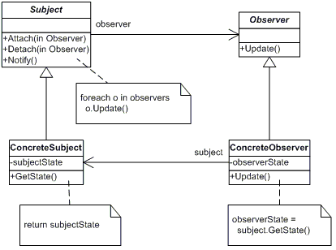
Observer Design Pattern

Slide 8
Observer Design Pattern
public interface Subject {
  public void addObserver(Observer o);
  public void removeObserver(Observer o);
  public void inform(Object o);
}

Slide 9
Observer Design Pattern
public interface Observer {
  public void update(Object o);
}

Slide 10
Observer Design Pattern
public class FriendsterAccount implements Observer, Subject{
  private String name;
  private List<Observer> friends = new ArrayList<Observer>();
  ...
}

Slide 11
Observer Design Pattern
public class FriendsterAccount implements Observer, Subject{
  ...
  public void inform(Object msg){
    Iterator<Observer> ite = friends.iterator();
    while (ite.hasNext()){
      Observer ob = ite.next();
      ob.update(msg);
    }
  }}

Slide 12
Observer Design Pattern
public class FriendsterAccount implements Observer, Subject{
  ...
  public void postBulletin(String msg){
    inform(name+": " +msg);
  }
}

Slide 13
Observer Design Pattern
public class FriendsterAccount implements Observer, Subject{
  ...
  public void update(Object msg){
    System.out.println(name+": New bulletin from "+msg);
  }
}

Slide 14
Reference
http://www.moock.org/lectures/introToPatterns/

