Slide 1
Fooled By Randomness, The Black Swan and Antifagility
A very short overview of the ideas of Nassim Nicholas Taleb and how they might be applied at Clockwork.
by Jachin Rupe

Slide 2
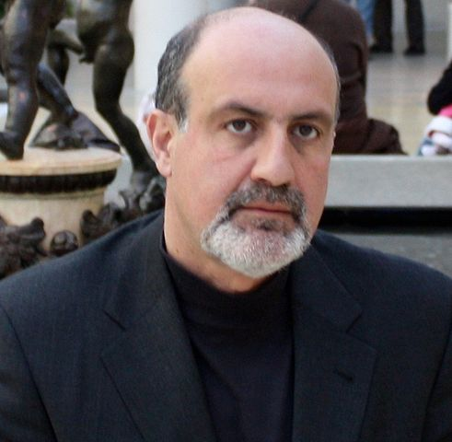

Slide 3
Nassim Nicholas Taleb
- @nntaleb:
https://twitter.com/nntaleb
- Home Page:
http://www.fooledbyrandomness.com/
- Wikipedia:
http://en.wikipedia.org/wiki/Nassim_Taleb

Slide 4
Applied Epistemology
randomness
probability
uncertainty
risk

Slide 5
Fooled By Randomness
Humans are not good at probabilities.
Humans really like causal relationships.

Slide 6
Birthday Problem
How many people do you need in the same room before there's a 50% chance that two people will have the same birthday?

Slide 7
Monte Carlo Machine
Flipping a coin 100 times
  Wow! 7 heads in a row. That amazing.
  Actually, there's a 52% chance that will happen.
10,000 traders
  Each has a 45% chance to make $10,000 per year
  Each has a 55% chance to lose $10,000 per year
  After 5 years
    184 have made $50,000

Slide 8
"Remember that nobody accepts randomness in his own success, only his failure."
--Nassim Taleb

Slide 9
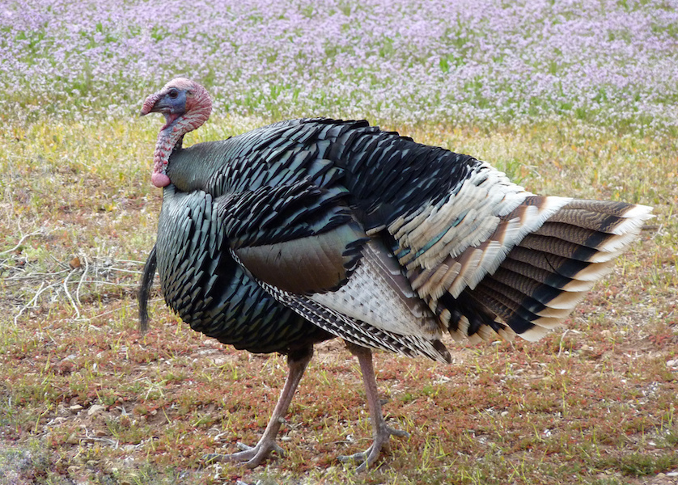

Slide 10
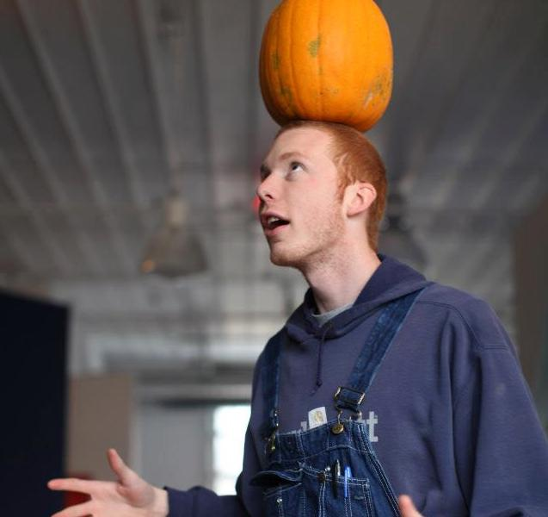

Slide 11
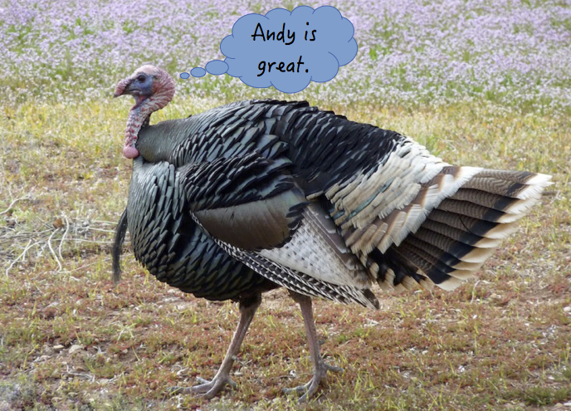

Slide 12
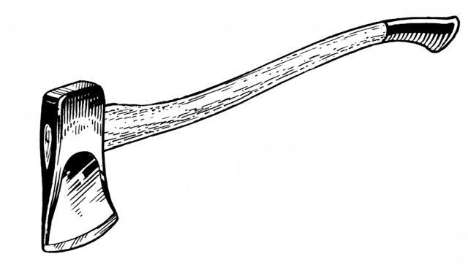
Tom Has "Just One Bad Day"

Slide 13
Solon’s Warning
"...it does not matter how frequently something succeeds if failure is too costly to bear."
-- Nassim Taleb

Slide 14
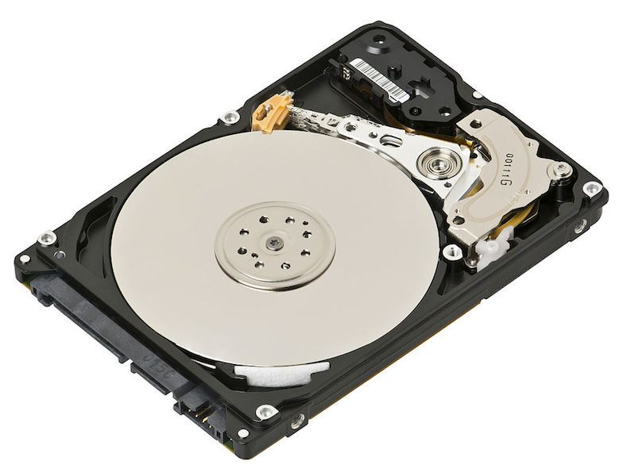
Jachin's Hard Drive

Slide 15
Passwords
Using the same password

Slide 16
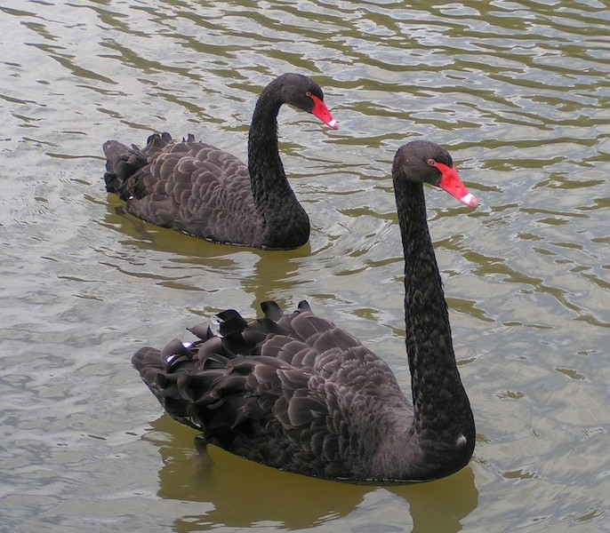

Slide 17
"Mistaking a naïve observation of the past as something definitive or representative of the future is the one and only cause of our inability to understand the Black Swan."
-- Nassim Taleb

Slide 18
"In general, positive Black Swans take time to show their effect while negative ones happen very quickly—it is much easier and much faster to destroy than to build."
-- Nassim Taleb

Slide 19
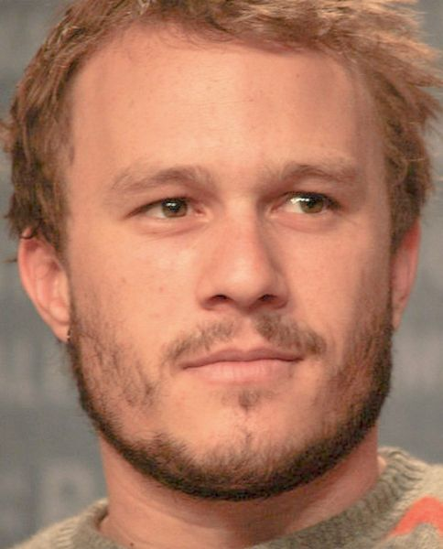

Slide 20
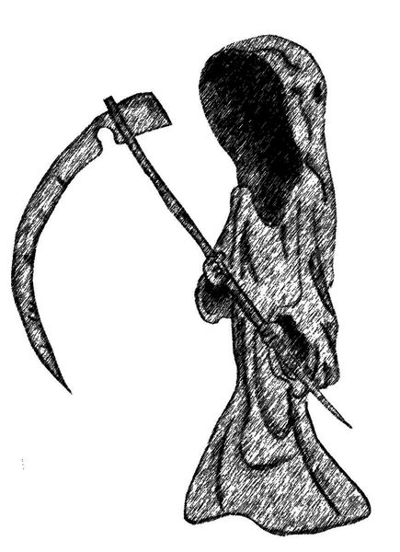

Slide 21
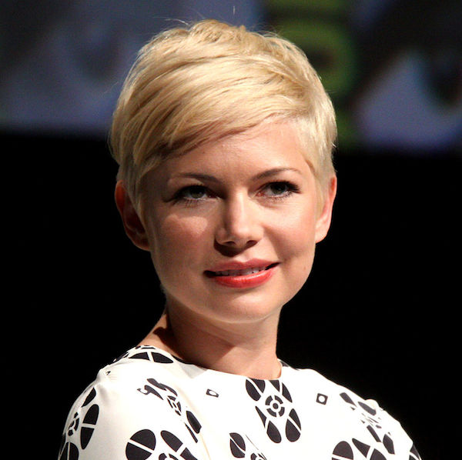

Slide 22


Slide 23


Slide 24
The Black Swan Formula
Heath Ledger dies
+ Michelle Williams
+ Google Image Search
+ Minnpost
= Insane Amounts of Traffic
"Literally, Heath Ledger brought our cluster down."
-- Matt Gray in an email sent to staff@ 2008-1-22

Slide 25
The internet is a hotbed of black swan events.
As our world becomes more interconnected Black Swans will only become more important.
"What do you think will be the next black swan?"

Slide 26
What is the opposite of "fragile"?

Slide 27
Antifragile
Fragile:
  Hurt by small amounts of stress.
Robust:
  Not hurt by small amounts of stress.
Antifragile:
  Small amounts of stress makes them stronger (often times lack of strees makes them weaker).

Slide 28
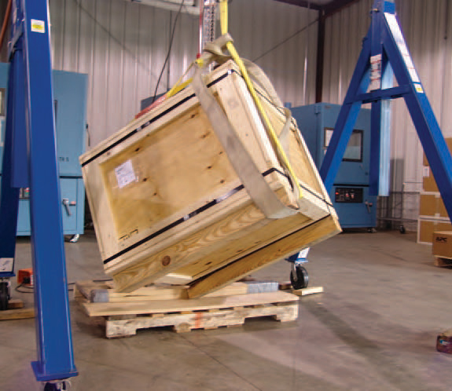
Shipping an Antifragile Box

Slide 29
Clockwork's Software
All software is very fragile
All the hardware we use is fragile.

Slide 30
Clockwork's Team
Trust grows when things go wrong

Slide 31
Questions and Discussion
Fooled By Randomness
Black Swan
Antifragile

Slide 32
Thanks
"May the odds be ever in your favor."
– Effie Trinket

